Slide 1
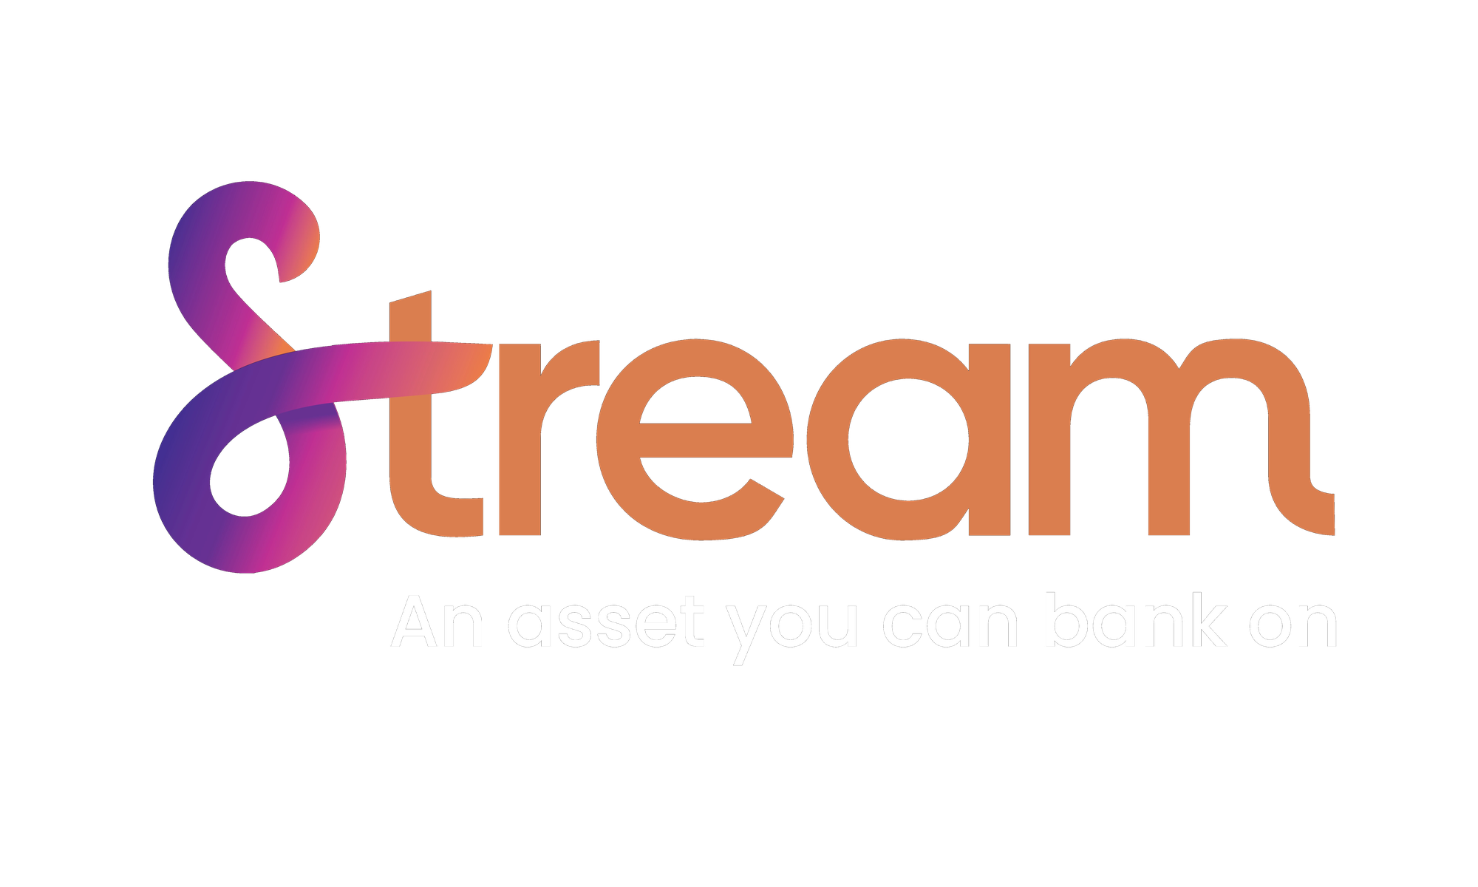

AGENT PRESENTATION
The Stream Plan
A smarter way to save: Indexed Universal Life built on pre-packaged bank funding.
Notes:
In today’s presentation our main two goals is to share with you is how to make smarter financial decisions and obtain financial freedom in your retirement.

Slide 2




THE FORMULA
What makes Stream different?
+
=
Indexed
Pre-Packaged
The Stream
Universal Life
Bank Funding
Protection Plan
Market-linked upside, zero downside
Stream is the borrower — not your client
A smarter way to save
Your client contributes. Stream and the bank do the heavy lifting.
02 / 22
Notes:
For many years, life insurance has been only viewed as a death benefit, with no living benefits. We have flipped that narrative. No longer is insurance just liability, it now is an asset.
Over the past 2 years we have put our brains together to help solve the problem of not being able to save efficiently for tax free retirement income and come up with our strategy, Stream Protection Plan.
Our program utilizes an indexed universal life product, partially funded by a bank, that we have packaged together to create Stream. So let’s talk about it…

Slide 3
AGENDA
What we'll cover
01
The Stream Plan
How a pre-packaged IUL + bank loan works
02
How It Works
The structure, client contributions & bank role
03
Case Studies
Real numbers across three client scenarios
04
The Streamline Portal
Quote, apply, and track — all in one place
03 / 22
Notes:
In today’s presentation our main two goals is to share with you is how to make smarter financial decisions and obtain financial freedom in your retirement.

Slide 4



WHY STREAM
Designed with the client in mind
We've done the work, so the client doesn't have to.
Pre-approved loans
Stream is the borrower
Stream has already negotiated financing with major banks — no loan application for your client.
Stream acts as borrower and loan guarantor. The client is not on the hook.
No credit impact
Short 5-year commitment
No collateral, no personal guarantee, no credit report, no reporting.
Client pays the annual contribution for 5 years — no long term obligation.
04 / 22
Notes:
Now that we have talked about the product and how we have paired it with leverage, lets talk about how the two work together in the Stream Plan.
-Stream acts as the borrower and guarantor.
-Clients are required to pay 5 year of contributions. Starting in year 6, the bank will fully fund the last 5 payments.
-We group clients together into a tranche to obtain favorable loan rates and make financing available to them.
-The clients don’t need to post and personal guarantee, no collateral is needed, and the clients have no commitments.

Slide 5
THE STREAM ADVANTAGE
$5.50
Up to
for every $1 the client contributes.
5 Years
10 Years
$0 Collateral
of client contributions
of bank funding
or personal guarantee required
05 /22
Notes:
Now that we have talked about the product and how we have paired it with leverage, lets talk about how the two work together in the Stream Plan.
-Stream acts as the borrower and guarantor.
-Clients are required to pay 5 year of contributions. Starting in year 6, the bank will fully fund the last 5 payments.
-We group clients together into a tranche to obtain favorable loan rates and make financing available to them.
-The clients don’t need to post and personal guarantee, no collateral is needed, and the clients have no commitments.

Slide 6


THE RIGHT FIT
Who is the ideal
Stream client?
The ideal Stream clients are HENRYs (High Earners, Not Rich Yet) and
high earners who are looking to grow, and protect their wealth.
$200K+ Income
Ages 1 – 55
Ages 30 – 60
Single earner at $200K+ per year, or $300K+ married couple, or $1M+
net worth.
Eligible age range for income-focused designs.
Eligible age range for death-benefit-focused designs.
06 / 22
Notes:
For many years, life insurance has been only viewed as a death benefit, with no living benefits. We have flipped that narrative. No longer is insurance just liability, it now is an asset.
Over the past 2 years we have put our brains together to help solve the problem of not being able to save efficiently for tax free retirement income and come up with our strategy, Stream Protection Plan.
Our program utilizes an indexed universal life product, partially funded by a bank, that we have packaged together to create Stream. So let’s talk about it…

Slide 7
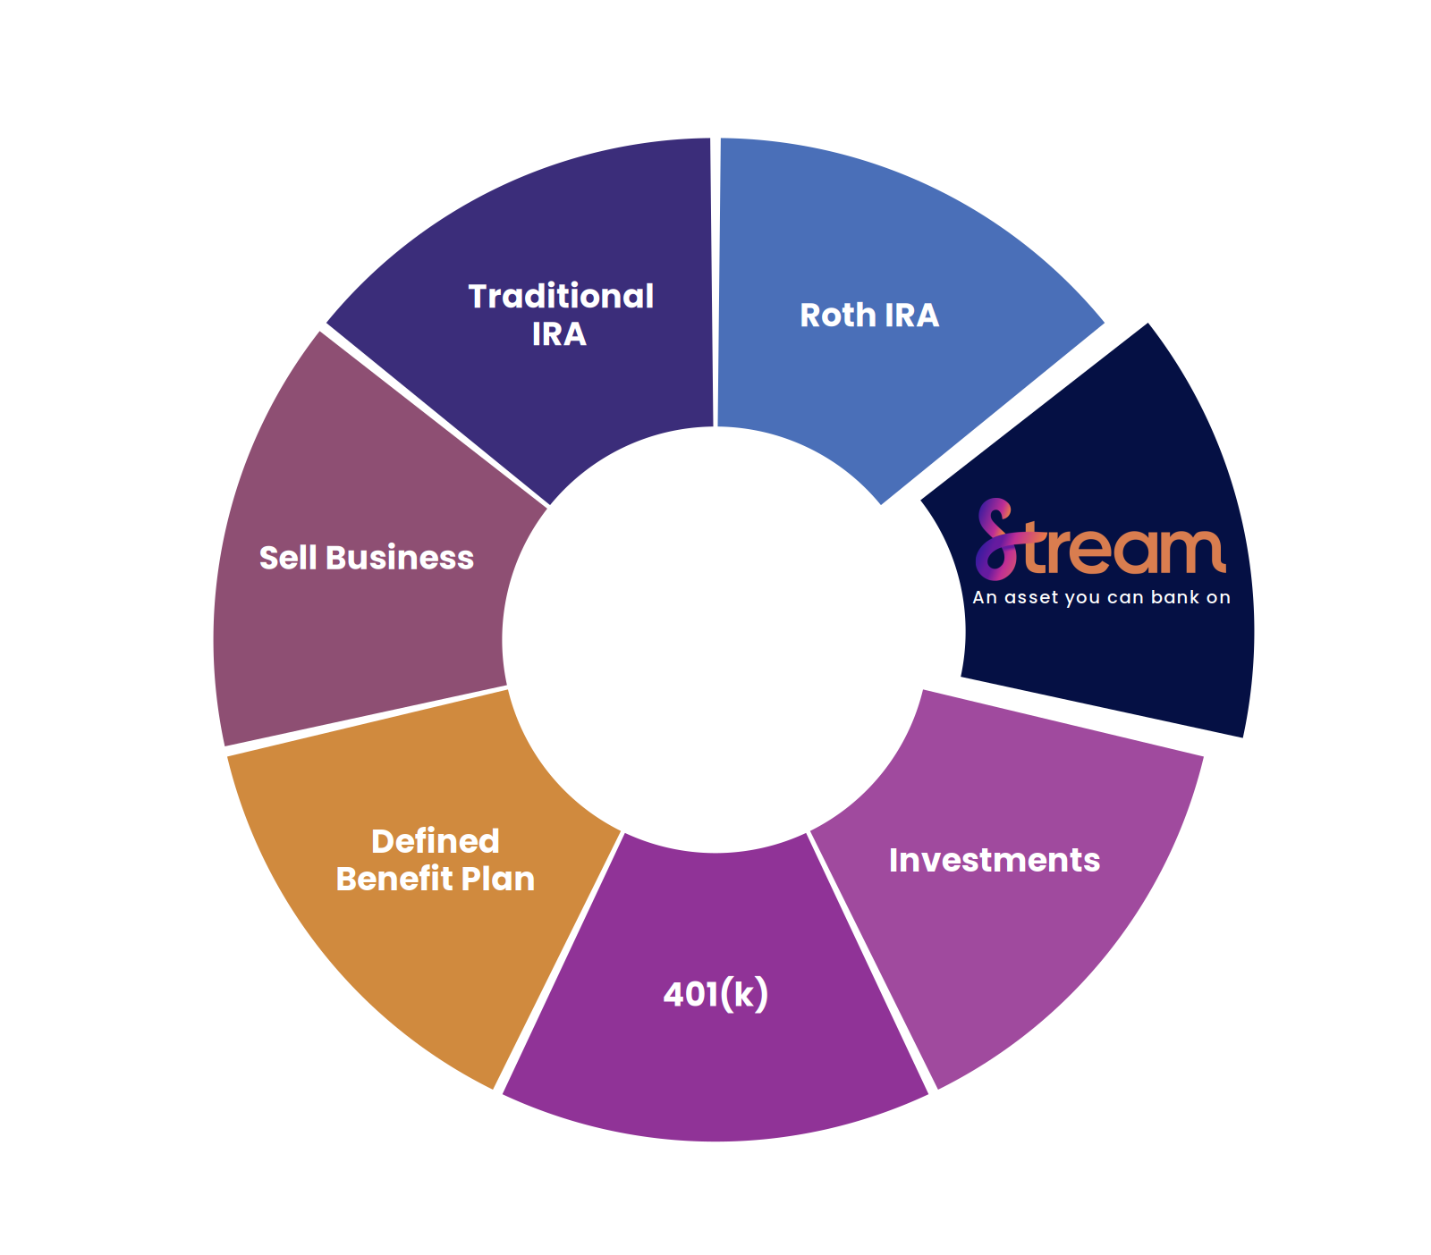
THE PROBLEM
Is my retirement
going to be enough?
Traditional retirement vehicles are capped, taxed, and exposed to market loss.
401(k) & IRA contribution limits are low
Business-sale proceeds are taxed heavily
Market losses compound at retirement age
07 / 22
Notes:
With national debt levels at an all time high, the government will only be able to repay these debts by consistently raising taxes in the future. With this being said, the way traditional retirement plans are structured are broken and will not be enough to fund our retirements, as they are taxed as the money is taken out. The problem is when they tax the money out it is all taxed as ordinary income. Two verhicles that rovide tax free income are rothiras and stream. The problem with the roth is that clients who make too much money can’t contribute. Think of the stream program as a roth on steroids.

Slide 8
HOW IT WORKS
The 10-pay structure
Your client funds 30–50% for 5 years. The bank covers the rest, plus all of years 6–10.
CLIENT + BANK
BANK ONLY
Your Client
$
$
$
$
$
The Bank
$
$
$
$
$
$
$
$
$
$
Years
Y1
Y2
Y3
Y4
Y5
Y6
Y7
Y8
Y9
Y10
$
CLIENT PAYS
BANK PAYS
THE LEVERAGE
$
Years 1–5, 30–50% of premium
Remainder Y1–5, plus all of Y6–10
Bank funds the majority of premium
5 contributions
10 contributions
Up to $5.50 : $1
08 / 22

Slide 9










THE STREAM FAMILY
Five ways to position Stream
One strategy for five unique clients.
Personal retirement
Business owners
Legacy planning
Medical professionals
Professional athletes
Tax-free income
Buy/sell funding
Multi-generation wealth
Practice growth capital
Tax-free income
Single or survivor death benefit
Key-person insurance
Estate-tax strategy
Education funding
Diversification of financial portfolio
Indexed growth
Deferred compensation
Trust-friendly design
Retirement income
Capital working post career
09 / 22

Slide 10
CASE STUDY 01
Why not just fund a life policy myself?
ASSUMPTIONS: Male, age 40, preferred health • 5 years of funding • $25,000 per year • 6.81% net assumed return
NON-FINANCED IUL
STREAM PLAN IUL
THE DIFFERENCE
Fund it yourself
With bank financing
Assumed Returns
Assumed Returns
6.81% Net
6.81% Net
—
Initial Death Benefit
Initial Death Benefit
+$750,821
$400,710
$1,151,532
Income Projected Age 65
Income Projected Age 65
+$40,957
$40,428
$81,385
Income Projected to Last Until
Income Projected to Last Until
120
120
—
Cumulated projected income to Age 88
Cumulated projected income to Age 88
+$783,117
$970,272
$1,871,855
Death Benefit at Life Expectancy
Death Benefit at Life Expectancy
+$600,347
$227,887
$828,234
Assume Male age 40 Preferred, 5 Years of Funding at $25,000 a Year
10 / 22

Slide 11
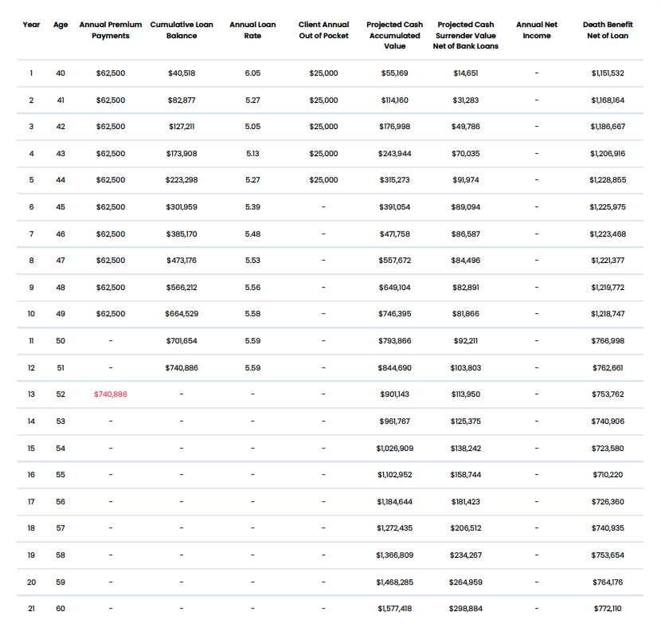
CASE STUDY 01
11 / 22
Notes:
Now lets take a look at self funding vs. using Stream’s funding.

Slide 12
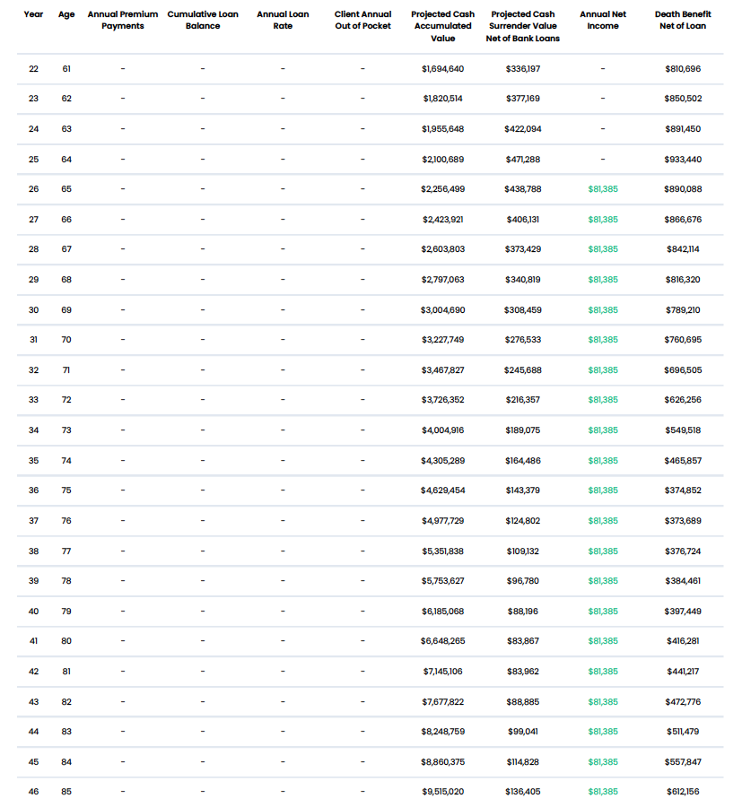
CASE STUDY 01
12 / 22
Notes:
Now lets take a look at self funding vs. using Stream’s funding.

Slide 13
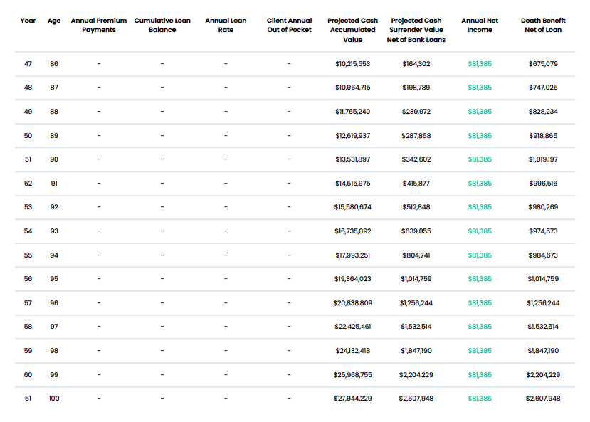
CASE STUDY 01
13 / 22
Notes:
Now lets take a look at self funding vs. using Stream’s funding.

Slide 14


CASE STUDY 02
The business owner preparing for exit
STREAM OUTCOME
CLIENT PROFILE
Flexible loan payoff, maximum legacy
HVAC Business Owner
AGE
Loan paid from business exit proceeds
43 years old
Bank loan can be repaid from the eventual business sale — or from policy cash value.
HORIZON
Plans to exit the business in 10 years
Tax-advantaged legacy to children
Death benefit passes tax-free to family
GOAL
Maximize future benefits for himself and his children
PRIORITY
Indexed growth with zero market loss
Passes as much assets tax-free to family
Policy cash value grows with the market but is insulated from downturns.
14 / 22
Notes:
For many years, life insurance has been only viewed as a death benefit, with no living benefits. We have flipped that narrative. No longer is insurance just liability, it now is an asset.
Over the past 2 years we have put our brains together to help solve the problem of not being able to save efficiently for tax free retirement income and come up with our strategy, Stream Protection Plan.
Our program utilizes an indexed universal life product, partially funded by a bank, that we have packaged together to create Stream. So let’s talk about it…

Slide 15
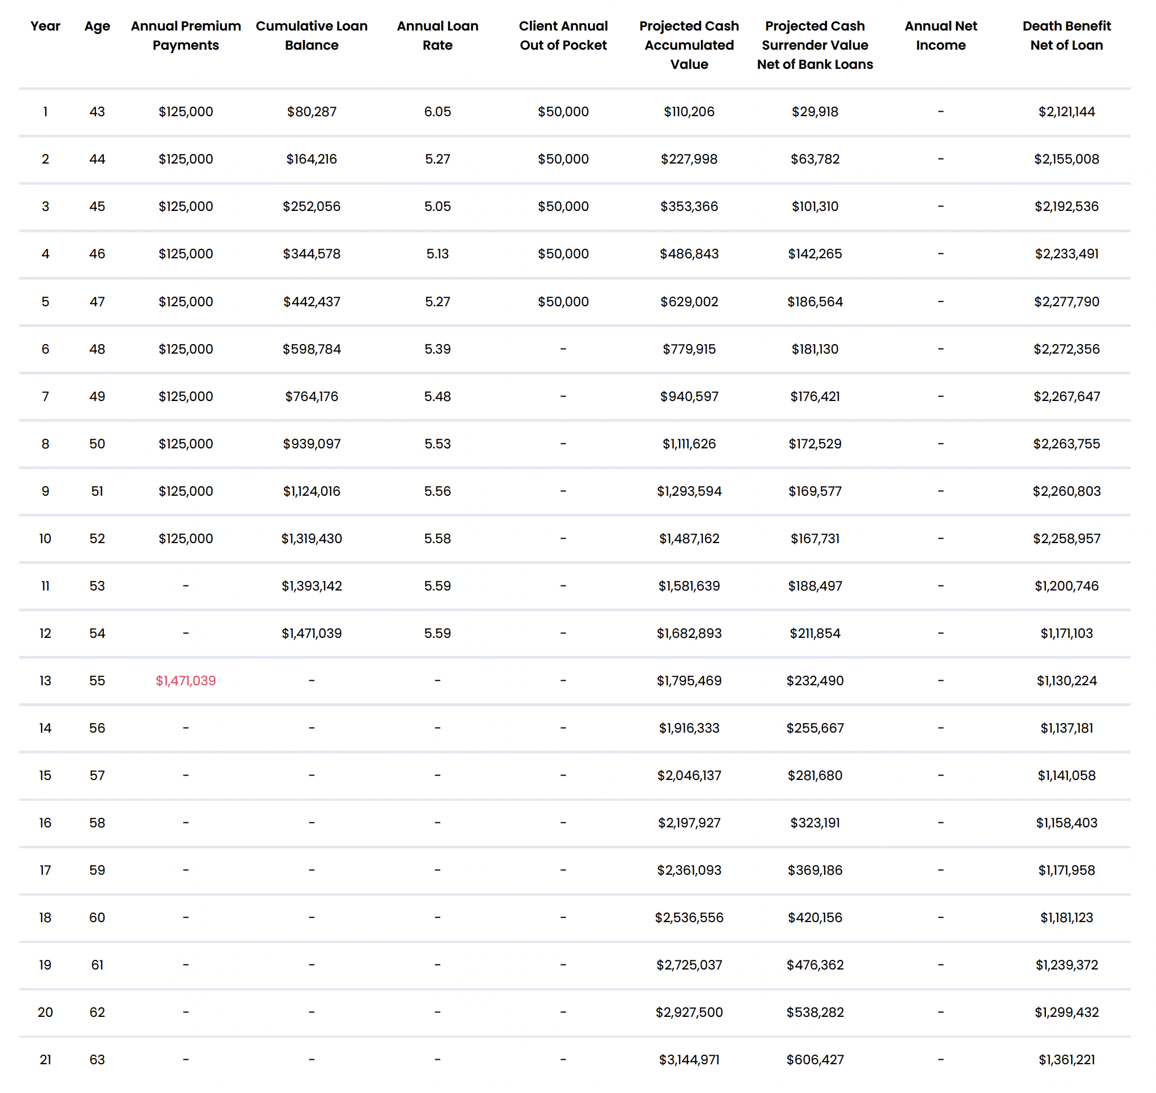
CASE STUDY 02 - Why Stream?
15 / 22
Notes:
For many years, life insurance has been only viewed as a death benefit, with no living benefits. We have flipped that narrative. No longer is insurance just liability, it now is an asset.
Over the past 2 years we have put our brains together to help solve the problem of not being able to save efficiently for tax free retirement income and come up with our strategy, Stream Protection Plan.
Our program utilizes an indexed universal life product, partially funded by a bank, that we have packaged together to create Stream. So let’s talk about it…

Slide 16
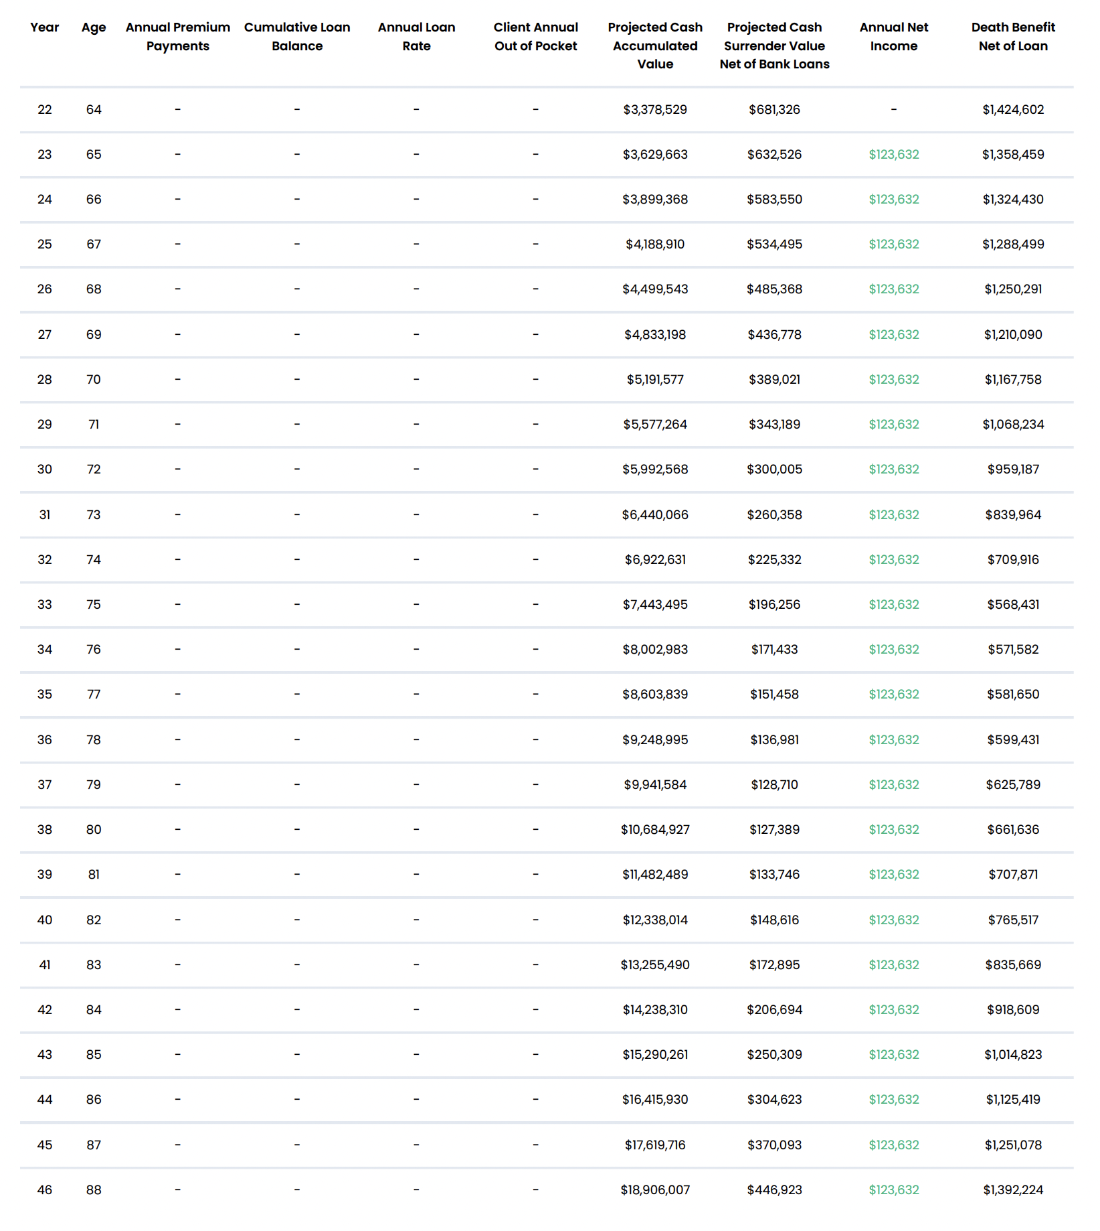
CASE STUDY 02 - Why Stream?
16 / 22
Notes:
For many years, life insurance has been only viewed as a death benefit, with no living benefits. We have flipped that narrative. No longer is insurance just liability, it now is an asset.
Over the past 2 years we have put our brains together to help solve the problem of not being able to save efficiently for tax free retirement income and come up with our strategy, Stream Protection Plan.
Our program utilizes an indexed universal life product, partially funded by a bank, that we have packaged together to create Stream. So let’s talk about it…

Slide 17
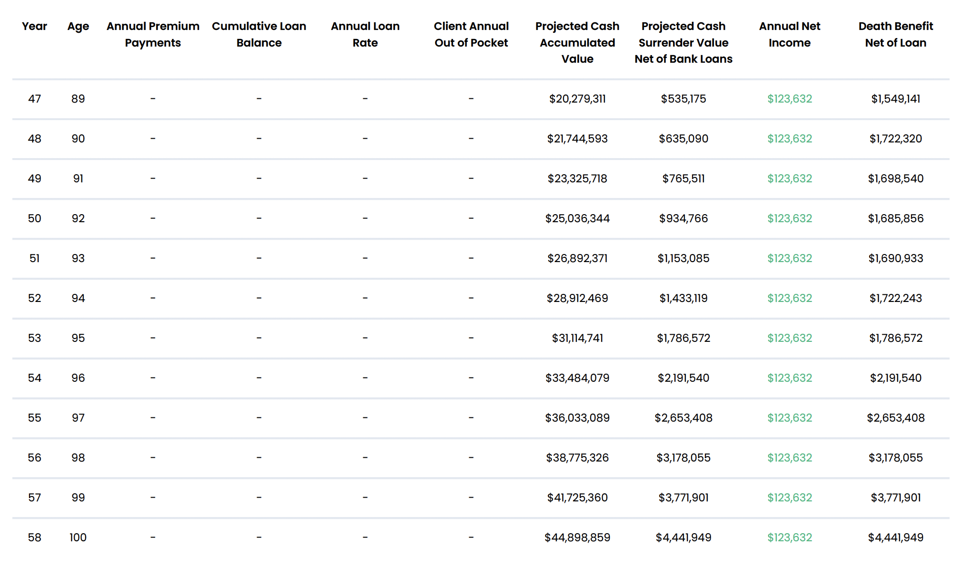
CASE STUDY 01
17 / 22
Notes:
Now lets take a look at self funding vs. using Stream’s funding.

Slide 18
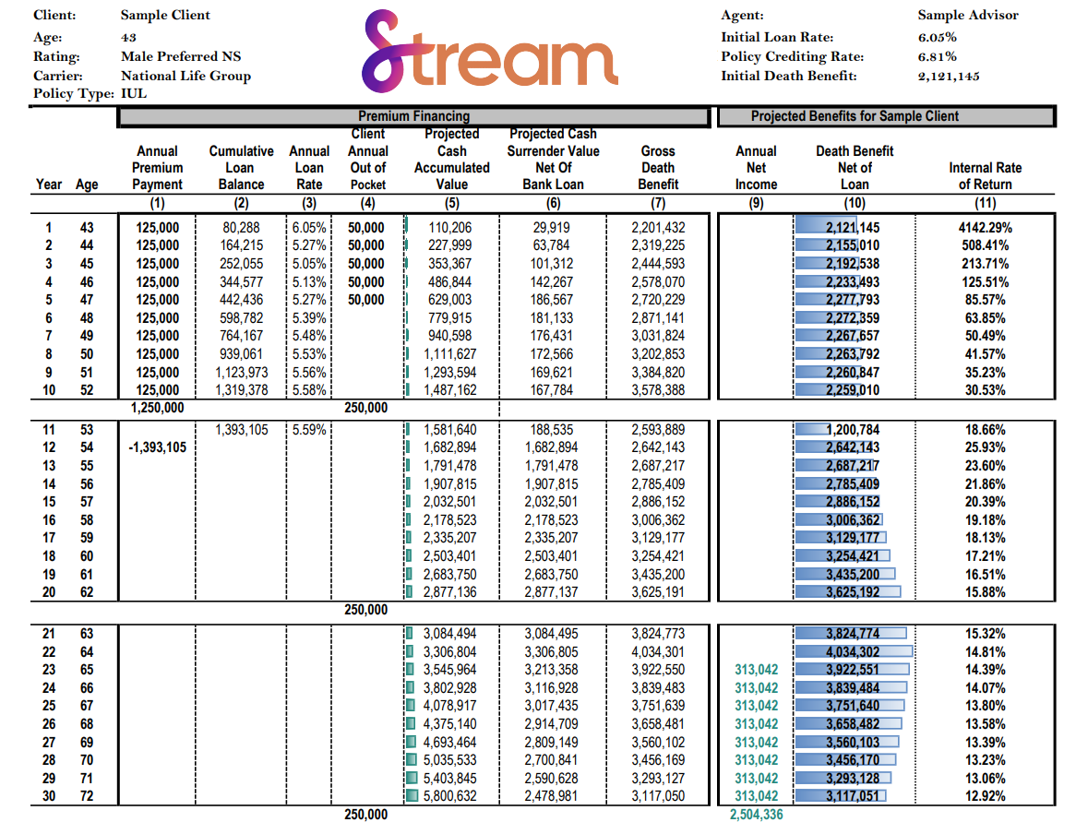
CASE STUDY 02 - Loan payoff with outside funds
18 / 22
Notes:
For many years, life insurance has been only viewed as a death benefit, with no living benefits. We have flipped that narrative. No longer is insurance just liability, it now is an asset.
Over the past 2 years we have put our brains together to help solve the problem of not being able to save efficiently for tax free retirement income and come up with our strategy, Stream Protection Plan.
Our program utilizes an indexed universal life product, partially funded by a bank, that we have packaged together to create Stream. So let’s talk about it…

Slide 19
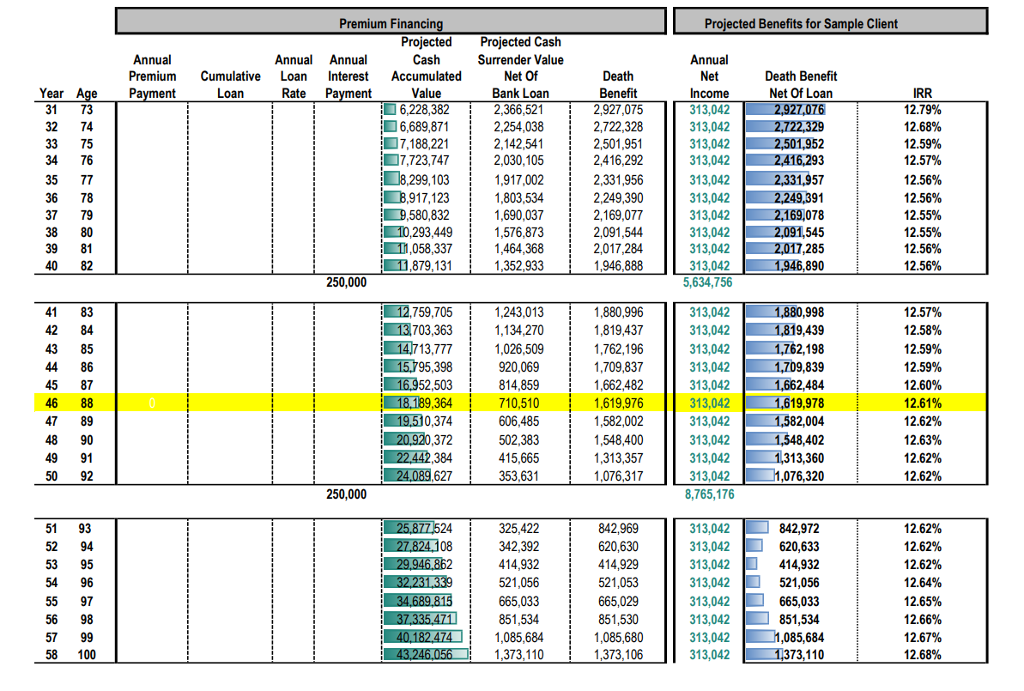
CASE STUDY 02 - Loan payoff with outside funds
19 / 22
Notes:
For many years, life insurance has been only viewed as a death benefit, with no living benefits. We have flipped that narrative. No longer is insurance just liability, it now is an asset.
Over the past 2 years we have put our brains together to help solve the problem of not being able to save efficiently for tax free retirement income and come up with our strategy, Stream Protection Plan.
Our program utilizes an indexed universal life product, partially funded by a bank, that we have packaged together to create Stream. So let’s talk about it…

Slide 20
NEXT STEPS
How to get your first quote
Four steps to your first Stream case — most agents complete all four in under an hour.
01
02
03
04
Visit our site
Complete training
Access Streamline Portal
Create custom quotes
Create your agent account at thestreamplan.com in 2 minutes.
Short, self-paced certification online.
Your client portal for quotes and applications.
Run illustrations in seconds. and apply for the policy, as well.
20 / 22
Notes:
For many years, life insurance has been only viewed as a death benefit, with no living benefits. We have flipped that narrative. No longer is insurance just liability, it now is an asset.
Over the past 2 years we have put our brains together to help solve the problem of not being able to save efficiently for tax free retirement income and come up with our strategy, Stream Protection Plan.
Our program utilizes an indexed universal life product, partially funded by a bank, that we have packaged together to create Stream. So let’s talk about it…

Slide 21

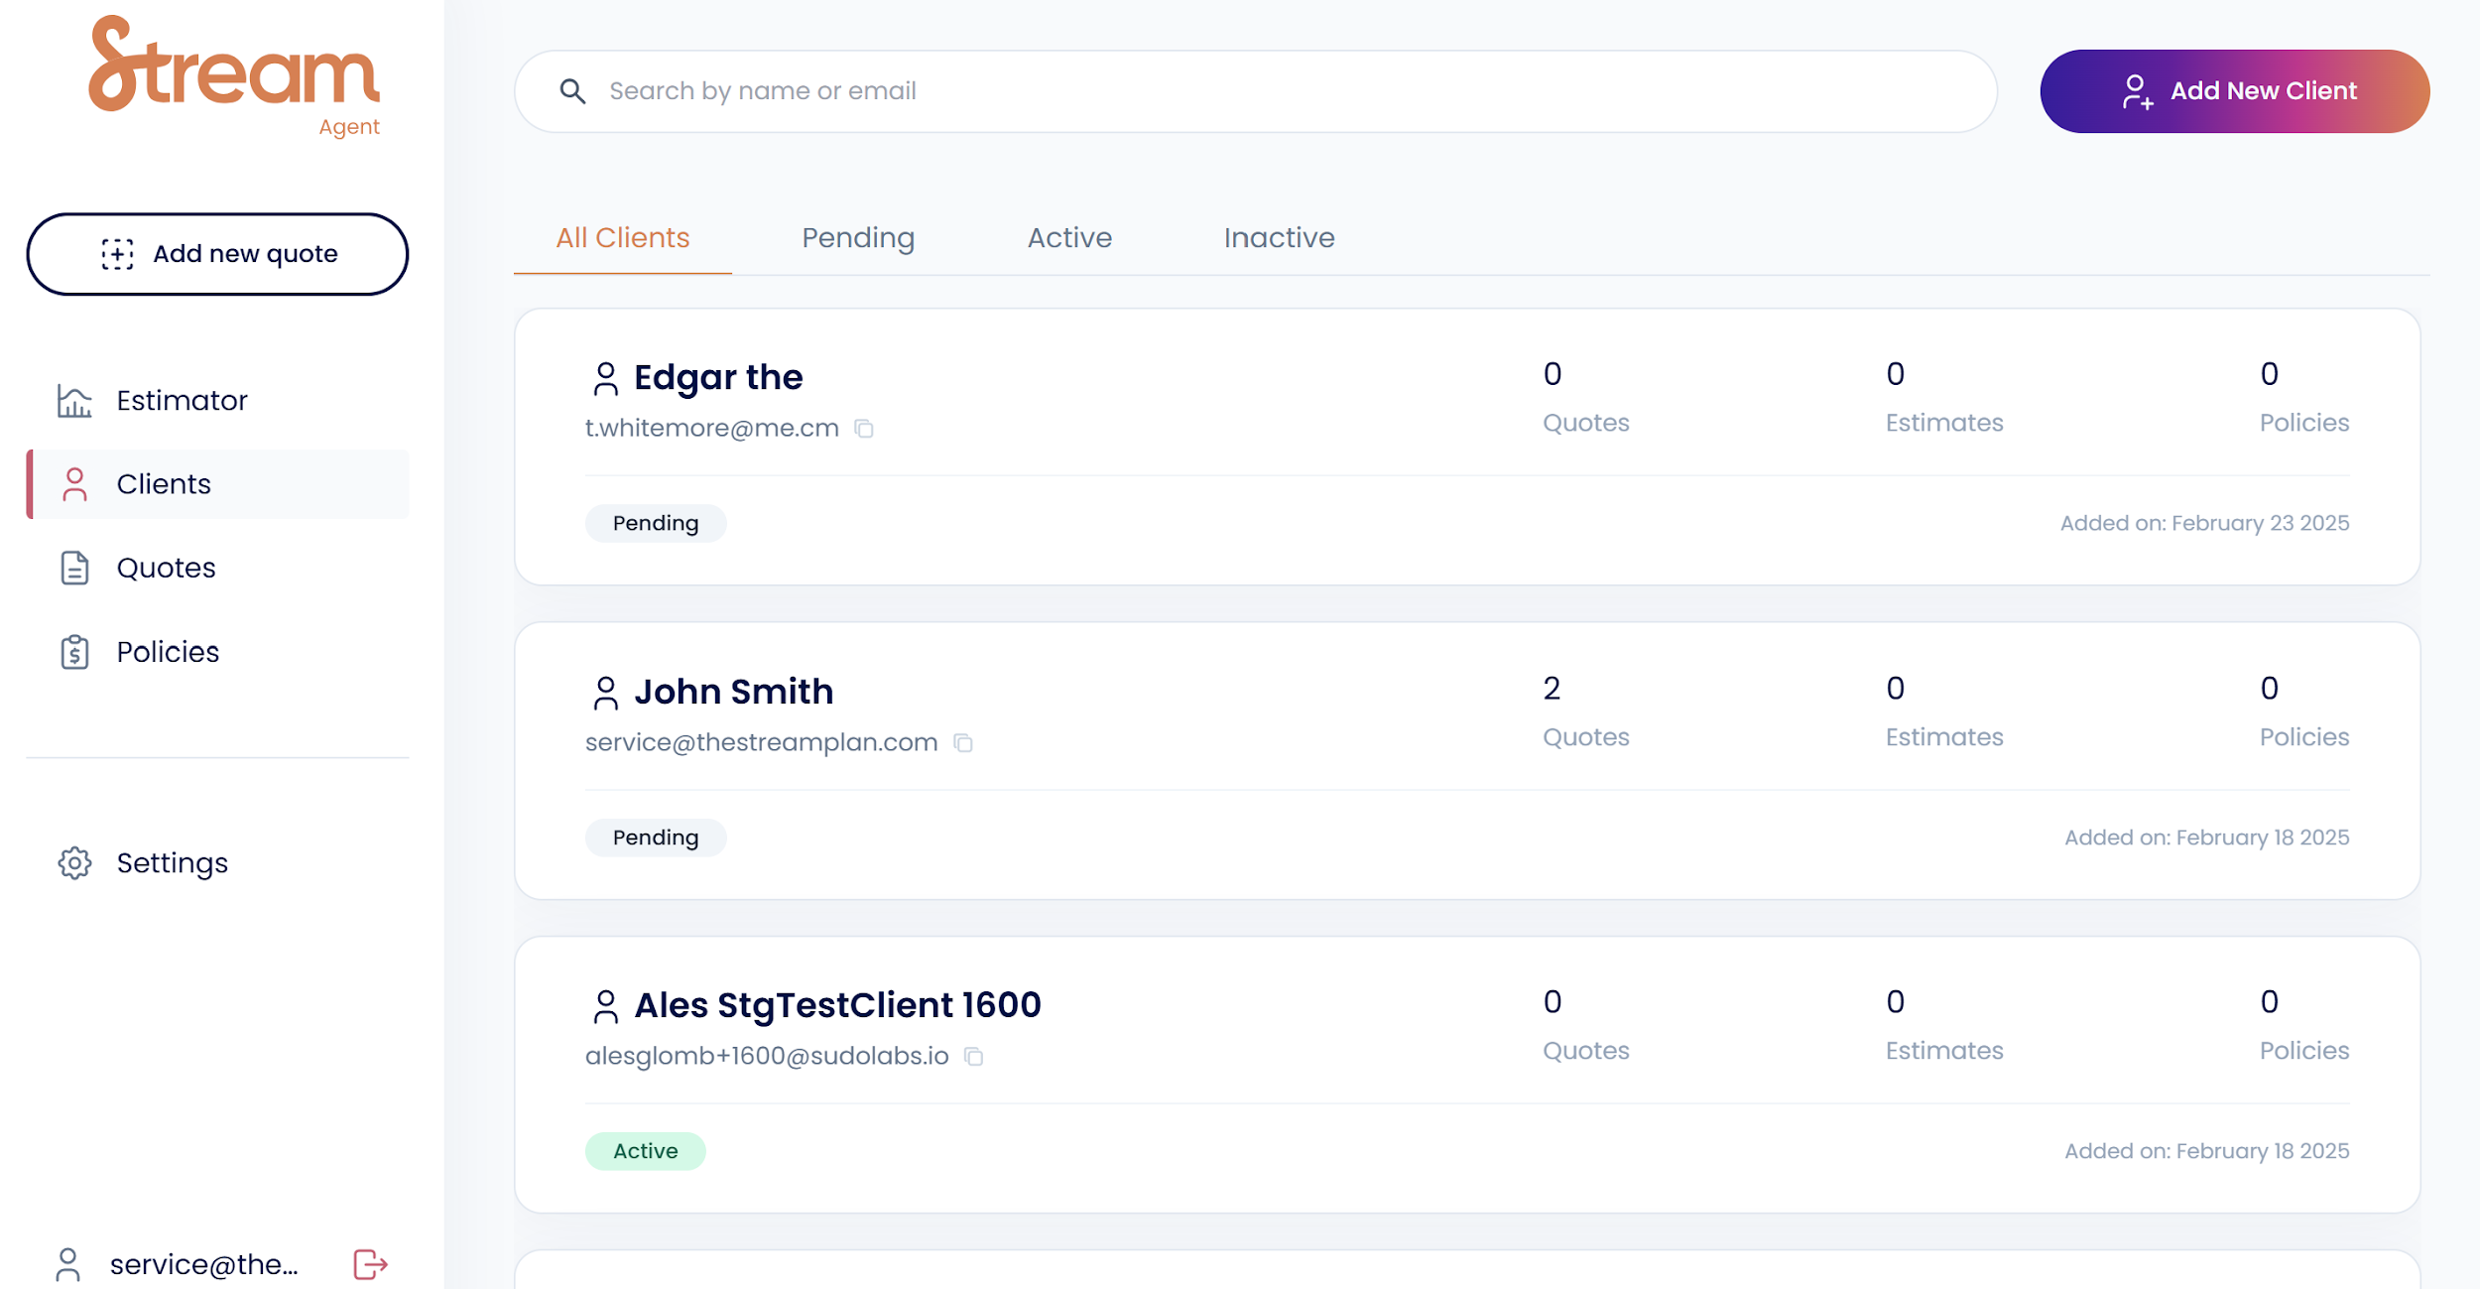
FOR AGENTS
The Streamline Portal
staging.thestreamplan.link/role
Your go-to dashboard
Agent training
Self-serve certification in minutes
Instant quotes
Build custom illustrations in seconds
Apply online
Complete applications end-to-end
Track pipeline
See every case in one dashboard
21 / 22
Notes:
Now that we have talked about the product and how we have paired it with leverage, lets talk about how the two work together in the Stream Plan.
-Stream acts as the borrower and guarantor.
-Clients are required to pay 5 year of contributions. Starting in year 6, the bank will fully fund the last 5 payments.
-We group clients together into a tranche to obtain favorable loan rates and make financing available to them.
-The clients don’t need to post and personal guarantee, no collateral is needed, and the clients have no commitments.

Slide 22

Thank you
Ready to get started? Let us know you’re interested!
Notes:
QR code links to interest form - let us know you’re interested!

