Slide 1


PRESENTACIÓN PARA AGENTES
El Plan Stream
Una forma más inteligente de ahorrar: Vida Universal Indexada con financiamiento bancario pre-empaquetado.
Notes:
In today’s presentation our main two goals is to share with you is how to make smarter financial decisions and obtain financial freedom in your retirement.

Slide 2




LA FÓRMULA
¿Qué hace diferente a Stream?
+
=
Vida Universal
Financiamiento Bancario
El Plan de Protección
Indexada
Pre-Empaquetado
Stream
Crecimiento ligado al mercado, sin riesgo a la baja
Stream es el prestatario — no su cliente
Una forma más inteligente de ahorrar
Su cliente contribuye. Stream y el banco hacen el trabajo pesado.
02 / 22
Notes:
For many years, life insurance has been only viewed as a death benefit, with no living benefits. We have flipped that narrative. No longer is insurance just liability, it now is an asset.
Over the past 2 years we have put our brains together to help solve the problem of not being able to save efficiently for tax free retirement income and come up with our strategy, Stream Protection Plan.
Our program utilizes an indexed universal life product, partially funded by a bank, that we have packaged together to create Stream. So let’s talk about it…

Slide 3
AGENDA
Lo que cubriremos
01
El Plan Stream
Cómo funciona una IUL pre-empaquetada + préstamo bancario
02
Cómo Funciona
La estructura, contribuciones del cliente y rol del banco
03
Casos de Estudio
Números reales en tres escenarios de cliente
04
El Portal Streamline
Cotice, solicite y dé seguimiento — todo en un solo lugar
03 / 22
Notes:
In today’s presentation our main two goals is to share with you is how to make smarter financial decisions and obtain financial freedom in your retirement.

Slide 4



POR QUÉ STREAM
Diseñado pensando en el cliente
Hemos hecho el trabajo, para que el cliente no tenga que hacerlo.
Préstamos pre-aprobados
Stream es el prestatario
Stream ya ha negociado el financiamiento con bancos importantes — sin solicitud de préstamo para su cliente.
Stream actúa como prestatario y garante del préstamo. El cliente no asume la responsabilidad.
Sin impacto al crédito
Compromiso corto de 5 años
Sin colateral, sin garantía personal, sin reporte de crédito, sin reportes.
El cliente paga la contribución anual por 5 años — sin obligación a largo plazo.
04 / 22
Notes:
Now that we have talked about the product and how we have paired it with leverage, lets talk about how the two work together in the Stream Plan.
-Stream acts as the borrower and guarantor.
-Clients are required to pay 5 year of contributions. Starting in year 6, the bank will fully fund the last 5 payments.
-We group clients together into a tranche to obtain favorable loan rates and make financing available to them.
-The clients don’t need to post and personal guarantee, no collateral is needed, and the clients have no commitments.

Slide 5
LA VENTAJA STREAM
$5.50
Hasta
por cada $1 que aporta el cliente.
5 Años
10 Años
$0 Colateral
de aportes del cliente
de financiamiento bancario
o garantía personal requerida
05 / 22
Notes:
Now that we have talked about the product and how we have paired it with leverage, lets talk about how the two work together in the Stream Plan.
-Stream acts as the borrower and guarantor.
-Clients are required to pay 5 year of contributions. Starting in year 6, the bank will fully fund the last 5 payments.
-We group clients together into a tranche to obtain favorable loan rates and make financing available to them.
-The clients don’t need to post and personal guarantee, no collateral is needed, and the clients have no commitments.

Slide 6


EL PERFIL IDEAL
¿Quién es el cliente
ideal de Stream?
Los clientes ideales de Stream son HENRYs (Altos Ingresos, Aún No Ricos) y
personas de altos ingresos que buscan hacer crecer y proteger su patrimonio.
Ingresos de $200K+
Edades 1 – 55
Edades 30 – 60
Un solo ingreso de $200K+ al año, o pareja casada con $300K+, o patrimonio neto de $1M+.
Rango de edad elegible para diseños enfocados en ingresos.
Rango de edad elegible para diseños enfocados en beneficio por fallecimiento.
06 / 22
Notes:
For many years, life insurance has been only viewed as a death benefit, with no living benefits. We have flipped that narrative. No longer is insurance just liability, it now is an asset.
Over the past 2 years we have put our brains together to help solve the problem of not being able to save efficiently for tax free retirement income and come up with our strategy, Stream Protection Plan.
Our program utilizes an indexed universal life product, partially funded by a bank, that we have packaged together to create Stream. So let’s talk about it…

Slide 7
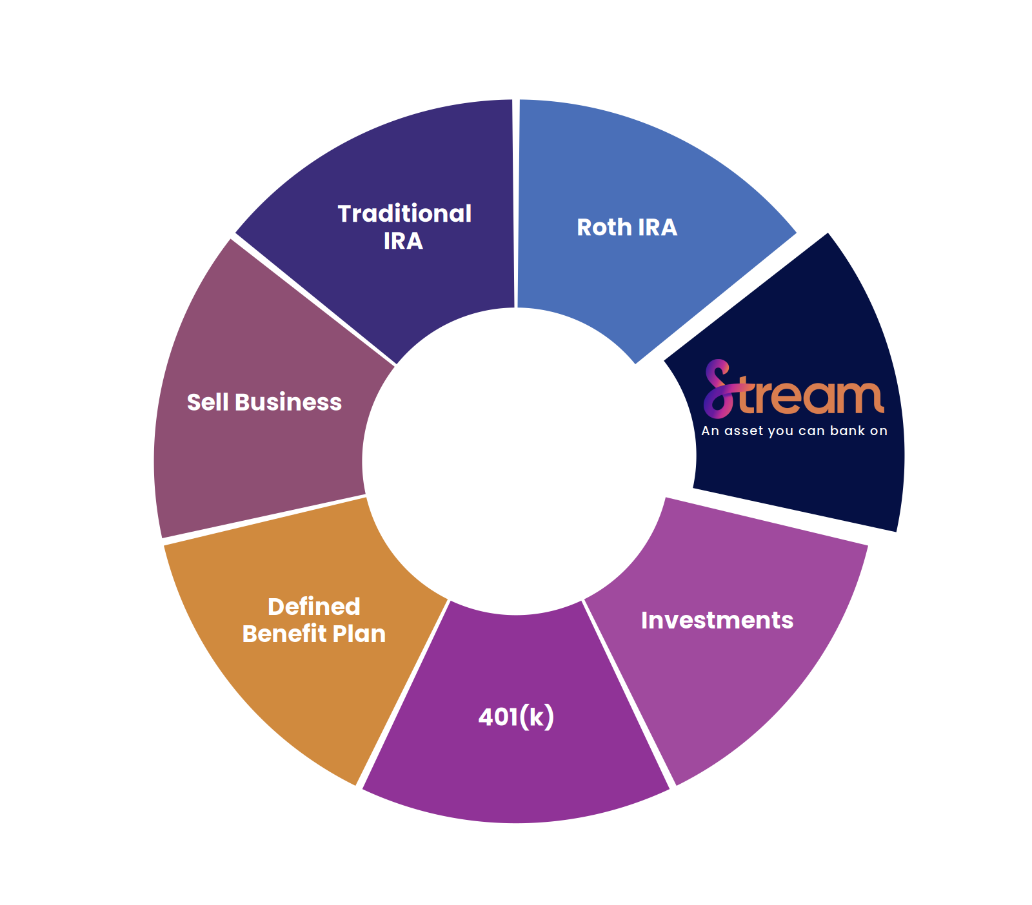
EL PROBLEMA
¿Será suficiente
mi jubilación?
Los vehículos tradicionales de jubilación tienen topes, están sujetos a impuestos y expuestos a pérdidas del mercado.
Los límites de aportación al 401(k) y IRA son bajos
Las ganancias de la venta de un negocio se gravan fuertemente
Las pérdidas del mercado se acumulan en la edad de jubilación
07 / 22
Notes:
With national debt levels at an all time high, the government will only be able to repay these debts by consistently raising taxes in the future. With this being said, the way traditional retirement plans are structured are broken and will not be enough to fund our retirements, as they are taxed as the money is taken out. The problem is when they tax the money out it is all taxed as ordinary income. Two verhicles that rovide tax free income are rothiras and stream. The problem with the roth is that clients who make too much money can’t contribute. Think of the stream program as a roth on steroids.

Slide 8
CÓMO FUNCIONA
La estructura de 10 pagos
Su cliente financia 30–50% durante 5 años. El banco cubre el resto, más todos los años 6–10.
CLIENTE + BANCO
SOLO BANCO
Su Cliente
$
$
$
$
$
El Banco
$
$
$
$
$
$
$
$
$
$
Años
A1
A2
A3
A4
A5
A6
A7
A8
A9
A10
$
EL CLIENTE PAGA
EL BANCO PAGA
EL APALANCAMIENTO
$
Años 1–5, 30–50% de la prima
Resto de A1–5, más todos los A6–10
El banco financia la mayoría de la prima
5 aportaciones
10 aportaciones
Hasta $5.50 : $1
08 / 22

Slide 9










LA FAMILIA STREAM
Cinco formas de posicionar Stream
Una estrategia para cinco clientes únicos.
Jubilación personal
Dueños de negocios
Planificación de legado
Profesionales médicos
Atletas profesionales
Ingresos libres de impuestos
Financiamiento de compra/venta
Patrimonio multigeneracional
Capital para crecimiento del consultorio
Ingresos libres de impuestos
Beneficio por fallecimiento individual o de sobreviviente
Seguro de persona clave
Estrategia de impuestos sucesorios
Financiamiento educativo
Diversificación del portafolio financiero
Crecimiento indexado
Compensación diferida
Diseño compatible con fideicomisos
Ingresos de jubilación
Capital trabajando después de la carrera
09 / 22

Slide 10
CASO DE ESTUDIO 01
¿Por qué no financiar yo mismo una póliza de vida?
SUPUESTOS: Hombre, 40 años, salud preferida • 5 años de financiamiento • $25,000 por año • 6.81% retorno neto asumido
IUL NO FINANCIADA
IUL DEL PLAN STREAM
LA DIFERENCIA
Financiada por usted mismo
Con financiamiento bancario
Retornos Asumidos
Retornos Asumidos
6.81% Neto
6.81% Neto
—
Beneficio por Fallecimiento Inicial
Beneficio por Fallecimiento Inicial
+$750,821
$400,710
$1,151,532
Ingreso Proyectado a los 65
Ingreso Proyectado a los 65
+$40,957
$40,428
$81,385
Ingreso Proyectado a Durar Hasta
Ingreso Proyectado a Durar Hasta
120
120
—
Ingreso proyectado acumulado hasta los 88
Ingreso proyectado acumulado hasta los 88
+$783,117
$970,272
$1,871,855
Beneficio por Fallecimiento a la Expectativa de Vida
Beneficio por Fallecimiento a la Expectativa de Vida
+$600,347
$227,887
$828,234
Supuesto: Hombre de 40 años Preferido, 5 Años de Financiamiento a $25,000 por Año
10 / 22

Slide 11
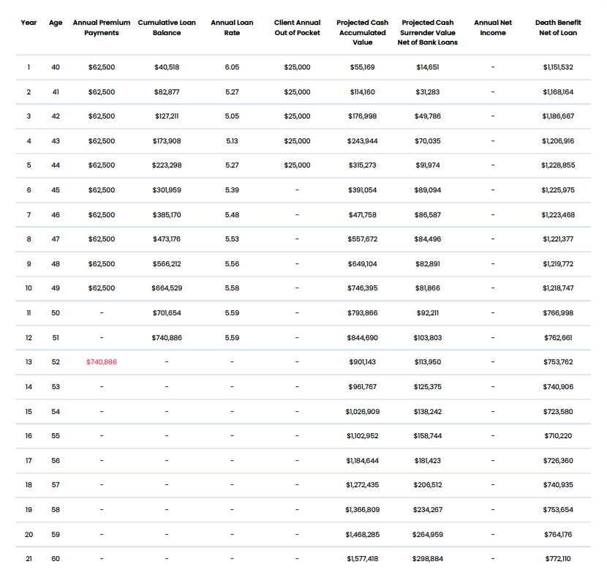
CASO DE ESTUDIO 01
11 / 22
Notes:
Now lets take a look at self funding vs. using Stream’s funding.

Slide 12
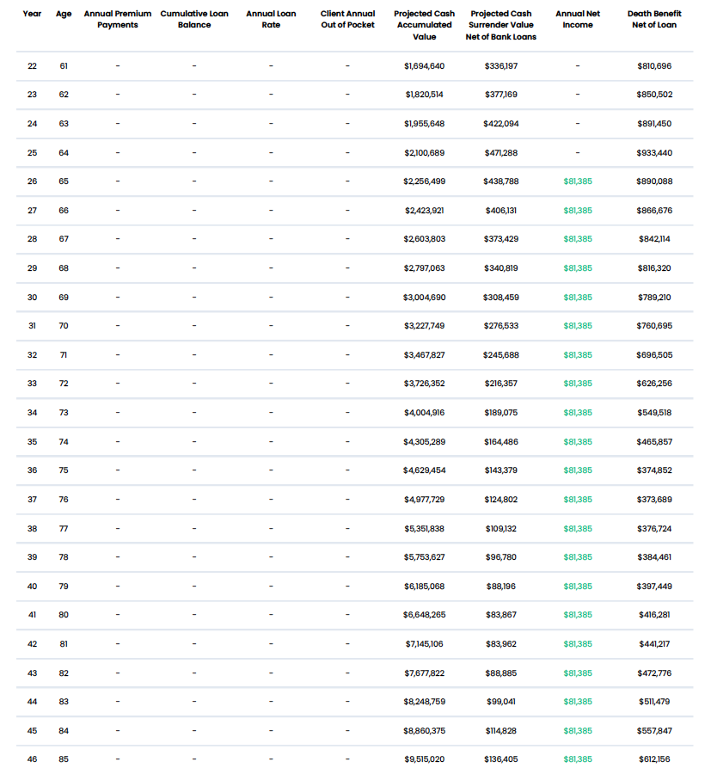
CASO DE ESTUDIO 01
12 / 22
Notes:
Now lets take a look at self funding vs. using Stream’s funding.

Slide 13
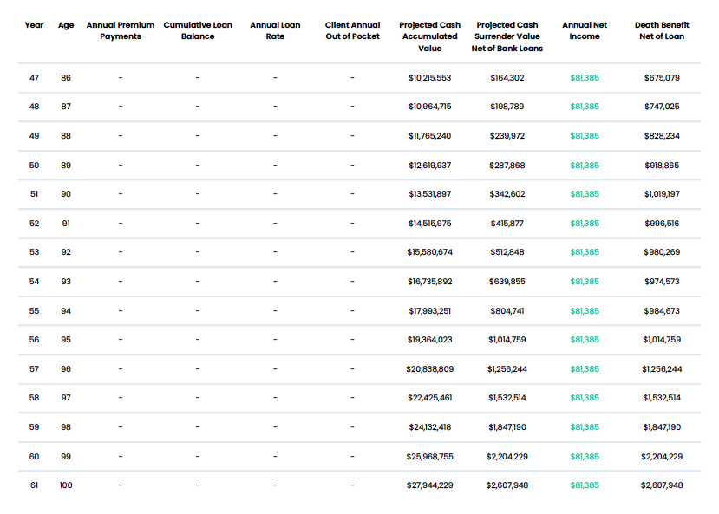
CASO DE ESTUDIO 01
13 / 22
Notes:
Now lets take a look at self funding vs. using Stream’s funding.

Slide 14


CASO DE ESTUDIO 02
El dueño de negocio preparándose para la salida
RESULTADO STREAM
PERFIL DEL CLIENTE
Pago flexible del préstamo, legado máximo
Dueño de negocio de HVAC
EDAD
Préstamo pagado con ganancias de la salida del negocio
43 años
El préstamo bancario puede pagarse con la eventual venta del negocio — o con el valor en efectivo de la póliza.
HORIZONTE
Planea salir del negocio en 10 años
Legado con ventajas fiscales para los hijos
El beneficio por fallecimiento pasa libre de impuestos a la familia
OBJETIVO
Maximizar los beneficios futuros para sí mismo y sus hijos
PRIORIDAD
Crecimiento indexado sin pérdidas del mercado
Transferir la mayor cantidad de activos libres de impuestos a la familia
El valor en efectivo de la póliza crece con el mercado pero está protegido de las caídas.
14 / 22
Notes:
For many years, life insurance has been only viewed as a death benefit, with no living benefits. We have flipped that narrative. No longer is insurance just liability, it now is an asset.
Over the past 2 years we have put our brains together to help solve the problem of not being able to save efficiently for tax free retirement income and come up with our strategy, Stream Protection Plan.
Our program utilizes an indexed universal life product, partially funded by a bank, that we have packaged together to create Stream. So let’s talk about it…

Slide 15
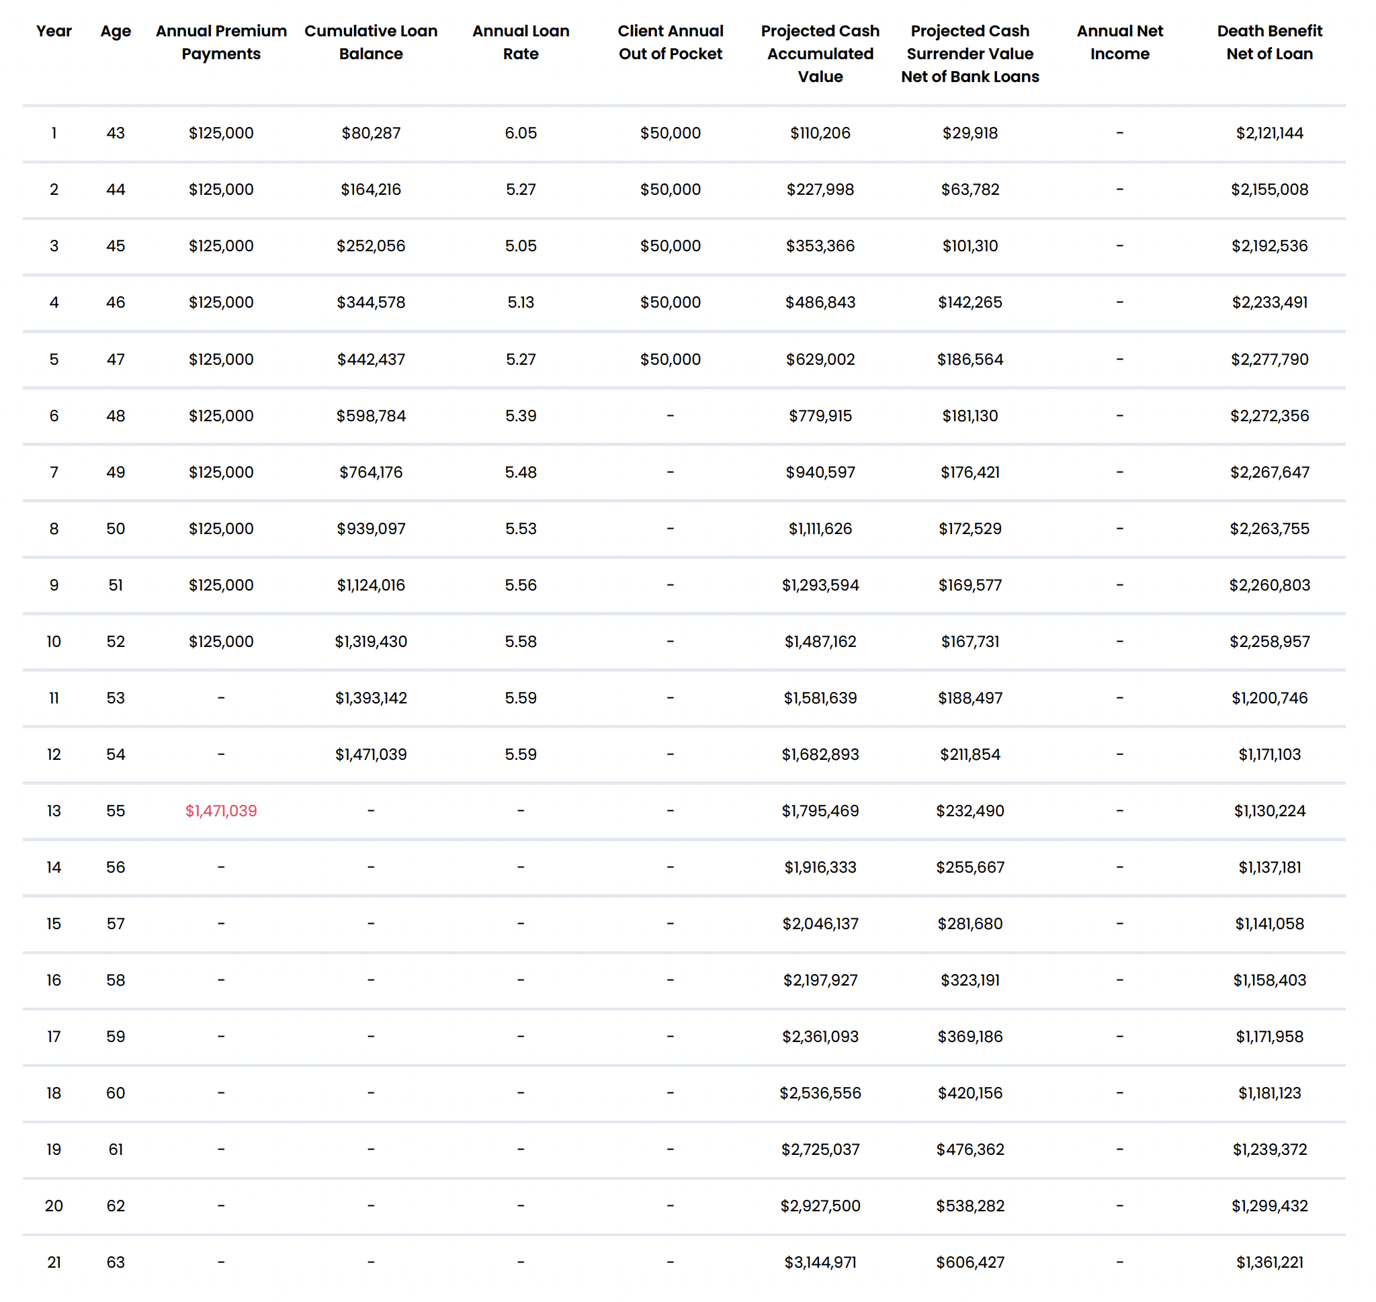
CASO DE ESTUDIO 02 - ¿Por qué Stream?
15 / 22
Notes:
For many years, life insurance has been only viewed as a death benefit, with no living benefits. We have flipped that narrative. No longer is insurance just liability, it now is an asset.
Over the past 2 years we have put our brains together to help solve the problem of not being able to save efficiently for tax free retirement income and come up with our strategy, Stream Protection Plan.
Our program utilizes an indexed universal life product, partially funded by a bank, that we have packaged together to create Stream. So let’s talk about it…

Slide 16
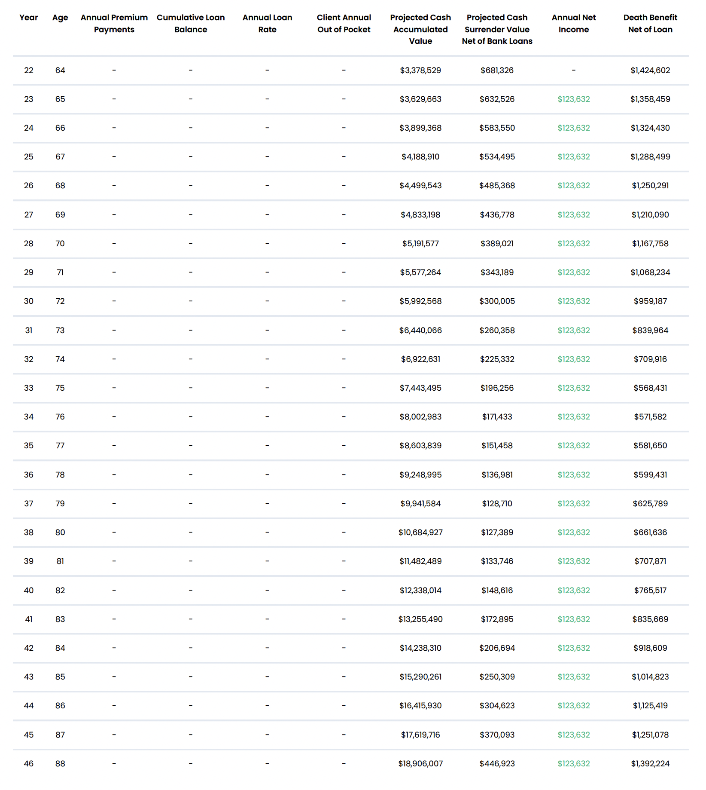
CASO DE ESTUDIO 02 - ¿Por qué Stream?
16 / 22
Notes:
For many years, life insurance has been only viewed as a death benefit, with no living benefits. We have flipped that narrative. No longer is insurance just liability, it now is an asset.
Over the past 2 years we have put our brains together to help solve the problem of not being able to save efficiently for tax free retirement income and come up with our strategy, Stream Protection Plan.
Our program utilizes an indexed universal life product, partially funded by a bank, that we have packaged together to create Stream. So let’s talk about it…

Slide 17
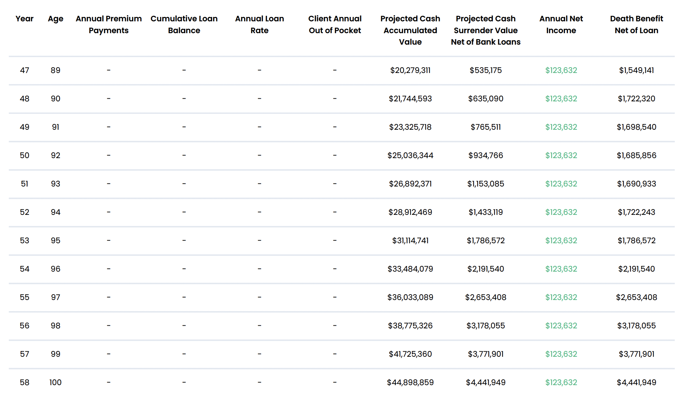
CASO DE ESTUDIO 02 - ¿Por qué Stream?
17 / 22
Notes:
Now lets take a look at self funding vs. using Stream’s funding.

Slide 18
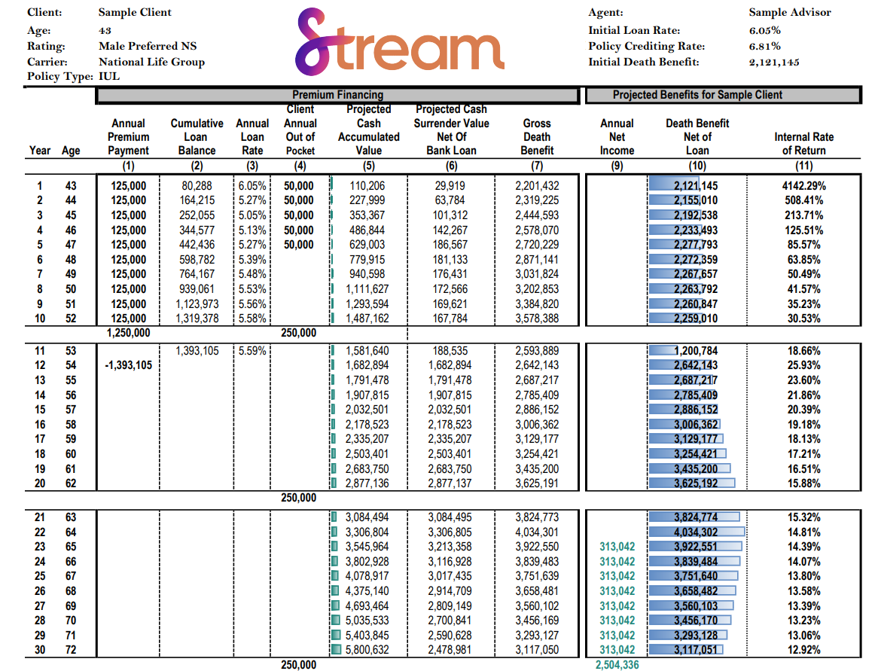
CASO DE ESTUDIO 02 - Pago del préstamo con fondos externos
18 / 22
Notes:
For many years, life insurance has been only viewed as a death benefit, with no living benefits. We have flipped that narrative. No longer is insurance just liability, it now is an asset.
Over the past 2 years we have put our brains together to help solve the problem of not being able to save efficiently for tax free retirement income and come up with our strategy, Stream Protection Plan.
Our program utilizes an indexed universal life product, partially funded by a bank, that we have packaged together to create Stream. So let’s talk about it…

Slide 19
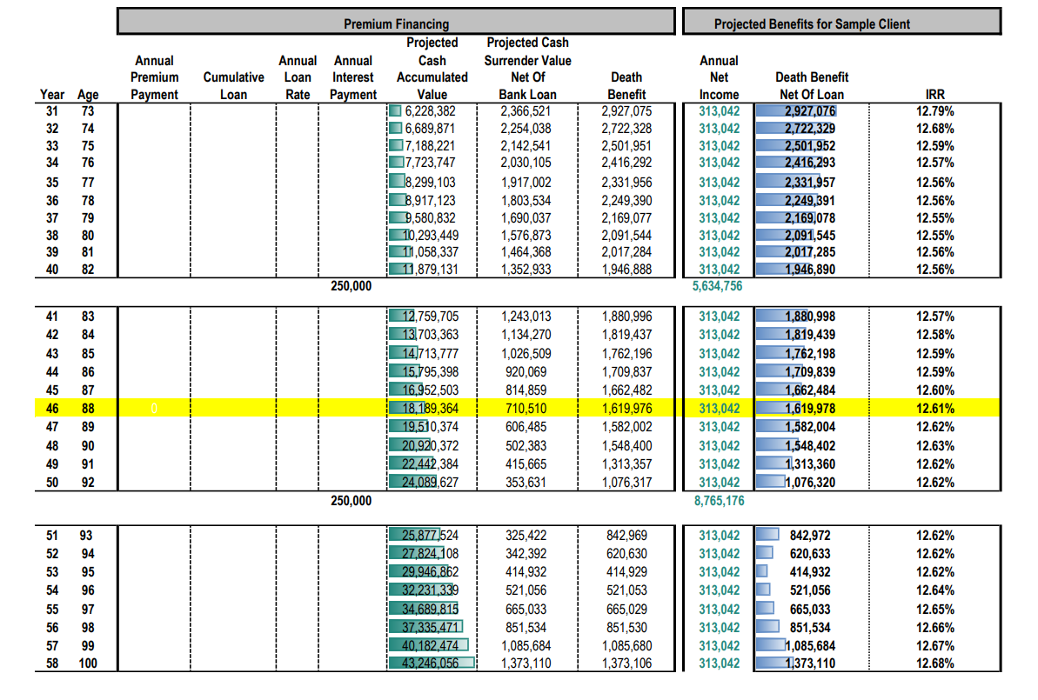
CASO DE ESTUDIO 02 - Pago del préstamo con fondos externos
19 / 22
Notes:
For many years, life insurance has been only viewed as a death benefit, with no living benefits. We have flipped that narrative. No longer is insurance just liability, it now is an asset.
Over the past 2 years we have put our brains together to help solve the problem of not being able to save efficiently for tax free retirement income and come up with our strategy, Stream Protection Plan.
Our program utilizes an indexed universal life product, partially funded by a bank, that we have packaged together to create Stream. So let’s talk about it…

Slide 20
PRÓXIMOS PASOS
Cómo obtener su primera cotización
Cuatro pasos para su primer caso Stream — la mayoría de los agentes completan los cuatro en menos de una hora.
01
02
03
04
Visite nuestro sitio
Complete la capacitación
Acceda al Portal Streamline
Cotizaciones personalizadas
Cree su cuenta de agente en thestreamplan.com en 2 minutos.
Certificación corta y a su propio ritmo en línea.
Su portal del cliente para cotizaciones y solicitudes.
Ejecute ilustraciones en segundos y solicite la póliza también.
20 / 22
Notes:
For many years, life insurance has been only viewed as a death benefit, with no living benefits. We have flipped that narrative. No longer is insurance just liability, it now is an asset.
Over the past 2 years we have put our brains together to help solve the problem of not being able to save efficiently for tax free retirement income and come up with our strategy, Stream Protection Plan.
Our program utilizes an indexed universal life product, partially funded by a bank, that we have packaged together to create Stream. So let’s talk about it…

Slide 21

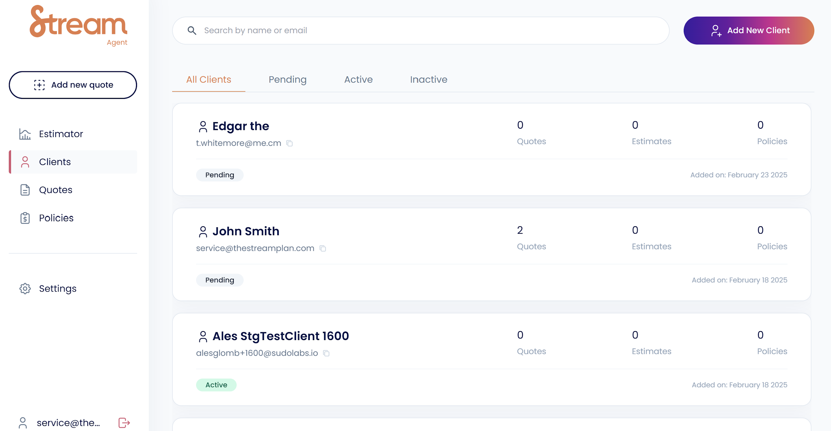
PARA AGENTES
El Portal Streamline
staging.thestreamplan.link/role
Su panel de control de referencia
Capacitación de agentes
Certificación de autoservicio en minutos
Cotizaciones instantáneas
Construya ilustraciones personalizadas en segundos
Solicite en línea
Solicitudes completas de principio a fin
Dé seguimiento al pipeline
Vea cada caso en un solo panel
21 / 22
Notes:
Now that we have talked about the product and how we have paired it with leverage, lets talk about how the two work together in the Stream Plan.
-Stream acts as the borrower and guarantor.
-Clients are required to pay 5 year of contributions. Starting in year 6, the bank will fully fund the last 5 payments.
-We group clients together into a tranche to obtain favorable loan rates and make financing available to them.
-The clients don’t need to post and personal guarantee, no collateral is needed, and the clients have no commitments.

Slide 22

Gracias
¿Listo para comenzar? ¡Háganos saber su interés!
Notes:
QR code links to interest form - let us know you’re interested!

