Slide 1


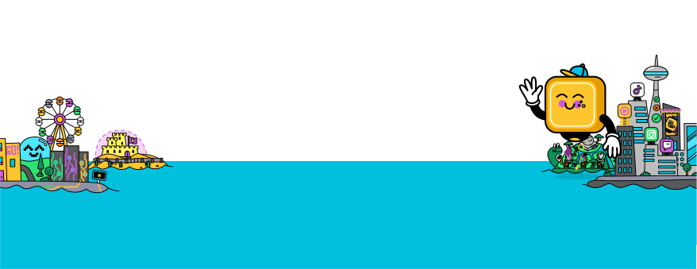
Resources
Create a fact sheet
Lesson slides

Slide 2
Resources
Let’s make a fact sheet!
Check out some fact sheet examples here:
What are fact sheets?
  A fact sheet provides key information on a topic.
  It uses bullet points and short paragraphs for easy reading.
  Fact sheets are quick, clear, and often include visuals.
  They inform or educate people in a simple format.
and here:
What would encourage you to read a fact sheet?
What do you like about the examples? What features are effective?

Slide 3

Resources
Contact risk area
What can we do?
  Tell a trusted adult if you feel uncomfortable.
  Don’t reply, but take a screenshot as evidence.
  Report it to the app or game.
  Report it to the eSafety Commissioner, who can investigate and take action.
  Block them.
  Set accounts to private and delete requests from strangers.
Statistics: From the eSafety Commissioner
  38% of young people in Australia have used the internet to talk to someone they did not know.
  24% of young people reported making friends with someone they first met online.
  17% of young people shared passwords to their emails and social media accounts.
  14% of young people share personal information with people they only know online.
  30% of Australian teenagers have been contacted by a stranger online.
Here are some examples of Contact risks.
Can you think of more?
  A stranger asks for your name, school, or address.
  You get a friend request from someone you don’t know.
  A stranger sends a link or file and says to open it.
  Someone tells you to keep your chats a secret from adults.

Slide 4

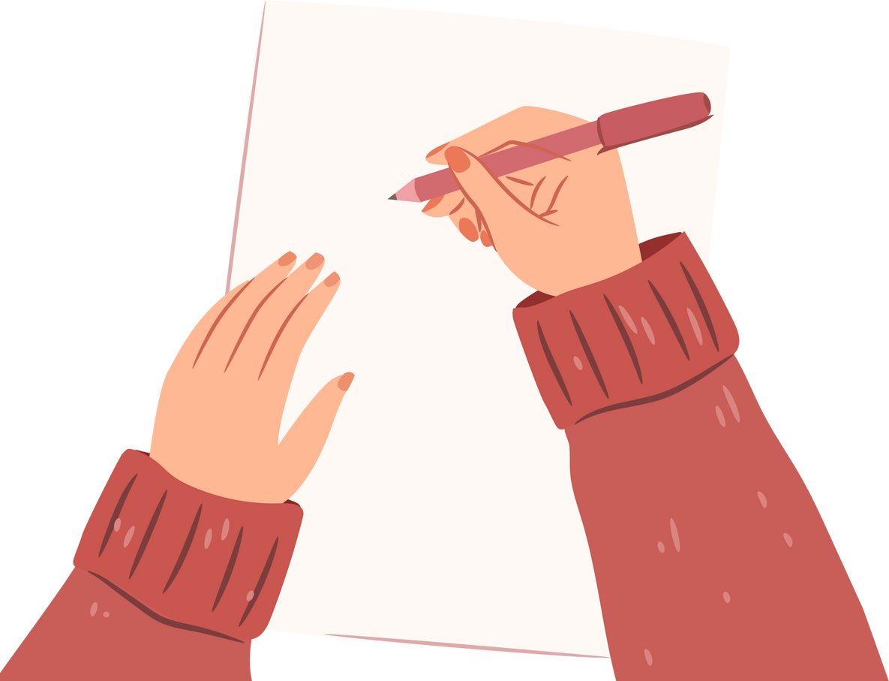
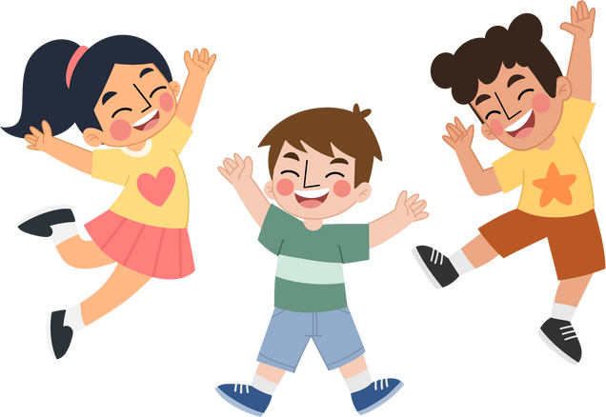
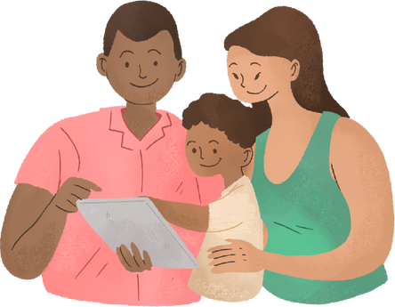



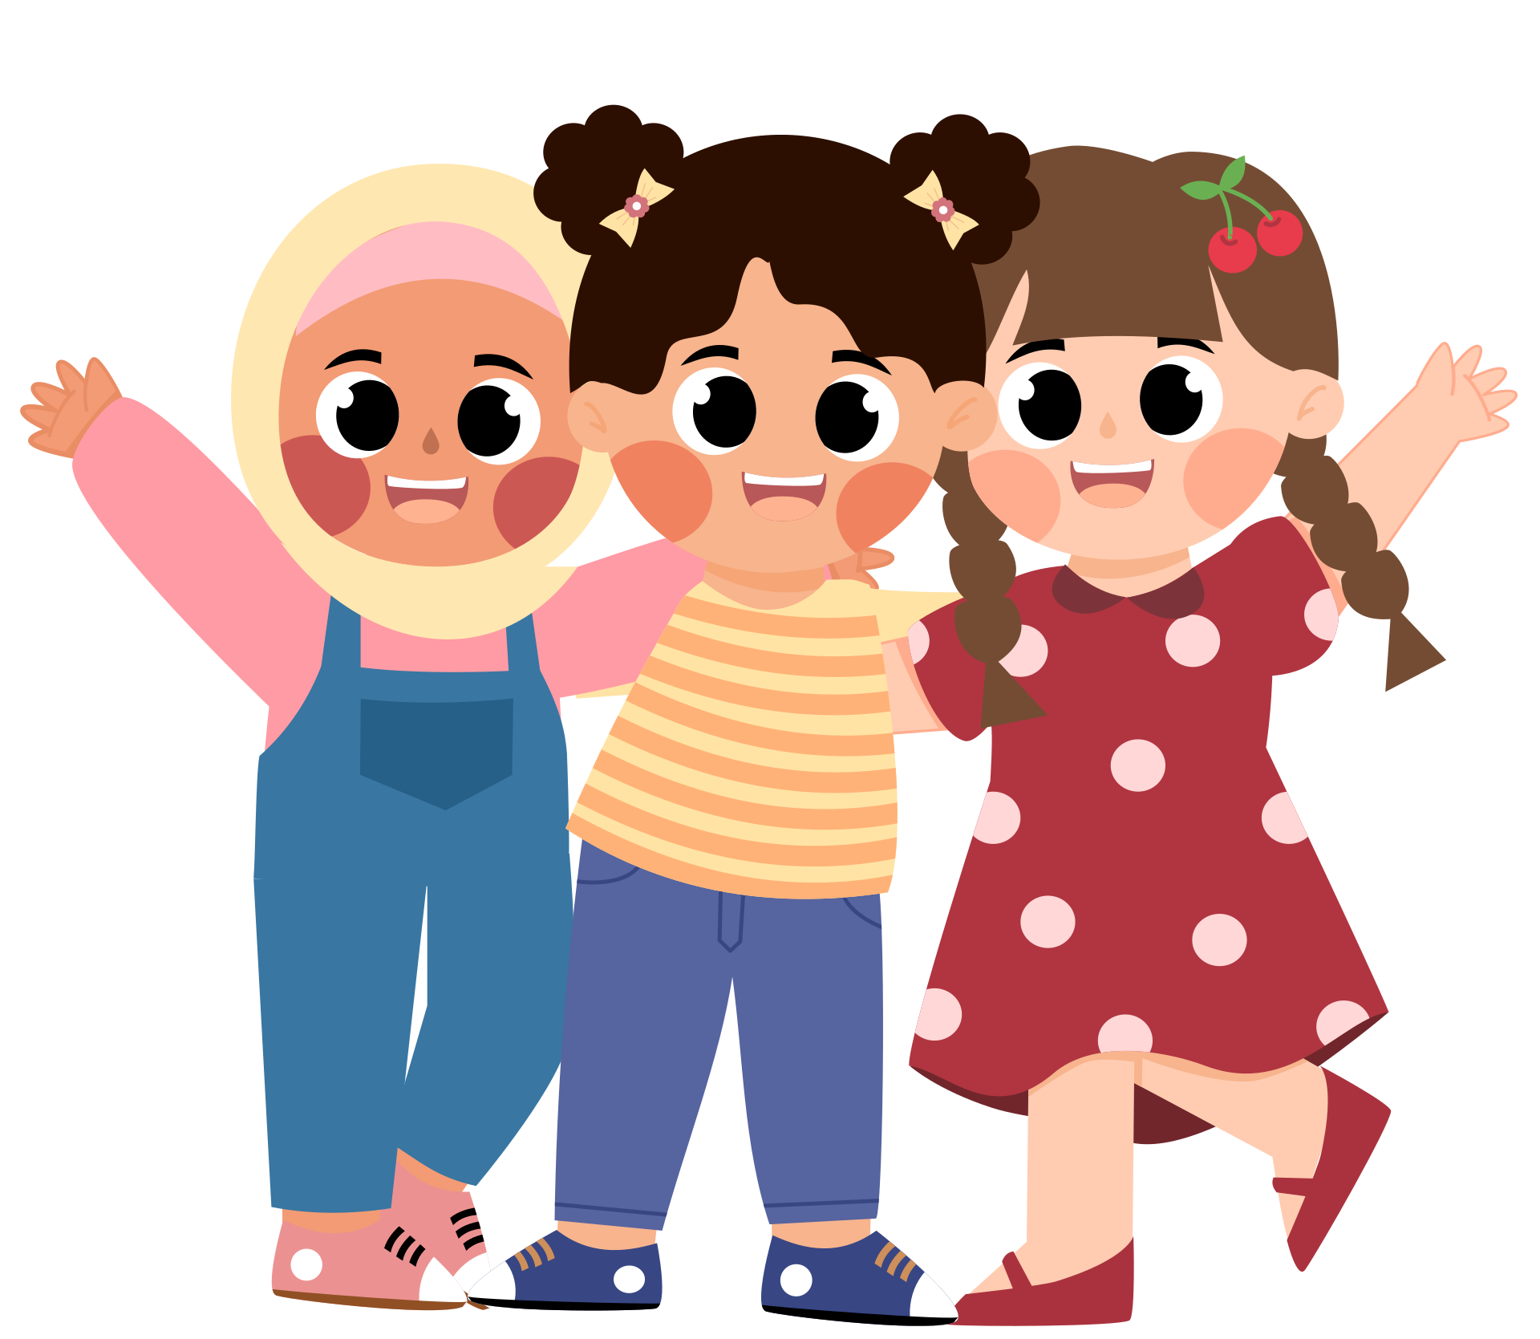
Resources
Possible fact sheet roles
Decide on your audience and tone:
Who is your audience?
Researcher
Writer
People your age
Parents
Teachers
Younger children
Designer
Editor
Will your fact sheet be serious, funny, professional, or casual? Why?

Slide 5
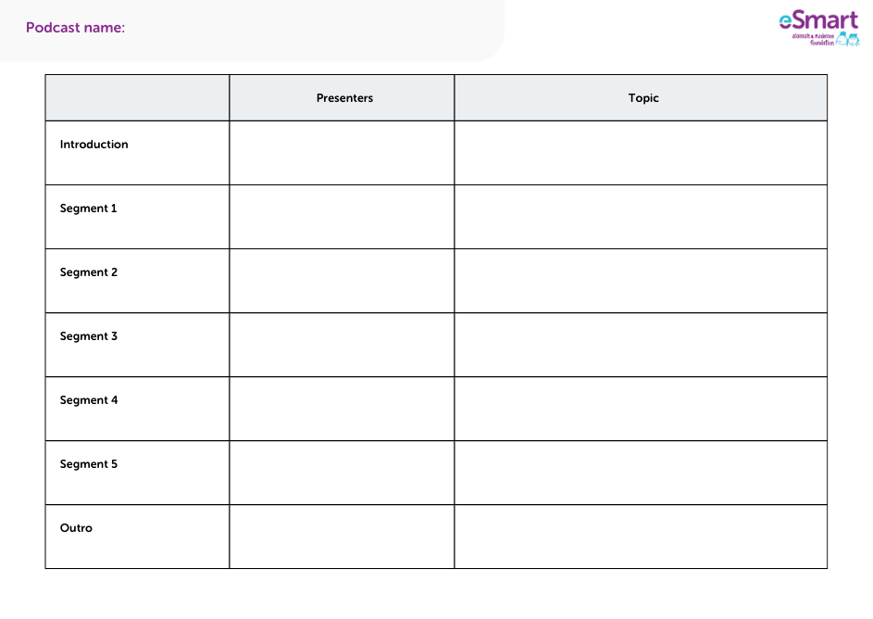
Resources
What topic(s) would you like to focus on?
  Choose a clear theme or topic.
  Start with a short introduction that explains the topic.
  Break the main topic into at least 3 segments, each focusing on a key point.
  Use simple facts, examples, or statistics in each segment.
  End with a conclusion that sums up the most important points.

Slide 6

Resources
Research your topics
Write up your research:
Look for:
  Facts and statistics
  People’s experiences
  Organisations that can help
Make sure that your sources are credible. This might mean they:
  Are from trusted websites, experts or organisations.
  Provide facts that can be checked or verified.
  Are up-to-date with current information.
  Show the author’s name and qualifications.
Opening sentence
  In this section, we will explore...
Definition
  [Topic] means...
Fact
  Did you know that...?
  According to [source],...
Story/Example (optional)
  For example, [person/group] shared that...
  People often say that...
  A recent story from [source] explains...
Solution/Action
  To make sure we are safe, we can...
  The best way to deal with this is...
Conclusion
  We’ve learned that...
  It’s important to remember...

Slide 7
Resources
Bias “watch-outs”:
Media law
Have we used sources we can trust for our information?
Are we including voices from different backgrounds, experiences, and opinions?
Is our language kind and respectful, without using words that are too emotional or unfair?
Are we sharing facts correctly without making things sound bigger than they really are?
Are there any important parts of the topic we might have missed or left out?
Do we know when we need to do more research or get more ideas to improve the conversation?
Do not use language that offends, excludes, discriminates, or defames.
Always credit work that you have adapted or that has inspired your ideas.
Swap out brand names for generic terms & don’t mention cost.
Do not endorse smoking, vaping, alcohol, drugs or gambling.
Do not promote violence or brutality.
Do not spread any false information - use subjective language.

Slide 8
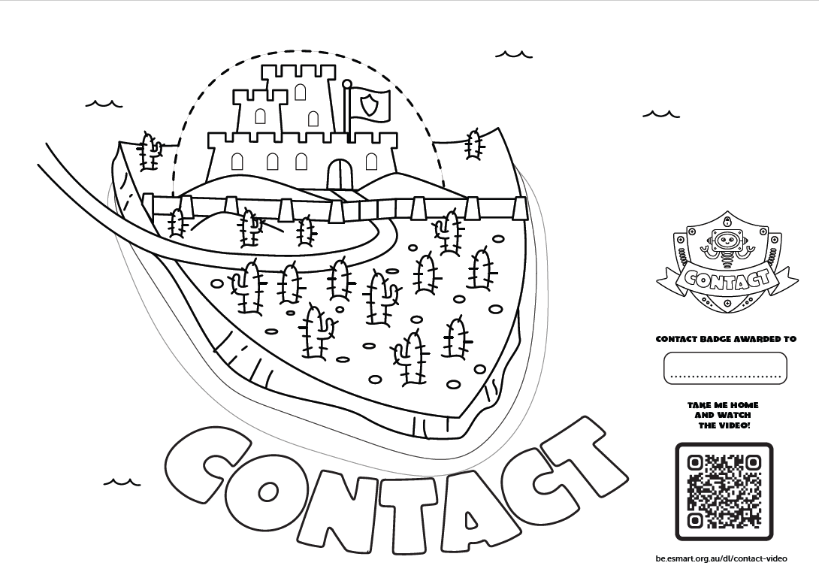
Resources
Resources
Colour in the Contact Island map.
Draw or write two situations where you might experience unwanted or unsafe contact online. What strategies could you use to stay safe and get help in these situations?

