Slide 1

Name of trainer

Slide 2

Day 1: Welcome and Overview

Slide 3
Who we are
Respect
The UK charity stopping perpetrators of domestic abuse. We work with our members, partners and allies to stop the harms done by those who cause harm and perpetrate domestic abuse.
Respect Young People’s Service (RYPS)
Supports professionals to respond effectively to young people and their families where a young person is engaging in abusive behaviour towards parents, carers and intimate partners.
Notes:
Hello I am going to do a quick introduction to the Respect Young People's team. Our focus within Respect is children and young people who are using harm themselves- that could be in their families towards parents or carers or it could be behaviour within their own intimate relationships. We train professionals and support to deliver high quality and effective interventions with the overall aim of stopping the current violence and preventing more harm in the future.

Slide 4
Ground rules/safety
Looking after ourselves and others
Confidentiality
Timekeeping
Multitasking
Using Zoom/ Teams:
Cameras on
Message trainer privately using zoom chat

Slide 5

Outline Day 1
Introductions
What is CAPVA?
RYPS approach- working with the whole family and safety
LUNCH
Theory of change
Family session 1: Meeting the family for the first time
Notes:
Any additional areas group would like to cover

Slide 6

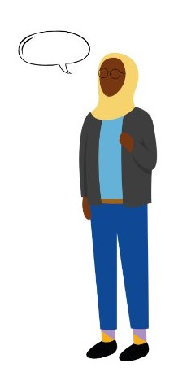
Introductions
10 mins in breakout rooms:
Name
Role
What were you like as a teenager
Notes:
Share what feels safe to share- choose one word to describe yourself to feedback to the whole group.
Take feedback- highlight how different many of us are from when we teenagers. Reflect that this is why it so critical to intervene with unhealthy behaviour in the teenage years.

Slide 7
The Respect Young People’s Programme (RYPP)
RYPP is a manualised programme & resources delivered over 12 weeks. It is targeted at reducing violence and abuse and other risk factors associated with CAPVA. It aims to:
Improve attachment
Improve academic attainment and/or school engagement
Increase confidence in parenting
Improve empathy
Improve conflict resolution skills
Improve emotional regulation
Reduce risk outside the family home to the young person.

Slide 8
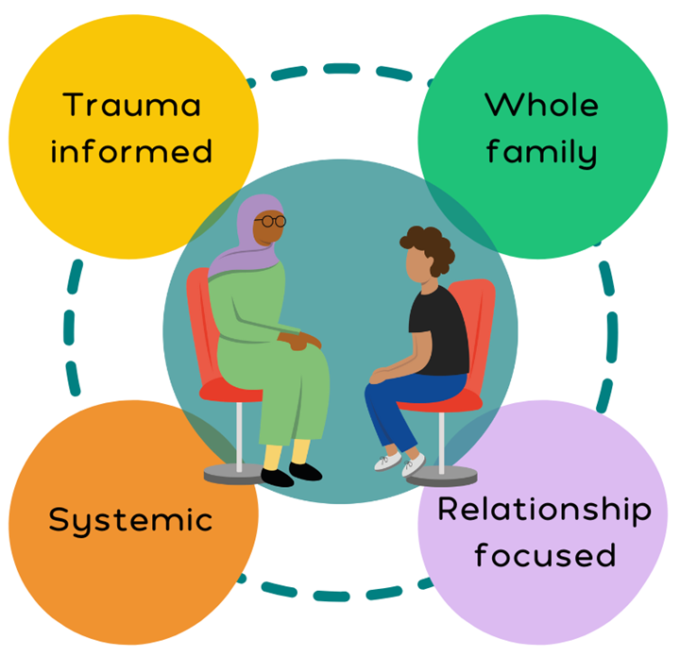

RYPP Structure
18 Sessions delivered over 12 weeks
7 sessions with parents
2 family sessions
2 sessions YP individually
6 sessions YP
1 exit / closure session
Delivered in accordance with practice and implementation manuals
Promote a child centered, culturally appropriate response
www.respectyps.org.uk

Slide 9
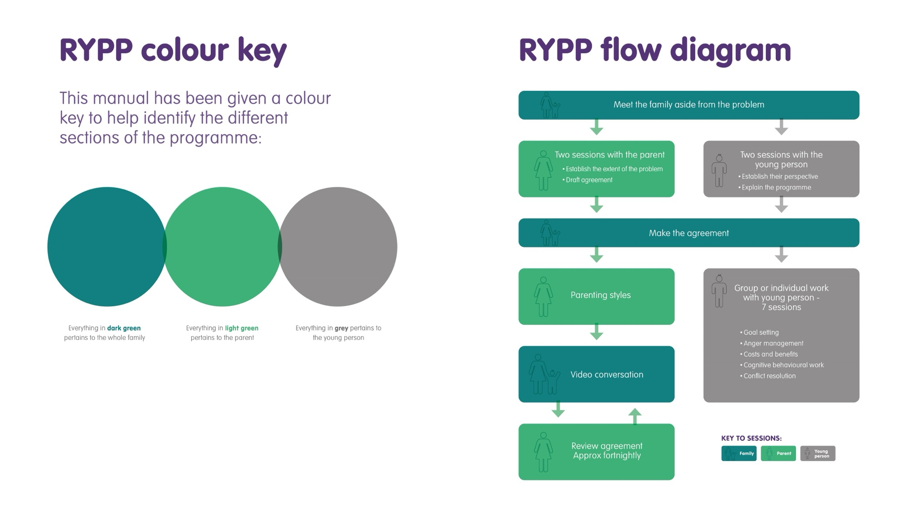

Slide 10

Understanding CAPVA

Slide 11
Child and Adolescent to Parent Violence and Abuse
Respect use the term Child and Adolescent to Parent Violence and Abuse (CAPVA) to describe the dynamic where a young person (8 years -18 years) engages in abusive behaviour* towards a parent or adult carer where the abusive behaviour is harmful and repeated.​
*By abusive behaviour we mean more than physical violence, but including emotional, coercive, or controlling behaviour, sexual abuse, and economic abuse. ​
Notes:
There currently isn’t a nationally agreed definition. There are current debates about language e.g. using the word abusive.
It must be a pattern of behaviour not a one- off incident
Not just physical violence although it usually is physical by the time families come forward for services/ support.
Causes?

Slide 12
Group work
What factors/ contexts for families would make CAPVA more likely to happen?

Slide 13
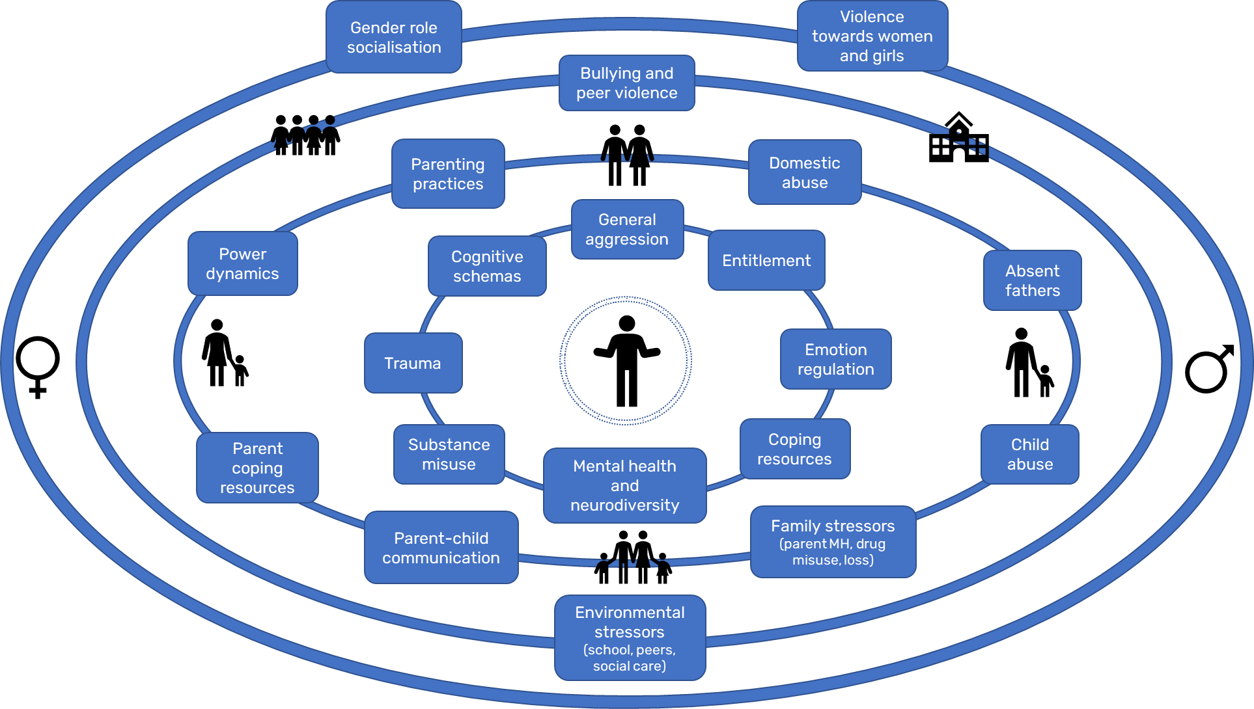
Notes:
This ecological model helps us understand the different influences and contexts that can contribute to child-to-parent abuse. It is taken from the literature review written for the DA Commissioner in 2021.

Slide 14
Break
Notes:
11

Slide 15
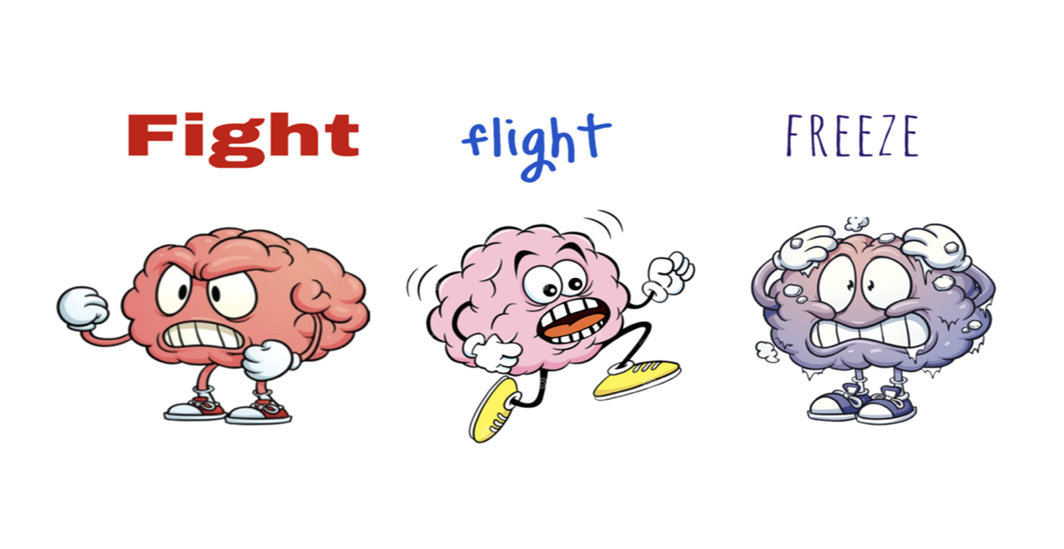
Impact of Trauma
www.respectyps.org.uk
Notes:
So here you can see we’ve pulled out most common individual factors that practitioners come across and we’re going to talk in particular about trauma and emotional regulation.
The fight or flight system is a physiological response to danger with its primary function being to keep us alive with the idea being that when danger is sensed the body starts preparing to fight or run away you spot danger and the system is activated sending neuro transmitters like cortisol and adrenaline rushing through the body; this is all very useful if you're facing a short term danger but bad for us physically and mentally if we are exposed to it long term as chronic stress.
so why is this relevant to CAPVA? Well the fight or flight system continues to develop post utero so if you happen to be growing up in a scary environment say domestic abuse the system gets calibrated at a really high level- you're always on alert you're looking for danger might see it when it's not bad misreading situations responding aggressively because you think you're under attack you become what Bessel van der Kolk calls an over active smoke alarm. Children and parents who are easily triggered into fight or flight may find it much harder to regulate their emotions and de-escalate conflict. Research on Aces shows that childhood trauma can alter stress-response systems and increase risks of:
Impulsivity
Aggression
Anxiety
Hypervigilance
difficulties managing emotions and conflict

Slide 16
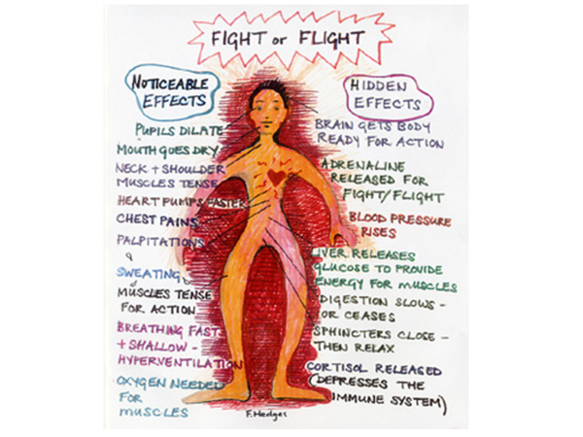
Notes:
This shows the body’s fight/ flight response- can also include freeze/ fawn/ flop
The fight-or-flight system is the body’s natural response to danger. When we sense a threat, stress hormones like adrenaline and cortisol are released to prepare us to fight or escape. This response is helpful in short-term danger, but when it is activated too often, it can become harmful both physically and emotionally.
For children who grow up in frightening or unpredictable environments – such as domestic abuse, parental mental ill-health, or conflict – this system can become over-calibrated. They may stay constantly on alert, scanning for danger even when they are safe.
This can lead to:
• Misreading situations as threatening
• Reacting quickly with anger or aggression
• Struggling to calm down after conflict
Trauma specialist Bessel van der Kolk describes this as having an “overactive smoke alarm” – the alarm goes off even when there is no real fire.

Slide 17
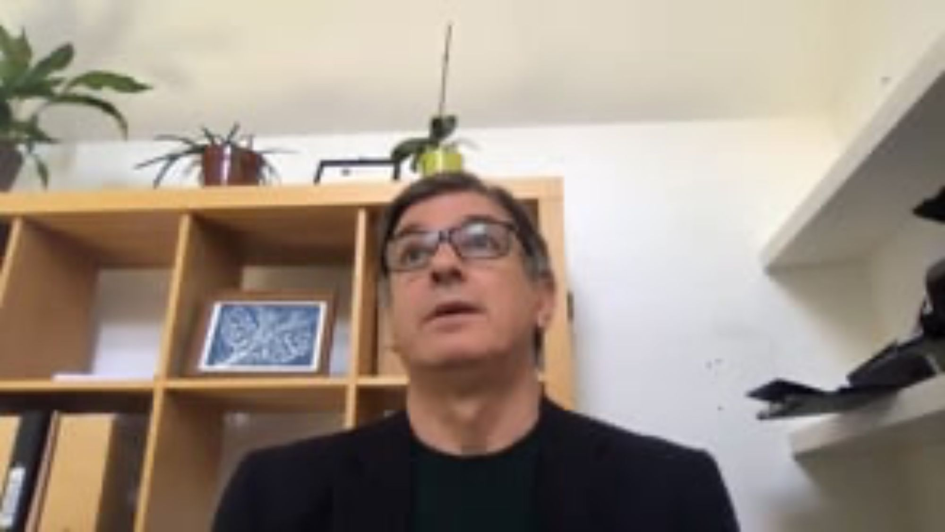
Fight Flight (Freeze Friend & Flop)

Slide 18
Trauma and CAPVA
Key messages:
Trauma informed approaches can help
Parents and children can be supported to recognise their stress responses and triggers
Trauma does not mean a child will become abusive and many traumatised children never use violence.
Notes:
trauma does not mean a child will become abusive and many traumatised children never use violence
CAPVA should be understood as multifactorial (e.g. trauma + family stress + neurodevelopmental factors + environment + learned behaviour + unmet needs)

Slide 19
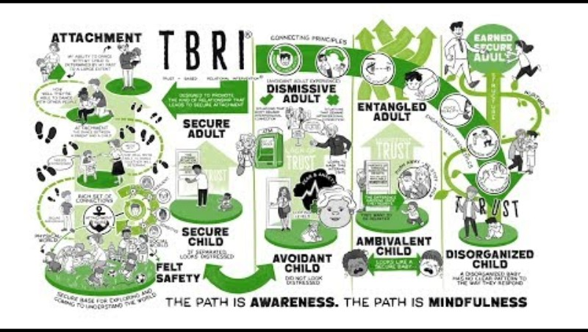
Attachment Theory and RYPP
Notes:
Disorganised attachment can lead to fear-based control. Disorganised attachment is particularly discussed in CAPVA literature. This can develop when a caregiver is experienced as both a source of comfort and fear. A child may then develop contradictory patterns:seeking closeness while attacking or rejecting the parent- intense dependency mixed with hostility and controlling behaviours designed to reduce anxiety. Some clinicians interpret violent behaviour toward parents through this lens. Over time, families can become trapped in cycles where:the child escalates aggression the parent withdraws or gives in and temporary calm reinforces the aggression. Both parent and child feel unsafe and powerless. Attachment insecurity may intensify these cycles because conflict becomes emotionally loaded with fears about rejection, shame, or abandonment. A 2024 scoping review on CAPVA identified attachment difficulties and family relational problems as recurring themes across studies.
Disrupted attachments can happen for many reasons- but can be repaired. When working with a family over 12 weeks we also model healthy attachment and create safety and reliability.

Slide 20

Adolescence
Time of great biological, social & psychological change
Period of experimentation – young people try to establish their own identity
Young people seek to separate from their families and identify with their peers and other social groups
Periods of intense short term thoughts and feelings – ‘test out’ relationships and their role in them

Slide 21
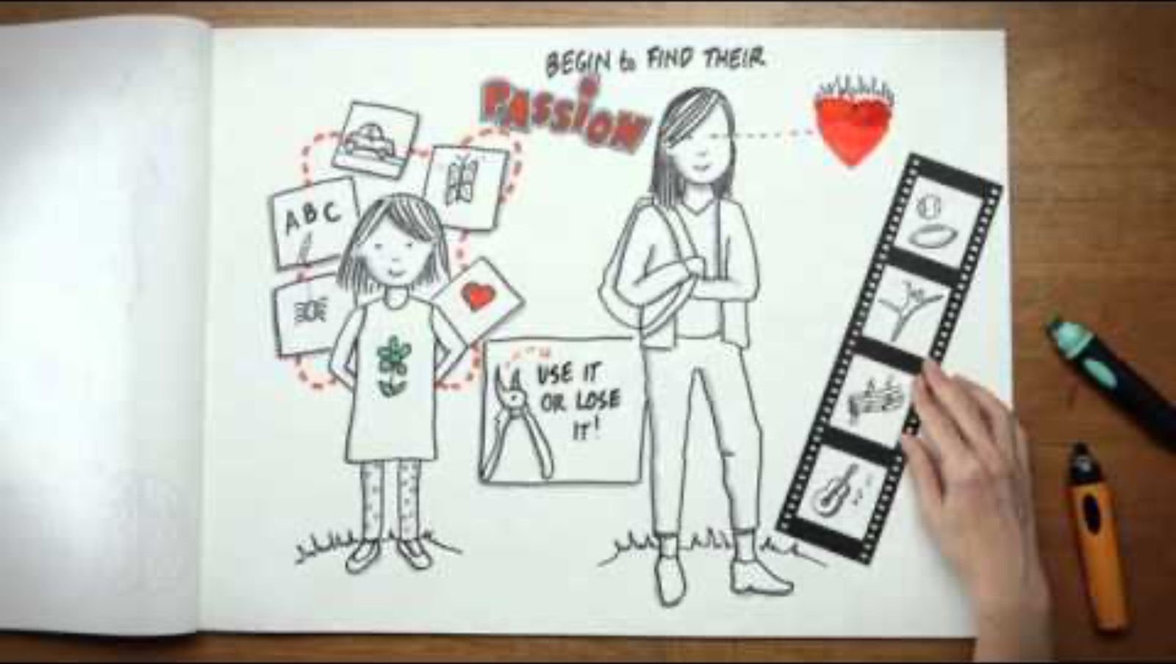

Slide 22
Neurodivergence and CAPVA
CAPVA sample from RYPP case files 2021:
57% neurodiverse/ developmental difficulties
ADHD and autism most likely to be identified.
Notes:
When including those cases that are either pending diagnosis or where there are recognized traits but no diagnosis sought practitioners indicate that proportions may be even higher, representing as much as 60% of their caseloads.
Prevalence of ADHD in general population is between 2 -5% of school age children
The prevalence of autism in England is approximately 1.76% of the population
(Roman-Urrestarazu et al, 2021))
Nerodivergence and violence currently seen through a lens of:
relational stress; dysregulation; communication difficulties; unmet needs; systemic failures

Slide 23
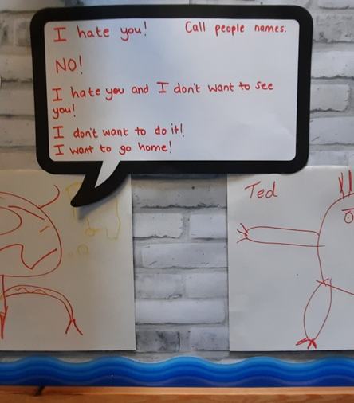
Neurodiversity and CAPVA
Debate around intent but harm is comparable
Violence often functional if not premeditated so the child has learnt that it gets something they need/ want e.g. child allowed to leave a classroom or not having to go to school.
Notes:
Take feedback- summary from lit review
ECIs are behaviours which are an unconscious or conscious attempt to resolve a need in the individual, with the unintended consequence of causing harm to others

Slide 24
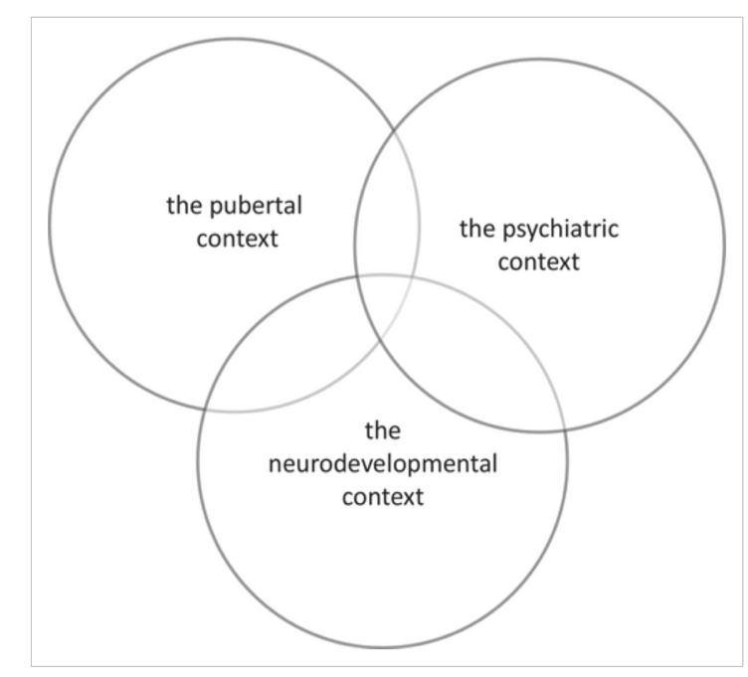
Neurodiversity and family dynamics
Need to recognise the intellectual labour of parents with neurodivergent children. They are trying to make sense of the behaviour.
Approaches need to be non- judgemental and responsive to the individual child
‘I don't know what is autism, what is normal teenage behaviour, and what is naughtiness’: Conceptualising child and adolescent to parent violence in the context of neurodevelopmental difference- Holt, 2023
Notes:
24

Slide 25
Neurodivergent Young People and the RYPP
The RYPP completion rate for young people with ASD and ADHD in 2017 group was 73%; higher than the average completion rate.
Notes:
RYPP can be delivered to YP who are neurodiverse- may need adaptation- practice support can give ideas/ support around this.

Slide 26
Domestic Abuse and CAPVA
♂
♀
Ω
♂
♂
♀
Ω
Ω
♀
♀
♀
♀
Ω
Ω
Ω
Ω
♀
Notes:
26

Slide 27
Social Learning Theory
Social learning theory suggests children learn behaviours through observing and copying others, especially within families.
Experiencing domestic abuse, children may learn that aggression is an effective way to gain control, avoid consequences, or resolve conflict.
Coercive cycles can develop where aggression is unintentionally reinforced when parents withdraw or give in.
What can help families? Challenge messaging around violence; discourage the “pay off” for violence.
Notes:
Albert Bandura’s social learning theory: children learn behaviours by observing, modelling, and being reinforced for them. In terms of CAPVA this means children exposed to violence, coercion, intimidation, or aggressive conflict resolution may learn that aggression is an effective way to gain control or resolve conflict. children can learn that violence can work to get what you need in the short term and that if you aren’t the abuser you may be the abused.. Others of us again learn that conﬂict is dangerous – potentially catastrophic – and we avoid it at all costs throughout life, trying over-hard to please others. Importantly: many children exposed to violence never become abusive- some CAPVA occurs without obvious violence modelling- trauma and dysregulation may interact with learned behaviour

Slide 28
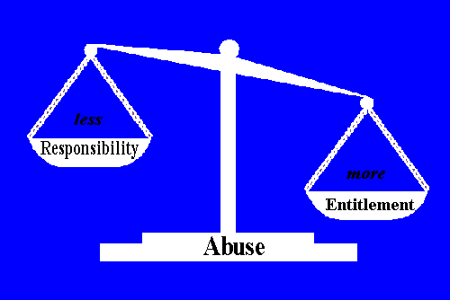
The Entitlement Discussion
Eddie Gallagher theory
Most violent behaviour occurs because the initiator has an inflated sense of entitlement to power which is greater than their sense of responsibility for the welfare of the other person
Notes:
Eddie Gallagher developed the diagram opposite to illustrate entitlement outweighing responsibility.
Eddie Gallagher believes that when a young person has an inflated sense of entitlement, they often have a reduced sense of responsibility for the welfare and feelings of others and that In this situation, when demands are not being met, abuse can occur
Entitlement is not be confused with trauma responses

Slide 29
Themes and sub themes from young people’s accounts
Violence, Abuse and Trauma | Trauma
 | Resentment and Blame
 | Violence as an adaptive response
Power, control and agency | Privileges, entitlement and responsibility
 | Strict and authoritarian parenting
 | Space, movement and socialising
Communication | Shouting and raised voices
 | Aggressive and hurtful language
 | Listening, honesty and “emotion” talk
Stress | Violence as communication
 | Young people’s stress
 | Parent and family stress
Anger and emotion regulation
Baker, V., Radford, L., Harbin, F. et al. Young People’s Accounts of their Violence and Abuse Towards Parents: Causes, Contexts, and Motivations. J Fam Viol (2025).
Notes:
Baker, V., Radford, L., Harbin, F. et al. Young People’s Accounts of their Violence and Abuse Towards Parents: Causes, Contexts, and Motivations. J Fam Viol (2025).

Slide 30

Notes:
Low hanging fruit. If we address all of these things this at this point to resolve CAPVA it creates a template for better future relatioships

Slide 31
Lunch
Notes:
11

Slide 32
Demographics of CAPVA
Quiz
Notes:
Robust evidence on the prevalence and incidence of CAPVA in the general population is lacking- studies producing varied results- no definition. Under reported.

Slide 33

1. What percentage of your CAPVA cases are likely to have a female victim (mother/female carer)?
A
40-50%
C
60-70%
B
50-60%
D
70+%

Slide 34
1. What percentage of your CAPVA cases are likely to have a female victim (mother/female carer)?
A
40-50%
C
60-70%
B
50-60%
D
70+%

Slide 35
2. In what age range (child) is CAPVA most commonly reported by parents?
A
8-10
C
13-15
B
11-13
D
16+
Notes:
Adolescent to parent violence and abuse - Iriss

Slide 36
2. In what age range (child) is CAPVA most commonly reported by parents?
A
8-10
C
13-15
B
11-13
D
16+
Notes:
Adolescent to parent violence and abuse - Iriss

Slide 37
3. True or False: Young People using harm to parents are more likely to be boys than girls
A
True
B
False

Slide 38
3. True or False: Young People using harm to parents are more likely to be boys than girls
A
True
B
False
Notes:
in community/self-report studies of child-to-parent abuse, the gender split can appear relatively more symmetrical (girls and boys both using aggression toward parents), but once cases enter the criminal justice system, the cases are disproportionately: male young people abusing mothers/female carers.
(Amanda Holt)
The best-known UK police study by Rachel Condry and Caroline Miles analysed 1,892 Metropolitan Police incidents involving abuse by 13–19 year olds toward parents/carers.It found:77% of victims were female victims were “usually mothers” 87% of perpetrators were male

Slide 39
CAPVA, Risk and Safeguarding

Slide 40
CAPVA Risk Factors
Frequency severity and recency of previous violent acts.
Has physical injury been caused?
Is the nature of the violence escalating?
Has there been previous use of weapons?
YP misusing alcohol or substances, very anxious, depressed, severe mental health difficulties
YP has feelings of being out of control when angry
YP has a violent/criminal peer group
YP carries a knife or other weapon outside the home
Notes:
What do you think would escalate risk in CPA cases? Ideas in chat – show slide and talk through risk factors.

Slide 41
Sibling Abuse
Happens in most families - violent sibling acts occurred in approximately 85% - 96% of families (Kolko et al 1996)
In college samples, 48% recalled having been seriously victimised by a sibling and 41% had perpetrated ‘severe’ sibling violence.
Majority of information available relates to sexual abuse (40% of CSA is committed by older siblings - NSPCC 2000)
One study (Teicher et al 2011) found a greater impact on children of witnessing violence to their siblings than witnessing violence to their mother.
Notes:
“whether 30% or 96% of children are victimised by siblings, it is evident that this is a prevalent source of violence in a child's life (Duncan et al 1999)
See Jonathan Caspi – Sibling Aggression, Assessment and Treatment – 2012 for a review.

Slide 42
Child to Parent Violence and Abuse Risk Screening Tool
How would you describe your relationship with your child?
When did your child’s behaviour start to concern you? Are there any triggers that result in this behaviour?
What happens when your child displays the behaviours which concern you? How often does this behaviour happen?
Please tick the appropriate box that reflects the risk |  | Y | N | NK
1 | Have you ever felt afraid of your child?
2 | Is the violent, abusive, aggressive behaviour happening more often?
3 | Is the violent, abusive, aggressive behaviour getting worse?
4 | Does your child try to control anything that you do, or display jealous behaviour towards you?
5 | Has your child ever attempted to strangle / choke / suffocate / drown you?
6 | Has your child ever said or displayed anything of a sexually disrespectful or derogatory nature that has made you feel uncomfortable or made you feel bad?
7 | Has your child ever used weapons or objects to hurt you?
8 | Has your child ever threatened to kill you or someone else and you believed them?
9 | Has your child ever mistreated an animal or family pet?
10 | Is there anyone else in the family at risk of violence or abuse? Who is at risk? How are they at risk?
11 | Does your child display these types of behaviours to anyone else in or outside of the family? E.g. School. Peer group, girl/boyfriend.

Slide 43
Has your child been involved with the Police in any way?
Has your child had problems in the past year with drugs (prescription or other), alcohol or mental health leading to difficulties in daily functioning?
Does your child have any problems with addictive behaviours e.g., on-line gaming, viewing pornography, social media? What are the details of these?
Has your child ever demanded money from you or tried to financially control you?
Does your child have any mental health issues, is depressed, suicidal or isolated or have a specific mental health diagnosis?
Does your child lack engagement with ETE e.g. truant?
Does your child associate with a difficult friendship/peer groups?
Has your child experienced personal trauma? If yes, please specify which and give relevant details if known.
Has your child ever experienced or witnessed abuse between adults?
Is your child currently being exposure to adult domestic abuse?
Is your child under any threat of violence or abuse from anyone at the moment? Provide details of who from and the nature of the abuse?
Do you see yourself as vulnerable in any way, or have you any special requirements in accessing support?
Are you feeling low or finding your emotions hard to cope with? Do you have suicidal thoughts or ever self-harmed?
Do you feel isolated from your family, friends or support networks due to your situation?
Have you ever used drugs and/or alcohol to manage difficult situations or feelings? What is the nature of your use?

Slide 44
Have you ever felt able to share your concerns with the Police or anyone else, such as a family member of professional because of your child’s behaviour?
If you had a magic wand what would you change?
What could professionals do to support change?
Narrative of professional judgement on risk level Please use the space below to include a narrative of the situation and your professional judgement in relation to the level of risk posed and vulnerabilities to the parent below: Based on the number of yes answer coupled with your professional judgement please circle the level of risk posed. Standard Medium High
Please state what outcome would you like for the Parent and young person victim?

Slide 45
Family contexts that can increase risk
Parent/Carer doesn’t see behaviour as abusive and professionals involved do not recognise CAPVA
Lack of support for parent: lack of support network, self- blame, mental health problems, substance misuse, being undermined by other family members or ongoing domestic abuse.
Barriers to implementation of safety planning – (e.g. fear of professionals, belief that nothing will work, sense of being the child’s last resort)
Risks to other children in the home
Notes:
Scotland? Safeguarding response?

Slide 46
Accessing multi agency support
MARAC referral can be made if young person using harm is 16+ and the parent is at risk of serious harm (using DASH RIC)
If young person is aged 16- 18 a dual referral should be made- MARAC and safeguarding.
IDVA support for victim can be accessed if person using harm is 16+
Refer to specialist domestic abuse support if it meets criteria
Children’s services referral- clearly indicate CAPVA e.g.
“This family are experiencing Child to Parent Abuse and there is a risk of…”
Notes:
Scotland? Safeguarding response?

Slide 47

Safeguarding
Who may be unsafe?
Notes:
Ask the question to whole group- Discuss harm to siblings and that risk is often minimised.

Slide 48
Siblings
Vulnerable adult?
Child using harmful behaviour
Impact can be minimised
Assess severity, frequency, difference in age, fear
Impact can be greater than experiencing parental domestic abuse
If adult is vulnerable under the Care Act 2014 - adult safeguarding processes put in place.
Direct and indirect risk of harm e.g. running away, peer group involvement, missed education.
Notes:
Discuss making safeguarding referrals for children using harm

Slide 49
Respect Young People’s Programme: Eligibility Criteria
  Aged 8 -18 during intervention
  Using violent, aggressive or abusive behaviour in the family
  Adult perpetrator no longer living in family home (if there is a history of domestic abuse)

Slide 50
My Violent Child: What needs to change for the family?

Slide 51
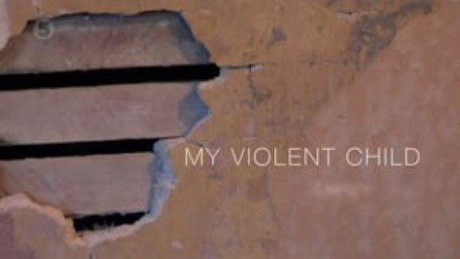
Notes:
Ask participants to watch observe and take notes of the video. Ask them what what their thoughts are, is there anything they think? What could be done to help? Etc etc

Slide 52
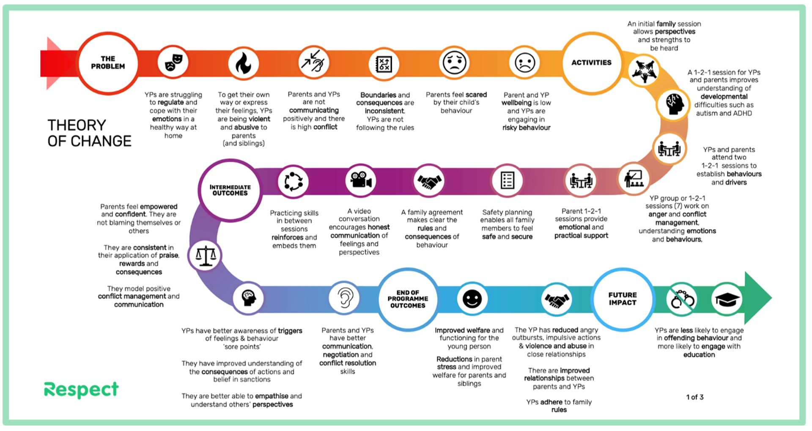
Notes:
This is respects theory of change for the programme

Slide 53
Week 1: Meeting the family for the first time
Notes:
Using a solution focused approach- not ignoring the problem though

Slide 54
“I know you have got problems in this family but is it okay if we don’t talk about that today? Instead, I want to find out what you have to meet the problem with/put against it.”
“Can I begin by asking your parent a bit about you so that can meet you through their eyes?”

Slide 55
If You Are Seeing YP Alone
What do you think your mum is most proud of about you?
Did you ever have a teacher you liked at school? What was it that that teacher saw in you, do you think?
Who are your best friends? What do you think they like about you?
Who in your family do you get on with the best? What do they appreciate about you?

Slide 56
Identifying Strengths and drawing out qualities
What makes you proud as a parent?
Can you teach me about your child’s strengths/qualities/what they’re good at?
If you were going to brag about her what would you say?
What should I know and appreciate about …. (You know her well)?
If we were shipwrecked on a desert island what would I come to appreciate about her? What would I come to depend on her for?
What are some good things about her that other people comment on?
Can you give me an example of that? Could you tell me a story about this that would really let me know what you meant by ….?
What would you call that ability to…

Slide 57
others appreciate about X ?
Desert island?
Boast about...
Good at?
.
Building strengths
Finding strengths
example
quality
What kind of quality
does that imply?
Give me an example
of that
quality
Where did X get that from?
And where did they get that from?
quality
Notes:
What makes you proud as a parent?
Can you teach me about your child’s strengths/qualities/what they’re good at?
If you were going to brag about her what would you say?
What should I know and appreciate about …. (You know her well)?
If we were shipwrecked on a desert island what would I come to appreciate about her? What would I come to depend on her for?
What are some good things about her that other people comment on
Can you give me an example of that? Could you tell me a story about this that would really let me know what you meant by ….?
What would you call that ability to…

Slide 58
Legacy
Where do you get that from?
Did you get that a bit from your mum/ dad?
What’s the best lesson in ….? She’s taught you? Give me an example of this quality in your that parent…
Did you work at fostering this quality in your child? Tell me a story to illustrate how you helped them develop this quality.
Where did you get this quality from?

Slide 59
Reverse Legacy
How has she been an inspiration to you?
Has being her mother lead you to live your life in any new ways - has she taught you anything about how to live life?

Slide 60
Praise For The Family
I’ll bet there’s never a dull moment in your house –you’ve got such a funny rapport together
I can see you’re all really ready to listen to each other
I can see how important you are to other
It makes me really hopeful to see how loving/ thoughtful/ determined/ you are as family

Slide 61
Summary for practice
Can you teach me about your / your child’s strengths / qualities?
What would your best friend say? Mum? Favourite teacher at school? Who in your family felt most proud of you - what would they have said? Get detail & specific examples
Where do you/your child get that from? a bit from mum? How did you/she model/ teach you that? Get specific examples
Where did mum get that from? Who in the family line would be proudest of these qualities and achievements?
How did the child inspire the parent?

Slide 62
End of Day 1

