Slide 1

Name of trainer

Slide 2

Day 2

Slide 3
Sessions covered in Day 1
 | Parent | Family | Young Person/Individual
Week 1 |  | Meeting the Family Aside from the Problem
Notes:
Brief reminder of content of each exercise

Slide 4

Outline Day 2
Starting the work with the young person: consent and confidentiality
Ecograms
Starting the work with parent/ carers: reducing blame and shame
Sequence analysis
LUNCH
Family agreement
Seeing the young person’s perspective: personal constructs
Notes:
Any additional areas group would like to cover

Slide 5


Week 2: Young Person Session 1
Confidentiality
Ecograms
Explaining the intervention

Slide 6
Week 3: Young Person Session 2
What are you like?
Getting the young person’s perspective on their behaviour
Small gratuitous acts of kindness and feelings cards
What’s next? (prep for family agreement)

Slide 7
Consent
Getting the YP’s consent to ask direct questions
“I’ve found out a lot about you generally and I have come to respect many things about you. As a result I am now ready to ask you some very direct questions about the problems that have brought you here – is that okay?”
“Would you tell me if I ask you something you don’t want to answer - would you speak out?”

Slide 8
Experience of the system
You can start by finding out about the YP’s experience of other professionals and the ‘the system’, repositioning the YP’s anger as you go by reflecting back values.
“You feel like no-one’s heard your side - so being listened to is really important to you? Why is that? Can you think of examples of that value playing out in your life?”
“So fairness really matters to you. Where might you have learned about that? From who? Can you give me an example of…”
“So justice is something you feel really strongly about – tell me more about that?”

Slide 9
Safety Needs
If the above gives you cause for concern, then you can ask:
If you begin to feel angry at me or misunderstood by me how can we make sure you won’t do (whatever the YP has done elsewhere) or smash my place up or just walk out on this for good?
What could you do in that situation?
What could I do to help?

Slide 10
Finding out about the violence/abuse
Are you worried about how you deal with anger?
Do you ever get out of control?
Do you feel there’s times when you’ve gone too far? / when you haven’t used the right methods to stand up for yourself?
Are there things you’ve done that you don’t feel so good about?
We all have rows at home sometimes. What happens in your home when you have a row?
What are you like when you are angry?
Have you ever hit her or pushed her around?
Have you ever frightened her?
What do you feel is the worst thing you’ve done?

Slide 11
Young Person Week 2:
Ecograms

Slide 12
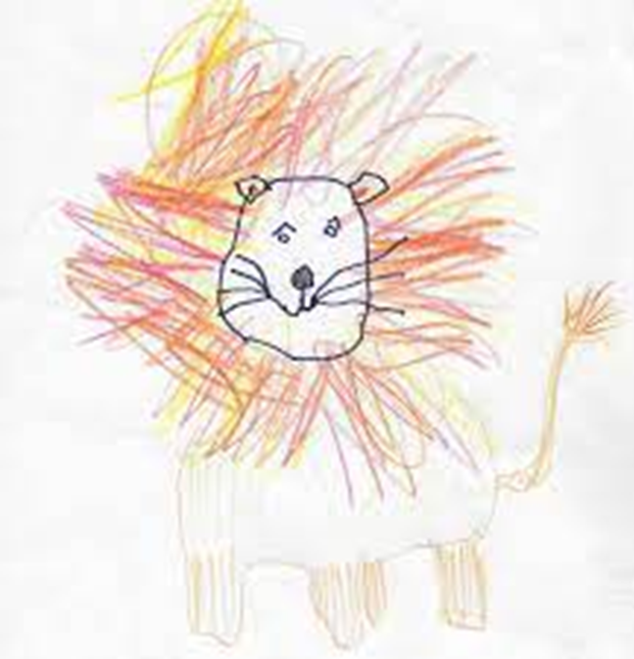
Ecogram
draw or represent yourself at the centre of the page as an animal which is in some way like you
draw the people who are closest around you as animals that are in some way like them
explain who each one is and why they chose that animal for them
Who are you closest to? Why is that?
Who gets at you most and how?
Who are you most likely to shout at? And who least likely? Why is that?

Slide 13
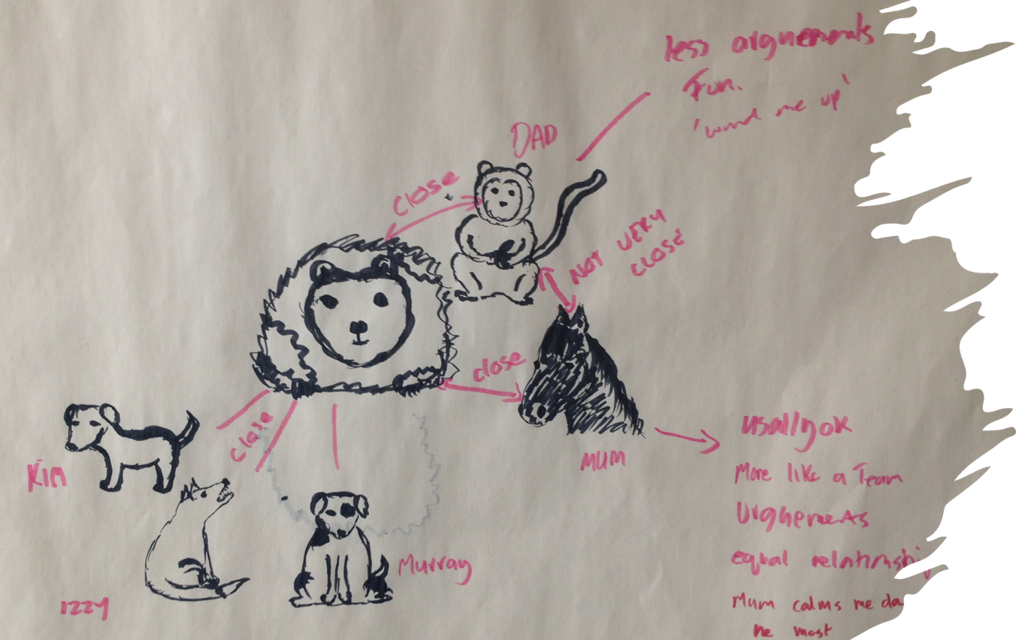
Ecogram

Slide 14
Week 2: Parent Carer Session 1 – Moving Away From Guilt

Slide 15
Influences on a child
For this exercise think of either:
one of your children as a teenager or
a teenager and a parent you have worked with
Think of the influence on the child’s more challenging behaviour and score the main carer’s influence as ten points. Now think of the other influences and score them accordingly.
Notes:
Main carer is baseline of 10- everyone else is related to that i.e. if half as influential score 5 if twice as influential 20. If you are in doubt underestimate rather than over estimate. Score 0 for those that do not apply.

Slide 16
Influences On A Child
Your Influence
Other Parent
Relationship Between Parents
Step-parent
Siblings
Other Relatives
School
Friends
Other People
TV & Media
Temperament
Physical – Appearance, Size, Health etc
Free Will or Choice
Specific Events
Any Other Influences
Total ________

Slide 17
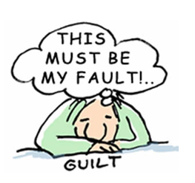
Influences on behaviour
Your influence/ primary carer = 10 points
Other parent = 50 points
Relationship between parents = 30 points
Brothers and sister = 30 points
School = 5 points
Friends = 30 points
TV/online gaming =60 points
Physicality/ puberty = 5 points
Any other influences = 5 points
Total influences = 225 points
Add the total number of influences
Divide your 10 points by the total number and multiply by 100 to give an indication of the percentage of your influence
10 divided by 225 x 100 = 4.4%

Slide 18
General points
Empowerment is key - similar yet different to work with survivors of domestic abuse
Reduce guilt - don’t create more
Take a neutral stance
Talking about the abusive behaviour: clarifying what is acceptable and what is normal teenage behaviour
Parents: focus on them as the solution not the problem and build confidence

Slide 19
Domestic Abuse and CAPVA
♂
♀
Ω
♂
♂
♀
Ω
Ω
♀
♀
♀
♀
Ω
Ω
Ω
Ω
♀
Notes:
19

Slide 20
Week 3: Parent/Carer
Sequence Analysis & Draft Agreement

Slide 21
Jason’s Story
Password: RYPP
Notes:
Play from 00:00 until 8:23

Slide 22
Sequence Analysis
Brief
Sequential – Who said and did what, what happened next and so on.
Gives a sentence or two to set the context – e.g., Time of day and who was where.
Absolutely without analysis or explanation (does not say things like ‘he always does that’)
As far as possible reports the words someone used and the actions, they did rather than saying things like ‘he blew up’, ‘he was verbally abusive’ ‘I swore’ or ‘he was violent’
In the present tense
In the 3rd person – rather than saying: ‘I do or say….’ It says: ‘mum/dad does or says….’

Slide 23
Sequence Analysis Example: Morning
In the morning Jason does not set his alarm clock for school.
Mum goes in to wake him up twice.
The second time mum goes in Jason slams the door on her
Mum goes straight back into his room saying “how dare you slam the door”
Mum pulls open the curtains and pulls the covers off Jason. Jason keeps hold of the covers and there is a scuffle
Jason gets up in mums face and shouts that she is a ‘wanker’, He also shouts in Kerry's face as he passes her.
Jason goes into the bathroom and Mum makes him breakfast while he washes. They don’t speak to each other.
Later the family leave for school. Jason tries to head off on his own but mum tells him it’s too late

Slide 24
Sequence Analysis Example: Afternoon
Jason comes home at 4.30- Kerry has been watching telly since she got in at 3.30- Mum is in the bedroom on the internet
Jason says hello to mum and Kerry-they don’t respond much
Jason wants to use the TV to play games- he goes to plug his console in and asks Kerry for the remote- she wont give it to him.
Jason goes to complain to mum, he says she has been watching TV for ages and its his turn.
Mum says “why do you always have to cause trouble as soon as you get in” and tells Jason to go and sort it out.
Jason goes back into the room to get the remote off Kerry and a fight breaks out- he pushes Kerry’s face into the sofa and starts shouting at her
Mum comes in and tells Jason to “get off her now”, kicks his behind knocking him to the ground
Jason screams at mum and goes outside and starts throwing things around the garden.
After 5 minutes he comes in, mum makes him a cup of tea and tells Kerry to let him use the console.

Slide 25
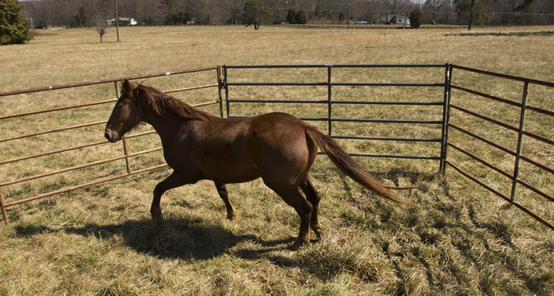
Family Agreement
Sequence analyses
Address unhelpful patterns
Family agreement
Select behaviours
Agree/ negotiate rewards and consequences
Safety plan
Make agreement
Reviews
Adjust, agree & review again

Slide 26
Family Agreement
Done collaboratively alongside the young person – The young person contributes to the family agreement by thinking about rewards and consequences that may be levied.
Focuses on unsafe or risky behaviours only, to help stabilise the environment and create a ‘safe space’ from which to recover from trauma
The collaborative approach reduces the likelihood of harsh and inconsistent consequences being invoked by parents who are struggling to cope.
Involves agreements for when inappropriate responses are used by parents. This promotes a sense of justice and fairness for the young person.
Taught alongside Time out as a strategy for managing emotions. Young people who have experienced trauma are likely to find self- regulation difficult and need a process to follow.

Slide 27
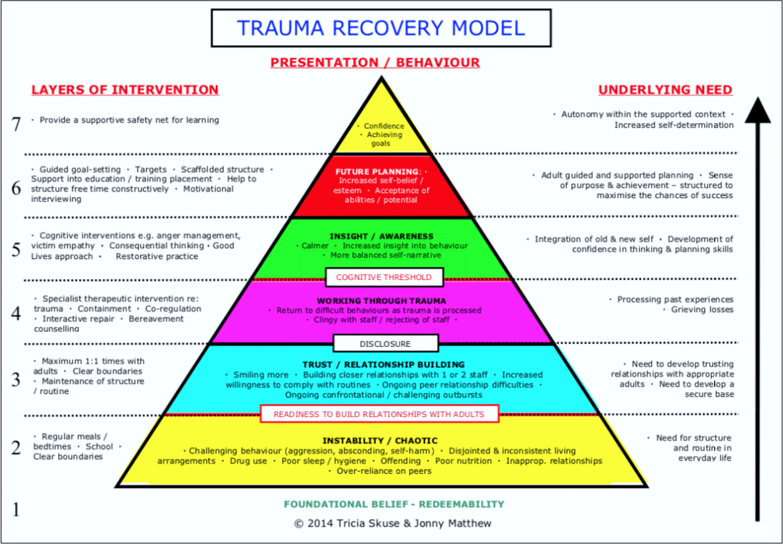
Notes:
Trauma-informed approaches accept the child and take their experiences into account, but do not excuse and accept all behaviour, This model is incorporated within the RYPP intervention. Taking responsibility, and holding back from acting on impulse, are the kind of life skills a trauma informed approach aims to develop. The way behaviour is managed provides a route to learning these skills, as within the RYPP programme It is not about punishing their absence of these skills but equipping the YP with strategies to cope and cease aggressive and abusive behaviour.

Slide 28
Risky or unsafe behaviours that have occurred in the past
Truancy - Jason attends school on average three days a week.
Verbal aggression- Jason often swears at his family, using words like "fucking", and “Twat” towards Mum and Kerry. His outbursts last from 5 minutes to an hour, happen almost every day and have been going on for the last year.
Threatening and risky behaviour has included his smashing and breaking things in the house. He has thrown an ashtray and a chair at Kerry. This kind of incident has happened 6-7 times in the last 4 months.
Physical violence towards Mum and Kerry happens about twice a month and includes ‘thumping’ and kicking them. This has resulted in bruising to both Mum and Kerry. It began about a year ago and is getting worse.

Slide 30
Notes:
Play from 8:23

Slide 31
Review
Was the safety plan used?
Has Ruth stuck to the family agreement?
Why do you think the plan was dropped before it was given a chance?

Slide 32
Week 3: Young Person
Personal Constructs
Preparing for Family Agreement

Slide 33
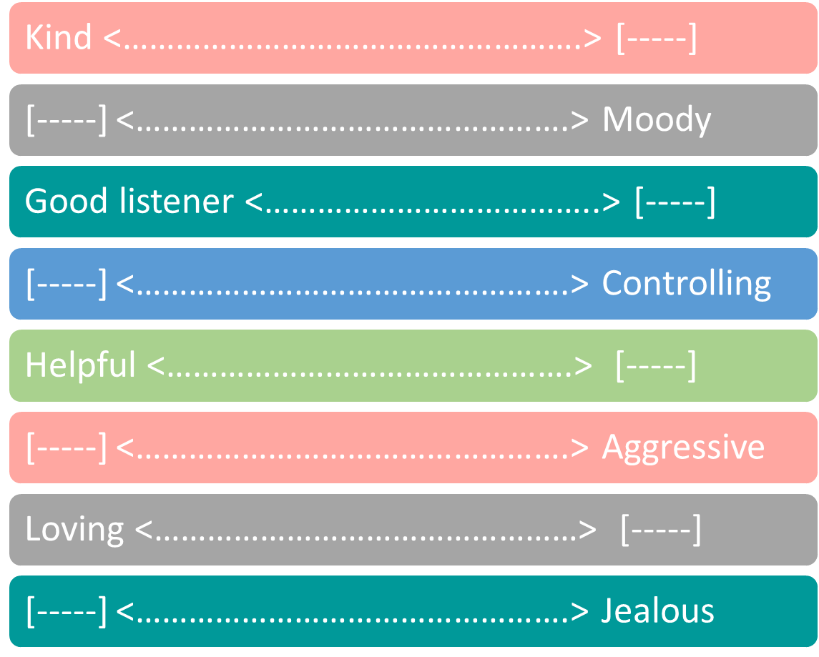
Personal Constructs

Slide 34
Personal Constructs
Place a mark on the continuum where you think are at your best in your relationship with e.g. with a given parent
Where are you on that continuum at your worst moments? (Use a different colour)
Where would you put your mum/dad on that continuum?

Slide 35
End of Day 2

