Slide 1

together we can end domestic abuse.
Name of trainer

Slide 2

Day 3 Welcome and Recap

Slide 3
Sessions covered in Day 2
 | Parent | Family | Young Person
Week 2 |  |  | Ecograms
Week 3 | Sequence Analysis Draft Family Agreement (Jason) |  | Personal Constructs Explaining the Programme
Week 4 |  | Family Agreement
Notes:
Brief reminder of content of each exercise

Slide 4

Outline Day 3
Parent Carer: Button Pushing
YP and PC: The Miracle Question
YP: Anger and Abuse
PC: Parenting Styles
LUNCH
YP: Costs and benefits of abuse
YP: Role Models
Notes:
Any additional areas group would like to cover

Slide 5


Week 5: Parent/ Carer Session 3
Button Pushing: You can’t push the buttons if they’re not there

Slide 6

Button pushing
What pushes your buttons?
What pushes their buttons?
Notes:
This session is to help parents “pick their battles”- not getting pulled into things/ arguments that don’t really matter. Can break a pattern of winding each other up- reduce low level conflict that can escalate.
Ask learners to reflect back to when they were teendagers- how did their parents push their buttons- what things did they say or do that wound them up and would get a response. How did they push their parent/carers buttons? (focus on little things rather than sensitive subjects).

Slide 7
Rope Pulling
Password: RYPP
Notes:
Rope Pulling Video

Slide 8
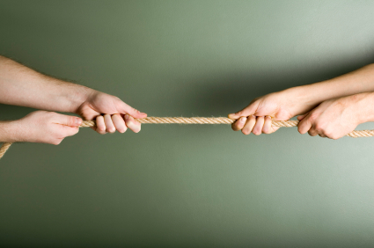
Letting go
Letting go – visual exercise
How can you let go?
Time out for parents

Slide 9
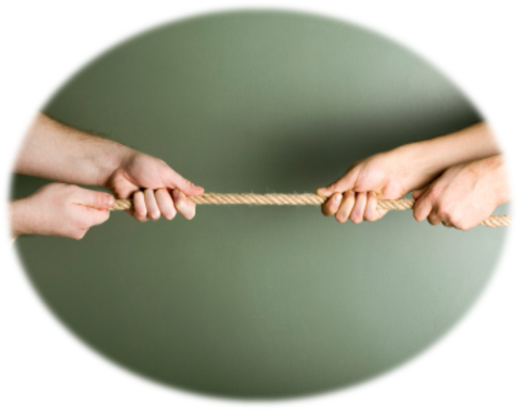
Letting go
Letting go – visual exercise
How can you let go?
De-escalation strategies for parents

Slide 10
Week 5: Young Person Session 3
The Miracle Question

Slide 11

The Miracle Question
Think of a change you want to make in your life
Draw something that represents life once the change is made
What do you see in this sketch?
What difference will this change make in your life?
How will you spend your time differently?
Who will be most pleased with the change in you?
What will they notice is different about you?
How might that have happened?
Notes:
What would be the first signs that the change has happened? Use “What else” to encourage fuller descriptions. Encourage participants to think of a change they would like to make- they will share this with a partner so choose something safe e.g. more exercise/ clear out a room/ eat more healthily. Introduce scaling “If 10 is the best your relationship has been and 0 is the worst moment you’ve had together what number are you at now?” What makes it a 3 not a 1?
Introduce a coping a question: When you have felt really frustrated/ angry/ upset what has helped you stay calm/ keep going etc.

Slide 12
Week 5: Young Person Session 3
Agree/ Disagree
Anger and Abuse

Slide 13
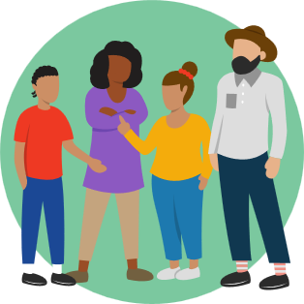
Agree/ Disagree
It’s okay for 3-year-olds to hit their mums
If one kid hits their sister, its okay for the ‘victim’ to tell
It’s okay for an 11-year-old to tell their mum to shut up
Shouting when angry is okay
Hurting yourself when angry at someone else is okay
It’s okay for a 13-year-old to lie to their parent/s to get out of trouble

Slide 14
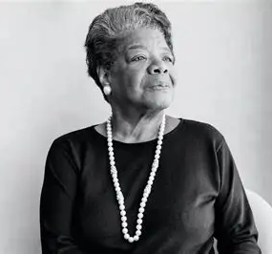
What is Anger for?
“So use that anger. You write it. You paint it. You dance it. You march it. You vote it….”
Maya Angelou
What does anger tell us?
about our situation?
what we need to do?
What use is it to us?
What behaviours count as abuse / violence?

Slide 15
Week 6: Young Person Session 4
Sore Points
Tension & Resentment – Balloon Exercise
Signals & Time Out

Slide 16
Think of 3 things that have bothered you in the past month.
Look at the ‘Anger Scale’ in the participants handbook
Write your ‘sore points’ in beside the appropriate number on the scale.

Slide 17
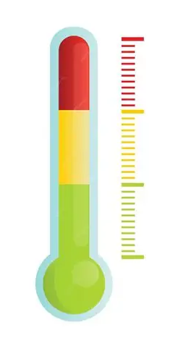
Anger Scale
10
9
8
7
6
5
4
3
2
1
Explosive
Raging
Seething
Irate
Frustrated
Annoyed
Irritated

Slide 18
Balloon Exercise
Password: RYPP

Slide 19


Slide 20
Time Outs
To help the young person to manage themselves
Not to win arguments or to control someone else
Not to avoid discussion of the issue over the longer term or to avoid hearing criticism.
YP should agree the plan with the people close to them who are likely to be affected (e.g., partners, parents, siblings etc) in advance so that they understand what is happening and might even support the strategy.
Should decide how long to leave for upfront and where to go that is safe
Must not drink or take drugs during this time or wind self up.
Notes:
Should decide how long to leave for upfront (usually between 20 mins and 1hr.
Where to go- that might be out for a walk or to their bedroom depending on the time and age of the YP

Slide 21
Week 6: Parent/ Carer Session 4
Parenting Styles

Slide 22
My Parent/ Carers
What would you like to repeat yourself about the way you were parented?
What would you like to do differently from the way you were parented?
Notes:
Describe this exercise and its purpose to participants – Ask them to think about this for a second and imagine how this might feel for the parent/carer to complete.

Slide 23
Parenting Styles
This exercise offers ways to invite the parent to thinking about their own parents and how they were parented. The worker should be looking for links all the time between the parent’s areas of low tolerance around their children’s behaviour and what was not tolerated from them as a young child or what they are unable to tolerate in themselves.
Notes:
Can give some examples form practice or personal examples. Eg. intolerance towards “picky” eating or illness in a family- how does this influence you as a parent.

Slide 24
Parenting Styles
It’s important to consider safety and wellbeing of the parent/carer when undertaking this exercise.
Safety plan for session end.
Inform parent of session content prior to session.
Notes:
Being trauma informed- this session needs to be done safely but it is important to discuss.

Slide 25
Week 7: Young Person Session 5
Costs & Benefits of Abuse
Role Models

Slide 26
Tracy’s Story
Password: RYPP

Slide 27
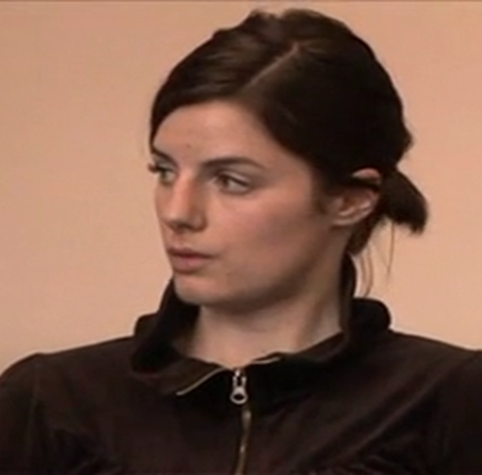
Costs, Benefits and Impact of Abuse
If Tracy continues to act like this, what will be the impact on her?
Let's discuss this and also look at the costs and benefits to Tracy of using abuse within her family

Slide 28
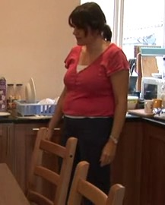
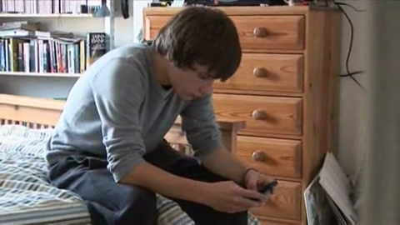
Impact on others
Think about the ongoing impact of Tracy's behaviour on her mother and brother.
Focus on:
The other person’s feelings
Their relationship with Tracy
Their lives/social lives outside the home

Slide 29

Role Models
Think of someone who would deal really well with the problem that you’re facing.
What made you choose this person?
What is it is about them that makes them good at it?
Can you give me any examples of this?
How do you think they would deal with the problem you face?
What would they need to tell themselves to manage the situation in this way?
What advice do you think this person would give to you now/about the possible difficulties you face in the coming weeks?
Tell me three qualities that make them particularly good at handling your problem

Slide 30
End of Day 3

