Slide 1


SUSTAINABLEIT.ORG
Sustainable IT Playbook Assets:
The Sustainable IT Reference Model©

Slide 2



Our Mission
SustainableIT.org is a 501(c)(6) nonprofit organization (NPO) led by technology executives with the mission of advancing global sustainability through technology leadership.
Our Mandates
Education and awareness of IT’s role in driving sustainability
Research and insights on best practices for tech-enabled sustainability transformation
Community connection among IT practitioners, business leaders, and sustainability experts worldwide

Slide 3
Introduction: Sustainable IT Reference Model©
The Sustainable IT Reference Model© encompasses the key focal points for IT-led sustainability.
It consists of two primary focus areas – “Sustainability by IT,” in which the IT organization applies its expertise and capabilities to drive sustainability transformation across the enterprise; and “Sustainability in IT,” in which IT transforms the IT function itself.
Two overarching responsibilities span both focal points – ESG standards, reporting and compliance, and sustainability culture.
It should be used to orient IT staff on the breadth and scope of IT’s sustainability journey – to transform itself into a more sustainable business function, thereby gaining credibility and expertise to be a transformative partner to the enterprise in accelerating its sustainability progress.

Slide 4
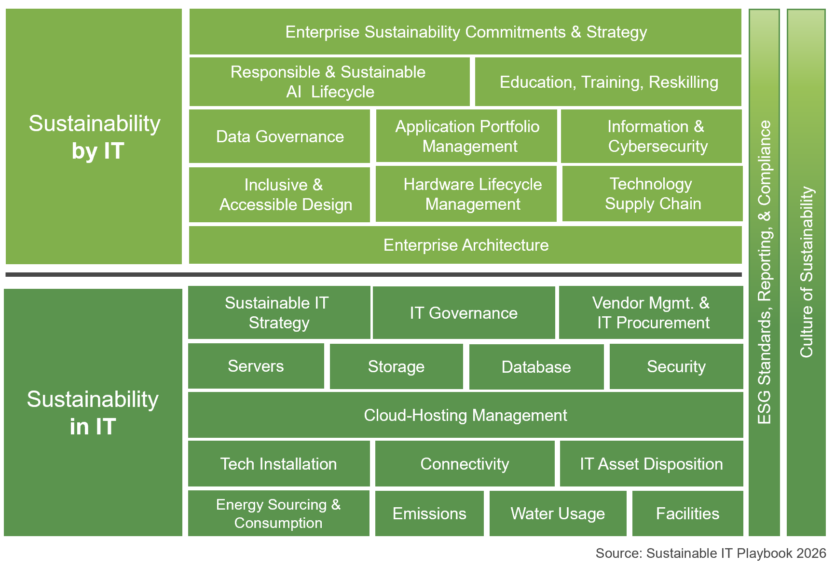
Sustainable IT Reference Model©
Aligns with and impacts enterprise sustainability
Directly engages or impacts enterprise stakeholders; visible
Influenced or jointly controlled by IT
Aligns with and impacts IT function operations sustainability
Fully controlled by IT
Largely invisible to enterprise stakeholders

Slide 5



The Model aligns with the sustainability Footprint & Handprint framework
Sustainability by IT – “Handprint”
Sustainability in IT – “Footprint”
Data center
and cloud
Application portfolio management
Sustainable software dev.
Circular hardware
Efficient
energy mgt.
Vendor mgt. & IT procurement

Slide 6
IT’s early sustainability actions follow two parallel paths, reflecting the reference models two dimensions
Educate & engage IT staff
Build IT’s ESG credibility
Achieve early environmental wins
Reveal IT’s sustainability impacts & how it can make a difference. Then provide staff with opportunities to contribute.
Measure IT’s baselines in energy and emissions (DCs & EUDs). Take credit for what IT is already doing that supports ESG goals.
Drive a few short-term, visible impact initiatives that are meaningful to business and sustainability leadership.
Team up
In IT
Blend IT and enterprise sustainability governance, pursue co-ownership of sustainability agenda/strategy & shared accountability.
Present IT as a sustainability partner
Enable enterprise ESG data management
Ask compliance or sustainability officers how they are collecting sustainability data and offer to automate and improve it.
Develop a centralized data management platform for essential ESG data delivered by tools familiar to constituents.
By IT

Slide 7





Contact Us
Steve Rovniak | Vice President
(M) +1 617.970.7720
Steve.Rovniak@sustainableIT.org
Advancing Global Sustainability through Technology Leadership

