Slide 1


April 2026
POTOMAC GROWTH Your Partner in Equity Crowdfunding and Community Round Success

Slide 2


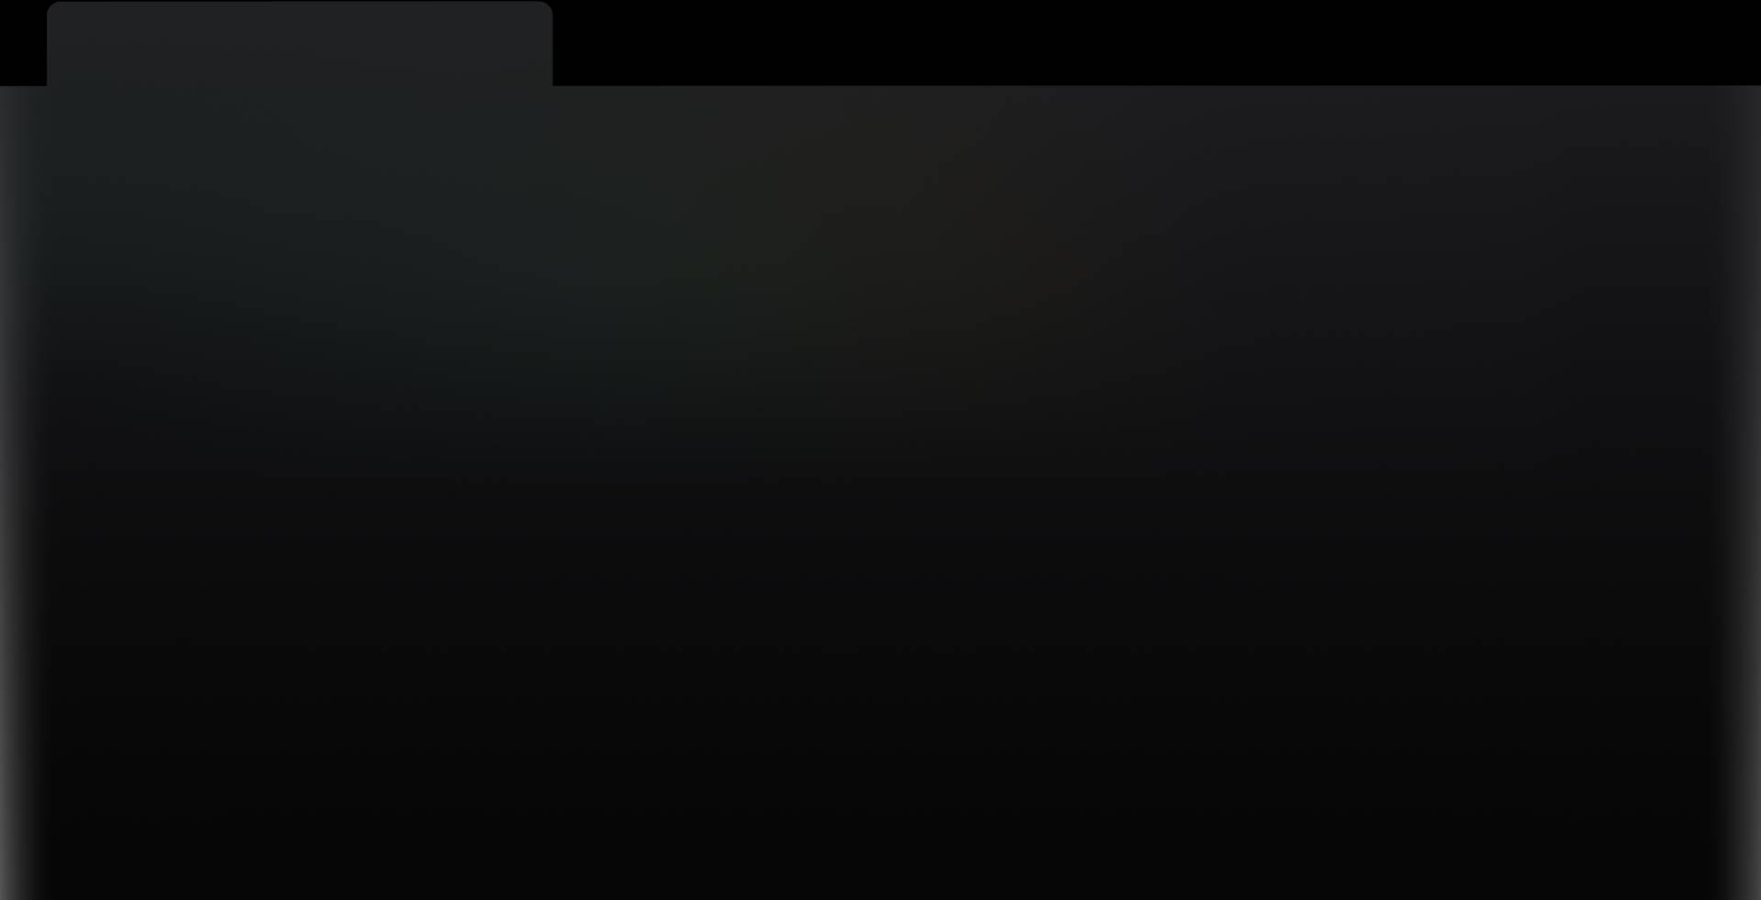

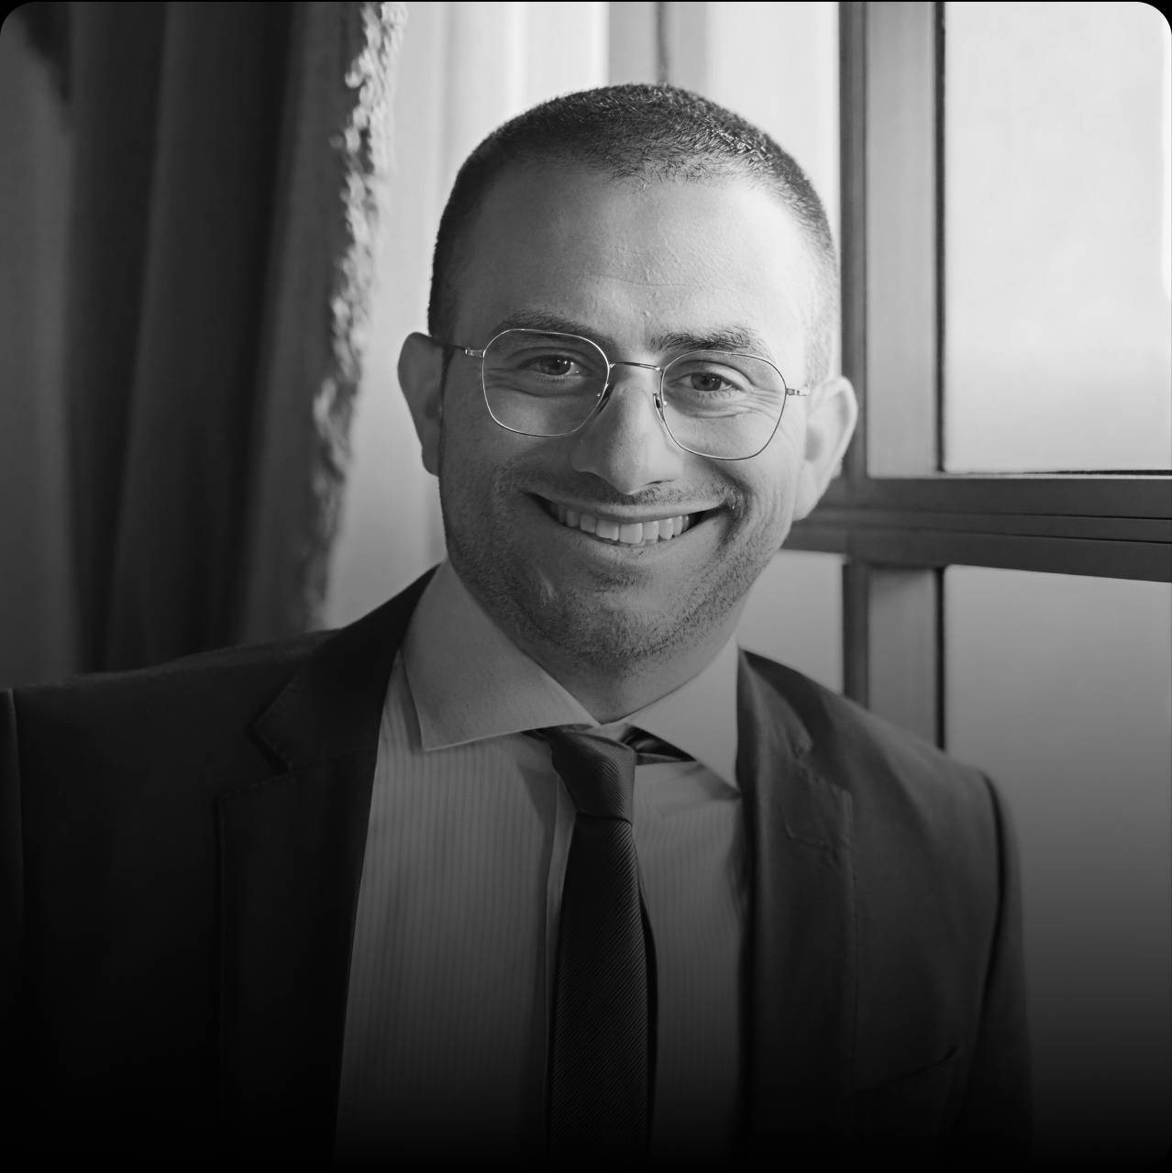
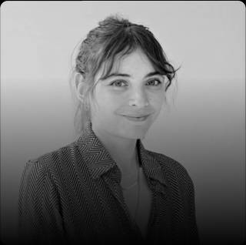
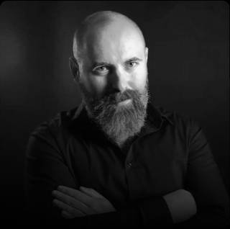
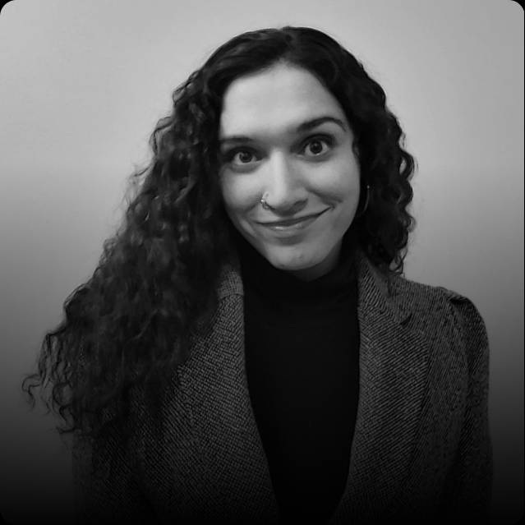
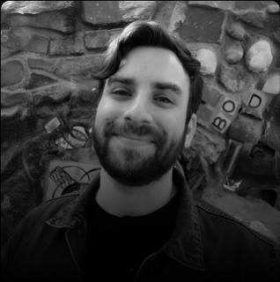

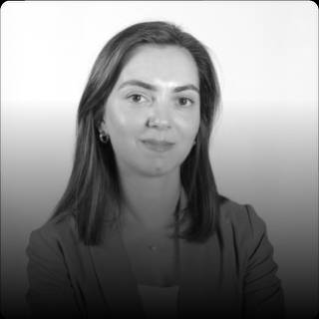
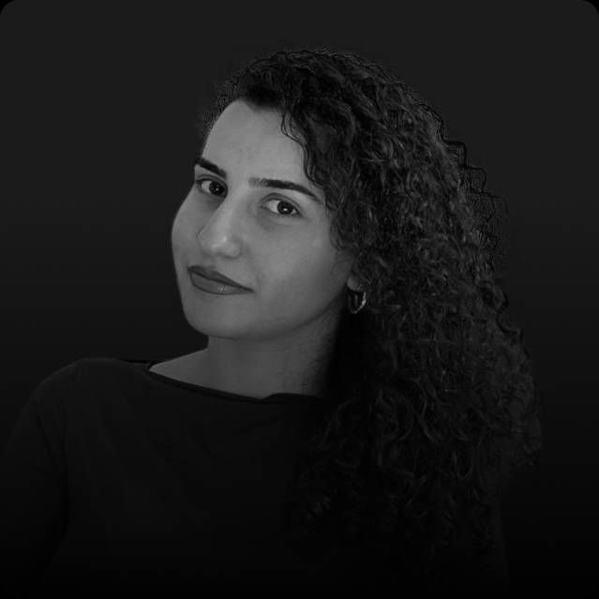
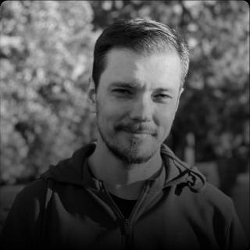
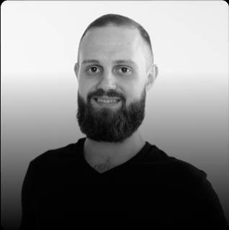
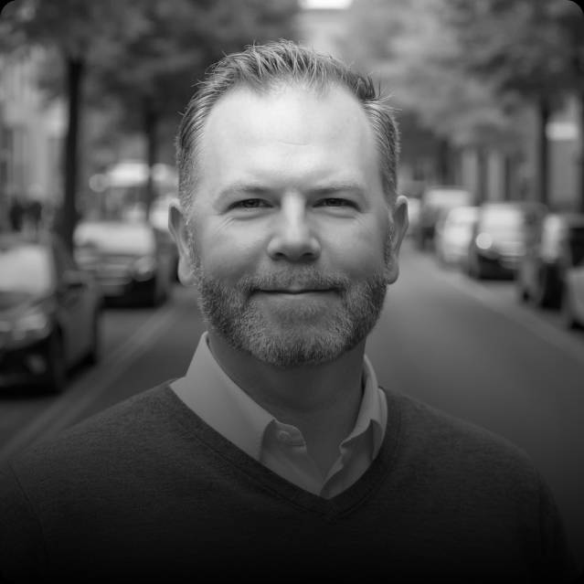
LEADERSHIP TEAM
Eitan Charnoff
Shelley Golan
Igor Zvagelsky
Sarah Janjua
Mike Mintz
Anara Bekmukhambetova
Founder & CEO
Co-Founder & COO
Co-Founder & CMO
Chief of Staff
VP Video Production
Growth Marketing Manager
Gohar Shaljyan
Susanna Sarikyan
Dima Tytarenko
Vladislav Terentiev
Chris Karl
Growth Marketing Manager
Growth Marketing Manager
Director of Design
Paid Ads Manager
Content Strategist

Slide 3


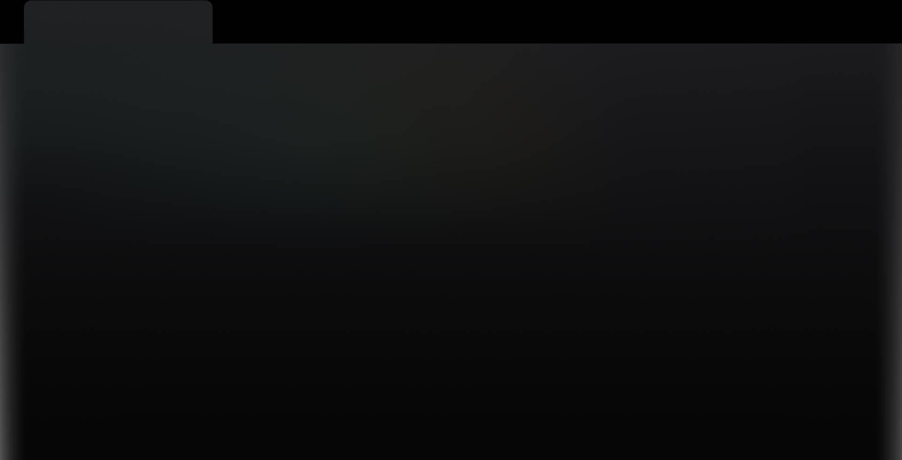















ABOUT US
Potomac Growth is one of the leading equity crowdfunding growth agencies in the USA.
We specialize in end-to-end campaign management that turns your community, followers, and customers into investors. We build momentum through audience activation, then we amplify that traction with targeted digital ads to bring in new investors and expand the campaign’s reach
Potomac Growth is led by serial founders and marketing experts, our team supports issuers across leading global platforms such as:

Slide 4
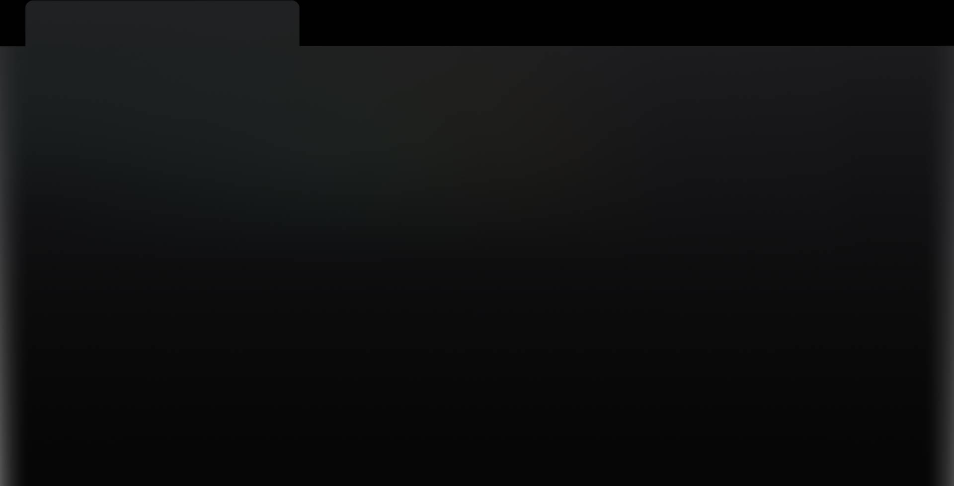


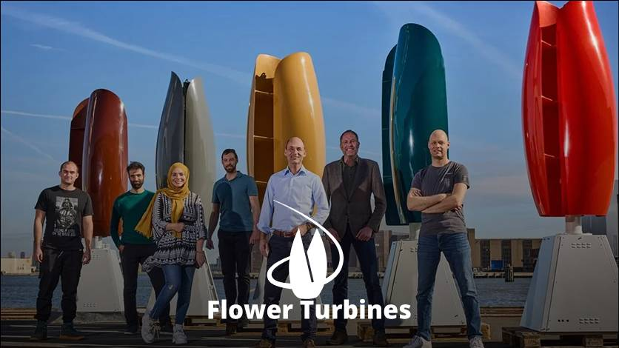


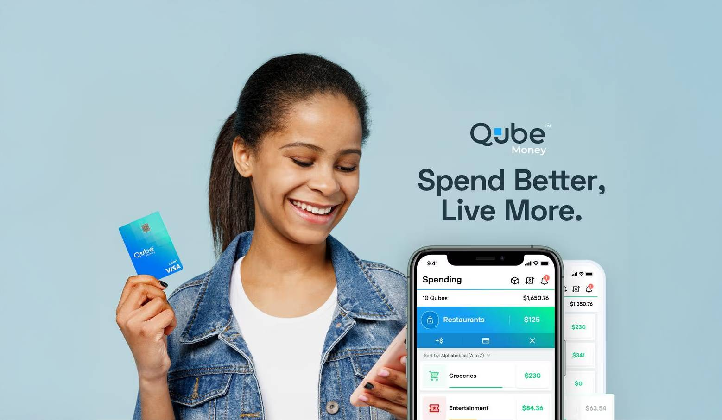

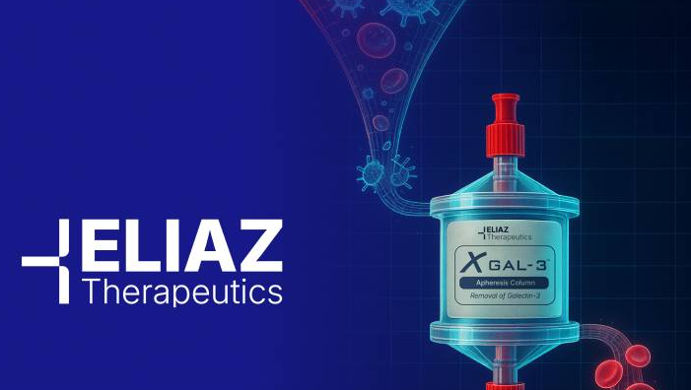
SUCCESS STORIES
We support raises of all sizes
$3,498,429 Raised
$1,309,141 Raised
$3,079,032 Raised
$849,879 Raised
Chi-Chi’s restaurants
Flower Turbines
AEXLAB
SmartDrone
$1,523,261.29 Raised
$608,644 Raised
$3,190,635 Raised
More projects on potomac.pro
Qube
FiftyFifty Brewing
Eliaz Therapeutics

Slide 5
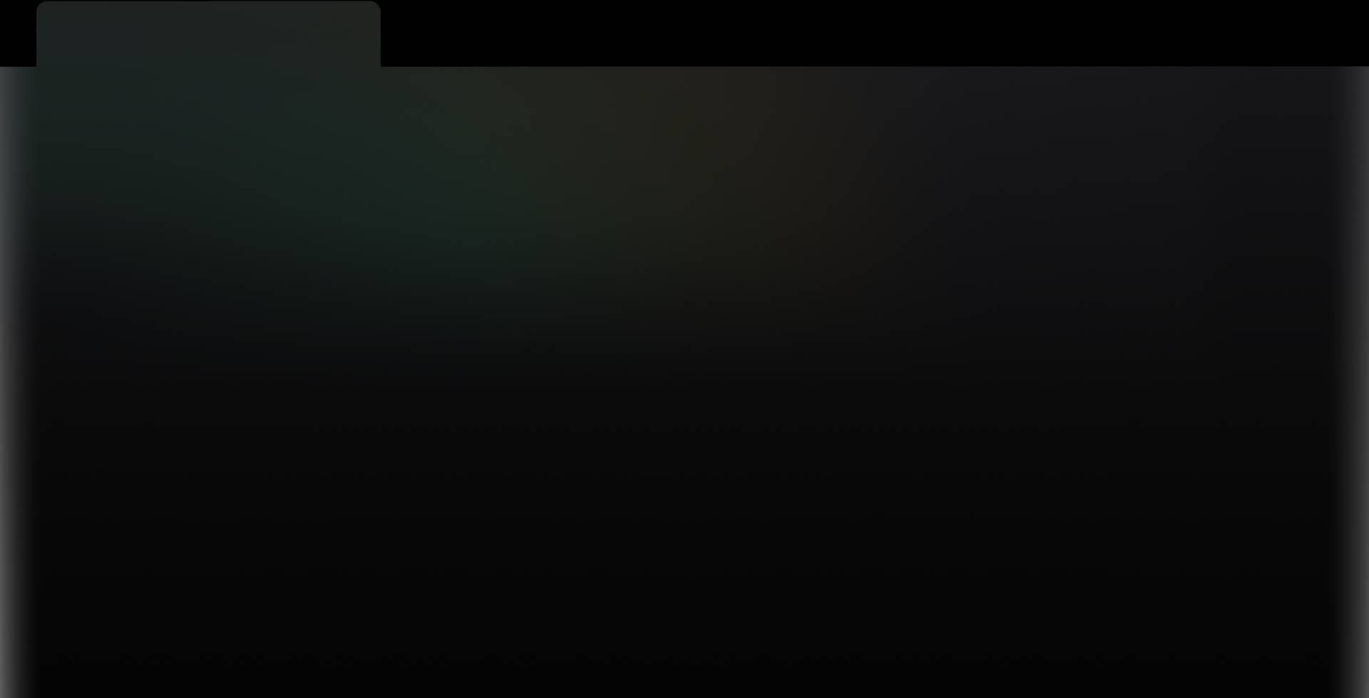

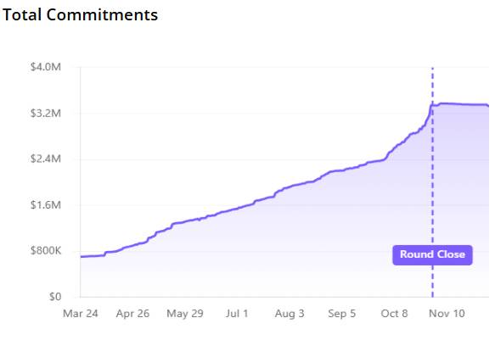















OUR METHOD
We take a high touch three-phase holistic approach to every raise:
Data Provided by:
1
Foundation
Amount Raised
Messaging, content, page build, leveraging founders networks and community. Creating the raise’s narrative and pitch.
Momentum
Followers
2
Investor Acquisition through paid advertising (when required), webinars, campaign updates and direct email and SMS outreach.
Foundation
Momentum
Final Push
3
Final Push
This model consistently drives strong returns, with most campaigns seeing their largest influx of investment in the final weeks
Amplified campaigns to convert interest to investment using compliant FOMO messaging.

Slide 6


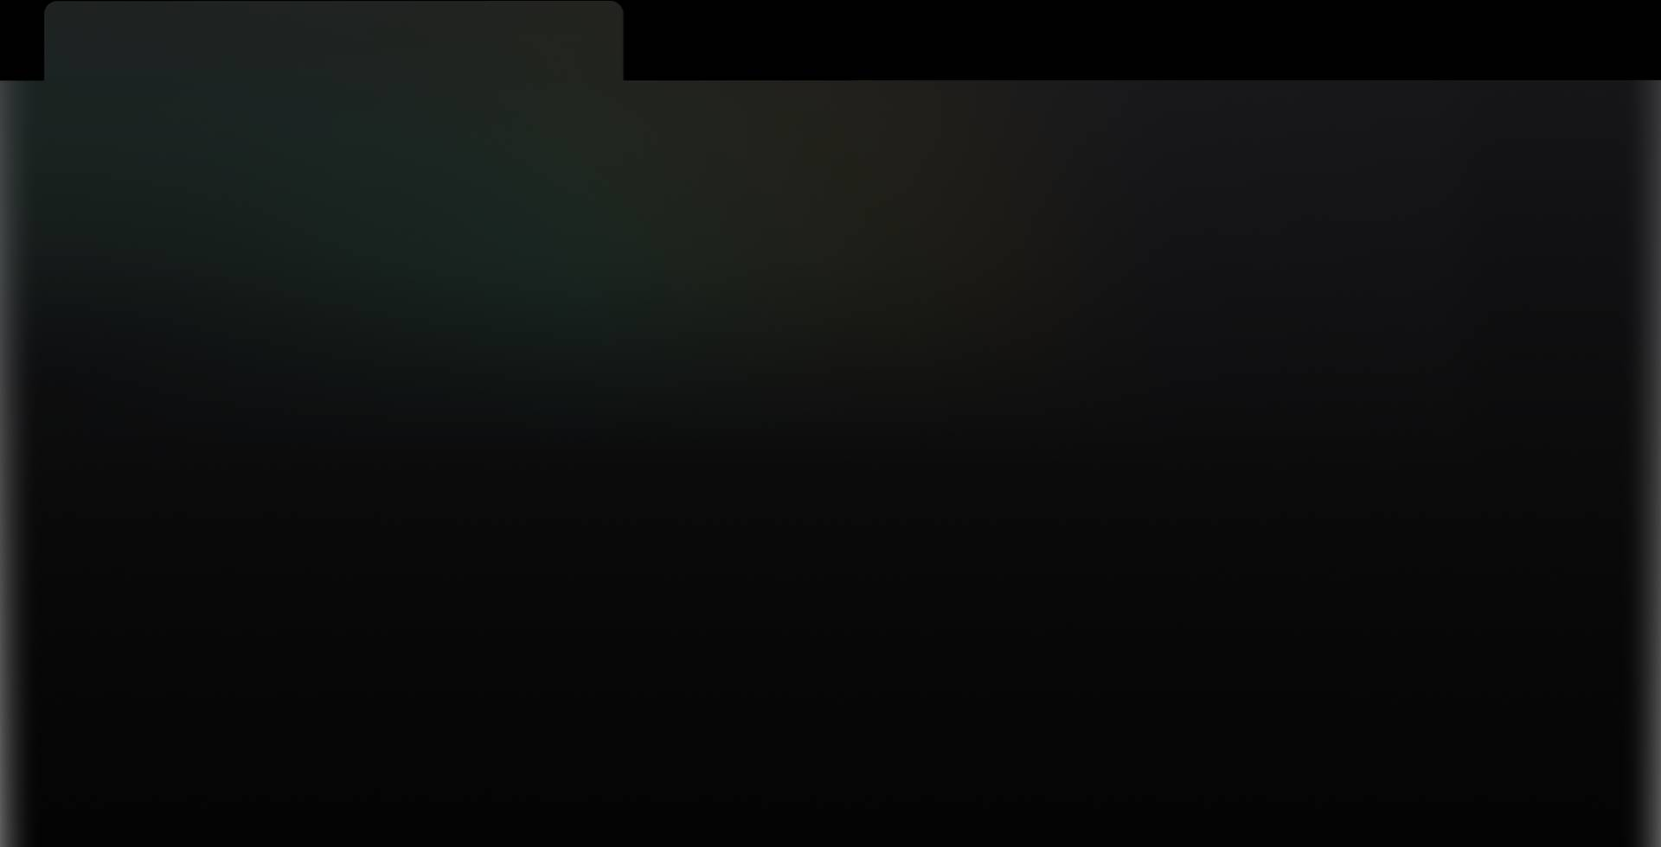













FULL SERVICES SCOPE
Full Crowdfunding Campaign Management
Page Development & Copywriting
Strategy, execution, community activation and investor communication.
Investor-focused design and messaging.
Paid Advertising
Campaign Content and Assets
Meta Ads, LinkedIn Ads, Google Ads, and beyond.
Professional visuals and marketing copy including SM ads, email, and SMS.
Video Production
SDR Outreach (RegA Only)
Feature videos + social clips (Additional Cost)
Calling to assist driving leads in visiting your offering page.

Slide 7







PRICING
$4,900 / Month
Most Popular
$7,400 / Month
$3,900
FULL CF CAMPAIGN MANAGEMENT
RegA Campaign Support
VIDEO PACKAGE
We manage every marketing aspect of your equity crowdfunding campaign – from strategy to execution.
For founders seeking a robust feature video, graphics and added clips for social.
Campaign Strategy & Execution
Crowdfunding Page Development
Includes everything in Full Campaign management
We create and implement a tailored strategy that helps you achieve your goals.
We'll optimize your fundraising platform's page to boost engagement and conversion for your target audience.
1 Feature video (1.5 - 2.5 minutes)
SDR Cold Calling
3 clips for social (15-30 seconds each)
Paid Advertising
Content Creation
Our highly trained SDR team will directly and compliantly reach out to interested leads and guide them to your investment page, maximizing conversion and engagement.
Scripting Service
We manage performance ads on Meta and LinkedIn to attract investors to your campaign.
Our team will manage all fundraising content, ensuring it is consistent, clear, and impactful across all channels including email and SMS
1 Day with Filmmaker Within Continental US
Basic Title Graphics
Graphics
Investor Communication
Content Optimization
Core Creative Network
From in-page graphics to ads, we’ll create any essential visual assets.
We keep investors informed and engaged with regular updates and transparent communication.
RegAs generally require more ads and more content then a RegCF.
Premium Stock Footage
*A one time setup fee of $1,500 is also required.
*$2,900 for scripting and editing services only
Affective until December 30th 2025

Slide 8




CONTACT US
Eitan Charnoff, Founder, CEO
eitan@potomac.pro
potomac.pro

