Slide 1


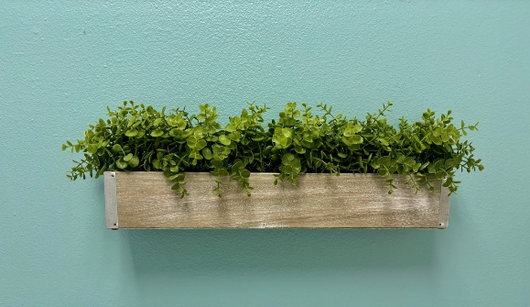

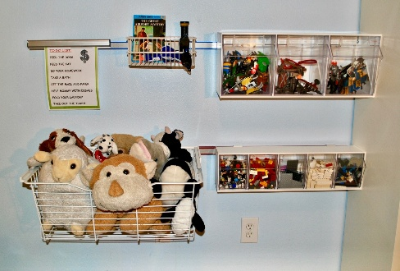
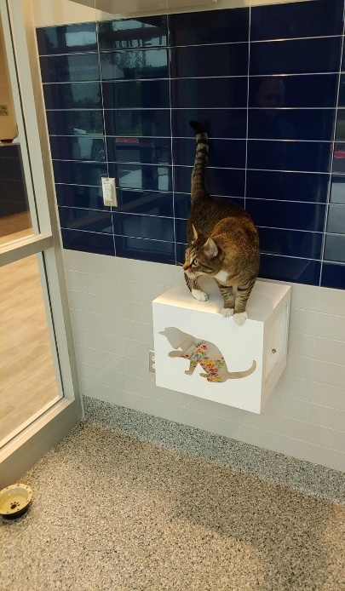
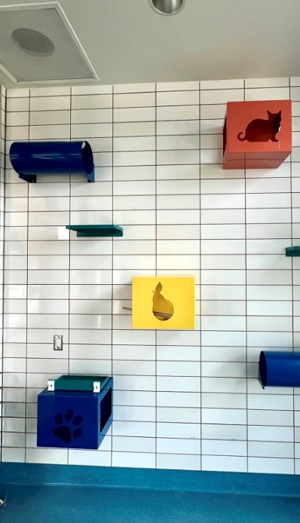
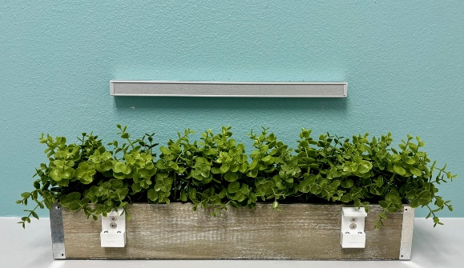
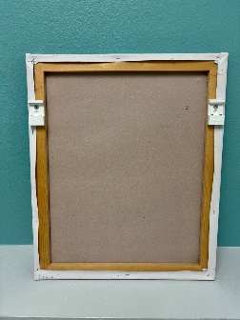
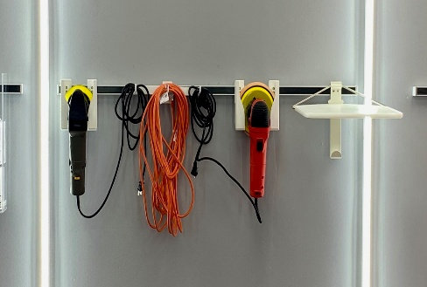
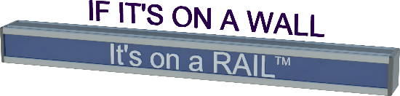
One Rail - Endless Applications
Maximize space! Simplify organization! Adapt to your needs! Unlimited flexibility!
Paladin Healthcare LLC offers a versatile rail-based system designed to support almost any application. Whether in healthcare environments, homes, schools, or workspaces, our rail solutions make it easy to mount, organize, and rearrange items—quickly and securely.
What Can You Mount on a Rail?
✔ Picture frames & signage ✔ Toy organizers & storage bins, even decorative planters ✔ Medical accessories & equipment ✔ Shelving, hooks & baskets ✔ Educational tools & displays
If it hangs, holds, or organizes—it can likely go on a rail.
Why Choose Paladin Rail Systems?
• Flexible & Modular – Change layouts without tools or damage • Space-Saving Design – Keep floors and surfaces clear • Durable & Reliable – Built for daily use • Clean, Professional Look – Ideal for healthcare and home settings • Easy Installation – Fast setup on most walls
Adapt. Organize. Create.
With Paladin Healthcare’s rail system, your space works for you—not against you.
Office (407) 614-8781
info@PaladinHC.com
www.PaladinHC.com
940 W. Oakland Ave, Suite A1
Oakland, FL 34787
DUNS NUMBER: 036980486
CAGE CODE: 75YN6

