Slide 1

A DECK TO BUILD YOUR BUSINESS CASE
Hey there! 👋
You've likely found this deck because you want to save time analyzing feedback in your company. But to take action, you need the support of others, including higher-ups.
We created these slides to help you build a business case.
Make a copy of this deck, then use any ideas that work for you and edit to make it your own.
Feel free to message us for more proof points!
sales@getthematic.com

Slide 2


Unlocking the value of our feedback
Empower everyone to take action on the things that matter

Slide 3

We’ve got lots of feedback data.
But we don’t use it to identify and act on opportunities…
Unlocking the value of our feedback
90%
71%
of unstructured data has been created in the last two years alone
of enterprises think it’s too hard to work with qualitative data
“
Every day your customers are sharing a huge amount of qualitative data. But a lot of companies either don’t know how or forget to use it.
Stewart Butterfield, CEO Slack

Slide 4
We need a fast, easy way to transform feedback into trustworthy answers
Unlocking the value of our feedback
Our new feature isn’t resonating with customers, but we don’t know why or what to do about it.
Our NPS is down but we don’t know why.
We’re losing market share to competitors but don’t really know why.
Customer churn rates are up but we don’t understand why and what can be done to prevent it.

Slide 5
Unlocking the value of our feedback
But realizing the value of feedback is challenging
Painful data & system integrations, diverse feedback channels
Limited customer understanding
Ad hoc analysis by different teams
Inconsistent and often inaccurate insights
It takes too long to analyze data and find answers
Problems become worse before they’re fixed
No unified analysis across data sources
Prioritization is a guessing game

Slide 6
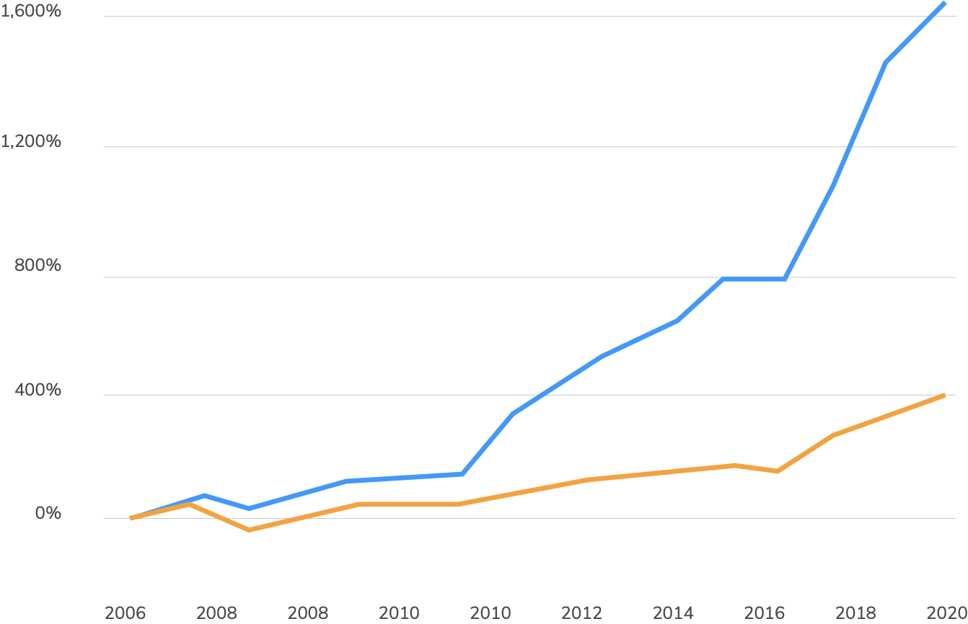
Unlocking the value of our feedback
4x
Feedback analytics unlocks the insight value in data
Companies that invest in customer insights
4x
Companies that don’t invest in customer insights
better returns
for companies that invest in understanding customers
Cumulative Stock Returns over time
The American Customer Satisfaction Index
(ACSI Leaders vs. the S&P 500)

Slide 7


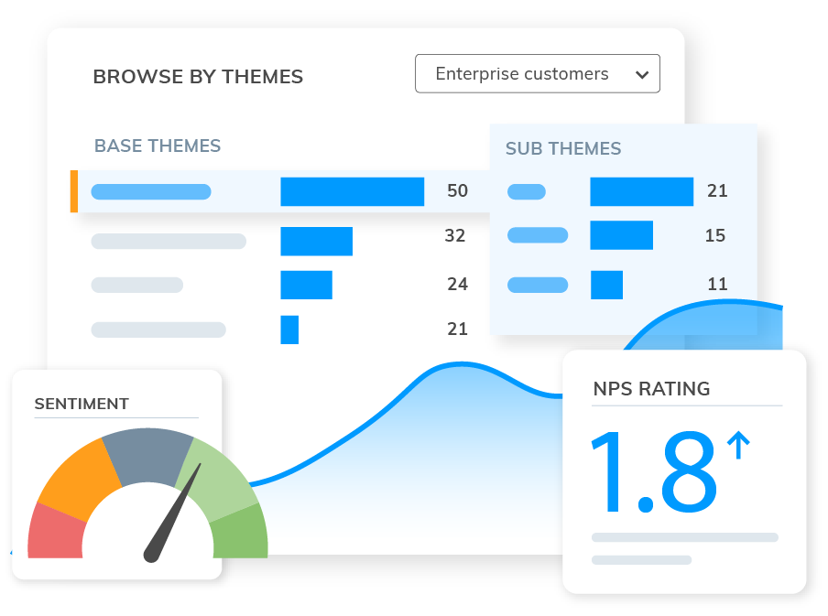
Unlocking the value of our feedback
How your company can make this happen
Raw feedback
Technology to instantly discover what matters, with the richness of why
We make decisions that boost satisfaction and support growth

Slide 8


Unlocking the value of our feedback
Investing in text feedback analytics is a winning strategy
Tangible benefits
Intangible benefits
Stronger revenue
Increased LTV
Avoided costs
Greater efficiency
Faster time to insights
Unified view of customer
Stronger motivation
Enhanced data-driven culture

Slide 9
Stronger revenue growth
Companies with superior experiences bring in 5.7x more revenue than competitors.
Our whole organization will benefit from knowing which levers to pull
Based on metrics from analyzing thousands of feedback comments, these multipliers show the cost savings and revenue uplift companies can realize from using a strategic feedback analytics program.
Forward-thinking companies are doubling down on feedback analytics to tap into all sources of feedback.
Higher lifetime value
Loyal customers are 5x more likely to renew purchases and 4x more likely to refer a friend.
Avoided labour costs
Offering a high-quality customer experience can reduce the cost of serving customers by 33%
Unlocking the value of our feedback
5.7x
5x
33%
Sources: 1. https://hbr.org/2014/08/the-value-of-customer-experience-quantified | Medallia

Slide 10
Faster and confident decision making
A deeper look at the significant intangible benefits…
Empower organization to be data-led
Unlocking the value of our feedback
No disruption to existing core processes
Faster time to insights, and to prioritization
Reduced dependency on manual processes
Prioritized insights from every channel
Easy access to unified view and granular context
Personalized support for stakeholders through multiple lenses per dataset

Slide 11
Unlocking the value of our feedback
Projected additional value
Calculate the value you can potentially unlock with Thematic over three years, using our free ROI tool.
What’s the bottom line of implementing Thematic?
Talk to our friendly sales team to get help with a tailored ROI.
Higher CLTV
Stronger revenue growth₁
Avoided costs₁
$
$
$
sales@getthematic.com
Projected ROI over three years
Value with Thematic₁
Less Cost of Thematic
$
$
Return on Investment =
$

Slide 12
Choose one of these testimonials to include

Slide 13


Unlocking the value of our feedback
“
I was blown away by the instant insights Thematic gave us into what mattered from thousands of survey comments. We could easily see what impacted our NPS score and why. There’s no reason PMs should be spending so many weeks manually analyzing feedback.
Robbie Allan, Director of Product

Slide 14


Unlocking the value of our feedback
“
Thematic is a powerful solution, easy to use, easy to get started.
It’s really helped us figure out where to prioritize our efforts – and gives us the ability to see improvement over time. They’re great to work with and incredibly responsive.
Chris Jones
Head of Member Experience

