Slide 1


Slide 2




Question:
Would you like to learn more about
climate change in school?

Slide 3

Would you like to spend more time in nature while you’re at school?

Slide 4

Nine out of ten children want to learn more about climate change and spend more time in nature. (Teach The Future, 2025).

Slide 5
Your Mission…
You are going to write a letter to the Secretary of State for Education, who is “the boss of England’s schools”, to ask for:
all children to have the opportunity to learn about climate change…
and spend more time in nature…
while they are in primary school.

Slide 6
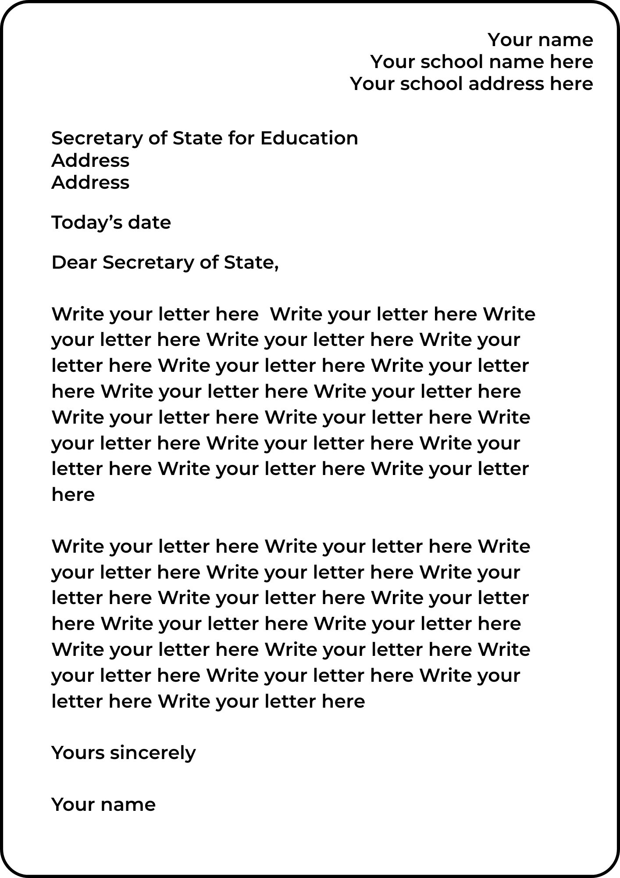
Setting out your letter
Your name and school address go in the top right
Below this and on the left, write the recipient’s address:
Secretary of State for Education
Department for Education
Piccadilly Gate
Store Street
Manchester
M1 2WD
Write today’s date below their address
Then start your letter with
“Dear Secretary of State,”

Slide 7
Example first paragraph
Dear Secretary of State,
I am from [your school’s name] and I am [your age] years old. I am asking you, as the Secretary of State for Education, to make sure that climate change is added to lessons so that children can learn about it at primary school. Teach The Future recently found out that 9 in 10 students from Year 5 upwards think it’s important that we learn about climate change.
It’s also really important for us to spend more time in natural surroundings.

Slide 8
Some questions to help write your letter
When you think about climate change, how does it make you feel? (e.g. scared/ confused/ not sure/ not at all scared, like I want to do something to help)
Can you explain why?
What do you already know about climate change - what does it mean to you?

Slide 9
Some more questions to help write your letter
How do you think climate change will have an impact on your future?
What would you like to learn in school about climate change? Why is this important to you?
How does being in nature make you feel - would you like to spend more time out in nature at school?
You could finish by drawing a picture of the future you’d like to live in.

Slide 10
Thank you!
By writing this letter, you have used your voice to ask for change from someone who has the power to make that change.
If for any reason you don’t want your letter to be sent to the Department for Education, please let your teacher know.

Slide 11
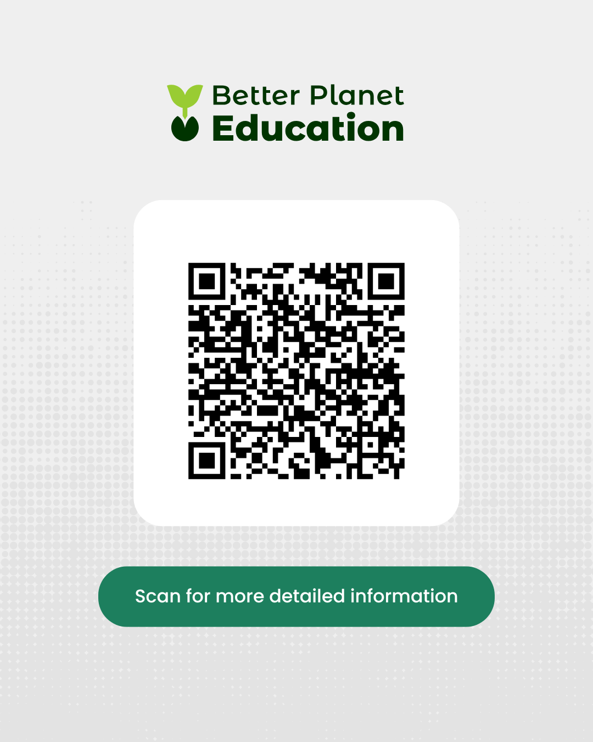
Teachers: Please remember to let us know how many letters
you’re sending us by completing the online form here:
And please post your letters by 7 November 2025. Thank you!

