Slide 1

Case Study
Sales Challenge

Slide 2

Brief Introduction
Who is the Ideal Client?
SImplified Sales Process for Growth and Retention
Metrics/Activities and Touch Points
Other Measurables

Slide 3
Who is the ideal Client?
1.
2.
Declining Growth Rate and “Improper” Targets
Sales are slowing and the team feels like the targets are borderline unachievable.
Leadership Principles Lacking
No consistency and a lack of accountability coupled with weak pipelines and forecasting.
3.
4.
Product Releases Focused on Stability
More intensive planning around long term scaling, means less innovative customer-facing features to promote
Cultural Challenges
Scaling back office operations = high administrative burden.
New business model and structural changes

Slide 4
Managing Activity and Results
What makes sense to measure at Shutterstock?
Activity
Contact and Coverage Plans – guideline to activity based on specific objectives and criteria
Activity Model – guideline based on specific tasks (ie: 50 Cold Calls, 20 in person visits, 10 New Presentations, 3 Flex appointments (cross selling/up selling), 3 deals signed)
CRM / Salesforce: Dashboards – tasks, calls made, emails sent, meetings booked
Field Visits, One x One’s,
Deal Clinics
Importance of defining Team Goals: company’s mission (or departmental shared goals) should be aligned with individual goals.
Recognize efficiency and coach to underperformance by modeling the right behavior
Results
Performance Measurement Report shared weekly and discussed as part of a 90 minute team meeting (metrics such as: revenue, unit sales, consent/compliancy, gross margin) increase/decrease WOW, MOM, YOY
Pipeline (how many deals, average deal size, average sales cycle length, time in each stage)
Churn rate and Acquisition rate – are we losing clients faster than we can bring them on?
Performance Management - When necessary, we will need to use performance improvement plans
Employee Engagement Surveys to judge the cultural state of the team: Role Clarity, Empowerment, Purpose, Belonging, Recognition, Feedback

Slide 5
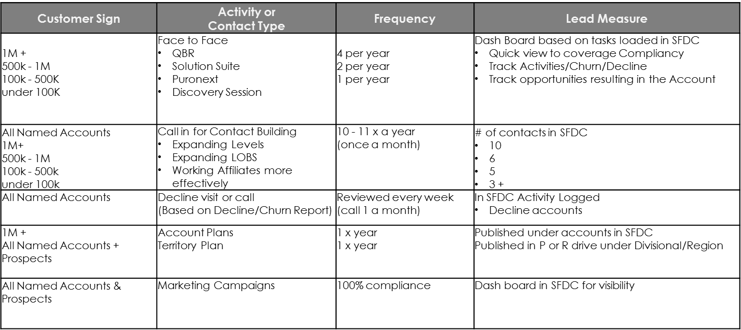
SAMPLE CONTACT and COVERAGE MODEL

Slide 6
KPI’s and Forecasting
Some of my “go-to” metrics
KPI’s
Average Spend per client
Churn rate of active clients YOY – compared to acquisition rate
Customer Value – what would it mean to lose them?
Revenue or Total Sales Volume
Active Subscriptions
Web Conversion
Number of Sales Calls
Broken down by rep/by product line/location
2. Forecasting Approach
Mixture of quantitative and qualitative. Quantitative is difficult when YOY, the comparables change. Purpose must be outlined first – for example: we want to focus on a marketing strategy for sales retention = detailed action/comms plan
Increase penetration in existing markets with new bundled solutions, Retention (focused on Churn reduction/training/support and stability in some product segments), New Channels of Distributions to review and managing your Loss Leaders/Aggressive Pricing in specific market segments
Using Market Research and a Delphi approach (panel of experts) – combination of Historical Patterns and Trend Projections

Slide 7
Customer Engagement
What matters?
1. Client Facing Team Feedback and Social Listening
2. NPS
3. Surveys after an interaction with Sales or Service
Post technical support or the implementation of a deal – Operational data helps as well (ie: an unusual amount of missed payments or returns)
4. Loyalty Programs and Measuring Sales Results – are they successful?
Revenues per customer, product penetration per customer, customer revenue increases, wait times, non-contact, abandoned calls, dead deals in the pipeline, referrals.
5. Committes that involve and engage customers
6. Customer Satisfaction Scores – Map out the Customer Experience
Interview the customer at various stages

Slide 8
APPENDIX

Slide 9
Engaging, Uniting, Motivating and Inspiring a Team
How to bring the Team together to achieve their individual and corporate goal
ENGAGE
Define the corporate/departmental goals and their meaning and communicate the importance, often
Provide training where necessary (skill/product/perception)
Forums for discussion (Big Ideas Meetings, Feedback Sessions or Debate Meetings)
Field work –builds accountability and loyalty
Encourage opportunities for them to work together or with other departments
2. UNITE
Safety, Significance, Connection and Communication (often)!
Allow for differences in opinions and creative thought
Positive momentum and energy builds a culture of “How” rather than “Why”
3. MOTIVATE
Listen (actively and without recourse), encourage positive ideas.
Be consistent in your scheduling (as a team and with individuals)
Share the impact of their actions
Incentives/SPIFF’s/contests
4. INSPIRE
“Purpose” conversations – managing to that specific idea for each person

Slide 10
Sales Accepted Demo’s and Qualification: Managing Activity and Results
A Demo is not a demo of the product and its features - it’s about the Pain Points. Have we answered the 3 most important questions in qualification? Does this address the questions you had? Can you see yourself using it? What would be the impact on your business?
Approach
Looking at MQL’s vs. SQL’s: Not every lead generated is sales ready, or a fit. Meaning sales teams need to work with a repeatable process to quickly engage or move on.
If the BDR is to: Qualify a high volume of leads based on a scorecard and schedule and set expectations for discovery calls, and an AE's job is to: Run the discovery call & ask for next steps, they need to move the opportunity to "Qualified" in the CRM and leave the BDR to continue hunting.
What is the activity of the BDR - What does ‘good’ look like?
KPI’s to measure in order to achieve optimal results for Results
Average Spend per client
Churn rate of active clients YOY – compared to acquisition rate
Customer Value – what would it mean to lose them?
Revenue or Total Sales Volume
Active Subscriptions
Web Conversion
Number of Sales Calls
Broken down by rep/by product line/location

Slide 11
Recruiting and Talent Management – Who to Hire?
Define the skill sets that I look for when growing or restructuring a team
Table Steaks for recruitment and team management
Sense of Urgency, Ease of Conversation, Business Acumen, Organized, Competence, Judgment, Energy, Focus and Trust
Assess Current Talent: Balance stability and change with organizational alignment (where do we want to be). Create an interview template – strengths and weaknesses of existing strategy, what resources could we leverage more effectively, biggest challenges, how could we improve together.
Need to Have Skills
Understand Business Value in order to demonstrate our products and services, Understand the dynamic of motivating to buy vs selling, Situation Fluency, Looks for Pain statements, able to manage conflict, not afraid to negotiate, cultural fit, experience in achieving quota, curious personality
Capacity to exercise judgement and not just technical skills. Process Driven and can demonstrate a repeatable pattern of success, can share data on performance, has relevant industry knowledge
Performance Reviews and Patterns of Behavior
Sales Results, Career Progression or Planning, Peer feedback, Stack ranking: Keep in place, move to another position, replace, observe.
Push/Pull tools: incentives, mission statement, procedures - shared vision, teamwork
Competencies – related knowledge, skills and characteristics
Process Management, Relationship Building/Management, Communicating/Influencing, Ingenuity/Creativity and a Drive for Results
Notes:
**Assessing the current skills and talent on the existing team by asking behavioral, theoretical and clarifying questions.

Slide 12
Pipeline Development
Activity
Execute a Contact and Coverage Plan – guideline to activity based on specific objectives and criteria
Activity Model – guideline based on specific tasks (ie: 50 Cold Calls, 20 in person visits, 10 New Presentations, 3 Flex appointments (cross selling/up selling), 3 deals signed) SHOULD HAVE 3X pipeline.
CRM / Salesforce: Dashboards – tasks, calls made, emails sent, meetings booked - reviewed DAILY.
Field Visits, One x One’s, Deal Clinics
Importance of defining Team Goals: company’s mission (or departmental shared goals) should be aligned with individual goals and compensation
Sales Methodology and Process adoption is critical (templates and verifiable outcomes in Salesforce)
Results
Performance Measurement Report shared weekly and discussed as part of a 90 minute team meeting (metrics such as: revenue, unit sales, consent/compliancy, gross margin) increase/decrease WOW, MOM, YOY
Pipeline (how many deals, average deal size, average sales cycle length, time in each stage)
Churn rate and Acquisition rate – are we losing clients faster than we can bring them on?
Performance Management - When necessary, we will need to use performance improvement plans
Employee Engagement Surveys to judge the cultural state of the team: Role Clarity, Empowerment, Purpose, Belonging, Recognition, Feedback

Slide 13
Quota Setting, Territory Management and Account Assignments
What is my approach?
Targets should be challenging yet achievable.
Comprised of both a commission portion and a bonus portion. The commission portion is based on growth revenue performance; the bonus portion is based on results as they apply to factors that are important to the Company. Factors include: Retention, Consistency and Selling Smart (ie: GP management, salesforce documentation)
Half of base salary, paid quarterly or more frequently, Billed revenue, gates to tiers of payment, uncapped.
What metrics does the business need to drive aside from growth and churn management (compliancy, consistency
Percentage of Org Achieveing Quota
On average, if 60% of your team is achieving 100%, you have a good set of business metrics to drive the right behaviors
2. Territory Management
Identify company goals (growth mindset) and the addressable market (client segmentation). New Clients, Current, Win-back, Groups. Define the roles and the capabilites the rep needs to have alongside they must have along with Lead Generation rules. Geography, T&E expense management, resources available
We should take into account: On Target Earnings, Average New Deal Size, Sales Cycle Length, Vertical Sales Adoption, Sales Preparedness
Salary including commissions and bonuses should be comparable to other similar industries and current sales measurements should be used to forecast future trends with quota setting.

Slide 14
SAMPLE CONTACT and COVERAGE MODEL

Slide 15
 | Stage 6 MQL / Sales Lead (Stage 0)
 | Only enter (Y)es, (N)o or (U)known in the highlighted cells
 |  | Y/N | Weight | Score
B | Rough understanding of annual content production spend | y | 1 | 1
A | Understanding of the prospect's buying process and the stakeholders involved | n | 3 | 0
N | Pain or gain Identified | y | 5 | 5
 | Understanding of how content is used today | Y | 1 | 1
 | Understanding of how content is sourced today | Y | 1 | 1
 | Understanding of impact of inaction | Y | 2 | 2
 | Understanding of what else they've tried to resolve the problem | Y | 2 | 2
T | Critical event driving timing | n | 5 | 0
 | Sales Lead Score |  | 20 | 12
 | Move to 1 - Identified |  | 60% | Yellow
Green | Convert Lead to Stage 0 Opportunity. Confirm sales is informed.
Yellow | Set lead Status to Nurture. SDR will continue to nurture lead.
Red | Set lead status to Disqualified. SDR will set disqualification reason. Lead will no longer be contacted.

Slide 16
SAMPLE SALES PROCESS BETWEEN BDR/AE
 | Research | Intro Discovery Call | Deep Discovery | Proof/Solution | Contracts & Close | Activation
SDRs
Hunters
Growers
CPs
Engagement |  |  |  |  | ***
SEs

Slide 17
Management of the Sales Trial Process and Win Rate Percentage Increases
Execution Plan
What is in our current Pipeline - are we effectively managing each stage?
Understand the behaviours that set the best sales reps apart and coach to them: Grit, Understands the Customer’s business, loves to debate, pushes the customer with a tailored message and solves problems.
Increase the number of SQL’s (best in class closes 50% + of SQL’s).
Recognize that you will lose approx 25% to a No Decision - get it early and move on fast
Recognize that you will lost 25-30% to the competition (Pain Point analysis early on will help focus)
Analyze the sales funnel by stage: Low Conversion Rates in the early stages? Team will need help with rapport building, better qualification, product knowledge and demo skills. Conversion rates low in the late stages - coaching skills: managing objections, gaining commitment, negotiation skills or closing skills.
*Look at win rate in conjunction with deal size or lead source. Our win rates can be higher when the original source of the opportunity is from referrals or from inbound marketing rather than outbound sales
**Win rate can decrease when sales reps work on opportunities that are considerably larger than the average deal size.
YOU GET TO YOUR FIRST MILLION DOLLAR CLIENT THROUGH TARGET ACCOUNT SELLING.
Notes:
Measure Opportunity, Compelling Events, Decision Criteria, Value Prop, SWOT, Milestones in the buying process etc..

Slide 18
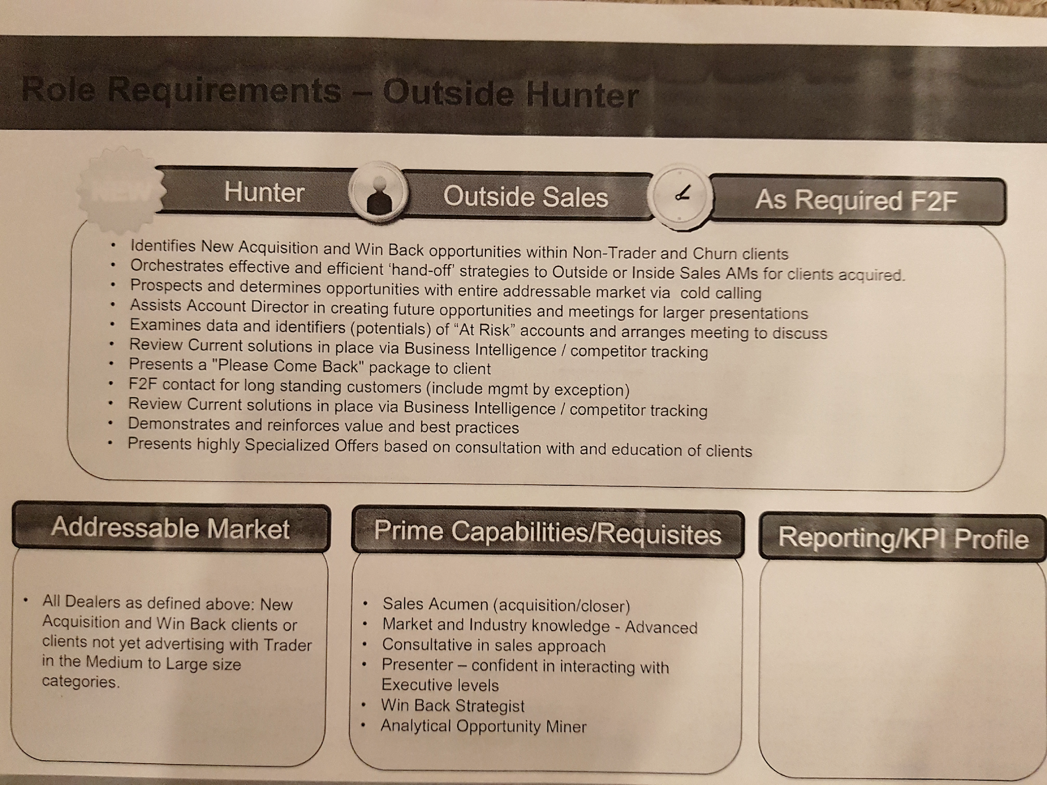
SAMPLE TERRITORY/REP SEGMENTATION

Slide 19
Timeline and Deliverables
14 days in:
Organize to Learn, Assessment/Analysis
Business/Stakeholder Orientation, Technical learning, strategy/markets/cultural and political climate, product (ongoing), Execute on Communication Process
30-60 days in:
Execution
Vision and Strategy, People, Processes in pace, Land Mines assessed., Early Wins, Challenges and Opportunities, Barriers and Resources
30-60 days in:
Establish A-List Priorities specific to each BDR/AE
Vital Goals and making some slow and deliberate moves focusing on systems and process execution, pipeline management, and skill set/competencies increasing
60 – 90 days in days in:
Team/Alliances, Early wins, Contributions
Evaluate the team for balance and talent, make a few important changes, shift the org mindset activity and process oriented with the tools (CRM/Pipeline) in place
90 days in:
Full Execution of Strategy on underperforming Metrics/Process to Actual Situation
People: Analysis and Motivation strategy
Customer & Partner: life cycle analysis
Growth Plan: What results will we drive in sales with which clients and when?
Operations/Infrastructure: Efficiency and Predictability

Slide 20
Timeline and Deliverables
14 days in:
Organize to Learn, Assessment
Business/Stakeholder Orientation, Technical learning, strategy/markets/cultural and political climate, product (ongoing)
30-60 days in:
Analysis
Vision and Strategy, People, Processes, Land Mines, Early Wins, Challenges and Opportunities, Barriers and Resources
30-60 days in:
Establish A-List Priorities
Vital Goals and making some slow and deliberate moves focusing on systems, culture and skills
60 – 90 days in days in:
Team/Alliances, Early wins, Contributions
Evaluate the team for balance and talent, make a few important changes, shift the org mindset from frustration to hope and awareness
90 days in:
Alignment of Strategy/Process to Actual Situation
People: Analysis and Motivation strategy
Customer & Partner: lifecycle analysis
Growth Plan: What results will we drive in sales
Operations/Infrastucture: Efficiency and Predictability

