Slide 1

The Advantages of Using IGeneX for Tick-Borne Disease Testing
Highlighting our advanced ImmunoBlot technology
August 2022

Slide 2
Content
The importance of testing for tick-borne diseases
Current testing: Is it that bad?
ImmunoBlotting- an IGeneX Exclusive!
Beyond ImmunoBlotting & Lyme: Why panel testing is important

Slide 3
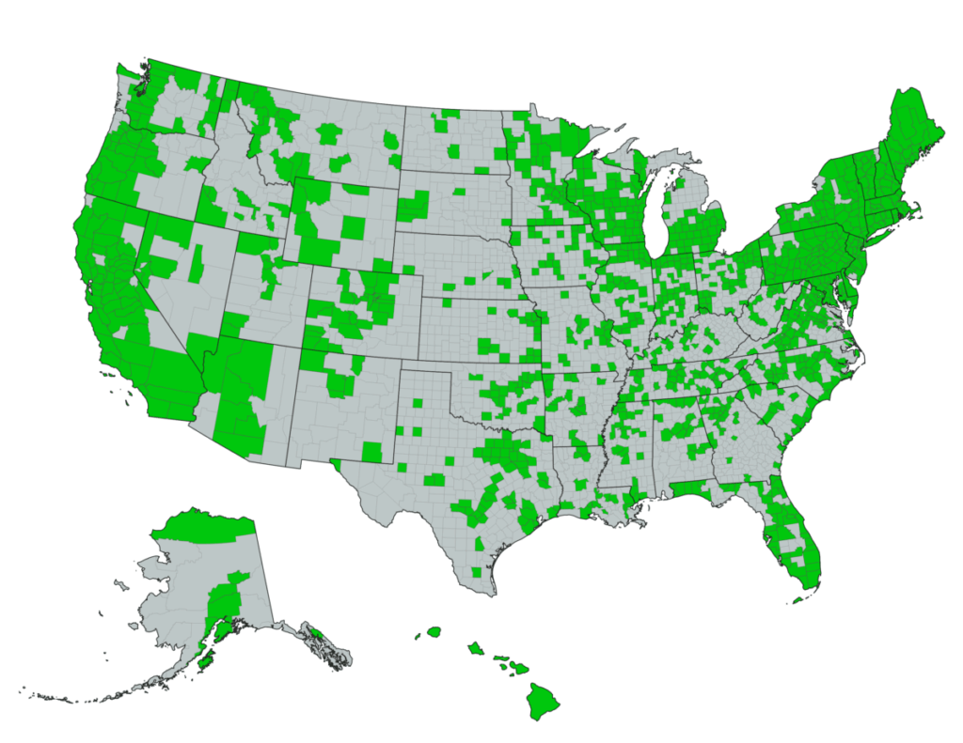
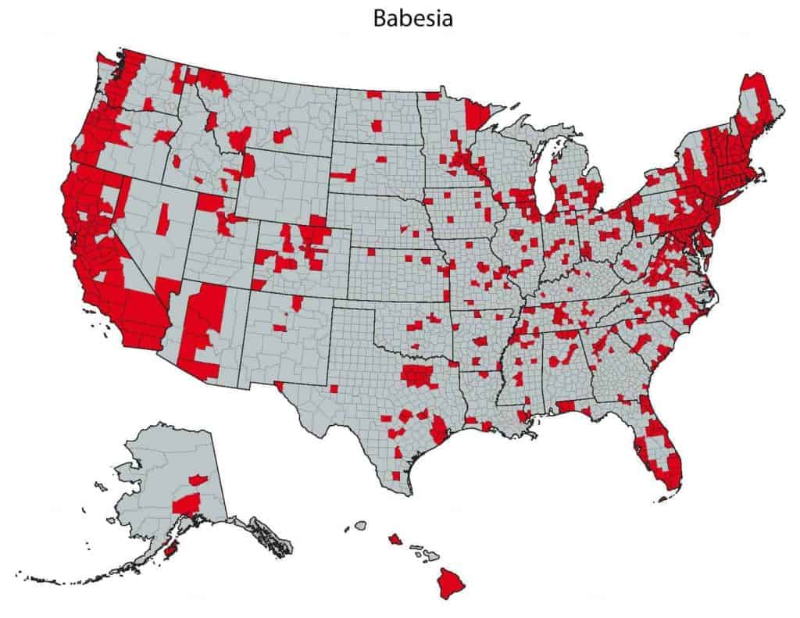
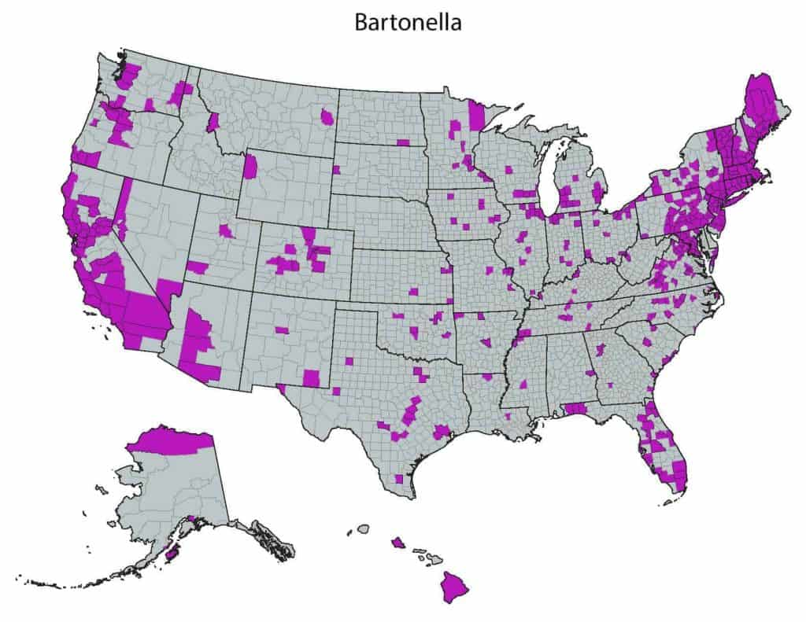
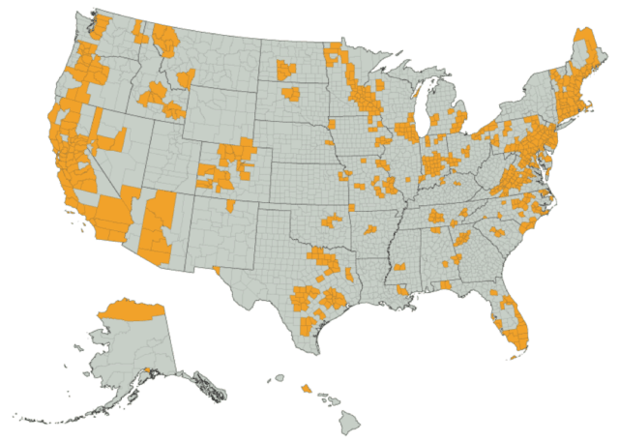
TBDs are spreading nationwide
Lyme disease
Most TBDs are present in all 50 states
TBDs look like a lot of different illnesses. Only through testing can you know for sure.
People travel and can contract disease in other countries or states
Babesia
Bartonella
TBRF
Source: IGeneX data

Slide 4
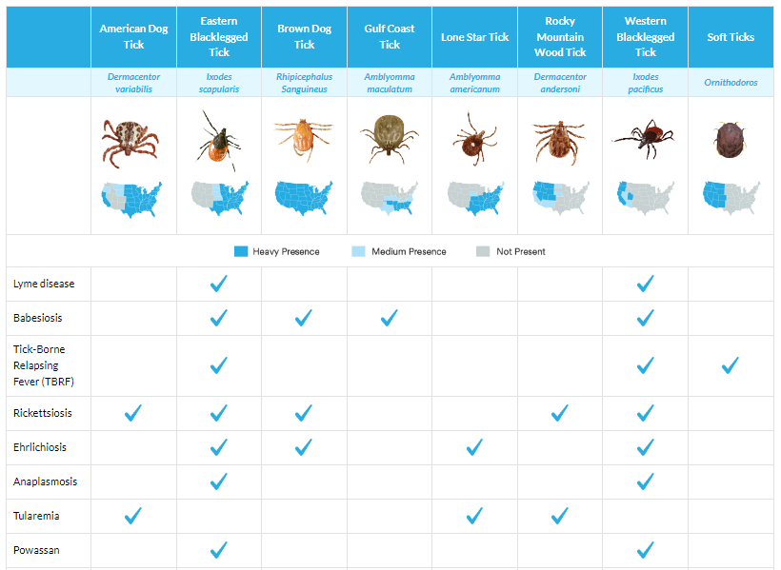
The tick population is growing and spreading

Slide 5
A single tick bite can transmit multiple pathogens
PCR testing confirmed multiple pathogens can be carried by the same tick.

Slide 6
Many “Lyme” patients are co-infected with other TBDs
Below is data from >10,000 patients showing exposure to multiple pathogens
Note: This data does not show active disease. It only demonstrates that pathogen antibodies or DNA or RNA was present in the clinical samples.

Slide 7
Evolution of Lyme testing
Lyme testing began with simple, low-technology immunofluorescent assays (“IFA”) which were found to be inaccurate
The ELISA (enzyme-linked immunoassay) was developed- automated the IFA technology so it could be run by machine rapidly and with more consistency- but still prone to false positives and negatives
Western blotting was developed for Lyme in an effort to increase accuracy

Slide 8
Introduction of Two-Tier Testing
The idea is to start with a VERY SENSITIVE ELISA as tier one so nobody is missed, then do a second VERY SPECIFIC western blot or another ELISA as tier two to filter out false positives.
ELISA- Sensitivity averages only 49% (range 29% to 75%)
PROBLEMS WITH TWO-TIER TESTING
The sensitivity of the ELISA at some big labs is no better than a coin toss! This would never be acceptable for any other illness- not cancer, not HIV-AIDS, not anything.
Even if tier two is done, because the western blot and second ELISA are nearly just as insensitive, and not highly specific, many cases are still missed
Study/Year | Sensitivity | Specificity
Schmitz et al, 1993 | 66% | 100%
Engstrom et al, 1995 | 55% | 96%
Ledue et al, 1996 | 50% | 100%
Bakken et al. 1997 | 75% | 81%
Trevejo et al, 1999 | 29% | 100%
Nowakowski et al, 2001 | 66% | 99%
Bacon et al, 2003 | 68% | 99%
Coulter et al, 2005 | 18% | -
Wormser et al, 2008 | 14.1% | -
MEAN TOTAL | 49.01% | 96%
    1. Schmitz et al. Eur J Clin Microbiol Infect Dis. 1993;12:419-24
    2. Engstrom et al. J Clin Microbiol. 1995;33:419-27.
    3. Ledue et al. J Clin Microbiol. 1996;34:2343-50.
    4. Bakken et al. J Clin Microbiol 1997; 35(3): 537-543.
    5. Trevejo et al. J Infect Dis. 1999;179:931-8.
    6. Nowakowski et al. Clin Infect Dis. 2001;33:2023-7.
    7. Bacon et al. J Infect Dis. 2003;187:1187-99.
    8. Coulter et al. ., J Clin Microbiol 2005; 43: 5080-5084.
    9. Wormser et al. Clin Vaccine Immunol. 2008;(10):1519-22.

Slide 9
Consequences of insensitive tests and Lyme Denialism
Lyme patients are told they do not have Lyme, to live with their symptoms, or seek psychiatric help
Insurance companies may deny covering treatment if there is not a positive test
If the doctor diagnoses Lyme on clinical grounds despite negative tests, then state medical Boards can and have charged them with misconduct

Slide 10
So why are these tests so insensitive?

Slide 11
Serologies must accept a
tradeoff between sensitivity and specificity
SENSITIVITY: Can someone have Lyme despite a negative test?
  Impaired immunity is known to occur in advanced cases of Lyme, so the serum antibody levels may be too low to be detected by standard tests
  Immune complexes may form and trap antibody, potentially causing free antibody levels to be too low to be detected
SPECIFICITY: How sure are you that a positive result is a true positive?
  Because non-Borrelia antibodies may be picked up by low-specificity tests, sensitivity cannot be turned up to overcome the above limitations

Slide 12
Multiple species are often not included in testing
Most Lyme tests detect only a single Borrelia species, B. burgdorferi B31 (Bb sensu stricto, or Bbss)
What about other species? B. afzelii; B. garinii; B. mayonii; B. californiensis; B. spielmanii; B. valaisiana (Bb senso lato, or Bbsl)
Common two-tier testing misses many patients because they don’t look for these additional species
A negative result may simply be due to testing for the wrong species!
  Can be another reason for seronegativity

Slide 13
ImmunoBlotting-
Moving beyond the Western Blot

Slide 14
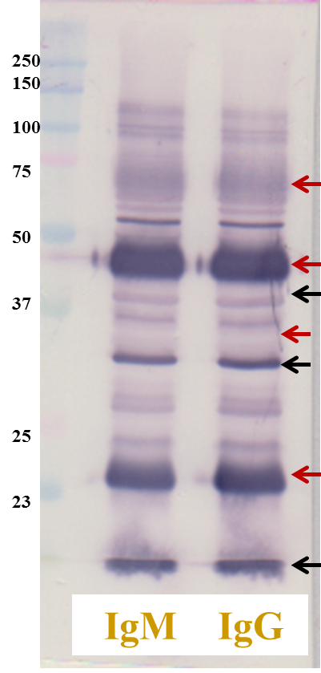
Western Blots- how they are made and interpreted
Cultured lab strains are lysed and the antigens are separated by electrophoresis
However-
Antigen identification is based upon position after electrophoresis: is migration-dependent
Migration is not an exacting process
Nonspecific or unimportant proteins may co-migrate with important proteins, and the WB cannot distinguish these.
Scoring (pos or neg) is based upon band intensity
How dark must a band be to be called positive? Intensity may simply relate to quality of the donor culture
RESULT- Imprecision

Slide 15
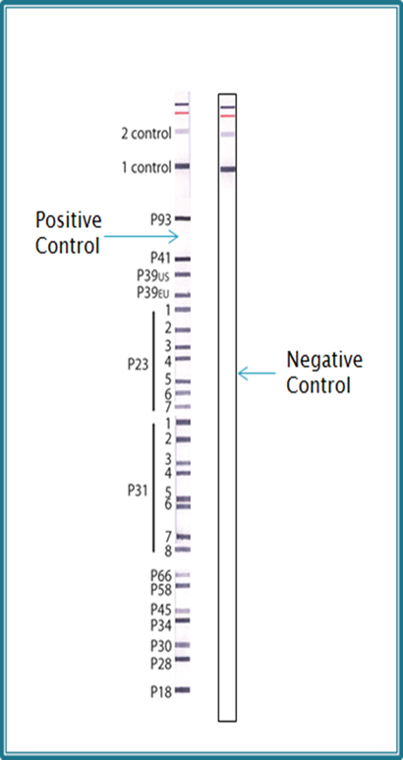
How ImmunoBlots are made
Recombinant antigens are created and are printed onto the test strips- not dependent on a culture
Antigens are placed at specific locations
Band locations are no longer migration-dependent
Know exactly what each positive band represents
No longer an issue with co-migration of other unwanted antigens (viruses, other bacteria, autoantibodies)
Precise amount of antigen
Band intensity is no longer culture-dependent
Positive bands are more clearly displayed
Reduces false positives and false negatives

Slide 16
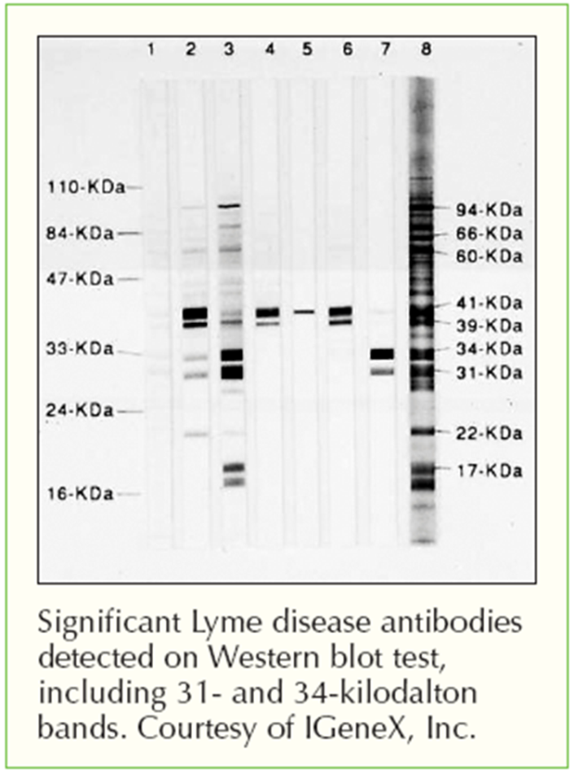
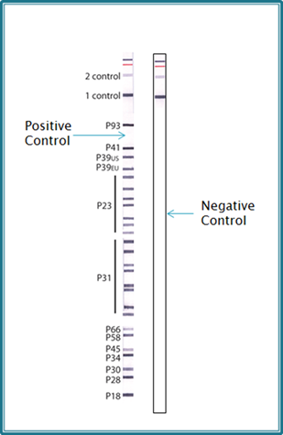
Comparison- Lyme WB vs. ImmunoBlot
Western Blot
IGeneX Lyme ImmunoBlot

Slide 17
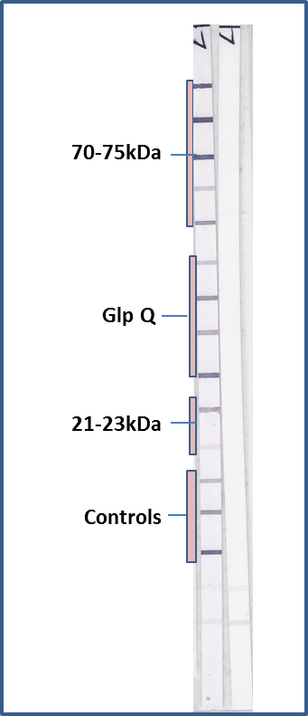
Comparison- TBRF WB vs. ImmunoBlot
TBRF Western Blot
TBRF ImmunoBlot

Slide 18
What are recombinant antigens?
Instead of getting antigens from cultured lab strains, recombinant antigens are created
Reverse engineering is used to create these specific antigens-
  The genetic sequence in the pathogen that codes for the specific surface antigens of concern are cloned into pET (viral) vectors
  These engineered viruses are introduced into E. coli which then produces this pure protein antigen
  These recombinant proteins are further purified using metal affinity chromatography followed by gel filtration
  They are then printed onto the strips at specific locations in exacting quantities
Recombinant antigens- ability to detect multiple species of multiple pathogens with increased sensitivity and increased specificity

Slide 19
Lyme ImmunoBlot vs. Lyme Western blot
 | IMMUNOBLOT | WESTERN BLOT
SOURCE | Recombinant antigens- multiple species | Lysed cultured Bb ss B31 (IGX also uses strain 297)
BAND LOCATION | Placed at specific locations | Migration-dependent
BAND SCORING | Precise, measured amounts | Culture-dependent
SPECIFICITY | 97+% | 96+% to Bb ss B31
SENSITIVITY- EARLY | 93% (blinded CDC samples) | 20% to Bb ss B31
SENSITIVITY LATE | 100% (blinded CDC samples) | 75% to Bb ss B31

Slide 20
Lyme ImmunoBlot specificity
Unlike standard serologies, no tradeoff between sensitivity and specificity
Samples | Negatives | Lyme IB (In-House) |  |  | Lyme IB (CDC)
 |  | IgM | IgG | IgM+IgG | IgM | IgG | IgM+IgG
CDC Set 1* | 5 | 0 | 0 | 0 | 0 | 0 | 0
CDC Set 2* | 20 | 0 | 1 | 1 | 0 | 0 | 0
PT Samples | 11 | 0 | 0 | 0 | 0 | 0 | 0
Autoimmune | 42 | 0 | 0 | 0 | 0 | 0 | 0
Viral Infections | 46** | 1 | 1 | 2 | 0 | 0 | 0
RPR + | 28 | 0 | 2 | 2 | 0 | 1 | 1
Total False + |  | 0 | 4 | 5 | 0 | 1 | 1
Total True - | 152 | 151 | 148 | 147 | 152 | 151 | 151
Specificity % |  | 99.3 | 97.4 | 96.7 | 100 | 99.3 | 99.3
*Western blot results were provided by CDC
**Out of 46 samples with antibodies to viruses, 11 had antibodies to CMV; 24 to EBV, 7 to HSV; and 4 to HCV
**Only 2 of 24 samples with antibodies to EBV were positive by Lyme IB
PT = proficiency test

Slide 21
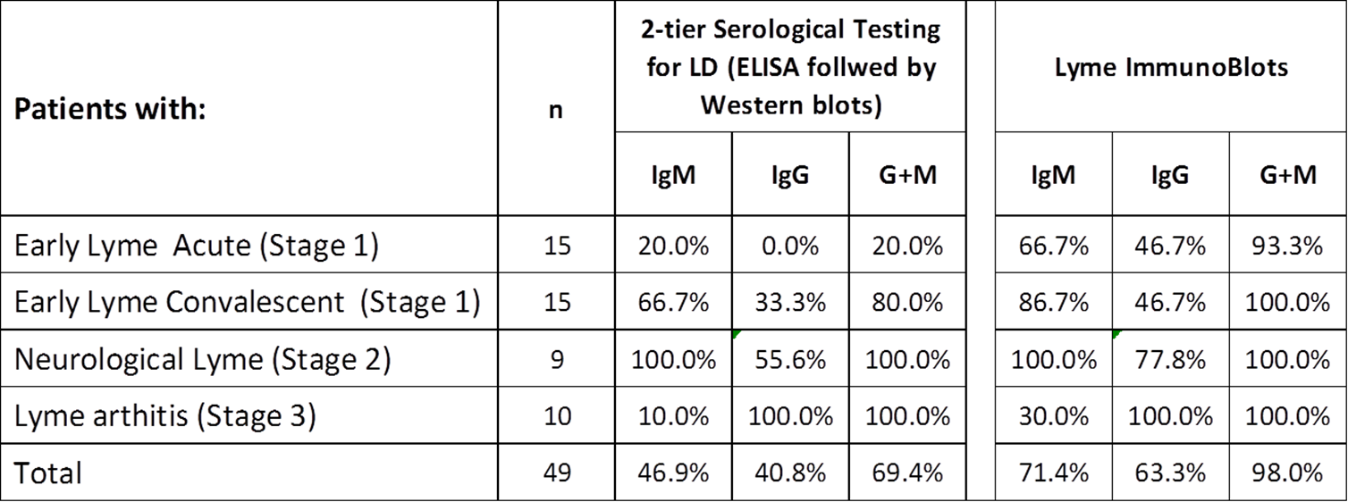
Lyme ImmunoBlot: Unprecedented sensitivity
GAME CHANGER!
IGeneX Lyme ImmunoBlot picked up 93% of early cases!!
No other test of any kind has been demonstrated to do this
Late-appearing IgM is significant (remember the 99.3+% specificity)

Slide 22
Comparison of assay performance on clinical samples
Data above based on 97 well-characterized samples (49 Lyme positive samples and 48 Lyme negative samples). 74 of the samples were provided by the CDC, which included 49 Lyme positive patient serum samples and 25 Lyme negative patient serum samples. EIA and Lyme Western Blot results too were provided by the CDC. The remaining 23 Lyme negative samples were purchased from New York Biologics, NY.
Based on the data, IGeneX Lyme ImmunoBlots should be used for detection of antibodies to B. burgdorferi in patients suspected of having Lyme disease.

Slide 23
IGeneX Lyme ImmunoBlot vs. Standard Testing
Multispecies capability
Standard Tests
Most tests detect only a single Borrelia species, B. burgdorferi B31. The IGeneX ImmunoBlot tests for eight species of Borrelia
ImmunoBlot has a sensitivity greater than 93%, whereas the ELISA and Western Blot two-tier testing protocol recommended by the CDC has a sensitivity of only 57.6%.
B. burgdorferi B31
IGeneX ImmunoBlot
B. burgdorferi B31
B. burgdorferi 297
B. californiensis
B. mayonii
B. afzelii
B. garinii
B. spielmanii
B. valaisiana
STANDARD
TESTS
IGENEX
IMMUNOBLOT
Source: Waddell LA, Greig J, Mascarenhas M, Harding S, Lindsay R, Ogden N (2016) The Accuracy of Diagnostic Tests for Lyme Disease in Humans, A Systematic Review and Meta-Analysis of North American Research. PLoS ONE 11(12): e0168613.

Slide 24
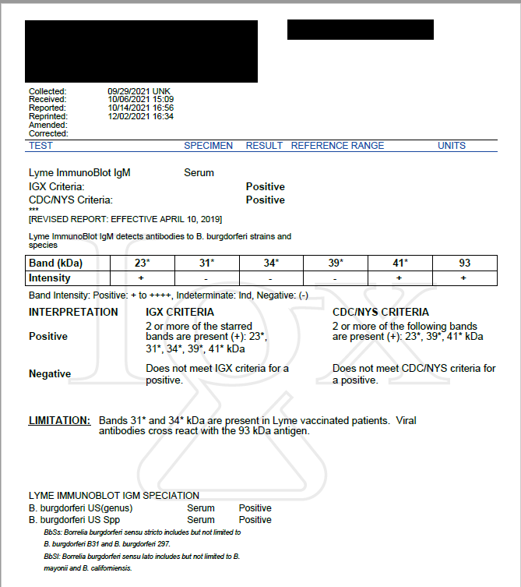
Copy of an actual report -
Lyme ImmunoBlot
The patient is positive for Lyme IgM by both IGeneX and CDC criteria.

Slide 25
IGeneX ImmunoBlots are available for five diseases
Lyme disease
TBRF (Tick-Borne Relapsing Fever)
Bartonella
Babesia – New!
SARS CoV-2 (COVID-19)

Slide 26
TBRF ImmunoBlots
TBRF is often confused with Lyme because both are Borrelia and both may present identically to the clinician
ImmunoBlots can detect the most commonly found TBRF species, not just B. hermsii or B. miyamotoi
Multiple antigens are included, not just one as with the B. miyamotoi ELISA
  Significantly increases real-world sensitivity
  Significantly increases specificity
Less likely to cross react with viruses, non-Borrelia bacteria and autoantigens
Species-specific- no cross reactivity between TBRF and Lyme Borrelia
Reports both IgM and IgG

Slide 27
ImmunoBlotting can distinguish Lyme from TBRF
Samples 1 and 2: Positive for antibodies to TBRF Borrelia
Sample 3: Positive for antibodies to TBRF Borrelia and B. burgdorferi
Sample 4: Negative for antibodies to both TBRF Borrelia and B. burgdorferi
Sample 5: Positive for antibodies B. burgdorferi.
M = Positive Control; N = Negative Control
https://www.researchgate.net/publication/336707596_Line_Immunoblot_Assay_for_Tick-Borne_Relapsing_Fever_and_Findings_in_Patient_Sera_from_Australia_Ukraine_and_the_USA [accessed Oct 06 2021].

Slide 28
ImmunoBlotting can detect multiple Lyme and TBRF Borrelia species known to exist in North America
Lyme Borrelia
TBRF Borrelia
B. burgdorferi B31
B. burgdorferi 297
B. californiensis
B. mayonii
B. spielmanii
B. valaisiana
B. afzelii
B. garinii
B. hermsii
B. miyamotoi
B. turcica-like
B. turicatae
B. texasensis
B. coriaceae
B. parkeri

Slide 29
Bartonella

Slide 30
Bartonella- ImmunoBlotting
As with other TBDs, Bartonellosis represents an infection with potentially many different species and serotypes (over 40 distinct species described)
Traditional tests have not been inclusive of these multiple Bartonella
Bartonella ImmunoBlots include 22 Bartonella specific recombinant antigens and 2 controls on every strip at predetermined positions
Significantly increased sensitivity
Much greater specificity - no band overlap or co-migration with nonspecific antibodies as on a western blot
Positive samples can detect multiple species and identify and report the following four: B. elizabethae; B. henselae; B. quintana; B. vinsonii

Slide 31
Bartonella ImmunoBlots

Slide 32
Bartonella Western Blots vs. ImmunoBlots
One IGeneX ImmunoBlot replaces multiple Western Blots

Slide 33
Bartonella ImmunoBlot Specificity Study

Slide 34
Bartonella ImmunoBlots are more sensitive than Bartonella Western Blots and are better at identifying species

Slide 35
Bartonella ImmunoBlot validation study (n=46)
Specificity
IgM – 100%
IgG – 100%
Sensitivity
IgM – 75%
IgG – 88.9%
Overall – 100%

Slide 36
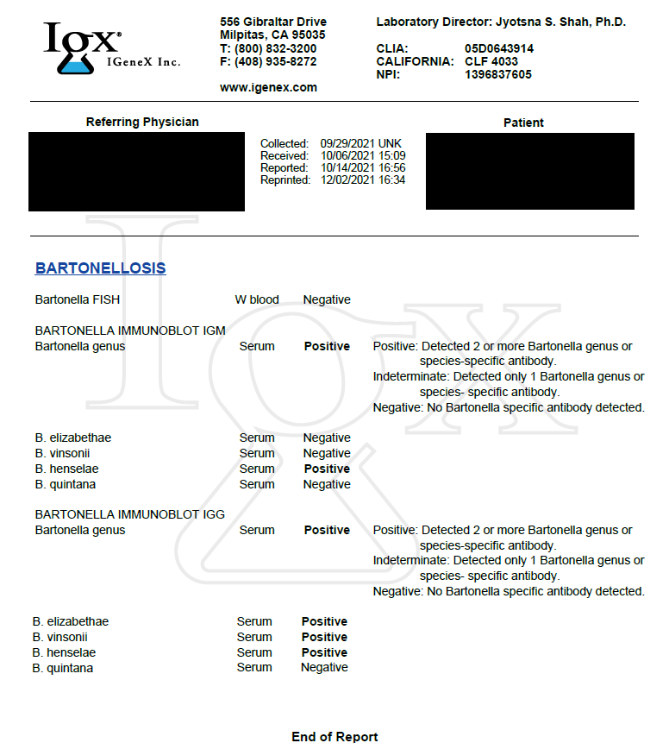
Copy of an actual report -
Bartonella ImmunoBlot
Interpretation:
Positive: two or more bands
Indeterminate: one band
Negative: no bands
Speciation:
Reports species if any of these are found:
  B. elizabethae
  B. vinsonii
  B. henselae
  B. quintana
Reports as genus-positive if other species are found
May find and report more than one species (surprisingly common!)
The patient is positive for both Bartonella IgM and Bartonella IgG.

Slide 37
Babesiosis

Slide 38
Babesia ImmunoBlots – New!
Babesiosis is the most common co-infection in Lyme
Babesiosis is caused by intraerythrocytic protozoan parasites that are transmitted by ticks, or less commonly through blood transfusion or transplacentally
Babesiosis shares many clinical features with malaria and can be fatal, particularly in the elderly and the immunocompromised
Currently there is no antibody test that can reliably detect Babesia infections. The IGeneX Babesia ImmunoBlot is the first test of its kind to detect antibodies.
Recent data shows B. microti is the most widespread variant throughout the US
B. duncani is also common, but slightly less widespread than B. microti
ImmunoBlots can be used to speciate Babesia to B. microti and B. duncani

Slide 39
Babesia ImmunoBlots detect Babesia Genus, plus B. microti and B. duncani
Sample 1 – Babesia Genus Positive
Sample 2 – Babesia microti Positive
Sample 3 – Babesia duncani Positive

Slide 40
Development of the Babesia ImmunoBlot
Dr. Choukri Ben Mamoun, Yale University supplied culture lysates to IGeneX
Results of ImmunoBlots were compared to Western blots to verify multispecies capability, sensitivity, clarity, and consistency
In the images below, patients 1 and 2 are positive for B. duncani, and patient 3 is positive for B. microti

Slide 41
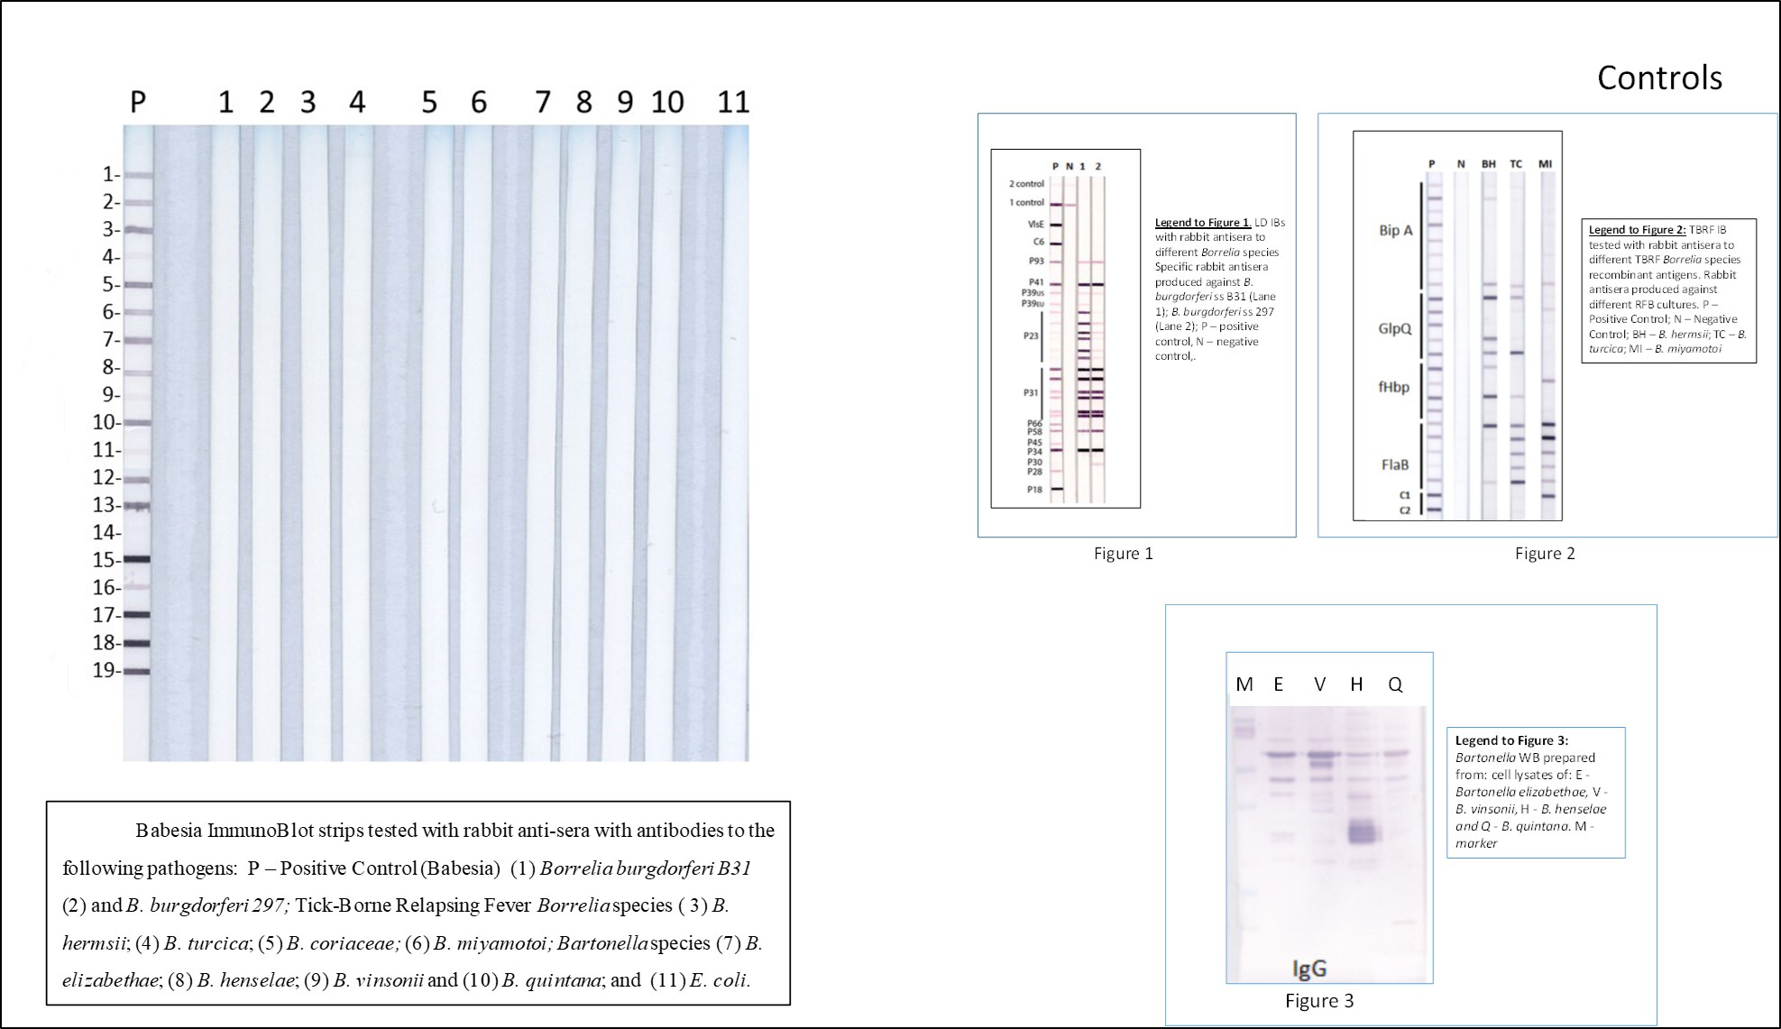
Babesia ImmunoBlots showed no cross reactivity to other pathogens
PATHOGENS
Lyme Borrelia
Bb B31
Bb 297
TBRF Borrelia
B. hermsii
B. turcica
B. coriaceae
B. mayonii
Bartonella
B. elizabetheae
B. henselae
B. vinsonii
B quintana
E. coli

Slide 42
Babesia ImmunoBlot – Unprecedented specificity

Slide 43
Babesia ImmunoBlot – Highly Sensitive

Slide 44
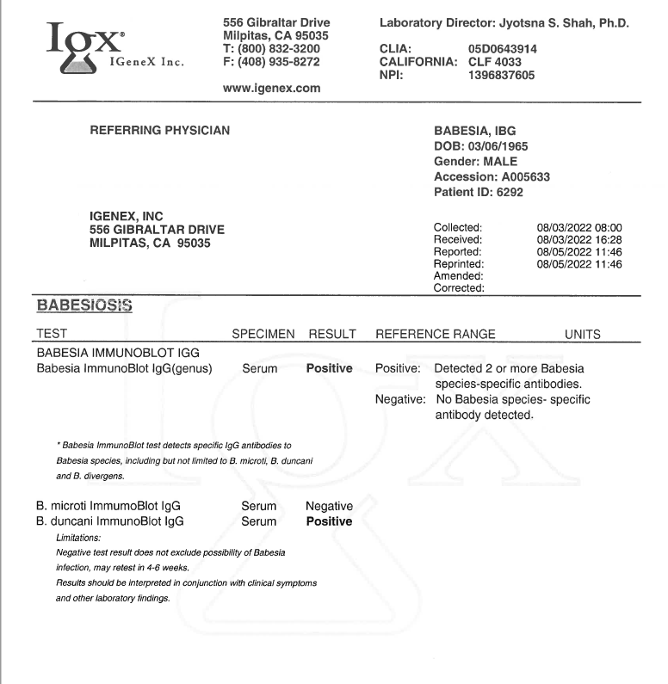
Sample Babesia ImmunoBlot Report
Interpretation:
Positive: two or more bands
Negative: no bands
Speciation:
Reports species if any of these are found:
  B. microti
  B. duncani
Reports as genus-positive if other species are found

Slide 45
Special Offer
Offer
Babesia ImmunoBlots are being offered at the same price as the Babesia microti and Babesia duncani IFA. $130 savings!
Expires
September 30th, 2022

Slide 46
Beyond ImmunoBlotting & Lyme
Why panel testing is the best approach

Slide 47
Testing for multiple pathogens is often necessary
Because of symptom overlap, often it is not possible to separate out the major TBDs on clinical grounds alone
EXAMPLE: Many of the co-infections mimic Borreliosis
  Symptoms of Lyme and TBRF can overlap
  Bartonella can cause joint pain, fatigue and neurologic issues
  Babesiosis can cause headaches, dizziness and fatigue
  All of these can become chronic
  All of these may be missed if not properly tested
Testing for multiple pathogens maximizes diagnostic accuracy

Slide 48
Testing by multiple methods increases accuracy-
Direct Testing These tests look for the pathogen in the specimen | Indirect Testing These tests look for antibodies or T-cell reactivity in the blood
Why use direct tests: Not every patient has detectable antibodies Patients may be immune-suppressed Antibodies may be bound in immune complexes Some patients are challenging blood draws (i.e. young kids) so urine specimens can be tested instead | Why use indirect tests: Pathogens not always in the bloodstream Superior at detecting early and/or late stage disease Certain tests can detect T-cell response, an early disease indicator and are useful in B-cell immune deficiencies
Types of direct tests: PCR (DNA)- multiple sources possible FISH (RNA)- blood samples only Urine antigen capture | Types of indirect tests: ImmunoBlot Western Blot IFA IgXSpot (T-cell response)

Slide 49
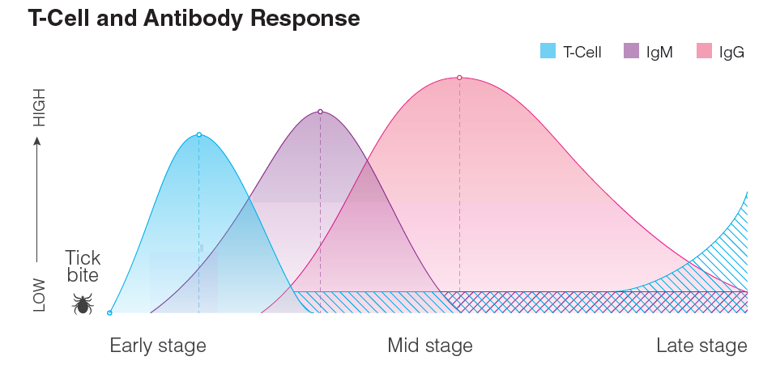


Understanding immune response is crucial when prescribing tests
Early after infection, T-cell response is the strongest, making IgXSpot the most effective early test.
IgM and IgG antibodies develop soon afterwards, at which time ImmunoBlots become most effective.
T-cell response may also re-appear later.
PCR is mostly positive in early disease, but may be positive at any stage, especially in the immune-deficient
PCR mostly positive during early stage; however
can be positive at any stage of the disease
A small percentage of patients produce T-cells during the middle stage, with a spike in the late stage of the disease
A small percentage of patients produce IgM antibodies throughout the entire stage of the disease.

Slide 50
Including PCR testing with ImmunoBlots increases yield
A set of 294 patient samples were tested by the Lyme ImmunoBlot and PCR. Results are summarized below:
RESULT SUMMARY
141 were positive by IB
Adding PCR revealed an additional 38 cases
CONCLUSION
Based upon this data set, the IB was the most sensitive but adding PCR revealed an additional 12.9% of cases
Test | n | # Positive | % Positive
Lyme ImmunoBlot, IGX criteria | 294 | 141 | 48%
PCR (+) |  | 38 | 12.9%
Total (+) |  | 160 | 54.4%
Recommendation: Based on this data, recommendation is to test Lyme patients with ImmunoBlots and PCR, because some people don’t produce detectable levels of antibodies.

Slide 51
IGeneX offers multiple tests for each major TBD
Disease | Tests Available
Lyme disease | Multi-species ImmunoBlots, IgXSpot, Western blots, IFA, PCR, LDA, BCA
TBRF (Tick-Borne Relapsing Fever) | Multi-species ImmunoBlots, PCR, BCA
Bartonella | Multi-species ImmunoBlots, IgXSpot, IFA, PCR, FISH
Babesia | Multi-species ImmunoBlots, IFA, PCR, FISH
Rickettsia | IFA, PCR
Ehrlichia/Anaplasma | IFA, PCR

Slide 52
IGeneX test panels simplify ordering and save money
A test panel is a logical grouping of tests that increases accuracy and completeness of results, while saving large amounts of money
Simplifies ordering tests for multiple pathogens using multiple methods
Designed to make ordering quick and easy!
Good “memory jogger” so you are more likely to be complete in your assessments
Examples of most popular panels
LTP1 - LYME/TBRF PANEL 1
  Includes IgM and IgG ImmunoBlots for Lyme and TBRF Borrelia
  Adds a screening IFA to satisfy two-tier requirements needed for some cases of insurance coverage
  Saves $204.50 over ordering tests individually
TBD6I - TICK BORNE DISEASE PANEL 6I
  LB, TBRF, Babesia microti and duncani, Bartonella, HME, HGA, R. rickettsia, R. typhi
  Includes IFA, ImmunoBlot, PCR, FISH; serum + whole blood
  Saves $1,308.50!!

Slide 53
Most comprehensive test panel
TBD6I (Tick Borne Disease Panel 6I)
Lyme disease tests
  IgG/IgM/IgA Screen
  ImmunoBlot IgM & IgG
  PCR serum & whole blood
TBRF tests
  ImmunoBlot IgM & IgG
  PCR serum & whole blood
Bartonellosis tests
  ImmunoBlot IgM & IgG
  FISH
Babesiosis tests
  ImmunoBlot IgM & IgG
  FISH
Ehrlichiosis tests
  IFA (IgM & IgG)
Anaplasmosis tests
  IFA (IgM & IgG)
Rickettsiosis tests
  R. rickettsii/typhi IgG
TBD6i panel combines direct (PCR, FISH) and indirect (ImmunoBlots, IFA) testing to look at the full spectrum of Lyme disease and the major co-infections.

Slide 54

About IGeneX
Servicing the Lyme and tick-borne disease community for nearly 30 years
Comprehensive Testing
  More diseases: Lyme, TBRF, Bartonella, Babesia, Anaplasma, Ehrlichia, Rickettsia, COVID-19
  More methods: PCR, Western Blots, IgXSpot, ImmunoBlots, FISH, IFA
  Most accurate: ImmunoBlots have proven to be nearly twice as sensitive as two-tier testing
Certified – IGeneX is fully CLIA/CMS certified, as well as being licensed to perform testing in all 50 states, including New York
Dr. Jyotsna Shah
President & Laboratory Director
IGeneX, Inc.

Slide 55
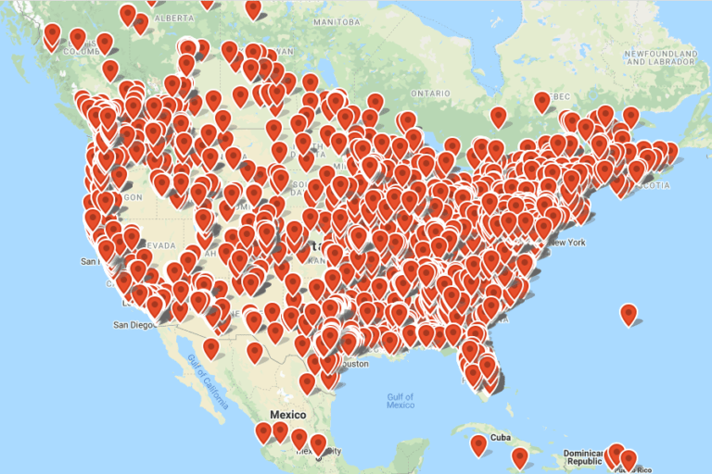








Over 10,000 doctors across North and Central America use IGeneX

Slide 56
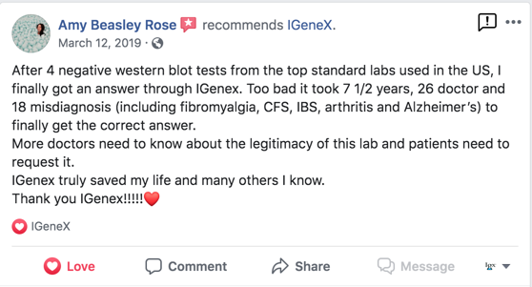

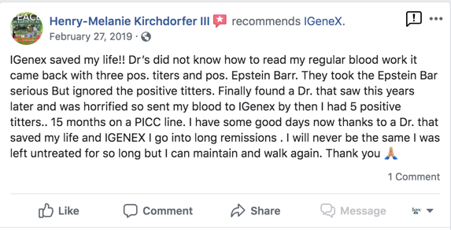
IGeneX has passionate patients
“Thank you, IGeneX!”
Patient health is the #1 priority
IGeneX has tested thousands of patients since 1991
Many patients used other testing before coming to IGeneX
“IGeneX saved my life!”

Slide 57
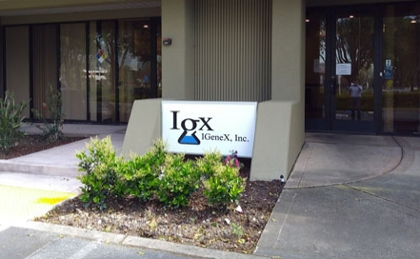
Conclusion
Thank you for allowing us to introduce you to IGeneX and ImmunoBlots. We look forward to collaborating with you to provide the best care for patients.
Additional Information
Please visit igenex.com
  Test methodologies and interpretations
  Webinars
  Research papers
  Sales material
  Price lists
For technical assistance with test interpretations, please contact Dr. Jyotsna Shah or lab manager Iris Cruz
  jshah@igenex.com
  icruz@igenex.com
For additional Marketing support, please contact Joe Sullivan at jsullivan@igenex.com
For customer support and issues with physician orders, please contact 1-800-832-3200

Slide 58
Thank you!
Joseph J. Burrascano Jr. M.D.

