Slide 1

EU banking and regulatory developments
François-Louis Michaud|Executive Director
Finance Malta 15th Annual Conference | 1st December 2022

Slide 2
Agenda
The current outlook for EU banking / financial firms
Regulatory developments in the EU banking / financial sector
  Basel 3
  Innovation
  ESG

Slide 3
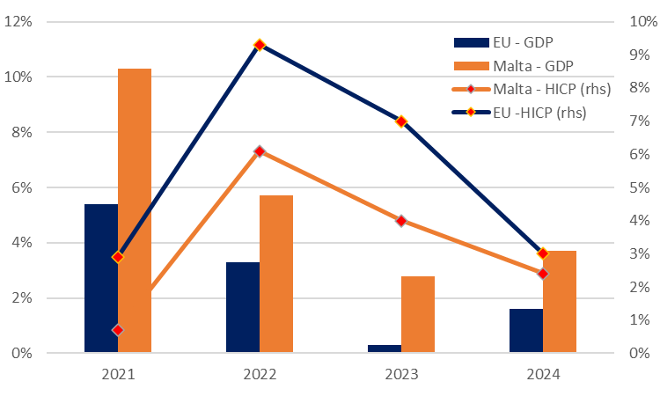
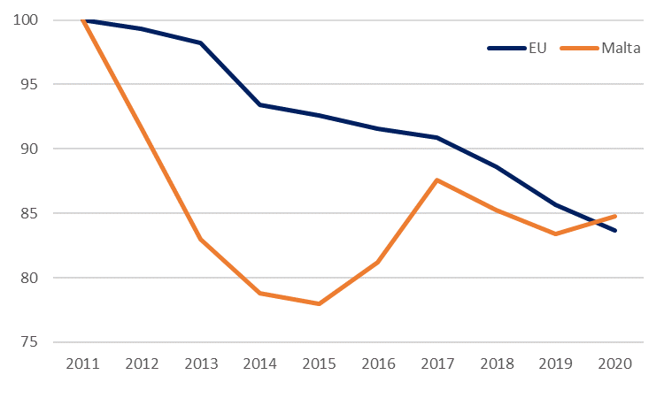
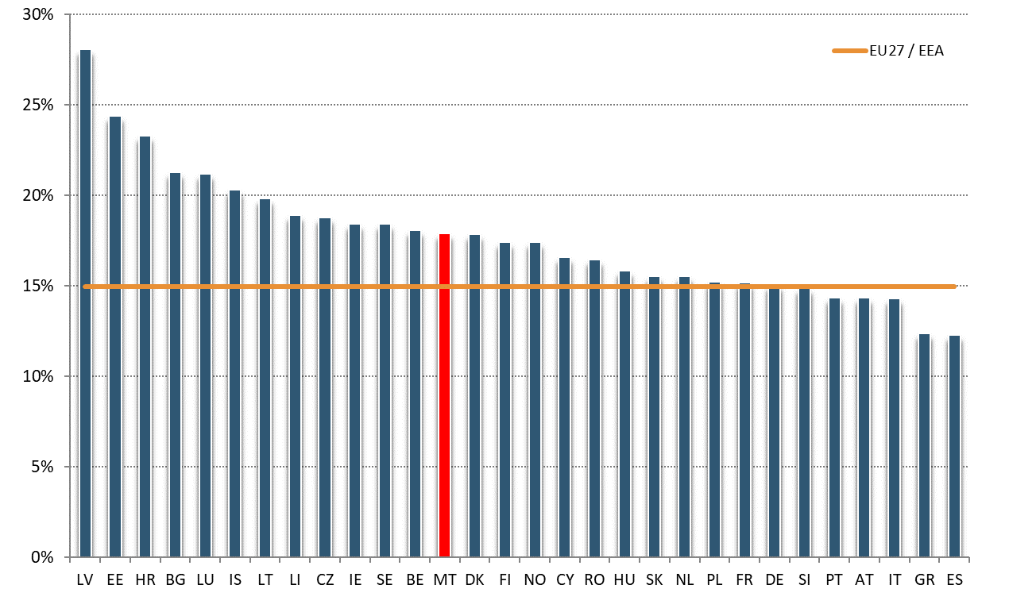
Challenging outlook for banks but robust capital levels…
GDP and inflation projections
  Recent macroeconomic projections point to a sharp economic slowdown, with EU possibly in technical recession in 4Q22-1Q23 and MT economy expected to fare comparatively better.
  Most EU countries reduced energy intensity in recent years (Eurostat).
  High banks capital ratios as of June 22: EU/EEA FL CET1 ratio at 15% (17.9% in Malta).
Source: European Commission Autumn 2022 Economic Forecasts
Energy intensity (100 = 2011)
FL CET1 ratios (June-2022)
Source: European Commission Autumn 2022 Economic Forecasts
Source: Supervisory reporting

Slide 4
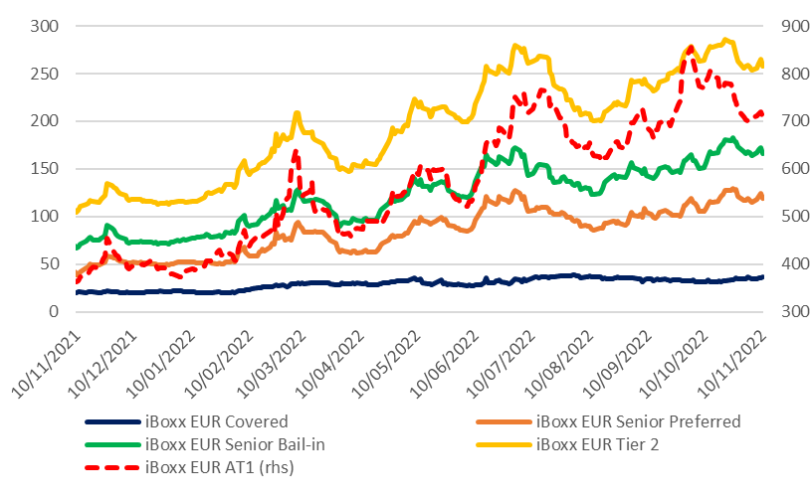
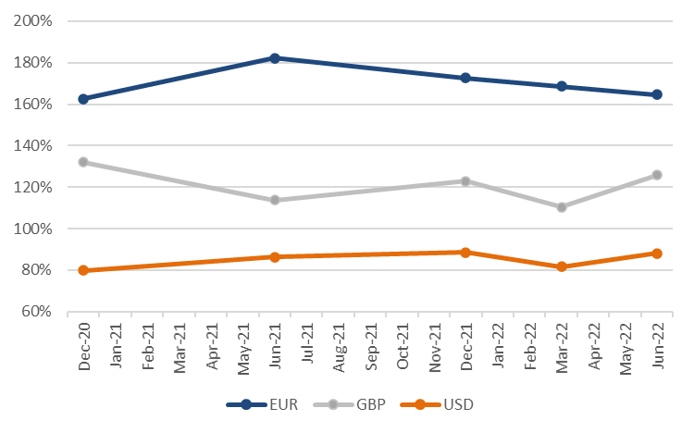
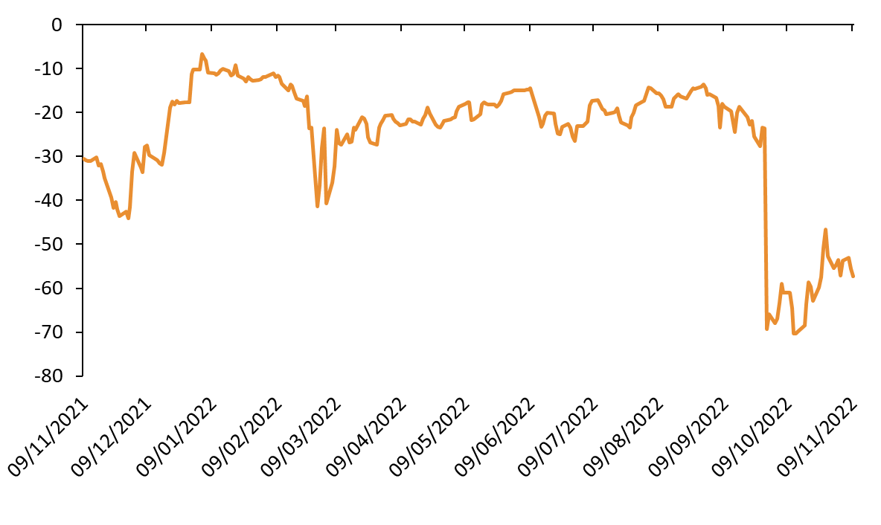
… and comfortable liquidity positions
Selected iBoxx indices (asset swap spreads)
  LCR and NSFR standing at 164.9% and 126.9% as of June 2022 respectively (415.4% and 183.1% in MT respectively).
  Going forward, more volatile/expensive market conditions may affect:
    Funding costs in a context of TLTRO-III loans repayments
    LCRs in USD and GBP often below 100%
    Refinancing/building up of MREL.
Source: IHS Markit
LCR by currency
EUR/USD 3-month cross currency basis swap
Source: Supervisory reporting
Source: Bloomberg

Slide 5
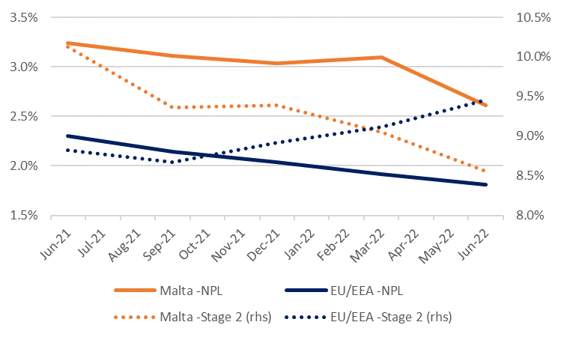
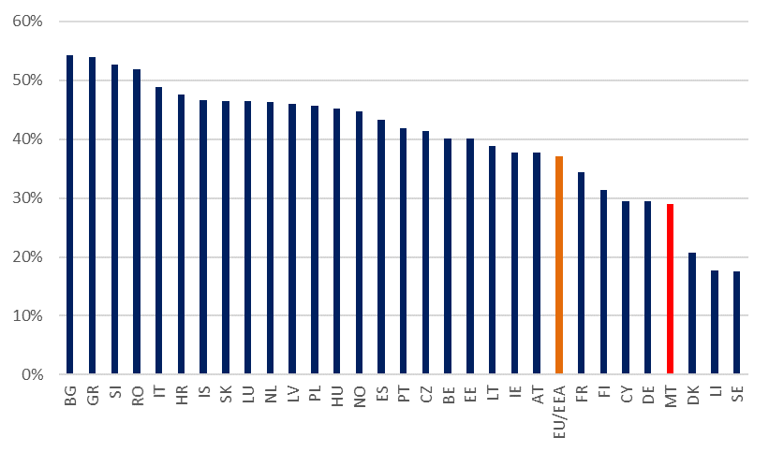
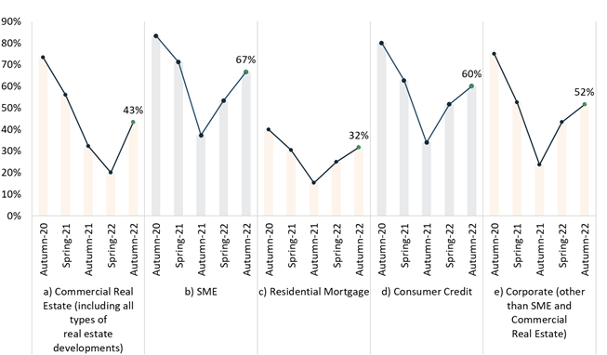
First signs of asset quality deterioration
NPL ratio and Stage 2 allocation
  NPL ratios further down but share of Stage 2 loans up, above pre-pandemic levels (but still going down in MT).
  Energy-intensive sectors particularly vulnerable? (their weight in MT banks’ portfolios is comparatively small).
  Banks have revised their expectations downwards on asset quality for all portfolios, with SMEs and consumer credit portfolios the main concern.
Source: Supervisory reporting
Share of loans to energy-intensive sectors* over total NFC loans
Banks expect asset quality deterioration in the next 12 months
Source: Supervisory reporting. *Energy intensive sectors include agriculture, mining, manufacturing, electricity and gas supply, construction, and transport
Source: Autumn 2022 RAQ (preliminary results)

Slide 6
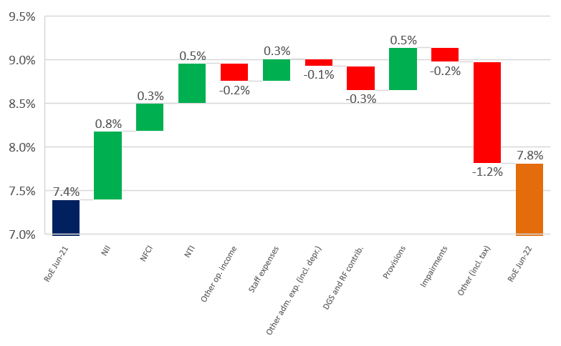
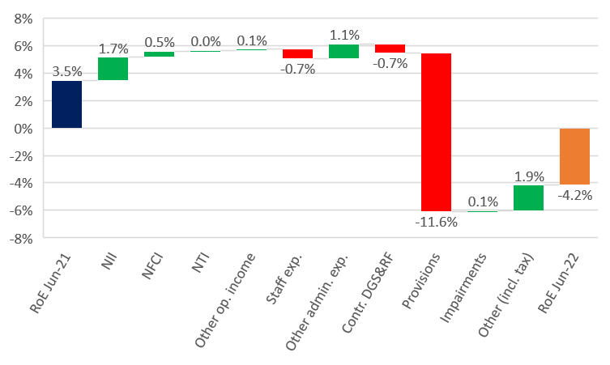
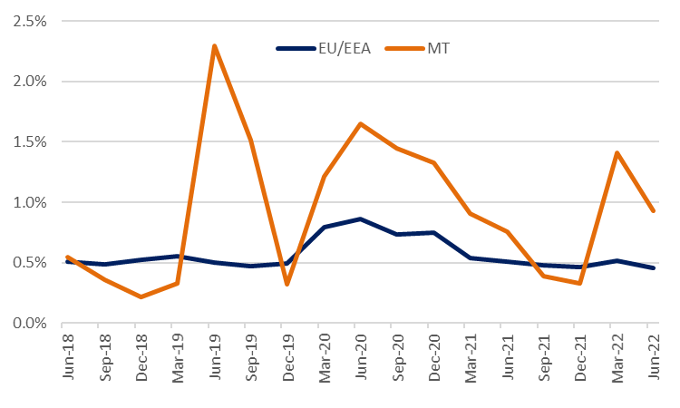
First signs of asset quality deterioration
Contribution to RoE of the main P&L elements – EU/EEA
  EU/EEA bank higher NII but less one-off >0 adjustments in 2022 (e.g. less negative goodwill adjustments). Specific case in MT.
  Many headwinds: deposit repricing faster than that of assets side (e.g. residential mortgages); fee income under pressure (payment services and AM pro-cyclical); Operating expenses up (inflation); deteriorating borrowers’ repayment capacity.
Source: Supervisory reporting
Contribution to RoE of the main P&L elements – Malta
Cost of risk of EU/EEA and Maltese banks
Source: Supervisory reporting. *Energy intensive sectors include agriculture, mining, manufacturing, electricity and gas supply, construction, and transport
Source: Supervisory reporting

Slide 7
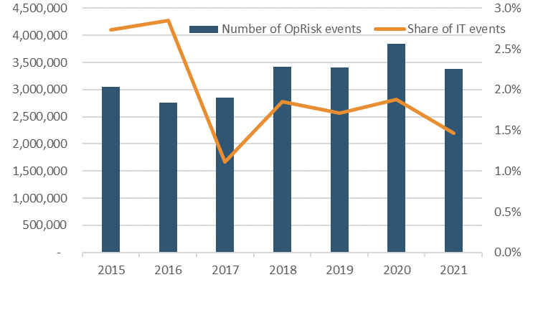
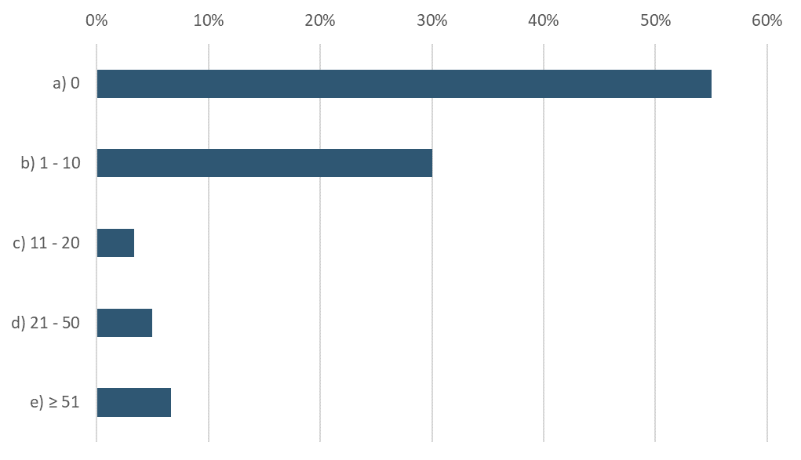
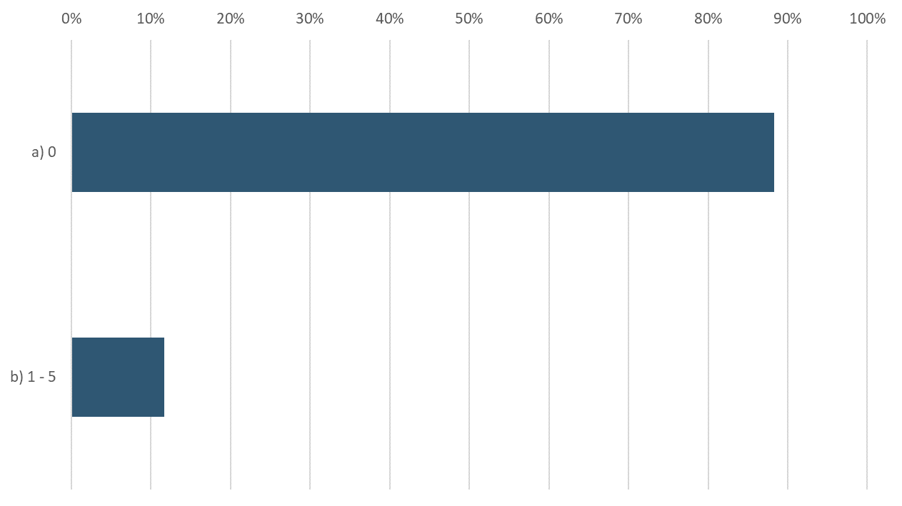
Non-financial risks (e.g. cyber)
Number of new OpRisk events & share of ICT related events over time
  Nearly 1/2 the banks in EBA’s RAQ reported at least 1 major cyber attack in 1H22.
  Most cyber attacks unsuccessful yet 10% of banks faced at least 1 major successful one.
  After a peak in 2020, new OpRisk events have declined.
  Share of new ICT related events also declined.
Source: Supervisory reporting
Number of cyber-attacks from 1 January to 30 June 2022*
Number of successful cyber-attacks 1 Jan. to 30 June 2022*
Source: Autumn 2022 RAQ (preliminary results)
Source: Autumn 2022 RAQ (preliminary results). * In the major ICT-related incident are defined as an ICT-related incident with a potentially high adverse impact on the network and information systems that support critical functions of the financial entity (DORA article 3(7)).

Slide 8
Agenda
The current outlook for EU financial firms
Regulatory developments in the EU financial sector
  Basel 3
  Innovation
  ESG

Slide 9
Basel III implementation in the EU: adoption process
Political negotiations between member states in the Council
27 October 2021 Publication of Commission proposal
Adoption of EU Council Stance on 8 November 2022
Trilogues between Commission, EU Council and EU Parliament
  European Commission’s proposal for amending CRR-CRD
    Implementing Basel III: better resilience to shocks, no significant capital increase, taking into account specific EU features, reducing compliance costs for smaller banks, without loosening prudential standards
    Sustainability: stronger ESG risk identification, disclosure and management
    Stronger supervision of Fit and proper, fintech, 3rd-country branches
  European Council: broadly in line with EC; considering further national specificities and practices (risk weighting of equity intra-group exposures, subordinated debt, exposures to land acquisition, development and construction and off-balance sheet trade finance exposures).
  EU Parliament discussions ongoing
1 Jan 2025
Entry into force of amended CRR / CRD
Adoption of EU Parliament stance

Slide 10
Basel III: CRR3 / CRD6 implementation and EBA’s work
  EBA expects around 100 mandates:
  Split across all the areas of the CRR3 / CRD6 proposal, with emphasis:
    Credit risk (mainly IRB related),
    Market risk (implementation of FRTB),
    Governance,
    Disclosure requirements, especially ESG,
    Other elements could still be included
  Timeline
    Still uncertain (depends on the outcome of the negotiations)
    As implementation is expected by 2025, a substantial number of consultations is to be expected in 2024

Slide 11
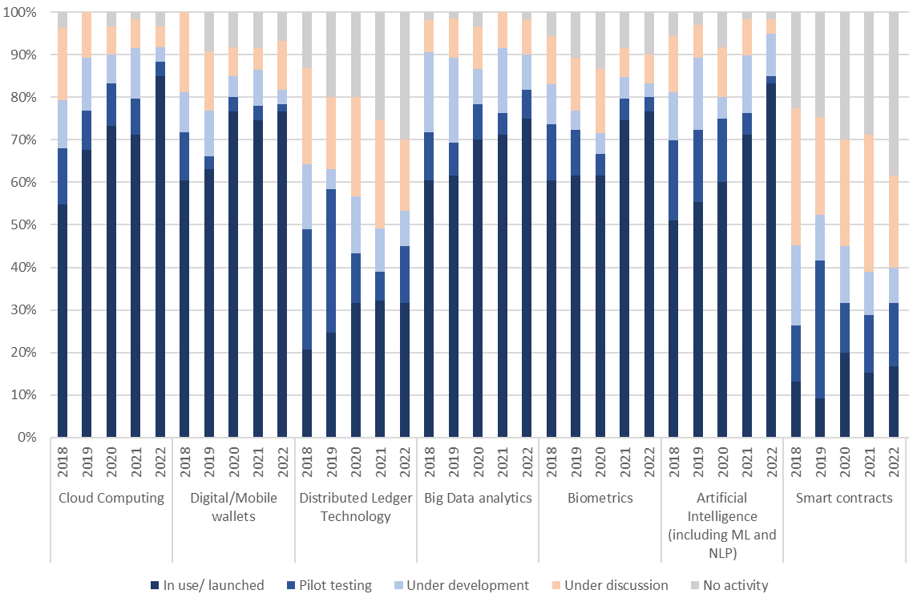
Innovation: EBA’s publications and deliverables
Continuous increase in the use of cloud computing (85% Y2022 vs 71% Y2021) and AI solutions (83% already in use)
EU banks still exploring the application of smart contracts and DLT, while the use of quantum computing is at very early stage
EBA focus on innovation monitoring
in 2023 and beyond
Following EBA‘s statutory duty to monitor new or innovative financial activities, the EBA expects to put further attention on:
Status of adoption of financial technologies by EU banks (YoY comparison, 2018-2022)
Artificial Intelligence/Machine Learning use cases in financial sector (e.g. creditworthiness assessment/credit scoring)
Tokenisation in relation to new financial products and services and Decentralised Finance (DeFi)
Digital identity management, to monitor emerging use cases related to digital identities, biometric recognition and self-sovereign identity
+
Supporting NCAs in adopting SupTech solutions
Source: EBA Risk Assessment Questionnaire (Autumn 2022) – based on 60 EU banks

Slide 12
Innovation: Digital Operational Resilience Act (DORA) and EBA’s future role
ICT risk management
ICT-related incidents
Digital operational resilience testing
ICT third party risk management
Harmonised ICT risk management requirements
Harmonised ICT-related incident reporting
Coordinated testing and mutual recognition of advanced testing for significant financial entities
Establishment of oversight framework for critical ICT third-party providers
Industry funded model
DORA expected to enter into force Q1 2023
Entry into application from Q1 2025 onwards
DORA 12 policy mandates (8 sets of RTS, 2 sets of ITS, 2 sets of Guidelines) and 4 other mandates (feasibility study, reports, responses to CfAs)
DORA = a regulation applicable to a wide range of financial entities + a directive stipulating the changes to sectoral directives to enable coexistence
ESAs/EBA tasks and role
  Receive, assess and notify major ICT-related incidents
  Lead overseer of critical ICT third-party providers –including cooperation with third-country authorities
  Info sharing on effective practices across financial sectors,
  crisis-management and contingency exercises

Slide 13
Innovation: Markets in Crypto-Assets (MiCA) and EBA’s future role
Crypto-asset service providers (other than issuers) e.g. wallets and exchanges (CASPs)
Issuers of significant asset-referenced or e-money tokens
Issuers of other asset-referenced or e-money tokens
Issuers of other crypto-assets
Supervised by the EBA
Supervised at the national level
EBA tasks and role
MiCA expected to enter into force Q2 2023
Entry into application Q4 2024 onwards
MiCA policy mandates (EBA to prepare 20 technical standards and GL - 2 joint with ESMA, 1 joint-ESA)
MiCA = a regulation intended to create a holistic approach to the regulation and supervision of crypto-asset activities
  EBA’s supervision tasks of issuers of:
    significant asset-referenced tokens (ARTs) and
    significant e-money tokens (EMTs)
  ‘Other’ tasks:
    opinion classification of crypto assets
    product intervention powers
    market monitoring

Slide 14
EBA’s work on ESG risks and sustainable finance
    Build an adequate framework for EU banks and their supervisors to mitigate ESG risks and support an orderly transition to a sustainable economy…
by
to
Closing the data gap - through risk analysis, monitoring, stress tests
Setting guidance for bank risk management and supervisors’ practices
Embedding ESG risks in bank regulation and bank strategies
Ensure a thorough but proportionate application
Facilitate convergence at EU and international levels
Foster resilience of the EU banking sector and broader economy
… through a holistic and sequenced approach…
… rooted in international and sectoral coordination (Basel, across EU financial sectors, NGFS…)

Slide 15
Main areas of EBA’s ESG work
    Risk-based approach addressing all three pillars of the banking prudential framework:
    Transparency and disclosures (pillar 3)
    Risk management and supervision (pillar 2)
    Risk assessment and stress-testing (pillar 2)
    Prudential (capital) treatment of exposures (pillar 1)
    Supervisory reporting
    Standards and labels
    Prevent greenwashing
    ESG risks and sustainable finance monitoring framework
Well engaged
More to come

Slide 16
EBA’s ESG publications and deliverables
ITS on Pillar 3 disclosures on ESG risks (implementation from 2023, further updates planned 2024-2025)
EBA’s advice to EU COM on Green Asset Ratio under the Taxonomy
Joint ESAs RTS under Sustainable Finance Disclosure Regulation (implementation from 2023, further updates ongoing)
Joint ESAs RTS on sustainability disclosures for STS securitisation (by end-2022)
Report on ESG risk management and supervision (June 2021)
Update of various guidelines to incorporate ESG considerations – loan origination, governance, remuneration
Report on incorporating ESG aspects in supervision of investment firms (October 2022)
Guidelines on ESG risk management (consultation planned in 2023)
Review of SREP Guidelines
Pillar 2: risk management and supervision
Pillar 3 and other disclosures
Pillar 1: prudential treatment
Stress testing
Industry standards and labels
Supervisory reporting
ESG risk monitoring
Pilot climate exercise (April 2021)
One-off cross-sector system-wide climate stress test (2023-2024)
Guidelines on banks’ ESG risks stress testing (consultation planned in 2023)
Regular EU-wide climate stress tests
Joint ESAs Guidelines on supervisory stress testing
Monitoring of climate-related financial stability risks by EC, ECB, ESAs and NCAs
Monitoring of ESG risks
Discussion paper on the role of environmental risks in the prudential framework (May 2022, final report in 2023)
Report on sustainable securitisation (March 2022)
Advice on green retail loans and green mortgages (end 2023)
Advice on greenwashing (progress report May 2023, final report May 2024)
Commission and ESAs expected to assess the need for standards for sustainable loans and bonds
ITS on the inclusion of banks’ exposures to ESG risks in supervisory reporting

Slide 17
  THANK YOU FOR YOUR ATTENTION!
  PLEASE VISIT OUR WEBSITE

