Slide 1

Finance Without Frontiers
11th Annual Financial Services Conference
Kenneth Farrugia
Chairman – FinanceMalta
Hilton Conference Centre, Malta
17th May 2018
Notes:
HON. MINISTER MALLIA, HON LORD MARLAND OF ODSTOCK, YOUR EXCELLENCIES, DISTINGUISHED GUESTS LADIES AND GENTLEMEN - GOOD MORNING AND ON BEHALF OF THE BOARD OF GOVERNORS OF FINANCEMALTA, A TRULY WARM WELCOME TO THIS 10th ANNUAL FINANCIAL SERVICES CONFERENCE.
A PARTICULAR WARM WELCOME TO OUR FOREIGN GUESTS SOME OF WHICH ARE REPRESENTING A NUMBER OF SPONSORS PRESENT HERE TODAY. ON THIS FRONT I WISH TO PARTICULARLY EXPRESS MY APPRECIATION TO MANAGING PARTNERS GROUP - DIAMOND SPONSORS OF THIS YEAR’S EVENT. MPG offers fund management and administrative services internationally and opened its Malta office in 2015 to launch a securitisation platform for the issuance of asset-backed securities.
IT GIVES ME IMMENSE PLEASURE TO WITNESS THIS RECORD LEVEL OF PARTICIPATION WHICH IS A CONFIRMATION OF THE SUSTAINED INTEREST BY DOMESTIC AND INTERNATIONAL OPERATORS IN THIS INDUSTRY’S VALUE PROPOSITION.
THIS IS FINANCEMALTA’S 10TH ANNUAL CONFERENCE AND EACH CONFERENCE HAS BROUGHT ABOUT AN INFLECTION POINT ON THE CURRENT STATE OF PLAY OF THE INDUSTRY AND THE ROADMAP GOING FORWARD. IN FACT THIS YEAR’S CONFERENCE – THE NEXT QUANTUM LEAP AND THE PROGRAM THAT HAS BEEN PREPARED IN THIS REGARD - IS ACTUALLY MOTIVATED BY TWO KEY THRUSTS –
FIRSTLY THE NEED TO SUSTAIN THE TRACTION OF THE CURRENT FINANCIAL SECTORS THAT HAVE CONTRIBUTED TO THE GROWTH OF THIS INDUSTRY AND ,
AND SECONDLY BUT I FEEL MORE IMPORTANTLY IT REFLECTS THE NEED FOR THE INDUSTRY TO WIDEN ITS STRATEGIC FOCUS TO THE NEW AND EMERGING FINANCIAL SECTORS AS THIS WILL FURTHER STRENGTHEN THE INDUSTRY’S VALUE PROPOSITION GOING FORWARD.
BLOCKCHAIN - CRYPTOCURRENCIES - FINTECH - CROWDFUNDING FORM AN INTEGRAL PART OF TODAY’S PROGRAM.

Slide 2
Agenda
1. Key Initiatives - CY 2017
2. State of Play of the Industry
3. Key Thrusts Going Forward
Notes:
IN MY INTERVENTION THIS MORNING, I WISH TO BRIEFLY ADDRESS THE FOLLOWING TWO 3 POINTS
1. FIRSTLY TAKING YOU THROUGH THE KEY INITIATIVES ORGANISED BY FINANCEMALTA OVER 2015
2. SNAPSHOT OF THE PERFORMANCE OF THE KEY FINANCIAL SECTORS.
3. AN OUTLINEOF FM PLANS GOING FORWARD

Slide 3
FinanceMalta
Key Initiatives - CY 2017

Slide 4
Key Financial Sectors
An ecosystem of financial sector diversity
Key Financial Sectors
Asset Management
Trusts
&
Foundations
Insurance
Pensions
Private Wealth
Financial Institutions
Securitisation
Fintech
DLT &
Virtual Financial
Assets
Crowdfunding

Slide 5
Key Communication Platforms
Conferencesand Events
Technology - Website, Podcasts and Email Marketing
Print, PR and Social Media
Educational Clinics

Slide 6
Key Sectors
Asset Management
Portfolio Managers
Private Wealth
Family Offices/Businesses
Distributed Ledger Technology and Virtual Financial Assets
Technology Service ffProviders
Insurance and Re-Insurance
Captives
Pensions
Securitisations
Trusts
Foundations
Fund Administrators
Depositaries
Investment Funds
Re/Insurance Principal Cos.
Insurance Intermediaries
Insurance Management Cos.
Virtual Financial Assets

Slide 7
Italy
USA
Switzerland
United
Kingdom
Dubai
Abu Dhabi
Singapore
Malta
Hong Kong
Conferences and Events
54 National &
International Initiatives

Slide 8
Technology
Dedicated Website
90,210 visits
CY 2015
115,918 visits
CY 2016
154,158 visits
CY 2017
Digital Audit and SEO initiatives increased site visits by 33%
Notes:
62% YEAR ON YEAR INCREASE IN WEBSITE VISITS BUT WHAT’S MORE INTERESTING IS THAT 62% OF THESE VISITS ARE NEW. THIS INCREASE IS ALSO THE RESULT OF
THE SOCIAL MEDIA PLATFORMS THAT WE VENTURED INTO OVER THE COURSE OF LAST YEAR.

Slide 9
Social Media Platforms
Strengthening reach through digital channels
+ 19%
+ 12%
+ 4%

Slide 10
Print Media
Key Sector Reports
Asset Management
Insurance
Securitisation
Trusts
Banking
Wealth Management
Public Relations Program
Thought Leadership Articles
Participation in Key Media Specialist Publications
The Euro-GCC Trade and Investment Guide
HFM Malta Report
Captive Insurance Times
IFC Review
World Commerce Review
Intelligent Insurer
ILS Report
The Banker
IFC Economic Report
Captive Review - ILS Report
Intelligent Insurer
Wealth
Notes:
PARTICIPATED IN A CAREFULLY SELECTED RANGE OF KEY INTERNATIONAL PUBLICATIONS COVERING THE MAIN FINANCIAL SECTORS OF THE INDUSTRY

Slide 11
State of Play of the Industry

Slide 12
Malta’s Financial Services Industry
Sustained Growth in the Overall Ecosystem
SECTOR
CLUSTERS
Trusts
+6%
Securitisations
+18%
+14%
Financial Institutions
+5%
Insurance Operations
+11%
Investment Services
Operations
+9%
Retirement Schemes
+17%
New Fund Licences and Notifications
163
Investment Services
Operations
+114
New Fund Licences and Notifications
63
Insurance Operations
€ 4.2bn Premiums
Notes:
Over 500 licensed operations in Malta

Slide 13
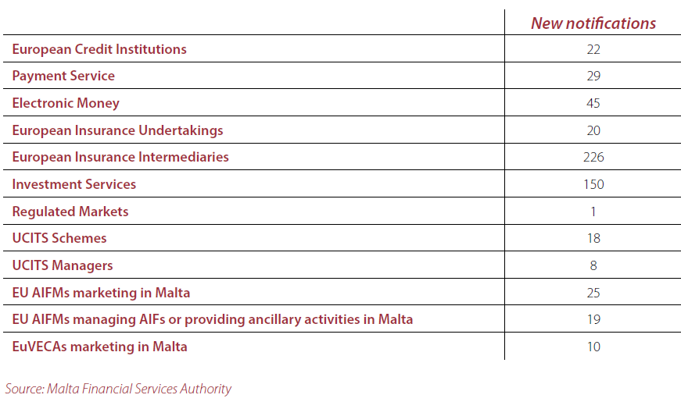
Malta’s Financial Services Industry
International Firms Passporting to Malta

Slide 14
International Attestations
Global Competitiveness Index 2017 – 2018
Rank out of 137 Countries – Top Quartile Position
3rd
17th
15th
13th
20th
Quality of the Education System
Internet Bandwidth per User
Soundness of the Banks
Quality of Maths and Science Education
Strength of the auditing/reporting standards
22nd
Regulation of Securities Exchanges

Slide 15
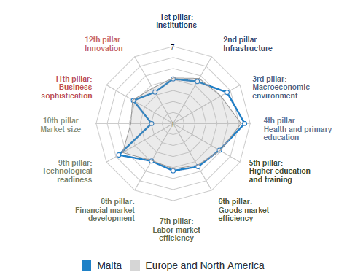
International Attestations
Global Competitiveness Index 2017 – 2018

Slide 16
Key Thrusts Going Forward

Slide 17
Context - Challenges that need to be managed
1. Human Resources
Industry needs to be much more dynamic in working closely with education service providers to tailor bespoke programs
An efficient process needs to be in place when recruiting foreign nationals, particularly when attracting non-EU nationals
2. Efficiency and Responsiveness
Increased industry engagement with the banking sector and the Malta Financial Services Authority to ensure we remain nimble and agile in servicing the growth of the industry
3. Innovation
Stronger industry engagement with regulator and policy makers to induce financial services innovation through our legal and regulatory frameworks
4. International Media
  Facilitate a three pronged Political, Regulatory and Industry PR outreach program to support key initiatives in mainstream communication channels

Slide 18
Context - Creating and Exploiting Opportunities
Distributed Ledger Technology
- ensure the presence of a supportive operational infrastructure
2. Innovation through Regulation - What next?
- opportunities in existing mainstream sectors should remain in focus and ownership duly assigned
3. Strengthen International Communications Program
- intensify outreach program to the existing and new markets

Slide 19
FinanceMalta - 5 Key Thrusts FY 2018
Sustain initiatives in support of the mainstream sectors and the new DLT Sector
Further strengthen Malta’s visibility in relatively new markets
  US - New York
  Gulf - Abu Dhabi and Dubai
  Asia - Hong Kong, Singapore and China (Shanghai)
Public Relations - International PR Strategy to further support initiatives in mainstream communication channels
Leverage Digital Marketing
Innovation – foster increased engagement between the industry, regulator and policy makers

Slide 20
Acknowledgements
Sponsors – Thomson Reuters and Castille
Speakers for today’s conference
Government of Malta, House of Parliament, the Malta Financial Services Authority and the Malta Stock Exchange
Members - Industry Practitioners and Operators
Board, Management & Staff at FinanceMalta
Special Mention – Professor JV Bannister
Notes:
Wish you all an enjoyable and thought provoking conference.

Slide 21
Thank You
Notes:
Fruitful Conference

