Slide 1


Malta’s Financial Services
Industy
July 2026

Slide 2








Malta | An Overview
Population & Area
EU Member State
Currency
Population: 588,254 (2025)
Area: 316 sq.km
Malta joined the EU in 2004 and is part of the Schengen area.
On 1 January 2008, the Euro became legal tender in Malta.
Official Languages
Double Taxation Agreements
Time Zone
Malta has two official languages: Maltese and English.
Malta offers an OECD and EU-approved fiscal framework and has a network of around 80 DTAs.
Central European Time (CET).
Notes:
Malta | An Overview - Notes
•Population (National Statistics Office: 2023) & Area
•EU membership
•Currency
•Official languages
•Double taxation agreements
•Time zone
All figures correct as at July 2023 unless otherwise indicated.
Malta currently has a population of nearly 550,000, living in an area of 316 square kilometres.
It became a member of the European Union in 2004, and just four years later, adopted the Euro as its currency in one of the most seamless transitions of any Member State.
It is very proud to have its own language – which has Semitic roots – but it also has English as an official language, with all the benefits that this brings to a cosmopolitan country in a globalised age. Even its legislation is available in both languages.
It has always been aware of its international role and has a taxation regime which was approved by both the OECD and the EU. It also has double taxation agreements with over 70 countries.
Sources:
https://nso.gov.mt/ - NSO
Double Taxation Conventions (gov.mt)

Slide 3

Malta’s Value Proposition
Picture: The Parliament of Malta

Slide 4





Malta’s Sovereign Rating
“A+” with a Stable outlook
'A-' with a Stable Outlook
(September 2025)
(December 2024)
'A2' with a Stable Outlook
'A (high)' with a Stable Trend
(November 2024)
(April 2026)
Notes:
Malta’s Sovereign Ratings - Notes
Credit rating agencies and their ratings:
•Fitch – March 2025
•Standard and Poor’s – December 2024
•DBRS MorningStar – April 2025
•Moody’s – November 2024
Sources:
Malta-Credit-Ratings.pdf (gov.mt)
•https://www.fitchratings.com/entity/malta-80442237 - Fitch ratings
•https://disclosure.spglobal.com/ratings/en/regulatory/org-details/sectorCode/SOV/entityId/128507 - Standard & Poor
•https://www.dbrsmorningstar.com/issuers/20626/malta-republic-of - DBRS Morningstar
•https://www.moodys.com/credit-ratings/Malta-Government-of-credit-rating-600012947 - Moodys
Rating agencies have maintained an ‘A’ rating for the island – A+ and A (high) in two instances – always with a stable outlook.

Slide 5




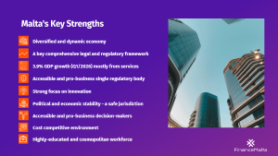
Malta's Key Strengths
Diversified and dynamic economy
A key comprehensive legal and regulatory framework
3.9% GDP growth (Q1/2026) mostly from services
Accessible and pro-business single regulatory body
Strong focus on innovation
Political and economic stability - a safe jurisdiction
Accessible and pro-business decision-makers
Cost competitive environment
Highly-educated and cosmopolitan workforce
Notes:
Malta’s Key Strengths - Notes
•Summary of economic strengths, regulatory framework, stability, cost-competitive environment, and educated/cosmopolitan human resources
•9.4% nominal GDP growth (Economic-Update-3-2025.pdf). CBM reported 6% real GDP increase in 2024. NSO – Q4/2024: 2.8% increase in volume terms.
Malta has had a democratically elected government since it became independent in 1964. It has two political parties in the House of Representatives. The country is also divided into councils which administer their respective localities.
The economy of the country has evolved as the country’s realities changed. The income derived from the British services until 1979 were replaced by income from tourism and manufacturing, with the EU bringing free trade which spurred the country to move to higher-value-added manufacturing – such as pharmaceuticals – as well as to develop a strong services offering, including financial services and gaming. This was complemented by the creation of a robust legislative framework aligned with that of the EU, and by regulators that have adopted a comprehensive approach to balance supervision and enforcement.
At the time it joined the EU, Malta had a below-average purchasing power compared with other member states but has since achieved and maintained an above-average PP as well as steady economic growth.
This has been sustained by an influx of employees from around the world, as well as by dramatically improving the country’s female participation rate, through a number of policy measures including free child care.

Slide 6


Not only business
Millenia of history and heritage
Central location between Europe and North Africa
Mediterranean lifestyle
Comprehensive health system
Diverse educational offering
Extensive flight network
Thriving cruise port
Notes:
Not Only Business – Notes
•Summary of lifestyle in Malta, including culture, location, health and education, as well as connectivity by air and sea
Being at the centre of the Mediterranean has shaped Maltese culture. Its weather enables an outdoor life, with regular cultural events covering all the performing arts with international names – as well as local events such as fireworks and feasts. The full-time working week is 40 hours long with 14 national holidays and 200 hours of vacation leave. Lifestyle is boosted by various sports, restaurants – with a number of Michelin stars – and an active nightife.
Education is mandatory till age 16, offered via free State schools, church-run schools and private schools. There are various options for post-secondary and tertiary education, including international schools and universities to cater for the expatriate population.
The country has free health services for eligible residents, as well as private hospitals and clinics.
Malta is connected by fast ferry to Sicily, while Malta International Airport has 26 partner airlines, which keep it connected to over 35 countries. Around 8.45 million passenger movements are forecast for 2024.
Sources:
Facts and Figures | Malta International Airport - Malta International Airport (maltairport.com)

Slide 7




Building on a solid foundation to define a new direction for the future
Ground-breaking legislation
Robust regulatory framework Infrastructure
A joint effort between all stakeholders
Constantly seeking responsible growth in this sector
A regulatory regime ensuring consumer protection without stifling innovation.
The country is focused on being an attractive and effective domicile across multiple verticals in financial services.
Notes:
Section 2: Financial Services Sector
Financial Services: An Overview – Notes
•Legislative and regulatory framework, coordinated approach across stakeholders; vision for the future based on ‘responsible growth’
The financial services sector was created with bipartisan parliamentary support, which enabled it to grow steadily – and relatively fast. Apart from the number of operators, ancillary services have grown in tandem, from auditors and legal
companies to consultancy firms.
The regulator for financial services is the Malta Financial Services Authority, set up in 2002, which employs some 400 people. It operates in close collaboration with the European Supervisory Authorities.
There is also a very active Stock Exchange, as well as the Central Bank of Malta which looks after monetary policy among other things.
Sources:
www.mfsa.mt

Slide 8








Building on a solid foundation to define a new direction for the future
INVESTMENT FUNDS & ASSET MANAGEMENT
CREDIT & FINANCIAL INSTITUTIONS
INSURANCE & REINSURANCE
AIRCRAFT
LEASING
FAMILY OFFICES & PRIVATE WEALTH
FINTECH & AI
CAPITAL
MARKETS
SUSTAINABLE
FINANCE
Notes:
Main Financial Sectors – Notes
Sectors:
·Investment Funds and Asset Management
·Credit and Financial Institutions
·Insurance and Reinsurance
·Family Offices and Private Wealth
·FinTech
·Capital Markets
There are over 2,359 authorised entities spread across the sectors, with innovation and digitisation becoming the main thrusts for the future. The MFSA’s strategy is based on a risk-based approach to supervision.
Sustainable finance and ESG are actively promoted – in line with regulatory guidelines.
Sources:
Authorised Persons Report Q3 2024 (MFSA)

Slide 9





+3.9%
GDP Growth
NSO Q1/2026
3.5%
Unemployment Rate
NSO May 2026
22nd
Ranked in Global Talent Competitivness Index 2025
A small country punching above its weight
World Economic Forum
32nd
Global Financial Centres
The Smart Centres Index 12 Report. Published by Z/Yen Group December 2025.
7th
Regulated FinTechs in EEA
Fintech Ireland – September 2025
Notes:
-Real GDP Growth (National Statistics Office)
-Unemployment rate (NSO February 2025)
-
Global Performance Benchmarks – Notes
There are a number of respected indices, including those published by McKinsey and Z/Yen Group, which cover not only Malta as a jurisdiction but also its performance in specific areas like FinTech. This is a competitive sphere and Malta is kept constantly on its toes, as other jurisdictions push themselves in tandem.
Sources:
Global Talent Competitiveness Index | INSEAD
SCI_10_Report_2024.11.26_v1.0.pdf (longfinance.net)2023

Slide 10



Sectorial Facts and Figures
7.3%
Financial Services Sector contribution to total GVA in 2025
+3.7%
Total GVA growth Q1 2025/2026 (NSO)
One of the few sectors to record growth during the pandemic, highlighting its resilience
9%%
Change in Financial Services/Insurance GVA: Q1 2025/2026 (NSO)
2,462
Authorised Entities (Q1/2026)
*Sources: Malta Financial Services Authority and National Statistics Office (2024/5) and Pre-Budget Consultation Document 2025
Notes:
GVA Chain Linked volumes from National Statistics Office

Slide 11
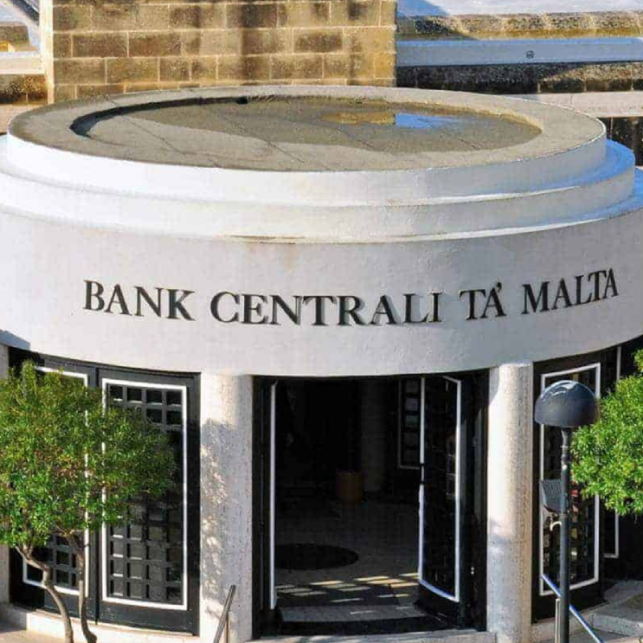



Sectorial Facts and Figures
18,858
Employees working in the financial services sector (Q1/2026)
235
CSPs (Q1 2026)
78
Financial Institutions (Q1 2026)
19
Credit Institutions (Q1 2026)
17
VFASPs (Q1 2026)
*Sources: Malta Financial Services Authority (Q1/2026) and National Statistics Office
Notes:
4 companies have a mica licence so far with a steady number of applications in the pipeline

Slide 12








Sectorial Facts and Figures
133
Trustees and fiduciary services (Q1 2026)
69
Insurance and re-insurance companies (Q1 2026)
67
Insurance intermediaries (Q1 2026)
230
Collective Investment Schemes + 463 sub-funds (Q1 2026)
80
Investment Firms (Q1 2026)
13
Fund Administrators (Q1 2026)
Sources: Malta Financial Services Authority and National Statistics Office

Slide 13









Malta’s Financial Services History
1994
Overhaul of Malta’s financial, legal and regulatory framework. ‘Onshore Malta’ response to globalisation & future EU membership.
2004
2023
EU Membership: Malta’s legal and regulatory framework aligned with EU standards.
The launch of the National Strategy for Financial Services, prepared by the Malta Financial Services Advisory Council (MFSAC).
1988
2002
2008
Malta Vision 2050
Introduction of international corporate & trusts legislation.
Malta Financial Services Authority established as regulator of the financial services sector, with bipartisan support.
Adoption of the Euro.
Financial services industry seen as a strong economic enabler.
Notes:
Malta’s Financial Services History – Notes
•Timeline of key milestones for the sector
-1988 International Corporate and trusts legislation
-1994 Move to ‘onshore’ framework
-2002 MFSA established
-2004 EU membership
-2008 Euro adoption
-2023 Launch of National Financial Services Strategy
-Future outlook
Within six years of its innovative financial services legislation in 1988, Malta placed itself as an onshore jurisdiction.
Joining the EU and then the eurozone was an important step for the country, enabling it to align its legislation with that of the other Member States, as well as to join the European Supervisory Authorities – all of which allowed Malta to gain relevance in spite of its size.
It is now looking ahead to ensure that it remains relevant in an age of disruption, innovation and digitisation. This prompted a holistic review of the current status of the financial services sector, as well as prioritising a comprehensive vision for the future.

Slide 14




Malta adopts multi-year strategy for financial services
The Malta Financial Services Advisory Council (MFSAC) Strategy For Financial Services. Published in 2023.
Prepared by the industry and backed by the Government of Malta
Key Drivers behind the strategy:
Speed
Standards
Simplification
Specialisation
Sustainability
Action points will tackle sector from legislation to innovation
Notes:
Section 3: National Financial Services Strategy
MFSAC Strategy – Notes
Malta adopts multi-year strategy for financial services, drawn up by the Malta Financial Services Advisory Council
•Five key drivers:
-Speed
-Standards
-Simplification
-Specialisation
-Sustainability
-
•175 action points
The Government set up the Malta Financial Services Advisory Council in 2021, bringing together the Government, regulators and private operators to come up with a coherent strategy for the coming years. The unprecedented consultation process brought together around 100 people, resulting in a document with 175 action points, from quick wins to longer-term evolutionary changes. The Council is monitoring the project closely to ensure that deadlines are met and to assist with any matters arising.

Slide 15






Six strategic objectives guide the implementation plan and the core transformational initiatives
STREAMLINE REGULATION
STANDARDISE PAYMENTS
CONSOLIDATE IDENTITY
MODERNISE TAXATION
REFORM
FINANCIAL LAW
BUILD
TALENT
Notes:
MFSAC Strategy – Notes
•Six Strategic Objectives
-Streamline regulation
-Standardise payments
-Consolidate identity
-Modernise taxation
-Reform financial law
-Build talent
The project was split into six strategic objectives, some of which require legislative changes, others which require action across various supporting areas, such as education and upskilling. The fact that the strategy was drawn up following such wide consultation means that it has the support required to mobilise the island and make the changes required.

Slide 16
Core focus areas
CENTRALIZED IDENTITIY MANAGEMENT
REGULATORY PROCESS INTEGRATION AND DIGITISATION
LAW REFORM AND HARMONISATION
Transformational Initiatives
DIGITAL PAYMENTS HUB
Transformational Initiatives
FINTECH &
AI
AIRCRAFT LEASING
FAMILY OFFICES
EMPLOYER PENSIONS
HUMAN RESOURCES AND EDUCATION
SUSTAINABLE FINANCE
Transformational Initiatives
TAXATION
Notes:
MFSAC Strategy – Notes
•Core Focus Areas:
•Transformation Initiatives:
oCentralised Identity Management
oDigital Payments Hub
oRegulatory Process Integration and Digitisation
oLaw reform and harmonisation
•New opportunity areas
oFinTech
oAircraft leasing
oFamily Offices
oEmployer pensions
•Supporting requirements
oTaxation
oHuman resources and education
oSustainable finance
The action points can be grouped into transformation initiatives for existing platforms, new opportunity areas for the country to consider, and supporting requirements to improve existing infrastructure.

Slide 17




About FinanceMalta
FinanceMalta is the public-private initiative set up to promote Malta as an International Financial Centre.
A member-based foundation with around 330 member firms.
Over 102,000 interactions via social media and website, and participation in 60 events in 2025
Mission
"To increase the visibility of Malta as an International Financial Centre, thereby enhancing business opportunities for our members by which the industry can sustain its growth traction."
Notes:
About FinanceMalta – Notes
•History and main metrics
•Founded in 2007
•Participated in 37 events in 2024
•98,000 content-related actions
Promotion of financial services is left to FinanceMalta, a public-private partnership which has been active for 15 years. Apart from participation in local and international events – 35 last year alone – it is also very active on social media and via its own website, ensuring that the key messages are disseminated to as wide an audience as possible

