Slide 1

School Leadership Team Meeting
SLT MONTHLY MEETING
DISTRICT 27Q319 • VILLAGE ACADEMY
OFFICIAL GOVERNANCE SESSION
School Leadership Team Meeting
The Revised Chancellor’s Regulation A-655
DATE & TIME
October 21, 2026 | 4:00 – 7:00 PM
ATTENDANCE & REGISTRATION
LOCATION
Sign in using Google Form
Virtual Zoom Conference

Slide 2

Monthly SLT Meeting Agenda
VILLAGE ACADEMY
Date: October 21, 2026 | Location: Virtual (Zoom)
4:00 PM
Call to Order & Roll Call
15 mins
4:15 PM
Quorum Verification; Review and Approval of Minutes
15 mins
4:30 PM
Revised Chancellor's Regulation A-655 Training (Includes 3 Activities)
90 mins
6:00 PM
Bylaws Amendment
30 mins
6:30 PM
VA Upcoming Events
15 mins
6:45 PM
Public Comments
15 mins
7:00 PM
Adjournment

Slide 3



Welcome & Administrative Setup
1. Member Introductions
2. Quorum Verification
3. Minutes Approval
Round-robin introductions across parent, teacher, and administrative constituencies.
Recording Secretary verifies core and elected member attendance for decision power.
Review, motion, and vote to approve official session minutes from prior meeting.

Slide 4
VILLAGE ACADEMY SLT
September 2026 SLT Minutes Review
September 22, 2026 • 4:30 PM – 7:00 PM • Quorum Confirmed • Previous Minutes Approved
Meeting Agenda
4:30 - 4:45
Welcome & Governance
4:45 - 5:25
Instructional Priorities
5:25 - 6:05
CEP Goals & Strategic Planning
6:15 - 6:35
Community Engagement & Operations
6:35 - 7:00
Next Steps & Outcomes
gavel
school
track_changes
Governance
Quorum verified
Previous minutes approved
Instructional Focus
Danielson 1e
Danielson 3c
Student discourse
Thinking routines
Small-group instruction
Strategic Planning
CEP goals reviewed
Attendance initiatives
Family engagement
Event planning

Slide 5
ACADEMIC & STRATEGIC DASHBOARD
Instructional Priorities & CEP Dashboard
Session Time: 4:45 PM – 6:05 PM • Key Goals, Workload Standards & Quarterly Milestones
school
Instructional Priorities
track_changes
CEP Goals
assignment
Workload & Roadmap
Danielson 1e: Designing Coherent Instruction
Purposeful lesson design
Alignment to standards
Coherent instructional planning
Danielson 3c: Engaging Students
Student discourse
Academic conversations
Student-centered learning
Thinking Routines
Visible thinking
Reflection
Small-Group Instruction
Targeted intervention
Differentiation
ELA Goal 46% → 60%
Math Goal 62% → 75%
Survey Growth 70% → 85%
Credits Attainment 37% → 60%
Chronic Absenteeism 41% → 25%
SWD Goal Attainment 75% → 85%
Student Workload Expectations
45+ min reading
10+ min XtraMath
2 i-Ready lessons
1 humanities writing assignment
Quarterly Diagnostic & Supports
Q1 Diagnostic Analysis
Q2 Attendance & Family Incentives
Q3 ICT/SWD Supports

Slide 6
COMMUNITY & OPERATIONS
Community Engagement, Operations & Outcomes
Session Time: 6:15 PM – 7:00 PM • Events, Operational Updates & Key Decisions
event
Community Events
settings
Operations & Decisions
task_alt
Meeting Outcomes
September Events
Curriculum Night
Hispanic Heritage Dress Down Day
PTA Meeting
October Events
Virtual Cooking Class
Poetry Contest Deadline
Schoolwide Read Aloud
Student vs. Staff Soccer Game
Family Movie Night (Encanto)
Everybody Eats Rice Potluck
Operational Updates
Volunteer staffing confirmed
Family outreach reviewed
Event logistics discussed
Community participation expectations established
Decisions
Maintain CEP targets
Continue emphasis on student discourse
Continue implementation of thinking routines
Expand family engagement opportunities
Quorum confirmed
Previous meeting minutes approved
Adjourned at 7:00 PM

Slide 7
GOVERNANCE & CULTURE
SLT Operating Norms
1
Start and End on Time • Big Picture Focus
Respect schedules and prioritize high-level strategic goals over minor details.
2
Assume Positive Intent
Trust that every member contributes with good intentions and shared commitment.
3
Keep Feedback Student-Centered
Anchor all discussions directly around scholar growth, well-being, and achievement.
4
Equity of Voice & Strive for Consensus
Ensure equal space for all perspectives and work toward shared solutions.

Slide 8



5 -Minute Health & Screen Break
Please step away, stretch, and refresh. Get any items that will support your comfort for the next 90 minutes.

Slide 9
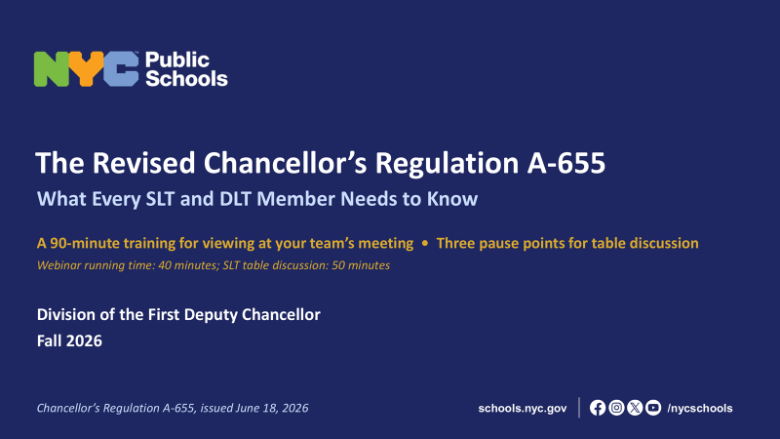

Slide 10
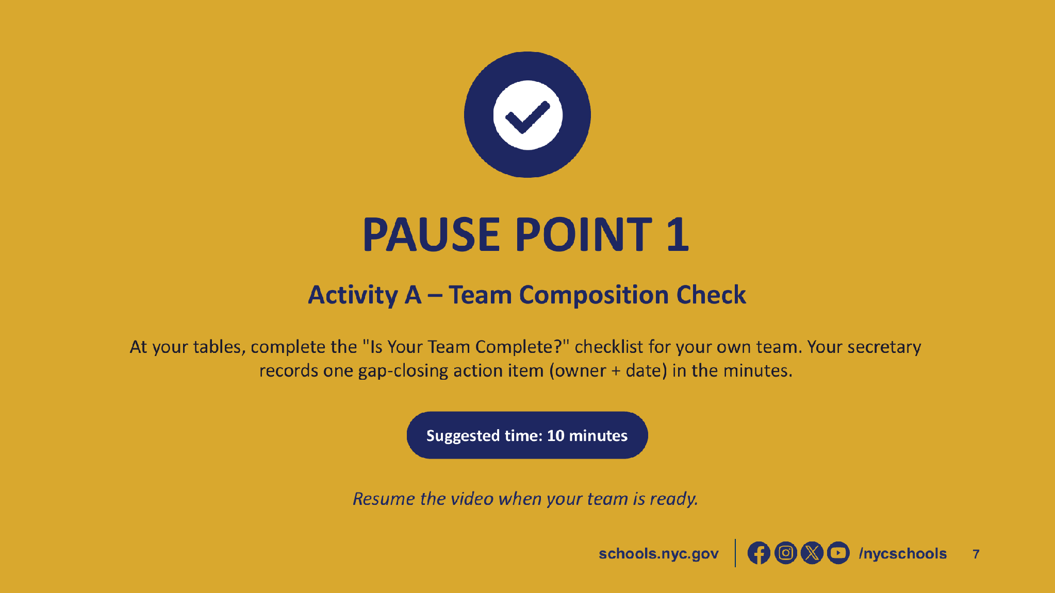
CR A655 - Activity A -SLT Composition Checklist

Slide 11
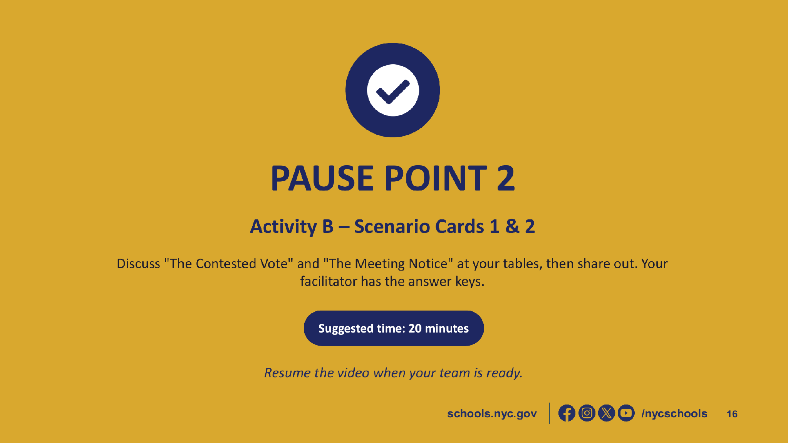
CR A655 - Activity B - Scenario Card Set

Slide 12
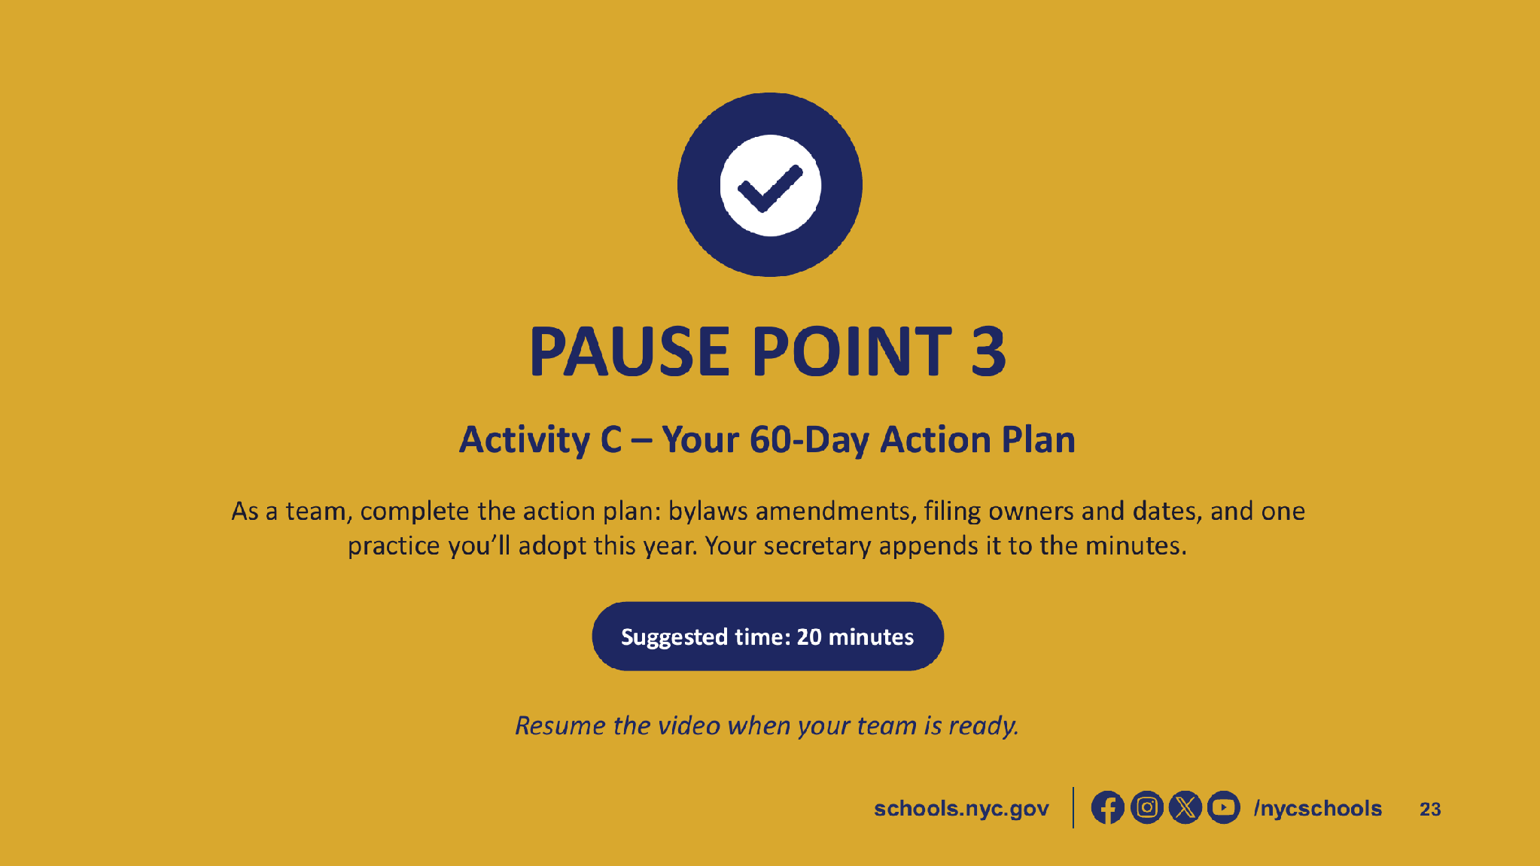
CR A655 -Activity C.1 - SLT 60-Day Action Plan
CR A655 - Activity C.2 - SLT Bylaws Required-Topics Checklist

Slide 13
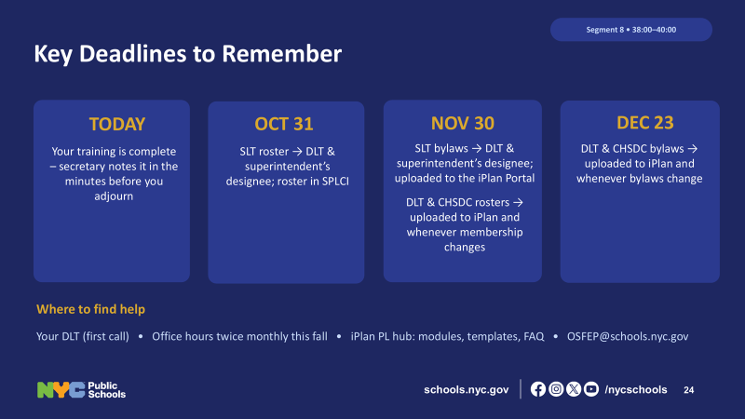

Slide 14
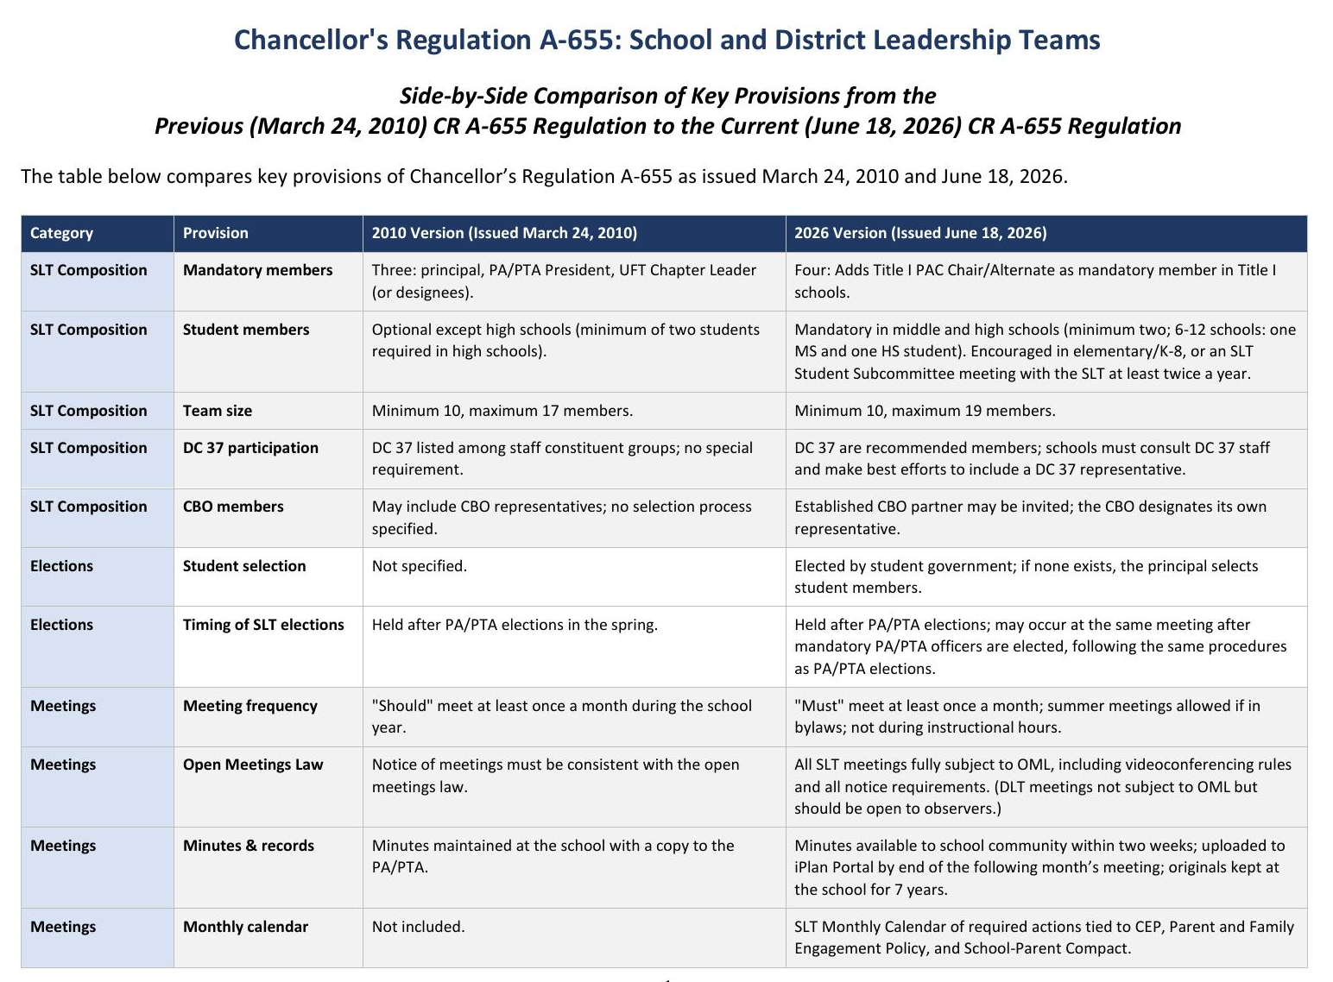

Slide 15
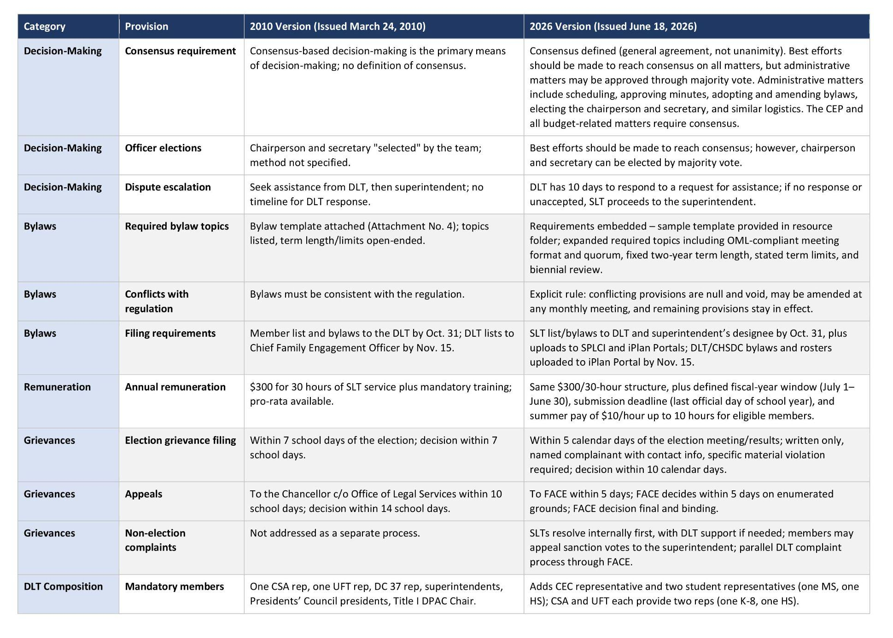

Slide 16
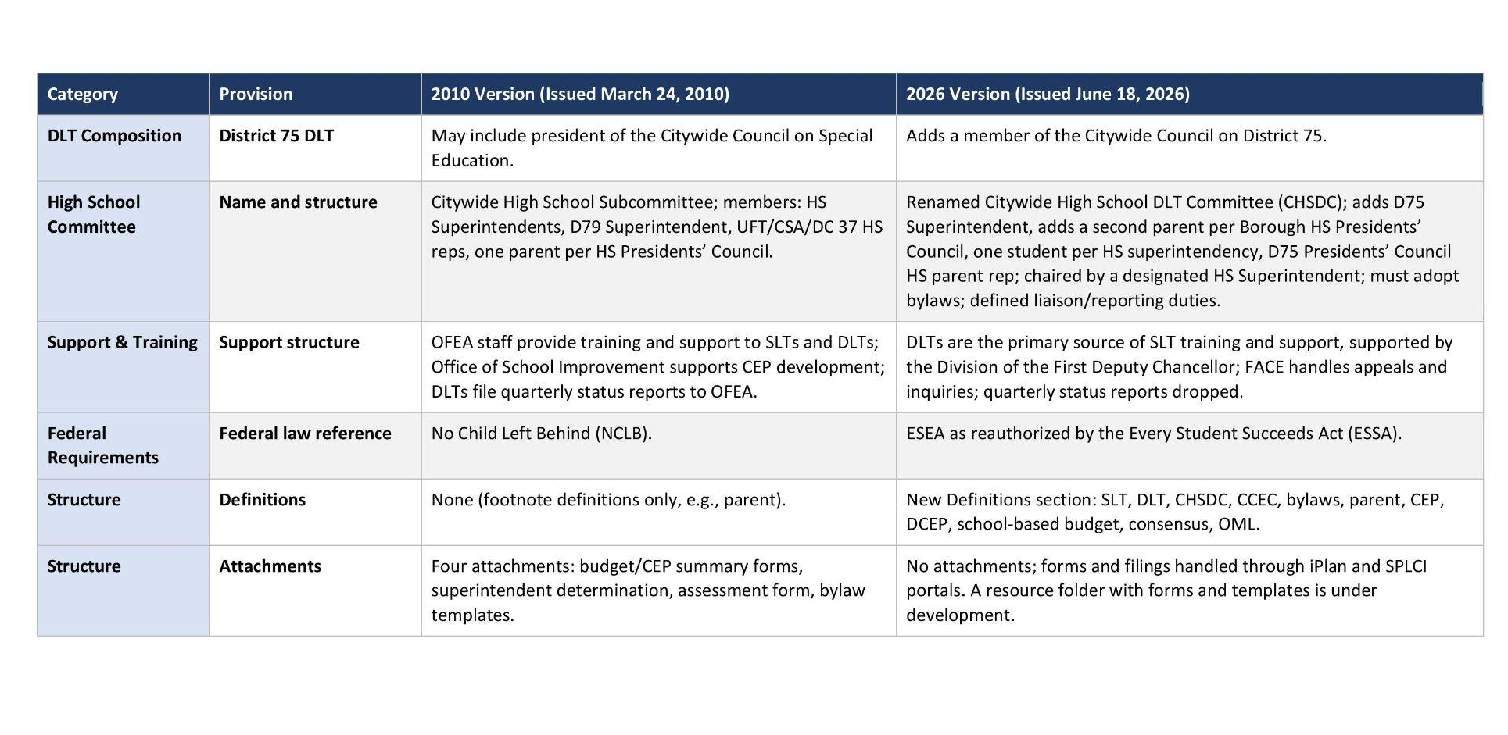

Slide 17




VA SLT Bylaws
CHANCELLOR'S REGULATION A-655
SLT Bylaw Mandates
Mandatory Roles
Meeting Cadence
Composition
Core Operations
10–19 members with strict parent-staff parity.
Rules for elections, term limits, and attendance.
Principal, UFT Leader, and PTA President required.
Minimum 10 meetings annually with recorded minutes.

Slide 18


Events @ Village Academy

Slide 19



Slide 20



Slide 21
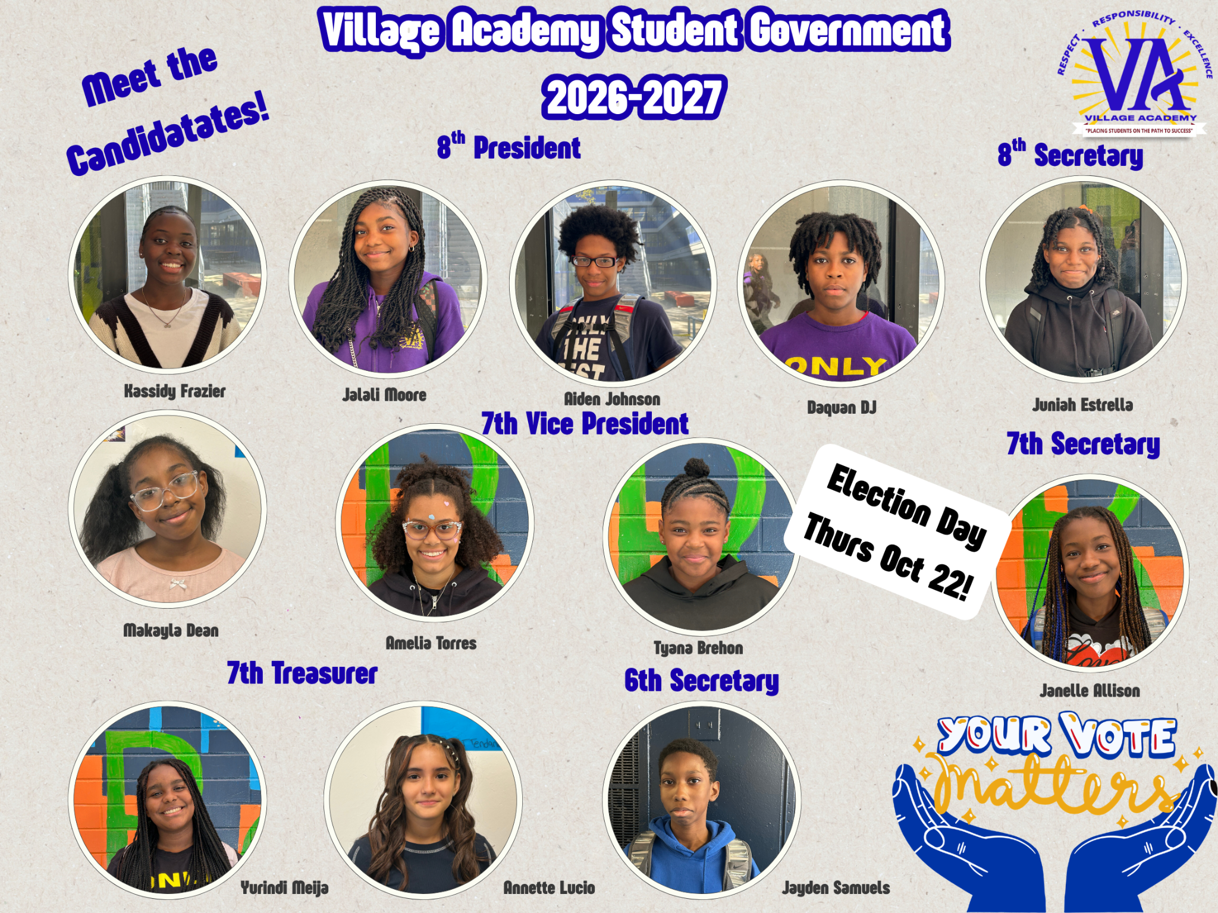

Slide 22



Slide 23
New Business & Open Forum
Public Comment Guidelines
Discussion Prompts
Open floor for visiting parents, staff, and community members. Speakers are allotted 2 minutes each to raise topics or share reflections.
1. Community Partnerships: Are there local events or partnerships members would like to share?
2. Emerging Priorities: Are there new parent concerns or trends that should be tabled for next month?
Digital Parking Lot Review
Reviewing unresolved questions submitted via attendance form.
RECORDED IN OFFICIAL MINUTES

