Slide 1



Greater Manchester VCFSE Accord Refresh:
Emerging Themes
As at 7th August 2025
Notes:
This slide deck will be refreshed and published on a regular basis.

Slide 2

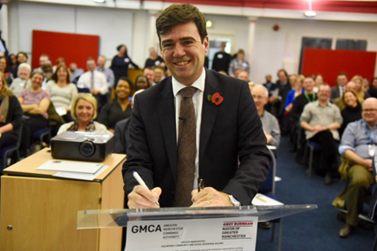
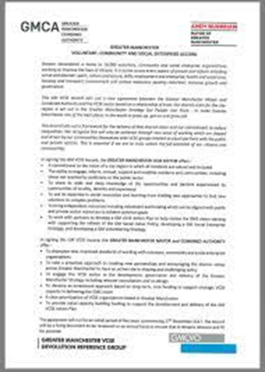
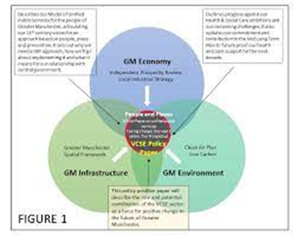



An agreement for how the Voluntary, Community, Faith and Social Enterprise (VCFSE) sector works together with the public sector to improve outcomes for Greater Manchester’s communities and citizens.
About: Greater Manchester VCFSE Accord
It’s a collaboration agreement between the Mayor of Greater Manchester, Combined Authority and the Greater Manchester Integrated Care System and the VCFSE sector based on a relationship of trust.
Formally approved by the GMCA, NHS and all 10 Local Authorities individually.
It’s delivered through:
  A shared understanding of the contribution that VCSE organisations make
  By building effective partnerships and relationships between the statutory sector and VCFSE
  Through a 5-year iterative programme of enabling work driven at a GM-wide footprint, which aims to maximise the ability of VCFSE organisations to achieve better outcomes.
The agreement so far
An agreement has been in place since September 2021.
It’s built from early collaboration with the VCFSE sector during the creation of GMCA in 2016 & 2017 Memorandum of Understanding.

Slide 3




Current context
Refreshed Greater Manchester Strategy (GMS)
NHS 10-year plan
GM Integrated Settlement
GM VCFSE Manifesto 2024-28 (see next slide)
GM Live Well
VCFSE Strategies in each of the 10 local GM boroughs

Slide 4
GM VCFSE Manifesto 2024-28
Continue to embed VCFSE sector as an equal partner
Listening city region
Embed VCFSE in public service delivery
Building caring, resilient communities
A ‘community wealth’ city region
Champion and value our workforce
Key policy areas
arts and culture;
green communities;
homelessness and planning;
refugees, asylum seekers & people subject to immigration control.
Read the full manifesto here: GM VCFSE Manifesto 2024-28

Slide 5
Scope of Refresh
These are the three areas which we are looking to develop through this consultation/ engagement process.
1. Values & Principles (agreement)
2. Taking action (implementation)
3. GM-level Transformational Projects

Slide 6

Early Conversations
Apr-Jul 2025
Dedicated meetings & agenda items Apr-Jul have explored emerging lines of enquiry & early thinking around a refreshed Accord’s purpose and scope
30th April Accord Commitment Delivery Group Q4 Meeting
19th May GMCA policy team meeting
2nd June Early Commissioner Meeting
11th June Accord Grant Leads Meeting
12th June GM=EqAl Away Day
18th Jun In-person VCFSE Leadership Group Meeting
23rd June Accord Away Day
24th June GM=EqAl Working Group Meeting
7th July GMCA Strategic Advisor Meeting
9th July Accord Grant Leads Meeting
29th July Online GM VCFSE Leadership Group Meeting
Please contact Anna Cooper at VSNW anna.cooper@vsnw.org.uk to organise any future conversations or input from now – End of October.

Slide 7

Methodology for the Accord refresh
The slides from this point are based on feedback from conversations so far.
A report on the existing intelligence and strategic context for the Accord refresh (lessons from list on slide 3) - will be published end of August.
See approach, rationale and structure document for full detail and engagement plans.
Please contact Anna Cooper at VSNW anna.cooper@vsnw.org.uk to organise any future conversations or input from now – End of October

Slide 8

An online platform to share your thoughts is accessible here.
Survey version here.
Get in touch if there is an alternative way you would like to feed in.

Slide 9
How long should the agreement last for?
Previous agreement was 5 years, with 3-year delivery plan refreshed in 2023.
Potential to be 10 years to align with Greater Manchester Strategy and NHS 10 Year Plan?

Slide 10
Which other partners might be included in an agreement?
Universities
NHS Trusts – especially via commissioning risk in 10y NHS plan
Community health organisations
Other public sector organisations…
Fire and Rescue
Police

Slide 11
1. A new Accord Agreement
For the public sector and VCFSE sector to work together in Greater Manchester in a relationship of trust, which has been jointly developed and endorsed, and contains shared purpose, principles/commitments, and values.

Slide 12
Values & Principles:
What are the values and principles we want to underpin the agreement?
Being authentic, transparent, and accountable – real data, honesty and learning from mistakes together
Integrity, trust and respect
Equity and genuinely devolving power – ensuring that the most excluded are centred
Putting people and communities first, with an asset-based approach
Devolution of power, equity and involvement – shift decision-making and resources
Partners are resourced to act – commitment to investment and joint working
Genuine co-production with local people, as active participants in shaping their future
Courage and Leadership
Valuing the VCFSE sector, the ecosystem and roles of different types of VCFSE organisations not just public service delivery, but voice, leadership, and change, infrastructure role in link to grassroots, equality orgs addressing structural inequity
Lived experience and intersectional perspectives paramount

Slide 13
2. A clear and agreed implementation methodology for the GM VCFSE Accord
A description of the approach that will be taken by all partners (VCFSE and public) in the Accord Agreement towards the implementation of the principles /commitments and values it contains – at a GM-wide, locality and individual organisation footprint.

Slide 14
    Taking action:
    How might partners in the Accord demonstrate that they are taking action on the values, principles and commitments that it will contain?
Devolution of power, equity and involvement – genuine shift decision-making and resources
Improved public sector processes to align to the Accord values
Accountability mechanisms – a way to raise concerns when Accord values/principles are not upheld
Partners are resourced to act – commitment to investment and joint working
Turning values into practice – measurable impact and actions at all levels,
not just intention and words at strategic levels
Challenging outdated systems together – e.g. commissioning reform
Shared co-production and lived experience principles implemented
Transparency in where decisions are taken and who is making them
Fair Funding Protocol implemented across whole of GM
More investment in VCFSE control
Suggestion to make this into a checklist
Reporting by public sector in future
These should have measures/ metrics

Slide 15
Impactful changes:
What is the one change that would have the biggest impact for the VCFSE sector in 3-5 years?
Improved commissioning measure of Social Value that gives weight and recognition to inherent social value of VCFSE
Implementation of a Fair Funding Protocol across GM
Better use of Provider Selection Regime
More co-commissioning and grants
VCFSE trusted to manage funding and influence commissioning
Shift of resources to follow Live Well principles – e.g. number of Live Well Centres owned by VCFSE sector as a metric
A focus on social, economic, and environmental outcomes for citizens and communities, with the impact of people having greater control over their lives
Better embedding co-ops and inclusive economy into strategy
Not just increasing market share, but increasing pathway share
Equal commissioning voice for VCFSE organisations
More investment in VCFSE control
Devolution of power

Slide 16
Developing Headline ‘Areas of Change’:
These are intended to provide broad, memorable, and unifying headline priorities - streamlining the previous eight commitments into a more focused framework.
Involve and devolve
Fairly Fund
Partnership and recognition Transparency, consistency and integrated ways of working
Do you agree with these headers?

Slide 17
3. An agreed programme of work to be funded and delivered at a GM footprint
This will include a small number of ‘transformative projects’ best delivered at a GM footprint, achieved collaboratively by GMCA, local authorities, NHSGM and the VCFSE sector, aimed at removing barriers and enabling more effective partnership working.
This will be enabled through a long-term funding agreement aligned with the new Accord’s intentions provided by the Accord’s GM-level partners.

Slide 18
GM Transformational Projects:
What are the specific pieces of work we need to deliver that are coordinated at GM level? e.g. data & intelligence, influencing of GM systems
What is better driven at locality - or joined up/spread/shared?
“We need to do less to achieve more”
Influencing GM systems – specifically around Integrated Settlement, NHS 10 Year Plan, Live Well, Acute Trust direction of travel
Joint work to improve procurement processes, for example to improve the way the inherent social value of VCFSE organisations is recognised
Support to assist the collaboration of VCFSE providers to win contracts together
Better collection of insight & evidence, economic and other data for lobbying
Shared participatory approaches which include co-design and co-production - recognising the voice of lived experience
A diversity of strategic VCFSE representatives are respected, meaningfully invited, supported, and mapped
VCFSE sector leaders well briefed for influencing e.g., key message briefings
New public sector approach to equalities impact assessments using intersectional equity and inclusion organisations for consultancy and accountability
Influencing national policy together for the benefit of communities
“Must be impact led with measurable outcomes”

Slide 19

Do you agree with the feedback so far?
Share your views!

