Slide 1



Greater Manchester VCFSE Accord Refresh:
Emerging Themes - 16th Sept

Slide 2
Help shape a refreshed agreement to further develop how the voluntary, community, faith and social enterprise (VCFSE) sector and public sectors in Greater Manchester work together.
A consultation is currently open to shape how the public sector in GM and the VCFSE sector work together to improve outcomes for communities and citizens.
This consultation will feed into a refresh of the GM VCFSE Accord from 1st April 2026.

Slide 3
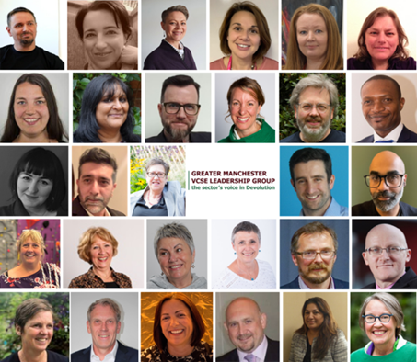
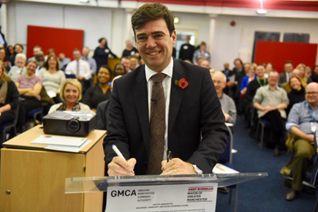
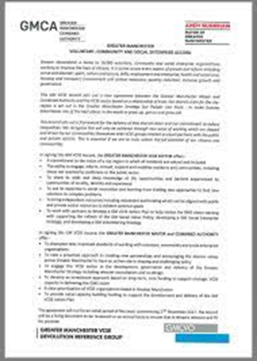
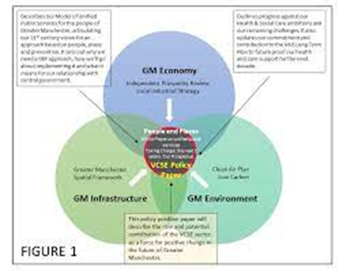



The Accord is an agreement for how the Voluntary, Community, Faith and Social Enterprise (VCFSE) sector works together with the public sector to improve outcomes for Greater Manchester’s communities and citizens.
The GM VCFSE Accord
It’s a collaboration agreement between the Mayor of Greater Manchester, Combined Authority and the Greater Manchester Integrated Care System and the VCFSE sector based on a relationship of trust.
Formally approved by the GMCA, NHS and all 10 Local Authorities individually.
It’s delivered through:
  A shared understanding of the contribution that VCSE organisations make
  By building effective partnerships and relationships between the statutory sector and VCFSE
  Through a 5-year iterative programme of enabling work driven at a GM-wide footprint, which aims to maximise the ability of VCFSE organisations to achieve better outcomes.
The agreement so far
An agreement has been in place since September 2021.
It’s built from early collaboration with the VCFSE sector during the creation of GMCA in 2016 & 2017 Memorandum of Understanding.

Slide 4




Context in which the Accord is being refreshed
As part of this process, we are synthesizing key messages from various relevant strategies, policies and programmes, to help shape the refreshed Accord. Below are just some of the list:
Greater Manchester Strategy (2025-2035)
NHS 10-year health plan for England
GM Integrated Settlement
GM VCFSE Manifesto 2024-28
GM Live Well
National Civil Society Covenant
Local VCFSE Strategies in each of the 10 boroughs
Notes:
Desktop research is being undertaken to synthesise the key messages from the strategies, programmes and policies that connect to and contextualise the Accord. The above is not the full list.
This will help ensure alignment, while also clarifying the Accord’s distinct role.
A new Accord can respond to these strategies whilst also acknowledging where it has informed some of them too

Slide 5

About: Consultation
August 2025 through October 2025.
There are multiple ways for individuals and organisations to share their thoughts:
An online survey
An online ‘mural’
Online workshop (30th September)
In-person workshop in Manchester (23rd October)
All the details of this consultation can be found online: www.vcfseleadershipgm.org.uk/news-and-events/accord-refresh

Slide 6
These are the three areas which are being looked at to develop through this consultation:
1. Values & Principles (the agreement)
2. Taking action (the implementation)
3. GM-level transformational projects (delivery)

Slide 7
1. A new Accord Agreement
This is an agreement for the public sector and VCFSE sector to work together in Greater Manchester in a relationship of trust, which has been jointly developed and endorsed, and contains shared purpose, principles/commitments, and values.

Slide 8
2. A clear and agreed implementation methodology for the GM VCFSE Accord
We need a description of the approach that will be taken by all partners (VCFSE and public sector) in the Accord Agreement towards the implementation of the principles /commitments and values it contains – at a GM-wide, locality and individual organisation footprint.

Slide 9
3. An agreed programme of work to be funded and delivered at a GM footprint
This will include a small number of ‘transformative projects’ best delivered at a GM footprint, achieved collaboratively by GMCA, local authorities, NHSGM and the VCFSE sector, aimed at removing barriers and enabling more effective partnership working.
This will be enabled through a long-term funding agreement aligned with the new Accord’s intentions provided by the Accord’s GM-level partners.

Slide 10
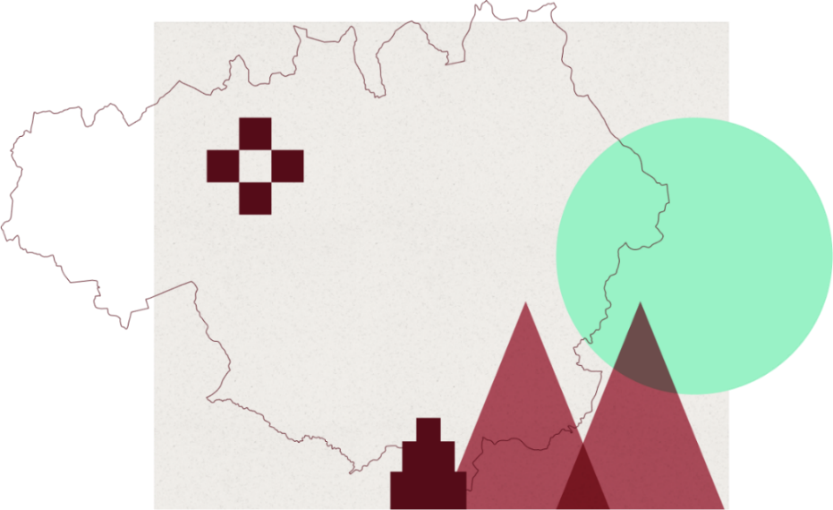
The slides from this point share the consultation questions and ask for your feedback.
They also highlight feedback from conversations so far as part of this consultation.

Slide 11
How long should an agreement run for?
The previous agreement was 5 years, with 3-year delivery plan refreshed in 2023.​
Engagement so far has suggested:
The agreement could be 10 years to align with Greater Manchester Strategy and NHS 10 Year Plan
If 10 years, there will need to be regular review points (e.g. every 3 years)
Agreement could be 10 years, implementation plans every 3 years

Slide 12
What do you think should be the overriding ambition for the GM VCFSE Accord?
Suggestions include:
Develop a shared understanding of where partners’ priorities align and differ, ensuring that resources are targeted effectively and used wisely.
Enable organisations to collaborate on an equal footing, driving change and making a meaningful difference to the lives of communities and citizens.
Champion a whole-system approach that strengthens the VCFSE ecosystem and improves outcomes for people and places across Greater Manchester.

Slide 13
Which other partners might be included in an agreement?
Suggestions include…
GM Universities
NHS Acute & Mental Health Trusts
Community health organisations
Fire & Rescue Service
GM Police
Probation & Prison Services
GM Housing Providers
Other public sector organisations…?

Slide 14
What are the values and principles you would want to see underpin VCFSE and public sector collaborative work?
Engagement so far has highlighted the following:
Being authentic, transparent, and accountable – real data, honesty and learning from mistakes together
Integrity, trust and respect
Equity and genuinely devolving power – ensuring that the most excluded are centred
Putting people and communities first, with an asset-based approach
Devolution of power, equity and involvement – shift decision-making and resources
Partners are resourced to act – commitment to investment and joint working
Genuine co-production with local people, as active participants in shaping their future
Courage and Leadership
Valuing the VCFSE sector, the ecosystem and roles of different types of VCFSE organisations not just public service delivery, but voice, leadership, and change, infrastructure role in link to grassroots, equality orgs addressing structural inequity
Lived experience and intersectional perspectives paramount

Slide 15
What are the values and principles we want to see underpin VCFSE and public sector collaborative work?
Do you agree that the values on the previous slides are the most important to underpin sector collaboration?
What else might be added to this list of values and principles?

Slide 16
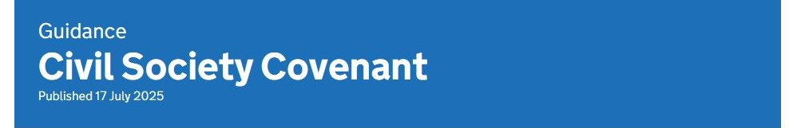
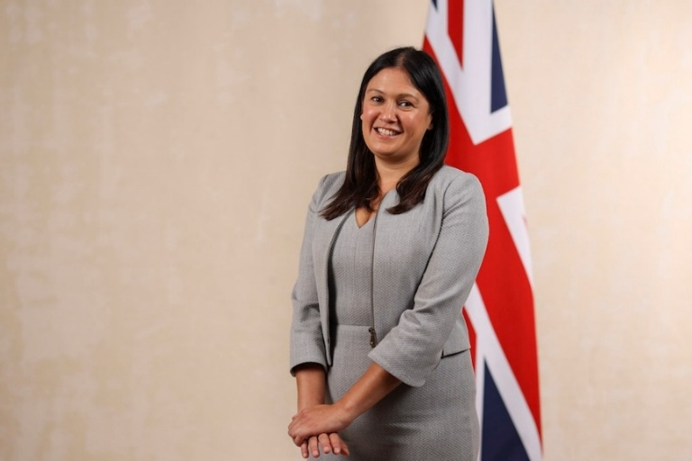
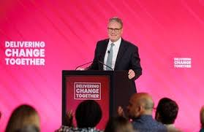
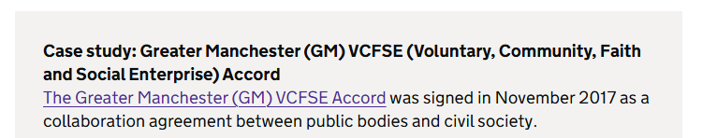
Civil Society Covenant
Published in July by the Government, the national Civil Society Covenant applies to all public bodies including strategic and local authorities, NHS Integrated Care Systems and the criminal justice system .
Recognition and value
  Respect for independence and legitimacy
  Recognition of value, role and different perspectives
  Understanding responsibilities and constraints
Partnership and collaboration
  Early, regular and ongoing engagement
  Creating the conditions for collaboration and innovation
  Addressing barriers to delivery in partnership
Participation and inclusion
  Enable diversity, equity and inclusion
  Engaging citizens and communities in decision making and delivery
  Removing barriers to active participation to build a healthy democracy and community resilience
Transparency and data
  Engage in open, honest and transparent communication
  Make evidence and data publicly available
  Improve data development
The Covenant cites the GM VCFSE Accord as its first case study

Slide 17
Discuss:
Do you agree that the Accord should be Greater Manchester’s Civil Society Covenant?

Slide 18
    How might partners in the Accord demonstrate that they are taking action on the values, principles and commitments that it will contain?
Engagement so far has suggested the following:
Devolution of power, equity and involvement – genuine shift decision-making and resources
Improved public sector processes to align to the Accord values
Accountability mechanisms – a way to raise concerns when Accord values/principles are not upheld
Partners are resourced to act – commitment to investment and joint working
Turning values into practice – measurable impact and actions at all levels,
not just intention and words at strategic levels
Challenging outdated systems together – e.g. commissioning reform
Shared co-production and lived experience principles implemented
Transparency in where decisions are taken and who is making them
Fair Funding Protocol implemented across whole of GM
More investment in VCFSE control
Anything else?
How could this be measured / reported on?

Slide 19
What is the one commitment to change we could make together that would have the biggest impact for the VCFSE sector over the next 3 to 5 years?
Engagement so far has suggested the following:
Improved commissioning measure of Social Value that gives weight and recognition to inherent social value of VCFSE
Implementation of a Fair Funding Protocol across GM
Better use of Provider Selection Regime
More co-commissioning and grants
VCFSE trusted to manage funding and influence commissioning
Shift of resources to follow Live Well principles – e.g. number of Live Well Centres owned by VCFSE sector as a metric
A focus on social, economic, and environmental outcomes for citizens and communities, with the impact of people having greater control over their lives
Better embedding co-ops and inclusive economy into strategy
Not just increasing market share, but increasing pathway share
Equal commissioning voice for VCFSE organisations
More investment in VCFSE control
Devolution of power
What else?

Slide 20
Discuss:
How might partners in the Accord demonstrate that they are taking action on the values, principles and commitments that it will contain?
What sector or type of organisation do you represent, and what do you think your role is in relation to the Accord?

Slide 21
Developing ‘Areas of Change’
These are intended to provide broad, memorable, and unifying headline - streamlining the current Accord which has eight commitments into a more focused framework.
Engagement so far has suggested the following:
Is anything missing?
Are these broadly the right areas within which systems and relationships must evolve and develop?
Involve and devolve
Fairly Fund
Partnership and recognition
Transparent, consistent & integrated ways of working

Slide 22
What are the specific pieces of work we need to deliver that are coordinated at GM level? e.g. data & intelligence, influencing of GM systems
What is better driven at locality - or joined up/spread/shared?
Engagement so far has suggested the following:
Influencing GM systems – specifically around Integrated Settlement, NHS 10 Year Plan, Live Well, Acute Trust direction of travel
Joint work to improve procurement processes, for example to improve the way the inherent social value of VCFSE organisations is recognised.
Support to assist the collaboration of VCFSE providers to win contracts together
Better collection of insight & evidence, economic and other data for lobbying
Shared participatory approaches which include co-design and co-production - recognising the voice of lived experience
A diversity of strategic VCFSE representatives are respected, meaningfully invited, supported, and mapped in governance positions. Specific support to encourage uptake by underserved communities.
VCFSE sector leaders well briefed for influencing e.g., key message briefings
New public sector approach to equalities impact assessments using intersectional equity and inclusion organisations for consultancy and accountability
Influencing national policy together for the benefit of communities
Challenging private-equity owned public services or community assets through VCFSE market development and/or adoption of ‘Keep it local’ principles
Funding for impact and evaluation - good work and lessons could be shared and good practice replicated.
“We need to do less to achieve more”
“Must be impact led with measurable outcomes”

Slide 23
Discuss:
Please share any ideas that you have for specific pieces of work which must be delivered once for the whole of Greater Manchester, delivered and coordinated at GM level.

Slide 24
Thank you

