Slide 1


Sourcing Support
Program Launch
Introducing a new way to streamline candidate research
Notes:
Zach - This program was born out of the sourcing workshops we had earlier this year
Challenges people mentioned
Using LinkedIn and ZoomInfo filters effectively
Identifying top companies to source from, outside of the standard go-tos
One of the suggestions was to create a ticketing system for sourcing, similar to how you request IT support
That is what we’ve done – created a ticketing system for sourcing support

Slide 2

Background & Context
Time-Consuming Manual Process
One-on-one desk sessions for LinkedIn, ZoomInfo, and PCR searches consumed valuable selling time.
System Management Issues
Difficult to track progress across multiple platforms with manual data entry into PCR, record by record.
Inefficient Use of Your Time
Top performers buried in research instead of building relationships and closing deals.
Notes:
Dyel
1. Previous Support System:
Over the past couple of years, many of you have worked with me individually to create searches in LinkedIn, ZoomInfo, and PCR.
Previously, this often meant:
Sitting together at my desk to set up searches on your computer for PCR and LinkedIn Recruiter or building targeted lists and saved searches in ZoomInfo
While helpful, this process was:
Time-consuming.
Hard to manage and track.
Still required logging into multiple systems and manually entering candidate data into PCR, one record at a time.
To solve these challenges, we’ve spent the past two years working on systems integration.
The goal: streamline the process, reduce friction across our tools, and free you up to spend more time selling.

Slide 3


Program Deliverables & Timeline
1
ZoomInfo Spreadsheet
2
LinkedIn Recruiter Project
3
Import Into PCR
An exported file of the ZoomInfo results that includes contact information
At least two saved searches: a keywords-based version and a companies-based version
Import good-fit candidates into a rollup list from the ZoomInfo list w/ role codes
Turnaround Time
Within 5 business days, based on request volume and complexity (sooner if possible)
Request Limits
10 requests per week (one per consultant)
Result: Focus on relationship building and deal closing while we handle the research heavy lifting and administrative work.
Notes:
Dyel
Candidate Sourcing:
We’ll source candidates from LinkedIn and ZoomInfo based on the info you provide.
ZoomInfo Spreadsheet:
Spreadsheet of candidates working at companies doing the projects you specify.
Includes a checkbox for you to mark which candidates fit and should be contacted.
LinkedIn Recruiter Project:
At least two saved searches per project.
Example search types:
Based on job requirements/qualifications.
Based on similar companies.
Turnaround Time:
Standard: up to one week (5 business days).
Sooner if possible.
Please plan around this timeline (not designed for 24-hour turnaround).
Limits:
10 total requests per week (one per consultant).
Priority may be influenced by seniority and billing if there’s a bottleneck.
We will go over each of the deliverables in detail in just a minute.

Slide 4
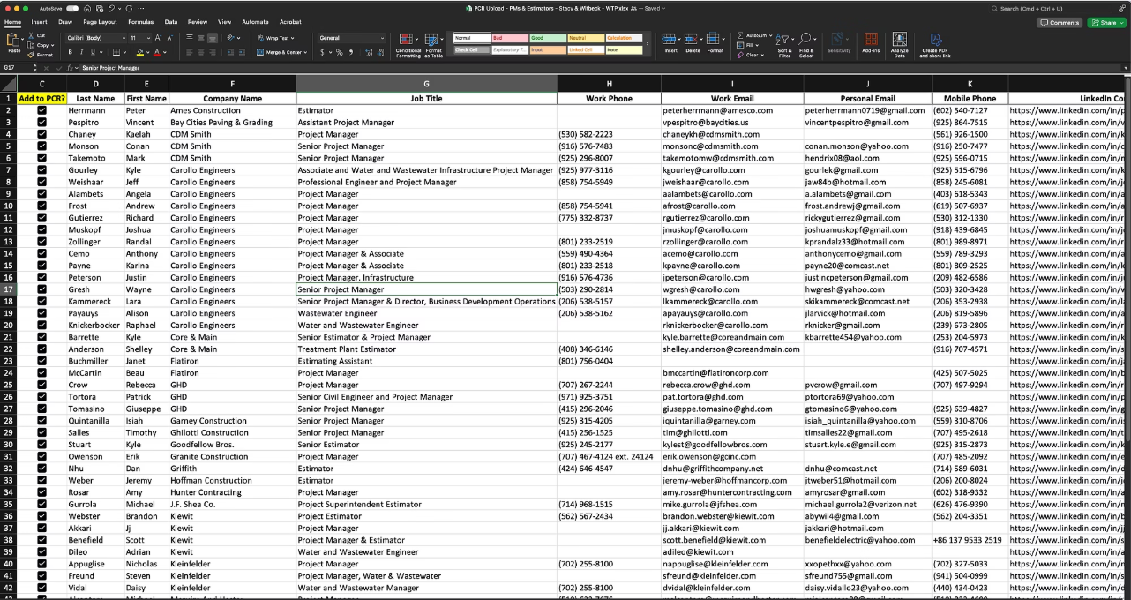
ZoomInfo Deliverables
Candidate Spreadsheet
Export includes contact information but not detailed experience. Click through from the LinkedIn profile for more details on the candidate.
Feedback Loop: Mark candidates for PCR importing within two weeks
Notes:
Dyel
1. What You’ll Receive
Spreadsheet Export of candidates sourced from ZoomInfo.
Includes:
Candidate contact information and company information.
Hotlink to their LinkedIn profile (when available).
Does not include detailed experience or qualifications—ZoomInfo searches are company/project-based, not skill-based.
2. How to Use the Spreadsheet
Review profiles in LinkedIn to confirm background and experience.
Important notes:
If the LinkedIn field is blank → the candidate may not have a profile, or ZoomInfo couldn’t confirm the match.
Having a LinkedIn profile on the spreadsheet does not guarantee the candidate will also show in your LinkedIn saved searches—filters differ between ZoomInfo and LinkedIn.
Bottom line: ZoomInfo gets you a broad, company-driven candidate pool; LinkedIn helps with refining qualifications.
3. Expectation of Feedback
To make this program effective, we need your input on candidate quality.
How to give feedback:
Use the checkbox column in the spreadsheet to mark which candidates you want to contact.
Most rows have a hotlink to LinkedIn to help you quickly evaluate.
Follow-up process:
If we don’t receive feedback within 10 days, we’ll reach out to review where adjustments may be needed.
4. What Happens After Feedback
Once you’ve checked the candidates you want to contact:
We’ll upload the list into PCR.
We’ll code class, role, and role II (when possible).
We’ll create a rollup list ready for you to use as a contact list.
Advantage:
Saves you the time of manual entry.
Candidates will be entered with full contact information and basic codes, making them immediately usable.

Slide 5
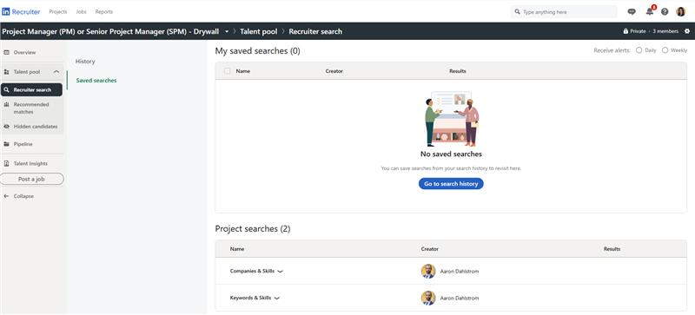
LinkedIn Deliverables
A LinkedIn Recruiter project with at least two saved searches:
a company-focused search and a keywords-focused search
Feedback Loop: Save candidates to the project’s pipeline
Notes:
Aaron
At least two saved searches
Companies
Keywords
Pilot program participants have shared different experiences with both lists – some find the companies list to work better, others found more success w/ the keywords/skills list
- Bottom-line: Every desk is different, every search is different.
On the feedback component – you can always get in touch to let us know any feedback you have. We are trying to find ‘hands off’ ways to evaluate the quality of the results.
https://www.linkedin.com/talent/hire/1787645514/overview

Slide 6
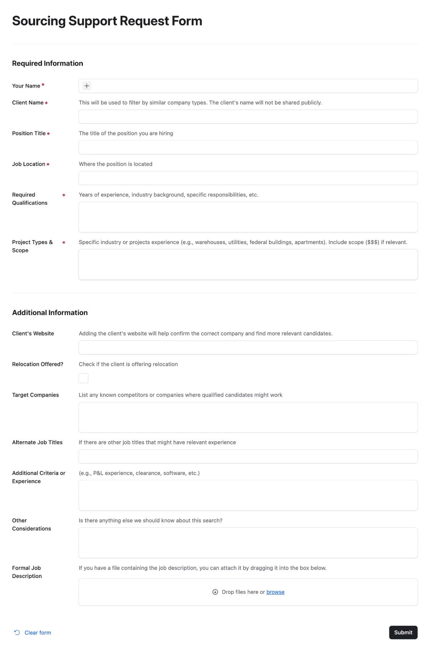
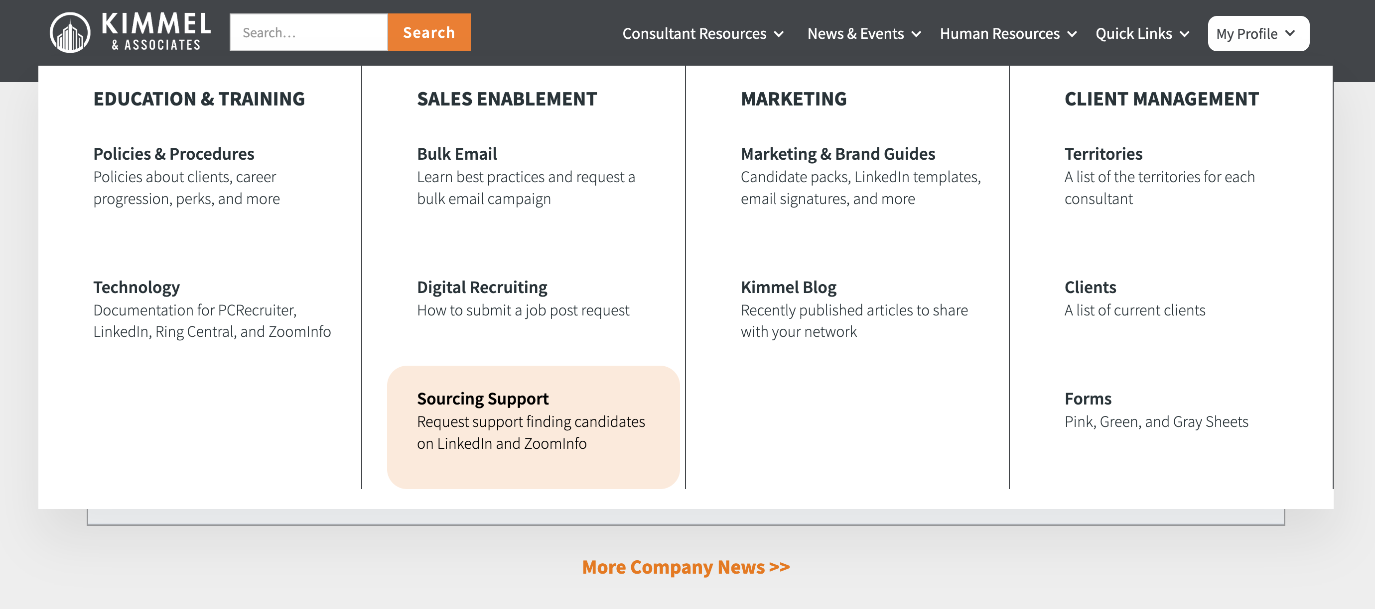

How to Request
Submit your request through a 1-minute form located on the intranet
Bookmark the form for easy access
Most fields are optional
Standardize the process
More accurate information = higher quality results
Notes:
Aaron
This is a very short form – should take less than 1 minute
Most of the fields are not required – but are helpful if you have the info
We will walk through the form in just a second – but this is how to access it
The form is short, but that doesn't mean to rush it. The more accurate and clear your needs are, the better the results.
If you are submitting the form for the first time and have questions or run into challenges, reach out to me. I can walk you through it individually.

Slide 7
How to Request
Submit your request through a 1-minute form located on the intranet
We promise, it really is short
But please don’t rush it
The form kicks off the conversation, not replace it
We’re here to help
Notes:
Aaron
It really is short: When I go over it line by line, it might seem long and complicated. But this information you probably know off the top of your head.
The form is short, but please don’t rush it. The better we can understand your needs, the better we can support you. One minute of your time here saves us hours down the line.
The form kicks off the conversation, not replace it. If we have questions after you submit the form or while we are putting together the searches, we will reach out to you. It is about giving us a better starting place.
We’re here to help: If you are submitting the form for the first time and are having trouble, reach out to me. I can walk you through it individually.

Slide 8
Recap of Program Guidelines & Expectations
Currently capping at 10 requests per week
Five-day turnaround time (sooner if possible)
One active search at a time
Your feedback will help us improve over time
Notes:
Aaron
ONE LINE

Slide 9
Final Takeaways
Most Requested Resource
Beta Tested…Early Wins
The #1 requested resource from our Q1 workshops and feedback sessions
Incorporated helpful feedback from the pilot program and have helped make placements
Simple as Possible
Open Now!
Easy, straightforward form to request support
Check your email for detailed instructions and direct access links to get started immediately
Notes:
Dyel

