Slide 1

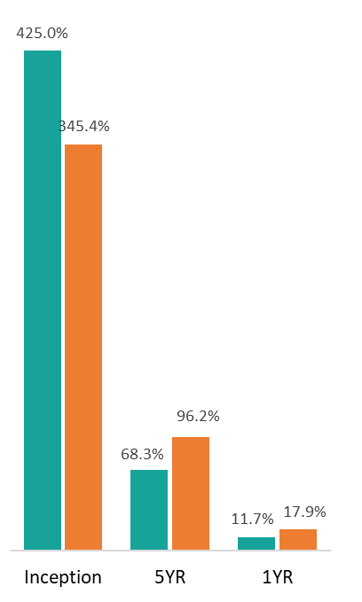
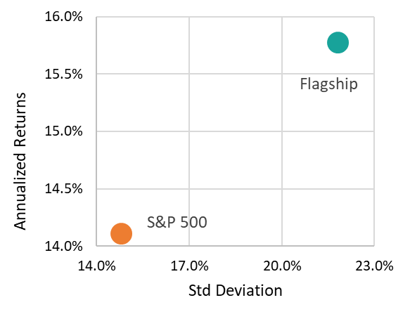
CONCENTRATED U.S. EQUITY GROWTH
December 2025
Investment Objective
At Stewart Asset Management, our goal is to double clients' money every five years by investing in companies that we believe will compound their earnings growth annually at 15% or more. We are committed to identifying businesses that demonstrate exceptional management, robust financial health, and a proven track record of consistent performance.
Investment Approach
Our portfolio is concentrated in 15 to 20 carefully selected companies, each with sustainable growth in earnings power over a five-year period. We use our time-tested valuation methodologies to purchase shares in these companies at an appreciable discount to their expected future price. Our focus is solely on businesses with predictable recurring revenues that are industry leaders, have impregnable balance sheets and high returns on invested capital. By employing this concentrated, high-conviction approach, we drive market outperformance while preserving value through quality and predictability.
Earnings Growth and Valuation
Top Holdings
Nvidia Corporation
Alphabet Inc.
Amazon.com Inc.
Mastercard Incorporated
Broadcom Inc.
Eli Lilly and Company
Annualized Returns vs Std Deviation (Since Inception)
Net Performance of a $1,000 Investment in the Stewart Flagship
Our People
William P. Stewart Founder
Investment Team:
Thomas Valenzuela Chief Investment Officer
Steve Powers, CFA Sr. Portfolio Manager
Sam Colleran Portfolio Manager and Analyst
Carl Short Analyst
Inception: 10/2014
Investment performance (net of fees) as of 12/31/2025
Contact
1 Rockefeller Plaza, 7th Floor New York, NY 10020 www.ingalls.net stewartasset@ingalls.net | (212) 269-7801
Performance Disclosures
Stewart Asset Management (“SAM”) is a team at Ingalls & Snyder, LLC (“Ingalls”), an investment advisor registered with the Securities & Exchange Commission and a FINRA member broker dealer. SAM is not affiliated with W.P. Stewart & Co. (“WPS”). More information including the firm’s Form ADV Brochure and Form CRS can be found at https://www.ingalls.net/important-information.
The information presented herein is for educational purposes only and is not intended to make an offer or solicitation for the sale of purchase of any specific securities, investments, or investment strategies. Investments involve risk and, unless otherwise stated, are not guaranteed. Be sure to first consult with a qualified financial advisor and/or tax professional before implementing any strategy discussed herein. Net performance from 1/1/2019 onwards reflects a 1% annual client management fee. All performance numbers for SAM prior to 1/1/2019 are shown net of its 0.80% annual client management fee and transaction costs associated with the Flagship portfolio.

Slide 2
CONCENTRATED U.S. EQUITY GROWTH
December 2025
The performance numbers reflect the transactions for certain accounts (“Flagship”) of SAM, representative client accounts from which other clients’ accounts of SAM are modeled according to SAM’s investment strategy (“Strategy”). The results for periods from inception of the SAM strategy until 12/31/2022 are the actual results for SAM’s initial Flagship account, and results for periods since 1/1/2023 are the actual results for SAM’s second Flagship account. Results presented during the periods shown were only adjusted for fees, and there were no other material additions or withdrawals from the Flagship accounts during the periods they were used for performance measurement. There are two Flagship accounts because the original Flagship account took on a margin loan during 2023, which no longer made its unadjusted performance results comparable to other client accounts thereafter. The stocks in the second Flagship account have been managed in a substantially identical manner to those in the original Flagship account during all relevant periods.
The comparison to the S&P is to provide a comparable large capitalization index to the SAM flagship accounts which are invested mainly in large capitalization equities. The SAM Flagship accounts are concentrated U.S. equity portfolios with less positions than the S&P 500 index. Performance charts in and of themselves cannot be the sole determinant in making an investment decision. Due to the timing of clients’ investments in the SAM strategy, which is patterned after the model, clients’ returns may be more or less than the actual performance of the flagship accounts. The performance of the Flagship accounts do not reflect actual client performance as fees and transactions costs may be higher. Past performance is not indicative of future performance.
Annualized returns provided herein are based on performance of the Flagship Portfolio as described above. Performance returns reflect the average annual rates of return. Performance from January 1, 2019, to March 14, 2024, reflects SAM’s investment performance as a team at Stewart Asset Management, LLC, which was a period prior to SAM’s move to and continued management of the Strategy at Ingalls. Generally, the Strategy maintains an allocation ranging from 1% to 4% in cash.
The Flagship represents how SAM generally implements its investment process under normal market conditions. Past performance is not an indication of future results. The performance of each client’s managed account may differ due to specific investment guidelines, restrictions and time period which the account has been open and under the management of SAM. Accordingly, individual results will vary.
Additional Disclosures
This Strategy is subject to market risk, which is the possibility that the market values of securities owned in an account will decline. Accordingly, you can lose money investing in this Strategy. Please be aware that this Strategy may be subject to certain additional risks. In general, equity securities' values also fluctuate in response to activities specific to a company. Investments in foreign markets entail special risks such as currency, political, economic, and market risks. American Depositary Receipts (ADRs) represent an ownership interest in securities of foreign companies and involve many of the same risks as those associated with direct investment in foreign securities, including currency, political, economic and market risks. The Strategy may, from time to time, invest in stocks of small- and medium-capitalization companies which entail special risks, such as limited product lines, markets and financial resources, and greater market volatility than securities of larger, more established companies.
The Flagship has employed the investment strategy in a similar manner to that employed in the SAM’s separately managed accounts (“SMAs”). However, portfolio management decisions made for the Flagship may differ. The holdings and portfolio activity in the Flagship may not be representative of some SMAs managed under this Strategy due to differing investment guidelines, client restrictions, and the time period the account was opened and managed by SAM.
There is no guarantee that any investment strategy will work under all market conditions, and each investor should evaluate their ability to invest for the long-term, especially during periods of downturn in the market. Please consider the investment objectives, risks and fees of the Strategy carefully before investing.
Contact
1 Rockefeller Plaza, 7th Floor New York, NY 10020 www.ingalls.net stewartasset@ingalls.net | (212) 269-7801

