Slide 1
Base Power
PJM RBP Proposal

Slide 2
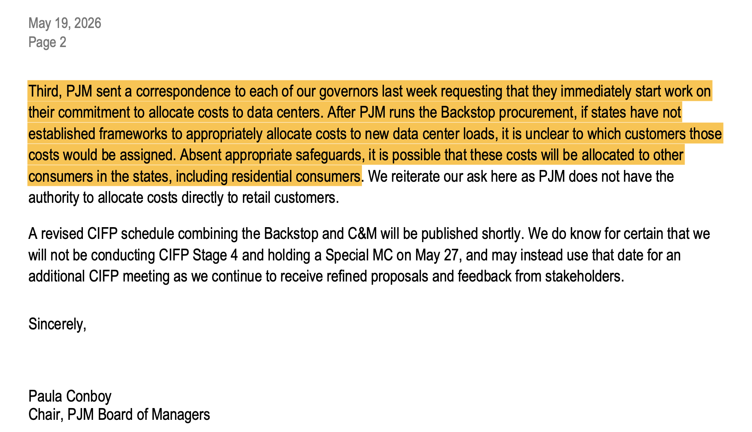
PJM has urged States to act quickly to develop corresponding policies for the RBP process
1. PJM Board Letter Re Reliability Backstop Procurement / Connect and Manage

Slide 3

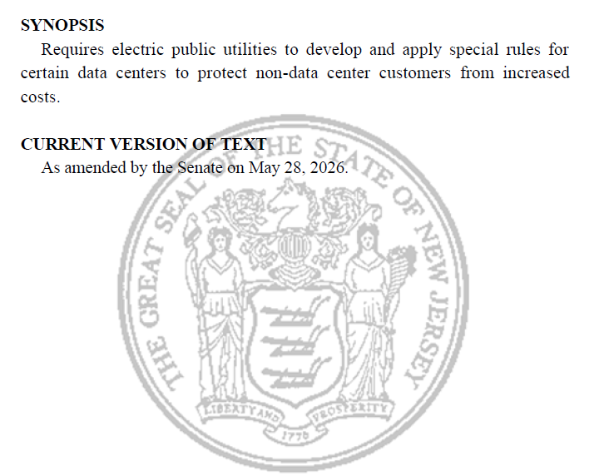
New Jersey has responded to PJM’s call with S.731¹
S.731 specifically describes how Reliability Backstop Procurement costs and Connect & Manage procedures are allocated to retail loads
Mandates that all costs attributable to large data centers, including from RBP, be allocated to those customers – preventing cost shifts to other ratepayers.
Allows data centers either to (a) bilaterally contract capacity resources or (b) bilaterally contract or pay into an EDC program for capacity demand reduction activities, in exchange for exemption from RBP cost allocation and C&M protocols
1. New Jersey S.371

Slide 4
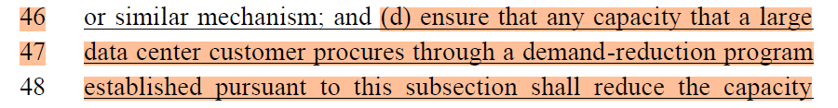
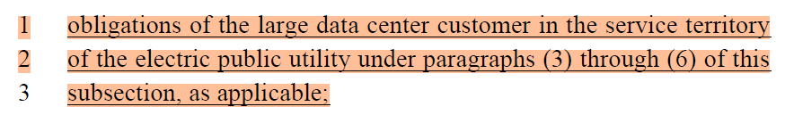
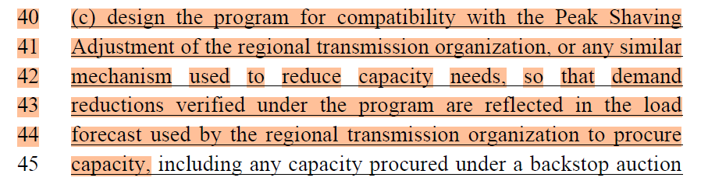
S.731’s framework for bilateral capacity reductions
The New Jersey S.731 frameworks establishes a paradigm whereby:
Data centers may contract for or fund a program to reduce other customers’ demand for capacity
No ratepayer funds used for these activities
Data centers receive credit for capacity, while residential & other customers receive the rest of benefits (e.g., free batteries, discounted power bills, etc.)
Contracted-for demand reductions are validated and registered through a Peak Shaving Adjustment or “any similar mechanism used to reduce capacity needs”
Demand-reduction contracts executed prior to RBP are filed with NJ BPU for approval
This volume is removed from the Backstop Procurement
1. New Jersey S.371

Slide 5

PJM’s current proposal does not allow full realization of NJ legislation and state policy objectives
Unless revised, PJM’s existing proposal does not allow NJ law to appropriately credit demand reductions
to data centers
What NJ S.731 Intends
Gap in PJM's current RBP draft
NJ S.731 Tenets
Data centers that bilaterally contract for demand reductions receive exemption from incremental cost allocation
The demand reduction is credited to the contracting data center – enabling both cost relief and grid benefit - establishing a direct financial incentive for data centers to fund demand-reduction programs
PJM RBP Framework
Data center’s RBP / C&M obligation reflects bilateral supply contracts for new capacity
No pathway for a data center's RBP / C&M obligation to reflect contracts for new peak demand reduction
An essential part of NJ S.731's would be rendered a dead letter unless PJM's RBP process recognizes and credits contracted demand reductions in a manner consistent with its proposed treatment of contracted supply.
In order to accommodate NJ S.731 and other enactments like it, PJM must establish a process whereby volumes that would otherwise be cleared in the RBP are reduced in amounts consistent with activities that reduce demand for capacity and are paid for by new large loads
State legislatures are acting; PJM's FERC filing must accommodate, not undermine, emerging state frameworks.

Slide 6

Base RBP Proposal aligns State and PJM policy pathways
Current PJM Proposal
Proposed Capacity Demand Reduction (CDR) or
Peak Shaving Adjustment (PSA) Consideration
Supply-side: Bilateral contracting process before RBP auction offsets LSE / EDC-submitted MW projections
Demand-side: EDC option to submit a Demand Reduction or PSA plan to PJM ahead of RBP auction to reduce LSE / EDC forecast for RBP / C&M allocation
Large loads bilaterally contract capacity from supply-side generators to reduce capacity obligations through RBP / C&M
EDCs in consultation with LSEs, Large Loads, & State Offices submit demand reduction or PSA to PJM based on bilateral agreements and state-policy supported retail market activities
PJM verification +
reduced RBP / C&M MW
PJM verification +
reduced RBP / C&M MW
EDC / LSE
EDC / LSE
Submission of large load MW & BYONC contracts
Submission of large load MW & BYOCDR contracts
Large Load
Bilateral contract for supply resource
Supply-side generation
Large Load
Bilateral contract for capacity demand reduction
Capacity Demand Reduction
(measurable & verifiable)
EDC / LSE RBP and C&M MW are reduced due to Large Load bilaterally-contracted BYONC MW
Large Load gets credited for contracted capacity
Ratepayers shielded from increased costs due to large load additions
EDC / LSE RBP and C&M MW are reduced due to Large Load bilaterally-contracted BYOCDR MW
Large Load gets credited for verified Demand Reduction
Ratepayers shielded from increased costs and
can receive additional financial & reliability benefits

Slide 7
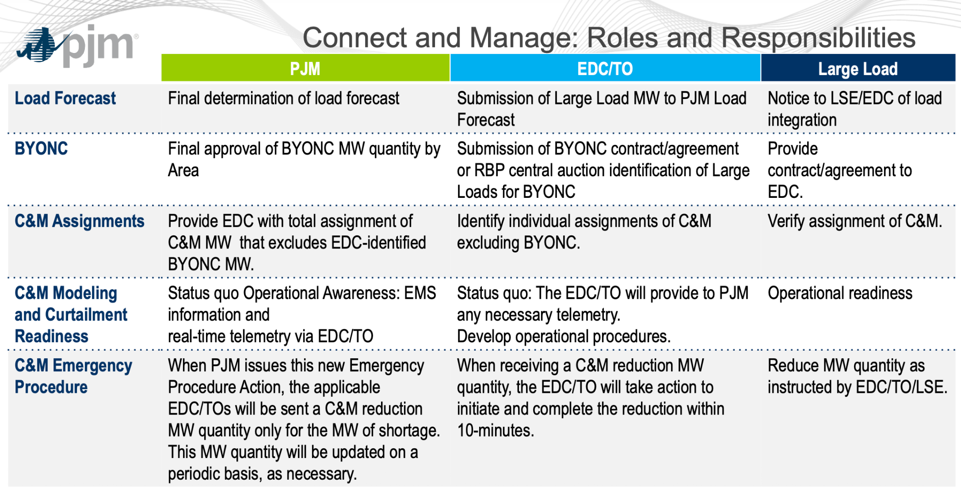
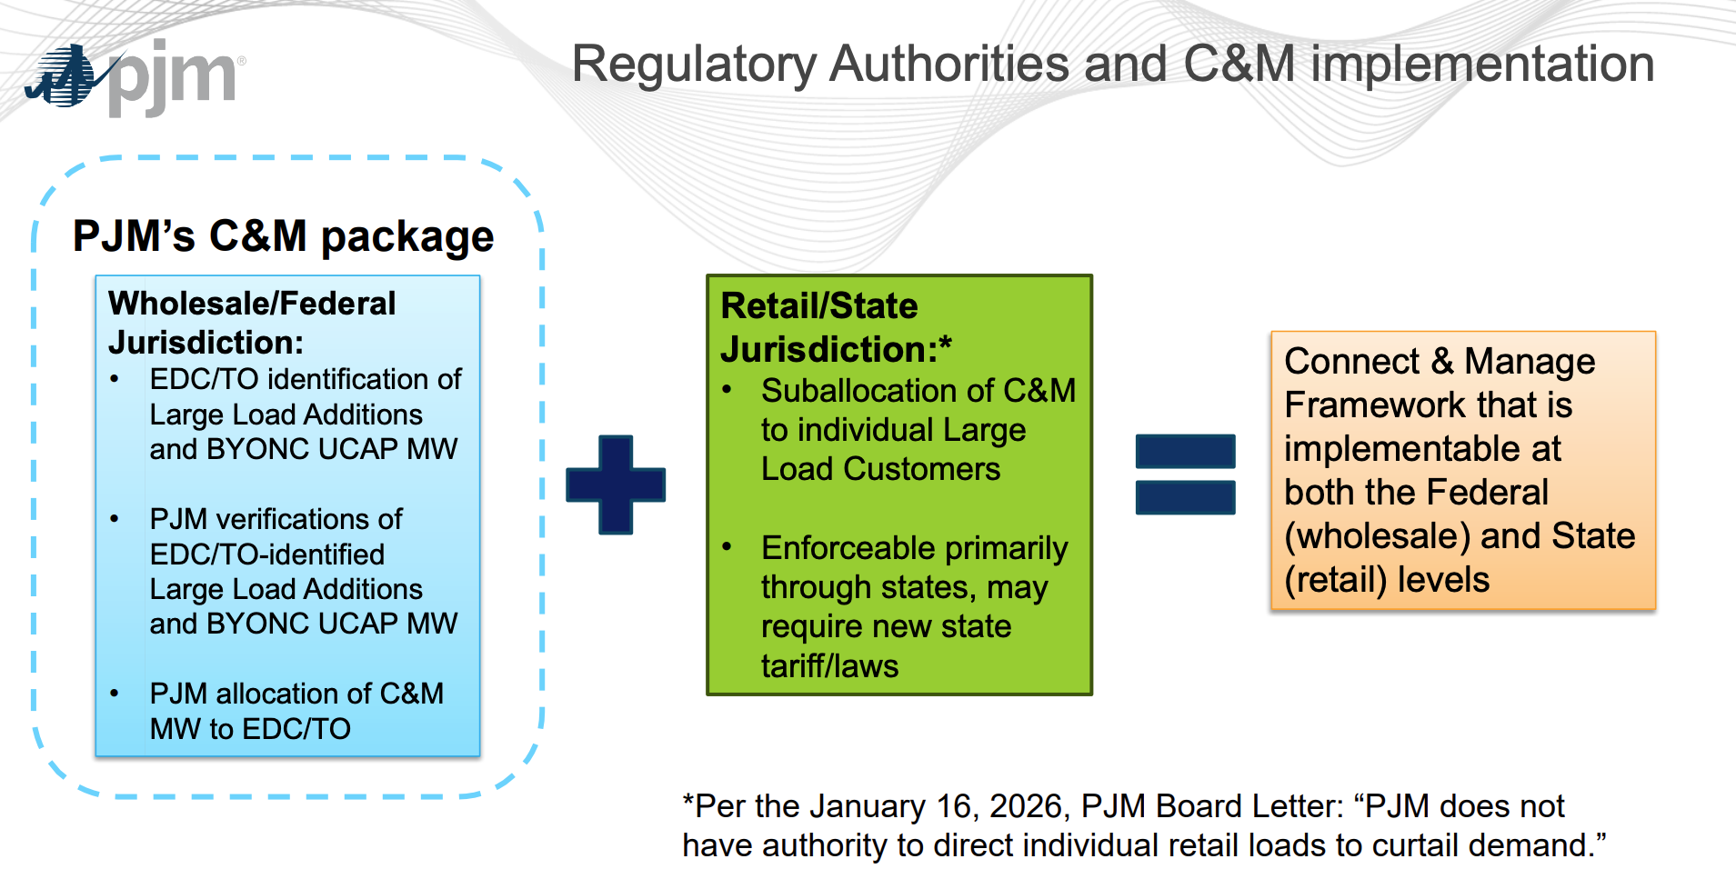
Proposal is compatible with PJM’s proposed Roles, Regulatory Authorities and RBP / C&M Implementation¹
PJM’s proposal recognizes bilateral contracting between large loads and generation resources as a basis to exempt those loads from incremental capacity charges.
Expanding this consideration to bilaterally contracted demand reductions is operationally and administratively compatible with the existing proposal
BYOCDR (Bring Your Own Capacity Demand Reduction) | Final approval of BYOCDR MW quantity by Area | Submission of BYOCDR contract/agreement or RBP central auction identification of Large Loads for BYOCDR | Provide contract/agreement to EDC.
and/or BYOCDR MW
and/or BYOCDR MW
Base RBP proposal modifications
1. Connect and Manage PJM Package (May 27, 2026)

Slide 8
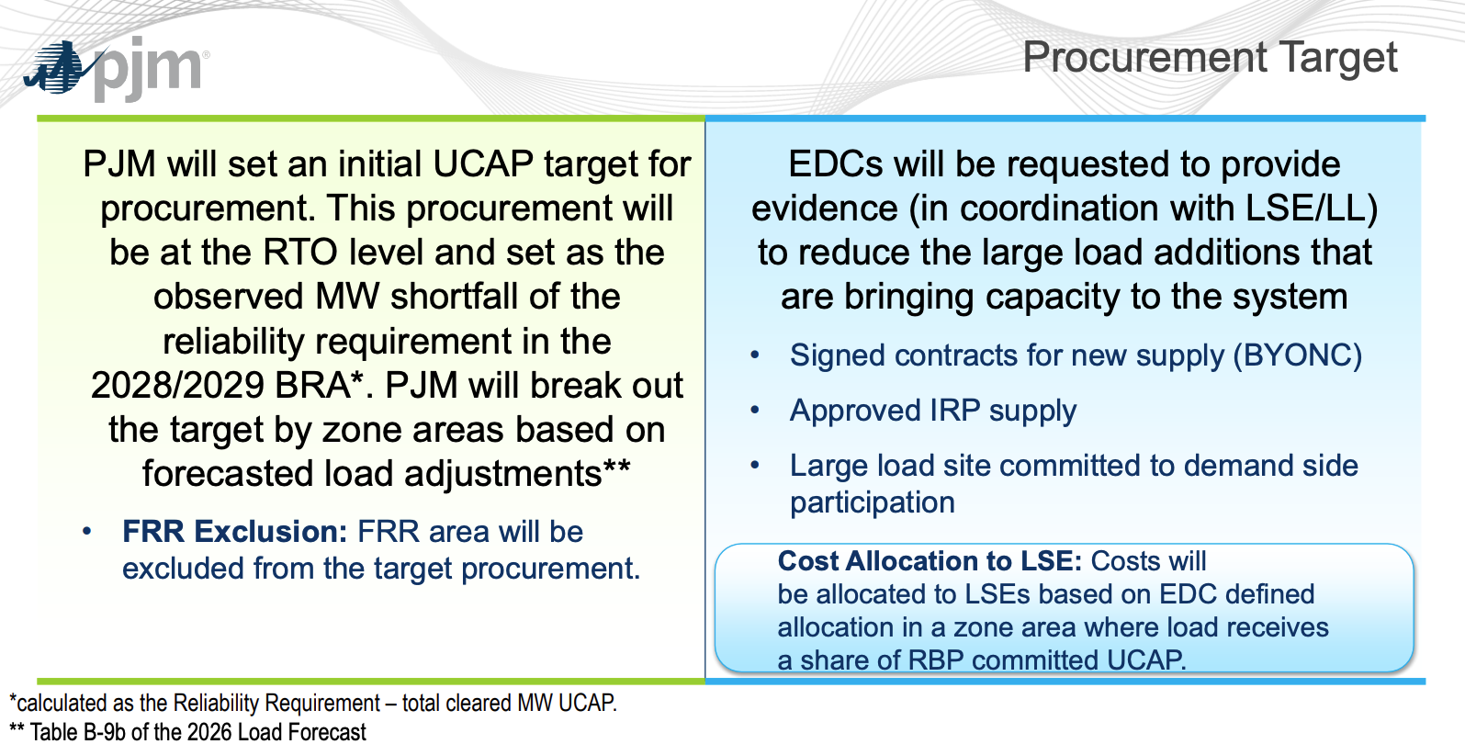
Clear pathway to implement Base proposal & effectively integrate Demand Reductions into Procurement Target
PJM Procurement Target¹
Base RBP proposal
Where a state law or regulation allocates costs to a large load (data center) based on its incremental demand, and that load bilaterally contracts for capacity demand reductions or supply additions, PJM's RBP/PSA process should: (1) Recognize the contracted supply or demand reduction as creditable toward the data center's capacity obligation, and (2) Allow the EDC to appropriately reflect that bilateral contract with evidence submitted to PJM — and receive appropriate multi-year forecast treatment, reflecting the nature of the agreement (3) A Peak Shaving Adjustment is a way to make a discrete, clearly denominated identification of a programmatic capacity-demand reduction contracted for by a data center, subjecting it to clear triggers and evaluation. Base continues to believe a PSA is a plausible approach. (4) Alternatively, an EDC/LSE could be allowed to adjust volumes of RBP being “locked” to adjust the load forecast in line with any bilateral demand-reduction activity that has occurred.
• Signed contracts for new demand reduction (BYOCDR)
Base RBP proposal modifications
Reliability Backstop Procurement Design (May 27, 2026)

Slide 9
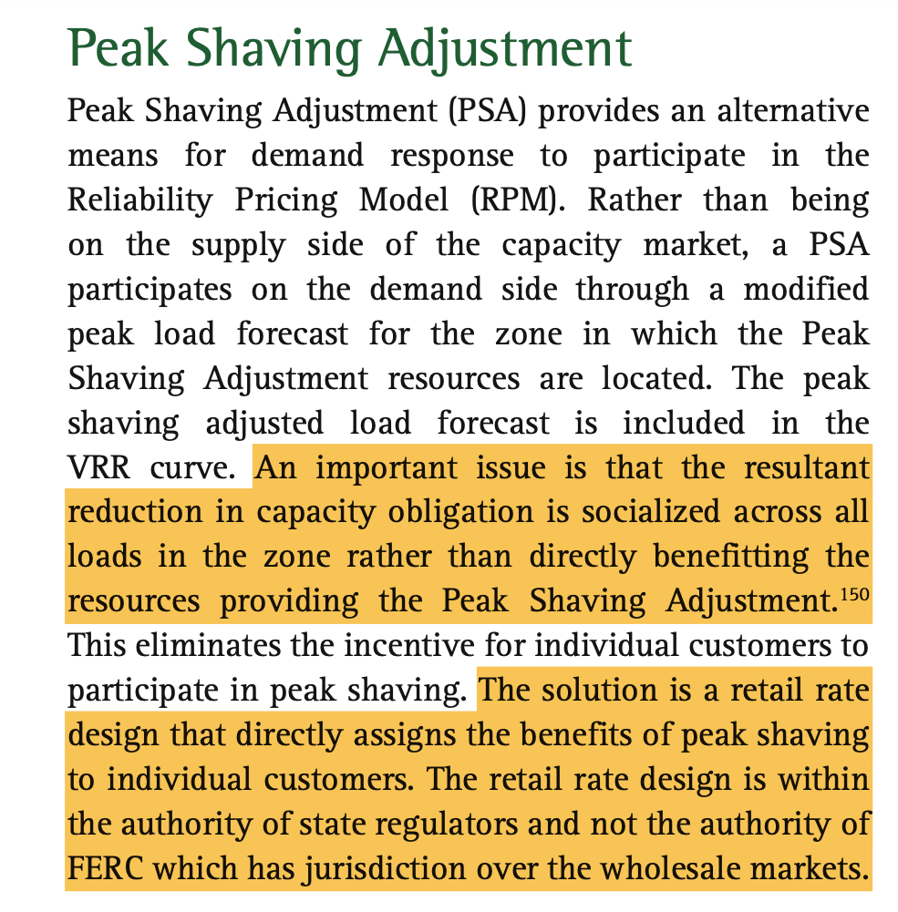
IMM commentary reinforces the role of retail demand reduction and PSA mechanisms
IMM State of the Market Report for PJM, 2025¹
1. Monitoring Analytics, 2025 State of the Market Report for PJM, Vol. II, at 418 (2026).

Slide 10
Appendix

Slide 11
Base Power proposal
C&M options matrix package
2 | Connect & Manage (C&M) designation | All new LLs (in MWs) that will be on-line during or after the 27/28 DY are potentially interruptible under C&M, UNLESS the LSE/EDC has submitted and PJM has accepted a Peak Shaving Adjustment (PSA) for that DY sufficient to offset the LL's incremental capacity impact on a net basis.
2a | Exceptions to Connect & Manage (C&M) designations | C&M exception available where the LL's LSE/EDC submits a PJM-accepted Peak Shaving Adjustment (PSA) demonstrating that state-regulated retail demand reduction programs (e.g., distributed battery storage aggregations, DR programs) funded by or cost-allocated to the LL reduce peak load by an amount equal to at least the LL's FPR-adjusted UCAP obligation for the relevant Delivery Year. Grounded in existing PSA process (Manual 19) and PLC netting methodology. Precedent: EKPC peak shaving adjustment accepted in 2026 PJM Long-Term Load Forecast.
3 | Bring Your Own New Capacity (BYONC) Eligibility | Same as Option A, PLUS: distributed retail DER programs (battery storage aggregations, DR aggregations) funded by or cost-allocated to the LL through state-regulated utility tariffs should be eligible as BYONC where the program produces a verifiable reduction in the LL's net peak load contribution (PLC netting). [Base: Extend BYONC eligibility to retail DER funded by large loads.]
3a | Definition of new Demand Response | Option C plus: Distributed battery storage deployed at residential or commercial customer premises and aggregated by an EDC or DER aggregator, where costs are allocated to a new large load through a state-regulated utility tariff or bilateral agreement, should qualify as BYONC-eligible DER Aggregations. PJM should adopt the PSA/PLC netting methodology from the Long-Term Load Forecast process as the accreditation standard for such programs.
3b | Definition of other new resources | Base supports Option A. See Option A for full PSA / peak shaving program definition.
4 | BYONC Location | For distributed retail DER BYONC (battery storage, DR aggregations), no locational requirement at the resource level. The aggregate portfolio must be located within the same EDC service territory as the large load's Point of Interconnection. LDA constraints addressed through PSA submission review by PJM.
5 | BYONC Quantity (Initial and Maintaining eligibility) | For DER/PSA-based BYONC: EDC submits PSA demonstrating net PLC reduction >= LL's FPR-adjusted UCAP obligation for the relevant DY. For newly launched programs without full 5CP history, PJM should accept forecast-based PSA submissions subject to: (a) program design documentation, (b) state regulatory authorization, (c) cost-allocation to LL documented, and (d) true-up against actual 5CP performance in subsequent DY. Precedent: EKPC PSA accepted in 2026 Load Forecast on program design basis.

