Slide 1
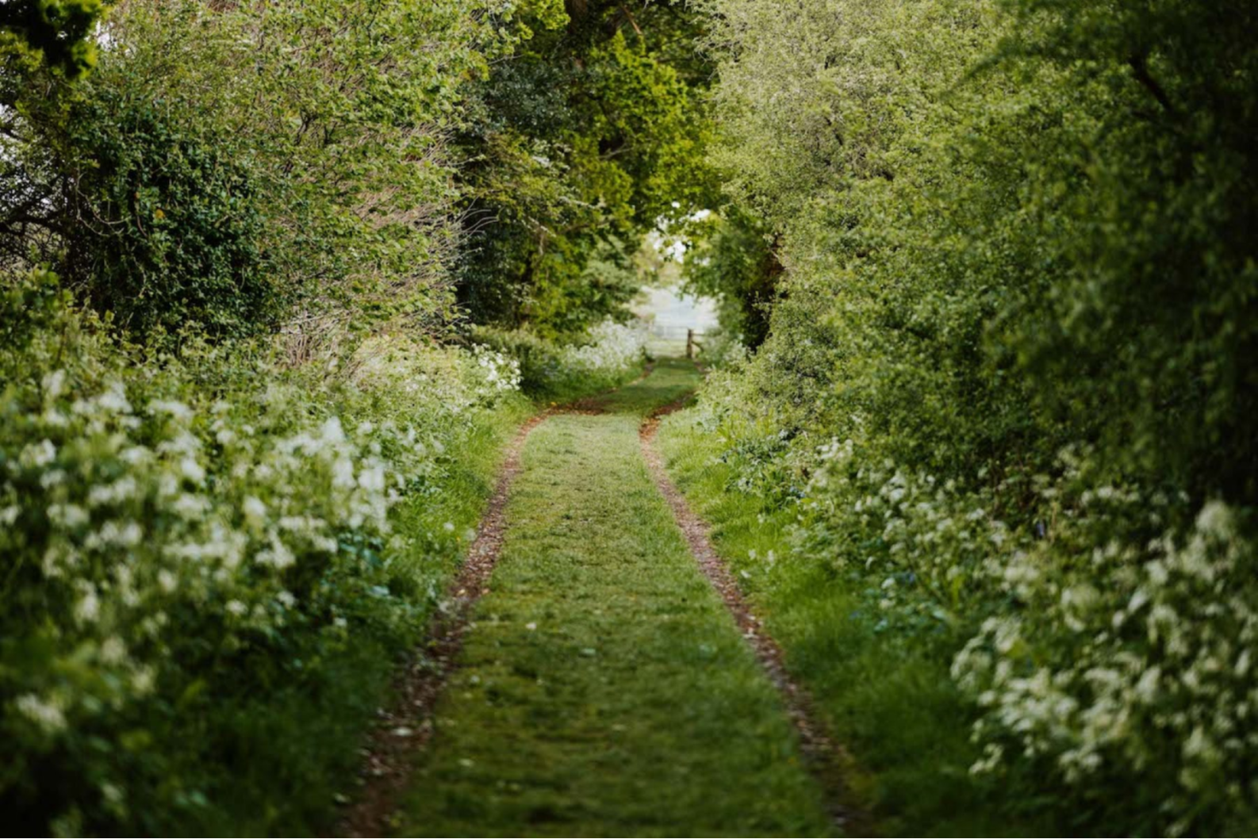

Lifelines

Slide 2
Welcome!
What is Lifelines?
An initiative of St Ethelburga’s Centre for Reconciliation and Peace.
Aims:
To enable people to meet across differences of all kinds in curiosity, respect, and with a unified desire to contribute to the Earth.
To create large-scale environmental impact by planting hedgerows and woodland across the UK.
To create meaningful, immersive experiences in and with the natural world, connecting with deepest values or faith.
Notes:
Tarot and Ila say a bit about the future aspirations for lifelines

Slide 3
Conversation Across Difference - some guidelines
At St Ethelburga’s our mission is ‘Bridging Divides, Loving Earth.’ We invite our communities to observe the following principles for how to engage with difference:
We respect one another despite differences of opinion, background, culture, religion, politics, and other differences of all kinds.
We speak our views honestly, with the expectation that we will receive a fair hearing.
We seek to listen generously to one another, hopeful that we may hear something that we can understand in what another person has said.
We try to put down our preconceptions, stereotypes and projections when we listen to one another. We know that none of us is perfect and we try to practise humility when we engage with different ideas.
We hope to learn from one another, and try to meet disagreement as an opportunity for deeper understanding.
We look for what we have in common and try to build bridges where we can.
We come together for the sake of our care and love for our shared home, Earth

Slide 4
Some practical tools in conversation:
Try not to make assumptions that views or values are shared by everyone in the space - we have intentionally tried to convene people with different views, values and concerns here.
When stating your own view or opinion, use ‘I’ statements, rather than speaking for groups of people.
If meeting opinions that are unfamiliar or that you disagree with, try to put aside the desire to be persuasive or ‘right’, and use this meeting as an opportunity for curiosity, encounter, and learning.

Slide 5


Slide 6
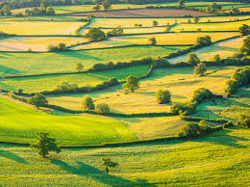
Why hedgerows?
Wildlife corridors
Shelter for wildlife
Protects from wind damage
Reduces soil erosion
Increased pollinators
Flood control
Carbon storage
Source of food
https://ptes.org/

Slide 7
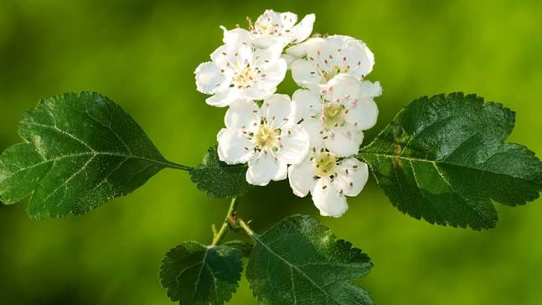
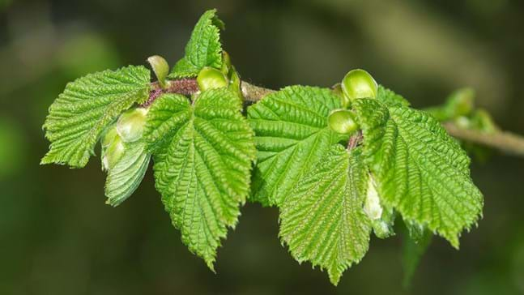
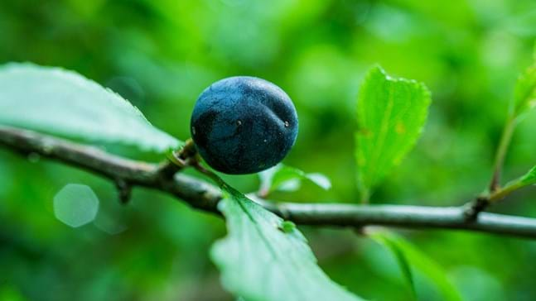

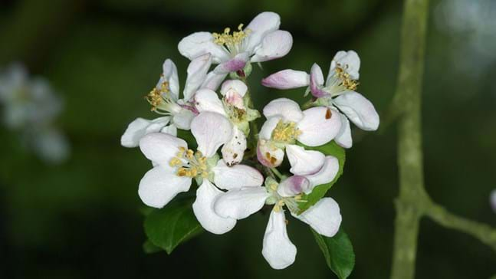
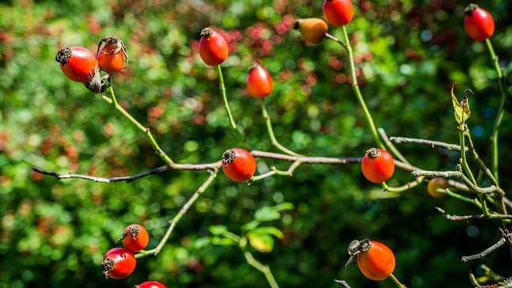
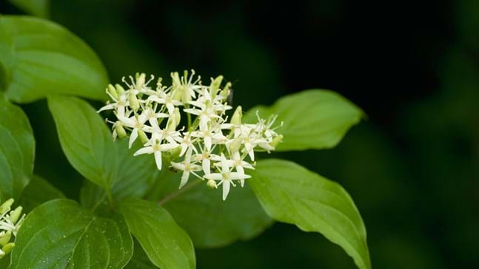
What are we planting?
Hedgerow plants:
Hawthorn
Hazel
Blackthorn
Field maple
Crab apple
Dog rose
Dogwood

Slide 8
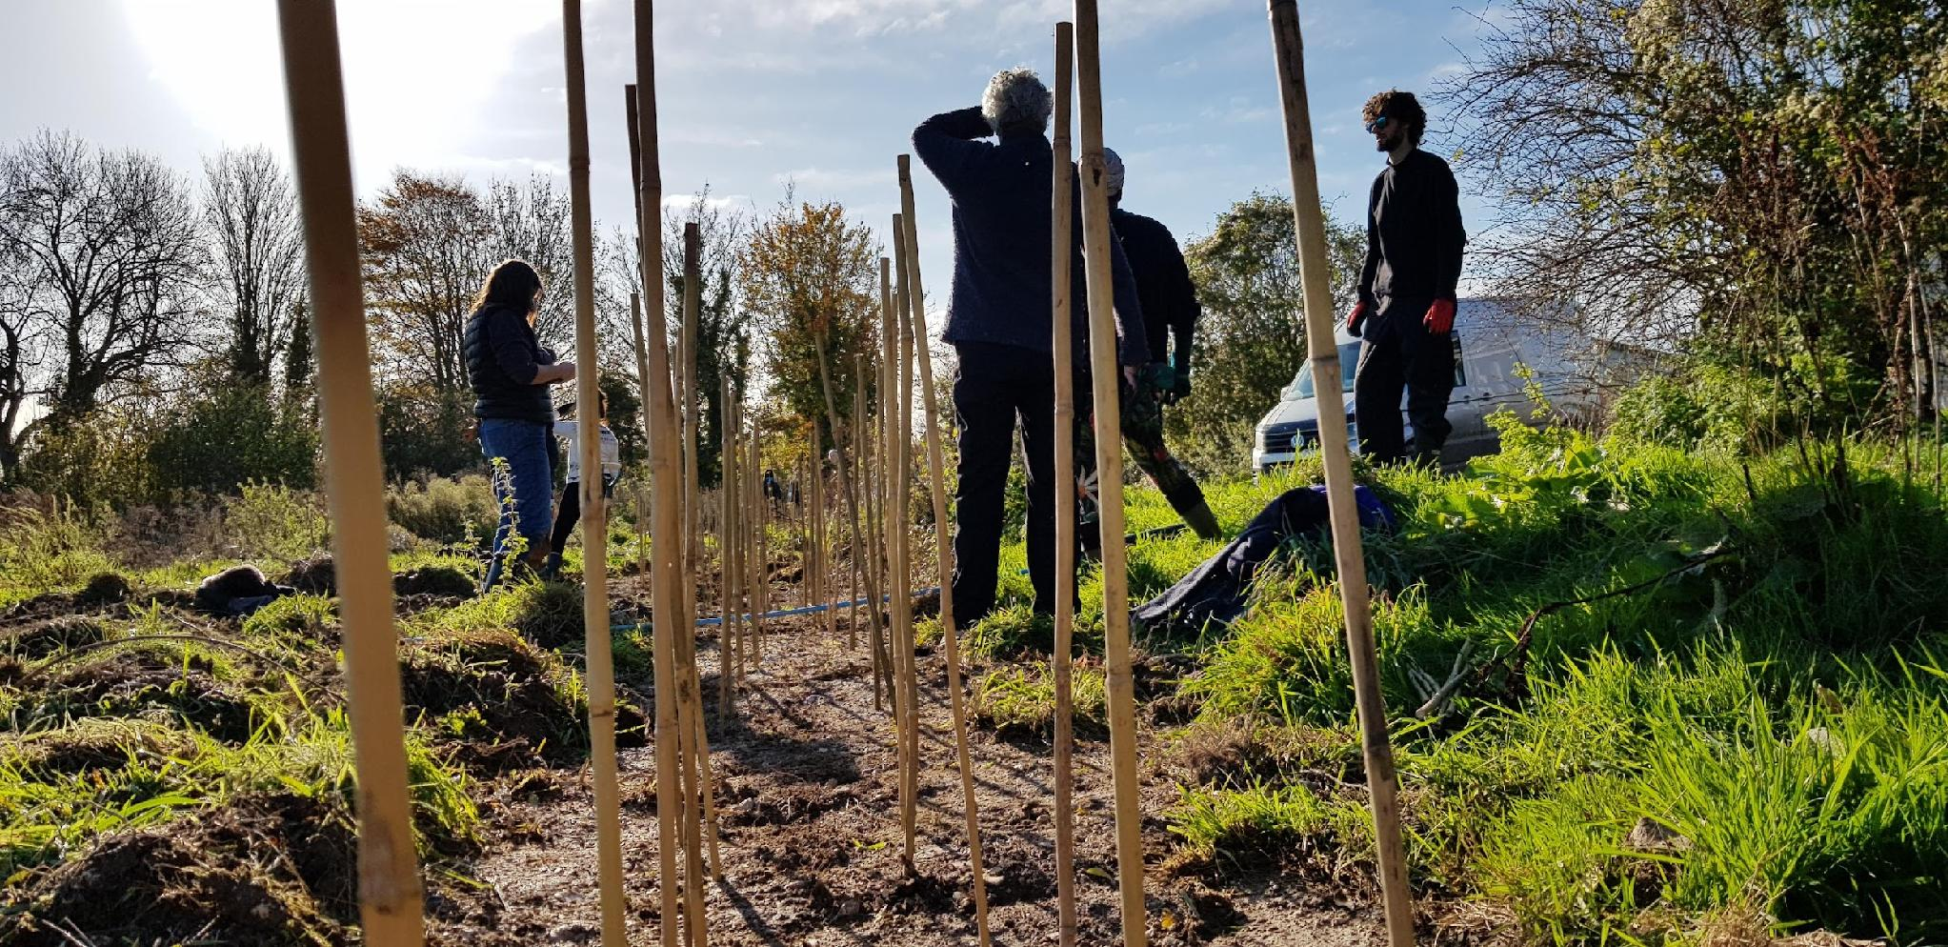
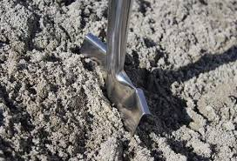
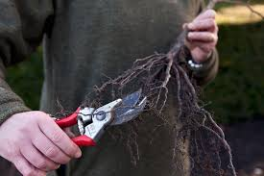
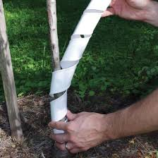
How we are planting?
4 rotating roles:
Stakers
Diggers
Planters
Protectors
Spiral around from the base to protect from deer/rabbits
Stays for 3 - 5 years
Bamboo stakes mark where trees are to be planted
Place every 30cm in 2 parallel lines.
Select plants
Place in hole trimming roots if needed
Heel them in securely
Create holes the depth of the spade, keeping ahead of the planters.
Planting ratio: 60% hawthorn, 40% mixed species, 1 full size tree every 6-8 metres

Slide 9



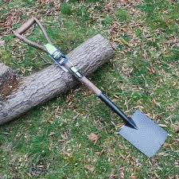
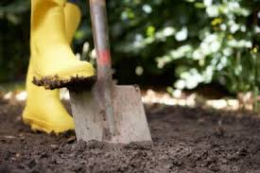
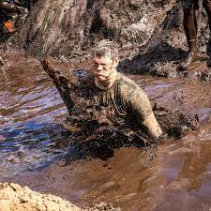
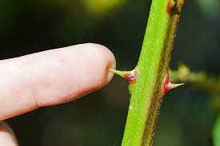


How to be safe

Slide 10
Are you ready?

