Slide 1
Cognitive Learning Interface (CLI) for Zebrafish Neurobehavioral Development
Shipei Huang
Department of Bioengineering,
University of Washington
5/23/2024

Slide 2
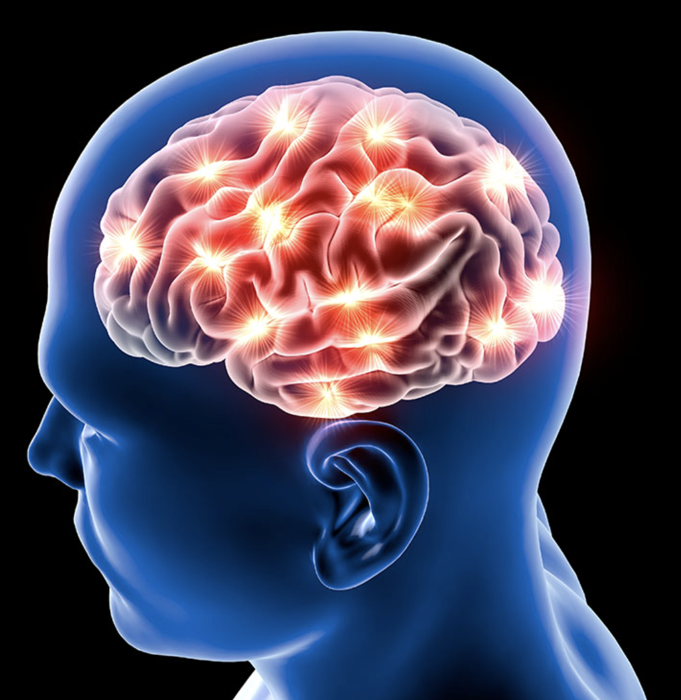
What’s the problem?
A neurological disorder is any disorder of the nervous system and it can result in a range of symptoms.
There are more than 600 diseases of the nervous system, such as brain tumors, epilepsy, parkinson's disease and stroke
The burden of noncommunicable neurological disorders is significant and growing, with substantial economic and social impacts globally.
Affect over 100 million Americans, representing nearly 50% of the total health burden in the United States*
Neurological disorders
*Wikipedia, 2024

Slide 3
Why we study this? (Relevance/impact):
Understanding the neurobiological mechanisms of behavior is crucial for advancing treatments and diagnostics for disorders such as Alzheimer's, Parkinson's, and autism.
Enhanced research methodologies can lead to better diagnostic tools and therapeutic strategies, ultimately improving patient outcomes and quality of life.

Slide 4
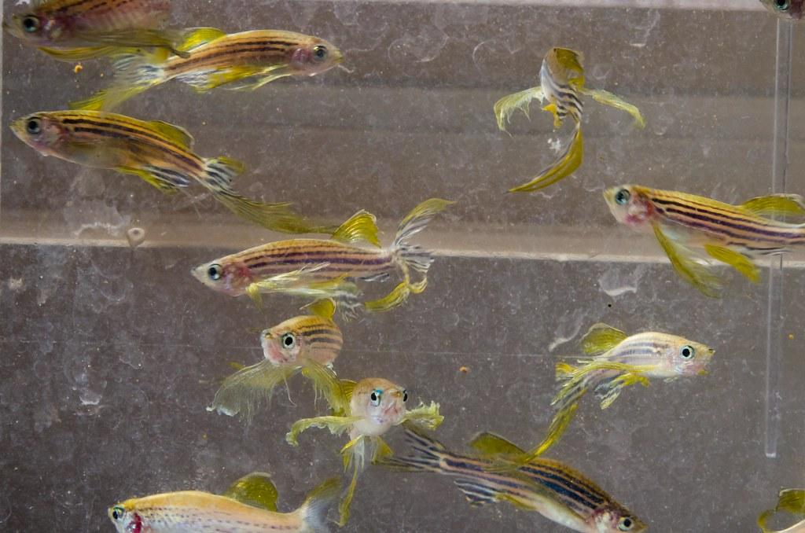
Problem of studying the neurobehavioral disorders of zebrafish:
Lack of methods or devices to quantify zebrafish behavior.
The limited methodologies to monitor and analyze complex neurobehavioral responses in real-time.
Existing methods often cannot provide immediate feedback or adjustment based on the observed behaviors.
Zebrafish

Slide 5
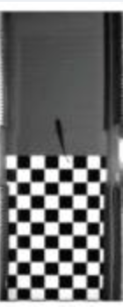
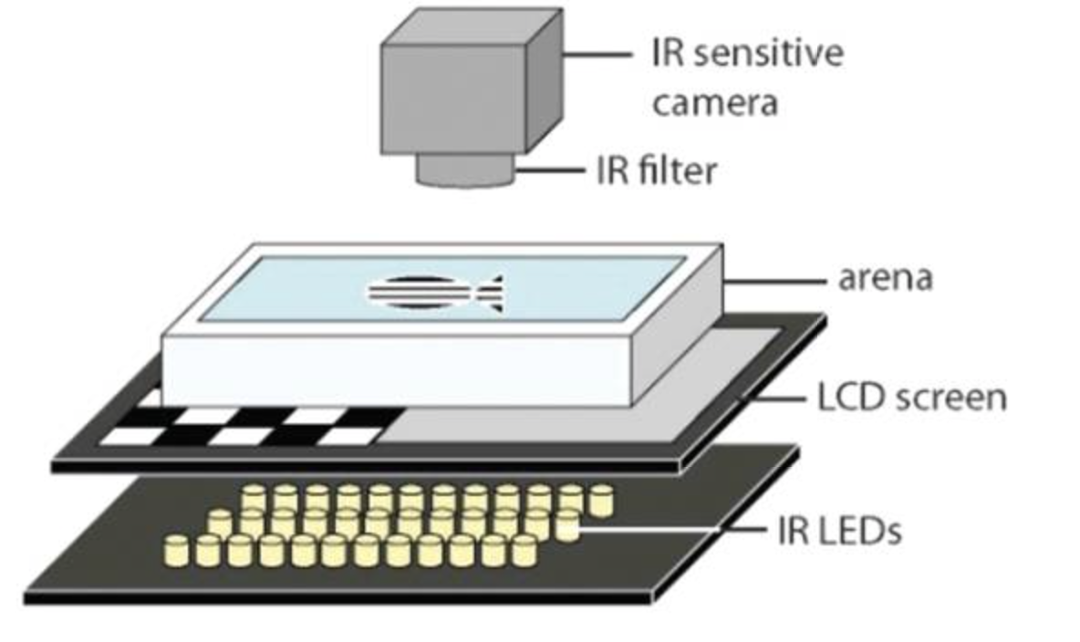
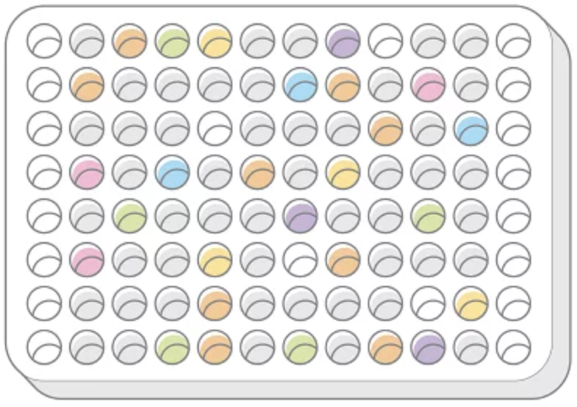
Plan of work:
Develop the ZebCLI: Zebrafish Cognitive Learning Interface to integrate real-time tracking and automated stimulus delivery systems.
Drug Screening: To identify potential therapeutic agents that are beneficial for treating neurological disorders.
ZebCLI Setup*
Left: electric zone; Right: safe zone
Compound library(96 wells)
*Valente, André et al. “Ontogeny of classical and operant learning behaviors in zebrafish.” Learning & memory (Cold Spring Harbor, N.Y.) vol. 19,4 170-7. 20 Mar. 2012, doi:10.1101/lm.025668.112

Slide 6


