Slide 1

Preparing for Life After High School: What Blind and Low Vision Graduates Say About Early Adulthood
Insights for Parents, Educators, and Students
Notes:
Update Title

Slide 2
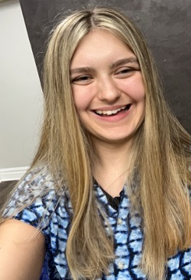
Who am I?
I am Katerina Kirbaba. I work with the EMPOWER VI team as an assistant on the project. I am someone who is visually impaired myself, who has graduated from high school and received transition support.

Slide 3
The Issue
Youth who are blind or have low vision (B/LV) often face poor outcomes after high school, including lower employment rates, difficulty with independent living, and challenges in college.​
Even though laws like IDEA and WIOA are supposed to help, many students still don’t get the support they need in high school.​
This study helps us understand what’s missing, as directly reported by the students themselves.

Slide 4

Study Purpose
We wanted to understand how students who are blind or visually impaired (B/LV) felt prepared for adult life after high school.​
Focused on:​
Independence​
Employment​
College Readiness​
Life skills

Slide 5

Research Questions
What are the high school experiences of B/LV students related to preparing for life after graduation?​
How prepared did these students feel for adulthood?

Slide 6

Who participated?
33 young adults between the ages of 18 and 25 who are blind or have low vision ​
Participants:​
were from 16 unique states ​
were from urban, suburban, and rural areas ​
mostly attended public schools, some attended schools for the blind, private schools, or charter schools​
42% had an additional disability

Slide 7
Who participated? A Closer Look
Breakdown of school types:
Local public school: 26 participants (78.8%)​
Private school: 4 participants (12.1%)​
Public charter school: 3 participants (9.1%)​
State school for the blind: 3 participants (9.1%)​
Homeschooled: 1 participant (3.0%)​
Co-occurring disabilities-​ 42.4% had at least one additional disability, including:​
Deafblindness ​
Learning disabilities​
Autism​
ADHD
Note: Some participants attended more than one school type.

Slide 8

Data Collection
Participants completed an online survey ​
The survey asked about high school experiences and how prepared they felt for adult life

Slide 9

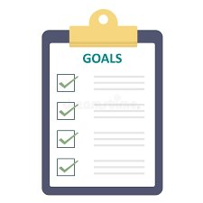


Supports Students Received
85% of participants had some kind of employment experience in high school ​
66.7% helped to create their own postsecondary goals ​
63.6% attended IEP meetings​
42.4% of participants reported that they received “a lot” of instruction in social and self-determination skills

Slide 10


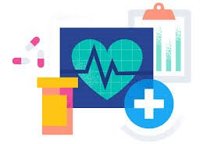

Supports Students Did Not Receive
Only 30.3% received Pre-Employment Transition Services (Pre- ETS)​
Only 39.4% took a Career and Technical Education (CTE) class (39.4%)​
Over half said they got little to no help with:​
Independent Living skills: 63.6% ​
Recreation and Leisure: 57.6%​
Healthcare: 72.7%​
Traveling alone: 51.5%​
Preparing meals: 57.6%​
Managing home: 57.6%

Slide 11
Why This Matters
Without hands-on life skills or real involvement in planning, students may leave high school unprepared ​
Just learning about self-determination isn't enough; students need to be in real situations and given real chances to practice making decisions

Slide 12
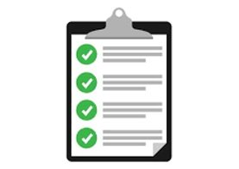
What Parents and Educators Can Do
Ask schools about Pre-ETS and CTE options ​
Make sure the Expanded Core Curriculum (ECC) is taught ​
Encourage students to lead their Individualized Education Program (IEP) Meetings ​
Support learning real world skills, such as budgeting, cooking, and travel ​
Make room for students to use their voice when planning their future

Slide 13
Learn more
Contact your state's vocational rehabilitation agency to learn about employment training and transition supports​
Visit organizations like Perkins School for the Blind for resources on education support, the American Printing house for the blind (APH) for accessible learning tools, or the National Federation of the Blind (NFB) for information on advocacy, scholarships, mentoring, and community support​
Reach out to your school's transition coordinator to learn about opportunities in your local public school

Slide 14

How can EMPOWER help?
EMPOWER VI offers several ways to support blind and low vision youth in their transition journeys:
Free courses on transition topics for students, families, and professionals
Mentorship opportunities
Communities of practice for professionals and adult family members
An accessible website filled with free resources: www.empowervi.org
Social Media and a YouTube channel (all linked in the footer of the website)

Slide 15
Research
Travers, H. E., Schutz, M. E., & Lanchak, E. R. (in press). Preparing for life after high school: Blind and low vision recent graduate perspectives on transition experiences. Journal of Visual Impairment & Blindness​ https://journals.sagepub.com/home/jvb

Slide 16
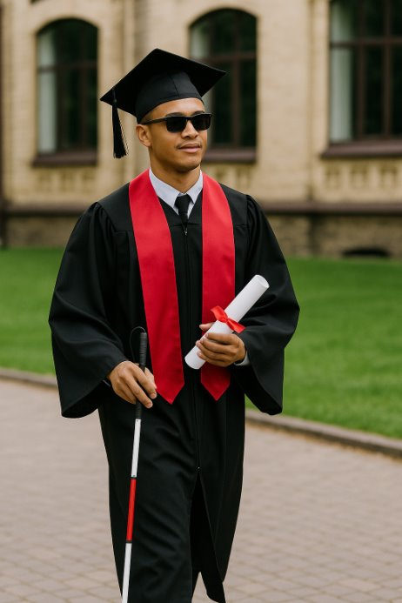


Thank you for caring about B/LV youth!
“Real preparation means letting us try, not just telling us how.” ​
- Quote inspired by an EMPOWER VI student advisory member

