Slide 1
How to use this deck?
This slide deck is designed to help instructors integrate the Flourish Challenge into your class. You are welcome to use any slides as they are or modify them as needed.
For example, faculty in the past have customized elements such as:
Whether students complete one activity per week or a set number of days.
Incentive mechanism (e.g., extra credits or Flourish swag)
The criteria for earning extra credit (e.g., number of days required)
The reflection questions (i.e., to align them with course content, see Page X)
The timing of the reflection essay (midway or at the end of the experience)

Slide 2
Ready to get started?

Slide 3
Flourishing
Challenge
A Fun & Uplifting 14-Day Well-Being Challenge
Notes:
Our vision for integrating STAR into mental health AI companion
Instantiate: physically realized version of your philosophy

Slide 4
Why participating in the Flourish Challenge?
Intrinsic motivations:
💪 Gain strategies to cope with daily stressors of busy (!) college life.
✨ Appreciate psychology in daily life
🌱 Build “happiness habits” over time
Extrinsic motivations:
🤩 Earn extra credits
🎁 Get cute swag as reminders of daily flourishing

Slide 5
What students said about the Flourish Challenge
“I learned to reach out to people more and deepen connections, and that breathing exercises are a really good way for me personally to refocus and relieve stress."
“I know I would’ve had a much harder time this quarter if I didn’t have this app as a way to reflect, learn, and grow in strength. Really inspires me for future quarters.”
“Using Flourish for 14 days was a transformative experience. At first, I was skeptical about the app’s ability to improve my mental health and well-being, but as I continued to use it, I noticed significant changes in my mood, productivity, and overall outlook.”
“The Pomodoro timer really helped. I tend to struggle with procrastination and that has helped mitigate my stress and motivate me.”
“Flourish really changed my mind about AI’s uses.”

Slide 6
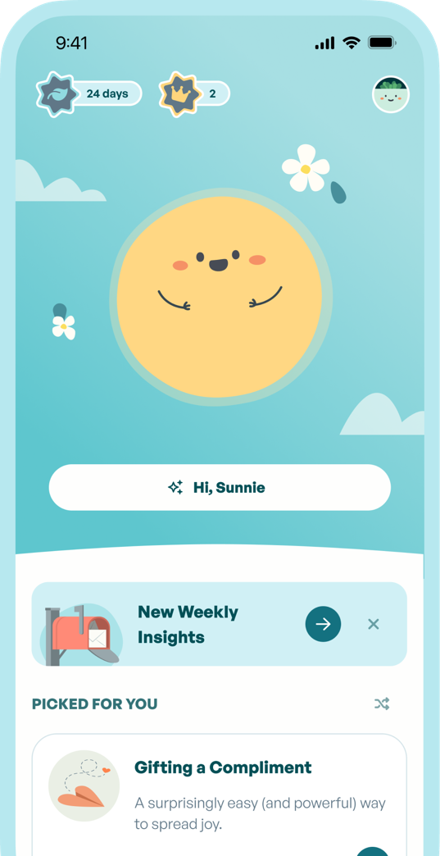
Step 1: Download the Flourish app
Flourish is an evidence-based app for mental and emotional health, stress management, and habit building (a.k.a. “Duolingo for Happiness”)
✨ Created by Flourish Science, a public benefit corporation founded by psychologists to solve “the last mile problem of science.”
✨ Grounded in positive psychology and affective science.
✨ Innovative integration with cutting-edge AI technologies.
✨ Private and secure (end-to-end encryption, HIPAA-compliant).
✨ Get personalized inspiration and support, 24/7!
P.S.: The founders and scientific advisors of Flourish have worked at Stanford, Harvard, UC Berkeley, Brown, UChicago, and NYU. Learn more about them HERE (myflourish.ai).

Slide 7
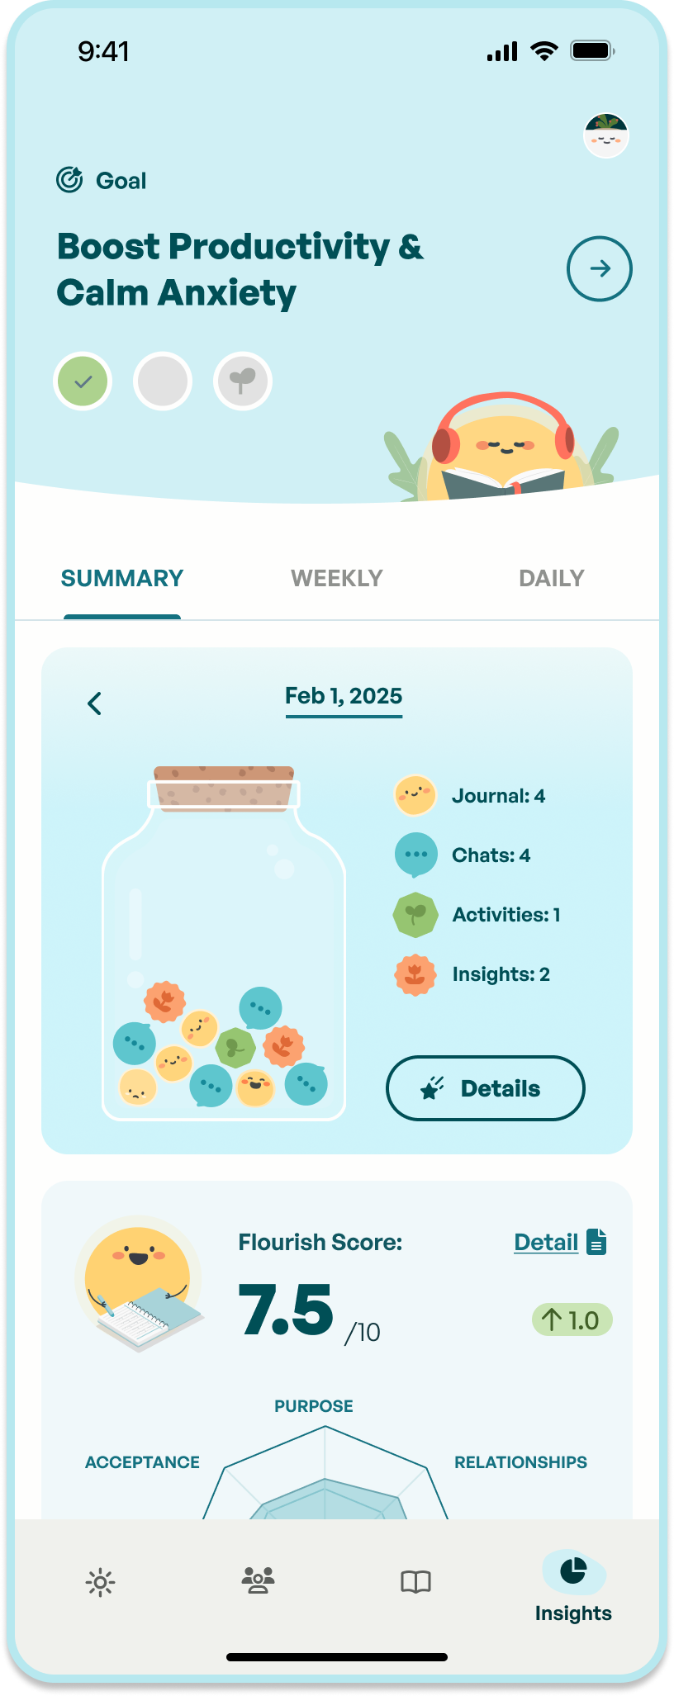
Step 2: Use the app
Use it however you like for 14 days, for example:
✨ Chat with Sunnie, the science-based wellness coach, for inspirations, knowledge, advice—or just vent!
✨ Complete science-based activities designed to reduce stress, find happiness, overcome procrastination, improve productivity, foster resilience, or build healthy habits.
✨ Use the journal feature to create your own Memory Jar—like in the Pixar movie Inside Out!

Slide 8
Step 3: Reflect on your experience
At the end of the challenge, write a short reflection (1–2 pages, 12-pt, single-spaced) on your experience. You can use these reflection questions to get started:
✨ How was your experience?
✨ What did you learn from using the Flourish app?
✨ Did anything surprise you about this experience?
✨ Were there any features that felt especially impactful or meaningful to you?
✨ What do you think about the AI aspect of the Flourish app?
✨ Are there things you wish to change to make the app more useful for you?
✨ Do you think this app would be a valuable wellness tool for students at [university]?

Slide 9
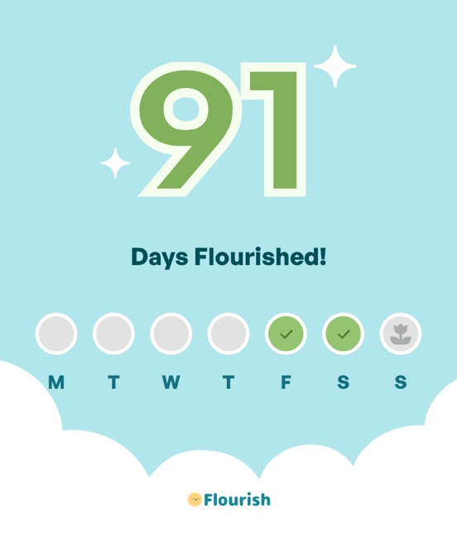
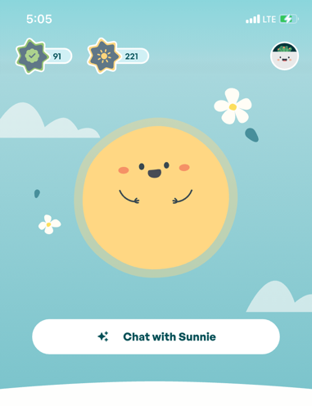
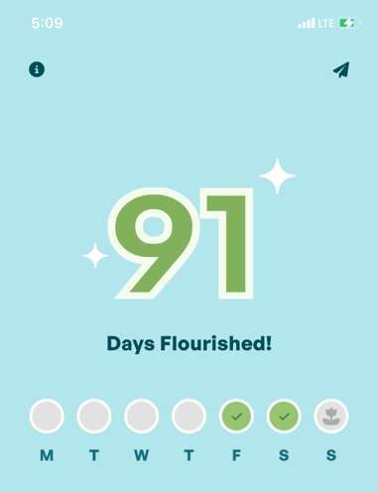
Step 4: Submit proof of completion
To get that:
✨ Click on the day tracker on the homepage of the Flourish app, then
✨ Click on the paper plan to download a photo
✨ Include the photo in your essay (and feel free to share with friends!)

Slide 10
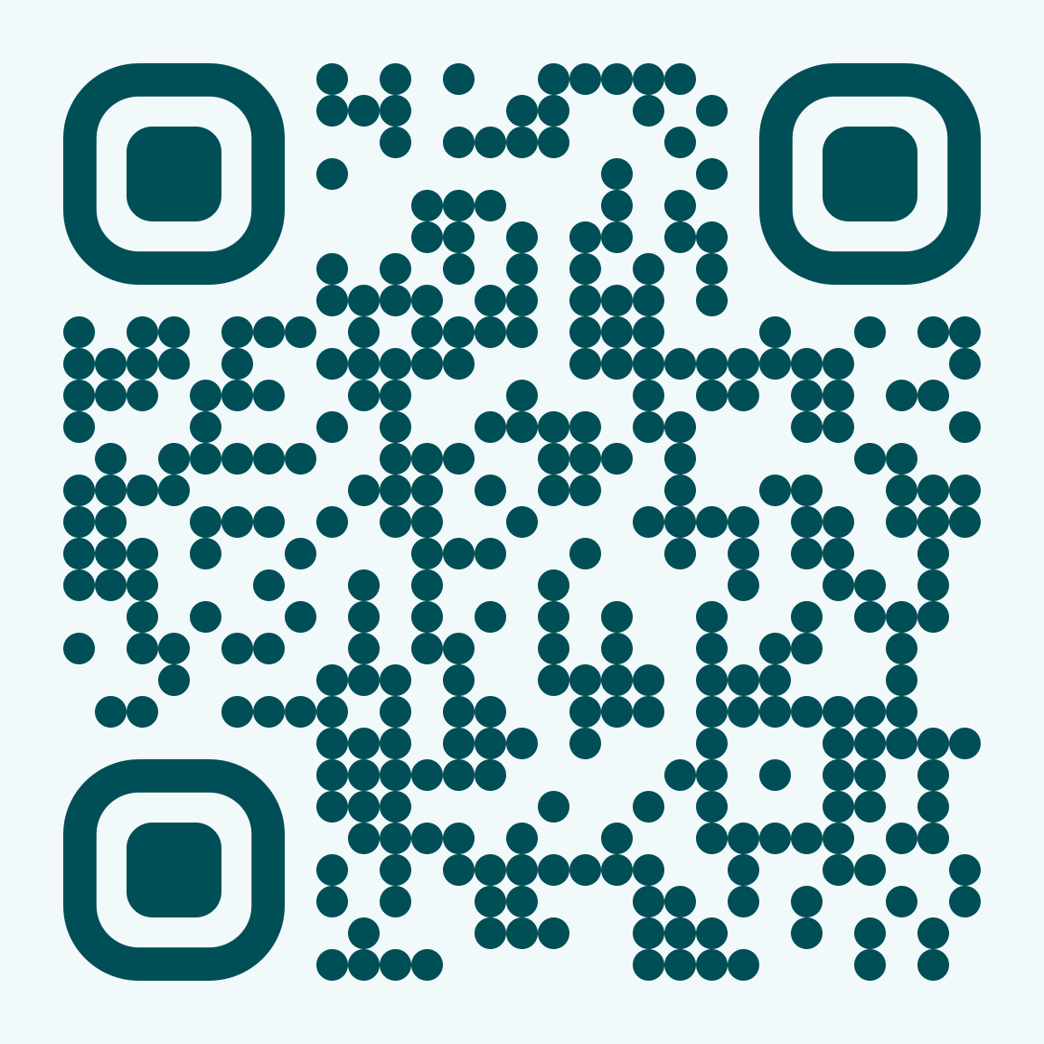
FAQs (1)
When does this challenge start?
Feel free to start today! Complete by the end of this semester for extra credit.
How do I use the Flourish app?
Here is a quick 90-second app overview! You can use this app to help you regulate negative emotions, boost positive mood, gain motivation, or simply celebrate a good day.
I’m up for the challenge! Where can I get the Flourish app?
Use this URL: https://www.flouriship.com/Stanford. Or scan this QR code 👉
How do I get my swag?
Anyone joining the Flourish Challenge can get a sticker and a compliment/intention card! Research shows that physical objects can serve as powerful reminders of our healthy habits (read more)! And feel free to get a card or sticker for your Flourish Buddies.
Notes:
We will remind you to submit your completion when you log in on the 7th day. You can submit your completion on homepage via feedback form

Slide 11
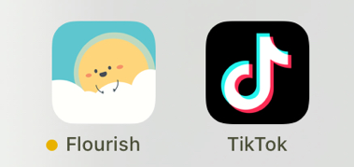
FAQs (2)
How to make healthy habits stick?
Strategy 1: Habit Stacking
Identify a current habit you already perform each day, then stack your new behavior on top — also known as “habit stacking.”
Example: When getting morning coffee, take a daily pulse to connect with yourself and unload your thoughts.
Strategy 2: Habit Replacement
Make the new habit more salient to replace an undesirable old habit.
Example: Place Flourish next to a social media app you want to use less often (e.g., TikTok). Whenever you feel like scrolling through TikTok, opt for Flourish instead.
Notes:
We will remind you to submit your completion when you log in on the 7th day. You can submit your completion on homepage via feedback form

Slide 12
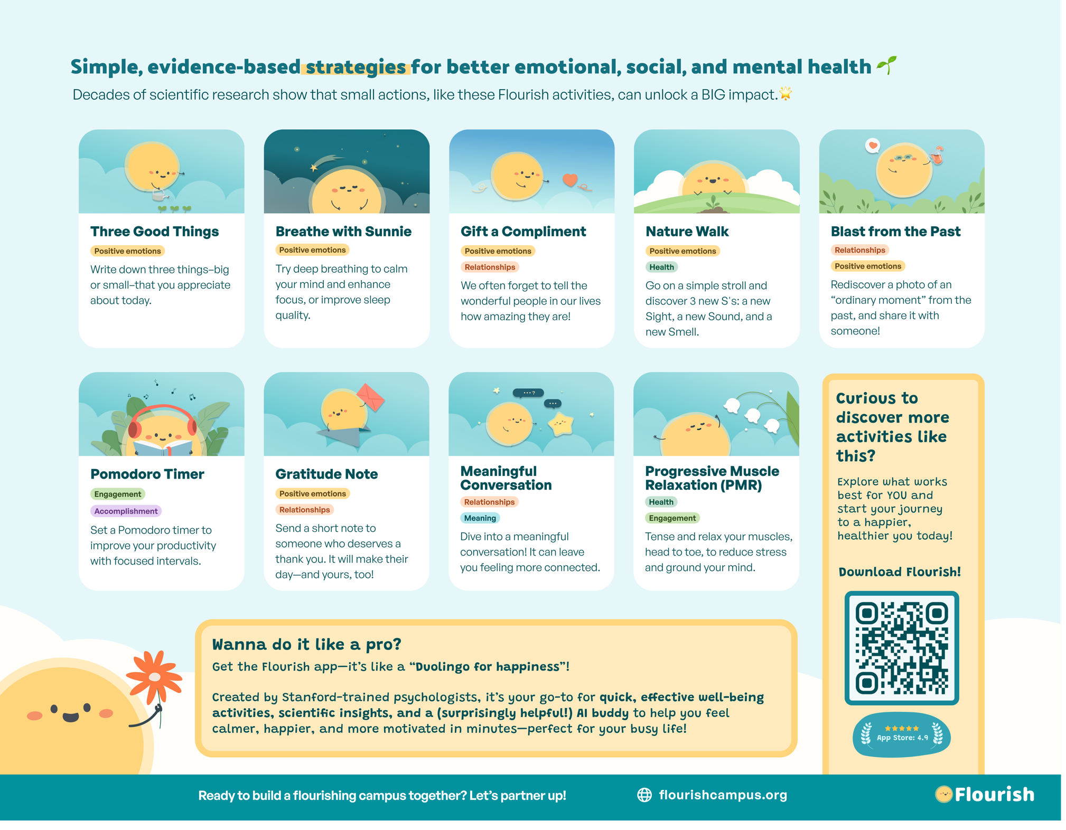

Slide 13
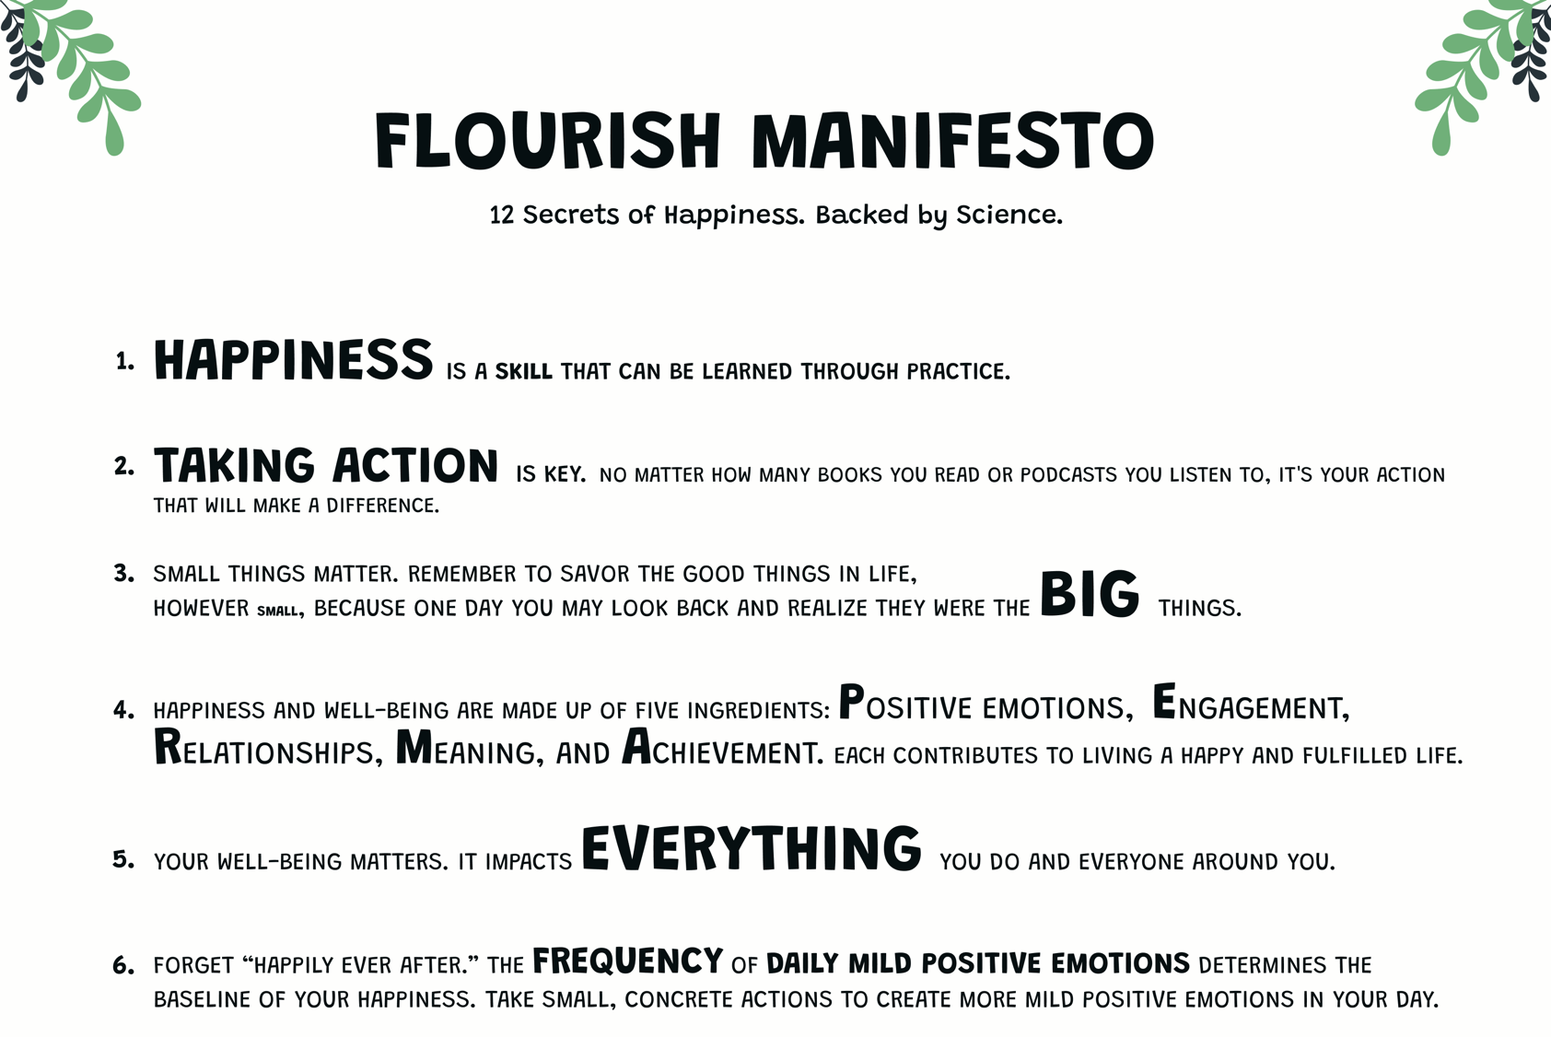
Notes:
Everyone can keep a copy. This is your visual reminder to take care of your well-being.

Slide 15
Congratulations, you just completed the Flourish Challenge!

Slide 16
But your well-being journey doesn’t stop here.
College life can be stressful.
Stay calm & keep flourishing 🌱

Slide 17
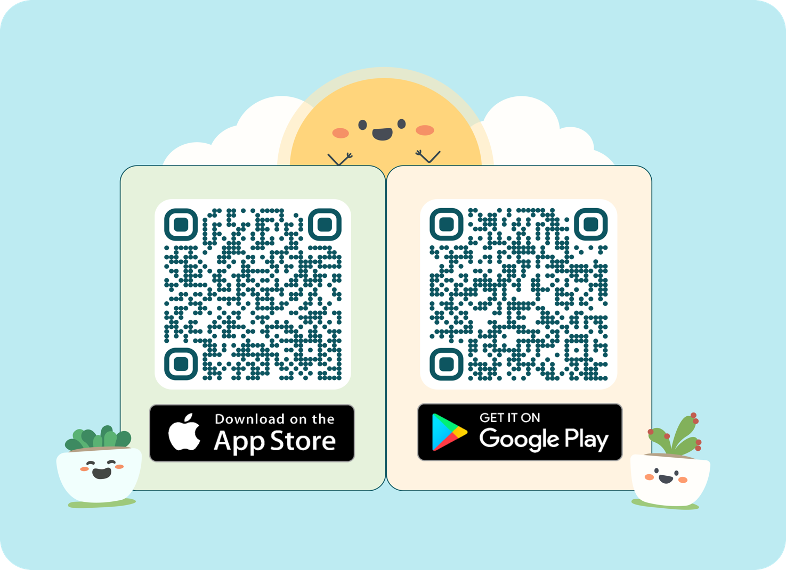
It’s time to get the Flourish app!

