Slide 1
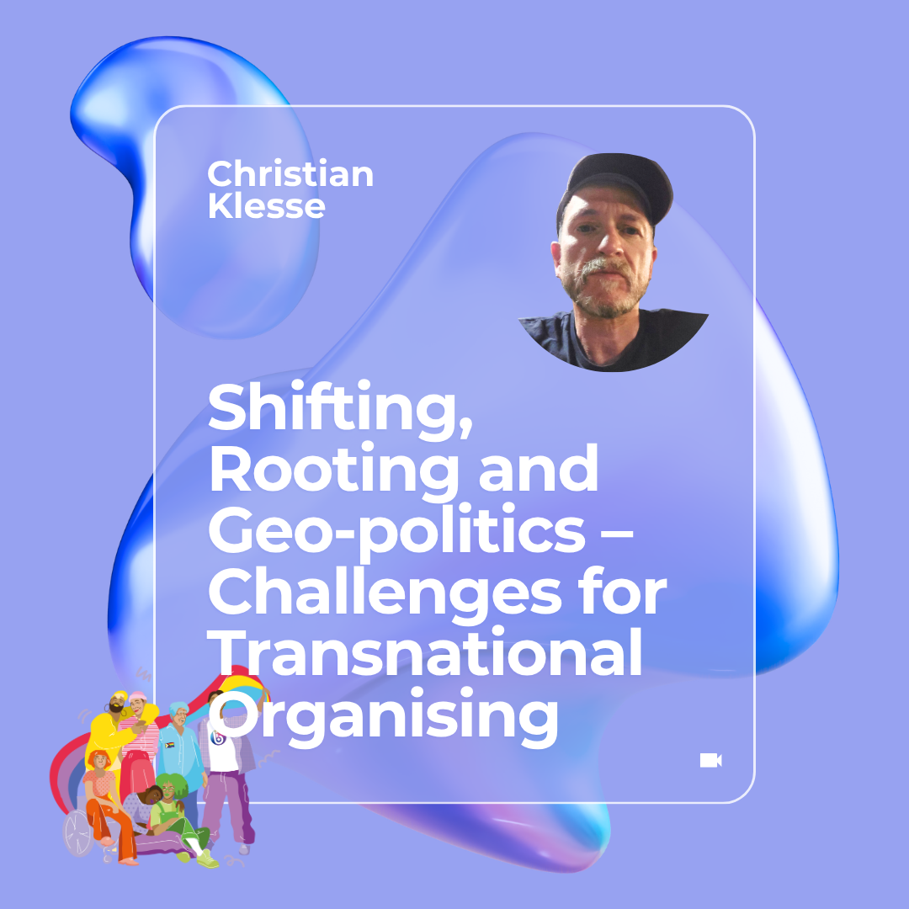
Bi+ Equal Conference
20-22 Oct. 2025, Vilnius, Lithuania
Christian Klesse, Professor of the Sociology of Contemporary Intimacies Manchester Met, UK, c.Klesse@mmu.ac.uk

Slide 2
Welcome!
Interactive workshop
facilitate dialogue about the challenges of transnational organising around gender and sexuality
reflect on linguistic, cultural, and racial differences and the impact of (historical or current) conflict in a (post) colonial world order and stratified Europe
consider an intersectional feminist ethics of shifting and rooting (Yuval-Davis)
Who am I? - location, scholarship and activism

Slide 3
Question 1
Could you say a few words about yourself and what you bring to this workshop, in terms of experience, visions and/or questions regarding international organising around gender and sexuality (incl. bi+ activism) ?

Slide 4
Question 2
What does the term solidarity mean to you? Is it a concept or value of importance for your ideas about bi+ activism?

Slide 5
Question 3
According to your experience or understanding, what are the key difficulties of solidarity-based cooperation that can emerge?

Slide 6
Question 4
In your opinion, what is the role of colonialism in shaping gender and sexual politics in Europe and globally?

Slide 7
Decolonial Thought and Transversal Politics
Intellectual Tools for Bi+ Activism
Provincialising Europe –(Dipesh Charkraborty)
Decentring Western Sexualities (Robert Kulpa and Joanna Mizielińska)
Transversal Politics – Shifting and Rooting (Nira Yuval Davis)

Slide 8
Question 5
What does it mean to provincialise one’s own experience, knowledge and political practice?

Slide 9
Question 6
What could an approach of shifting and rooting mean practically in working with others in political organising?

Slide 10
Question 7
What – if anything – are you taking away from this workshop?

Slide 11
Question 8
What – if anything – would you like to share with the group before going apart?

Slide 12
Quotes to be Considered
Sources used for the preparation of the workshop and cited in excerpts on the following slides

Slide 13
Quote 1: Solidarity is messy
“There is no consensus on what solidarity actually is - neither in public nor in academic discourses. At the same time, something that everyone agrees on deserves our reasonable doubt. Because, like every social praxis and political demand, solidarity is never pure or innocent. Rather, different political beliefs and convictions, epistemological and cosmological perspectives, ethical and moral frameworks, as well as social structures, operate within - and not outside of - whatever we might call solidarity. In short, solidarity is as messy as any other social praxis and discourse.”
Sebastian Garbe 2022: 13

Slide 14
Quote 2: Solidarity values particularity and difference, is decolonial and transnational
Intellectually, I was writing in solidarity with the critics of Eurocentric humanism who drew attention to its false universalizing and masculinist assumptions. My project was anchored in a firm belief in the importance of the particular in relation to the universal—a belief in the local as specifying and illuminating the universal. My concerns drew attention to the dichotomies embraced and identified with this universalized framework, the critique of “white feminism” by women of color and the critique of “Western feminism” by Third World feminists working within a paradigm of decolonization. I was committed, both politically and personally, to building a noncolonizing feminist solidarity across borders. I believed in a larger feminist project than the colonizing, self‐interested one I saw emerging in much influential feminist scholarship and in the mainstream women’s movement.’
Chandra Talpade Mohanty (2003: 503)

Slide 15
Quote 3: Solidarity is anti-capitalist
'While my earlier focus was on the distinction between “Western” and “Third World” feminist practices, and while I downplayed the commonalities between these two positions, my focus now is on what I have chosen to call an anticapitalist transnational feminist practice—and on the possibilities, indeed on the necessities, of cross‐national feminist solidarity and organizing against capitalism. While “Under Western Eyes” was located in the context of the critique of Western humanism and Eurocentrism and of white, Western feminism, a similar essay written now would need to be located in the context of the critique of global capitalism (on antiglobalization), the naturalization of the values of capital, and the unacknowledged power of cultural relativism in cross‐cultural feminist scholarship and pedagogies.'
Chandra Talpade Mohanty (2003: 509)

Slide 16
Quote 4: coalition politics vs home
‘Coalition work is not work done in your home. Coalition work has to be done in the streets. And it is some of the most dangerous work you can do. And you shouldn’t look for comfort. Some people will come to a coalition and they rate the success of the coalition on whether or not they feel good when they get there. They’re not looking for a coalition; they’re looking for a home! They’re looking for a bottle with some milk in it and a nipple, which does not happen in a coalition. You don’t get a lot of food in a coalition. You don’t get fed a lot in a coalition. In a coalition you have to give, and it is different from your home. You can’t stay there all the time. You go to the coalition for a few hours and then you go back and take your bottle wherever it is, and then you go back and coalesce some more. It is very important not to confuse them—home and coalition.’
Bernice Johnson Reagon 1983:358

Slide 17
Quote 5 – Beyond Eurocentrism and Colonial Universalism
‘European thought is at once both indispensable and inadequate in helping us to think through the experiences of political modernity in non-Western nations, and provincializing Europe becomes the task of exploring how this thought—which is now everybody’s heritage and which affect us all— may be renewed from and for the margins.
But, of course, the margins are as plural and diverse as the centers. Europe appears different when seen from within the experiences of colonization or inferiorization in specific parts of the world. Postcolonial scholars, speaking from their different geographies of colonialism, have spoken of different Europes.’ -
Dipesh Chakrabarty (2000: 16)

Slide 18
Quote 6 – Europe stratified by coloniality
‘The relation of leveraged pedagogy is possible due to the geographical, cultural, and religious proximity of CEE to the West/Europe (it is the Other, but more fluid and ambiguous, especially in contrast to Islam, which is framed as the ultimate Other). The relation of leveraged pedagogy is also a relation of the hegemonic temporality, where the West/Europe is rendered as more knowledgeable, consummate, older, wiser, and the CEE is rendered as naïve, younger, and inexperienced (specifically in human rights and liberal democracy). ‘ Robert Kulpa 2014: 432
How is it possible to ensure that a good thing – to help others in need, to be in non-patronising solidarity with them – will not become a manifestation of the moral superiority of those capable of help? How might it be possible to ensure that it will not become a hegemonic and orientalising manifestation of power relations between the ‘West and the Rest’?’ Robert Kulpa 2014: 443

Slide 19
Quote 7: Transversal Politics - Shifting and Rooting
‘NY-D: Transversal politics is dialogical politics, but dialogue which is bounded not by membership in a grouping but by a common value system. And the way it works is via what the Italian feminists (who first used the terms) called ‘rooting’ and ‘shifting’, trying to imagine the world from the situated gaze of the other participants in the dialogue but at the same time not losing your own perspective on things and having politics of uncritical solidarity [as in] right or wrong. Transversal politics ask you to recognise and respect the differential power locations of the participants, and yet, these differences are encompassed by equal treatment.’
Nira Yuval Davis 2009: 136

Slide 20
Sources
Chakrabarty, D. (2000) Provincializing Europe: postcolonial thought and historical difference (new edition). Princeton University Press. Available at: https://www.jstor.org/stable/j.ctt7rsx9 (Accessed: 3 August 2025).
Garbe, S. (2022) Weaving solidarity: decolonial perspectives on transnational advocacy of and with the Mapuche. 1st edn. Bielefeld, Germany: transcript Verlag (Edition Politik). Available at: https://doi.org/10.14361/9783839458259.
‘Interview with Professor Nira Yuval‐Davis: After Gender and Nation’ (2009) Studies in Ethnicity and Nationalism, 9(1), pp. 128–138. Available at: https://doi.org/10.1111/j.1754-9469.2009.01034.x.
Kulpa, R. (2014) ‘Western leveraged pedagogy of Central and Eastern Europe: discourses of homophobia, tolerance, and nationhood’, Gender, Place & Culture, 21(4), pp. 431–448. Available at: https://doi.org/10.1080/0966369X.2013.793656.
Mohanty, C.T. (2003) ‘“Under western eyes” revisited: feminist solidarity through anticapitalist struggles’, Signs: Journal of Women in Culture and Society, 28(2), pp. 499–535. Available at: https://doi.org/10.1086/342914.
Reagon, B.J. (1983) ‘Coalition politics: turning the century’, in Home girls. A black feminist anthology. New |York: Kitchen Table: Women of Colour Press Press, pp. 356–368. Available at: https://womenwhatistobedone.wordpress.com/wp-content/uploads/2013/09/1983-home-girls-coalition-politics-bernice-johnson-reagon.pdf (Accessed: 19 October 2025).

