Slide 1











Renewable Fuels and Chemicals for Switzerland*
Titel: Swiss policy analysis
Presenter: Paula Castro, ZHAW
*reFuel.ch is a consortium sponsored by the Swiss Federal Office of Energy‘s SWEET programme and coordinated by Empa.

Slide 2
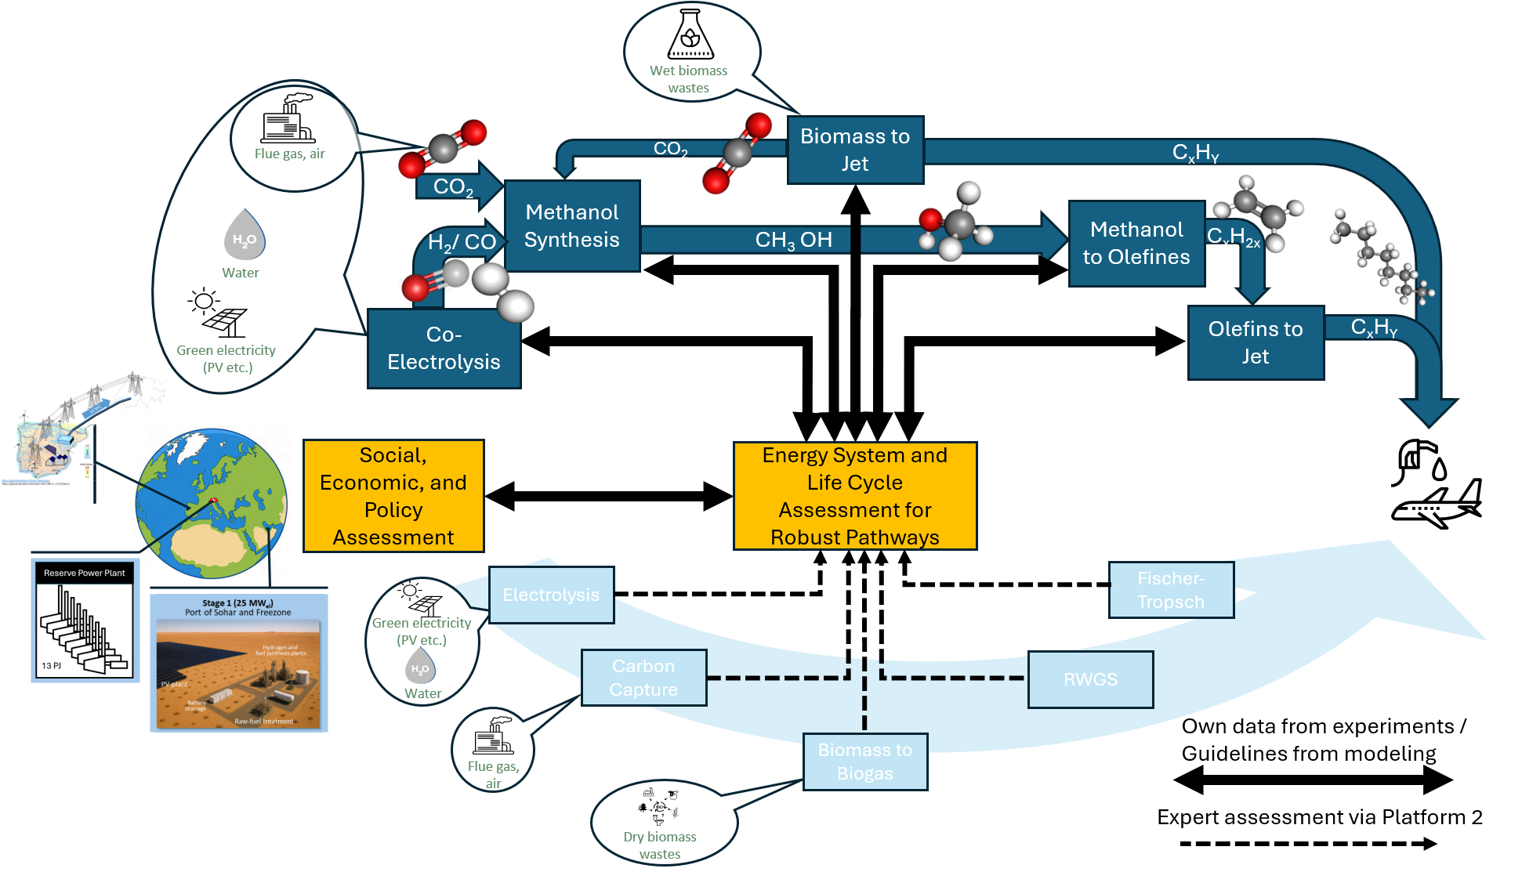
High-level introduction & link to consortium

Slide 3
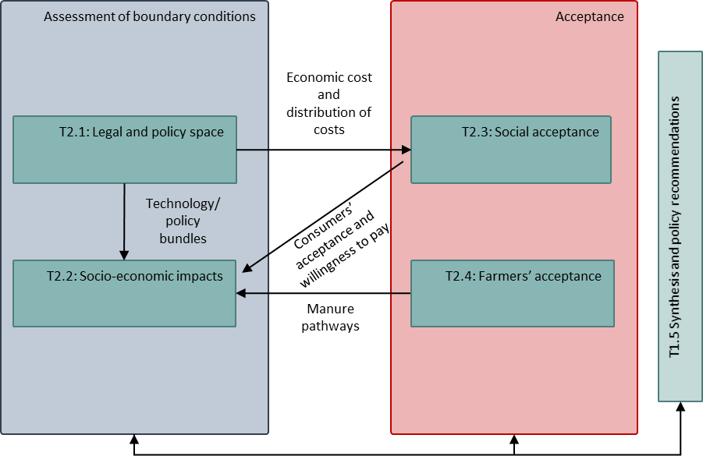
Focus of WP1
WP1 addresses hurdles and constraints to increasing the Policy Readiness Level and enabling robust and sustainable pathways for SFPC supply through following tasks:
Assess the Swiss legal and policy space for SFPC markets and recommend policy instruments for SFPC deployment in Switzerland
Provide a quantitative analysis of socio-economic impacts of SFPC use in Switzerland
Assess social acceptance of different technological pathways and their impacts in Switzerland
Assess farmers’ acceptance of manure use given legal and organizational constraints
Notes:
--- Full wording removed from the slide (for speaking) ---
• WP1 aims to identify, understand and resolve existing hurdles and constraints to increase Policy Readiness Level and enable robust and sustainable pathways for SFPC supply through the following tasks:
• Assess Swiss legal and policy space for SFPC market integration and recommend the development of policy instruments to enable SFPC deployment in Switzerland
• Provide a quantitative analysis of the socio-economic impacts of using SFPC in Switzerland
• Assess the social acceptance of different technological pathways and related environmental and social-economic impacts in Switzerland
• Assess farmers’ acceptance of manure use in light of existing legal and organizational constraints

Slide 4
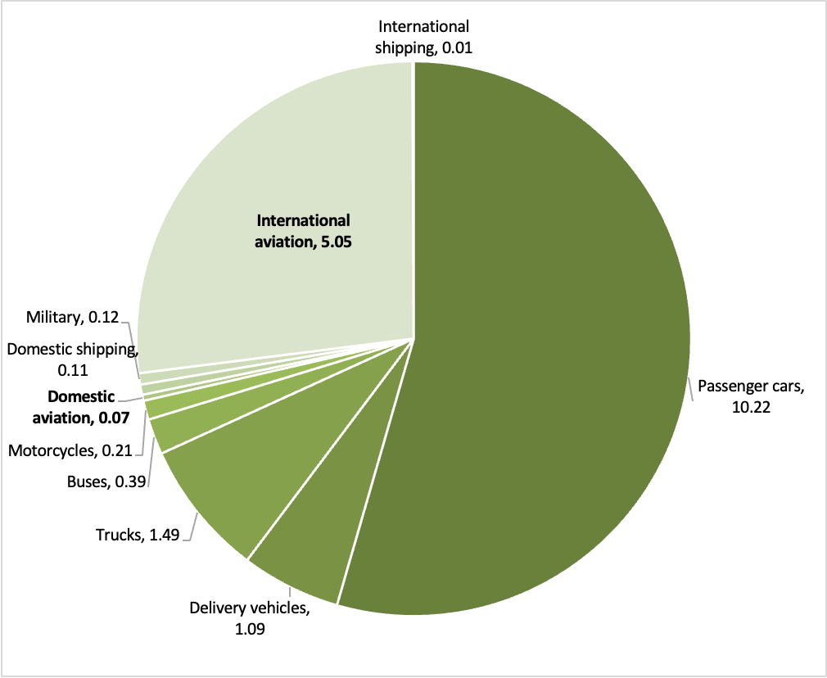
Analysis of Swiss policy space: Focus
Focus: sustainable aviation fuels (SAF)
  Aviation: hard-to-abate sector, dominates CH GHG emissions in 2050
  Only SFPC area with a substantive policy framework
  Other transport fuels: policy less focused on sustainable fuels
  H₂: only a roadmap so far
  (Platform) chemicals no specific policy framework yet
  Agricultural sector (manure): Task 1.4 and WP6
Those other policy areas will be covered in a subsequent report
GHG emissions (Mt CO₂e) from road transport, aviation and shipping in Switzerland in 2023 (data from Swiss GHG inventory 2025)
Notes:
Graph: not full transport emissions, just road, aviation and shipping → those Swiss subsectors that consume fuels
International aviation: roughly 11% of total Swiss GHG emissions when international aviation is counted
--- Full wording removed from the slide (for speaking) ---
• Focus of analysis: sustainable aviation fuels (SAF)
• Aviation as a hard-to-abate sector, dominating CH GHG emissions in 2050
• Main area within SFPC where a substantive policy framework has developed
• For other transport fuels policy is less focused on sustainable fuels
• For H2 there is so far only a roadmap
• For (platform) chemicals no specific policy framework identified yet
• Policy in the agricultural sector (use of manure) covered in Task 1.4 and WP6
• Those other policy areas will be covered in a subsequent report
• GHG emissions (Mt CO2e) from road transport, aviation and shipping in Switzerland in 2023 (data from Swiss GHG inventory 2025)

Slide 5
Analysis of Swiss policy space: Methods
Steps of analysis
  Identify market failures hampering SAF uptake
  Describe the policy framework and how it addresses them
  Identify remaining policy gaps
  Interviews: Stakeholder feedback on policy gaps
  Past consultation processes: to identify gaps supported beyond the interviewees
  Literature review (academic and grey): verify identified gaps
  Identify gaps with highest support and disagreements
  Suggestions for further research within reFuel.ch, e.g.
    systematic assessment of policy options,
    quantification of policy effects through modelling,
    assessment of legal feasibility
Notes:
Goal of our report: Investigate which regulatory gaps hinder the effective scale-up of SAF in Switzerland and discuss how these gaps can be addressed through targeted policy instruments
Focus is on the identification of the market failures characterizing the decarbonization of the Swiss aviation sector, the necessary incentives to address them, and how the policy framework is fulfilling this aim.
--- Full wording removed from the slide (for speaking) ---
• Identification of market failures that hamper the uptake of SAF
• Description of policy framework and how it addresses those market failures
• Identification of remaining policy gaps
• Interviews: Feedback from stakeholders about remaining policy gaps
• Analysis of past consultation processes: to identify gaps with support among stakeholders beyond interviewees
• Literature review (academic and grey): verify, as far as possible, identified gaps
• Identification of gaps with highest support among stakeholders and literature, as well as sources of disagreement
• Suggestions for further research and action within reFuel.ch, e.g.
• systematic assessment of policy options to fill identified gaps,
• quantification of policy effects through modelling,
• assessment of legal feasibility

Slide 6
The Swiss SAF market structure
Supply expected to rely strongly on imports
  bio-SAF: limited sustainable feedstocks in CH
  e-SAF: limited renewable energy surplus for H₂ production
  Supply from within Europe:
    Sufficient for SAF quotas
    Uncertain for e-SAF quotas, due to missing final investment decisions
Innovation-driven ecosystem
  Substantial technological development in CH
  Limited transition from demonstration to commercial-scale
Demand-led market
  Driven by regulatory mandates, not by cost competitiveness or voluntary uptake
Potential gap between targets and implementation
  Policy targets imply rapid SAF scaling after 2035
  Many announced (e-SAF) projects miss investment decisions → supply uncertain
→ Market in transition: implementation needs to accelerate to meet policy ambition
Notes:
High capital intensity, long development timelines, and uncertainty regarding future market conditions delay investment decisions even where long-term demand signals exist.
--- Full wording removed from the slide (for speaking) ---
• Supply expected to rely strongly on imports
• bio-SAF: limited sustainable feedstocks in CH
• e-SAF: limited renewable energy surplus for H2 production, compared to other locations
• Sufficient for fulfilling SAF quotas
• Not yet certain for fulfilling e-SAF quotas, due to missing final investment decisions
• Substantial technological development within Switzerland
• Limited transition from demonstration-scale to commercial-scale production
• Driven by regulatory mandates rather than by cost competitiveness or voluntary market uptake
• Rapid scaling of SAF after 2035 implied by policy targets
• Many announced (e-SAF) projects failing to reach final investment decisions → supply uncertain
• → Market in transition: policy ambition so far faster than industrial implementation

Slide 7
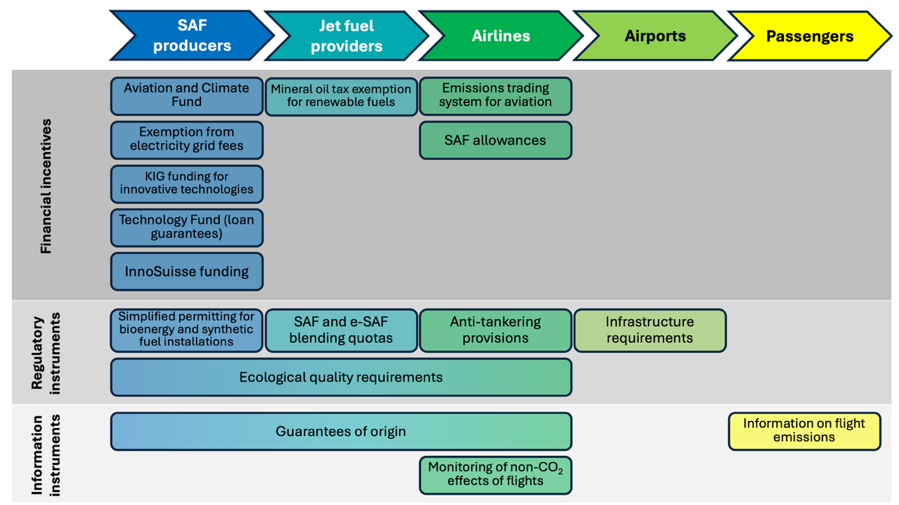
The Swiss policy framework along the SAF value chain
Notes:
Not going to present the policy framework in detail, as that is what we did last year at this same conference; this time we focus on the analysis that we carried out subsequently.
However, this and the next slide present useful overviews. We classify the policy instruments introduced by the Swiss legal framework for SAF according to the type of instrument (financial incentives, command and control regulation, or information instruments), and across the SAF value chain, from the SAF producers, through the jet fuel providers, the airlines, airports, up to the passengers. We classify the instruments according to where they have a direct effect; however, it is often the case that incentives are passed along the value chain; if airlines have to pay for emission allowances under the ETS, that cost is finally passed on to the passengers; if fuel providers have to acquire expensive SAF for blending, that cost will also be passed on to consumers

Slide 8
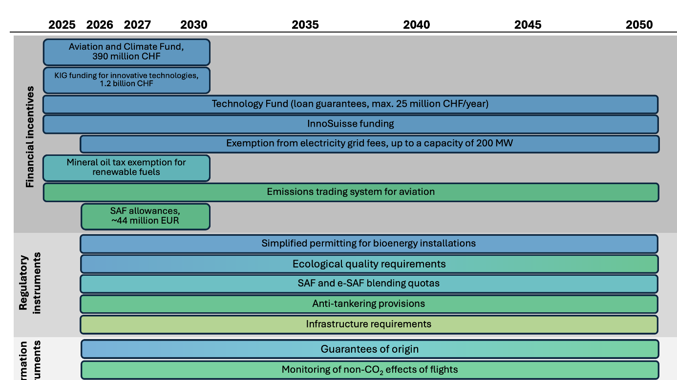
The Swiss policy framework over time
Notes:
Here we classify the same policy instruments identified in the previous slide, but according to how long they are in place according to the current legal framework. One aspect that becomes apparent in this graph is that several of the financial support instruments introduced to help reduce the competitive disadvantage that SAF has compared to conventional fuels and also to support innovation, are currently in place only until 2030.
This is of course not due to short-sightedness, but simply due to the fact that Swiss climate policy follows the 5-year implementation cycles established by the international framework; new targets are set every 5 years, the CO2 law is revised accordingly, most policy instruments are extended, some are replaced. This means, however, that central sources of funding for those financial support mechanism (such as the auction revenues from the ETS) are secured for those 5-year cycles, and consequently, funding is promised for 5-year cycles. While the intention may in principle be to continue with such support, the political reality is that the support is not secure as long as it is not written into law.

Slide 9
Market failures hampering decarbonization of the aviation sector
Climate cost externality
Innovation spillovers
Coordination failures
Information asymmetry
Price of fossil fuels does not cover costs of climate impacts
New (SAF) technology generates unpriced societal benefits
Between various market participants along value chain
Between producers, regulators, and consumers of aviation fuels

Slide 10
The climate cost externality
The problem
Fossil fuels structurally subsidized globally
International aviation historically exempt from (climate) regulation
→ Price advantage for kerosene over sustainable alternatives (SAF, rail)
The policy response
Aviation ETS → carbon price on intra-European flights
SAF blending quotas → high penalties if unmet
Anti-tankering → prevents circumventing SAF quotas
Sustainability criteria for SAF → GHG reduction requirements
Globally: CORSIA requires offsetting or SAF
Remaining gaps
ETS price (71 €/tCO₂e in May 2026) below social cost of carbon
ETS covers only flights between CH, EU and UK
Non-CO₂ climate effects unpriced
Quotas address only blended share
CORSIA relies on offsetting (19 €/tCO₂e in late 2024)
Tax exemptions for international aviation remain
Notes:
Aviation ETS → price on carbon emissions on flights between Europe → airlines and consumers
Blending quotas → failure to meet them leads to high compliance costs for fuel suppliers
Anti-tankering provisions preventing airlines from avoiding the SAF quotas by refuelling outside CH or the EU
Sustainability criteria for SAF, establishing minimum requirements for life-cycle GHG reductions
CORSIA, with the goal of achieving carbon-neutral growth of international aviation
--- Full wording removed from the slide (for speaking) ---
• International aviation historically exempted from (climate) regulations affecting other sectors
• → Price advantage for kerosene compared to more sustainable alternatives (SAF, rail)
• Aviation ETS → price on carbon on flights within Europe
• SAF blending quotas in supplied jet fuel → high penalties if unmet
• Anti-tankering provisions → prevent circumventing SAF blending mandate
• Globally: CORSIA, requiring offsetting of emissions
• Carbon prices in aviation ETS (71 €/tCO2e in May 2026) below social cost of carbon
• Aviation ETS covers only flights between CH, EU and UK
• Non-CO2 climate effects of aviation unpriced under ETS
• Blending quotas only address emissions of blended component
• CORSIA relies on offsetting (19 €/tCO2e in late 2024)
• Tax exemptions for international aviation remain

Slide 11
Innovation spillovers
The problem
New technological expertise (in PtX, or e-SAF) has positive externalities for industry
Production has very high upfront investment costs
Underinvestment despite high societal value
→ “first mover, first loser” problem
The policy response
Funding for technology and value chain creation:
FOCA’s Aviation and Climate funding programme
Innovative clean technologies under Climate and Innovation Act
P&D funding from the SFOE
Other smaller or less targeted instruments (e.g. Innosuisse)
Remaining gaps
P&D funding discontinued following austerity measures
Support limited in scope and duration, and partly hard to access
High investment cost barrier for commercial operation unsolved
Notes:
--- Full wording removed from the slide (for speaking) ---
• New technological expertise (for PtX, or e-SAF production) has positive externalities: broader industry benefits
• Production has very high upfront investment costs
• Several funding instruments offer support for tech development and value chain creation:
• Funding for innovative technologies under the Climate and Innovation Act
• Other smaller or less targeted funding instruments (Innosuisse)
• P&D funding discontinued following recent austerity measures
• Support available limited in its scope and temporal availability, and partly difficult to access
• High investment cost barrier for commercial operation not solved

Slide 12
Coordination failures
The problem
e-SAF producers need long-term offtake certainty to raise capital
Offtakers reluctant at current prices; used to a spot market
Industry waits for regulation to improve (more support) or weaken (relax mandates)
Projects fail to materialize
→ Failures deter potential investors further (vicious circle)
The policy response
Strong demand signal: blending quotas with high penalties
Repeated signalling that quotas will not be weakened
Financial support, particularly the loan guarantees (Aviation and Climate programme)
SAF allowances reduce the price gap of SAF for airlines
Remaining gaps
Planned 2027 review of ReFuelEU Aviation weakens demand signal
Petroleum industry not investing in SAF production
Financial support limited; mostly for pre-investment studies
SAF allowances only for ETS flights, so far only until 2030
Notes:
--- Full wording removed from the slide (for speaking) ---
• E-SAF producers require long-term offtake certainty to secure up-front capital
• Offtakers reluctant to enter long-term contracts at current prices; used to a spot market
• Industry waits for regulation to improve (more support) or weaken (relax mandates)
• → Repeated failures deter potential investors further (vicious circle)
• Strong demand signal from SAF blending quotas with strong penalties for non-compliance
• Repeated signalling by regulatory bodies that blending quotas will not be weakened
• Financial support instruments, particularly the loan guarantees available under the Aviation and Climate programme
• SAF allowances reduce price differential of SAF for airlines
• Planned 2027 review of the ReFuelEU Aviation Regulation weakens demand signal
• Petroleum industry uninterested in investing in SAF production
• Financial support limited; mostly to support pre-investment studies
• SAF allowances only for flights covered under the ETS, and so far available until 2030

Slide 13
Information asymmetries
The problem
Information imbalances across actors along the value chain
On fuel sustainability, feedstock origin, certification systems
→ May undermine confidence, increase greenwashing risk, hinder compliance
The policy response
Quality requirements for (e-)SAF and feedstocks aligned with EU
Guarantees of origin, certification and proof of sustainability to ensure CH-EU interoperability and transparency
Obligation to inform consumers about flight emissions (from 2027)
Remaining gaps
Overlapping regulatory systems make access to information difficult
Parallel CH quality criteria for renewable fuels may cause confusion
Criteria and certification under CORSIA differ from CH/EU rules
Complex lifecycle accounting
Consumer information on non-CO₂ effects not comparable
Notes:
FOEN (environment – ETS, SAF quality), SFOE (energy – guarantees of origin), FOCA (CORSIA, blending quotas, funding), MAA (military aviation), FOCBS (import, mineral oil tax)

Slide 14
Progress made, but gaps remain
Market failure | Coverage | How is it addressed | Remaining gap
Negative externalities | 🟡 | Aviation ETS, blending quotas, anti-tankering, fuel standards | Carbon price volatility and limited coverage; kerosene tax exemption; non-CO₂ effects not yet priced
Innovation spillovers | 🟡 | Financial support for P&D projects, Aviation and Climate funding programme, others | Limited support at commercial stage; uncertainty about future support
Coordination failure | 🔴 | Blending quotas, loan guarantees, SAF allowances | Remaining regulatory uncertainty; limited support for derisking of investments; no long-term offtake guarantees
Information asymmetries | 🟢 | Guarantees of origin, sustainability criteria, emissions disclosure, monitoring, certification | Harmonization challenges; complex lifecycle accounting; non-CO₂ reporting to consumers
Notes:
Next steps:
Look at concrete policy proposals (e.g. learning from what other countries are implementing, which we have already screened in another report under WP2), and analyse their effects (legal, economic, on the energy system) in more detail, including quantitatively through modelling under WP3
Offer policy recommendations on that basis

Slide 15
Acknowledgement
The research published in this presentation was carried out with the support of the Swiss Federal Office of Energy as part of
The authors bear sole responsibility for the conclusions and the results presented.
reFuel.ch - Renewable Fuels and Chemicals for Switzerland
reFuel.ch is a consortium sponsored by the Swiss Federal Office of Energy‘s
SWEET programme and is hosted by Empa.

