Slide 1











Renewable Fuels and Chemicals for Switzerland*
Assessment of international policies
Anna Panarella (USI)
*reFuel.ch is a consortium sponsored by the Swiss Federal Office of Energy‘s SWEET programme and coordinated by Empa.
Notes:
Goal:
Share WP results that will be included in the WP progress report in the annual report 2026
Practice stakeholder adequate communication (young scientists)
Get feedback from Peers
→Concise Annual report, on the spot (present highlights of work done and results achieved, no recounting of last year/proposal) and with reduced effort.

Slide 2

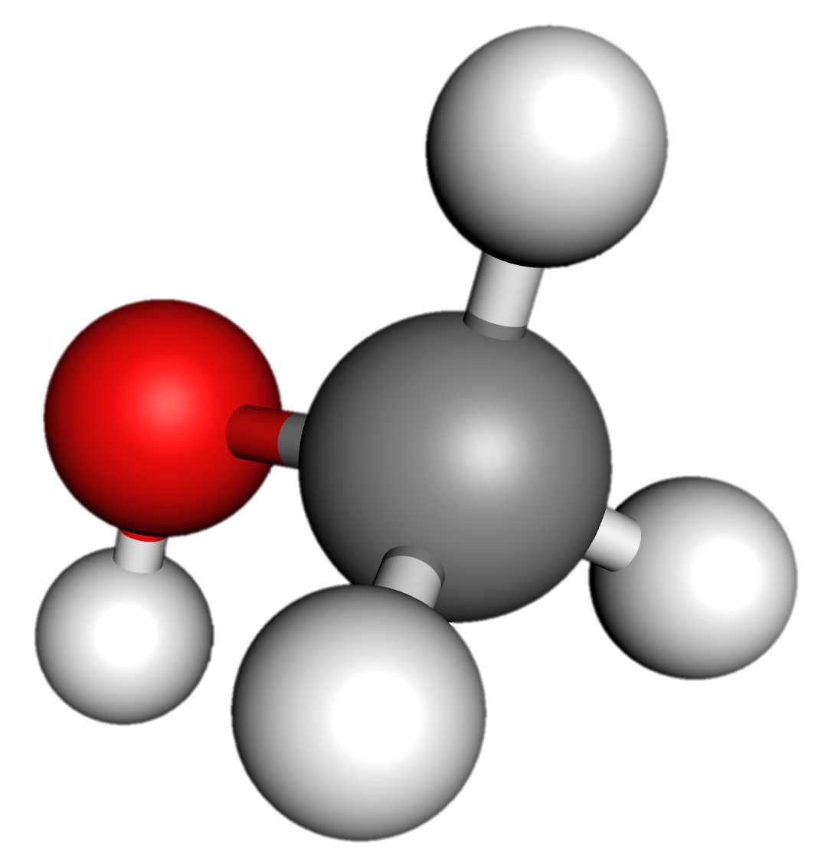
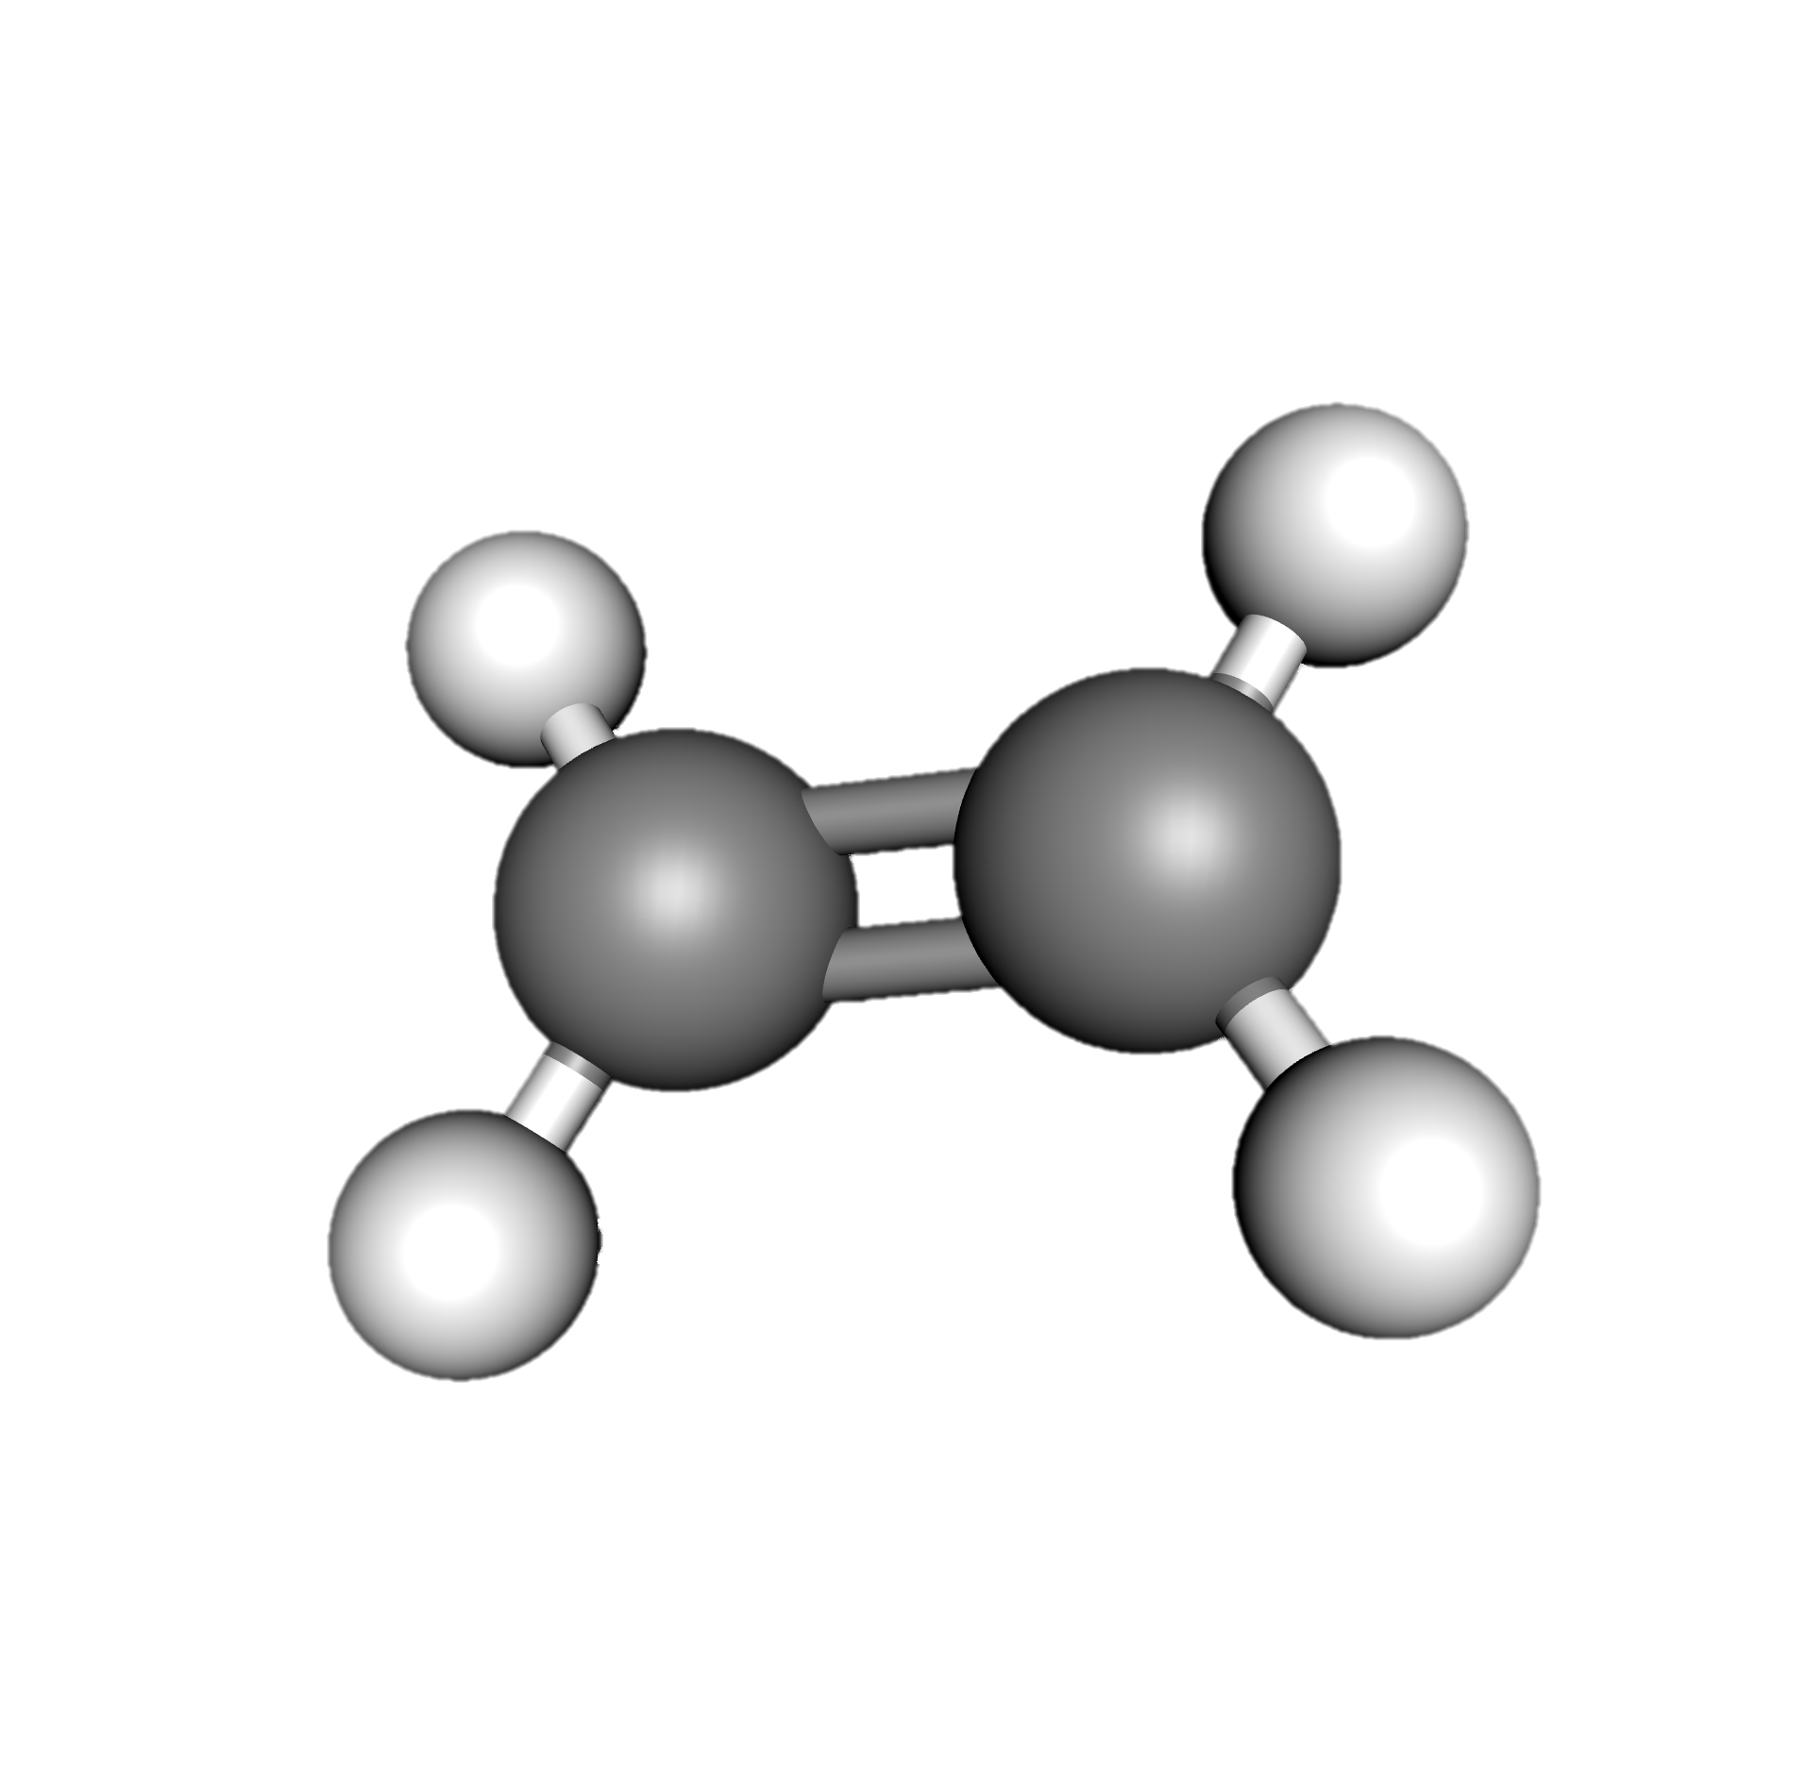



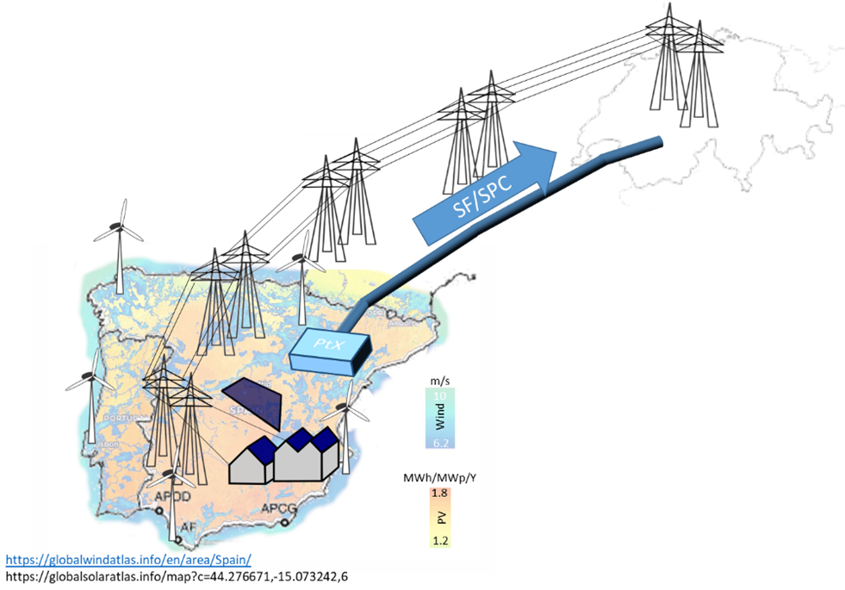
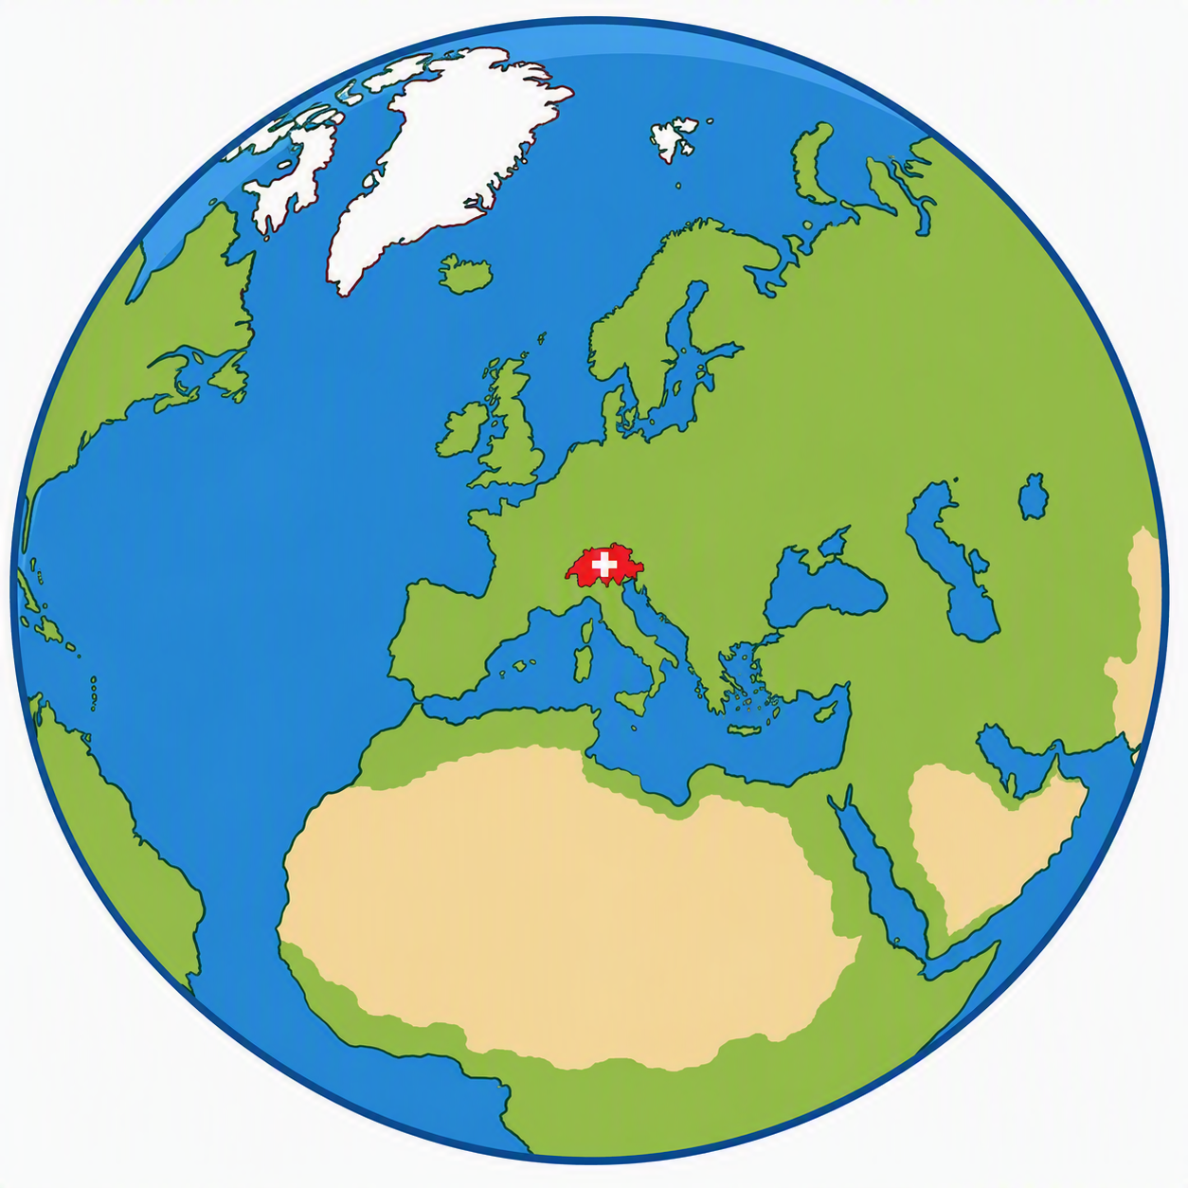
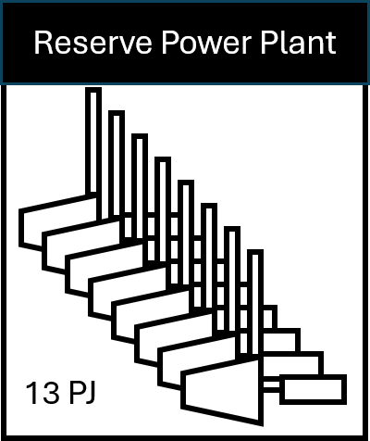
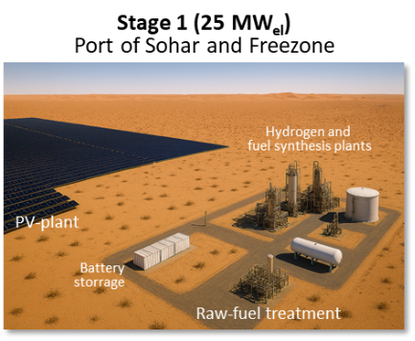
High-level introduction & link to consortium
CO₂
Wet biomass
wastes
Flue gas, air
Biomass to Jet
C_{x}H_{Y}
CO₂
Methanol Synthesis
H₂/ CO
CH₃ OH
Methanol to Olefines
C_{x}H_{2x}
Water
Co-Electrolysis
Olefins to Jet
C_{x}H_{Y}
Green electricity
(PV etc.)
Social, Economic, and Policy Assessment
Energy System and Life Cycle Assessment for Robust and Sustainable Pathways
Electrolysis
Fischer-Tropsch
Green electricity
(PV etc.)
Carbon Capture
RWGS
Water
Own data from experiments / Guidelines from modeling
Biomass to Biogas
Flue gas, air
Expert assessment via Platform 2
Dry biomass wastes

Slide 3
SAF policies and international law: outline
The legal analysis: scope and methodology.
SAF policy measures under international law.
Main international law regimes relevant to SAF policies.
Conclusions.

Slide 4
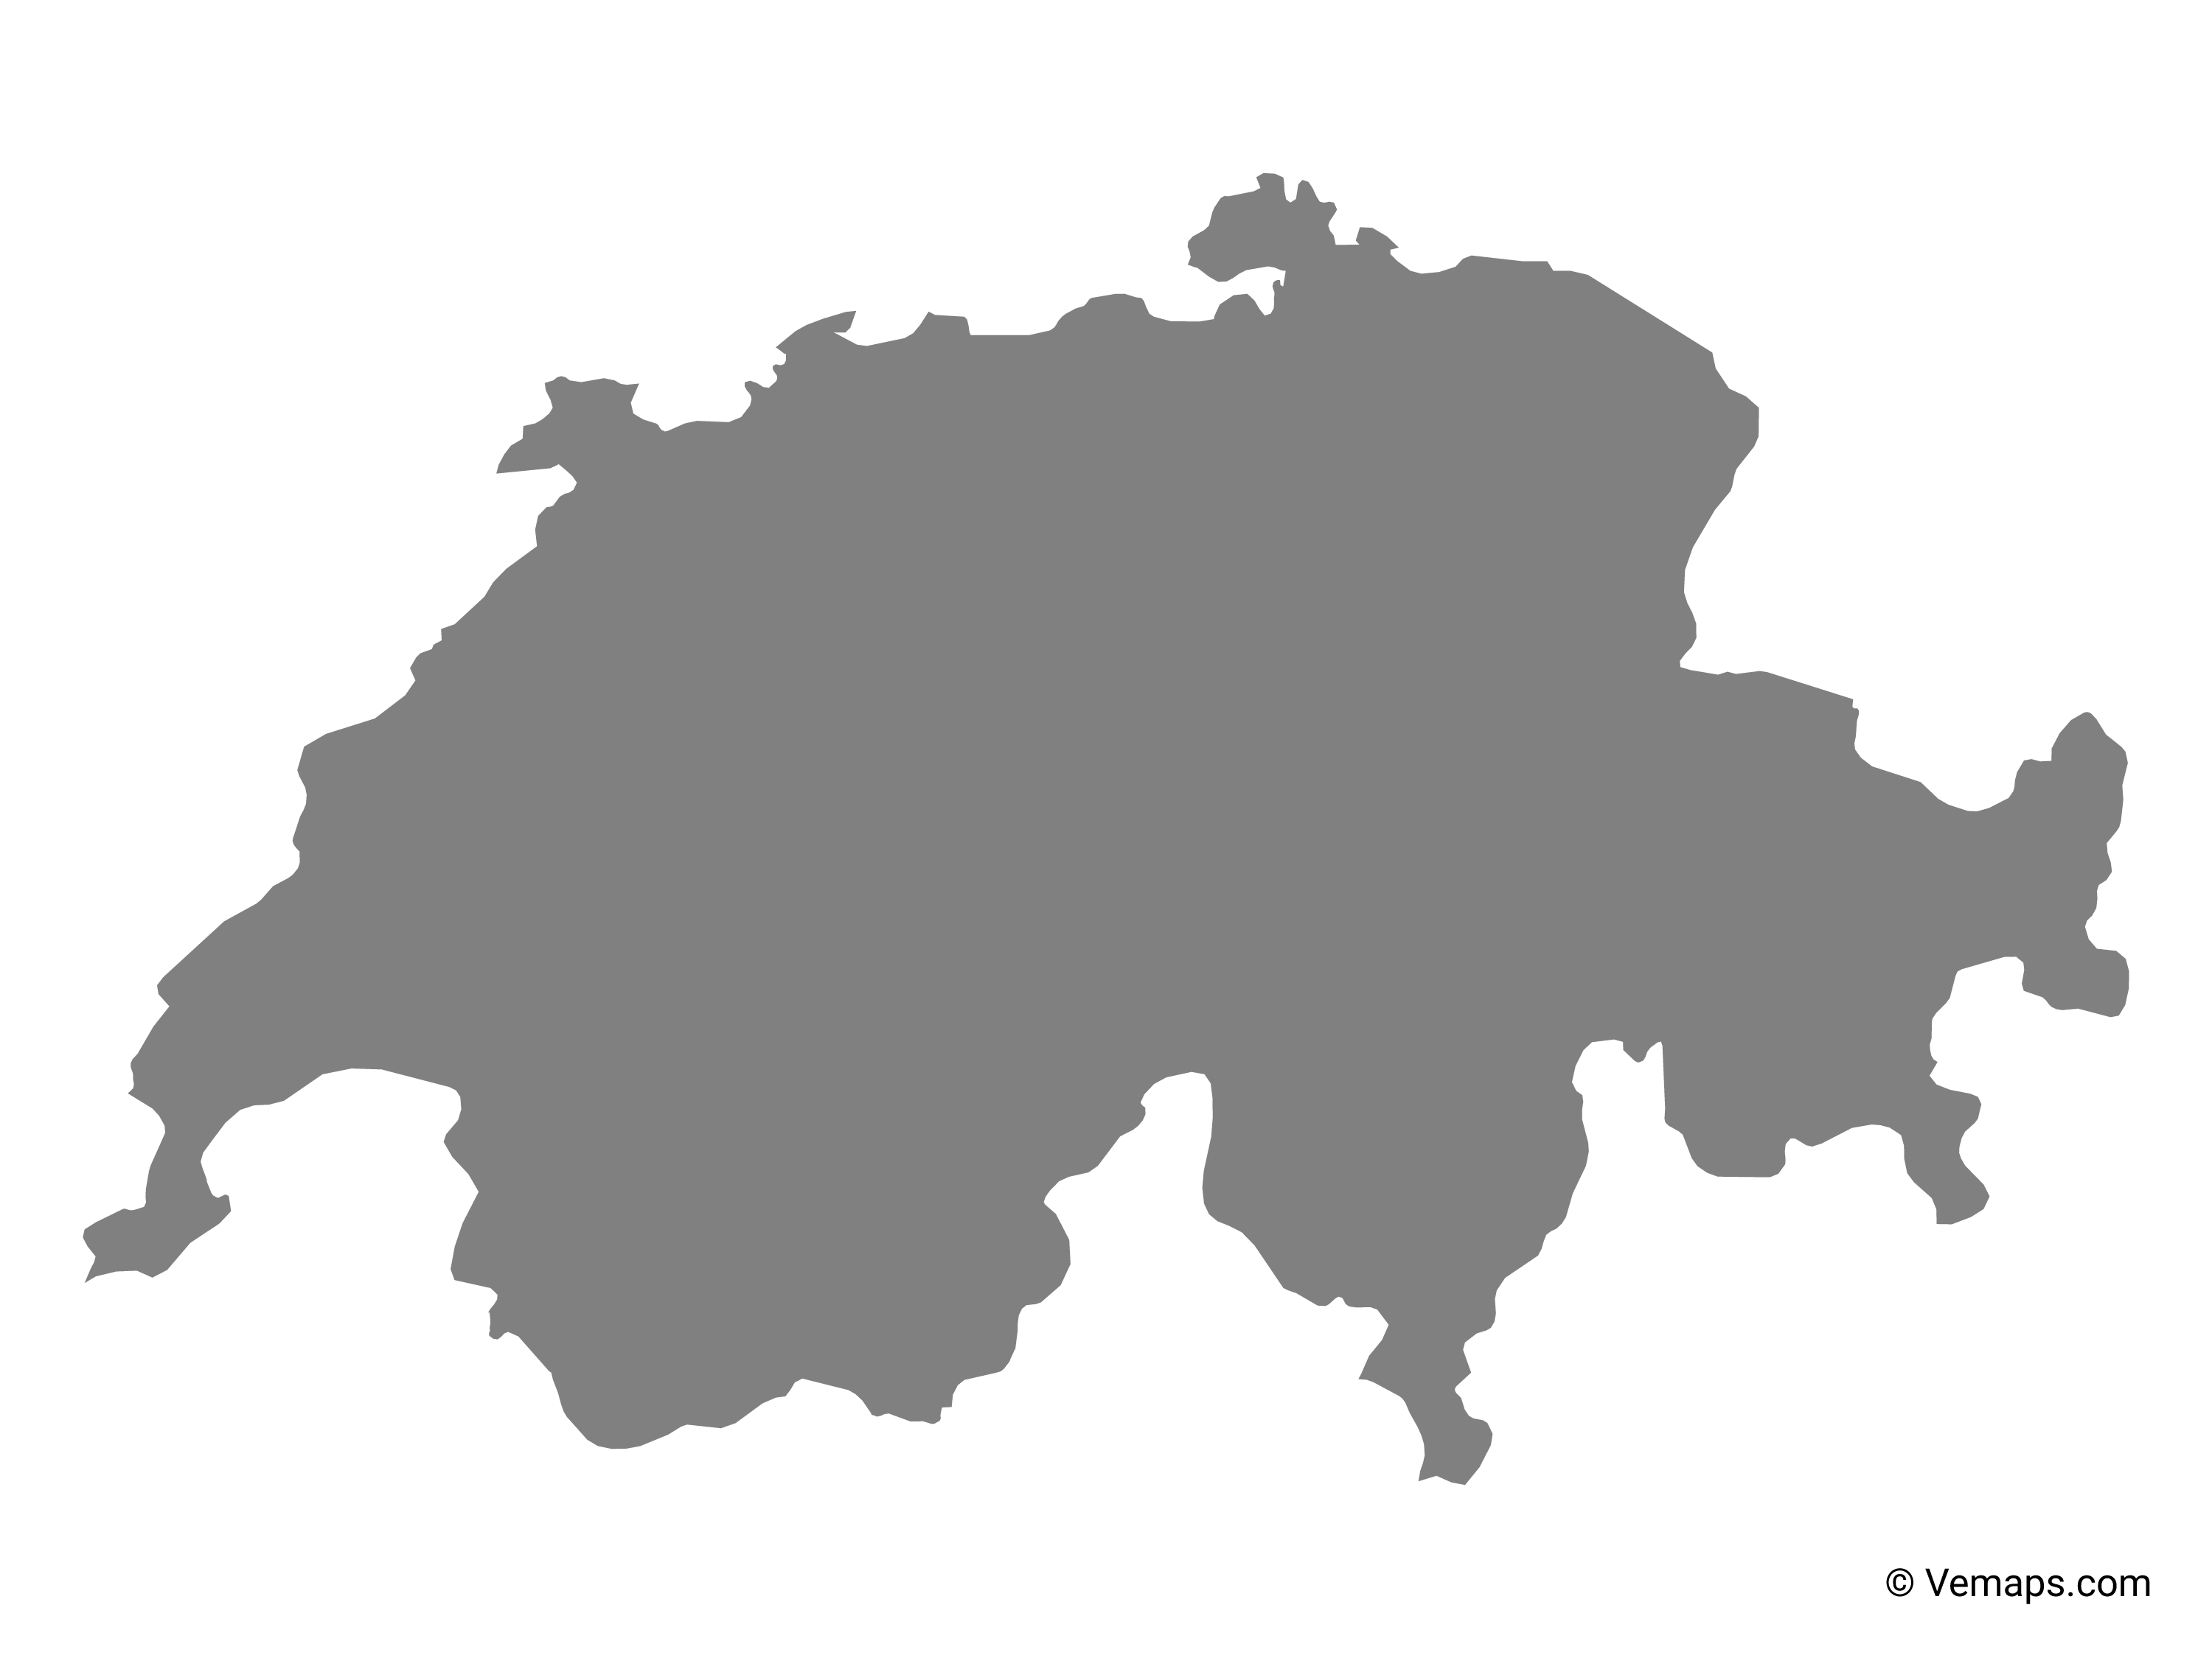
The legal analysis: scope and methodology
Regional dimension
Global dimension
EU law
Public international
law
International environmental law and human rights
UNFCCC – Paris Agreement
ICAO – CORSIA
WTO Agreements
Investment treaties
Geographical proximity
The «Brussels effect»
EU-CH ETS Linking Agreement
Autonomous adaptation of
Swiss law to EU law
A single policy measure may fall under the purview of multiple legal regimes.

Slide 5
The legal analysis: scope and methodology
Fuel Eligible for EU ETS Support (FEETS)
Carbon offsetting for aviation (CORSIA)
Carbon border adjustment mechanism (CBAM)
Sustainability/ecological requirements
Free aviation allowances
Blending mandates
Guarantees of Origin
Taxation
Certification schemes

Slide 6
The legal analysis: the global dimension
International environmental and human rights law
Customary law
International treaties
Case law
Principle of prevention
(due diligence).
Precautionary principle.
UNFCCC.
Paris Agreement.
ECHR.
ICJ Advisory Opinion 2025
Obligations of States in Respect of Climate Change
ECtHR KlimaSeniorinnen v Switzerland case
From this framework, we derive…

Slide 7
Global dimension – SAF Policies
Cross-cutting principles relevant to all SAF policies
International law and SAF policies
1.
Transition away from fossil fuels required by international law → economy-wide targets for all sectors, including aviation.
2.
Ambitious SAF policies comply with the due diligence principle – non-regression
3.
Full life-cycle Environmental Impact Assessment are required for SAF projects.
4.
As a high-income country, Switzerland faces a stringent standard → Instrument choice (e.g. blending mandates) remains a national prerogative.
Notes:
Non è chiaro il

Slide 8
SAF Policies and international law: blending mandates
EU – CH intersection
Interoperability: RFO-compliant SAF and EU-compliant SAF (certified ex Art. 30 RED III) both eligible to count towards Swiss SAF quotas.
For operators
Compliance costs vary depending on route(s) covered.
SAF claims to be attributed to one specific scheme.
SAF Blending mandates; Sustainability requirements.
ICAO - CORSIA
CORSIA Eligible Fuels and own sustainability requirements vs. EU/ CH sustainability requirements
WTO - TBT Agreement
Blending mandates and sustainabilityrequirements as "technical regulations» → international standards if existing and/or appropriate; non-discrimination; not more trade-restrictive than necessary
MRV obligations
Offsetting mechanism vs. ETS
Current Swiss framework likely compliant with this framework:
GHG emission reduction objective;
Extraterritorial reach grounded on the need to target adverse effects linked to Swiss consumption.
Objective undermined unless both national and foreign SAFs targeted
Interoperability with EU facilitates imports.
Flexibility; account for comparable situations across different SAF-producing trading partners.

Slide 9
SAF Policies and international law: SAF allowances
EU – CH Linking Agreement - ETS
Free ETS allowances for SAF use
Level playing field between aircraft operators
Key insights
For operators:
Trade-offs between different schemes.
For policy makers:
SAF support measures, such as Contracts for Difference, to be designed in accordance with ASCM rules to avoid scrutiny from trading partners. → e.g., auctioning-based; non-discrimination.
ETS SAF
allowances
WTO – Subsidy discipline (ASCM)
Trading partners and flights departing from, or arriving in Switzerland from, third countries excluded from ETS SAF allowances
→ aircraft operators can still claim the reduction of offsetting obligations under CORSIA .

Slide 10
SAF Policies and international law: other relevant instruments
Taxation
of fossil kerosene
Bilateral Investment Treaties
ICAO Convention, Article 24
Kerosene on board of the aircraft v. kerosene loaded at the point of arrival
Air Service Agreements
Typically exempt unloaded aviation fuels from tax duties on a reciprocal basis
110+ bilateral investment treaties
(BITs)
Mostly concluded before SAF policies
Energy Charter Treaty
(ECT)
Reformed text (not yet ratified)
Offer protection to energy investment broadly, without differentiating between fossil and renewable energy → Reform / update needed
Switzerland has excluded from protection (a) non-low-carbon hydrogen (b) synthetic fuels that do not achieve a minimum life-cycle GHG emissions saving of 70%. → FF investments remain protected

Slide 11
An enabling environment for SAF development: International law imposes real but manageable constraints (design and implementation of SAF policies) and offers more policy space that it is commonly assumed.
Reforming existing regulatory frameworks that do not reflect SAF policy priorities (such as BITs) and navigate multi-level legal obligations in the design and implementation of new instruments/legal frameworks.
Risks and opportunities: A less ambitious design (e.g. weaker sustainability criteria or blending mandates) breaches non-regression and invites investor challenge. Flexible instruments, such as CfDs, are preferable.
Main takeaways for Switzerland:
  Global dimension: Switzerland's action should be guided by the cross-cutting principles of international environmental and human rights law, along with international trade rules as they apply to SAF policy.
  Regional dimension: different possible strategies
    Full alignment with the EU framework → greater integration of Switzerland into the EU SAF market.
    Maintain a distinct, comparatively less stringent framework than the EU → market-differentiation strategy, positioning itself as a complementary, cost-competitive destination for SAF imports .
Conclusions

Slide 12
Acknowledgement
The research published in this presentation was carried out with the support of the Swiss Federal Office of Energy as part of
The authors bear sole responsibility for the conclusions and the results presented.
reFuel.ch - Renewable Fuels and Chemicals for Switzerland
reFuel.ch is a consortium sponsored by the Swiss Federal Office of Energy‘s
SWEET programme and is hosted by Empa.

