Slide 1
PRESENTED TO: Name of Recipient Here
DATE: February 27, 2025
SEAM_Pitchdeck_052924

Slide 2

SEAM (Strategic Eudaimonia Asset Management) is the managed investment program offered by KEAP.
We seek to help your clients enjoy better lives and thrive. Through SEAM, we offer professionally managed portfolios that blend strategic with tactical investment approaches. KEAP’s skilled and experienced team focuses on a strategic three-to-five year investment outlook, while adjusting tactically to address dislocations in the markets, as needed.
SEAM portfolios are a core component of your clients’ overall wealth strategy. They employ our Wealth Protection Signal (WPS) using real-time market measurements to help protect client wealth during periods of extreme volatility. Our Recession Probability Tool (RPT) looks into the future to measure the likelihood of long-term market conditions. Together WPS and RPT encourage objective investment decisions based on facts rather than emotions.

Slide 3
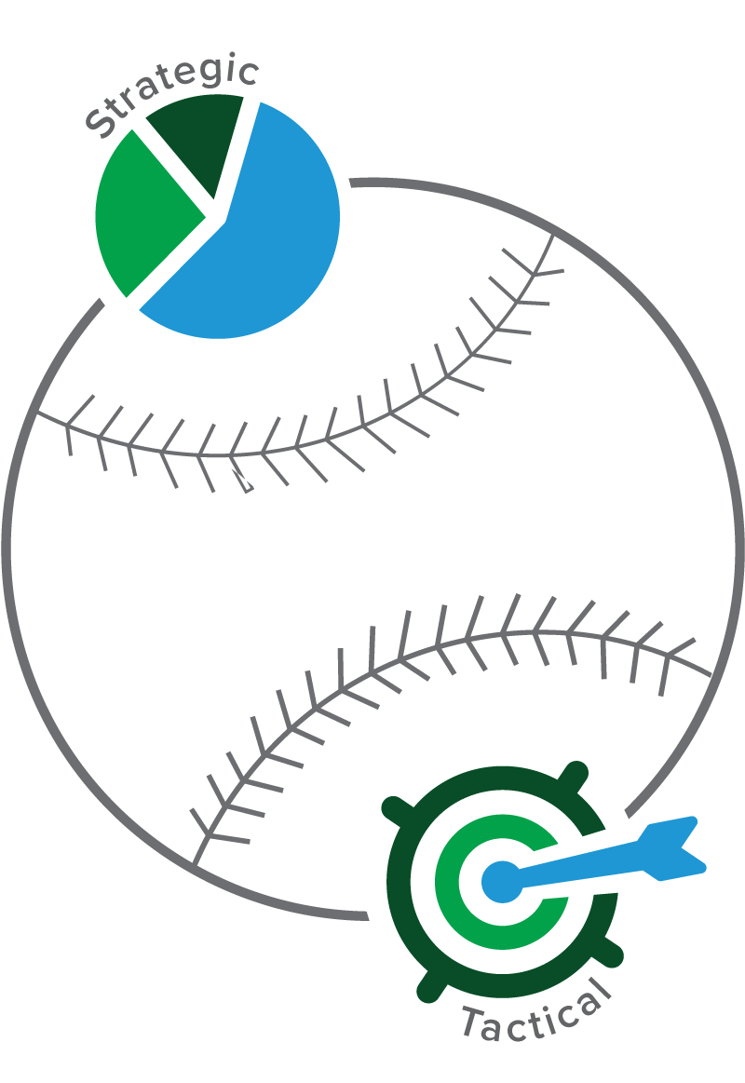
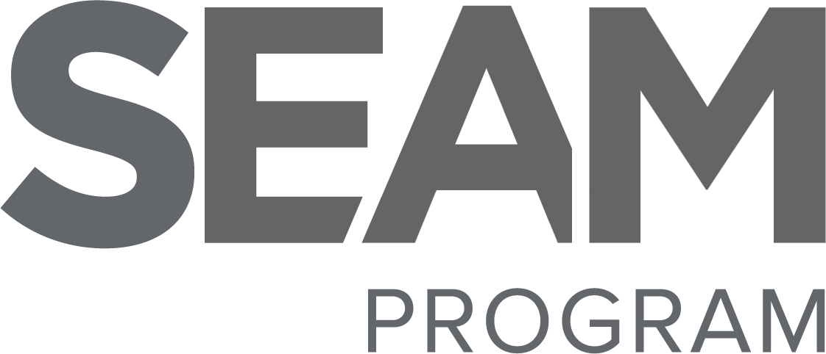
Why
By combining Strategic and Tactical investment approaches, your clients benefit from a sound, time-tested process to asset allocation and rational, emotionless analysis to protect investor capital.
Like a “seam”, our portfolios merge the benefits of both investment styles.

Slide 4
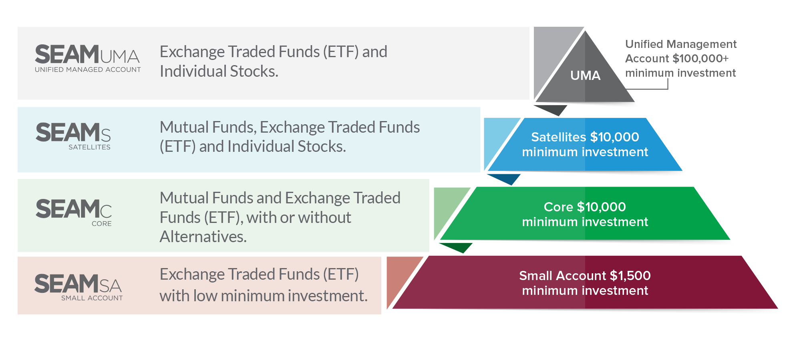
Programs
SEAM offers a range of investment programs to meet the needs of most investors
Customized
Targeted
Foundational
New Investor

Slide 5
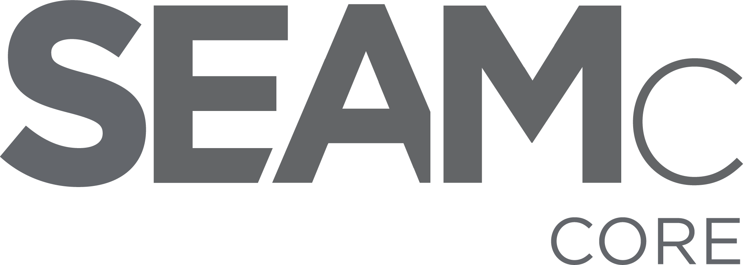
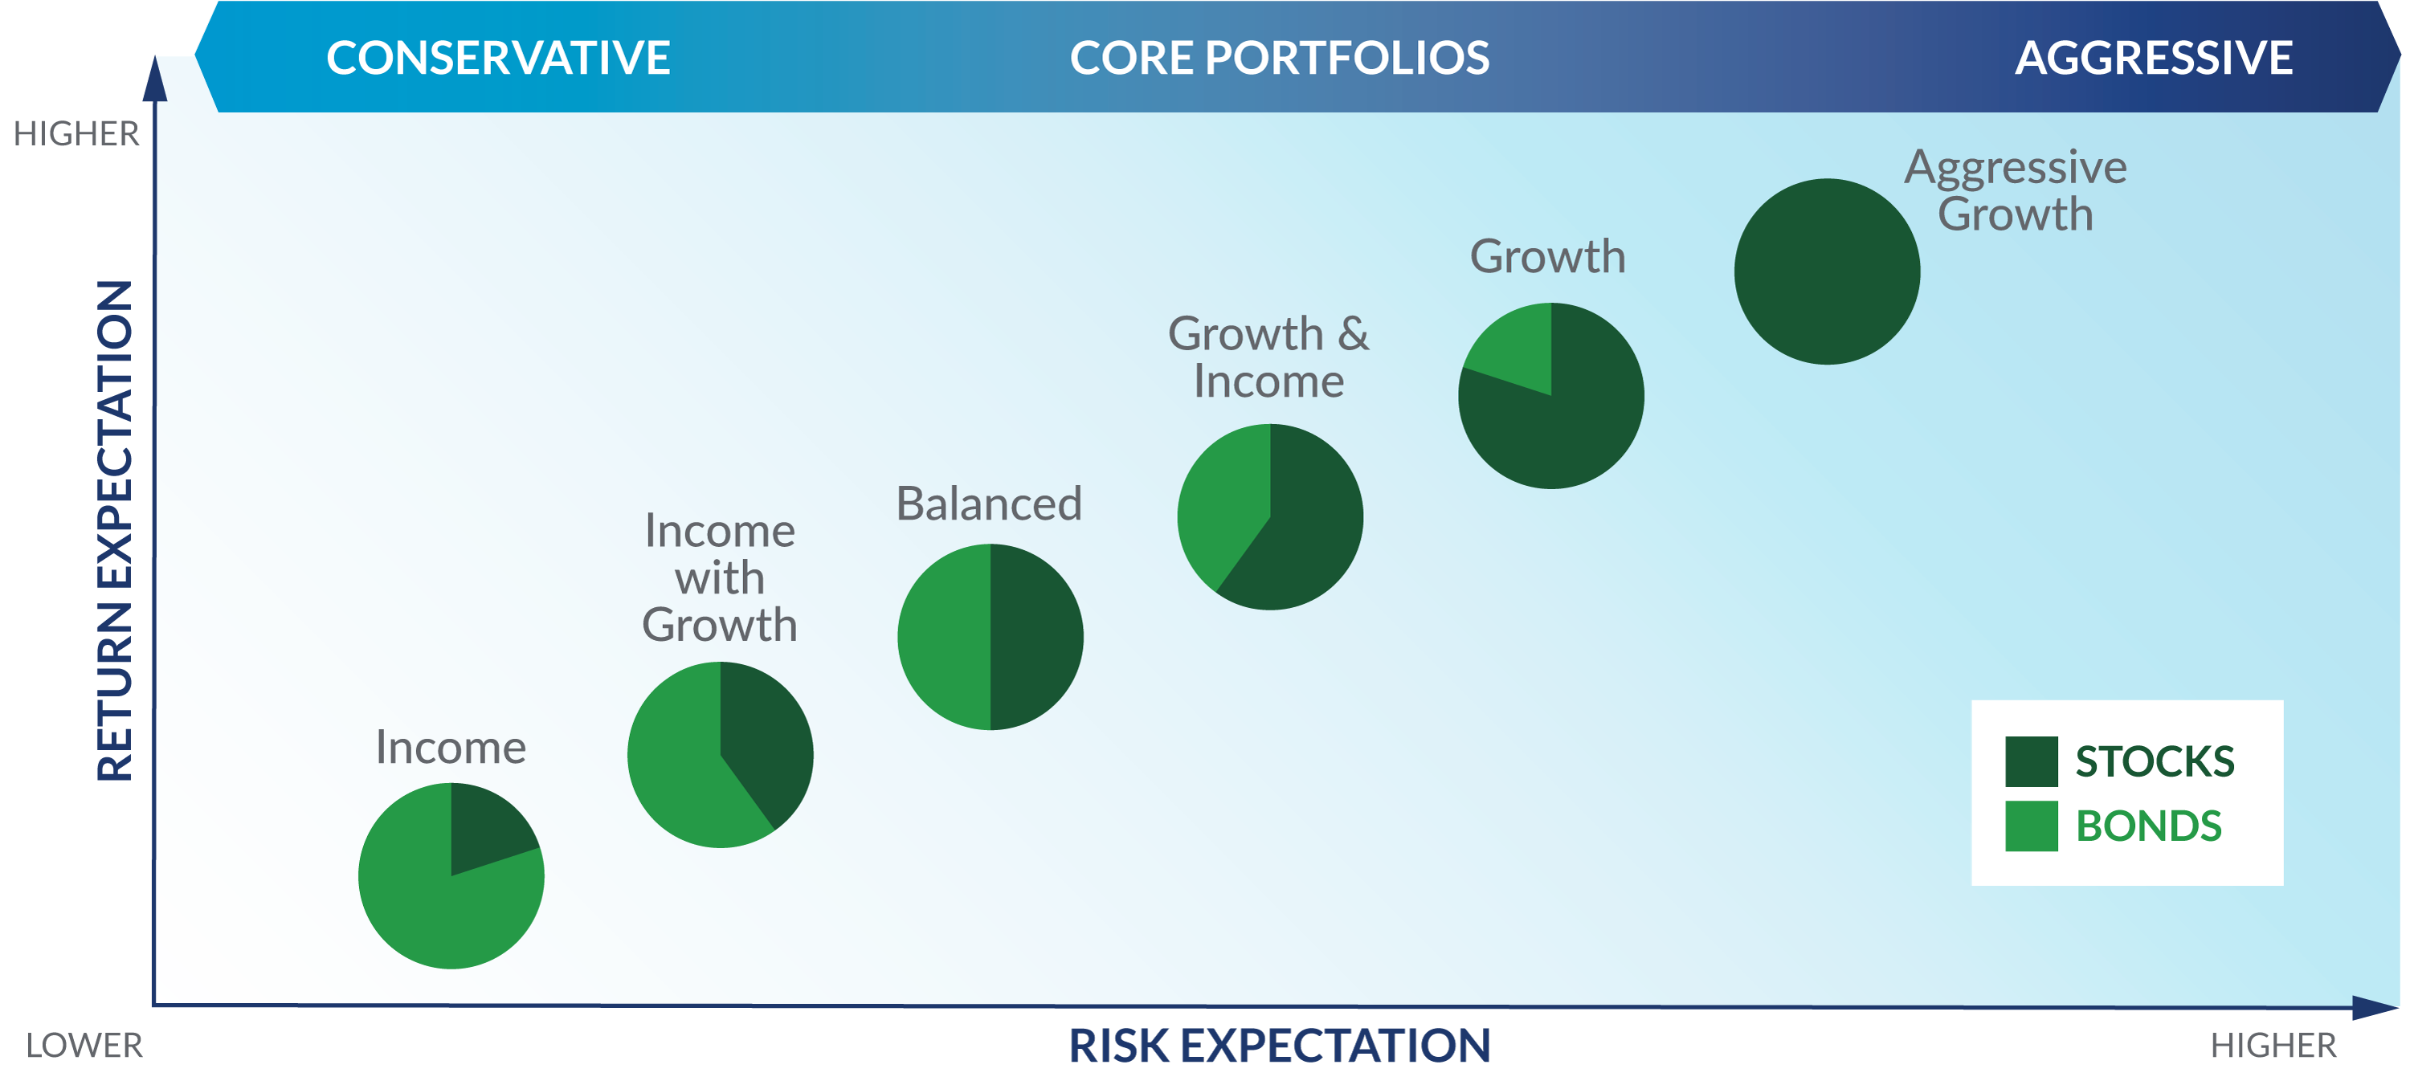
Portfolios
Core without Alternatives
Clients select from different portfolios to match their risk tolerance and targeted long-term goals.
Six SEAM Mutual Fund models. Appropriate for tax-deferred accounts.
Six SEAM ETF (Exchange-traded Funds) models. Appropriate for taxable accounts.

Slide 6
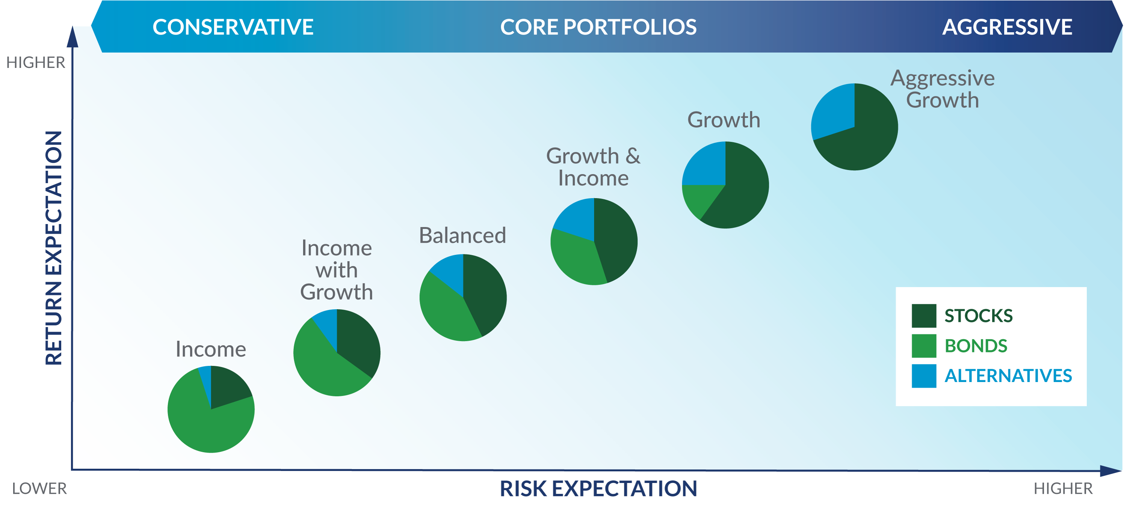
Portfolios
Core with Alternatives
Clients select from different portfolios to match their risk tolerance and targeted
long-term goals.
Six SEAM Mutual Fund models. Appropriate for tax-deferred accounts.
Six SEAM ETF (Exchange-traded Funds) models. Appropriate for taxable accounts.

Slide 7
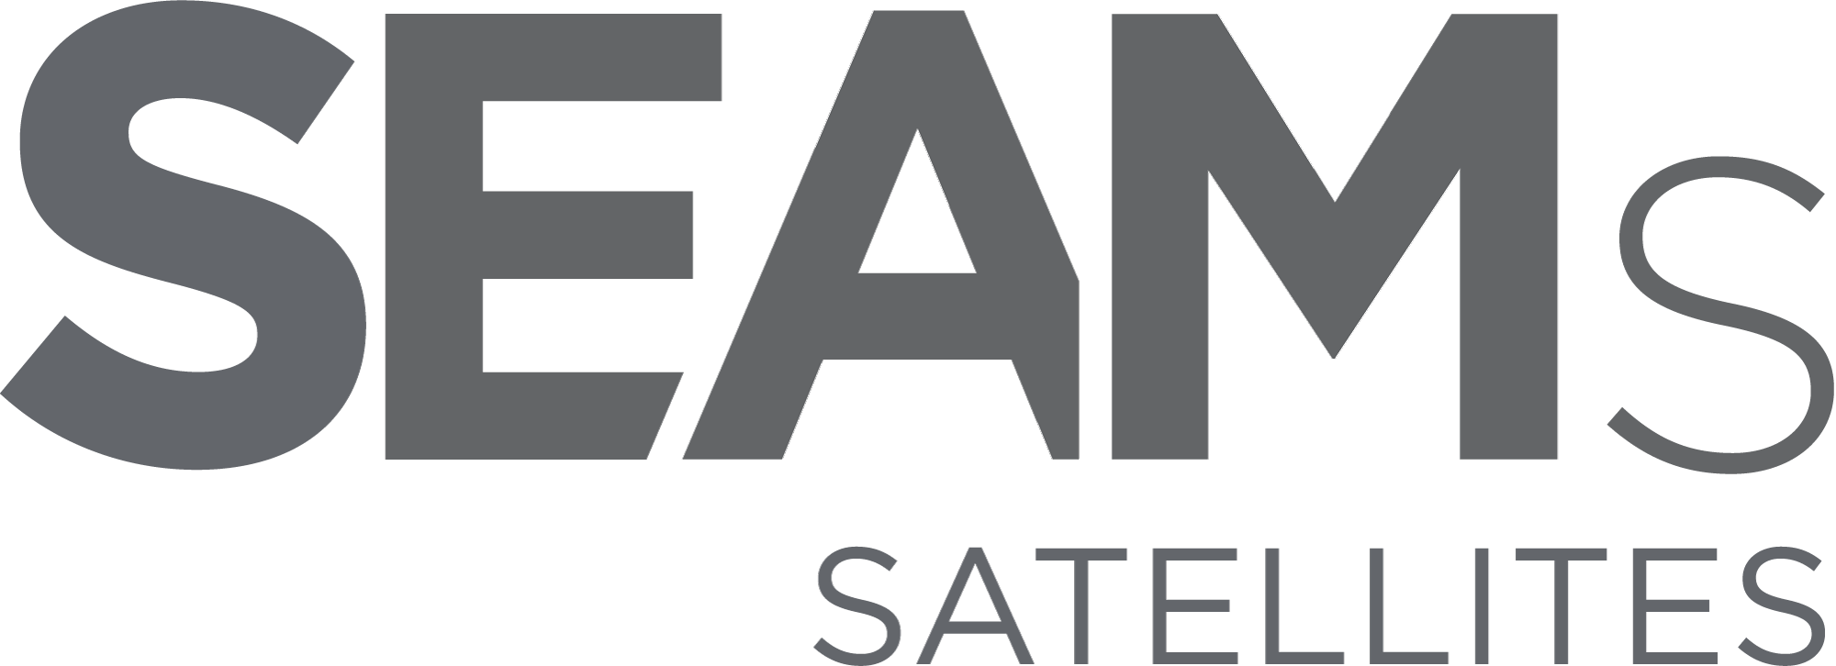
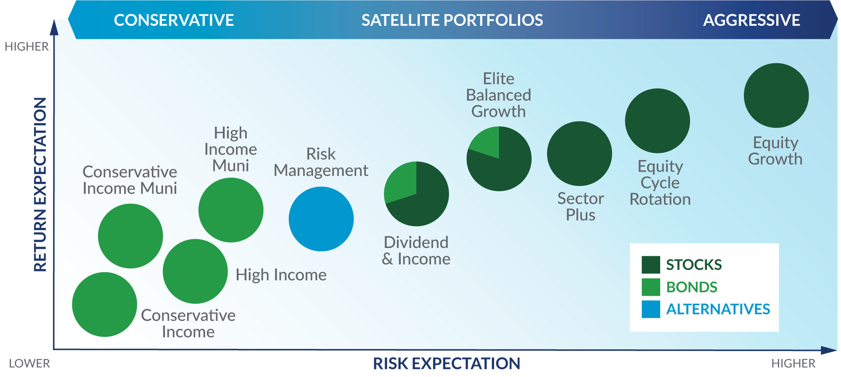
Portfolios
Core with Satellites
Clients select from different portfolios to match their risk tolerance and targeted
long-term goals.
Six SEAM ETF (Exchange-traded Funds) models. Appropriate for taxable accounts (excluding Elite Balance Growth portfolio) and/or accounts with specific objectives.

Slide 8
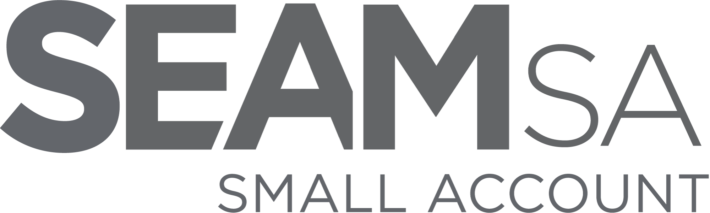
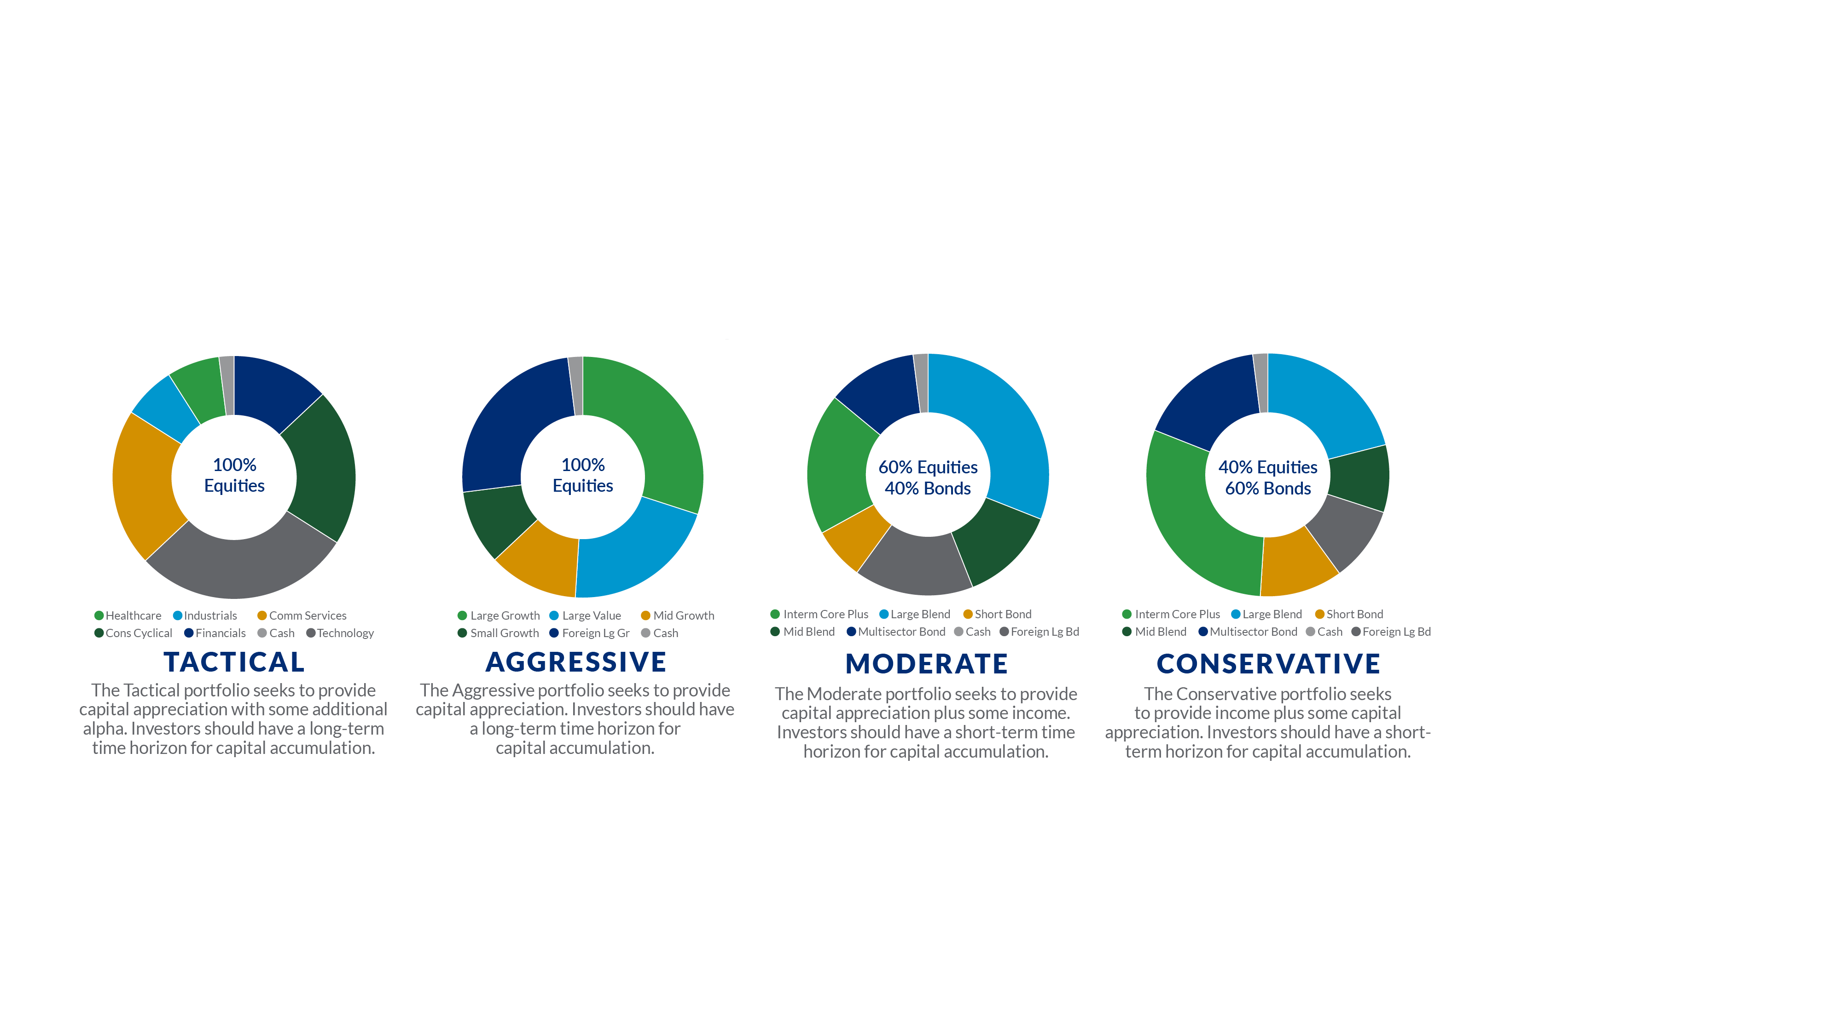
Portfolios
Small Account
Clients select from different portfolios to match their risk tolerance and targeted long-term goals.
Four SEAM ETF (Exchange-traded Funds) models. Appropriate for taxable accounts.

Slide 9
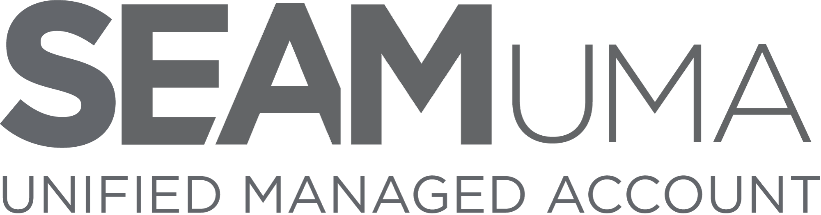
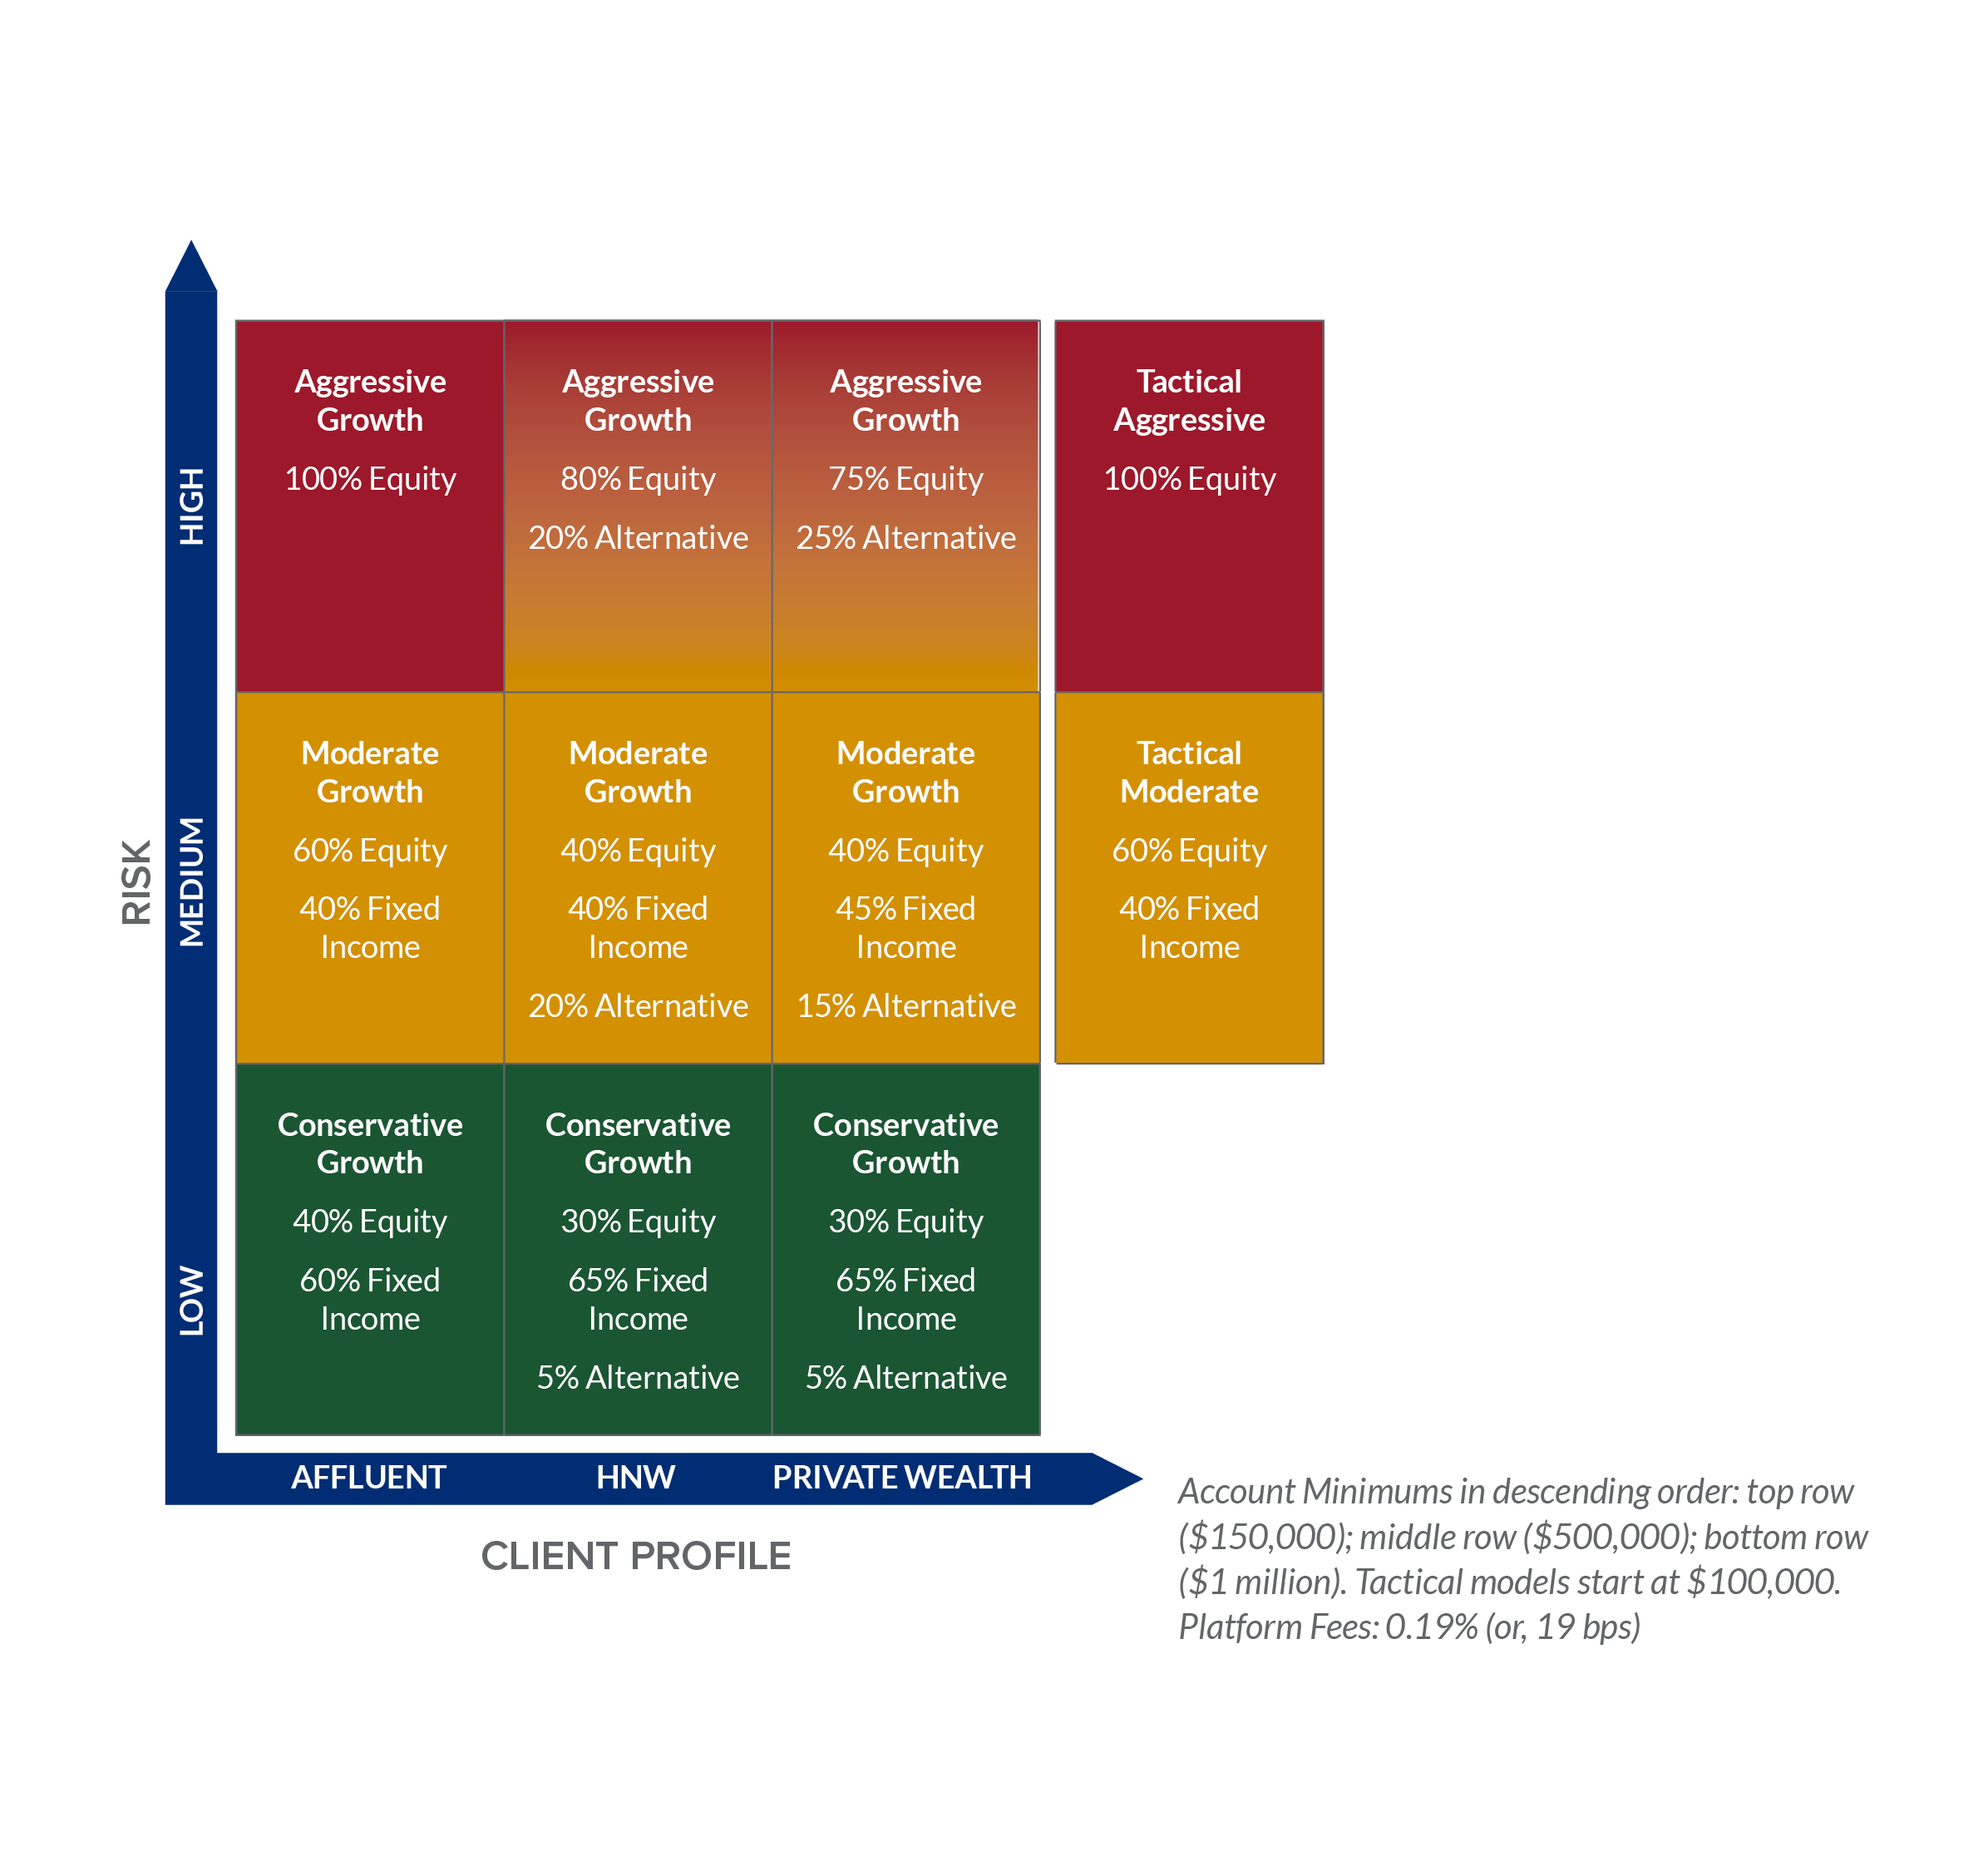
Portfolios
Unified Managed Account
Clients select from different portfolios to match their risk tolerance and targeted long-term goals.
Eleven SEAM UMA models utilizing ETFs (Exchange-traded Funds) and individual securities utilizing SEAM portfolios.
Account minimums apply as follows:
Affluent ($150,000)
High Net Worth ($500,000)
Private Wealth ($1,000,000)
Tactical portfolios ($100,000)

Slide 10
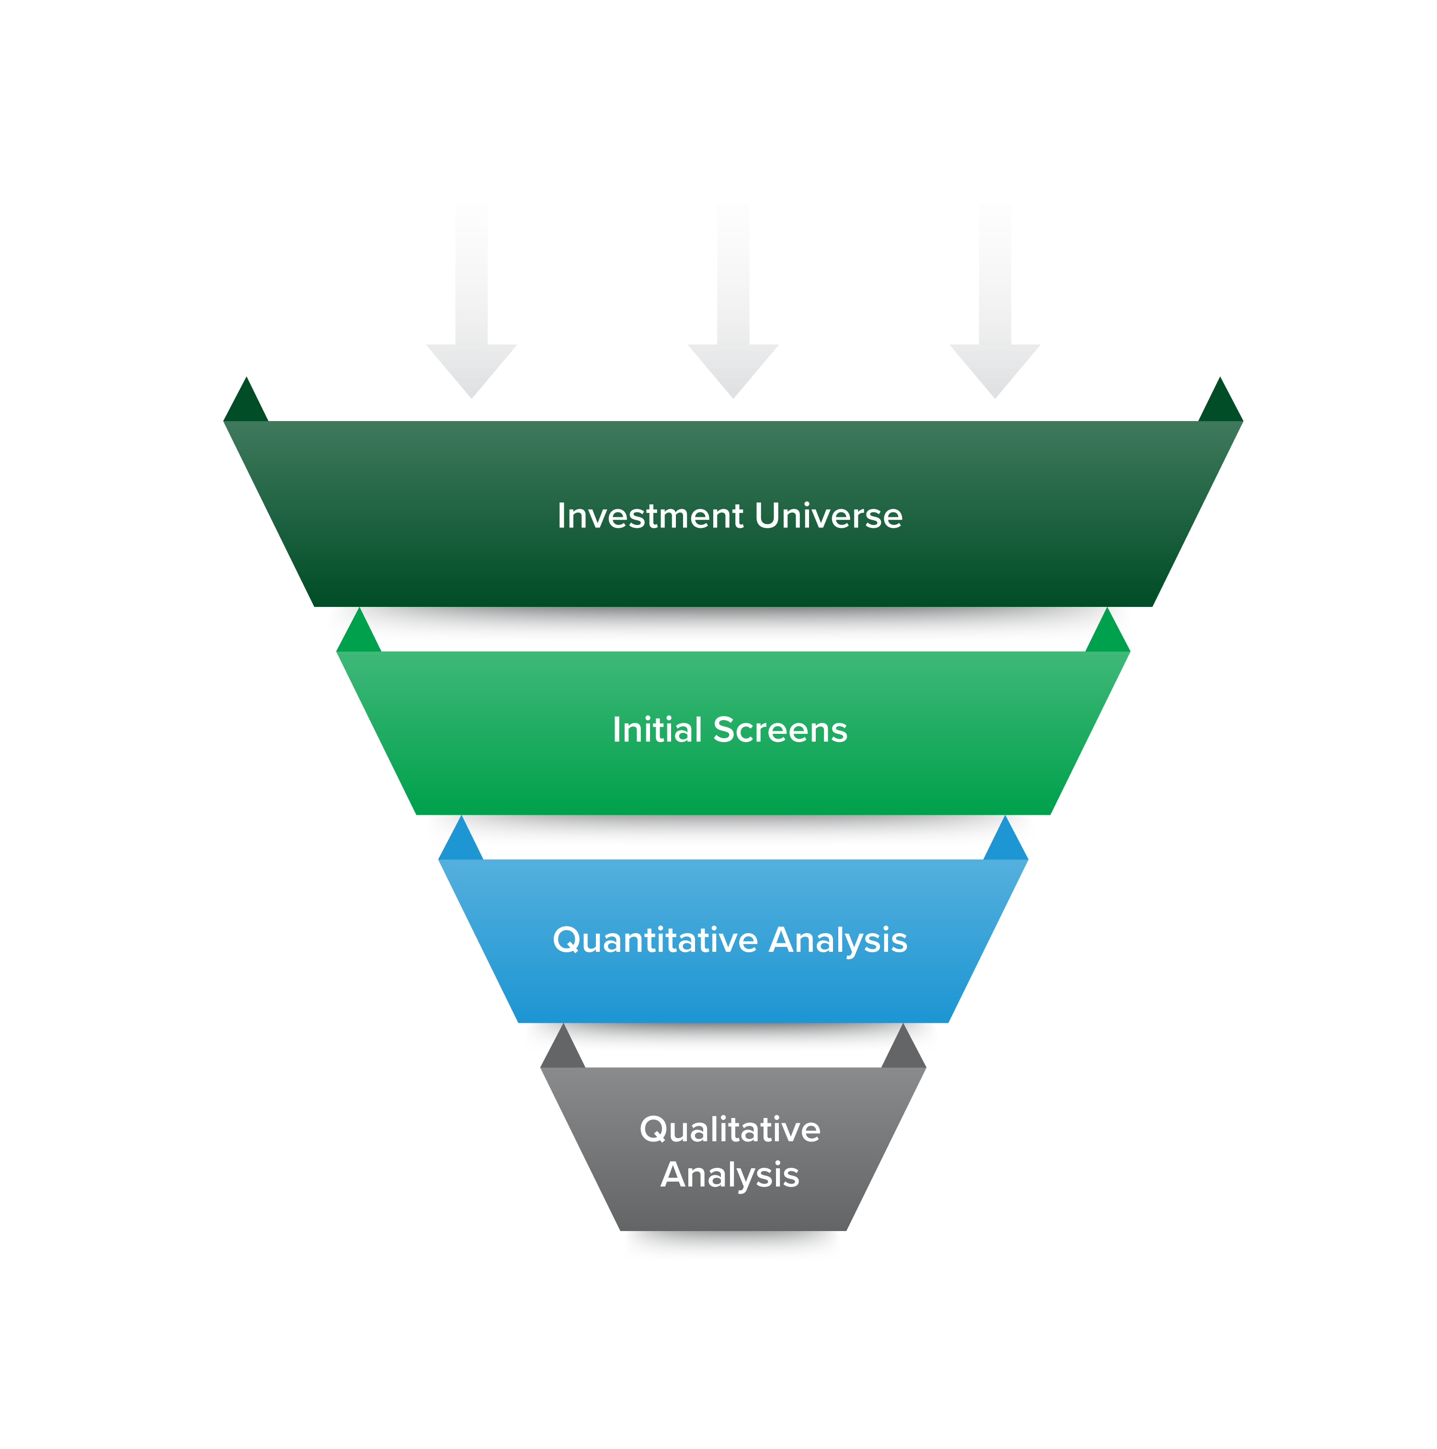
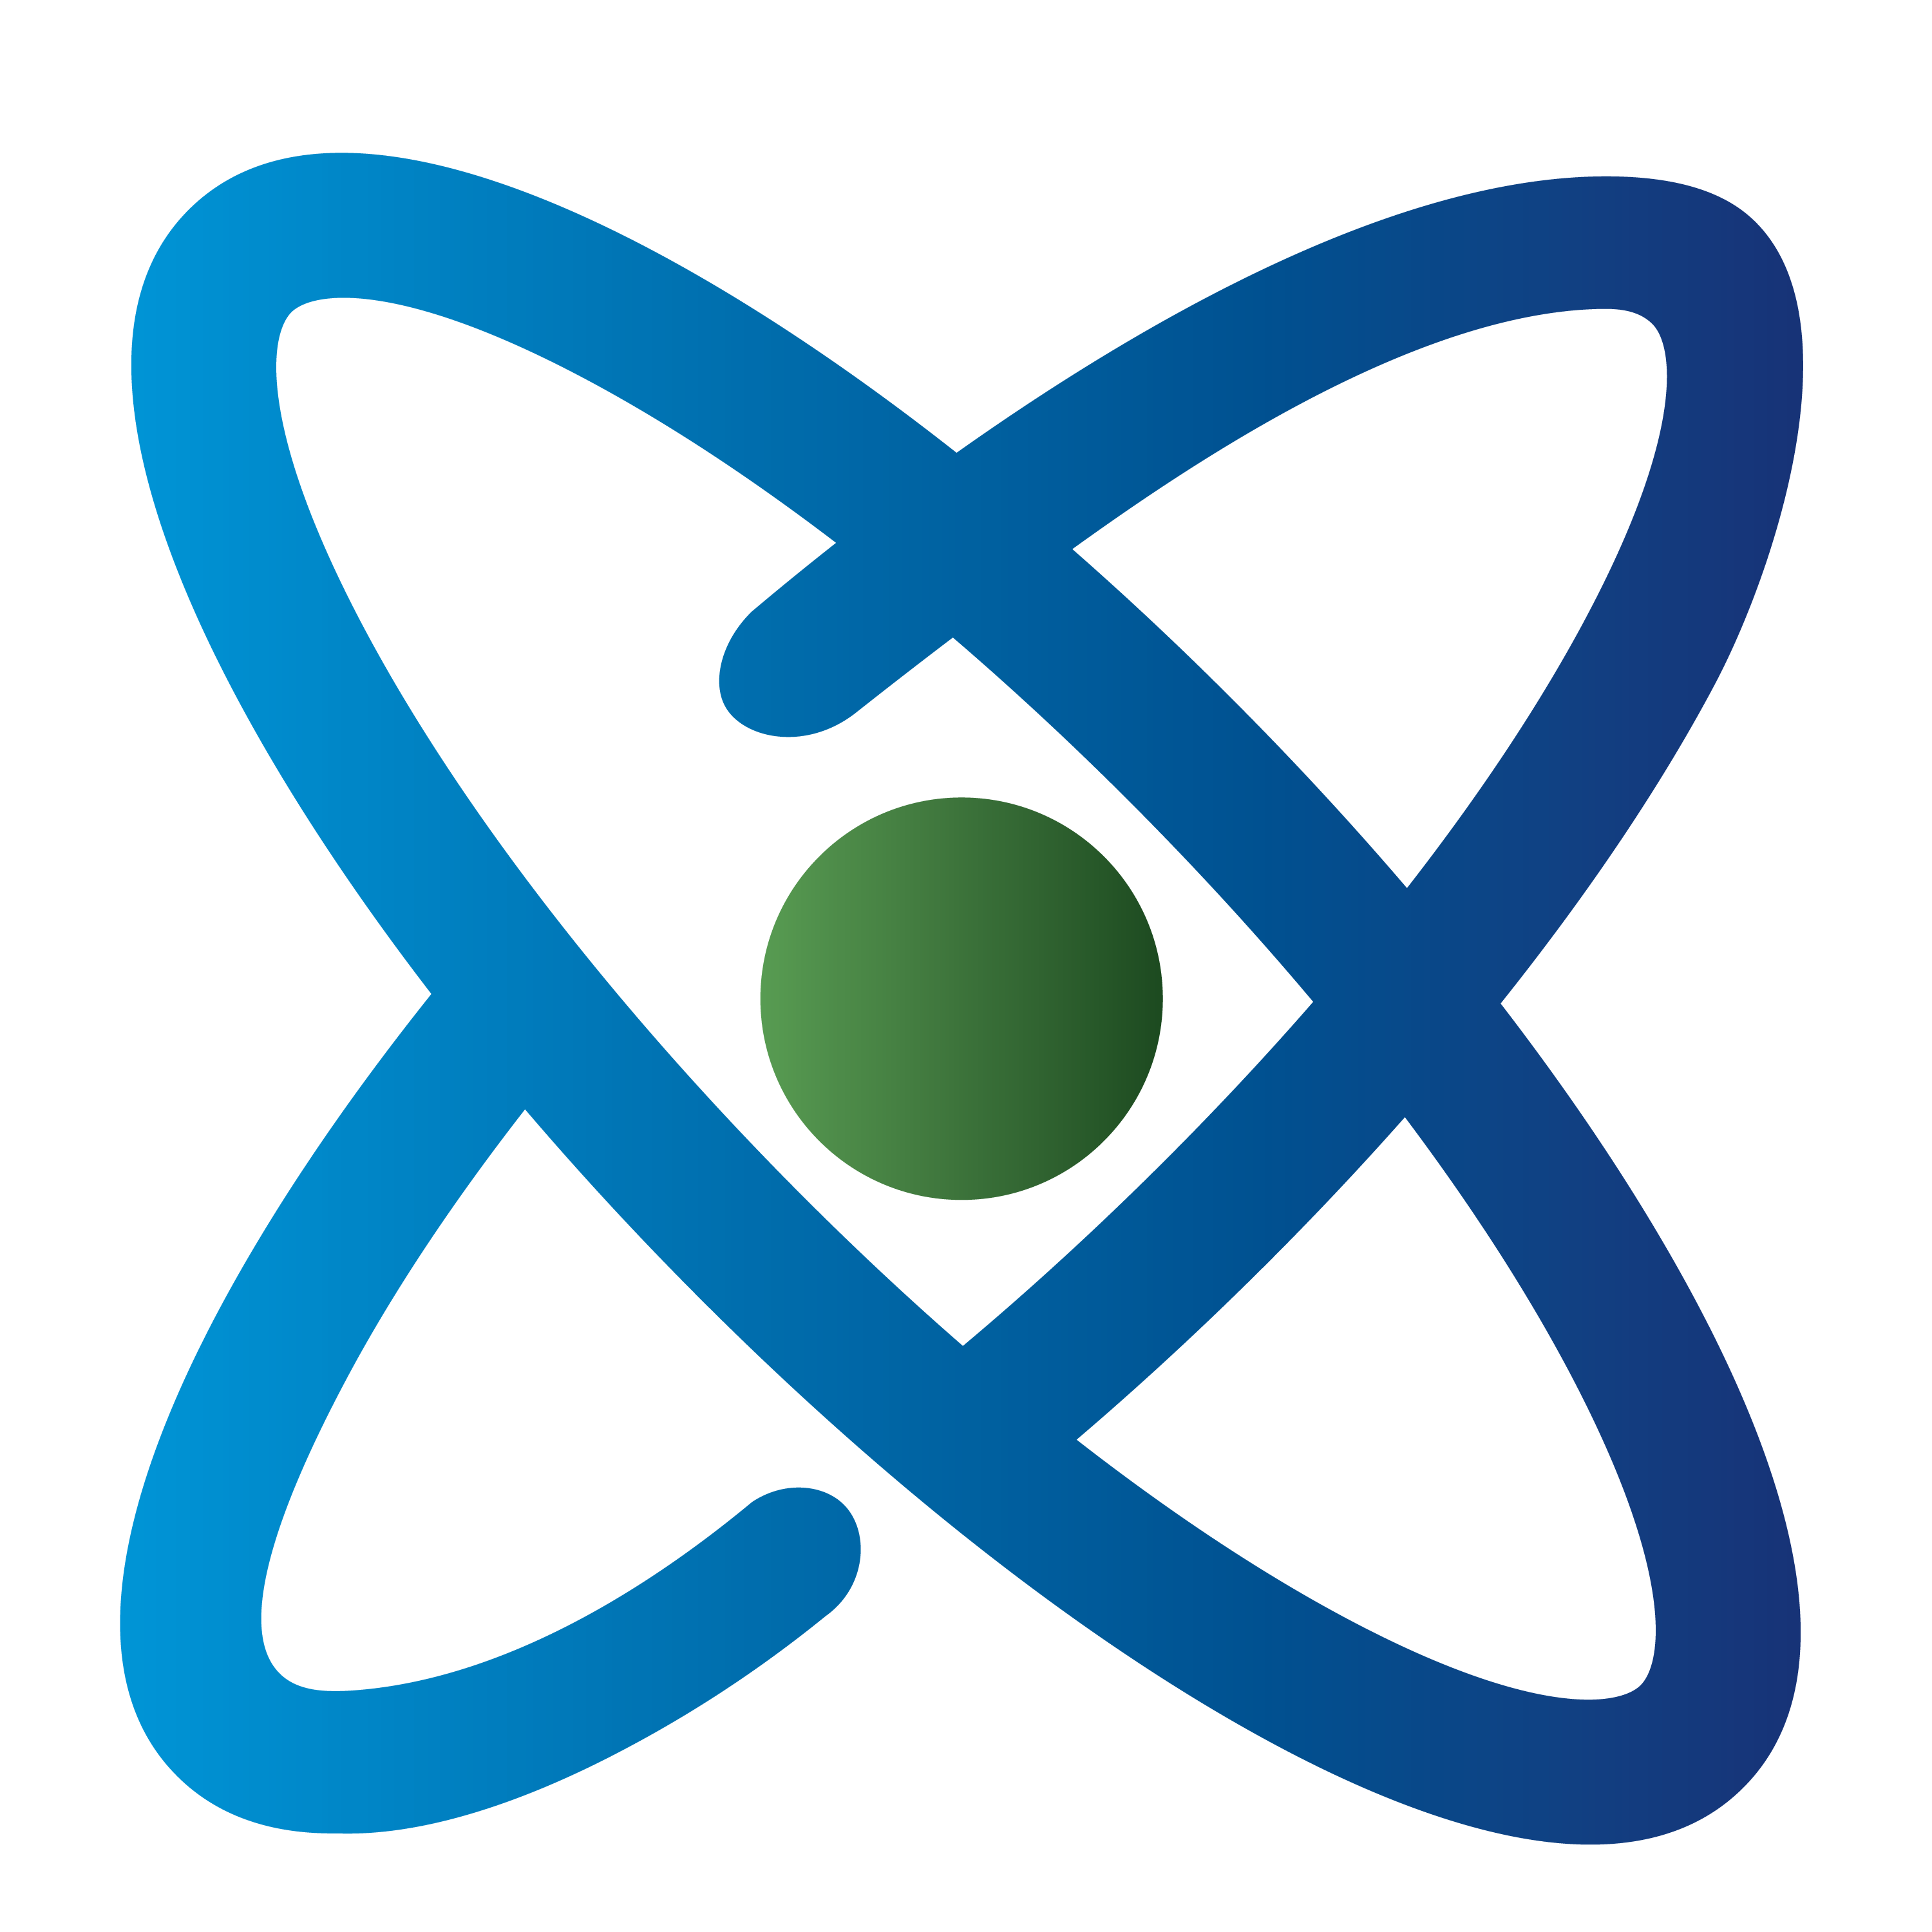

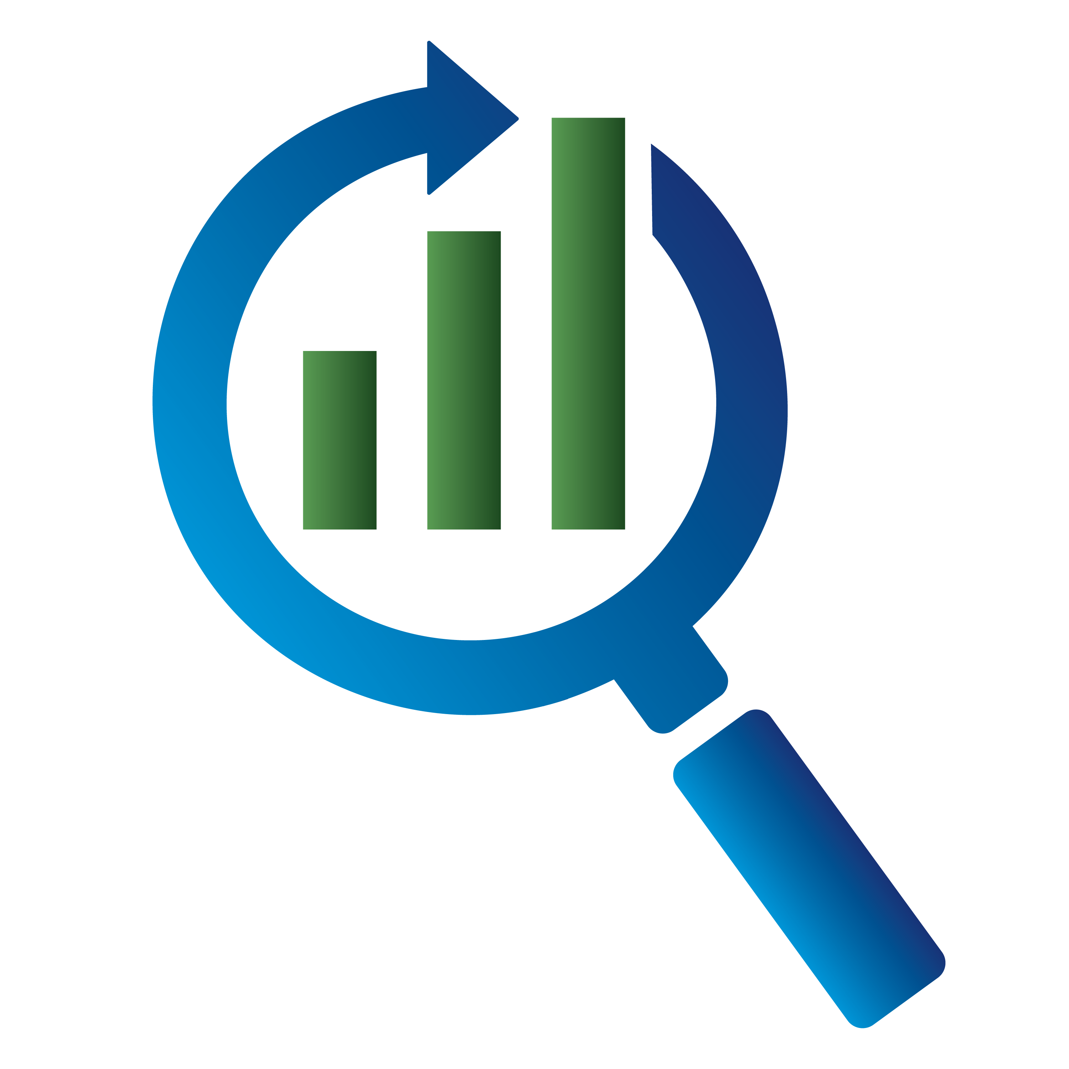
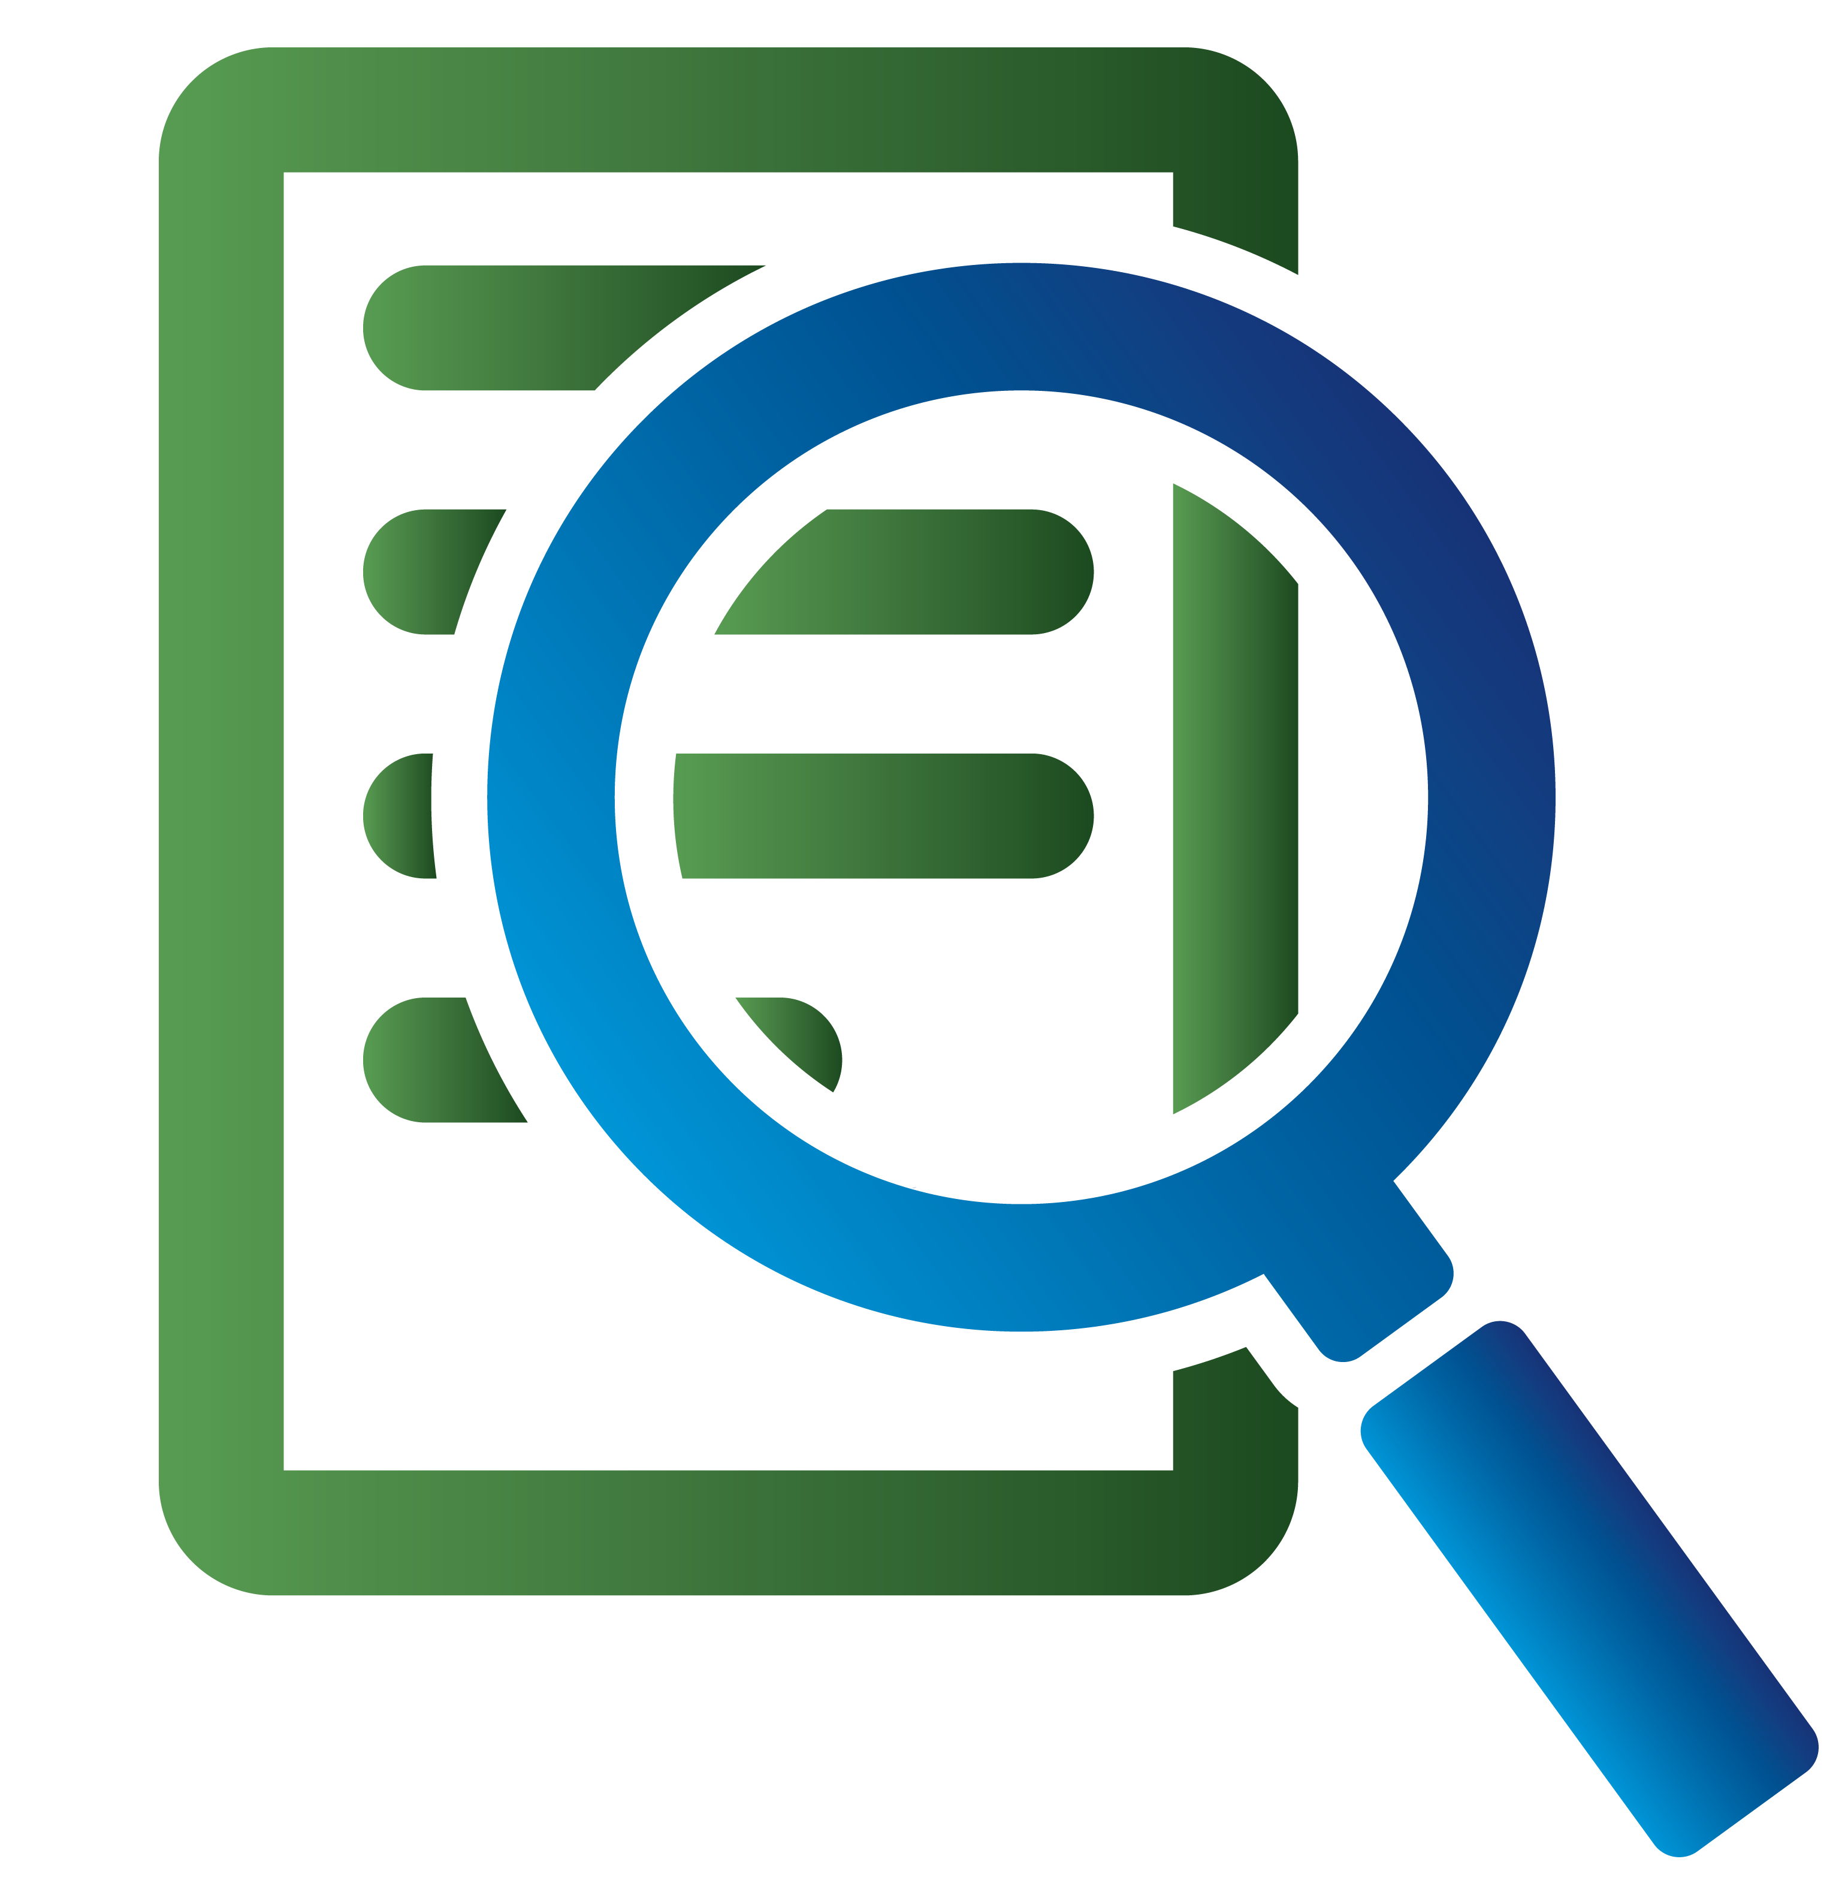
Due Diligence
Every investment utilized in SEAM portfolios is subject to rigorous due diligence
Dissect the investment universe of mutual funds and ETFs among various asset classes.
RIGOROUS DUE DILIGENCE
Conduct initial screens to identify investments with exceptional qualities and eliminate investments not fit for our clients.
Conduct statistical and attribution analyses (including risk and return measurements) on each investment to ensure it meets our strict standards.
Complete an in-depth analysis including discussion with managers and decision-makers at each investment company to determine the quality of the people, process, and business structures, as potential investments for our clients.

Slide 11
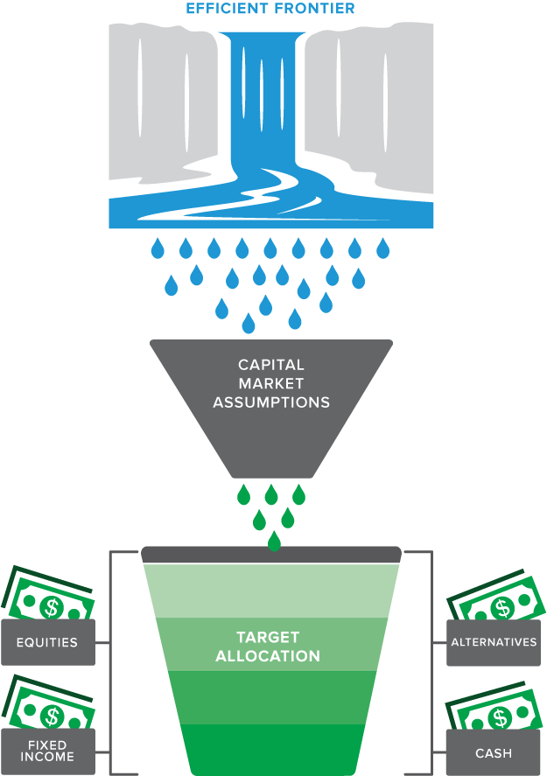
Strategic Process
SEAM portfolios construction begins with Modern Portfolio Theory* and an understanding of how asset classes tend to behave and perform under different business and market cycle environments. This investment approach is considered strategic in nature. We combine Efficient Frontier (part of MPT) studies with time-tested asset studies given different economic variables as the basis of our asset allocation decisions.
Efficient Frontier is the unfiltered universe of asset classes based on historical behavior, which provides our Neutral Allocation.
Capital Market Assumptions adjust Efficient Frontier universe to determine Client’s Target Allocation.
With a validated Target Allocation, appropriate Asset Classes
are identified.
$$ are distributed among suitable investments to activate Client’s investment strategy.
*Modern Portfolio Theory (MPT) postulates the concept and potential benefits of portfolio diversification through mathematical formulations with attempt to maximize expected returns for given amounts of portfolio risk/volatility.

Slide 12
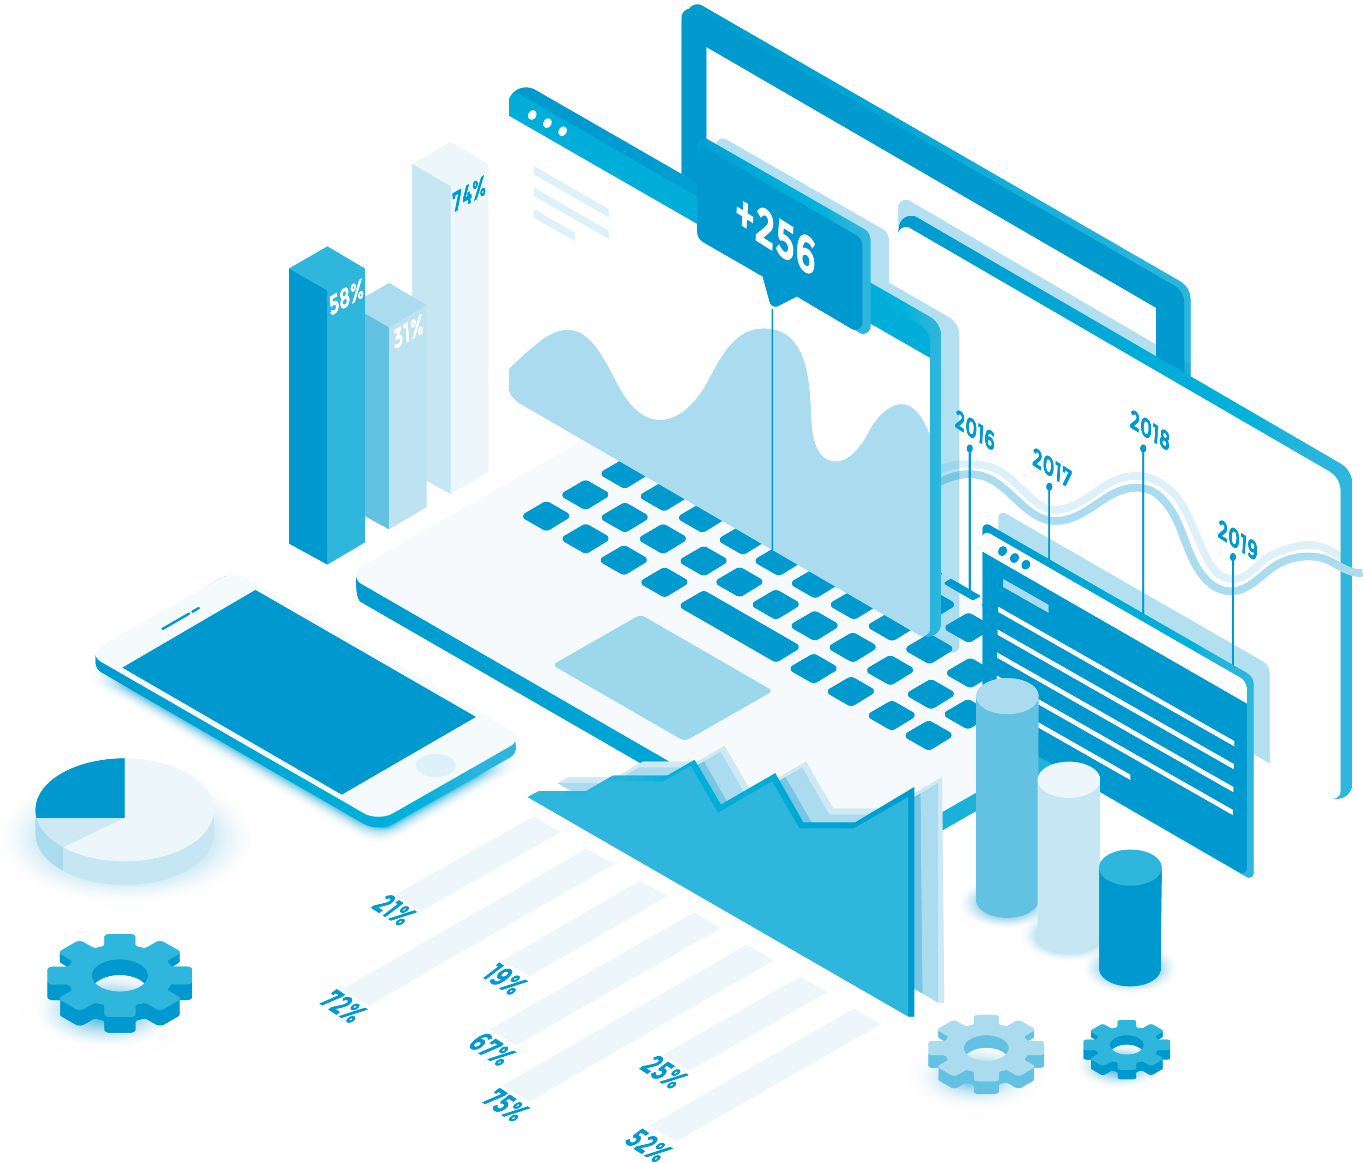

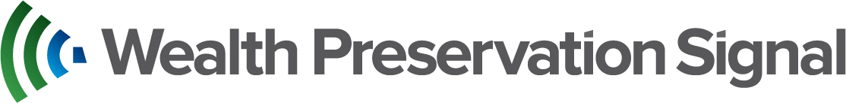
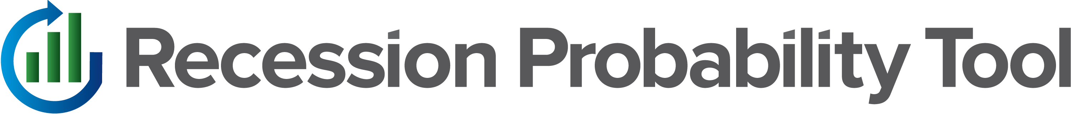
Tactical Process
Strategic investment approaches work well over long-term timeframes. Extreme market volatility requires a tactical investment approach to help protect investors’ wealth. Our tactical process leverages CIO Scott Poore’s years of experience participating in all categories of investment cycles. Through this experience and success, Mr. Poore and his team have developed propriety tools to provide insight and direction to apply to a broad range of market conditions.
Measures panic or “fear” among investors
along with market volatility.
Measures the probability of a recession
occurring within the following 6-12 months.

Slide 13
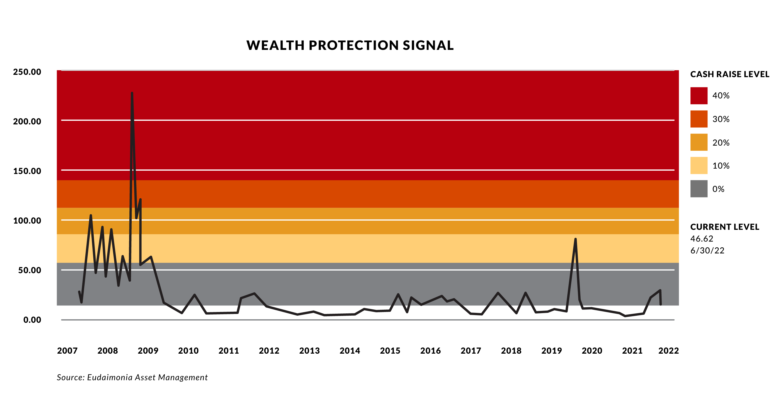
Wealth Protection Signal
Our Wealth Protection Signal measures panic or “fear” among investors along with market “volatility”.
WPS is comprised of a proprietary weighting to the VIX Index (volatility) and the TED Spread (fear). When these indices spike, major market meltdowns tend to follow.
WPS is also measured against the Yield Curve. When the 1st Cash Raise Level is reached, the Yield Curve must also be inverted or have been inverted in the previous 90 days (2yr Treasury Bond Yields > than 10yr Treasury Bond Yields) for the 1st Cash Raise indication to trigger.
When WPS is triggered, we raise cash from equity positions in SEAM portfolios in 10% increments as each level of the Signal is reached (max of 40% cash). When Signal levels decrease, cash will be re-deployed to equity investments in 10% increments until all defensive cash has been re-allocated.
Sources: Eudaimonia Asset Management and StockCharts.com. Graph shown is for illustrative purposes only. Opinions and forecasts expressed herein may not actually occur. Performance data quoted represents past performance, which is not a guarantee of future results. All indices shows are unmanaged and investors cannot invest directly in an index. VIX Index is the Chicago Board of Options Exchange (CBOE) Volatility Index, which shows the market’s expectation of 30-day volatility. TED Spread is the price difference between 3-month futures contracts for U.S. Treasuries and 3-month futures contracts for Eurodollars having identical expiration months.

Slide 14
Recession Probability Tool
The Recession Probability Tool measures ten economic criteria to determine if a recession is either highly probable or not likely within the next 6 to 12 months. While recessions cannot be predicted with any certainty, many historical recessions have been preceded by similar economic conditions.
ECONOMIC CRITERIA:
Yield Curve
Unemployment
Federal Financial Stress
GDP
Housing Starts
NAAIM*
Inflation
Consumer Sentiment
Wage Growth
ANFCI
23
HIGH PROBABILITY
LOW PROBABILITY
PROBABILITY OF RECESSION
Low | 30-24
Moderate | 23-17
High | 16-10
As of 12/29/2023; *National Association of Active Investment Managers

Slide 15
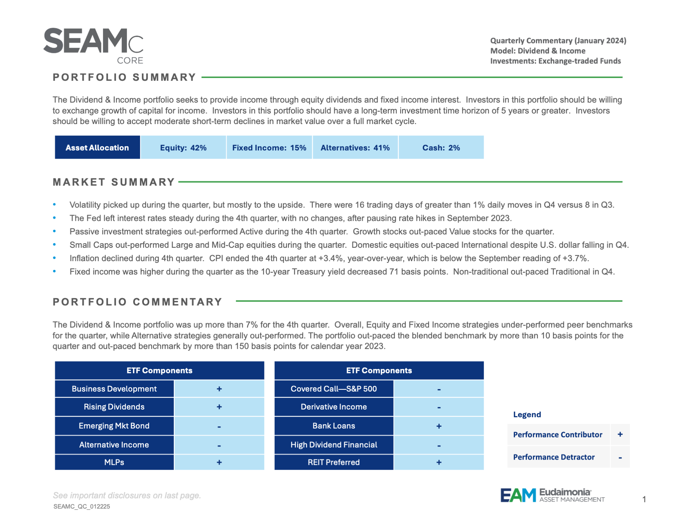
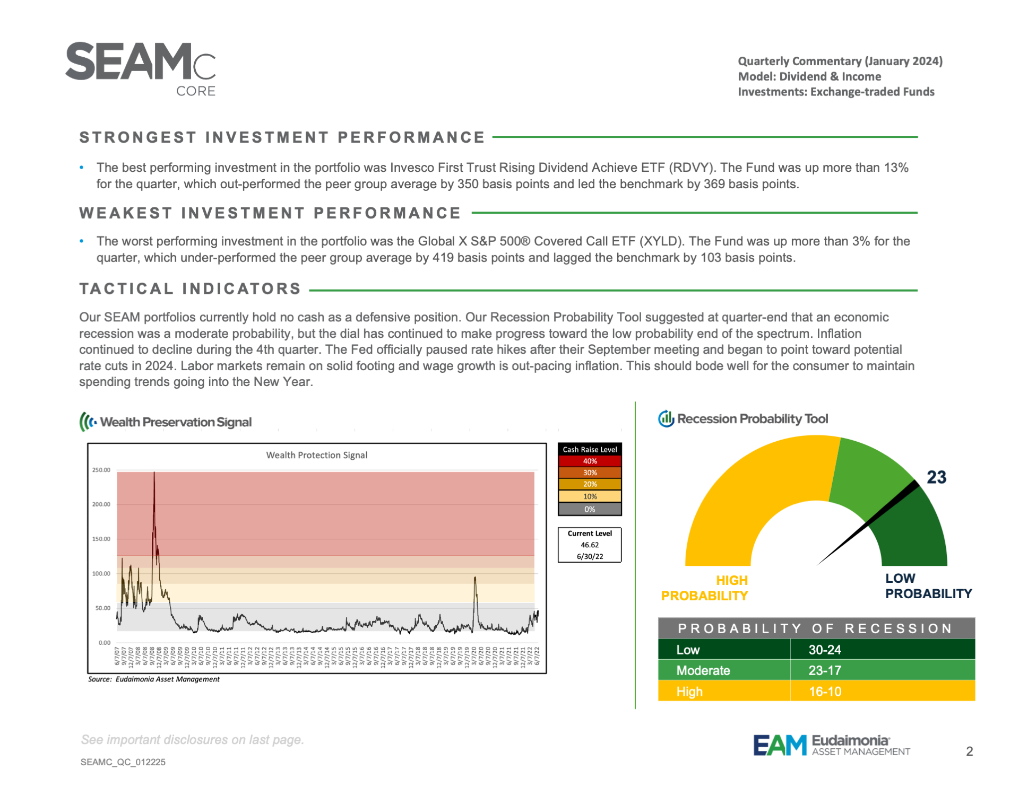
Quarterly Commentary
Every quarter, financial advisers will receive commentary from our Investment Management Team explaining:
How the portfolio is allocated.
What occurred in the markets during the quarter.
How the portfolio performed.
What key contributors impacted performance.
What the current WPS and RPT levels are.
Financial advisers may discuss the commentary with clients at their convenience. This tool is a transparency pledge to you and your clients.

Slide 16
Benefits Investing with
Decades of Investment Expertise
Managed by Eudaimonia Asset Management (EAM), led by Chief Investment Officer, Scott Poore. Mr. Poore has more than 27 years of investment experience.
Targeted Investments from Broad Universe
Each SEAM portfolio is built through the selection of appropriate, vetted investments. Mutual Funds and ETFs are selected from an investment universe of thousands options.
Rigorous Due Diligence
EAM evaluates all investments, whether from funds new to our program or those current used in SEAM portfolios. Without exception, due diligence is conducted on all funds. Investments in SEAM portfolios undergo on-going review.
Continuous Oversight
Portfolio rebalancing occurs automatically when market conditions, due diligence, or model performance dictate action be taken. SEAM portfolios remain up-to-date due to EAM’s results-oriented process.
Options for all Investors
Low minimum investment of $1,500 for SEAM Small Account portfolios ensures investors across all asset spectrums have access to Eudaimonia Asset Management’s expertise.
Hybrid Strategic-Tactical Approach
With SEAM’s hybrid Strategic and Tactical investment process, investors capture benefits of both approaches and may reduce overall investment risk.

Slide 17
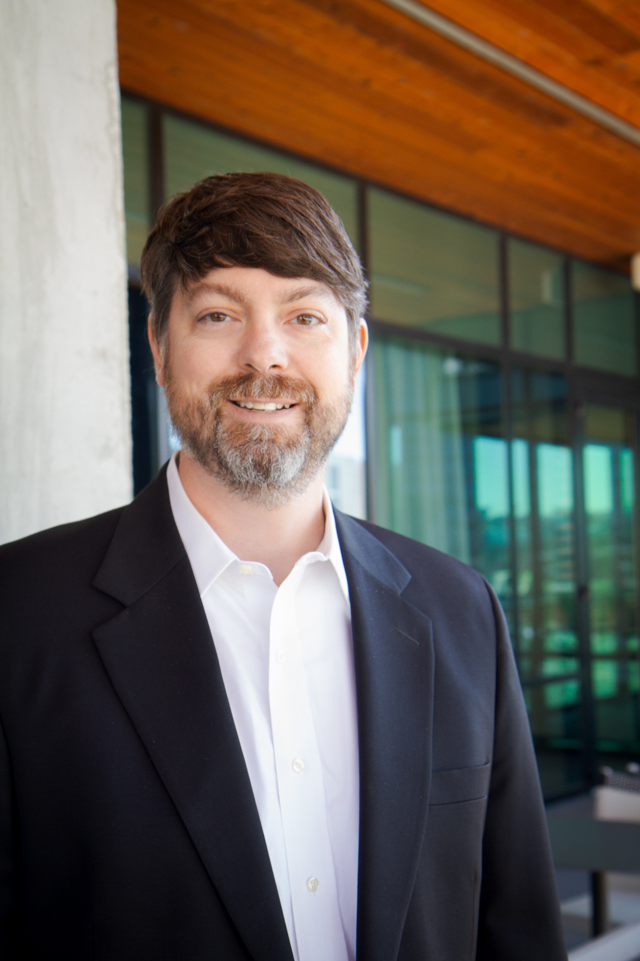
Scott Poore, AIF®, AWMA®, APMA®
Chief Investment Officer, Kingswood Wealth Management/Eudaimonia Asset Management
Scott Poore is responsible for developing investment strategies for individual and institutional clients
and manages the firm’s discretionary program. He has served in this role since 2019.
Prior to joining Eudaimonia, Scott served as Director of Investment Solutions for B. Riley Wealth Management, formerly Wunderlich Securities from 2012 until 2019. Between 1998 and 2012, he was Director for Institutional and High Net Worth services for Morgan Keegan & Co., Inc.
Scott has more than 27 years of experience in the financial services industry. His earned credentials include:
  ACCREDITED INVESTMENT FIDUCIARY® (AIF®) - Center for Fiduciary Studies (associated with the University of Pittsburgh)
  ACCREDITED WEALTH MANAGEMENT ADVISORSM (AWMA®) - College for Financial Planning
  ACCREDITED PORTFOLIO MANAGEMENT ADVISORSM (APMA®) –
  College for Financial Planning.
  Executive Certificate in Financial Planning - Christian Brothers University
Scott holds a B.A. in Political Science and History from the University of Tennessee and earned a M.B.A. in Finance from Christian Brothers University. He is a board member of TEN45, Inc. and he is a past board member of Juvenal Diabetes Research Foundation - JDRF of West Tennessee. Scott is based in Eudaimonia Group's Memphis office.

Slide 18
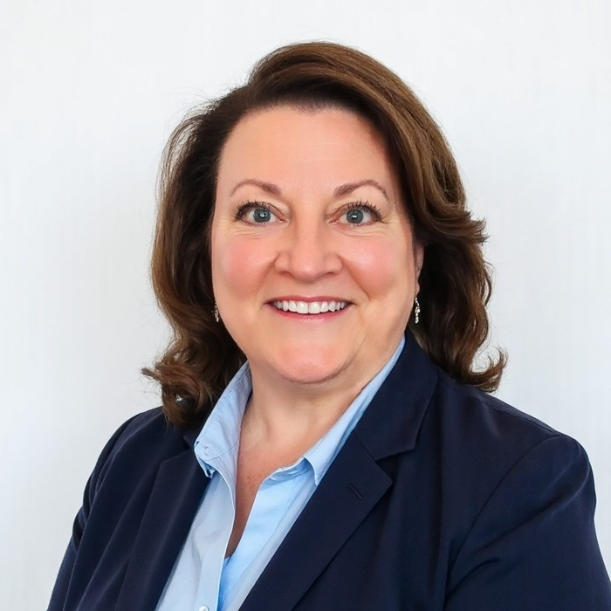
Deborah Bradford, FINRA Series 7, 63, 65, 24
Director of Trading, Kingswood Eudaimonia Asset Platform (KEAP)
Deborah oversees the KEAP trading process to ensure all trades are executed accurately and in a timely manner. She joined Eudaimonia Asset Management in 2024 with 30 years financial sector experience in a variety of roles including business development, mutual fund wholesaler, senior fixed income trader, and portfolio analyst.
Prior to joining the KEAP team, she held both corporate and client facing management and supervisory positions with Wells Fargo Investment Institute (and predecessor firms), and Wells Fargo Advisors, LLC.
Debbie attended Salem College in Winston-Salem NC. She and her husband are passionate about animal rescue and adoptions and have fostered and adopted many dogs over the years. She is based in Eudaimonia Group's Winchester, TN office.

Slide 19
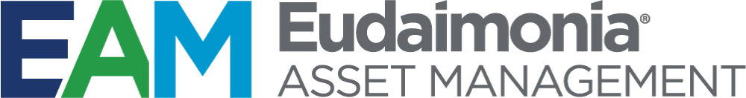
Eudaimonia Asset Management (EAM) was established in 2016 as the asset management division of Eudaimonia® Group (EG), a financial resources firm based in Nashville, Tennessee with $1 Billion in Assets Under Management (AUM) and adviser offices across the Southeast.
EAM's services became a shared resource for both EG and Kingswood US (KW) financial advisers through a partnership agreement in 2024. EAM is led by EAM/KWA CIO Scott Poore, drawing on his more than 27 years of investment management experience.
EAM operates Kingswood Eudaimonia Asset Platform (KEAP) providing KW and EG independent financial advisers access to the Strategic Eudaimonia Asset Management (SEAM) programs. SEAM portfolios offer managed investment options to meet the goals of most investors.

Slide 20
Disclosures
The information contained herein has been prepared to assist you with your investment planning, is developed from sources believed to be reliable, and is for informational purposes only. Recession Probability Tool is comprised of 11 economic measurements including the Yield Curve, Weekly Economic Index, Inflation, Kansas City Fed Labor Market Conditions Index, Sahm Rule, Housing Starts, Consumer Sentiment, ANFCI (Adjusted National Financial Conditions Index), the Fed’s Financial Stress Index and the S&P 500% Above 200-day Moving Average. Wealth Protection Signal is comprised of the VIX and the TED Spread Indices. The VIX Index is the Chicago Board of Options Exchange (CBOE) Volatility Index which shows the market’s expectation of 30-day volatility. The TED Spread is the price difference between 3-month futures contracts for U.S. Treasuries and 3-month futures contracts for Eurodollars having identical expiration months.
The decision to review or consider the purchase or sell of any security should not be undertaken without consideration of your personal financial information, investment objectives and risk tolerance with your financial professional. Any market indexes discussed are unmanaged, and generally, considered representative of their respective markets. Index performance is not indicative of the past performance of a particular investment. Indexes do not incur management fees, costs, and expenses. Individuals cannot directly invest in unmanaged indexes. The S&P 500 Composite Index is an unmanaged group of Securities that are representative of the stock market in general. Past Performance does not guarantee future results.
Important Information
Eudaimonia Asset Management, LLC (“Eudaimonia Asset Management”) is a registered investment advisor. Advisory services are only offered to clients or prospective clients where Eudaimonia Asset Management and its representatives are properly licensed or exempt from licensure. Eudaimonia Asset Management, LLC, is an affiliated entity under common control of Eudaimonia Group. Certain advisory services of Eudaimonia Asset Management, including SEAM, are available to the advisor representatives and clients of the affiliated entities – Kingswood Wealth Advisors, LLC. Clients of Kingswood Wealth Advisors, LLC are under no obligation to utilize the services of Eudaimonia Asset Management. Where clients agree to obtain services from Eudaimonia Asset Management, Kingswood Wealth Advisors, LLC has a conflict of interest as it receives greater compensation in this scenario over client relationships where services are provided by unaffiliated providers. For current Eudaimonia Asset Management information, please visit the Investment Adviser Public Disclosure website at www.adviserinfo.sec.gov by searching with Eudaimonia Asset Management’s CRD #299379. For current Kingswood information, please visit the Investment Adviser Public Disclosure website at www.adviserinfo.sec.gov by searching with Kingswood’s CRD #2888792.
Risk Disclosure
No investment strategy or risk management technique can guarantee returns or eliminate risk in any market environment.
All investments include a risk of loss, which may include a loss of principal, that clients should be prepared to bear. The principal risks of Eudaimonia Asset Management strategies are disclosed in the publicly available Form ADV Part 2A.

Slide 21
Thanks for your time and attention.
SEAM_Pitchdeck_052924

