Slide 1
BNI Aurora
Education Moments

Slide 2


Slide 3



WHO:
HOW:
WHAT:

Slide 4
WHO:
Laser Focused (anybody = nobody)

Slide 5
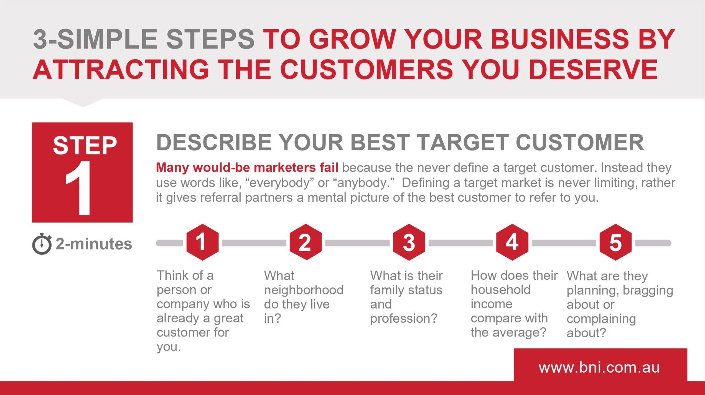

Slide 6
HOW:
How will they tell your story? Context
WHAT:
What can they say to refer you to them?

Slide 7
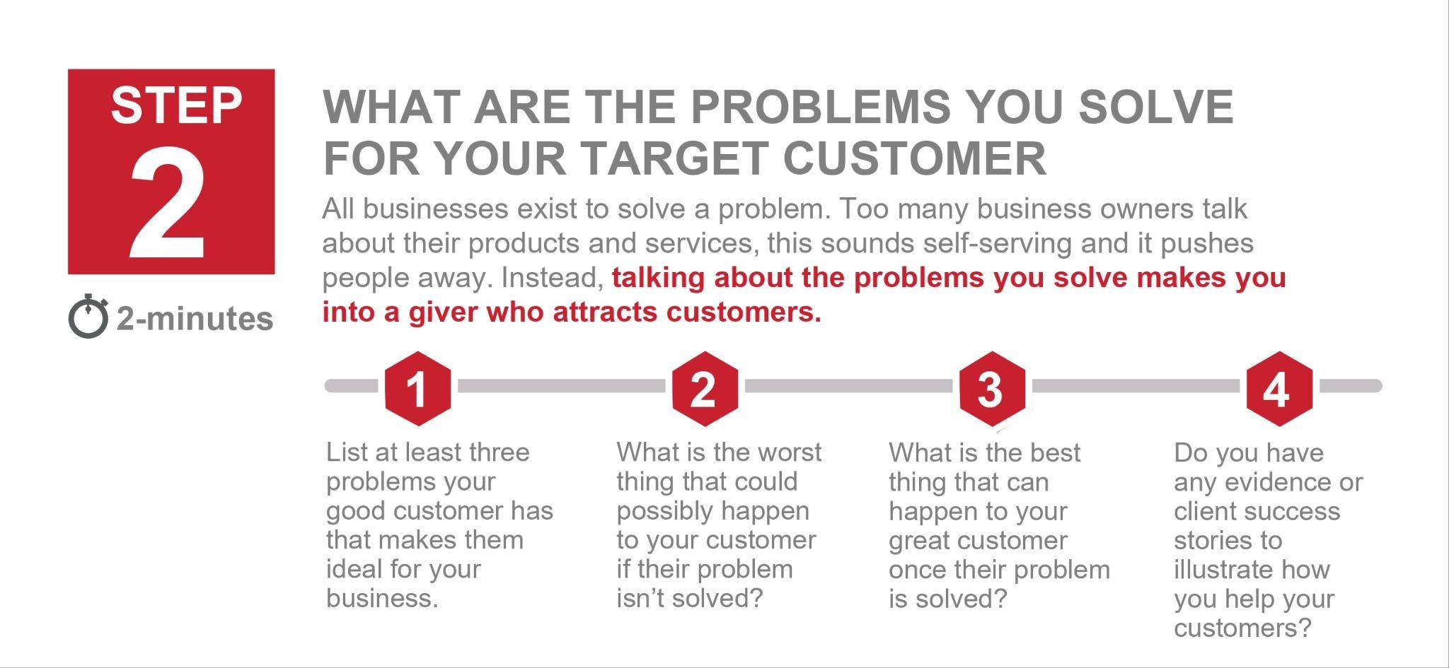

Slide 8
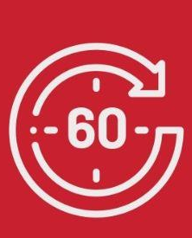

REFINE INTO A WEEKLY PRESENTATION
The business owner with the clear message is the one who attracts the most customers. Too many marketers complicate their message by talking too much about themselves. We help you focus on the few simple elements to create a powerful marketing message, the problems you solve for your customers.
Once you learn how to create these presentations for your business, this is a skill you can use for any club, charity or campaign you lead to be the person who helps to make it into a success.
BNI Power Of One Podcasts
Review Weekly Presentations

Slide 9
WHO:
Laser Focused (anybody = nobody)
I'm looking for your cousin who just bought a business.
HOW:
How will they tell your story? Context
When they want to tell you about that ask them for their website so you can have a look at what they are up to.
What can they say to refer you to them?
WHAT:
If they are embarrassed or website is not mobile friendly, and the site needs improvement tell them you work closely with a web developer that works across all platforms and can offer advice.

Slide 10
Education Moments

