Slide 1
Welcome
As you prepare for Implementing Tier II, please:
  Sit with your school team.
  Download all materials for this session, if you haven't already.
Wi-Fi Network:
Password:
Notes:
Purpose: Include WIFI information on this slide, if the location has access to wifi for participants.

Slide 2

Implementing Tier II Interventions and Supports
Tennessee Tiered Supports Center
Date
© Tennessee Department of Education

Slide 3
Disclaimer: Generative AI Tools
The State of Tennessee does not currently permit the use of generative AI tools (e.g., Otter, Fireflies) in meetings hosted on state resources. Meetings with contractors, vendors, and subrecipients are not public meetings and may involve discussion of protected state data. Generative AI tools are not adequately regulated and are designed to train on data that is collected and may misrepresent data or release protected data to the general public.
While the state supports your desire to maintain documentation of the meeting and what you learn, please respect our decision to safeguard information and do not attempt to use tools such as these. If you choose to use a tool such as these, the state will block such tools from the meeting.

Slide 4

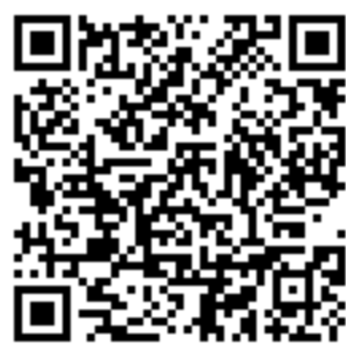
Attendance and Tennessee Academy for School Leaders (TASL) Survey
Complete the Attendance and TASL Survey (https://tinyurl.com/AttendTASL).
You must be present for the entire session to receive TASL credit.
A TASL certificate will be sent to you via email at the end of the semester.
Notes:
Main Point: TASL and Attendance are combined on the same QR Code and survey, and there is a question asking if they need TASL credit on the attendance survey. If you are a school administrator and you would like to receive TASL credit please complete the same survey using the QR code.
Link here: https://tinyurl.com/AttendanceTASL
Note: Consider if you would like to add this QR code to a table tent or remind teams to scan the code on their copy of the electronic or paper presentation if they are far away from the screen.

Slide 5
Introduction
Notes:
Main Takeaway: The following slides are an introduction to Best for All, TN-TSC, and the TN-TAN network.

Slide 6

Tennessee Technical Assistance Network
(TN-TAN)
TN-TAN provides school districts, administrators, educators, and families access to free high-quality training, resources, and supports designed to improve outcomes for students with disabilities, ages 3–22. See below for our areas of support and the partners who lead the specific support areas:
Assistive Technology: Assistive Technology Project for Education (ATP)
Autism Supports: TRIAD at Vanderbilt
Family Engagement: The Arc Tennessee
Intensive Behavior: TRIAD at Vanderbilt
RTI²-A+B: Tennessee Tiered Supports Center
Secondary Transition: Transition Tennessee (TransitionTN)
Visit the TN-TAN website for more information: https://tn-tan.tnedu.gov.
Notes:
Main Takeaway: The Tennessee Tiered Supports Center (Tennessee TSC) is a Tennessee Technical Assistance Network (TN-TAN) member. TN-TAN is a consortium of grantees dedicated to providing school districts, administrators, educators, and families with access to high-quality training, resources, and support, all of which aim to enhance student outcomes. By leveraging the expertise of these grantees, TN-TAN ensures a comprehensive and coordinated approach to improving educational outcomes for all students, particularly those with unique needs.

Slide 7
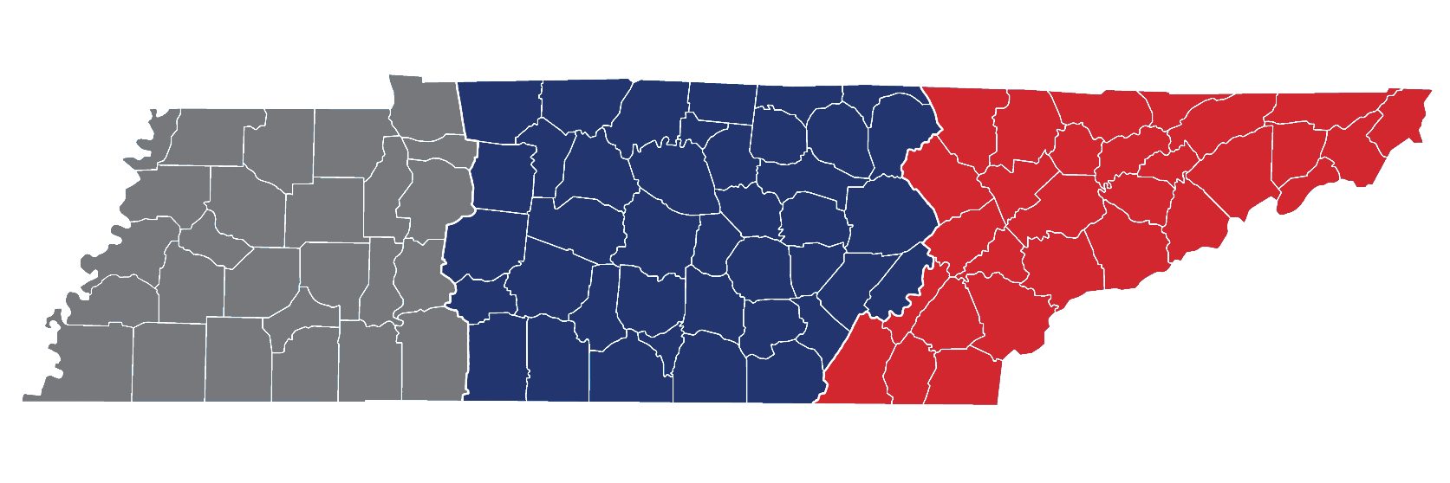
Tennessee Tiered Supports Center
Vanderbilt University – West TN Team
Vanderbilt University – Middle TN Team
University of Tennessee, Knoxville – East TN Team

Slide 8
Learning Objectives
After completing this training, participants will be able to:
Audit current implementation structure to support tiered frameworks for Tier II interventions and supports.
Understand characteristics of Tier II support and identify evidence-based instruction and intervention practices.
Recognize how a Data-Based Decision-Making Team uses multiple data sources to evaluate student need and begin to apply this process themselves.
Notes:
Main Takeaway: The objectives for the training are shared here. After completing this training, participants will be able to:
Audit current implementation structures to support tiered frameworks for Tier II interventions and supports.
Understand characteristics of Tier II support and identify evidence-based instruction and intervention practices.
Recognize how a Data-based Decision-making Team uses multiple data sources to evaluate student need and begin to apply this process themselves.

Slide 9
Introduction of Presenters
Victoria Perry, Technical Assistance Director
Tara Axelroth, Education Consultant
Jessica Ogburn, Education Consultant
Tell us about your team!
Notes:
Main Takeaway: Presenter introduction should include a description of your expertise related to the content.
Guided Notes:
Please provide your name, your background, and your expertise.
Share how you became interested in the topic, and how it changed your practice and led to improved outcomes.
OTR: Have participants briefly introduce themselves and/or their team in any way you choose. For example, have DCs introduce each table as a school, have both academic and behavior representation stand up to introduce themselves, or have each person introduce themselves individually.

Slide 10
Agenda
8:30 Welcome and Introductions
8:45 Aligning Tier II Implementation Structures
10:45 Characteristics of High-quality Interventions
12:00 Lunch
1:15 Evaluating Student Need Using Multiple Data Sources
3:15 Wrap-Up
Notes:
Main Takeaway: This is our schedule for the day. After the welcome we will cover the alignment of our academic and behavior structures, then focus on characteristics of high-quality interventions. Participants will have lunch on their own then return to learn about evaluating student need using multiple data sources before wrapping up for the day.

Slide 11

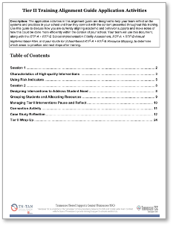

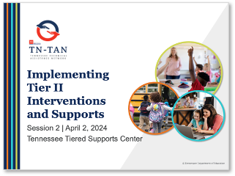

Training Materials
Notes:
Main Takeaway: These are the training materials that participants will need for the day. If you haven’t already done so, please visit the Tennessee Tiered Supports Center webpage to download the necessary resources. The materials are located under the “Tiered Trainings” section in “Tier II”. The password to access these materials is tsc2.
The materials that are needed today:
Tier II Training Alignment Guide: This guide includes application activities and space for schools to reflect on their current status and formulate improvement plans. At least one team member from each school must download this guide to document the team's responses to the activities.
Implementing Tier II Interventions and Support PowerPoint: The PDF of this PowerPoint presentation is available for participants who prefer to have a copy of the presentation for reference during the training.
Tier II Resource Binder: This binder contains resources designed to assist schools in implementing Tier II interventions. Throughout the training, an icon will appear on slides to indicate when participants should refer to the binder for specific resources being discussed.

Slide 12
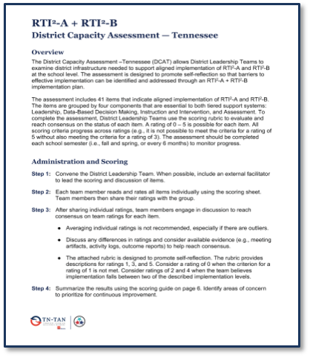
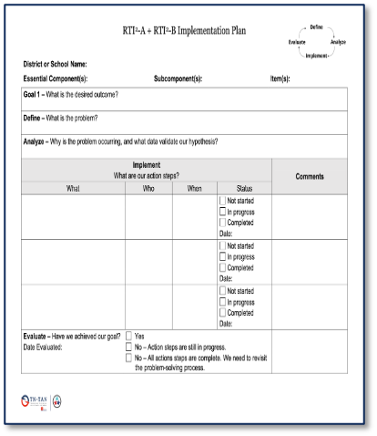
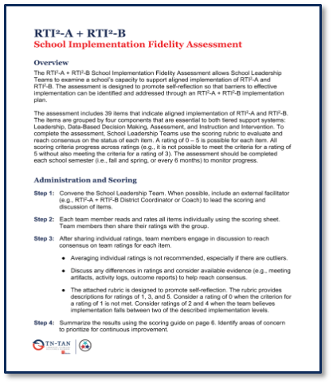
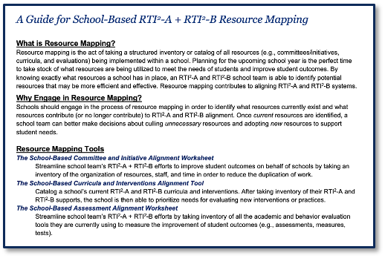
Roadmaps
Notes:
Main Takeaway: Completing these assessments helps teams follow a roadmap for the implementation of RTI²-A and RTI²-B and reflect on their progress throughout implementation. School teams or district teams will reference the SIFA or DCAT, respectively, throughout training activities today while reflecting on their current practices. Doing this allows teams to consider what next steps or actions should be taken based upon their fidelity assessment scores and the material shared today as they draft their school’s Annual Implementation Plan or review their District Implementation Plan. Teams will also use the Guide for School-based RTI²-A + RTI²-B Resource Mapping to determine additional tools needed to support students.

Slide 13
Pre-Work on Collaborative Teaming
Topics Covered
Leadership for Implementing Tiered Supports Systems
Data-Based Decision-Making Teams
A Guide for School-Based Tiered Support Resource Mapping
Notes:
Main Point: All participants should have completed the pre-work on collaborative teaming. By completing these pre-work objectives, participants will be better prepared to engage in the Tier II training, contributing to a more productive and impactful learning experience. This slide is meant to remind them of the objectives from their pre-work.
The objectives of the pre-work were designed to help leaders:
Understand Leadership Infrastructures Supporting Tier II Systems:
Examine the various leadership roles and structures within the school that are crucial for successfully implementing Tier II systems.
Identify how effective leadership can facilitate and sustain the Tier II framework.
Reflect on the current leadership infrastructure and explore areas for enhancement to better support Tier II initiatives.
Identify the Functions and Responsibilities of a Data-Based Decision-Making Team:
Gain a clear understanding of team members' specific roles and responsibilities in data-based decision-making processes.
Learn how to analyze and interpret data to make informed decisions that drive the success of Tier II interventions.
Discuss the importance of having a diverse team that includes various stakeholders, ensuring comprehensive and balanced decision-making.
Evaluate the roles and expertise needed for effective participation in the Implementing Tier II training.
Select team members who will contribute meaningfully to Implementing Tier II training and subsequent implementation.
Ensure that selected participants are well-prepared and equipped with the necessary pre-work knowledge to maximize the effectiveness of the training.
Prepare for Implementing Tier II Training by Updating School-Based Resource Mapping Tools:
Review and update the school's resource mapping tools to accurately reflect current Tier II support resources.
Identify any gaps in resources and plan strategies to address these deficiencies.
Ensure that resource mapping tools align with the Tier II training objectives, facilitating a smooth transition into the training sessions.

Slide 14

Resource Mapping Activity
Revisit Pre-Work Application Activity
Open your Guide for School-based RTI²-A + RTI²-B Resource Mapping.
Update each resource mapping tool within the guide.
Remember, your team completed the School-Based Assessment Alignment Worksheet as part of the Alignment Guide at Tier I Training.
Notes:
Purpose: To provide school teams with dedicated time to discuss and reflect on their responses to the pre-work activities, fostering collaboration and shared understanding. By facilitating this structured discussion, teams will be better prepared to engage in the training, leveraging their pre-work insights to enhance their understanding and application of Tier II strategies.

Slide 15
Aligning Tier II Implementation Structures
RTI²-A + RTI²-B School Fidelity Assessment:
Tier II Instruction and Intervention (36-37)
Notes:
Main Takeaway: This professional development session begins by focusing on aligning Tier II Implementation Structures. Specifically, we will concentrate on key elements corresponding to items 36 and 37 of the SIFA (School Implementation Fidelity Assessment) related to Tier II Instruction and Intervention. This alignment is critical for ensuring that Tier II supports are effectively integrated into your school's broader educational framework. By addressing these areas, your school can enhance the effectiveness of Tier II interventions, ultimately leading to improved student outcomes and greater overall fidelity to the Tier II implementation framework.

Slide 16
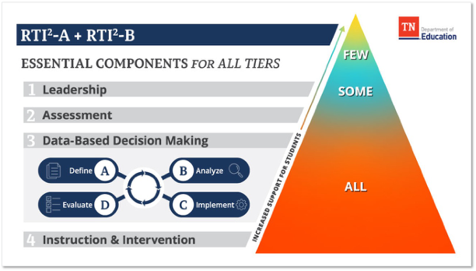
Aligned Supports
Notes:
Main Takeaway: As a reminder, the RTI²-A + RTI²-B framework comprises four essential components: Leadership, Assessment, Data-based Decision Making, and Instruction and Intervention. By understanding and implementing these four components, schools can effectively support students' academic and behavioral needs through a structured and data-driven approach.

Slide 17
Tier II
When a data-based assessment process that uses various assessment data from multiple sources indicates that a student is not making adequate gains from Tier I alone, Tier II intervention is implemented in addition to Tier I instruction.
(TDOE, 2023)
Notes:
Main Takeaway: Teams employ a range of assessments from multiple sources to identify students who require Tier II supports. It is crucial to understand that a student receiving a Tier II intervention continues to participate in Tier I instruction; the intervention is supplemental and not a replacement for Tier I instruction. The goal here is to offer extra assistance without diminishing the student's access to the core curriculum. Further, it is essential to ensure that Tier II interventions demonstrate instructional coherence with the core instruction provided in Tier I. This alignment fosters cohesion and helps in the seamless transfer of skills from the intervention to the classroom environment. By understanding these key points, teams can effectively implement Tier II interventions that support student success while maintaining the integrity of Tier I instruction.
Guided Notes:
TDOE Critical Message: Multiple data sources should be used to inform decisions regarding a student's instruction and intervention.
Multiple data sources must be used at all decision points – when identifying risk, selecting interventions, monitoring progress and determining a student’s response to intervention, and making changes to instruction and intervention.
Teams must measure skills/behaviors in more than one way.
Teams must consider multiple measurements or data points; no single data point or single assessment drives an instructional decision.
Supplementary Nature of Tier II Supports: When a student qualifies for Tier II supports, these interventions are provided in addition to the regular core instruction time. The goal is to offer extra assistance and support to increase the student’s access to the standard curriculum.

Slide 18
Tier II Intervention
Tier II intervention includes explicit and systematic skill-based interventions designed to address the specific needs of students and have application opportunities anchored in grade-level content and expectations, whenever possible.
(TDOE, 2023)
Notes:
Main Takeaway: Tier II interventions must be explicit, systematic, and research-based, targeting students' academic and behavioral needs, and provide application opportunities that are anchored in grade-level content and expectations. Students qualifying for Tier II support should always receive these interventions in addition to their core instruction rather than as a replacement.
Guided Notes:
TDOE Critical Messages: Skills-specific intervention and Tier I instruction should be cohesively linked.
Tier I instruction and intervention should not occur in siloes.
Instructional goals, strategies, and methodologies should be connected to promote students’ transfer and generalization of skills across educational contexts.
Interventionists and Tier I teachers should collaborate to ensure all students receive the support they need to access grade-level content.
Students should have opportunities to apply developing and recently mastered skills using grade-level content.
Identification of Students Needing Tier II Supports:
Teams will utilize assessment data and additional risk indicators determined by data-based decision-making teams to identify students who may need Tier II interventions.
Additional data will be analyzed before it is determined that a student needs support.
Once a student is identified as needing support, the team will determine the most appropriate intervention based on the student's specific needs.
Implementation of Tier II Interventions:
Ensure that interventions are explicit and systematic, providing clear and direct instruction.
Interventions should be supported by research to ensure effectiveness.
Interventions must address the specific academic and behavioral areas where the student needs support.
Integration with Core Instruction:
Tier II support should be provided in addition to the student's regular core instruction, not as a substitute.
This ensures students get all essential core instructional content while receiving targeted support.
Monitoring and Adjusting Interventions:
Regular progress monitoring should be conducted to assess the effectiveness of the interventions.
The intervention plan should be adjusted based on the student's response to ensure continuous progress and improvement.
Resource: Instructional Coherence Module

Slide 19
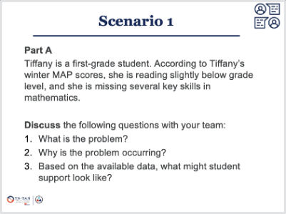
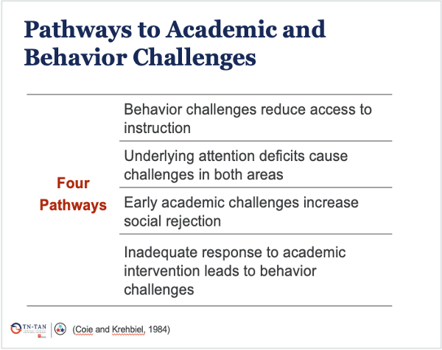
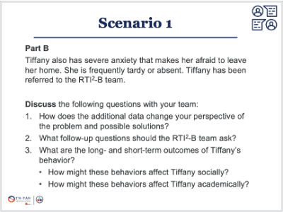
Data for Decision-Making
Access to the “right” data helps school teams problem solve.
Access to limited data can narrow a team’s perception of the problem.
Notes:
Main Takeaway: Data-based decision-making teams need to collect appropriate data to help get to the root of a student concerns. Participants who attended our Overview Training will recall examples of pathways that illustrate how academic difficulties can impact behavior and how behavior can impact academic performance. These pathways underscore the importance of examining multiple data sources and obtaining multiple perspectives when considering the needs of the whole child.

Slide 20
Benefits of Collaborative Problem Solving
More efficient and effective data-based decision-making process
More opportunities for collaboration between stakeholders
Facilitates clearer understanding of the problem and shared commitment to the solution
Allows for planning of interventions that address behavior and academic needs
Notes:
Main Takeaway: In a collaborative culture, staff members must share the responsibility of ensuring that all students receive appropriate instruction, intervention, and enrichment. Collaborative teams enhance the effectiveness and efficiency of the data-based decision-making process. It is crucial to find opportunities to include the voices of all individuals who may provide valuable insights into student performance and needs.

Slide 21
The Characteristics of High-Quality Interventions
RTI²-A + RTI²-B School Fidelity Assessment:
Selection of Instructional Practices and Interventions (19)
Tier II Instruction and Intervention (36-37)
Notes:
Main Takeaway: This section covers the characteristics of high-quality interventions. It corresponds with SIFA items 19, 36, and 37, which focus on Tier II instruction and intervention.

Slide 22

Rolling Hills Scene 1
Discussion Questions
Listen to the audio recording of a discussion at Rolling Hills School.
Consider these questions and prepare to discuss them during the next activity:
  How is this Tier II conversation similar to conversations your data-based decision-making team has had?
  How is it different than conversations you’ve heard?
Notes:
Purpose: The Rolling Hills scenes offer participants a model of meetings conducted by a School Leadership Team or a data-based decision-making team. Listen to this recording and reflect on how the dialogue aligns with the conversations your teams are currently having or need to have. Consultants can also have participants act out the scene by reading the script instead of listening to the audio recording.

Slide 23
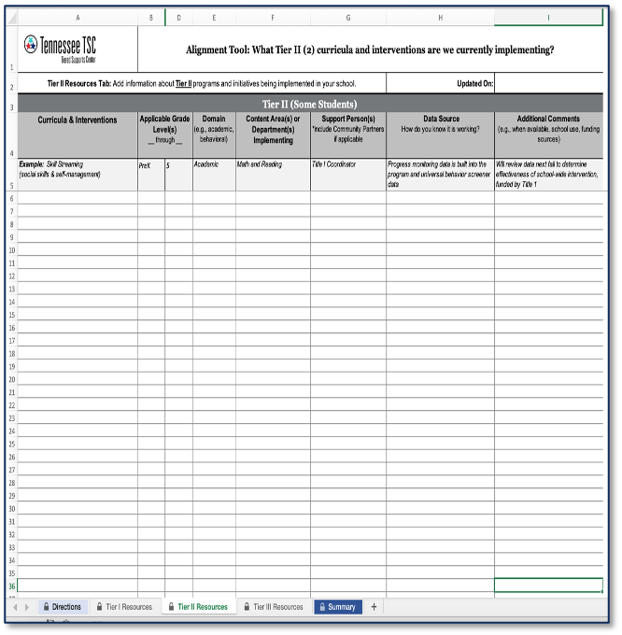
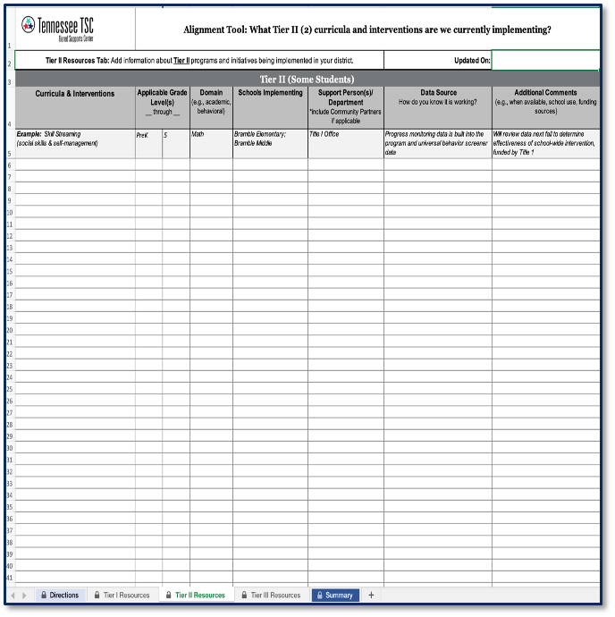
School and District Curricula and Intervention Alignment Tools
Notes:
Main Takeaway: These are the School and District Curricula and Intervention Alignment Tools. You will be reviewing these in the next activity. This slide serves as a reminder or an explanation to participants about the purpose and function of these tools.

Slide 24
Inventory of Interventions
Alignment Guide Application Activity
Turn to the Inventory of Interventions Activity in the Alignment Guide.
Use the School Curricula and Interventions Alignment Tool completed prior to training and refer to the District Curricula and Interventions Alignment Tool for your district as you work through the steps.
Answer the questions in each step with your team members.
Be prepared to share with the whole group.
Notes:
Purpose: The purpose of this activity is to review your school and district needs regarding Tier II interventions. This review will help you identify any gaps as you learn about the characteristics of high-quality interventions in the upcoming section.

Slide 25
Group Discussion
How do your interventions for academic needs compare to your interventions for behavior needs?
When selecting interventions, how does your team make sure to consider students' needs first instead of merely assigning students to available interventions?
Is there a better way for you to utilize your teams and staff?
Are there any organizational barriers (e.g., personnel, schedules, professional development) that need to be addressed?
Notes:
Purpose: Encourage participants to reflect on their current limitations in interventions, the effectiveness of their support for students during interventions, the efficiency of staff utilization, and any other challenges they are facing. The goal is to facilitate a collaborative environment where other teams can offer solutions and share best practices.

Slide 26
Characteristics of High-Quality Interventions
High-quality interventions are:
supported by research,
standardized,
delivered by trained interventionists,
administered at an appropriate dosage,
comprehensive, and
aligned with needed skills or behaviors.
Interventions must also be cohesive with Tier I instruction and expectations.
(Fuchs et al., 2017; National Center on Intensive Intervention, 2022)
Notes:
Main Takeaway: These are the essential qualities of interventions, including Tier II interventions. High-quality interventions are:
Research-supported: Based on evidence and supported by research to ensure effectiveness.
Standardized: Implemented with consistency and fidelity across different settings and groups.
Delivered by Trained Interventionists: Conducted by professionals who have received specialized training in delivering these interventions.
Appropriate Dosage: Administered at a frequency and intensity that is suitable for addressing the student’s needs.
Comprehensive: Includes explicit, systematic instruction.
Aligned with Needed Skills: Specifically designed to target and improve the skills identified as deficient.
Cohesive with Tier I Instruction: Integrated seamlessly with the core instruction and aligned with the overall educational expectations and curriculum.
Supplemental to Core Instruction: Provided in addition to, rather than as a replacement for, Tier I instruction. All students continue to receive high-quality core instruction.

Slide 27
Supported by Research
Intervention programs and practices should be based on reliable and valid knowledge gained from scientific research.
  Research-validated interventions are directly shown to have an evidence base through high-quality studies.
  Research-based interventions are based on reliable and trustworthy evidence of effective practices.
Both provide evidence that the program or practice will lead to student improvement.
(IRIS Center, 2014; National Center on Intensive Intervention, 2022; TDOE, 2023)
Notes:
Main Takeaway: Scientifically research-based interventions produce reliable and valid results. When appropriately used, adequate gains are expected. Interventions should be supported by research and have evidence of effectiveness for the student’s particular area of difficulty.

Slide 28
Standardized
Standardized interventions have well-articulated procedures for delivery with step-by-step directions.
The teacher follows the structure of the lesson accurately and delivers the intervention in the way that it is intended by the creator.
This standardization ensures fidelity.
Standardized interventions can be adapted as needed to be responsive to student need.
Notes:
Main Takeaway: A standardized intervention clearly articulates step-by-step directions and procedures for delivery, ensuring fidelity. Although standardized interventions provide the benefit of a set procedure, they should be adapted as needed to be responsive to student needs. Interventionists should use their professional judgment and collaborate with other educators and specialists when considering adaptations.

Slide 29
Trained Interventionist
Trained interventionists are individuals trained to deliver a prescribed intervention with fidelity.
Training should include:
  standardized procedures for intervention delivery,
  application of fidelity checklists or self-reflection logs,
  answers to frequently asked questions, and
  a variety of 'just in time' strategies to respond to student needs as those needs are presented.
Interventions should be taught by qualified, certified teachers, whenever possible.
(Fuchs et al., 2017; National Center on Intensive Intervention, 2022; TDOE, 2023)
Notes:
Main Takeaway: Interventions should be provided by individuals who have received professional learning on how to deliver the selected intervention with fidelity. Ideally, these interventions should be taught by qualified, certified teachers, as research supports that the most trained personnel should work with the most at-risk students. Ongoing fidelity monitoring should inform any necessary support or retraining needed by the interventionist.

Slide 30
Dosage
Dosage is the number of opportunities a student has to practice needed skills and receive feedback.
Dosage relates to the:
  size of the instruction group,
  number of minutes each session lasts, and
  number of sessions provided in a week.
The intervention should provide ample time to practice needed skills after they are clearly explained and modeled.
(Fuchs et al., 2017; National Center on Intensive Intervention, 2022)
Notes:
Main Takeaway: Dosage refers to the number of opportunities a student has to respond and receive feedback. It also encompasses the group size, the duration of each session, and the frequency of sessions provided in a week. Dosage can be intensified by providing additional time and a lower student-to-instructional staff ratio which allows interventionists to provide more explicit instruction and feedback. Interventionists should keep in mind that the extended time, reduced group must allow for more opportunities for student practice with teacher feedback.

Slide 31
Comprehensive
Comprehensiveness is the extent to which the intervention includes elements of explicit instruction, including:
  Systematic cumulative review
  Opportunities for feedback
  Sequence skills logically
(Fuchs et al., 2017)
Notes:
Main Takeaway: Comprehensiveness refers to the number of explicit instruction principles incorporated into an intervention. All interventions should be explicit and systematic. Interventions can be intensified by adjusting how explicit instruction the instruction is and how much support is provided. Interventionists can ensure instruction is explicit through systematic, cumulative review, high quality feedback, and sequencing skills for instruction in a logical order.

Slide 32
Comprehensive
Systematic Cumulative Review
Initial Acquisition: Skill 1
Practice: Skill 1
Practice: Skill 1
Practice: Skill 1
Initial Acquisition: Skill 2
Practice: Skill 2
Practice: Skill 2
Practice: Skill 2
Academic Example
Segmenting a CVC word
Practice
Practice
Practice
Segmenting a CCVC word
Practice
Practice
Practice
(McLesky et al., 2022)
© Tennessee Department of Education
Notes:
Main Takeaway: This is an example of a comprehensive academic lesson. In this example of systematic, cumulative review, students are practicing blending and segmenting words.
This example shows the initial and second skills a student needs to learn to segment words. The first skill to work on, or Initial Acquisition Skill 1, is a consonant vowel consonant (CVC) word like cat. After multiple opportunities to practice, the student is introduced to a new skill, or Initial Acquisition Skill 2, a consonant, consonant, vowel, consonant (CCVC) word like trip. The student is also given multiple opportunities to practice those words.
OTR: Ask participants if they can think of an additional academic example.

Slide 33
Comprehensive
Systematic Cumulative Review Continued
Initial Acquisition: Skill 1
Practice: Skill 1
Practice: Skill 1
Practice: Skill 1
Initial Acquisition: Skill 2
Practice: Skill 2
Practice: Skill 2
Practice: Skill 2
Behavior Example
Respectfully disagreeing
Practice
Practice
Practice
Acknowledging others' feelings
Practice
Practice
Practice
(McDaniel et al., 2024)
© Tennessee Department of Education
Notes:
Main Takeaway: This is an example of a behavior focused comprehensive lesson.
This example relates to students who are working on conflict resolution skills within a social skills group. The first skill to work on, or Initial Acquisition Skill 1, is respectfully disagreeing with peers or adults. The second, more advanced skill, or Initial Acquisition Skill 2, within this category includes acknowledging others' feelings.
OTR: Ask participants if they can think of an additional behavior example.

Slide 34
Comprehensive
Opportunities for Feedback
Affirmative Feedback
Corrective Feedback
is timely, genuine, and commensurate with effort; lets a student know exactly why they are being praised.
Example: Christina, thank you for pushing your chair in when you stood up to walk to the line.
is timely; meant to prevent future errors by addressing mistakes when they occur so that a student does not practice errors repeatedly.
Example: Destiny, check your first sentence, and make sure that it begins with a capital letter.
(McLesky et al., 2022)
Notes:
Main Takeaway: Comprehensive feedback includes both affirmative and corrective elements. Affirmative feedback is timely, genuine, and proportional to the student's effort, providing clear reasons for praise. Corrective feedback is timely and aims to prevent future errors by guiding students toward the correct understanding or behavior.

Slide 35
Comprehensive
Sequence Skills Logically
This considers several variables including teaching simpler skills before more complex skills and teaching high-frequency skills before those used less frequently.
Lessons should be designed to recognize mastered skills and begin with area of need.
(McLesky et al., 2022; Archer & Hughes, 2016)
Notes:
Main Takeaway: Intervention lessons should be designed to recognize a student’s already mastered and prerequisite skills as confirmed by data. After determining what skills a student has already mastered, intervention lesson should begin with the student’s skill needs and be sequenced to introduce skills from simple to more complex and also consider teaching skills that are used more frequently earlier. Sample lessons should ensure that there is a connection between the student's mastery of prerequisite skills and current skills for instruction so they may understand how skills build upon each other. Additionally, scaffolding should be incorporated to support students with gaps in their prerequisite knowledge.

Slide 36
Alignment
Intervention teaches an alternative behavior to match the perceived function of the target behavior.
Attention Motivated
Check-In/Check-Out
Escape Task Demand
Breaks are Better
Intervention focuses on specific academic skills that students need to acquire to provide greater access to and opportunity within Tier I.
Elementary Reading
Phonics and Fluency
Comprehension
Secondary Math
Computation
Application
Notes:
Main Takeaway: Alignment refers to how well an intervention program addresses the student's specific needs, avoids targeting skills the student has already mastered, and incorporates a meaningful focus on grade-appropriate curricular standards. Effective alignment ensures that interventions are explicitly linked to core content and expectations whenever possible. The intervention should teach an alternate behavior for students with a behavior concern. For example, teaching a student to raise his hand for the teacher's attention instead of getting out of his seat to go to the teacher. In academics, an intervention teaches a specific skill. For example, teaching a student repeated addition during intervention to help a student understand multiplication in 4th grade. Note: the behavior interventions listed on this slide are examples, there are other interventions that can address these different behavioral examples.

Slide 37
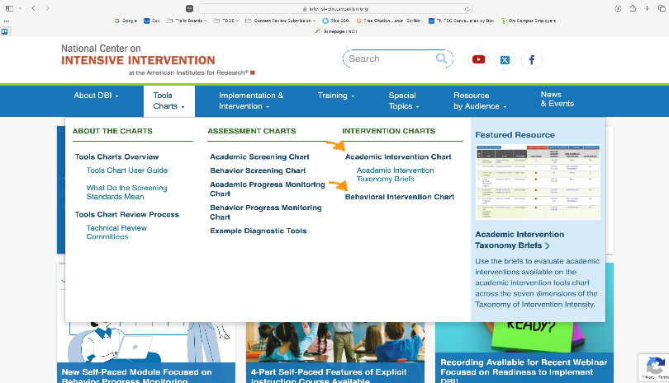
Intervention Skills Matching
Application Activity
Go to the National Center on Intensive Intervention website (https://intensiveintervention.org) and read about the following interventions: Sound Partners (1-3), ROOTS, and the Coping Power Program.
The resources and opinions shared have not been vetted by the TDOE and are not an endorsement on quality or content of these materials or any vendor.
Notes:
Purpose: Give participants practice navigating to the NCII website, ask them to look at the program on the website and identify one characteristic from NCII's summary. Consultants will demonstrate navigating this website at training.

Slide 38
Intervention Skills Matching
Application Activity Continued
With your table group, match each skill on the left to an intervention on the right.
Raise your hand and wait to check your answer and receive an acknowledgement.
Externalizing Behavior
Phonics
Calculation
Sound Partners (1-3)
ROOTS
Coping Power Program
Notes:
Purpose: Give participants practice navigating to the NCII website. The previous slide asked them to read about Sound Partners (1-3), ROOTS, and Coping Power Program on the NCII website. After reading about those interventions, participants will complete this activity by identifying one skill on the left with each intervention listed on the right.
Additional information: If a computer program is used it should not replace explicit instruction by the interventionist

Slide 39
Cohesion with Tier I
Instructional coherence ensures that instructional experiences are connected and skill development is aligned with grade-level learning expectations at all tiers.
Notes:
Main Takeaway: Instructional coherence refers to the alignment of instructional goals, strategies, and methodologies to promote students' transfer and generalization of skills across all educational contexts. It involves the integration of leadership, data-based decision making, instruction and intervention, and assessment to create a cohesive student learning experience. This unified approach supports students' achievement of grade-level expectations. Students who experience higher levels of instructional coherence are more likely to achieve these expectations and feel a stronger sense of connection and purpose related to their instruction (TDOE, 2023).

Slide 40
Cohesion with Tier I
Examples
Academics
Behavior
Connecting the skills learned in intervention with core instruction
For example, pre-teaching academic vocabulary related to selected concepts and skills focused on during core instruction
Providing opportunities to practice new skills using Tier I behavioral expectations
For example, prompting a student before they enter a new setting using language taught during intervention
Notes:
Main Takeaway: We must align our academic and behavioral lessons with Tier I instruction. The ultimate goal of intervention support is to help students achieve a level of proficiency that allows them to succeed within the core instructional framework. That includes helping students meet grade-level expectations through providing access and opportunity.

Slide 41
Characteristics of High-quality Interventions
Alignment Guide Activity
Turn to the Characteristics of High-quality Interventions Activity in the Alignment Guide.
Use the checklist to review a Tier II intervention offered at your school.
Complete the Pause and Reflect chart.
Be prepared to discuss with the whole group how the interventions used at your school are, or could be, linked to Tier I instruction or expectations.
Notes:
Purpose: The purpose of this activity is to determine if the Tier II interventions used in your school have most, or all, of the characteristics of high-quality interventions shared today.

Slide 42
Discussion
How are you linking your Tier II interventions to core content? Share one example with the group.
Notes:
Main Takeaway: Participants need to consider how they link the skills students learn during intervention to core content for both academics and behavior. The idea is that they will learn new strategies from other teams in the room.

Slide 43
Evaluating Student Need Using Multiple Data Sources
RTI²-A + RTI²-B School Fidelity Assessment:
Selection of Instructional Practices and Interventions (18-19)
Monitoring Response to Instruction and Intervention (21)
Assessment Tools and Administration (26-31)
Environment for Learning (32-34)
Tier II Instruction and Intervention (35)
Notes:
Main Takeaway: This section covers evaluating student need using multiple data sources. It corresponds with SIFA items 18-19 which focus on selection of instructional practices and interventions, 21 which focuses on monitoring response to instruction and intervention, 26-31 which focus on assessment tools and administrations, 32-34 which focus on the environment for learning, and 35 which focuses on Tier II instruction and intervention.

Slide 44
Rolling Hills Scene 2
Discussion Questions
Listen to the audio recording of a discussion at Rolling Hills School.
Consider these questions and prepare to discuss them during the next activity:
  How is this Tier II conversation similar to conversations your data-based decision-making team has had?
  How is it different than conversations you’ve heard?
Notes:
Main Takeaway: Training participants are able to listen to an example discussion teams have by following along with the script, which can be downloaded from the website containing the other training materials.

Slide 45

Assessment
Assessment provides data that are used within a continuous improvement model and encompasses multiple data sources and data management.
Notes:
Main Takeaway: Districts should be using a variety of data to make decisions, including decisions regarding instruction, intervention, and progress in intervention.

Slide 46

Determining Need for Intervention
A process of identifying and verifying risk for academic and behavioral difficulties that involves comparing a student’s current performance to expected performance using multiple data sources
Notes:
Main Takeaway: The universal screening process involves identifying and verifying the need for intervention using multiple data sources which can include universal screeners, survey-level assessments, diagnostic assessments, teacher observations, student record reviews, and progress monitoring data, or other data sources. Screening should be done for all students.

Slide 47
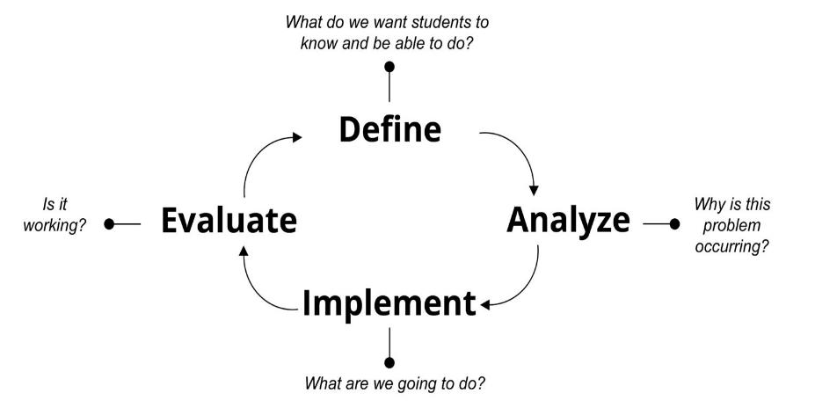
Screen All Students
How to Identify Risk Using a Universal Screener
Administer brief universal screening tools to all students three times per year, across multiple domains (e.g., reading, written expression, math, and behavior).
Use this data in combination with other readily available data, administering drill-down assessments if necessary.
Notes:
Main Takeaway: Universal screeners are one way to begin to identify students who may need additional support but should be used along with other sources of data. It’s important to use multiple sources of data when identifying students who may need intervention.

Slide 48
Screen All Students
How to Identify Risk Using an Early Warning System
Early warning systems use existing assessment, attendance, behavior, and academic performance data to:
  identify students at risk,
  inform decisions about students needing support,
  target resources to support these students, and
  identify school climate issues.
  Universal screening should use multiple data sources to identify students at risk of poor outcomes.
(Wisconsin RtI Center, 2022; Balfanz, 2007)
Notes:
Main Takeaway: Early warning systems are another way to identify students who may need additional support. In Early Warning Systems, multiple data sources are used to identify students at risk. Early Warning Systems are used at the high school level, but elementary and middle schools have used the idea of an Early Warning System as a way of identifying students who are at-risk across different domains (academics, behavior, attendance).

Slide 49
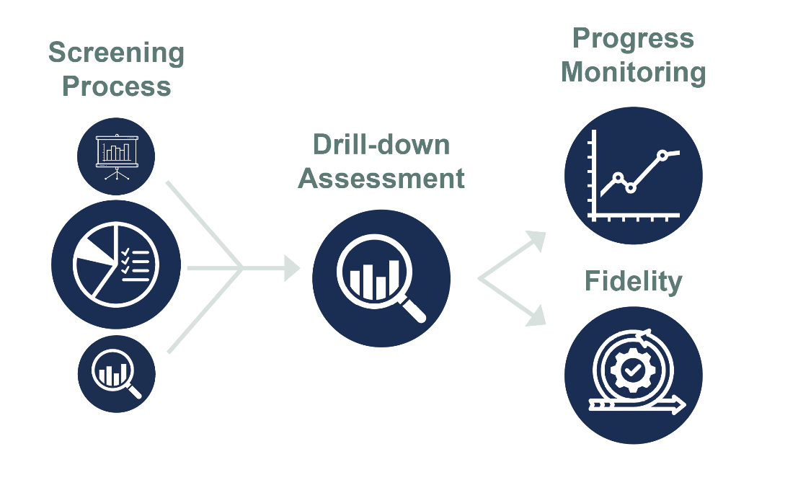
Assessment Process
Screening Process
Progress Monitoring
Drill-down Assessment
Fidelity
  A variety of data sources should be used at all points in the assessment process.
Notes:
Main Takeaway: The assessment process highlights how a variety of data sources should be used for data-based decision making. In the screening process, multiple sources of data should be used to identify a student as at risk. These sources of data could include universal screener data, survey-level assessment data, diagnostic assessment data, teacher observations, students records review, and more. After, through the screening process using multiple data sources, a student is identified as at risk, drill-down assessments are administered as needed and data is analyzed to determine specific needs and plan the intervention. Once the student is in the intervention, progress monitoring and fidelity data are gathered to determine intervention effectiveness. Progress monitoring data should come from multiple sources and can include formative assessments that are sensitive to small changes in a student's performance, summative assessments that show how a student's performance compares to intervention benchmarks, end-of-unit assessments, and assessments/observations aligned to grade-level standards and/or schoolwide expectations. Fidelity data take into account a variety of metrics that will be discussed in detail later our Tier II training. Having an organized assessment process allows teams to make informed decisions while using the problem-solving process.

Slide 50
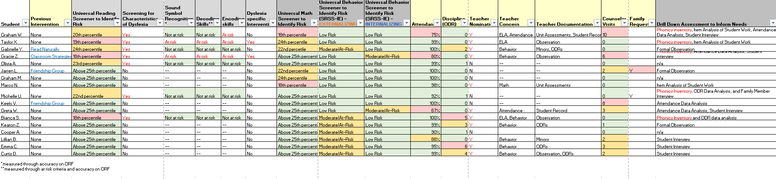
List of Students At Risk
Example
Previous Intervention(s)
Screeners
Attendance, Discipline
Teacher Nomination, Unit Assessments
Classroom Discipline Events
Counselor Visits, Family Referral
Multiple data sources should be used to make decisions.
Notes:
Main Takeaway: It is helpful to have a way to organize the multiple sources of student data so you can see students’ comprehensive profile when making data-based decisions. This is one example of a spreadsheet that lists multiple sources of data by student which can be reviewed by the data-based decision-making team as part of the assessment process. You will see full examples of this spreadsheet in the Tier II Binder as part of the Rolling Hills Elementary and Sandy Creek Secondary scripts and activities.

Slide 51
Requests for Assistance
Importance of Use
Screening data may not detect some student needs or teacher concerns.
Process
A structured referral process may be used in addition to a systematic screening process to identify areas where support is needed and request assistance.
Helpful Features of Referral Forms
Request forms should capture information that allows a data-based decision-making team to identify and begin thinking about the underlying reason for a problem.
Notes:
Main Takeaway: Requests for assistance are another source of data that can help identify student need. Requests for assistance help compile valuable additional data (e.g., anecdotal data, strategies tried, classroom assessments, etc.).

Slide 52
Rolling Hills Scene 3
Discussion Questions
Listen to the audio recording of a discussion at Rolling Hills School.
Consider these questions and prepare to discuss them during the next activity:
  How is this Tier II conversation similar to conversations your data-based decision-making team has had?
  How is it different than conversations you’ve heard?
Notes:
Main Takeaway: Training participants are able to listen to an example team have discussions by following along with the script, which is available in our training materials.

Slide 53
Pause and Think
What if your school’s triangle looks like this?
10%
35%
55%
This is an example of risk distribution and should not be equated to a specific expected percentage of students operating within tiers. Tier I is for all students.
Notes:
Main Takeaway: This is an example of conveying student performance as risk distribution and should not be equated to a specific expected percentage of students operating with the tiers. This slide is designed to help teams move away from traditional thinking and prompt discussion related to risk distribution and problem-solving to improve RTI2 implementation.
OTR: Ask participants what they would do if they had a high percentage of students identifying as at risk like shown on the slide. Emphasize multiple strategies targeted across tiers may be needed. Emphasize striving towards constant improvement.

Slide 54
Addressing a Tier I Problem
Strengthen Tier I practices.
Provide Tier I support centered on learning acceleration.
Recommend or change classroom interventions to provide scaffolding and access points.
Continue to monitor the students’ data.
If a large proportion of students are identified through the screening process, consider adjustments to Tier I instruction.
Notes:
Main Takeaway: If a large proportion of students are identified as needing additional support through the screening process, consider adjustments to Tier I instruction. This applies to academics and behavior. Tier I can be strengthened through scaffolding, access points, and by focusing on learning acceleration.

Slide 55

Tier I Fidelity Monitoring
Review Fidelity of Tier I Instruction to Verify Risk
Evaluate the fidelity of Tier I instructional delivery to rule out inadequate instruction at Tier I as underlying issue.
Determine if a lack of fidelity at Tier I has resulted in an overidentification of students needing Tier II support.
Consider if Tier I interventions should be implemented or revised.
Notes:
Main Takeaway: As you are thinking about addressing a Tier I problem, always consider the fidelity of instruction to make sure students are getting the instruction they need to achieve grade-level expectations. Fidelity refers to providing instruction with integrity, aligning with instructional goals for student learning, and attending to critical features of instructional fest practice designed to meet those goals (RTI-A manual, p.19). Some forms of fidelity monitoring may include but are not limited to Instructional Practice Guide walkthroughs, review of lesson plans, curriculum maps, and/or the review of student academic data, work and outcomes for student proficiency (RTI-A manual, p.19).

Slide 56
Supporting Students In Tier I
High-quality Instructional Materials​
Flexible Grouping​
Scaffolding
Tier I Intervention Academic Example
Collaborative Strategic Reading (CSR)
Tier I Intervention Behavior Example
Class-wide Function Related Intervention Teams (CW-FIT)
Notes:
Main Takeaway: This slide shows examples of ways to provide support to students in Tier I. These are both examples of Tier I interventions. Take note that Collaborative Strategic Reading (CSR) includes explicit instruction from the teacher, as well as teacher feedback provided during the small group collaboration, so it includes these critical components of Tier I instruction. The same goes for CW-FIT – the teacher provides explicit instruction and feedback regarding desired classroom behaviors, while students earn points in small groups.
CSR
Reading intervention focused on comprehension
Comprehension strategies explicit taught by teacher first
Students are grouped, roles are assigned, and strategies are practiced in small groups while teacher monitors and provides feedback
CW FIT
Behavior intervention focused on teaching appropriate behavior
Teacher first identifies behavioral skills to target and teaches them explicitly to the whole group
Students are divided into teams and teams can earn points towards rewards while teacher monitors behavior and provides feedback and praise
Teacher provides additional supports to students having difficulty demonstrating target behavior

Slide 57
Evaluating Student Need Using Multiple Data Sources:
Risk Indicators and Drill-Down Assessments
Notes:
Main Takeaway: The following slides focus on using risk indicators to identify risk along a continuum and introduce drill-down assessments.

Slide 58
Using Risk Indicators
Purpose
Goal
To systematize how we begin to identify risk when expectations for academic and non-academic performance aren’t met
To “catch” and respond to as many needs as we can, as soon as we can, including needs that aren’t straightforward
(Brown-Chidsey & Bickford, 2016)
Notes:
Main Takeaway: The purpose of using risk indicators is to systematize how we begin to identify risk when expectations for academic and non-academic performance are not met. By doing so, we aim to catch students who are struggling early and thus can begin to respond quickly. This includes identifying students with needs that aren’t straightforward, for example students who have risk in multiple areas.

Slide 59

Risk Indicator Continuum
An Organization Tool
Highlights a range of risk levels for each indicator that considers national norms, district policy, and local context.
Assessment scores suggest a certain level of risk but should not be considered a "cut off" for additional support.
Scores should be considered alongside other data to determine a student's instructional needs.
Notes:
Main Takeaway: We can organize risk indicators in a risk indicator continuum. This tool lists various assessments used to identify risk, and schools can identify risk along a continuum determined by national norms, district policy, and local context. Scores indicate risk but should not be used alone to determine intervention and supports. A variety of data gathered from multiple measures should be used to identify students at risk
It’s important to remember:
Risk exists along a continuum.
Do not use prescriptive cut scores to identify risk, identify need for further assessment, or quality students for intervention.
Multiple data sources should be used to identify and verify risk.

Slide 60
Analyzing Data
When analyzing data gathered using a risk indicator continuum, consider the following questions.
In what area(s) did the student flag for risk?
Is risk evident across multiple data sources?
Has the student received adequate Tier I instruction in the skill area?
How does the student’s performance compare to grade-level peers in the same context?
How have we considered prerequisite and related skills to ensure we have identified the root cause?
What other factors we should consider and what data should we gather?
Notes:
Main Takeaway: Guiding questions for helping DBDM teams analyze data included in a risk indicator continuum are included here.
In what area(s) did the student flag for risk?
Potential areas of risk are reading, math, written expression, attendance and behavior
Is risk evident across multiple data sources?
We should consider multiple data sources when evaluating risk and identifying students for intervention
Has the student received adequate Tier I instruction in the skill area?
Consider if the student has received adequate grade-level instruction in both the skill area and also in key skills that contribute
For example, if the student is failing a content area class like social studies, we may want to consider if the student has received adequate Tier I instruction both in the Social Studies class and in English Language Arts since reading for understanding and writing are key skills in the content area
How does the student’s performance compare to grade-level peers in the same context?
Consider how the student performing relative to other at the school in the grade. Is the level of performance different from peers and what we expect?
Considering the context is key. Students that may be identified at risk in some contexts may not be identified in other due to different expectations and experiences
How have we considered prerequisite and related skills to ensure we have identified the root cause?
Ensure data is central in this process. We recommend gathering additional data or re-analyzing existing data to determine prerequisite and related skills
Prerequisite skills: Skills needed before another set of skills can be acquired. For example, before a student can write a word, they need to know how to write the individual letters
Related skills: Skills that relate to other skills and performance in one impacts the other in some way. Vocabulary and comprehension are related skills. A student’s vocabulary impacts their reading comprehension. The more word knowledge they have, the better they will understand what they read.
What other factors we should consider and what data should we gather?
Other factors may include behavior and/or academic performance/concerns, prior school experience, performance in prior school years, medical/health history, and others
Collect data and/or re-analyze existing data that helps determining the root cause and provides more information on other factors.

Slide 61
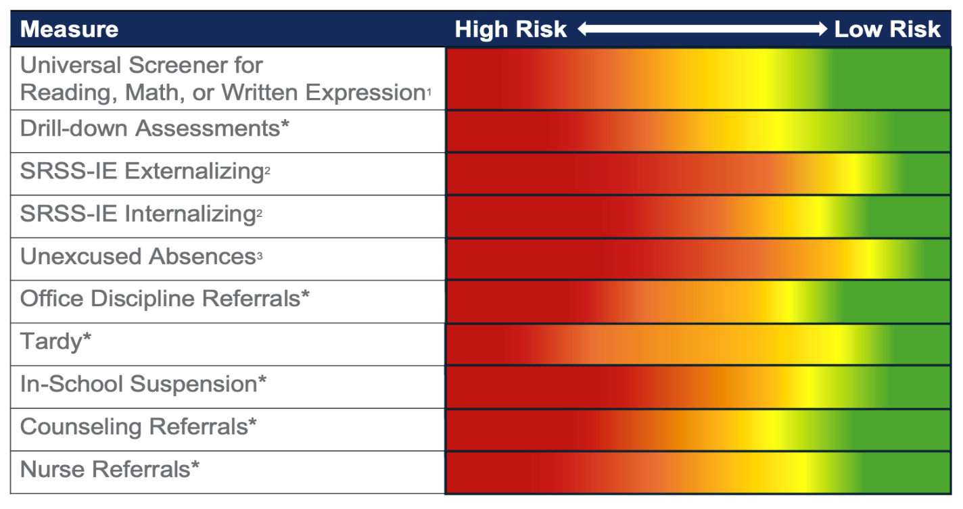
Elementary Example
* Determined by district or school guidelines
(¹TDOE, 2021; ²Lane et al., 2015; ³Attendance Works, 2022)
Notes:
Main Takeaway: Here is an example of a risk indicator continuum for an elementary school. This continuum organizes different measures of risk by row. A continuum of risk is shown along each row horizontally, from high risk on the left to low risk on the right as indicated by the color gradient. The school identifies where students fall along a continuum of risk for each indicator and use multiple data sources and perspectives to determine a student's needs. The continuum allows schools to organize this information so that teams can quickly identify students in need of additional support.
It's important to remember:
Do not use prescriptive cut scores to identify risk, identify need for further assessment, or quality students for intervention.
Do not use prescriptive cut scores to identify students for specific tiers (e.g., Tier II or Tier III intervention).

Slide 62
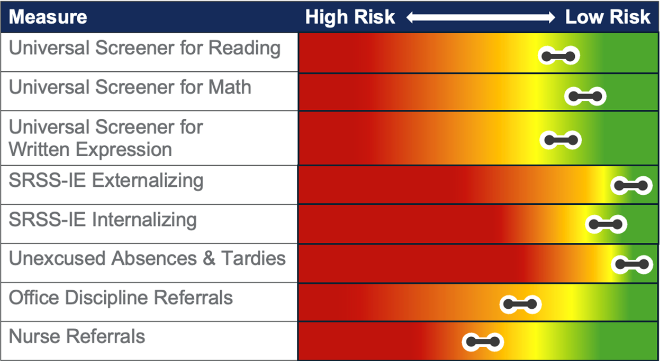
Elementary Example – 5th grader
Avoid the use of prescriptive cut scores to identify risk and qualify or disqualify students for intervention.
Notes:
Main Takeaway: Here the example risk indicator continuum for elementary is used identify areas of potential risk for a fifth grader. You can see the specific measures used to begin to identify areas of risk. The level of risk is indicated by the color where the bar falls on the continuum. In this initial round of assessments, it appears that there are only concerns in behavior scores that fall along the at-risk range on the continuum for office discipline referral and nurse referrals (nurse office visits) as those are where the student score clearly falls in the orange to red portion of the gradient. However, the classroom teacher reports concerns in literacy and says the student is having trouble ”keeping up.”
Remember the following:
Risk exists along a continuum.
Placement in an area of risk high or some risk does not qualify a student for intervention.
Placement in an area of low risk does not disqualify a student for intervention.
Do not use prescriptive cut scores to identify risk, identify need for further assessment, or quality students for intervention.
Do not use prescriptive cut scores to identify students for specific tiers (e.g., Tier II or Tier III intervention).
Multiple data sources are needed to identify risk.
The next slide shows additional data that was collected.

Slide 63
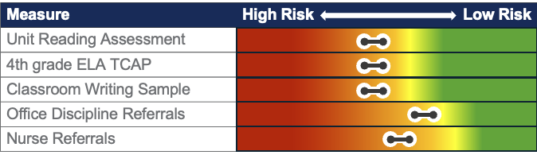
5th grader continued
Description of Results
The student received ”C’s” on the last two reading unit assessments focused on comprehension skills and scored “basic” on the ELA subtest of last year’s state assessment. A writing sample scored using a holistic rubric showed performance was below expectations.
The student has several nurse referrals for headaches and received 2 office discipline referrals this year for work refusal. Student reported work refusal was due to not being able to see the board.
The team identified deficits in the areas of reading comprehension, writing, and the student was referred for a vision exam.
Notes:
Main Takeaway: Here we can see the additional data the school gathered and also organized in the risk indicator continuum. The school gathered additional academic data including classroom assessments and the previous year’s state assessments which showed the student struggled on various reading comprehension and writing skills (beyond spelling). The team further analyzed office discipline referral and nurse referral data and referred the student for a vision exam.
More information on the case:
Student was identified as risk during the fall screening window.
Student was not identified as at risk during prior school years.
Other important reminders:
Identification of risk can differ by context.
Choice of drill-down assessments should differ according to student data profile and data-based decision-making team decisions.
Team has not yet determined why the student is struggling in reading comprehension and writing.
Additional data may be gathered and existing data may be reanalyzed in later steps.

Slide 64
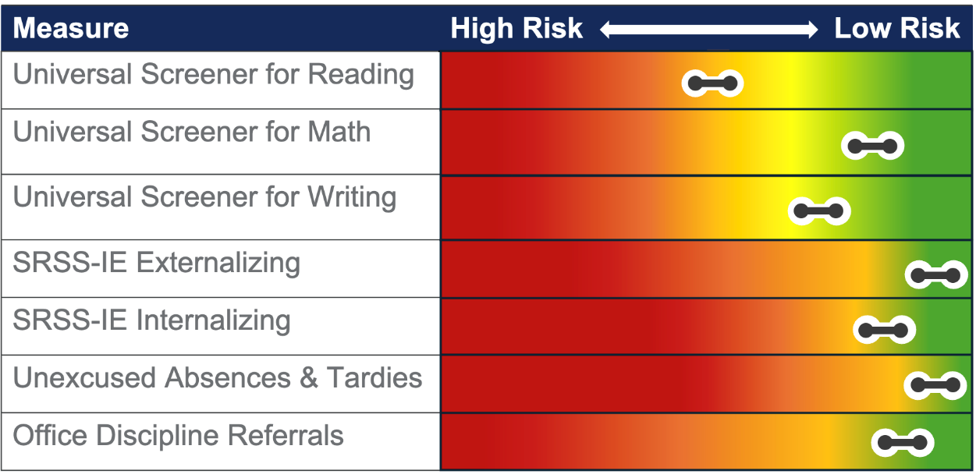
Elementary Example – 2nd grader
Avoid the use of prescriptive cut scores to identify risk and qualify or disqualify students for intervention.
Notes:
Main Takeaway: Here the example risk indicator continuum for elementary is used to identify areas of potential risk for a second grader. These are the universal screeners which is a first step in identifying risk. You can see the specific measures used to begin to identify areas of risk listed from top to bottom along the left. You can also see the student’s score which is shown by a line with circles indicating the score may fall in that area of the risk continuum. The level of risk is indicated by the color where the bar falls on the continuum. In this initial round of assessments, you see the student is showing risk in reading. In this instance, the DBDM team spoke with the classroom teacher to confirm this as an area of concern where additional data should be collected. The teacher also confirmed that the student does not show risk in the other academic and non-academic areas, although the student does show a range of performance. The next slide shows additional data that was collected.
Remember the following:
Risk exists along a continuum.
Placement in an area of risk high or some risk does not qualify a student for intervention.
Placement in an area of low risk does not disqualify a student for intervention.
Do not use prescriptive cut scores to identify risk, identify need for further assessment, or quality students for intervention.
Do not use prescriptive cut scores to identify students for specific tiers (e.g., Tier II or Tier III intervention).
Multiple data sources should be used to identify risk.

Slide 65
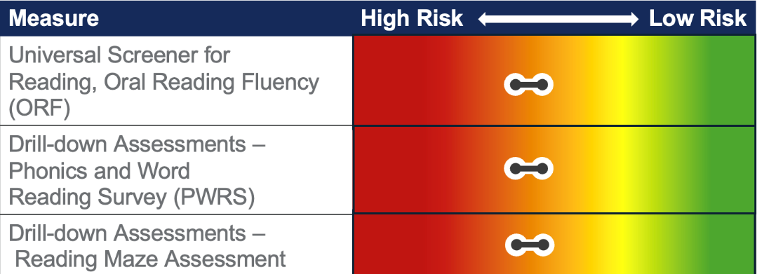
2nd grader continued
Description of Results
The student was identified as at potential risk after the winter screening window. ORF Accuracy and Rate: 68 words per minute, 96% accuracy.
PWRS: The student read almost all grade-appropriate words correctly but read slowly, sounding out many words aloud.
Reading Maze: The student made 7 correct choices and 1 incorrect choice.
The team identified the need for further instruction in the area of reading fluency and decided to serve the student through a standards-based intervention since need was covered by grade-level instructional expectations.
Notes:
Main Takeaway: Here we can see the additional data the school gathered and also organized in the risk indicator continuum. The school gathered additional data using the PWRS and a Maze. After reviewing the results (shown on the slide) the team identified potential skill deficits in the area of reading fluency. The student has decoding skills but is not applying them with ease and speed, which is expected by this point in the school year for second grade. However, since this is an instructionally relevant skill for the grade and the need was covered in grade-level expectations, the team decided to serve the student in a standards-based Tier I (rather than skills-based Tier II) intervention.
More information on the example and assessments:
Student was not identified as at-risk until the winter screening window.
Student has foundational skills and made growth, but did not develop the fluency with skills needed at this point in the school year.
Part of decoding is developing automaticity or the ability to decode words quickly, accurately, and easily. If a student fails to develop automaticity in their word reading it will impact their reading fluency, or ability to read passages.
If a student is decoding slowly and with a substantial amount of effort, as was happening with this student, it can also impact their ability to understand what they are reading. Consider if a student is putting great mental effort towards just reading the words on the page. They will have limited cognitive resources left to devote to pulling meaning from what they are reading.
Identification of risk can differ by context. Ask participants to consider if the choice for intervention for a student like this may differ across schools in their district.
Phonics and Word Reading Survey
Student names letters, sounds, and reads words with specific patterns.
Assesses letter-sound knowledge and decoding skills.
Reading Maze Assessment:
Student reads a short passages silently. Throughout the passage, one word is replaced with a choice of three. Student circles the best word to complete the sentence.
Assesses silent reading fluency and surface-level comprehension skills.
Remember the following:
Choice of drill-down assessments should differ according to student data profile and data-based decision-making team decisions.
Additional data may be gathered and existing data may be reanalyzed in later steps.

Slide 66
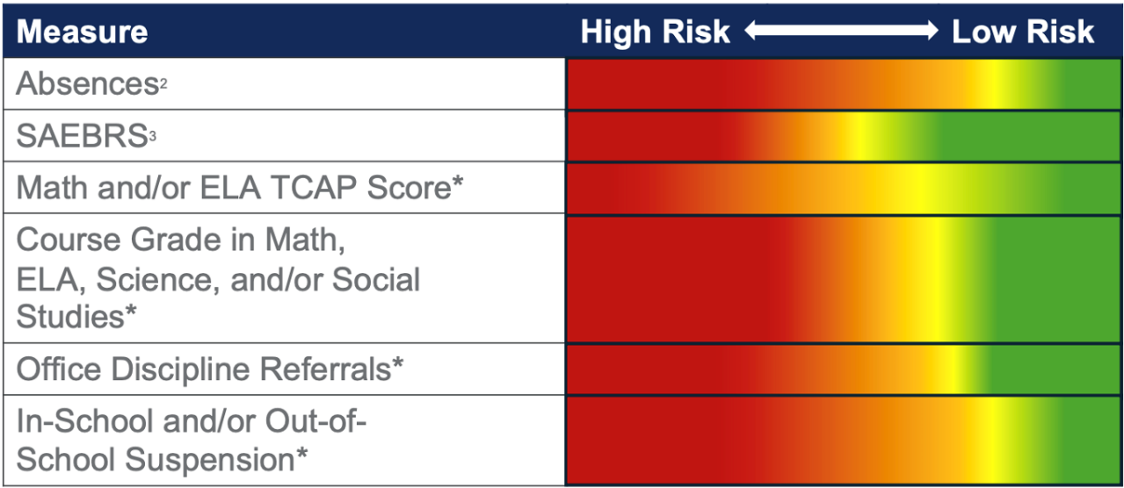
Secondary Example
* Determined by district or school guidelines
(¹TDOE, 2021; ²Attendance Works, 2022, ³Illuminate Education, 2021)
Notes:
Main Takeaway: Here is an example of a risk indicator continuum for a secondary school. This continuum organizes different measures of risk by row. A continuum of risk is shown along each row horizontally, from high risk on the left to low risk on the right as shown by the color gradient. The school identifies where students fall along a continuum of risk for each indicator, using multiple data sources and perspectives to determine a student's needs. The continuum allows schools to organize this information so that teams can quickly identify students in need of additional support.
It's important to remember:
Do not use prescriptive cut scores to identify risk, identify need for further assessment, or quality students for intervention.
Do not use prescriptive cut scores to identify students for specific tiers (e.g., Tier II or Tier III intervention).
Guided Notes:
Similar to early warning systems, just another way to look at a variety of data for students
Continuum should include a variety of academic and nonacademic assessments/data
Measures may vary according to context but should met state-requirements
Continuum should list specific measures used, for example the name of the drill-down assessment
Risk should be viewed along a continuum
Placement in an area of risk high or some risk does not qualify a student for intervention
Placement in an area of low risk does not disqualify a student for intervention
When introducing the risk continuum, we suggest following these steps
Connect the risk continuum to a risk indicator grid. Note similarities (for example that both use multiple sources of data across academic and nonacademic areas) and differences (no hard cuts between risk categories).
Call attention to the fact that both academic and nonacademic measures are included. Example measures will differ according to the data gathered during the universal screening process by the school. Draw the connection between the measures used in the continuum and an Early Warning System.
Explain that the colors show the continuum of risk from high risk represented by red to low risk represented by green. Note that this shifts across the rows according to the individual measure and scale of those measures, which is why the area of red/orange/yellow/green varies.
Explain that schools would use national norms, district policy, and local context to inform thresholds for risk.
Explain that we will plug student scores into this continuum and that data-based decision-making teams can use this to discuss individual student data for students for who risk is suspected. We won’t do this for all students, but rather those for who a flag is raised on a universal screener or additional data source (e.g., classroom assessment data, teacher/parent report).

Slide 67
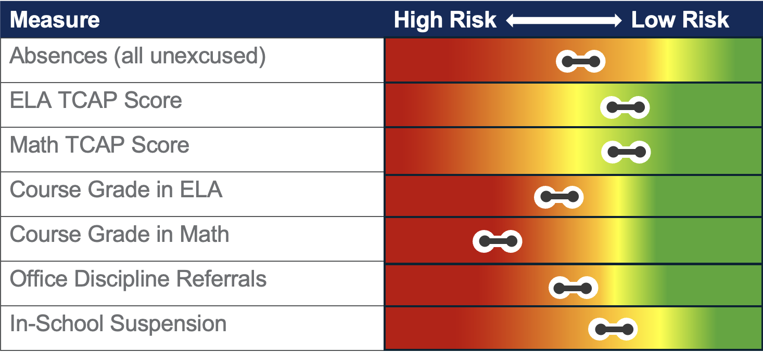
Secondary Example – 9th grader
Avoid the use of prescriptive cut scores to identify risk and qualify or disqualify students for intervention.
Notes:
Main Takeaway: Here the example risk indicator continuum for secondary is used to identify areas of potential risk for a ninth grader. You can see the specific measures used to begin to identify areas of risk listed along the left. These are the measures that are included in the Early Warning System. You can also see the student’s score which is shown by a line with circles indicating the score may fall in that area of the risk continuum. The level of risk is indicated by the colors where the line falls on the continuum. In this initial round of assessments, you see concerns with attendance, course performance, grades, and behavior. This data is an initial indication of risk, but additional data is needed prior to determining risk and placing the student in intervention. The next slide shows additional analysis of existing data that is needed to determine risk.
Remember the following:
Risk should be viewed along a continuum.
Placement in an area of risk high or some risk does not qualify a student for intervention.
Placement in an area of low risk does not disqualify a student for intervention.
Do not use prescriptive cut scores to identify risk, identify need for further assessment, or quality students for intervention.
Do not use prescriptive cut scores to identify students for specific tiers (e.g., Tier II or Tier III intervention).
Multiple data sources should be used to identify risk.

Slide 68
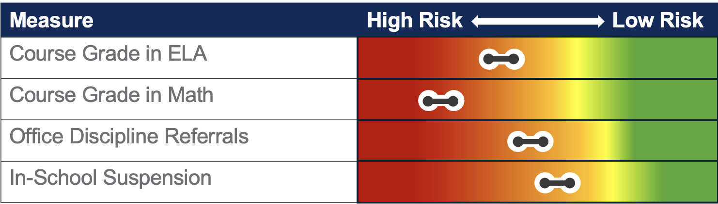
9th grader continued
Description of Results
ELA and Math teachers state student has missed and failed to make up several exams. Review of office discipline referral and in school suspension data reveals the most common offenses include work refusal and leaving class to go to the bathroom during exams and not returning. ELA and Math teachers report this behavior is confined to exams and the student participates actively in classes on non-exam days and does well on daily assignments. They also mentioned the student seems worried on test days.
The team identified emotional regulation as the area of need.
Notes:
Main Takeaway: This example of another risk indicator continuum began during Session 1. This slide shows the Define step and the “Description of Results.” This step begins the conversation on determining risk, root cause, and planning an intervention focused on behavior needs. In the initial round of assessments, it appeared that there are concerns in both academics and behavior with the most substantial area of risk being math performance. Here we can see further analysis of existing data to determine risk and area of need for intervention. The team analyzes course grades and attendance and finds the student has missed exams in ELA and Math which affects their grades in these classes. In addition, the student frequently skips class on test days. Analysis of office discipline referral data reveals common offenses include work refusal and leaving class to go to the bathroom during exams and not returning. The team identifies emotional regulation as the area of need. The team decides to analyze more data to determine why the student is demonstrating interfering behaviors.
More information on the case:
Missed exams lowered grades substantially.
More analysis of course grades and work refusal are presented later to help determine why the student is demonstrating interfering behaviors.
Additional data to help determine why the student is demonstrating interfering behaviors is is presented later.
Other reminders:
Identification of risk can differ by context.

Slide 69
Reminder
Remember, a risk indicator flags students who may need additional support based on one data source.
Decisions must be made using multiple data sources.
Notes:
Main Takeaway: Individual measures may provide one indication a student may be at risk. Decisions to identify risk and and place students in intervention must be made using multiple data sources.
Remember the following:
Risk indicators: assessments and gathered data that identify students who are struggling who may need intervention.
Using risk indicators is a beginning point of where we start to identify risk.
Multiple data sources should be used to identify and verify risk.
Do not use prescriptive cut scores to identify risk, identify need for further assessment, or quality students for intervention.
Do not use prescriptive cut scores to identify students for specific tiers (e.g., Tier II or Tier III intervention).

Slide 70

Drill-down Assessments
(e.g., Diagnostic and Survey-level Assessments)
Assessments that identify skill-specific strengths, needed skills, and environmental factors that may influence student performance.
Notes:
Main Takeaway: Drill-down assessments are a source of data that can be used during the universal screening process to identify risk. Drill-down assessments include diagnostic and survey-level assessments that identify skill-specific strengths, needed skills, and environmental factors that may influence performance.
Drill-down assessments
can be formal or informal
can be existing assessments or teacher-made
will differ according to the skill(s) assessed
help teachers identify specific skill deficits and/or behavioral challenges
help teachers determine how to make targeted, individualized changes to an intervention
Drill down assessments can also be used later to determine the root cause behind why a student is struggling.
Drill down assessments provide useful data for planning intervention for a student.

Slide 71
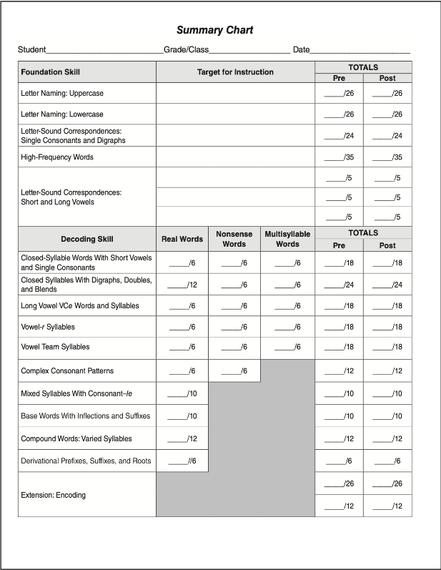
Drill-down Assessments
Academic Examples
Phonological Awareness Screener
Phonics and Word Reading Survey
Developmental Spelling Inventories
Placement tests
Teacher made tests
Benchmark assessments
Common assessments
Writing samples
Error analysis
Others?
(Voyager Sopris Learning, 2018)
Notes:
Main Takeaway: There are many different drill-down assessments. This slide lists examples academic drill-down assessments, but there are more than are shown here. Remember that other data sources, such as teacher observation (for example), can also assist with drill-down assessment, as their observations may detect subtleties in student performance that were not measured in another drill-down assessment. On the last bullet, presenters can ask participants what other data sources can be useful in a drill-down assessment.
Remember the following:
Remember to make decisions based on a variety of data.
Plan drill-down assessments according to each student’s need.
Make sure to have a purpose for administration.
Often multiple assessments are administered.

Slide 72

Drill-down Assessments
Non-academic Examples
Office discipline referral data analysis
Attendance data analysis
Daily behavior reports review
Preference assessments
Informal interviews
Functional Behavior Assessment
Teacher Rating Scales
Others?
(TDOE, 2023)
Notes:
Main Takeaway: There are many different drill-down assessments. This slide lists examples non-academic drill-down assessments used to gather data on attendance and behavior, but there are more than are shown here. Presenters can ask participants to name another example of a drill-down assessment for a non-academic example.
Remember the following:
Remember to make decisions based on a variety of data.
Plan drill-down assessments according to each student’s need.
Often multiple assessments are administered.
Start with low resource assessments.
Save high resource assessments, like functional behavior assessments, for complex/difficult cases.
Make sure to have a purpose for administration.

Slide 73
Review Additional Data Sources
Formative assessments
Summative assessments
Drill-down assessments
Teacher observations
Attendance records
Office discipline referrals
Family concerns
Additional academic or behavior screener data
Student record review
Verify risk by comparing screening data with other information to confirm that intervention is needed.
(TDOE, 2023)
Notes:
Main Takeaway: Make sure to review additional data sources throughout the universal screening process. Go beyond universal screeners. Verify risk by comparing data gathered through multiple data sources. Some examples are presented on the right side of this slide.
Remember the following:
Multiple sources of data should be used when identifying and verifying risk.
A single data source should not be used to identify students at-risk or qualify or disqualify a student for intervention.

Slide 74
Note to Remember
When making team decisions to identify and verify risk, examine both academic and behavior data at the same time.
(McIntosh & Goodman, 2016)​
Notes:
Main Takeaway: To make risk identification more efficient and effective, teams can examine academic and behavior data simultaneously.
Benefits
Helps catch students with overlapping needs
Makes meetings more efficient
Single data-based decision-making team can look at both behavior and academic data, no need for two teams!
Keep in mind:
Member of DBDM team can include administrators, school psychologists, academic and behavior interventionist, classroom teacher, instructional coach
Include specialists such as ESL teacher, special education teacher, school counselor, or other staff according to the needs of the child.

Slide 75
Identifying Students for Tier II Interventions
Before determining if a student at risk needs Tier II intervention, data-based decision-making teams should ask:
Have we examined multiple data sources, including drill-down data if needed?
Have we considered a variety of types of data?
Have we weighed the intensity of the student's needs and how much support they will need to meet grade-level expectations?
Notes:
Main Takeaway: Before placing students in Tier II interventions, data-based decision-making teams can ask themselves the following guiding questions to help determine if they have the data necessary to make the decision and if the placement is appropriate.
Have we examined multiple data sources, including drill-down data if needed?
Have we considered a variety of types of data?
Have we weighed the intensity of the student's needs and how much support they will need to meet grade-level expectations?
Remember the following:
Multiple data sources should include drill-down assessments according to student need.
Intensity of the student need considers things such as response to previous intervention and gap between current and expected performance.
Do not use prescriptive cut scores to identify risk, identify need for further assessment, or quality students for intervention.
Do not use prescriptive cut scores to identify students for specific tiers (e.g., Tier II or Tier III intervention).

Slide 76
Using Risk Indicators
Alignment Guide Application Activity
Turn to the Using Risk Indicators Activity in the Alignment Guide.
Consider the discussion questions as you begin to create a Risk Indicator Continuum for your school.
Discuss data sources used at your school to identify and verify risk.
Determine guidelines for risk levels using national norms, district policy, and student population considerations.
Complete the Pause and Reflect chart.
Notes:
Purpose: The purpose of this activity is to identify the multiple data sources your school uses to identify risk. Consider guidelines for risk levels using national norms, district policy, and student population considerations, but remember, risk exists along a continuum. Teams should work to ensure decisions are not being made according to cut scores or prescriptive guidelines.

Slide 77
Wrap Up

Slide 78
Coming Next!
Session 2
Managing Tier II Interventions Pre-work
Using Drill-down Assessments to Understand the Problem
Selecting and Managing Tier II Intervention to Address Student Need
Determining to Response to Intervention
Notes:
Main Takeaway: Now that Session 1 is complete, there are two more parts to our Implementing Tier II Training. Next, you will need to complete the Managing Tier II Interventions Pre-work on your own or with your team. Just like the pre-work before today’s session, this is a short, recorded presentation that you can watch and discuss with your team before the next in-person session. Managing Tier II Interventions is the focus of this pre-work session. Then Session 2 is another in-person day of training just like today. The following topics will be discussed:
Using drill-down assessments to understand the problem.
Selecting and managing Tier II intervention to address student need. This builds upon the Session 2 pre-work, so it is important to watch that recording before attending this day of training.
Determining response to intervention.

Slide 79
Session 1 Wrap Up
Complete the TESS Evaluation.
Plan to attend training on XXXX.
Create a reminder to bring student-level data for one or two students at your school receiving Tier II interventions or who you believe will need Tier II support to the next session.

Slide 80
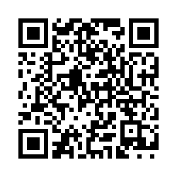

TN-TAN End-of-Session Survey (Full)
Please complete the evaluation survey using the following link or by scanning the QR code:
Open the TN-TAN End-of-Session Survey (https://tinyurl.com/3j4m7rb3).
Project provider: TSC
Event title: Tier 2: Day 1
Learning objectives:
Audit current implementation structures to support tiered support frameworks for Tier II interventions and supports.
Understand characteristics of Tier II support and identify evidence-based instruction and intervention practices.
Recognize how a Data-Based Decision-Making Team uses multiple data sources to evaluate student need and begin to apply this process themselves.

Slide 81


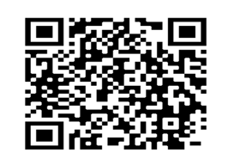
Connect With Us
To learn more about our services, connect with us on our website, through our newsletter , and on social media.
Website
Newsletter
Social Media
tennesseetsc.org
@tennesseetsc
Permission is granted to use and copy these materials for noncommercial educational
purposes with attribution credit to the Tennessee Department of Education. If you wish
to use these materials for reasons other than noncommercial educational
purposes, please contact the Office of General Counsel at (615) 741-2921.
Notes:
Main Takeaway: We look forward to seeing you at Session 2 of Tier II Training, but please visit our website, subscribe to our newsletter using this QR code, and follow us on social media to stay connected to us in the meantime.

Slide 82
References
Review a full list of references at Implementing Tier II Interventions and Supports.

Slide 83
References
Archer, A.L., & Hughes, C.A. (2016). Explicit instruction: Effective and efficient teaching. The Guilford Press, New York, NY
Attendance Works (2022, December) Chronic absence: 3 tiers of intervention. https://www.attendanceworks.org/chronic-absence/addressing-chronic-absence/3-tiers-of-intervention/
Balfanz, R., Herzog, L., & Mac Iver, D. J., (2007). Preventing student disengagement and keeping students on the graduation path in urban middle-grades schools: Early identification and effective interventions. Educational Psychologist.
Brown-Chidsey, R. & Bickford, R. (2016). Practical handbook of multi-tiered systems of support: Building academic and behavioral success in schools. New York, NY: Guilford Press.
Florida Problem Solving/Response to Intervention Project. (2021). Guiding tools for instructional problem solving (GTIPS). (3rd ed.). https://floridarti.usf.edu/resources/gtips/GTIPS_3rdEd.pdf
Notes:
Main Takeaway: These are references mentioned throughout today’s presentation.

Slide 84
References 2
Fuchs, L.S., Fuchs, D., & Malone, A.S. (2017). The taxonomy of intervention intensity. TEACHING Exceptional Children, 50(1), 35-43. DOI: 10.1177//0040059917703962
Illuminate Education (2021). FastBridge social emotional behavior national norms report. FastBridge. https://fastbridge.illuminateed.com/hc/en-us/articles/1260802344370
IRIS Center. (2014). Evidence-based practices (part 1): Identifying and selecting a practice or program. Retrieved from https://iris.peabody.vanderbilt.edu/module/ebp_01/
Lane, K. L., Oakes, W. P., Swogger, E. D., Schatschneider, C., Menzies, H., M., & Sanchez, J. (2015). Student risk screening scale for internalizing and externalizing behaviors: Preliminary cut scores to support data-informed decision making. Behavioral Disorders, 40, 159-170.
McIntosh, K. & Goodman, S. (2016). Integrated multi-tiered systems of supports: Blending RTI and PBIS. New York, NY: Guilford Press.
Notes:
Main Takeaway: These are references mentioned throughout today’s presentation. The full list of references are available using the link on the slide.

Slide 85
References 3
McLesky, J., Maheady, L., Billingsley, B., Brownells, M.T., Lewis, T.J. (2022). High leverage practices for inclusive classrooms. New York, NY: Routledge.
National Center on Intensive Interventions at the American Institutes for Research. (2022, December). Levels of Intervention and Evidence: Tier 2 (Validated Intervention Program). https://intensiveintervention.org/tools-charts/levels-intervention-evidence
Pearson. (2020). aimswebPLUS.
Tennessee Department of Education. (2023, September). Response to instruction and intervention framework. https://www.tn.gov/content/dam/tn/education/special-education/rti/Updated_RTI2_Manual.pdf
Tennessee Department of Education. (2021, September). TN universal reading screener administration guidelines. https://www.tn.gov/content/dam/tn/education/2020-21-legsession/TURS%20Admin%20Considerations%20Final.pdf
Notes:
Main Takeaway: These are references mentioned throughout today’s presentation. The full list of references are available using the link on the slide.

Slide 86
References 4
Tennessee Department of Education. (2022). Data-based decision making within the response to intervention framework [Webinar]. Tennessee Department of Education.
Wisconsin RtI Center. (2022). Using early warning systems for middle and high school universal screening in a culturally responsive multi-level system of support.
Voyager Sopris Learning (2018). Phonics and word-reading survey. Letrs 3rd edition.
Yau, N. (2013, June). Understanding data - context. Big Think. https://bigthink.com/articles/understanding-data-context/
Notes:
Main Takeaway: These are references mentioned throughout today’s presentation. The full list of references are available using the link on the slide.

Slide 87
Break
Newsletter
Social Media
@tennesseetsc

Slide 88
Lunch
Newsletter
Social Media
@tennesseetsc

