Slide 1

Welcome
As you prepare for Implementing Tier II, please:
Sit with your school team.
Download all trainings for this session, if you haven't already.
Wi-Fi Network:
Password:
Notes:
Purpose: Include WIFI information on this slide, if the location has access to wifi for participants.

Slide 2


Implementing Tier II Interventions and Supports Session 2
Tennessee Tiered Supports Center

Slide 3
Disclaimer: Generative AI Tools
The State of Tennessee does not currently permit the use of generative AI tools (e.g., Otter, Fireflies) in meetings hosted on state resources. Meetings with contractors, vendors, and subrecipients are not public meetings and may involve discussion of protected state data. Generative AI tools are not adequately regulated and are designed to train on data that is collected and may misrepresent data or release protected data to the general public.
While the state supports your desire to maintain documentation of the meeting and what you learn, please respect our decision to safeguard information and do not attempt to use tools such as these. If you choose to use a tool such as these, the state will block such tools from the meeting.

Slide 4
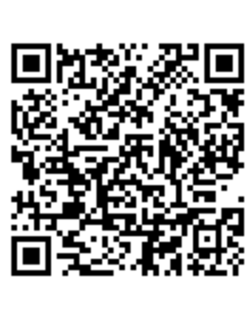
Attendance and Tennessee Academy for School Leaders (TASL) Survey
Complete the Attendance and TASL Survey (https://tinyurl.com/AttendTASL).
You must be present for the entire session to receive TASL credit.
A TASL certificate will be sent to you via email at the end of the semester.

Slide 5
Introduction
Notes:
Purpose: The following slides are an introduction to Best for All, the TN-TAN network, our presenters, schedule, materials needed, and learning objectives for the day.​

Slide 6

Tennessee Technical Assistance Network
(TN-TAN)
TN-TAN provides school districts, administrators, educators, and families access to free high-quality training, resources, and supports designed to improve outcomes for students with disabilities, ages 3–22. See below for our areas of support and the partners who lead the specific support areas:
Assistive Technology: Assistive Technology Project for Education (ATP)
Autism Supports: TRIAD at Vanderbilt
Family Engagement: The Arc Tennessee
Intensive Behavior: TRIAD at Vanderbilt
RTI²-A+B: Tennessee Tiered Supports Center
Secondary Transition: Transition Tennessee (TransitionTN)
Visit the TN-TAN website for more information: https://tn-tan.tnedu.gov.

Slide 7
Learning Objectives
After completing this training, participants will be able to:
Refine their Data-based Decision-making Team's process to evaluate student need and select appropriate interventions by utilizing multiple data sources.
Enhance their skills in selecting and managing tailored interventions to meet diverse student needs and practice and reflect on these processes within their student populations.
Identify types of student response to intervention using fidelity monitoring and progress monitoring data.

Slide 8
Introduction of Presenters
Victoria Perry, Technical Assistance Director
Tara Axelroth, Education Consultant
Jessica Ogburn, Education Consultant
Tell us about your team!

Slide 9
Agenda
8:30 Welcome and Introductions
8:45 Using Drill-down Assessments to Understand the Problem
10:45 Selecting and Managing Interventions
12:00 Lunch
1:15 Determining Response to Intervention
3:00 Wrap-Up

Slide 10



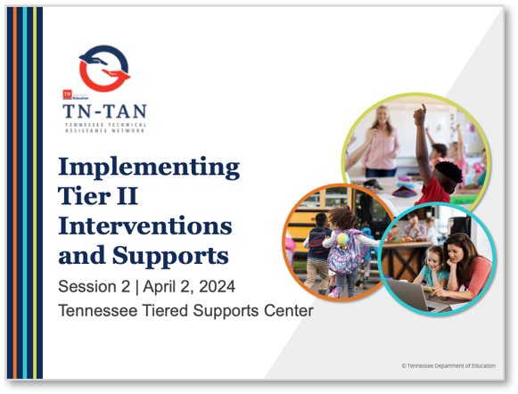
Training Materials
Notes:
Main Takeaway: These are the training materials that participants will need for the day. If you haven’t already done so, please visit the Tennessee Tiered Supports Center webpage to download the necessary resources. The materials are located under the “Tiered Trainings” section in “Tier II”. The password to access these materials is tsc2.

Slide 11
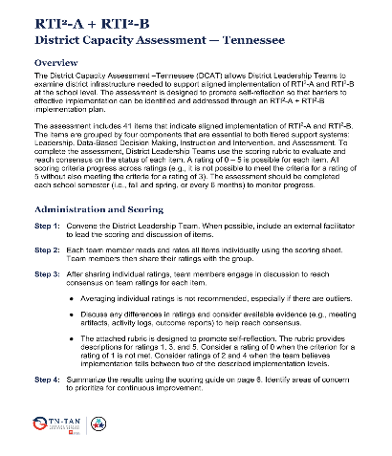
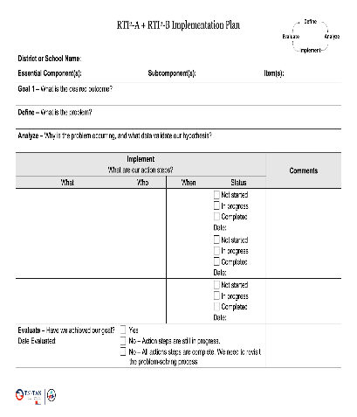
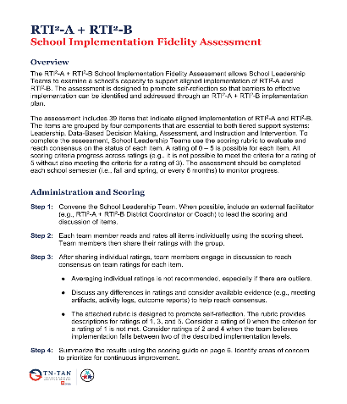
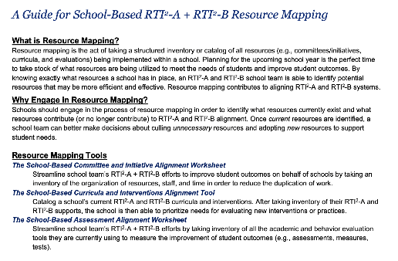
Roadmaps
Notes:
Main Takeaway: As we mentioned at the beginning of Session 1, these assessments help teams follow a roadmap for the implementation of RTI2-A and RTI²-B and reflect on their progress throughout implementation. School teams or district teams will continue to reference the SIFA or DCAT, respectively, throughout training activities today while reflecting on their current practices. Doing this allows teams to consider what next steps or actions should be taken based upon their fidelity assessment scores and the material shared today as they draft their school’s Annual Implementation Plan or review their District Implementation Plan. Teams will also use the Guide for School-based RTI²-A + RTI²-B Resource Mapping to determine additional tools needed to support students.

Slide 12
Training Review
Session 1 and Session 2 Pre-work
Collaborative Teaming Session 1 Pre-work
Aligning Tier II Implementation Structures
Characteristics of High-quality Interventions
Evaluating Student Need Using Multiple Data Sources
Managing Tier II Interventions Session 2 Pre-work
Notes:
Main Point: At this point, all participants should have completed the Session 1 Pre-work on Collaborative Teaming and attended the in-person Session 1 training. Since that training day, all participants should have also completed the Session 2 Pre-work on Managing Tier II Interventions. By completing the pre-work objectives, participants are better prepared to engage in the Tier II training today, contributing to a more productive and impactful learning experience. We will have some time to review the pre-work and create a plan from your pre-work later in the training today.

Slide 13
Using Drill-down Assessments to Understand the Problem
RTI²-A + RTI²-B School Fidelity Assessment:
Selection of Instructional Practices and Interventions (19)
Tier II Instruction and Intervention (36-37)
Notes:
Main Takeaway: This section focuses on using drill-down assessments to understand the problem. Specifically, it emphasizes key elements corresponding to items 19, 36, and 37 of the School Fidelity Implementation Assessment (SIFA) related to Tier II Instruction and Intervention. By effectively addressing these areas, schools can enhance the effectiveness of Tier II interventions, leading to improved student outcomes and greater overall fidelity to the Tier II implementation framework.

Slide 14
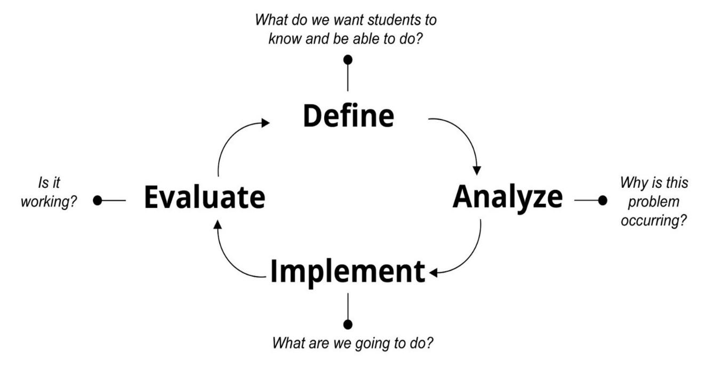
The Problem-Solving Process
Notes:
Main Takeaway: This training follows the problem-solving process. On Day 1 we walked through the first step of the process, which is defining the issue that the team will address. In the next section we will begin walking through the Analyze step of the process, within the context of using data to make decisions as a data-based decision-making team. The team using multiple sources of data as they consider student need and how to best provide support that meets those needs.

Slide 15

Drill-Down Assessments
(e.g., Diagnostic and Survey-Level Assessments)
Assessments that identify skill-specific strengths, needed skills, and environmental factors that may influence student performance.
Notes:
Main Takeaway: In the analyze step of the problem-solving process, the data-based decision-making team uses multiple sources of data to identify and verify students' strengths as well as the level of risk students may have in different content areas (academic, behavior, attendance, etc.). Diagnostic and survey-level assessments, as well as other data sources such as student records, classroom assessments, response patterns and others, are used to drill down to the specific skills that should be the focus of intervention and support for each student. You may remember, from our first session, the different examples of drill-down assessments we reviewed. We'll be expanding on those examples during today's training as well.

Slide 16
Prerequisite and Related Skills
Academic Skills: Reading Example
Oral language comprehension
Reading comprehension
Vocabulary
Reading fluency
Word recognition and decoding
Spelling
Letter-sound knowledge
Phonological awareness
Notes:
Main Takeaway: Screening data give us a first indication of an area of need, but we need to drill down and consider related and prerequisite skills in order to find the root cause of the problem. This slide provides an example of the different prerequisite and related skills that are needed for reading, as these skills build on each other. For example, a screener may indicate difficulties in reading comprehension, but this is an overarching skills. Oral language comprehension and vocabulary are related skills that directly contribute to reading comprehension and impact performance. If a screener indicates difficulty with an overarching skill, related skills should be considered and investigated. In order to have adequate reading comprehension, students also need to have mastered prerequisite skills like reading fluency, word recognition and decoding, letter-sound knowledge, and phonological awareness. If a student is struggling with an overarching skill, drilling down and considering prerequisite skills can help determine the area of weakness and provide important information for planning intervention.​

Slide 17
Using Screeners to Inform Drill-down Assessment Selection
Screener: Phoneme Segmentation Fluency
Screener: Phonemic Awareness
Drill-Down Assessment:
Phonological Awareness Skills Survey
Specific Skill Deficit: Blending, Segmentation, Deletion
Notes:
Main Takeaway: Screeners help tell us the broad area of weakness for a student which can be used to inform which drill-down assessment should be used to learn more about why the problem is occurring. Keep in mind that a screener doesn't have to show need for a team to to engage in additional drill-down analysis. If a different source of data, such as a student, family member, or teacher request for assistance, indicates an area of need for a student, teams should still engage in a drill-down assessment to pinpoint the specific skill deficits within that area of weakness. Once the specific skills (or root causes) of the weakness are identified, teams will be able to identify interventions that have been shown to be effective in addressing those specific skills, leading the team to answer the question in the third part of the problem-solving process, "Where do we start?”
Notes on the example:
Phoneme segmentation fluency screener may indicate broad need in phonemic awareness
To further investigate, team may administer additional drill down assessments or re-analyze existing data.
Team administered phonological awareness skills survey to pinpoint phonological awareness skills to target for intervention
According to the assessment, deficits were identified in blending, segmentation, and deletion

Slide 18
Characteristics of Dyslexia: T.C.A. § 49-1-229
All students K-12 must go through an approved universal screening process.
LEAs must have the capacity to measure skills in the areas of phonological awareness, phonemic awareness, sound-symbol recognition, alphabet knowledge, decoding skills, rapid naming, and encoding.
Multiple sources of data should be analyzed to identify students as “at risk.”
(TDOE, 2018)
Notes:
Main Takeaway: Administering additional assessments to determine intervention needs is something you are already doing as part of the universal screening process. This slide and the one that comes next focus on requirements for universal screening for characteristics of dyslexia. Notice that, for T.C.A. 49-1-229, screeners are required to assess specific skills according the grade level and development needs of the student. This law also identifies that multiple sources of data should be used to identify students at risk. This includes administering survey-level assessments as needed as part of the universal screening process and using these results, along with other sources of data, to plan intervention
Survey-level assessments may be administered as needed to determine student intervention needs as part of the universal screening process. The results of the survey-level assessment should be used to plan intervention.

Slide 19
Characteristics of Dyslexia:
T.C.A. § 49-1-229 and SBE Rule 0520-01-22-.02
If a student is identified as having characteristics of dyslexia, he/she must receive a dyslexia-specific intervention.
Students who are identified as having characteristics of dyslexia and meet criteria should receive an Individualized Learning Plan – Dyslexia (ILP-D). If a student's parent declines an ILP-D, the student would still receive a dyslexia-specific intervention and be served through a student intervention plan.
TDOE, 2018
Notes:
Main Takeaway: The data-based decision-making team uses drill-down data to determine which intervention is most appropriate to meet a student’s needs. If the data indicate that a student has characteristics of dyslexia, he/she must receive a dyslexia-specific intervention, which may be documented through an ILP-D or a student intervention plan. The ILP-D has additional criteria, including family consent (this consent can be passive). If you have questions about this topic, check the TDOE website and the Dyslexia Resource Guide for additional information.

Slide 20
Drill-Down Assessments
Assessing the Function of Behavior
Consider resources–such as time, personnel, materials, and training–required to conduct the assessment.
Less intensive
More intensive
Indirect Assessment
Direct Assessment
Functional Analysis
At Tier II, begin with the less resource-intensive options!
Notes:
Main Takeaway: We’ve discussed drilling down in academics, now let’s discuss how to drill-down in behavior. Drill-down assessments provide more information about a student’s behavior needs. Once broad areas of strengths and needs are identified through the screening process, drill-down assessments should be used to provide more information about why the problem is occurring, which could include learning more about the reason for, or function of the student’s behavior. Consider using assessments that match the intensity of the student's needs to gather this information. Examples of less intensive measures include completing the Strengths and Difficulties Questionnaire (SDQ), conducting an office discipline referral or attendance data analysis, or reviewing reinforcement records. Examples of more specific and/or intensive measures are student, teacher and/or parent interviews or direct observation. A school may also use an even more intensive assessment, such as a functional behavior assessment, to learn more about the function of the student's behavior. Administering a functional behavior assessment requires more time, a formal process with personnel who are trained, and parent permission so this example is more resource-intensive. This helps ensure the intervention will be designed to teach an appropriate alternative behavior and remove reinforcement for the behavior of concern.

Slide 21
Common Areas of Need and Example Challenging Behaviors
Area of Need
Example Behavior
Interfering behaviors
Self-regulation
Social interactions and problem-solving
Emotional regulation
Co-occurring academic and behavior skill needs
Aggression, lying
Distractibility, difficulty concentrating
Arguing, refusing to cooperate
Anxiety, withdrawal
Disruptive behaviors, off-task behavior
Notes:
Main Takeaway: This slide intends to provide a few examples of how a variety of behaviors identified during the drill-down assessment may be grouped in ways that make it easier to provide small group instruction for common skill deficits.
You may remember from Session 1 of our training that Tier II interventions frequently use small groups to deliver interventions to students who share common needs. This may seem straightforward when we're talking about academic skills. For example, it's easy to think about forming two reading intervention groups, one which focuses on phonological awareness and letter-sound recognition (early skills), while the other focuses on reading fluency and vocabulary (more advanced skills). With behavior however, identifying small groups that address common needs may seem less straight-forward, especially when teams are drilling down into a wide variety of behavior concerns reported through a variety of data sources. This slide provides a few examples of how a variety of behaviors may be grouped in ways that make it easier to provide small group instruction for common skill deficits. In this case, behaviors are grouped into five broad categories.
Examples of each area of need, and the corresponding example behaviors, are listed below:
Interfering behaviors – observable, measurable, and disruptive to school procedures, classroom instruction, and learning of the target student and classmates. Examples: short or extended, non-age-appropriate temper tantrums; outbursts of anger; verbal or physical aggression; bullying; deviant behaviors such as being sneaky and telling lies, hiding information, cheating, and stealing.
Self-regulation - noticed most during classroom instruction. Characterized by externalizing behavior patters that often stem from difficulty understanding expectations, managing impulsive tendencies, and directing behavior towards meeting those expectations. Examples: restlessness, overactivity, difficulty sitting still for periods of time required for instruction or task completion, fidgeting, being easily distracted by typical classroom behaviors (pen clicking or chatting with peers), wandering, impulsiveness, distractibility, difficulty concentrating, and poor focus.
Social interactions and problem solving – student’s inability to appropriately interact with others, specifically peers. Characterized by externalizing behavior patterns which may co-occur with internalizing behaviors, that involve difficulties forming and maintaining relationships, effectively interacting with others, and problem solving with others. Examples: being solitary, avoiding interactions with others, struggling to initiate or maintain conversations, misunderstanding others' emotions, arguing, refusing to compromise or cooperate, having few or no same-age friends, choosing to play alone, being picked on by others, failing to share with peers, getting along better with adults and even younger children.
Emotional regulation - internalizing behaviors that are generally not disruptive, or even obvious. Characterized by behavior patters in which feelings, thoughts, and actions are directed inward. Examples: symptoms of anxiety, nervousness, sadness, or fearfulness; social withdrawal; somatic complaints
Co-occurring academic skill deficits – students who have an academic and social emotional behavior area of need. The social emotional needs may impact academic learning or vice versa. Characterized by externalizing behavior patterns, which may co-occur with internalizing behaviors, that involve difficulty meeting academic expectations. Examples: off-task behavior during instruction or academic activities, disruptive behavior during instruction or academic activities, refusal, elopement, truancy. Another example would be a student’s unmet academic need reduces their motivation to complete tasks and stay in class. Student then engages in disruptive behavior to be removed from class, distract the teacher, or not be required to complete academic work.
Trainers can ask participants if they can think of behaviors (other than those listed on the right) that might fit into each area of need. Affirm correct answers, ask for clarification for groupings that aren't clear.
ASK: With the five areas of need you see here, what sorts of positive behavioral interventions might be appropriate? (Common answers might include social skills groups, community-building groups, groups that teach self-regulation strategies, groups that teach problem-solving, groups that teach coping skills, and groups that address a combination of areas [such as self-regulation skills to use when frustrated by an assignment, and problem solving to identify ways to get help with assignments]). Try to solicit additional examples of mapping common areas of need to different interventions

Slide 22
Prioritizing an Area of Need
With Universal Behavior Screening Scores
Universal Behavior Screener
Externalizing Score
Internalizing Score
Item Analysis
Data Sources
Area of Need:
Internalizing Behaviors
Without Universal Behavior Screening Scores
Multiple, Relevant Data Sources (e.g., ODRs,
Suspension Records,
Attendance Records,
Teacher Report)
Aggression
Area of Need: Interfering Behaviors
Notes:
Main Takeaway: This is what the drill-down process to help group by common needs could look like in a school that uses a universal behavior screener and in a school that doesn't. When teams identify areas of need, they may utilize various screening methods. Some use a comprehensive screening process that includes a universal behavior screener, suspension records, attendance data, teacher reports, and other relevant sources. Others might refrain from using a universal behavior screener and instead rely solely on these additional sources to assess risk and dig deeper to understand the problem. Regardless of the chosen method, teams incorporate detailed behavior data as part of their data-based decision-making process to identify specific areas of need.
Keep in mind there are additional benefits to using a universal behavior screener as part of the screening process. First, it can help identify student needs that may get overlooked when relying on student record data alone, such as students with internalizing behaviors. It can also help identify students at risk earlier than student record data, so we can intervene earlier instead of waiting for the problem to be serious enough to be identified through other data sources. As we discussed in Session 1, a risk indicator flags students who may need additional support based on one data source, but decisions must be made using multiple sources of data. Universal behavior screeners alone cannot be used to make decisions and multiple data sources must be consulted before identifying students as at-risk and in need of intervention.
Other important points
These are just some examples of how we can use universal screening data and other available data to help us identify students' broad areas of need.
Using a Universal Behavior Screener: If teams include a universal behavior screener in their process, they can leverage its unique function. The screener provides externalizing and internalizing scores which can be used alongside details from office discipline referrals, suspension records, and teacher reports to identify the most problematic behavior the student is displaying and which broad category of need it falls under to make data-based decisions. This comprehensive approach helps to pinpoint specific areas of need.
With a Universal Behavior Screener: If a universal behavior screener is used, teams can use the information, along with other data sources, to assess risk and assist with identifying specific area of need.
In the example on the left, the data-based decision-making team uses a universal behavior screener as part of the screening process. After reviewing a student's externalizing and internalizing scores on the universal behavior screener, they complete an item analysis to gather more information. They also review the student's office discipline referral data, along with additional sources like suspension records, attendance records, and teacher report, and learn that the student has been displaying aggression. They use this all of this information to determine the student's area of need falls into the category of interfering behaviors.
Without Universal Behavior Screener Scores: If a universal behavior screener is not used, teams must analyze all relevant sources of information about the student's challenging behavior to identify the most problematic behavior and which broad category of need it falls under.
In the example on the right, the data-based decision-making team does not use a universal behavior screener as part of the screening process. Instead they review office discipline referrals, suspension records, attendance records, and teacher reports to learn more about the student's behavior. Through this process they learn the student has been displaying aggression. They use this information to determine the student's area of need falls into the category of interfering behaviors.
Both examples require teams to consider multiple data sources, with the takeaway on this slide being that while universal behavior screeners provide valuable information, there are ways to drill-down to learn more about a student's areas of need without it.

Slide 23
What Are Your Needs?
Behavior Needs
Academic Needs
Can’t Do
Acquisition Skills Deficit
Won’t do
Performance Deficit
Basic reading skills
Reading fluency
Reading comprehension
Mathematics calculation
Mathematics problem solving
Written expression
Notes:
Main Takeaway: When we think about needs, we can group them generally. Drill-down assessments use multiple sources of data to help teams understand if a student has a skill, needs to practice a skill, and/or needs to learn a specific sequence of skills to remediate the problem. You can have a starting point of knowing what type of help a student needs to make progress, but drill-down assessments help you pinpoint specific needs to address so your team can make decisions based on data instead of guessing.
For behavior skills we might think of behaviors a student has not yet mastered. These are acquisition deficits because the student needs support in acquiring the behavior and support would focus on teaching the behavior. There are also performance deficits where a student has mastered a behavior but is having difficulty consistently demonstrating the behavior. For performance deficits, we would focus on adjusting the environment to support the behavior and strategies to support transferring the behavior to other settings.
For academic needs, we are thinking about 6 general areas of need: basic reading skills which focuses on skills like phonological awareness and phonics (which includes reading and spelling), reading fluency, reading comprehension, math calculation, math problem solving, and written expression.
But student needs do not always fit nicely into buckets. Students might have multiple areas needs. For example, students may have academic needs in basic reading skills and math calculation. Students can also struggle with specific skills within these areas. For example within math problem solving, a student may struggle specifically with solving word problems but be strong in other skill areas like measurement. Overarching difficulties can also impact performance across multiple areas. For example, difficulties with language comprehension and vocabulary can impact performance in reading comprehension and math problem solving. The drill-down process can help uncover not only the specific skills but overarching difficulties that impact a student more broadly. Always view the whole student and avoid a fragmented view where you consider isolated skills or needs out of context.

Slide 24
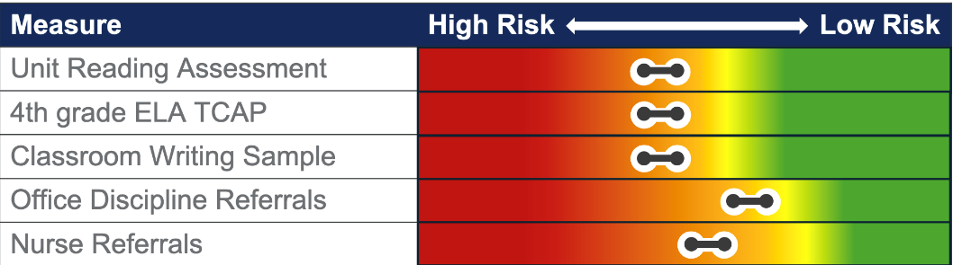
Elementary Example – 5th grader
Define
Description of Results
The student received ”C’s” on the last two reading unit assessments and scored “basic” on the ELA subtest of last year’s state assessment. A writing sample scored using a holistic rubric showed performance was below expectations. The student has several nurse referrals for headaches and received 2 office discipline referrals this year for work refusal. Student reported work refusal was due to not being able to see the board.
The team identified deficits in the areas of reading comprehension, writing, and the student was referred for a vision exam.
Where is additional drill down necessary to plan intervention?
Notes:
Main Takeaway: This example of a risk indicator continuum began during Session 1. This slide shows the Define step and the “Description of Results.” This step begins the conversation on determining risk, root cause, and planning an intervention focused on academic needs. In the initial round of assessments, it appeared that there are only concerns in behavior scores that fall along the at-risk range on the continuum for office discipline referral and nurse referrals (nurse office visits). However, the classroom teacher reports concerns in literacy and the student having trouble ”keeping up”. Classroom and state assessment data showed concerns in reading comprehension, writing, and the student was referred for a vision exam.

Slide 25
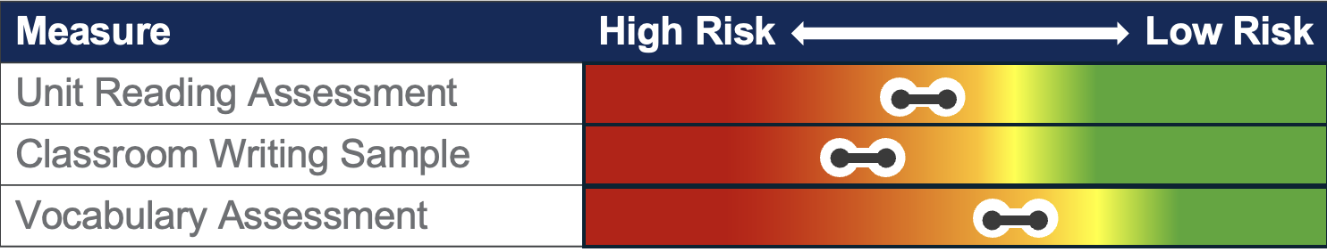
Elementary Example – 5th grader
Analyze
Additional Drill Down
To gather more information on reading comprehension and writing performance, the data-based decision-making team decided to re-examine the unit reading assessments and writing sample and rubric. The team also decided to administer a vocabulary assessment to consider this related skill and how it impacts both areas.
On the writing sample, the student demonstrated adequate mastery of the conventions of writing but struggled with organization, providing sufficient detail, and using precise language. On the reading assessments, the student showed the most difficulties with comprehension of informational texts. The vocabulary assessment showed the student performance was below grade level in this area.
The parent reported that the student was prescribed glasses after the vision exam.
What skill(s) should be targeted for intervention?
Notes:
Main Takeaway: This slide builds on content from the previous slide and shows the Analyze step. Here the team determines the root cause of the problem and the skills that should be targeted for intervention. The team decides to both re-analyze existing data and gather new data to drill down. The team re-analyzed the reading unit assessments and classroom writing sample. Results are presented on the slide. Summary of the student's risk profile: 5th grade student has moderate risk in ELA, specifically being below grade level in vocabulary, having difficulty with comprehension of informational texts and written expression. The student was prescribed glasses.

Slide 26
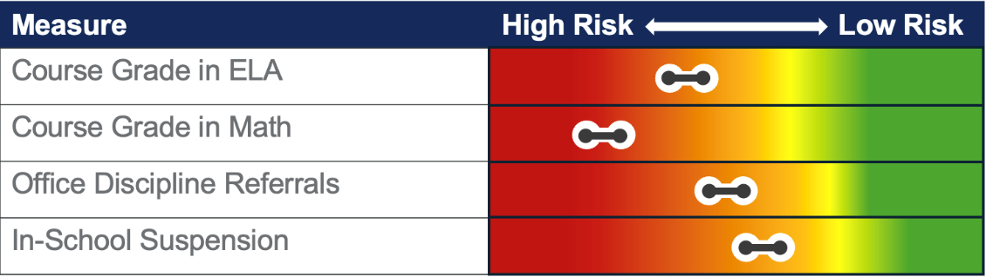
Secondary Example – 9th grader
Define
Description of Results
ELA and Math teachers state student has missed and failed to make up several exams. Review of office discipline referral and in school suspension data reveals the most common offenses include work refusal and leaving class to go to the bathroom and not returning. ELA and Math teachers report this behavior is confined to exams and the student participates actively in classes on non-exam days and does well on daily assignments. They also mentioned the student seems worried on test days.
The team identified emotional regulation as the area of need.
Where is additional drill down necessary to plan intervention?
Notes:
Main Takeaway: This example of another risk indicator continuum began during Session 1. This slide shows the Define step and the “Description of Results.” This step begins the conversation on determining risk, root cause, and planning an intervention focused on behavior needs. In the initial round of assessments, it appeared that there are concerns in both academics and behavior with the most substantial area of risk being math performance. Here we can see further analysis of existing data to determine risk and area of need for intervention. The team analyzes course grades and attendance and finds the student has missed exams in ELA and Math which affects their grades in these classes. In addition, the student frequently skips class on test days. Analysis of office discipline referral data reveals common offenses include work refusal and leaving class to go to the bathroom during exams and not returning. The team identifies emotional regulation as the area of need.The team decides to analyze more data to determine why the student is demonstrating interfering behaviors.

Slide 27
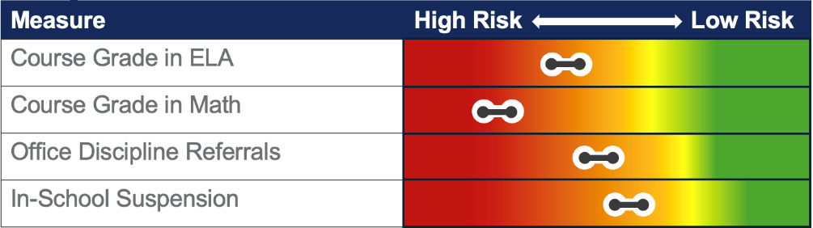
Secondary Example – 9th grader
Analyze
Additional Drill Down
A review of the Early Warning System verified that the student has attended 80% of school days this year and has missed every math exam and several ELA exams. The student averages "B's" on daily assignments in math and ELA and scored proficient on last year's state assessment in both areas. The student transferred from another state, so team members reviewed his past records thoroughly. Although there is no record of an IEP, the mother shared that the student was provided with the accommodation of extended time and usually took exams in the school counselor's office due to test anxiety. The student also reported feeling anxious during exams. The team is considering if a special education or 504 evaluation is warranted.
What skill(s) should be targeted for intervention?
Notes:
Main Takeaway: This slide builds on the previous slide and shows the Analyze step. Here the team determines the root cause of the problem and the skills that should be targeted for intervention. The team decides to re-analyze existing data as part of their drill down assessment. The team decided to re-analyze course grades in ELA and Math. The team also completed a parent interview. Results are presented on the slide. Summary of the student's risk profile: 9th grade student has questionable risk in academics (overall course grades showing risk but state assessments and analysis of assignments showing evidence of skill mastery) and moderate risk for behavior (office discipline referrals and in-school suspension). Other data sources show that this is a new student, and that the student used to receive accommodations for test anxiety, and that the student reports feeling anxious during exams. The team is considering if a special education or 504 evaluation is warranted.

Slide 28
Selecting and Managing Interventions to Address Student Need
RTI²-A + RTI²-B School Fidelity Assessment: Selection of Instructional Practices and Interventions (19)
Tier II Instruction and Intervention (36-37)
Notes:
Main Takeaway: This section focuses on selecting and managing interventions to address student needs. Specifically, it emphasizes key elements corresponding to items 19, 36, and 37 of the School Fidelity Implementation Assessment (SIFA) related to Tier II Instruction and Intervention. By effectively addressing these areas, schools can enhance the effectiveness of Tier II interventions, leading to improved student outcomes and greater overall fidelity to the Tier II implementation framework.

Slide 29
Rolling Hills Scene 4
Discussion Questions
Listen to the audio recording of a discussion at Rolling Hills School.
Consider these questions and prepare to discuss them during the next activity:
  Does this sound like a conversation that teams in your building have had when discussing Tier II?
  How is it different from conversations you have heard?
Notes:
Purpose: The Rolling Hills scenes offer participants a model of meetings conducted by a data-based decision-making team. Listen to this recording or follow along with the script and reflect on how the dialogue aligns with your teams' current or need-to-have conversations.​

Slide 30
Problem-Solving Process
Notes:
Main Takeaway: The implementation step is the third phase of the problem-solving process, following the definition and analysis of the problem. This step involves implementing the strategies and interventions that have been selected to address and resolve the identified issues. In other words, the implementation step addresses the skill deficit with specific, evidence-based interventions.

Slide 31
Intervention Selection
After determining which students need interventions, the team should consider how to best serve those students including:
  how to select and adapt interventions to meet student need,
  how to support students who exceed grade-level expectations,
  how to support students with multiple academic needs,
  how to support overlapping areas of academic and nonacademic need, and
  which need(s) to target first.
Remember: Academic and behavior needs are often related!
Notes:
Main Takeaway: Selecting the appropriate intervention for students requires a team with extensive knowledge related to areas of need and practical strategies to address them. The primary consideration when choosing interventions is that they must immediately respond to student needs. Our goal is not to fit students into pre-defined interventions but to ensure interventions meet their needs. The following points should be topics of collaborative conversations during team meetings when considering how to best support students:
How to best select and adapt interventions to meet student needs – Interventions should not be selected just because they are available, but because they have effective strategies to support the student. Teams should be prepared to adapt interventions to meet student need effectively. Teams may also determine if it is best to provide multiple interventions instead of taking a "first then next" approach.
How to support students who exceed grade-level expectations – Teams must strategize how to help high-achieving students. Many schools implement an intervention period and schedule interventions for all students during this time. This can include enrichment for students who exceed grade-level expectations.
How to support students with multiple academic needs – For students with multiple academic-skill needs, target skills that are prerequisites for other skills first and those that will give the student the best chance to access Tier I first. Also ensure Tier I supports, like access points and instructional scaffolds, are in place to ensure access to grade-level instruction. Schools may also allocate intervention time so that a student's greatest academic need receives the greatest amount of support during intervention time.
How to support overlapping areas of academic and nonacademic need – Schools may be able to create a schoolwide schedule with multiple intervention periods or integrate support for nonacademic skills into academic intervention times.
Which need(s) to target first – It is essential to target the lowest-level foundational skill and connect it to core instruction before progressing to more advanced skills. For students with multiple academic needs, target prerequisite skills first. For students with multiple behavior needs, target the behavior that is having the greatest negative impact on learning first.

Slide 32
Steps to Select and Manage Interventions
Consider how validated interventions meet student need.
    Academic interventions: match skill-specific needs to intervention and consider instructional coherence
    Behavior interventions: match area of need to intervention and adjust environment to support desired behavior
Adapt intervention to meet student need.
Group students for intervention delivery.
Plan for intervention management.
(McDaniel et al., 2024)
Notes:
Main Takeaway: Implementing effective interventions requires careful consideration of validated strategies that address specific student needs, whether academic or behavioral. It also involves adapting interventions, grouping students appropriately, and planning for effective management. Consider the steps on the slide for how to select and manage interventions.
Guided Notes
Adjustments to the environment, like a change in seating location, closing the classroom door or minimizing items student's keep on their table, should help decrease opportunities for the student to engage in challenging behavior and increase opportunities for the newly learned behavioral skills to be used across settings so students can generalize those skills.

Slide 33
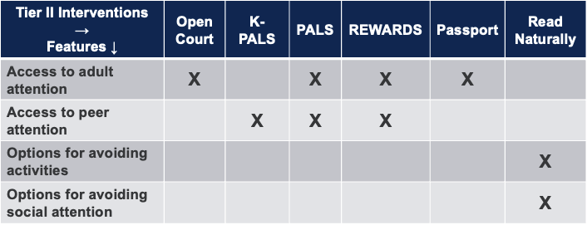
Integrated Academic and Behavior Resource Map
A tool created to help staff identify all available academic interventions and which behavior intervention features can be covered while students receive that intervention.
(McIntosh & Goodman, 2016)
Notes:
Main Takeaway: An Integrated Academic and Behavior Resource map is a comprehensive tool designed to help staff identify available academic interventions and the behavior intervention features that can be addressed concurrently to ensure that students receive holistic and practical support.

Slide 34
Designing Interventions
Alignment Guide Application Activity: Part 1
Turn to Designing Interventions to Address Student Need in the Alignment Guide.
Review the List of Students At Risk in the Tier II Binder.
Keep this data available while we continue through the next section and think about the students in the data set.
Notes:
Purpose: This activity gives teams an opportunity to practice matching students to appropriate interventions and discuss any potential adaptations to the interventions to meet students’ needs.

Slide 35

Analyze Data to Identify Appropriate Interventions
To match interventions to a student’s needs:
Use screening data to identify critical areas of need.
Match the least intensive interventions to the critical areas of need.
Analyze other data sources to make initial adaptations to the interventions to ensure it meets student needs.
(McDaniel et al., 2024)
Notes:
Main Takeaway: Matching an intervention to a student's needs requires identifying areas based on screening data, selecting the least intensive interventions, and using additional data to make necessary adaptations.

Slide 36
Designing Interventions to Meet Need
Academic Drill-Down Assessment Results
The team selects an intervention that teaches the unmastered skill and plans initial adaptations to meet student need.
The drill-down assessment reveals an academic skill that needs to be taught.
Notes:
Main Takeaway: When a drill-down assessment identifies an unmastered academic skill, the team should select an appropriate intervention to teach that skill and plan initial adaptations to ensure it meets the student's specific needs. Ensure that the intervention planning and adaptation process is collaborative, involving input from teachers, support staff, and, when appropriate, the student and their families. This holistic approach helps in creating a supportive learning environment.
For example, drill-down assessment results may reveal unmastered skills in basic reading. The student may struggle to read and spell words with certain advanced vowel patterns but have mastered others. The reading intervention selected should focus on teaching letter-sound correspondences, phonics patterns, and reading and spelling words that contain the patterns the student has not mastered. The intervention should also be adapted to consider prior knowledge and begin with the area of need. Meaning it should not include instruction in patterns the student has already mastered and rather can incorporate practice towards maintaining those skills through brief review.

Slide 37
Designing Interventions to Meet Need
Behavior Drill-Down Assessment Results
The drill-down assessment reveals a behavioral skill deficit but no underlying academic concerns.
The team selects an intervention that addresses the area of need and adjusts the environment to support desired behaviors.
Notes:
Main Takeaway: When a drill-down assessment identifies a behavioral skill deficit without underlying academic concerns, the team should select an intervention that addresses the specific behavioral need and adjust the environment to support the desired behaviors and decrease opportunities to engage in challenging behavior. Ensure that the intervention planning and adaptation process is collaborative, involving input from teachers, support staff, and, when appropriate, the students and their families. This holistic approach helps create a supportive environment for behavioral improvement.
For example, for a student with needs related to social interactions and problem solving, drill-down assessment results may reveal unmastered conflict resolution skills. The student may struggle with respectfully disagreeing with peers. The behavior intervention selected should focus on teaching the student how to respectfully disagree and when to express those feelings. In addition to teaching the student how to respectfully disagree, the intervention may feature a behavior contract component. This could include having the student write out the steps they will take when handling conflict and an agreed upon reward for engaging in the desired behavior for a set amount of time. An example statement in a behavior contract could be, “I agree to use kind words during conflict when expressing my feelings to explain why I am frustrated. If I am kind to my peers during conflict in math class four out of five days this week, I will get to have lunch with my teacher.” As the student builds on their skills, the intervention can incorporate more advanced skills such as learning when to walk away from conflict. Adjustments can be made to the classroom environment to support this desired behavior. The classroom teacher can provide reminders to the student on how to use kind words and respectfully disagree by using the same language as the interventionist. The classroom teacher could also allow the student to display the steps they will take when handling conflict or examples of kind words they can use so it can be easily referenced by the student when conflict arises. The classroom teacher could also move the student's locker or desk to avoid conflict with one particular antagonist. In addition, the classroom teacher and interventionist can coordinate how they provide feedback on newly learned behaviors and challenging behaviors so students hear consistent messages as they use and develop their skills in different settings.

Slide 38
Designing Interventions to Meet Need
Academic and Behavior Drill-Down Assessment Results
The team selects interventions that teach unmastered academic skill, addresses the behavioral area of need, adjusts the environment to support desired behaviors, and plans initial adaptations to meet student need.
The drill-down assessments reveal academic and behavioral skill deficits.
Notes:
Main Takeaway: When drill-down assessments reveal academic and behavioral skill deficits, the team should implement a comprehensive approach that includes selecting targeted interventions for academic and behavioral skills, adjusting the environment to support desired behaviors, and planning initial adaptations to meet individual student needs. Ensure that the intervention planning and adaptation process is collaborative, involving input from teachers, support staff, and, when appropriate, the student and their families. This holistic approach helps in creating a supportive learning environment.
For example, drill-down assessments may reveal academic difficulties in written expression and behavior difficulties related to disruptive behaviors that occur throughout the day and more frequently during writing tasks. The student may struggle in particular with writing organization and development of ideas. The student may also have difficulties with fine motor tasks and may dislike having to write and demonstrate disruptive behavior to escape from writing tasks. The academic intervention should focus on writing organization and development of ideas and include adaptations to support desired behaviors and handwriting skills. The intervention may include accommodations like access to word processor for extended writing tasks. The behavior intervention should address the disruptive behavior and adjust the environment to support accessing breaks appropriately, when the student can earn breaks, and which activities the student can engage in during the break. It should also incorporate opportunities for the student to regularly receive positive and corrective feedback on their behavior, especially when demonstrating the desired behavior. The classroom teacher and interventionist should coordinate what positive, instructive, and corrective feedback looks like so the student is hearing consistent messages across environments. As a reminder, adjustments to the environment includes how the teacher interacts with the student, so these strategies can be used by the teacher to create a classroom environment that supports the desired behavior. Adjustments also consider environmental changes when they are helpful. For example, if a student is easily distracted during instruction, the classroom teacher may choose to close the classroom door to minimize hallway distractions. Additional examples of initial adaptations could include working with the classroom teacher to incorporate intervention language into classroom interactions, pairing feedback with reinforcement, increasing the opportunities to earn reinforcement during the day, or increasing the number of breaks a student is able to request each day.

Slide 39
Addressing Student Need
Remember!
When academic and behavior needs are present, the student should receive intervention addressing the most pressing academic challenges along with intervention for the behaviors of concern.
(McIntosh & Goodman, 2016)
Notes:
Main Takeaway: When both academic and behavioral needs are present, interventions should simultaneously address the most pressing academic skill needs along with the intervention for behavioral needs to ensure comprehensive student support and maximum access to Tier I instruction. If students have academic concerns in multiple content areas, teams must create a plan to target all academic concerns. For example, if students require support to master reading, math, and behavior skills, interventions should be provided for all skills.

Slide 40
Using Drill-Down Assessment to Inform Intervention Selection
Screener: Phoneme Segmentation Fluency
Area of Need: Phonemic Awareness
Drill-Down Assessment:
Phonological Awareness Skills Survey
Specific Skill Deficits: Blending, Segmentation, Deletion
Intervention: Phonological Awareness Training
Notes:
Main Takeaway: This slide shows how drill-down assessment data can drive intervention selection. In this example, assessors used the phoneme segmentation screener to identify phonemic awareness as a general area of need. Then, they used the Phonological Awareness Skills Survey, a drill-down assessment, to identify the specific skill deficits the student had within phonemic awareness, blending, segmentation, and deleting. This provided the information needed to select the intervention, phonological awareness training, which focuses on these skills.
Important reminders
Multiple sources of data should be used to identify risk.
Screeners are one assessment that can be used to identify an area of need. Other assessments, like survey-level assessments can also be used
Intervention should be adapted to consider student-specific needs.

Slide 41
Using Drill-Down Assessment to Inform Intervention Selection – Math Example
Screener: Math Concepts and Application
0
Area of Need: Math Problem Solving
Drill-Down Assessment: Teacher-Made Assessment of Concepts of the Operations and Word Problems
Specific Skill Deficit: Solving Word Problems
Intervention: Explicit Instruction in Problem-Solving Strategies
Notes:
Main Takeaway: This slides shows how drill-down assessment data can drive intervention selection. In this example, assessors used the math concepts and application screener to identify math problem solving as a general area of need. Then they used a teacher-made assessment of the concepts of the operations and word problems as the drill-down assessment to identify the specific skill deficits the student had within math problem solving. They identified the student had the specific skill deficit of solving word problems. This provided the information needed to select the intervention, explicit instruction in problem solving strategies.
Important reminders
Multiple sources of data should be used to identify risk.
Screeners are one assessment that can be used to identify an area of need. Other assessments, like survey-level assessments can also be used
Intervention should be adapted to consider student-specific needs.

Slide 42
Using Drill-Down Assessment to Inform Intervention Selection – Writing Example
Screener: Writing Fluency, Total Words Written
Area of Need: Written Expression
Drill-Down Assessment: Writing Samples Evaluated with Rubric
Specific Skill Deficit: Writing Quality Across Genres
Intervention: Self-Regulated Strategy Development
Notes:
Main Takeaway: This slide shows how drill-down assessment data can drive intervention selection. In this example, assessors used a writing fluency screener, scored by total words written to identify written expression as a general area of need. Then they used writing samples evaluated using a rubric as the drill-down assessment to identify the specific skill deficits the student had within written expression. They identified the student had the specific skill deficit poor writing quality across different genres of writing. This provided the information needed to select the intervention, self-regulated strategy development.
Important reminders
Multiple sources of data should be used to identify risk.
Screeners are one assessment that can be used to identify an area of need. Other assessments, like survey-level assessments can also be used
Intervention should be adapted to consider student-specific needs.

Slide 43
Matching Interventions to Needs 1
Area of Need
Intervention Options
Check-in/Check-out (CICO)
Check and Connect
Check, Connect, Expect
Goal setting
Self-monitoring
Self-graphing
Behavior contract
Social skills group
Restorative meetings or circles
Interfering Behaviors
Self-Regulation
Social interactions and problem solving
(McDaniel et al., 2015; McDaniel et al. 2024)
Notes:
Main Takeaway: It is crucial to select intervention(s) that are aligned to the areas of need. As mentioned earlier in the presentation, teams may need to consider how specific behaviors of concern map on to an area of need so that efficient and effective research-based supplemental support can be provided to small groups of students.
The categories on the left are areas of need, and the lists on the right are intervention options to meet those needs. There are five main areas of need/categories for behaviors of concern. Examples of intervention options for the first three categories (Interfering Behaviors, Self-Regulation, Social Interactions and problem-solving) are shared on this slide. The remaining two areas are paired with examples of intervention options on the following slide.
Note that these are just some options and others exist. We won’t be talking specifically about these interventions today but wanted to provide examples of how interventions can be mapped onto areas of need and illustrate the multiple options for interventions that exist.

Slide 44
Matching Interventions to Needs 2
Area of Need
Intervention Options
Small-group counseling
Individual counseling
Check, Connect, Expect
Intensified academic instruction on needed skills
Breaks Are Better (BRB)
Emotional Regulation
Co-occurring academic and behavior skill needs
(McDaniel et al., 2015; McDaniel et al. 2024)
Notes:
Main Takeaway: When matching interventions to needs, it is crucial to base the selection on the areas of need. These are the final two categories of need for behavior, emotional regulation, and co-occurring academic and behavioral skill needs.

Slide 45
Initial Intervention Adaptations
Academic Examples
Example adaptations:
Skills to target
Entry point
Sequence of instruction
Grade-level application of targeted skills
Make initial adaptations to ensure the intervention teaches needed skills and supports performance of those skills in the grade-level context
Notes:
Main Takeaway: To ensure interventions are effective, initial adaptations should be made to teach the necessary skills and support the performance of these skills within the appropriate grade-level context. These are common types of initial adaptations to academic interventions teams can consider.
Skills to target
Teams may add or increase or delete or decrease instruction and/or practice in particular skills according to student need
Entry point
Teams should consider skills the student has already mastered to determine where to begin the student in the intervention program. We don’t always need or want to start students with lesson 1!
Sequence of instruction
Teams should consider how skills are sequenced in the intervention program and may choose to adapt the sequence. For example, teams may move an easier or more critical skill to earlier in the instructional plan to improve intervention effectiveness.
Grade-level application of targeted skills
Teams should consider adding practice of targeted skills with grade-level materials. This helps students transfer skills the performance of skills developed in intervention to the grade-level classroom.

Slide 46
Initial Intervention Adaptations
Nonacademic Examples
Example adaptations:
Skills to target
Context for practicing new skills
Feedback method
Feedback schedule
Goals
Reward type
Reward frequency
Materials
Group composition
Make initial adaptations to ensure the intervention teaches needed skills and supports desired behavior.
(Majeika et al., 2020; McDaniel et al., 2024)
Notes:
Main Takeaway: To ensure interventions are effective, initial adaptations should be made to teach the necessary skills and support the performance of the desired behavior. These are common types of initial adaptations to behavior interventions teams could consider.
Skills to target
Teams may add or increase or delete or decrease instruction and/or practice in particular behavior skills according to student need.
Context for practicing new skills
Teams should consider the various ways students will use their newly learned behavior skills and ensure they have multiple practice opportunities in a variety of settings. This includes practicing the skills with a variety of people (e.g., peers, adults who they are comfortable interacting with, adults who they are less comfortable interacting with) and in a variety of places (e.g., intervention, grade-level classroom, related arts, hallway, cafeteria, recess).
Feedback method and schedule
Students need clear and consistent positive and corrective feedback on their newly learned behavior skills. Teams should consider if they need to include, or adjust, a feedback component that occurs during intervention and the grade-level classroom. Adaptations could also include adjusting how often feedback is provided.
Goals, reward type, and reward frequency
The initial goal for engaging in the newly learned behavior may need to be adjusted, especially for students who need to experience success first to buy in to the intervention. It is more motivating for students to engage in the newly learned behavior when they have an opportunity to earn the reward, and the reward earned should be something desirable for the student. As the intervention progresses, the goal, reward type, and reward frequency can then be adjusted as the student builds their skills.
Materials
Teams should consider any additional materials that may be incorporated into the intervention. For example, the team may determine that a student in a social skills group will also use a Daily Progress Report throughout the day to receive feedback on their newly learned social skills.
Group composition
Teams should consider the number of students in the group as well as how the student may interact with others who are part of the same intervention.

Slide 47
Elementary Example – 5th grader
Implement Part 1
Plans for Intervention
The team decides to place the student in two interventions, one targeting reading and one targeting written expression.
The reading intervention the team selects is a multi-level reading comprehension program that includes vocabulary instruction.
The writing intervention the team selects is writing strategy instructional approach.
What initial adaptations should be considered for the interventions to ensure they match the student’s needs?
Notes:
Main Takeaway: This is an interactive slide that builds on the 5th grade example started on slides 25-26. This is the Implement step where the team plans an academic intervention. The presenter will summarize the interventions selected for this student and ask participants to use the information from slides 47-48 to identify some initial adaptations the team could make to these interventions. In the 'implement' step of the problem-solving process, reviewing and discussing initial adaptations and adjustments to interventions to better meet students' needs is crucial. Educators can better support students at moderate risk and enhance their skills through targeted and responsive interventions. Recall the 5th-grade student identified as being at moderate risk in reading and writing. Specifically, being below grade level in vocabulary, having difficulty with comprehension of informational texts and written expression. The student was prescribed glasses. Based on previous assessments and discussions, consider the student's current status and progress. Discuss potential adaptations and adjustments to the intervention plans to meet the student's specific needs better.
For example, the multi-level reading comprehension program could be adapted to include more practice with informational texts which is an area of need. The writing strategy program could be adapted to reduce/eliminate instruction in conventions of writing and consider the entry point when teaching strategies for organization.

Slide 48

Secondary Example – 9th grader
Implement Part 1
Plans for Intervention
The team places the student in the counselor’s coping strategies group and also provides the parent with information on the math study group that is available to all students and meets after school twice per week as a way to build confidence for exams. The team schedules a meeting with homeroom, math, and ELA teachers, parent, and the student to discuss other classroom supports and ways to help the student build relationships at the new school.
What skill(s) should be targeted for intervention?
Notes:
Main idea: This is an interactive slide that builds on the 9th grade example started on slides 28-29. This is the Implement step where the team plans a behavior intervention. In this example, the team previously determined there were no skill deficits in math or ELA and low grades were due to the student skipping class on exam day and therefore having zeros recorded for those exams. The mother and student did report test anxiety which the team thinks is the root cause behind behavioral and academic difficulties. Therefore, the team decided on a Tier I support for math (since no skill deficits were found in math and the team thought it would be helpful avenue to build confidence for exams) and a Tier II support for behavior. The team also considers if a special education or 504 evaluation is warranted. The presenter will summarize this information and ask participants to use the information from slides 47-48 to identify some initial adaptations the team could make to these interventions to meet the student’s specific needs.
For example, the counselor's coping strategies group could focus on skills for coping with anxiety, which would be directly aligned to our 9th grader's need.

Slide 49
The Role of Environment
Desired and challenging behaviors are supported by the environment.
Effective environments provide:
consistency,
connection,
encouragement,
recognition,
instruction,
opportunities to respond, and
routines to avoid reinforcing behaviors of concern.
Notes:
Main Point: The environment plays an important role in shaping behavior. This includes all types of behavior, including desired behavior and challenging behavior. When thinking about providing support to students, consider what changes can be made across all learning environments to support desired behavior and minimize challenging behavior.

Slide 50
Designing Interventions to Address Student Need
Alignment Guide Application Activity: Part 2
Turn to Designing Interventions to Address Student Need in the Alignment Guide.
Review student data from one grade at your school and consider your List of Students At Risk.
Use your school’s Risk Indicator Continuum and School Curricula and Interventions Alignment Tool to identify appropriate interventions for the students in your data set and match students to interventions.
If you do not have data from your school or if you have additional time, review the Rolling Hills or Sandy Creek materials to complete step two.
Notes:
Purpose: This activity gives teams an opportunity to practice matching student needs to appropriate interventions and discuss any potential adaptations to the interventions that may be beneficial.

Slide 51
Grouping Students
Pre-Work Review
After schools identify appropriate interventions for each student, teams must consider how to group the students best to optimize effectiveness and efficiency.
Maximize resources by grouping students with common needs.
Create group sizes that ensure all students have increased opportunity to practice and receive feedback.
Consider available resources, in terms of interventionists, time, and space.
Notes:
Main Takeaway: Once student needs have been identified, teams must strategically organize students with similar needs into small groups for intervention. This maximizes the efficiency of the interventions and helps to ensure that students receive supplemental support in a timely manner. By carefully considering how to group students based on their needs, optimizing group sizes for effective practice and feedback, and evaluating available resources, schools can enhance their intervention strategies' overall efficiency and impact.

Slide 52
Grouping Students and Allocating Resources
Alignment Guide Application Activity
Turn to Grouping Students and Allocating Resources in the Alignment Guide.
Review your ideas from the session two pre-work and consider all grades at your school.
Answer the discussion questions with your group.
Complete the Managing Tier II Interventions Pause and Reflect chart on the next page.
If time, review the Checklist for Aligning Practices handout in the Tier II Binder and discuss additional considerations with your group.
Notes:
Purpose: This activity will help teams consider how to best group students who are receiving Tier II interventions and maximize available resources.

Slide 53
Determining Response to Intervention
RTI²-A + RTI²-B School Fidelity Assessment:
Monitoring Response to Instruction and Intervention (22)
Adapting and Intensifying Instruction and Intervention (24-25)
Notes:
Main Takeaway: This section focuses on determining the response to intervention. Specifically, it emphasizes vital elements corresponding to items 22, 24, and 25 of the School Fidelity Implementation Assessment (SIFA) related to monitoring response to instruction and intervention and adapting and intensifying instruction and intervention.

Slide 54
Problem-Solving Process - Evaluate
Notes:
Main Takeaway: The evaluation step is the fourth and final phase of the problem-solving process, following the implementation of strategies and interventions. This step involves assessing the effectiveness of the interventions and determining whether the desired outcomes have been achieved. In other words, the evaluation step measures progress in addressing the skill deficit and informs any necessary adjustments or continued support.

Slide 55
RTI²-A + RTI²-B
Notes:
Main Takeaway: The evaluation step is crucial in determining the effectiveness of interventions and deciding the next steps for student support. It involves assessing the intervention's impact on student performance and using data-based decision-making to plan future actions.

Slide 56
Determining Response to Intervention Tasks
Meet regularly as a team to analyze data.
Use multiple sources of data to measure the effectiveness of interventions and monitor student progress towards goals.
Regularly evaluate student performance to ensure interventions provide appropriate support that meets their needs.
Use multiple sources of progress monitoring data and consider if adjustments to interventions are necessary.
(Lemons, n.d.; TDOE, 2023)
Notes:
Main Takeaway: Reviewing multiple sources of progress monitoring data allows teams to measure the effectiveness of interventions, check student progress towards goals, and determine if intervention adjustments should be made to better meet student need.
Important reminders:
Teams should meet at least quarterly to analyze data (RTI2 Manual page 23) as part of a collaborative process.
Multiple pieces of data should be used to understand a student's performance.
A comprehensive profile of performance should drive decisions instead of a single data source.
Using a single data source may cause teams to make decisions that do not align with the student's true need, because they do not have an accurate picture of the student's progress.
Using progress monitoring data helps teams determine if an intervention is meeting a student's needs. If a student is not making adequate progress, then it may be necessary to make adjustments to the intervention.
Teams may consider adjusting a variety of features, including the frequency of intervention sessions, the size of the intervention group, the intervention program, how the intervention aligns with the targeted academic or behavior skills, the intervention provider, or the time of day the student receives the intervention.
Data should drive decisions about adjusting the intensity of the intervention.
Increase intensity when a student’s needs are inadequately met by the intervention.
Decrease intensity when a student’s performance meets or exceeds expectations.
Maintain intensity when a student is on track to reach performance expectations.
The upcoming sections of this training will go in to more detail on how to use multiple sources of data to regularly evaluate a student's performance and make adjustments to the intervention to better meet their needs.

Slide 57
Individuals with Disabilities Education Act (IDEA)
IDEA requires local education agencies (LEAs) to:
  identify students at risk for disabilities through child find and parent referrals,
  evaluate students suspected of a disability,
  determine students’ eligibility for special education services,
  develop an individualized education program (IEP) for eligible students based on student need, and
  provide a free and appropriate public education (FAPE) for students with disabilities.
(TDOE, 2022)
Notes:
Main Takeaway: The Individuals with Disabilities Education Act (IDEA) mandates that local education agencies (LEAs) identify and support students with disabilities through structured steps. These steps include identifying students at risk, evaluating those suspected of having a disability, determining their eligibility for special education services, developing individualized education programs (IEPs), and ensuring the provision of a free and appropriate public education (FAPE). By understanding and following these guidelines, LEAs can effectively support students with disabilities and ensure they receive the education and services they are entitled to under IDEA.

Slide 58
Reminder!
A referral for special education evaluation may happen at any time, regardless of the student’s current tier of intervention, the number of current data points, or the number of weeks a student has received intervention. There is no cut score to determine appropriate interventions and/or a referral for a special education evaluation.
(TDOE, 2022)
Notes:
Main Takeaway: A referral for a special education evaluation can be initiated at any point, regardless of the student's current intervention tier, data points, or duration of intervention. No specific cut scores are required to determine the appropriateness of interventions or referrals for special education evaluations. Referrals for special education evaluations should be made whenever a disability is suspected.

Slide 59
Determining Response to Intervention: Collecting Progress Monitoring and Fidelity Data
Notes:
Main Takeaway: Now we will discuss the different types of data needed to determine a student’s response to intervention.

Slide 60
Assessment Data Needed
Intervention Fidelity
Progress Monitoring
Notes:
Main Takeaway: Think back to the assessment process slide from Session 1. We have moved through the assessment process and now we are ready to use intervention fidelity data and progress monitoring data to understand the impact of instruction and intervention on student progress.

Slide 61

Monitoring Intervention Fidelity
Fidelity monitoring is the systematic monitoring by a responsible instructional leader (e.g., administrator or instructional coach) to determine the extent to which the delivery of an intervention adheres to the protocols or program models as originally developed.
(TDOE, 2023)
Notes:
Main Takeaway: The purpose of fidelity monitoring is to provide ongoing information about the effectiveness of the provided intervention.
At Tier II and Tier III, fidelity is measured by the accuracy or extent to which the instructional methods and materials are used to provide instruction (RTI2 Manual page 19).
The goal of fidelity monitoring is the insure the intervention is being implemented with integrity and to the specifications of the intervention methodology or program being utilized.
Districts should have a process for monitoring fidelity that includes:
who is responsible (e.g., administrator, instructional coach, other qualified personnel as determined by the district), and
how often fidelity in Tier II and Tier III interventions will be monitored.

Slide 62
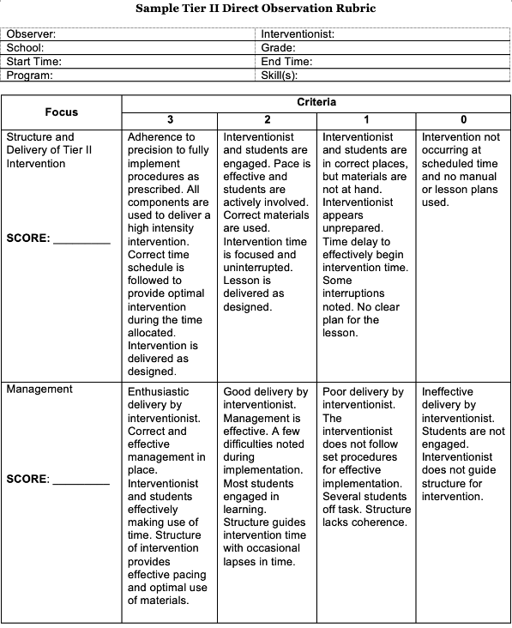
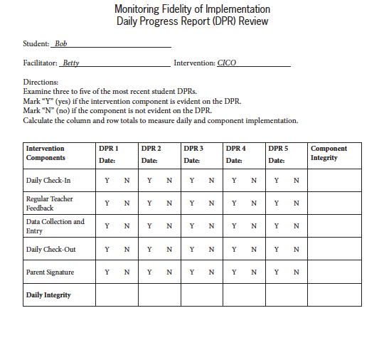
Fidelity Monitoring Examples
(Crone et al., 2010; TDOE, 2023)
Notes:
Main Takeaway: These are examples of forms that can be used to monitor fidelity. The example on the left shows a Direct Observation Rubric that can be used to monitor academic interventions. Notice how this tool can be completed by someone doing an observation of the intervention.
The example on the right shows a Daily Progress Report (DPR) card that can be used to monitor behavior interventions that use a daily point system such as Check-In/Check-Out and Breaks are Better.
Fidelity tools can be completed by an observer or it can also be completed by the interventionist as a self-reflection.
Observations are an example of direct fidelity checks.
Examples of indirect fidelity checks include a review of progress monitoring data, a review of intervention lesson plans, a review of schedule, a review of attendance (including reasons for absence), and self-checks.
Fidelity monitoring should include both direct and indirect fidelity checks.

Slide 63
Elements of Intervention Fidelity
Student Engagement
Adherence
Intervention Fidelity
Exposure/Dosage
Program Specificity
Quality of Delivery
(Graphic adapted from National Center on Intensive Intervention, 2021)
Notes:
Main Takeaway: There are five elements of intervention fidelity. It helps to consider these questions as you evaluating fidelity to determine if the intervention is being delivered as intended.
Student engagement – How attentive and involved are the students in this intervention or activity?
Program specificity – How well is the intervention defined and different from other interventions?
Quality of delivery – Does the interventionist have the necessary training, knowledge, and skills to deliver the intervention correctly? How well is the intervention or instruction delivered? Are quality teaching practices used consistently and with appropriate intensity across all sessions or interventionists?
Exposure/Dosage – Does the schedule allow the intervention to be delivered for the recommended dosage (duration and frequency)? How often does a student receive the intervention? How long does it last? Is the student regularly attending school? Is the teacher regularly available to support instruction? Did any factors prevent the student from receiving the intervention?
Adherence – How well did we stick to the plan/curriculum?

Slide 64
A Sample of Strategies to Increase Intervention Fidelity
Retrain school staff.
Create an implementation team to support interventionists.
Communicate trust in the intervention and interventionists.
Plan for continued monitoring.
Share deidentified fidelity data with stakeholders.
Provide recognition to staff with high rates of fidelity.
Check in with staff early after beginning the intervention to identify and resolve any challenges to implementation.
(Johnson et al., 2006)
Notes:
Main Takeaway: Evaluating fidelity may reveal that it needs to be improved. This slide shows some examples of next steps to increase intervention fidelity.

Slide 65
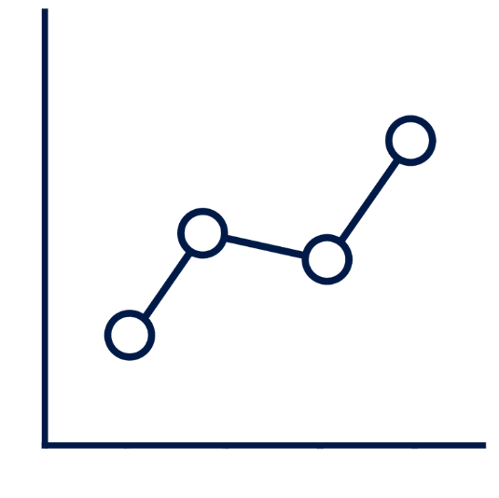
Progress Monitoring
Formative assessment tells us how well students are responding to instruction; it relies on multiple data sources.
(National Center for Intensive Intervention, 2022e)
Notes:
Main Takeaway: When used with other data sources, progress monitoring allows educators to determine if the response to instruction and intervention is effectively being met for the individual student.
Formative assessment tells us how well students are responding to instruction.
Progress monitoring must be conducted with measures that are at a student’s skill/instructional level.
Progress monitoring must be completed according to the area of deficit using an instrument that is sensitive to change (RTI2 Manual page 18).
A variety of progress monitoring data should be gathered on students receiving interventions. These measures should focus both on how a student is progressing towards long-term learning goals and also how a student is progressing with the specific skills targeted in intervention.

Slide 66
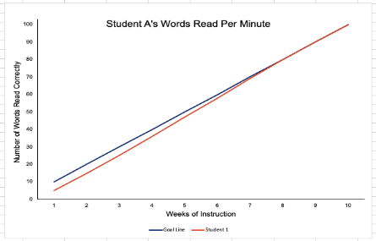
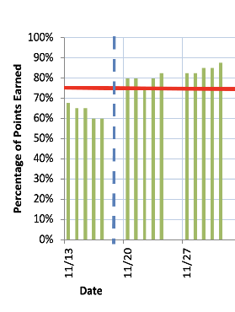
Progress Monitoring
Formal progress monitoring data allow us to:
estimate rates of improvement,
begin to identify students who both are and are not demonstrating adequate progress, and
begin to determine when an instructional change is needed.
  Formal progress monitoring data is necessary but not sufficient to determine if an intervention is effective for a student.
Notes:
Main Takeaway: Progress monitoring data serves multiple purposes to help schools evaluate instruction, intervention, and the supports provided to students. Formal progress monitoring data allows teams to estimate ROI, identify students who are and are not making progress, and determine when a change is needed. However, formal progress monitoring data alone is not sufficient to determine whether an intervention is effective. Mutiple sources of data should be used to determine student response and inform any potential changes to intervention.
Any progress monitoring tool must (RTI2 Manual page 19)
Report according to national percentiles
Allow for repeated measures
Be sensitive to change
Specific areas of deficit
Report results so that the rate of improvement (ROI) can be calculated and transferred to graph form

Slide 67
Academic Progress Monitoring
Guidelines
Gather a variety of measures on both long-term learning goals and specific skills targeted in intervention.
Consider using:
  curriculum-based measures,
  daily formative assessments,
  post-unit assessments, and
  classroom assessments and observations.
Notes:
Main Takeaway: Teams should gather a variety of data to understand a student’s progress towards mastery of skills as well as progress towards meeting grade level expectations. This includes gathering both formal (curriculum-based measures) and informal measures (daily formative assessments, unit assessments, classroom assessments and observations) that measure student progress on the specific skills targeted in intervention and long-term learning goals.
Some examples of multiple sources of progress monitoring data are on the slide.

Slide 68
Academic Progress Monitoring
Formal Progress Monitoring Measures
Select and administer probes that measure skills related to the identified skill deficit.
Progress monitor at least every other week at the student’s instructional level.
In addition, progress monitor monthly at the student’s grade level.
Consider using:
  Curriculum Based Measurement (CBM) probes,
  assessments from intervention materials/kits, or
  computer-based assessments.
Notes:
Main Takeaway: The guidelines for gathering formal progress monitoring data are shown on this slide. Effective progress monitoring involves selecting and administering appropriate probes to measure skills related to the student's identified skill deficit. Various assessment tools are used to monitor progress regularly at both the instructional and grade levels.
Choose probes that directly measure the student's specific skill deficits. Keep in mind, these might be a far transfer measure. For example, using oral reading fluency passages to monitor a student in an intervention targeting word reading skills
Monitor progress at least every other week at the student's instructional level and at least monthly at the student's grade level.
Curriculum-Based Measurement (CBM) Probes: These are standardized assessments that can be used frequently to measure student progress.
Intervention Materials/Kits: Assessments included with intervention programs can provide valuable insights into student progress.
Computer-Based Assessments: Digital tools can offer efficient and detailed progress monitoring data.
Implementation Tips:
Ensure probes are closely aligned with the skills being targeted in interventions.
Use data from both instructional and grade-level assessments to inform instructional decisions.
Regularly review assessment data to make necessary adjustments to instruction and interventions.

Slide 69
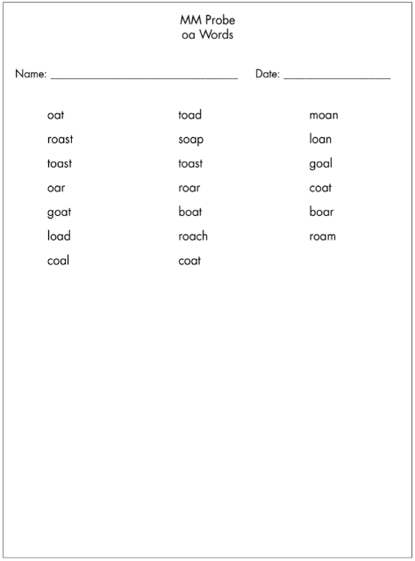
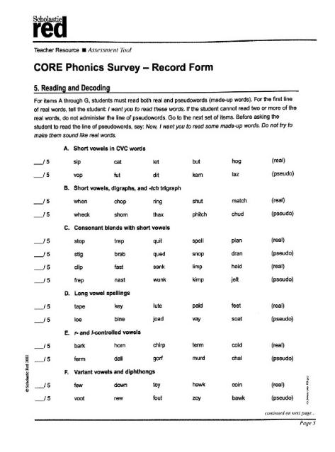

Building a Comprehensive Data Profile
Academic Examples
Ongoing
Anecdotal Data
Weekly Probes
Post-unit Survey
(NCII, 2023b; Scholastic Red, 2002; Reading Elephant, 2018)
Notes:
Main Takeaway: Teams should use multiple types of data to monitor progress. This includes formal and informal data sources. The examples on this slide are intended to show a variety of data sources that can be used.
Multiple sources of data should be used to monitor progress. Weekly probes are an example of a general outcome measure and are more formal.
You can also have measures that are more informal that are tied to the skills you are teaching. For example, after you are finished teaching a unit, you can give a measure on that skill. Then you can also take a broader look at those skills by giving a survey on those skills once a semester.
There are a variety of anecdotal data sources that also can be used for progress monitoring. For example, the interventionist can share information on how a student read a passage during intervention. This could also include qualitative data sources like conversations with teachers, family members, and the students about their progress.
Using qualitative and quantitative progress monitoring data sources help the team understand the numbers and the story they tell together.

Slide 70
Elementary Example – 5th grader
Implement Part 2
Plans for Intervention
The team decides to place the student in two interventions, one targeting reading and one targeting written expression.
The reading intervention the team selects is a multi-level reading comprehension program that includes vocabulary instruction.
The writing intervention the team selects is writing strategy instructional approach.
What types of progress monitoring data should the team gather to build a comprehensive data profile for this student?
Notes:
Main Takeaway: This interactive slide expands upon the 5th grade example, previously introduced on slides 26-27 and 49. This is the Implement step. It emphasizes the importance of compiling comprehensive progress monitoring data to develop a thorough student data profile. Recall the 5th grade student identified as being at moderate risk in reading and writing. Specifically, being below grade level in vocabulary, having difficulty with comprehension of informational texts and written expression. The student was prescribed glasses.
The presenter will summarize this information and ask participants to identify multiple data sources that could be used to monitor student progress and build a comprehensive data profile for the student.
Different data sources for progress monitoring could include writing fluency and MAZE cbm data, writing samples scored using a holistic rubric, unit assessments aligned with the intervention program, intervention lesson formative assessment data, classroom reading assessments, vocabulary assessment
Important reminders
Highlight the critical role of continuous assessment in tracking student progress. Stress the importance of being flexible and willing to implement and adjust interventions as new data and insights become available.
Recognize that participants may not be able to make definitive decisions on progress monitoring during the discussion and that this is part of the collaborative process.
Interventions chosen are the beginning point. Interventions should be adapted according to student response and changes can be made at any time, there is no minimum number of datapoints needed.

Slide 71
Behavior Progress Monitoring
Guidelines
Identify skill(s) that will lead to goal attainment.
Align skill(s) to the schoolwide expectations.
Identify multiple data sources that can inform the targeted skill(s).
Use formative sources that are sensitive to small changes in the behavior/skill(s).
Monitor regularly, and consider monitoring more often when:
  There is a change in the Tier 2 intervention status, and/or
  Sufficient progress has not been demonstrated
Notes:
Main Takeaway: To effectively support student progress, it is crucial to identify skills that contribute to goal attainment and align them with schoolwide expectations. Utilize multiple data sources to gather comprehensive information on targeted skills and employ formative assessments that can detect small changes in behavior or skills. Ensure monitoring of student progress on a regular basis (we recommend at least weekly, to prevent long stretches of time where the student isn't progressing), and increase the frequency of monitoring when there are changes in Tier II intervention status or when progress is insufficient.
Data should be regularly collected and analyzed, with the data and frequency of data collection depending on the behavior of concern and the intervention.
Decisions about the frequency of data collection and data analysis should be made by the DBDM team.
Data should reflect the student's behavior before intervention (baseline) and during intervention.
Multiple data sources for behavior could include:
Classroom write-ups ("minors")
Office referrals - more of an identification and summative measure
Suspensions - more of an identification and summative measure
Universal screening instrument for behavior - identification & summative measure
Intervention artifacts - may or may not be sensitive to small changes in the behavior/skills
Attendance
Tardies
Observations - may or may not be sensitive to small changes in behavior/skills (effect of being observed, timing of observation, opportunities to engage in behavior, etc.)
Data sheets - formative perception measure
Behavior Report Card – based on schoolwide expectations, simple rating scale
Individualized Behavior Rating Scale Tool (IBRST - Iovannone, R et al., 2013) This is a perceptual direct behavior rating tool that was used by typical school personnel to record behavior occurrence in students requiring individualized interventions.
Frequency, Rate, Duration, Latency, Intensity
Teacher, family member, student report
Background:
From RTI2 for Behavior Framework manual, 2016 (https://www.tn.gov/content/dam/tn/education/special-education/rti/rti2b_framework.pdf) : "When additional intervention is being provided in Tier II, the effectiveness of the intervention should be monitored to ensure that it is helping the student reach a goal. This is accomplished through frequent data collection. While the universal screening tool measures student internalizing and externalizing behaviors, progress monitoring requires measures that are specific to measuring the students’ identified behavior need and growth toward their goal" (p. 38). Also: "During Tier II intervention, a student’s progress should be monitored closely to measure the effectiveness of interventions and check student progress toward goal(s)" (p. 38).

Slide 72
Behavioral Progress Monitoring Specificity Examples
Schoolwide Expectations
Direct Behavior Ratings
Systematic Direct Observation
Broad Rating Scale
More Specific Rating Scale
    Frequency
    Rate
    Duration
    Latency, or
    Intensity
Notes:
Main Takeaway: This slide shows examples of behavioral progress monitoring options.
Broad Rating Scale - Student demonstration of schoolwide expectations is rated on a 1-3 scale. Advantages are that all teachers are already familiar with the schoolwide expectations, and the simple rating scale makes progress monitoring efficient.
Direct Behavior Ratings - Student behavior is rated on a continuum after a specific period of time.
Systematic Direct Observation - A student is observed for a period, and behavior is measured in one of these ways:
frequency,
rate,
duration,
latency, or
intensity

Slide 73
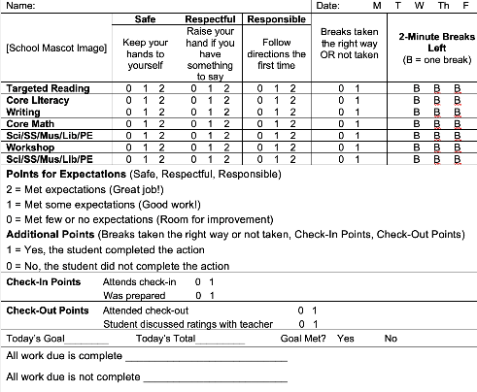
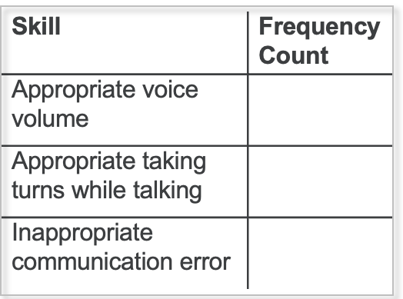


Building a Comprehensive Data Profile
Behavior Examples
Behavior
Progress Report
Observation Recording Form
Ongoing
Anecdotal Data
Use multiple types of data to monitor progress.
(McDaniel et al., 2024)
Notes:
Main Takeaway: Just like we shared with the academic examples, teams should use multiple types of data to monitor progress for behavior as well. This includes formal and informal data sources. The examples on this slide are intended to show the variety of data sources that can be used.
Multiple sources of data should be used to monitor progress. Daily progress reports are an example of using intervention data to monitor progress. The example on this slide is a Breaks are Better Daily Progress Report.
You can also have measures that are more informal that are tied to the skills you are teaching. For example, after you are finished a lesson on social skills, the teacher can complete an observation checklist on how many times the student engaged in that skill. The example on the slide asks the teacher to record a tally mark for each time they see the student display the skill.
There are a variety of aneddotal data sources that also can be used for progress monitoring. For example, the interventionist can have conversations with the teacher, student, and parent on their progress. This qualitative data is important to help provide a context on how the student is generalizing the skills taught as part of the intervention.
Using qualitative and quantitative progress monitoring data sources help the team understand the numbers and the story they tell together.

Slide 74
Secondary Example – 9th grader
Implement Part 2
Plans for Intervention
The team places the student in the counselor’s coping strategies group and also provides the parent with information on the math study group that is available to all students and meets after school twice per week as a way to build confidence for exams. The team schedules a meeting with homeroom, math, and ELA teachers, parent, and the student to discuss other classroom supports and ways to help the student build relationships at the new school.
What types of progress monitoring data should the team gather to build a comprehensive data profile for this student?
Notes:
Main idea: This is an interactive slide that builds on the 9th grade example started on slides 27-28 and 50. This is the Implement step. It emphasizes the importance of compiling comprehensive progress monitoring data to develop a thorough student data profile. In this example, the team previously determined there were no skill deficits in math or ELA and low grades were due to the student skipping class on exam day and therefore having zeros recorded for those exams. The teacher reported that the student is successful with demonstrating skills in non-test situations. The mother and student did report test anxiety which the team thinks is the root cause behind behavioral and academic difficulties. Therefore, the team decided on a Tier I support for math (since no skill deficits were found in math and the team thought it would be a helpful avenue to build confidence for exams) and a Tier II support for behavior (coping strategies small group instruction for the test anxiety). The team also considers if a special education or 504 evaluation is warranted. The presenter will summarize this information and ask participants to identify multiple data sources that could be used to monitor student progress and build a comprehensive data profile for the student.
Different data sources for progress monitoring could include attendance on test days, student ratings of anxiety levels, the percentage of opportunities where the student applied their coping strategies, teacher report of student's behavior during test (did they see coping strategies being used). Summative measures could include office referrals for skipping class, test scores, class grade.
Important reminders
Highlight the critical role of continuous assessment in tracking student progress. Stress the importance of being flexible and willing to implement and adjust interventions as new data and insights become available.
Recognize that participants may not be able to make definitive decisions on progress monitoring during the discussion and that this is part of the collaborative process.
Interventions chosen are the beginning point. Interventions should be adapted according to student response and changes can be made at any time, there is no minimum number of datapoints needed.

Slide 75
Building a Comprehensive Data Profile
Alignment Guide Application Activity: Parts 1 & 2
Turn to Building a Comprehensive Data Profile in the Alignment Guide
Part 1: Prepare for the activity by reviewing the example student data and questions and responses.
Part 2: Practice applying your knowledge by answering the questions.
Be prepared to discuss your responses.
Notes:
Purpose: The purpose of this activity is for participants to apply what they have learned about collecting multiple data sources to build comprehensive data profiles for students and practice integrated multiple sources of information for data-based decision making

Slide 76
Determining Response to Intervention Reminder
There are no set requirements for the number of data points, time in intervention, or tier of intervention required to make progress monitoring or instruction and intervention changes.
(TDOE, 2022)
Notes:
Main Takeaway: Needing to collect a certain amount of data points can be a misconception and should be corrected.
There are no set requirements for the number of data points, time in intervention, or tier of intervention required to make progress monitoring or instruction and intervention changes.
The team should use data to make decisions related to making adaptions, but there are not set requirements that should prevent them from making a necessary change to better support students.

Slide 77
Determining Response to Intervention: Interpreting Data
Notes:
Main Takeaway: We’ve covered the different types of data that should be collected. Now we will we discuss how to use these multiple data sources to determine response to intervention. In other words, how do we interpret progress monitoring data.

Slide 78
Considering Data
When we review our intervention data, we need to be sure to look at each variable in relation to the others.
"Without context, data is useless, and any visualization you create with it will also be useless.”
- Nathan Yau
(Yau, 2013)
Notes:
Main Takeaway: When interpreting data, its important consider the whole picture. As this quote points out, we need to consider the context including other data collected. A single data point viewed in isolation doesn’t provide much information and can be misleading
Important reminders
Consider multiple data sources together.
Consider the full picture when collecting data and planning for multiple data sources.
Don’t make decisions based on a single data source.

Slide 79
Using Progress Monitoring Data
Define the Gap
Set a Goal
Evaluate
  Academic
  Data from universal screening process determines student’s current performance
  Behavior
  Baseline data establishes a student’s current performance
  Academic
    Benchmarks
    Rate of Improvement
    Other data
  Behavior
    Baseline data
    Team, family, student input
    Achievable
  Positive Response
  Adequate progress
  Poor Response Limited or no progress
  Questionable Response
  Conflicting or unclear data
Notes:
Main Takeaway: The above shows an overview of the steps of using both academic and behavior progress monitoring data. First you need to define the gap between students’ current and expected performance, then you need to set a goal, finally after implementing the intervention you need to evaluate the student’s response. You can see across academics and behavior, we follow these same steps but the actions we take to accomplish each may vary. While we set goals specific to formal progress monitoring measure, we should evaluate progress using multiple data sources. Consider that the overall goal for all students should always be to increase a student’s ability to engage and experience success in the Tier I.
Notes on behavior: Baseline data provides a benchmark for measuring progress and improvement. It establishes a student's current level of performance prior to intervention, which is compared to the student's progress monitoring data to see if the behavior of concern is changing once the intervention is started. The same measures should be used to collect baseline AND progress monitoring data. With behavior, it's essential that teams include family and (as appropriate) student input when setting goals. These stakeholders have the most insight about the student ,behavior of concern, learning history and context. With behavior, it's recommended that the team work to identify a small reward the student can obtain once they meet their goal for a certain period of time. It's also essential to establish a goal that is relatively easy for the student to achieve – at first. Once the student experiences reinforcement for meeting their goal, the goal can be gradually increased until the it reflects the longer-range criteria established by the family & team.

Slide 80
Examples of Methods for Setting Academic Goals
End-of-Year Benchmarks
May be used when student’s performance is close to grade level
Rate of Improvement
May be used when end-of-year benchmarks are a poor fit
Daily and weekly goals may help to motivate students and ensure they stay on track.
When setting academic goals, teams should consider methods that accelerate a student's progress beyond what is typical to close the gap.
Notes:
Main Takeaway: Two methods of setting academic goals are end of year benchmarks and rate of improvement (or ROI). Students receiving interventions are behind their peers, therefore when setting goals, teams should consider that the student needs to grow faster than their peers to close the gap. In other words, their progress needs to be accelerated. If progress isn’t accelerated, the student will never “catch up” to their peers. It’s also important to remember that these are methods for setting long-term goals, but setting short term daily and weekly goals is also important and can help motivate students and ensure they stay on track.
End-of-year benchmarks
Use end-of-year benchmarks to set the goal
Consider this method if a student is close to grade level
Rate of improvement
Uses vendor-supplied average rates of growth to set the goal
Consider this method if end-of-year benchmarks are a poor fit

Slide 81
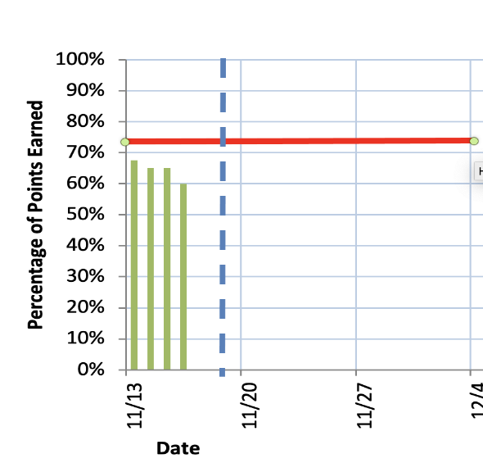
Setting Behavior Goals
Initial goals should come from baseline data and should be:
  established slightly above or below the student’s baseline performance of the expected behavior,
  reviewed regularly to be increased as necessary, and
  relative to peers’ expected behavior goals.
Goal Line
Notes:
Main Takeaway: Behavior goals should be set considering baseline data. There are no standard growth rates or mastery criteria for behavioral progress monitoring. Measurements of target and replacement behaviors can be used to set intervention goals, against which progress can be assessed while also considering other data sources. Initial goals should be set following the guidelines on the slide. Remember, students with behavior challenges should experience success and reinforcement soon after interventions begin.
Baseline data is gathered before intervention begins.
Set goal slightly above or below baseline.
A goal might be set below baseline is the behavior being monitored is one we are trying to decrease
Review goals regularly and adjust as necessary.
Consider typical performance and classwide and schoolwide expectations for behavior performance when setting goals.

Slide 82

Interpreting Progress Monitoring Data
Compare the student’s current performance to their goal using multiple data sources.
Confirm the intervention is being implemented with fidelity.
Notes:
Main Takeaway: When interpreting progress monitoring data to determine if a student’s intervention is effective teams should 1) compare student’s performance to their goal using multiple data sources and 2) confirm the intervention is being implemented with fidelity.
Remember to:
Gather multiple sources of progress monitoring data.
Compare those multiple sources before making decisions.
Examine fidelity before determining an intervention is not effective.
Poor or inadequate implementation can impact intervention effects.

Slide 83

Response to Intervention
Possible Outcomes
Positive Response
Poor Response
Questionable Response
Notes:
Main Takeaway: Students can show a positive response, poor response, or questionable response to intervention. Response should be determined using multiple data sources. The type of response they show determines if the intervention is effective for them. Examples of each type of response across multiple data sources are included on the following slides.
More information on each type of response.
Positive response: the student is making adequate progress, is on track to meet their goal, and we can see this across multiple data sources.
Poor response: the student is making slow progress, no progress, or may even be regressing; they are not on track to meet their goal according to their current rate of growth and we can see this across multiple data sources.
Questionable response: we have conflicting or unclear data; it could be some data sources show adequate progress and others don’t; it could be the students’ data is very variable making it hard to predict further growth, it could also be the student is very close to meeting their goal and we aren’t sure if they will or not.

Slide 84

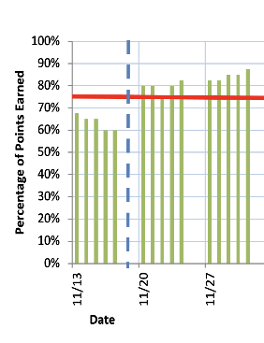

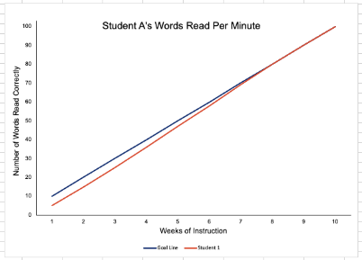
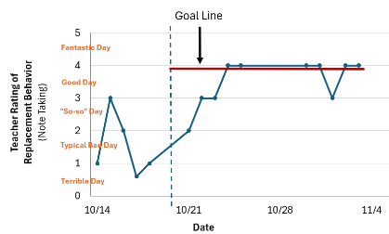
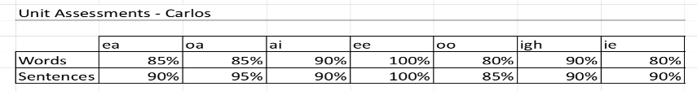
Positive Response
Adequate Progress
Academic Examples
Behavior Examples
(FL PS/RTI, 2021; Lovannone et al., 2013)
Notes:
Main Takeaway: When a student shows a positive response, it means they are making adequate progress. They are is on track to meet their goal, and we can see this across multiple data sources. Examples of positive response for academic interventions are shown on the left side of the slide and behavior interventions are shown on the right side of the slide.
Academic examples (left side)
Academic example (left, top): Observational data can help determine if skills focused on intervention are transferring to other contexts, like the grade-level classroom. Skills transferring across contexts is one indication of positive response.
Academic example (left, middle): Graphed formal progress monitoring data (e.g., cbm data) can also be used to determine response. This is the most common source for determining response but should not be the only source used. Here we see the gap closing between the student performance (shown in red) and the goal line (shown in blue) which is an indication of positive response.
Academic example (left, bottom): Data gathered through intervention program assessments, such as assessments given at the end of an instructional unit, can also be used to determine response. Here we see an example from a reading intervention focused on word reading skills, you can see the student is showing adequate levels of mastery across the different vowel combinations that have been taught and words containing those patterns both in isolation and in sentences. This is also an indication of a positive response
Behavior examples (right side)
Behavior example (right, top): This is an example of progress monitoring that could be obtained by using the Daily Progress Report which focuses on ratings aligned with schoolwide behavioral expectations. Frequently associated with the Check-In/Check-Out intervention, this tool uses the schoolwide expectations as the basis for a student's goals. The student receives feedback throughout the day, and at the end of the day their percentage of total points earned is calculated. The Daily Progress Report can be used with just about any Tier II intervention for behavior. It's a great tool for early Tier II monitoring but is not the only type of progress monitoring that should be used. Here you see the student’s performance of behavioral expectations have met and exceeded the goals set. This is on indication of a positive response.
Behavior example (right, middle): Observational data can help determine if skills and behaviors focused on intervention are being demonstrated across educational settings. Skills transferring across contexts is one indication of positive response.
Behavior example (right, bottom) Teacher rating of a specific replacement behavior (Note Taking). Here you see that the student’s performance of the replacement behavior has increased and is meeting the goal set. This is one indication of positive response. This is an example of progress monitoring that could be obtained using the IBRST (Iovannone et al., 2013). This is a perceptual direct behavior rating tool that can be used by typical school personnel to monitor progress for students who need individualized interventions, or for more direct monitoring of a priority behavior (e.g., note taking). The IBRST uses a specific process to develop anchors for the scale and ensure that the anchors are useful for the observer over time.
More examples than what shown here exist.

Slide 85
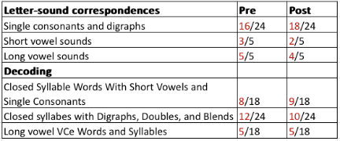
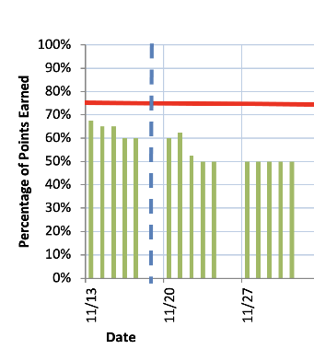

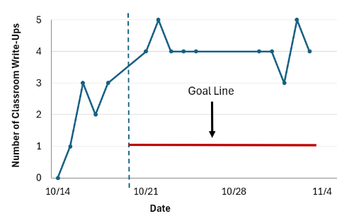
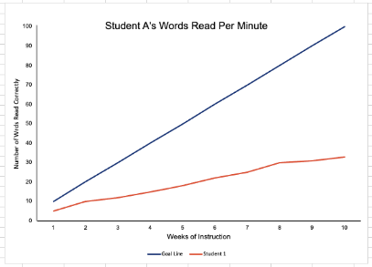
Poor Response
Limited or No Progress
Academic Examples
Behavior Examples
(FL PS/RTI, 2021)
Notes:
Main Takeaway: When a student shows a poor response, it means they are making limited or no progress. A student who is showing a poor response may be making progress, but the progress is not happening consistently or fast enough. They are not on track to meet their goal, and we can see this across multiple data sources. Examples of poor response for academic interventions are shown on the left side of the slide and behavior interventions are shown on the right side of the slide.
Academics examples (left side)
Academic example (left, top): Survey–level assessment data can be used to determine response. Choose assessments aligned with the specific skills taught in intervention. Here the results are summarized from a phonics and word reading survey with scores gathered at the beginning of an intervention focused on beginning word reading and after several months of intervention. You can see a lack of progress in the student's scores. This is one indication of a poor response
Academic example (left, middle): Observational data can help determine if skills focused on intervention are transferring to other contexts, like the grade-level classroom. Skills failing to transfer to the grade-level classroom or continued poor performance in the grade-level classroom despite substantial intervention is one indication of a poor response.
Academic example (left, bottom): graphed formal progress monitoring data (e.g., cbm data) can also be used to determine response. This is the most common source for determining response but should not be the only source used. Here we see the gap widening between the student performance (shown in red) and the goal line (shown in blue) which is one indication of poor response.
Behavior examples (right side)
Behavior example (right, top): This graph shows that the daily percent of points earned for desired behavior doesn't look much different from baseline data. This is one indication of a poor response. The daily percent of points earned is a metric that can be calculated for students using the Daily Progress Report.
Behavior example (right, bottom): This graph shows the monitoring of another source of data, the number of classroom write ups. This option can help teams see if incremental improvements for behavior are having a practical impact for the student. For example: Nathan may call out during instruction less often than he did before starting his intervention, but he's still regularly receiving classroom write ups at a rate that doesn't approach his goal. This example shows one indication of a poor response.

Slide 86
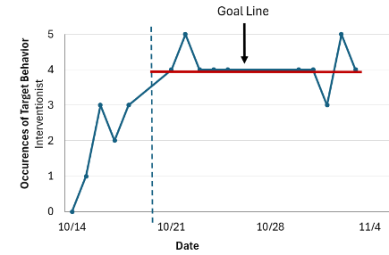
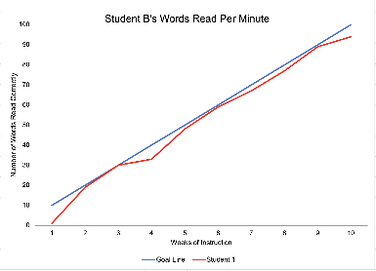

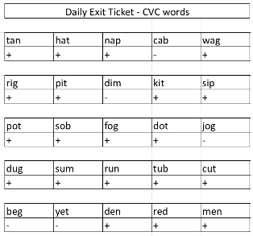
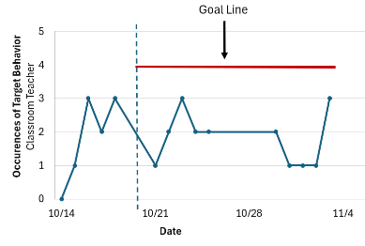
Questionable Response
Conflicting or Unclear Data
Behavior Examples
Academic Examples
Interventionist
Observations
Teacher
Observations
(FL PS/RTI, 2021)
Notes:
Main Takeaway: When a student shows a questionable response, it means we have conflicting or unclear data. It could be some data sources show adequate progress and others don’t. It could be the student's data is very variable making hard to predict further growth. It could also be the student is very close to meeting their goal and we aren’t sure if they will or not.
Academic examples (left side)
Academic example (left, top): graphed formal progress monitoring data (e.g., cbm data) can be used to determine response. This is the most common source for determining response but should not be the only source used. Here we see the student (shown in red) is very close to meeting their goal line (shown in blue) but performance tends to stay just below the goal, an indication of a questionable response where we would need more data.
Academic example (left bottom): daily formative assessments can also be used to help determine response. If we have a student showing a poor response on their graphed formal progress monitoring data but is showing mastery on daily formative assessments, like shown here, the response would be questionable, and we would need to investigate further using multiple data sources.
Behavior examples (right side)
Behavior examples (right, top and bottom graphs): Here we see a situation where the interventionist sees improvement in the student's behavior but the classroom teacher does not. This is an indication of a questionable response where we need more data. It's important to check in with both observers to learn why there may be such a discrepancy between two observers.
There are times when it may be more efficient and/or effective to monitor the student's use of a replacement strategy, rather than the occurrence of a situationally-inappropriate behavior.
The photo on the right is meant to be a teacher who is very stressed out. This is to make the point that even if multiple observers note improvements in the student's behavior, teams should be sure to check in with the student's primary instructor(s), because if this/these individuals are still feeling overwhelmed and stressed because of the student's behavior, something still needs to change with regards to intervention and instruction.

Slide 87
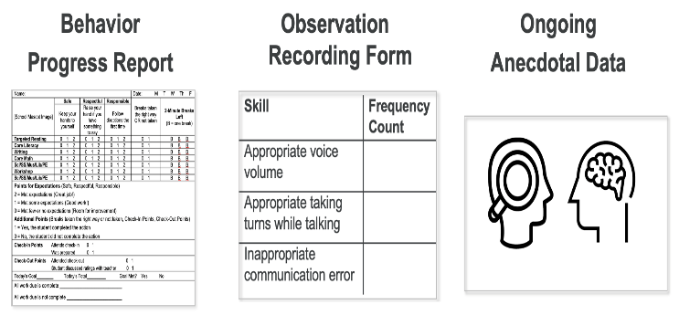
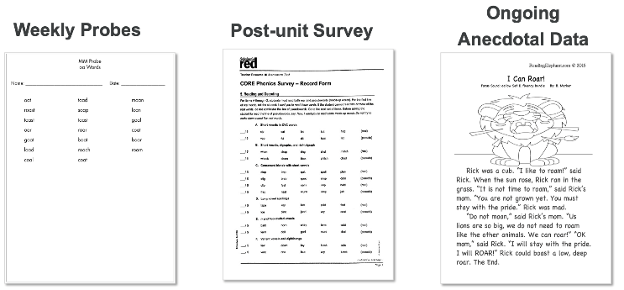
Determining Response
When deciding whether student response is positive or poor, teams should make decisions based on a wealth of data and with consideration given to the unique circumstances of the student.
(Fuchs & Mellard, 2005)
Notes:
Main Takeaway: When determining student response, it’s especially important to consider multiple data sources. When deciding if the response is “positive” or “poor” we make decisions based on multiple data sources that consider the intervention, setting, and other details regarding the student’s specific needs and circumstances.
“Positive” or “poor” depend on:
the expected level of performance for the student’s same-grade peer group,
the target or goal of the individual student,
the student’s progress toward the target or goal
the trajectory of the student’s improvement, and
intervention fidelity.
Examples of multiple sources of data are shown on the slide, but more examples of these exist.
Questions to help team analyze data are included on the next slide.

Slide 88
Guiding Questions
  Teams can ask these questions when interpreting the data:
  Will the student reach the established goal within a reasonable time period?
  Are there data outliers that should be excluded from our analysis?
  What do our other data sources tell us?
  Is the intervention being implemented with fidelity?
  Are our progress monitoring probes sensitive to change and aligned with skills targeted by the intervention?
(National Center on Intensive Intervention, 2023)
Notes:
Main Takeaway: Before making decisions, teams need to interpret progress monitoring data. The questions listed can help the team generate possible explanations and next steps. Teams should remember to consult multiple data sources before making decisions.
Outliers are data points that deviate significantly from the overall pattern or trend of the data. These data points are not a good representation of the student’s overall performance.

Slide 89
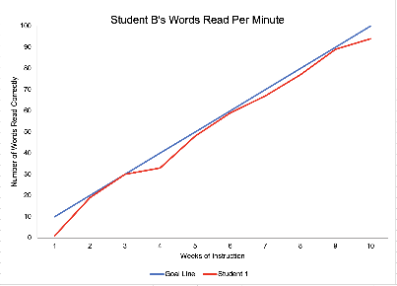

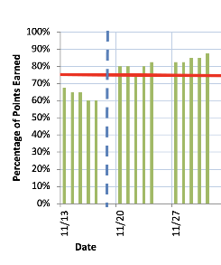
Analyzing Data
Formal Progress Monitoring Data
Other Data Sources
Consider student performance relative to the goal line.
Consider evidence (e.g., classroom assessments, work samples, teacher report, observations) that conveys level of skill mastery.
Notes:
Main Takeaway: Teams should have methods for analyzing both formal progress monitoring data and other data sources. Both of these data sources are equally valuable and necessary for determining student response
Formal Progress Monitoring Data
This includes data such as CBM data and data gathered through daily behavior reports
To analyze this data, consider student performance relative to the goal line
Student performance on or above the goal line is one indication of a positive response
Student performance below the goal line is one indication of a poor response
Other Data Sources
This includes everything outside of formal progress monitoring data. For example, classroom assessments, work samples, teacher report, observations, diagnostic and survey-level assessments, and others
This data can be quantitative (such as percent correct) or qualitative (such as descriptions of performance)
DBDM teams should be able to glean information on level of mastery on targeted skills from this data

Slide 90
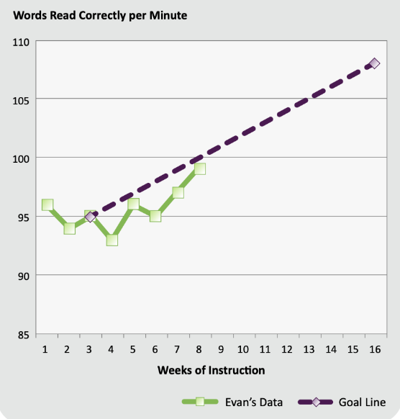
Analyzing Formal Progress Monitoring Data
Academic Data 1
Compare student’s performance to the goal line.
Do these data suggest the student is making progress?
What other data should be considered?
(National Center on Response to Intervention, 2013)
Notes:
Main Takeaway: There are different methods of evaluating progress and analyzing academic data. This slide and the next show methods of evaluating progress using formal progress monitoring data (e.g. cbm data). When evaluating progress using formal progress monitoring data, we compare student performance to the goal line. We want student performance to be consistently at or above the goal line to indicate the student is making progress. The slide shows a graph of student progress monitoring data for a student receiving a reading intervention. Ask participants to examine the graph shown on the slide and consider if the student is making progress according to this data source. Keep in mind, formal progress monitoring data is one data source and can be one indication of student response to intervention. Multiple data sources are needed before determining student response and making decisions. Also ask participants what other data should be considered when evaluating this student’s progress.
The four-point method is one method that can be used for evaluating graphed formal progress monitoring data. Facilitators may guide participants in using this method to evaluate the data.
Compare four most recently gathered data points to the goal line
If these data points are on or above the goal line, it is one indication of a positive response
If these data points are below the goal line, it is one indication of a poor response
This method is quick, but may not be the best choice if student’s data is highly variable

Slide 91
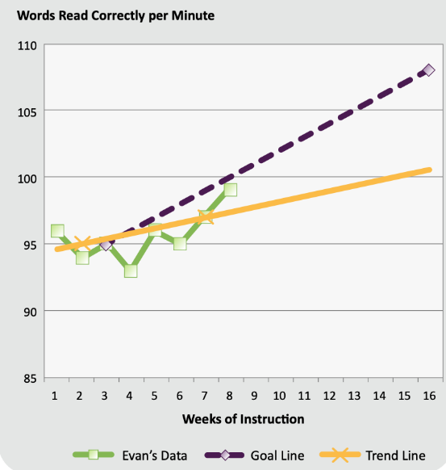
Analyzing Formal Progress Monitoring Data
Academic Data 2
A trend line has been added. The trend line summarizes the student's data and predicts future performance.
Now evaluate the student’s progress by comparing the trend line to the goal line.
Has your perception of student progress changed?
What other data would help your decision?
(National Center on Response to Intervention, 2013)
Notes:
Main Takeaway: There are different methods of evaluating progress and analyzing academic data. This slide shows another method of evaluating progress using formal progress monitoring data, trend line analysis. The trendline summarize student’s data and predicts future performance using a mathematical formula (i.e., linear regression). This graph show the same student data and goal line with the addition of a trendline. Now ask participants to evaluate student progress using trend line analysis.
Trend line analysis
Compare the student’s trend line to the goal line
If the student’s trend line is steeper than the goal line, it is one indication of a positive response
If the student’s trend line is flatter than the goal line, it is one indication of a poor response
Ask participants if their perception of student progress has changed with the addition of the trend line. Keep in mind, formal progress monitoring data is one data source and can be one indication of student response to intervention. Multiple data sources are needed before determining student response and making decisions. Ask participants what other data would help they decide if the student is making poor or positive progress and inform their next steps.

Slide 92
Considering a Comprehensive Data Profile
Academic Data
Intervention Lesson Data
Applies multisyllabic word reading strategies across passages included in intervention program
Intervention Assessments
Earned 90% on the last two unit assessments
Classroom Assessments
Earned 65% on last two English Language Arts assessments
Notes:
Main Takeaway: Formal progress monitoring data is one data source and can be one indication of student response to intervention. Multiple data sources are needed before determining student response and making decisions. Here we see formal progress monitoring data along side anecdotal notes taken during intervention lesson by the interventionist, data from recent intervention program assessments, and data from classroom assessments. Ask participants to make the final determination on if the student is having a positive response and the interventionist should continue with intervention without any adjustments or if there is a poor or questionable response and the interventionist may need to gather additional data and/or adjust the intervention to increase effectiveness.
Prompts to guide discussion
What would you want to know in this situation?
What would your decision be about student progress?
What would be your next step to support this student?
Additional information
Reading multisyllabic words is a key skill of focus for the intervention
Intervention lesson data and assessments indicate the student is performing well in intervention and can use multisyllabic word reading strategy taught in intervention when reading passages.
Classroom assessments indicate the student is still struggling in Tier I instruction and may be struggling to transfer skills learned in intervention to other settings.
Taken together, data indicates a questionable response. The team may consider reanalyzing existing data or analyzing additional data sources. For example, the team may choose to re-analyze the intervention and classroom assessments to determine which skills the student has mastered and is struggling with.
Team may decide to adapt intervention to increase connection between Tier II intervention and Tier I core instruction. For example, the interventionist may choose to add practice with the multisyllabic word reading strategy using carefully selected text from Tier I instruction.
Other possible solutions exist. Encourage participants to discuss and share and also consider what additional data may need to be collected before making a decision.

Slide 93
Evaluating Progress
Behavior Data
When interpreting a student’s behavior data, compare baseline data to intervention data, and consider variability, level, trend and other informative data.
(Cooper et al., 2019)
Notes:
Main Takeaway: When interpreting a student’s behavior data, compare the student’s baseline data gathered before intervention began to data gathered during intervention. Consider variability, level, and trend.
Variability: refers to the extent to which the data are similar in value.
Variable data makes it difficult to predict the next data point and assess change.
Stable data increase confidence that future data will be similar under similar circumstances.
Level: the amount of behavior or where data are in relation to vertical axis.
Can be categorized as low, moderate, and high.
Can be compared to evaluate trend (e.g., pre-intervention levels vs. intervention levels).
Trend: refers to the overall direction of the data path.
Can be categorized as increasing, decreasing, or no trend/change over time.
Always consider multiple data sources when evaluating progress.

Slide 94

Considering a Comprehensive Data Profile
Behavior Data
Teacher Report
Student behavior may be improving but student is struggling with daily classroom activities.
Discipline History
No change in the rate of classroom or office-managed referrals.
Family Feedback
Family was happy that student met their goal, but they don't believe their child is doing as well as they could.
Notes:
Main Takeaway: Formal progress monitoring data is one data source and can be one indication of student response to intervention. Multiple data sources are needed before determining student response and making decisions. Here we see formal progress monitoring data alongside anecdotal teacher report, recent discipline data, and feedback gathered from the student’s family. Ask participants to make the final determination on if the student is having a positive response and the interventionist should continue with intervention without any adjustments or if there is a poor or questionable response and the interventionist may need to gather additional data and/or adjust the intervention to increase effectiveness.
Prompts to guide discussion
What would you want to know in this situation?
What would your decision be about student progress?
What would be your next step to support this student?
Additional information
Formal progress monitoring data shows overall level of performance, but may not reveal nuances.
For example, the teacher agreed that the student engaged in behavior that earned a full score for the day/period. However, the behavior was sporadic – the student demonstrated desired behaviors at the beginning of class, but when they began an assignment, the student commonly reverted to earlier patterns.
Or, the student demonstrated the desired behavior but continued to receive discipline marks in the classroom for other challenging behavior.
Or, the student demonstrated some progress, but family reported that they knew their child could do much better.
Taken together, data indicates a questionable response. The team may consider reanalyzing existing data or analyzing additional data sources. Some ideas about other data:
Times of day, activities that the challenging behavior is likely to occur
What happens immediately before and after the behavior
Possible antecedents (e.g., fight with family member)
Possible motivation
Student's perception of what's happening
What the other students are doing when the student's challenging behavior pops up
Team may choose to interview student and examine classroom activities that precede the behavior, comparing the student’s behavior to that of their peers. Then they may choose to adapt the intervention to improve effectiveness with a potential focus on selected daily classroom activities or routines noted by the teacher as most challenging.

Slide 95

Considering a Comprehensive Data Profile
Teams should consider multiple sources of academic and behavior data together to provide the full picture of the student.
Notes:
Main Takeaway: DMDM teams should consider multiple sources academic and behavior data together to provide the full picture of student performance and need. A single data sources or single assessment will only provide a limited view of the student and their progress. Consider multiple sources together, especially when evaluating student progress and making decisions regarding intervention.

Slide 96
Connection Activity
Alignment Guide Application Activity
Turn to the Connection Activity in the Alignment Guide.
Discuss the questions with your school team.
Be prepared to share your responses.
Notes:
Purpose: The purpose of this activity is for participants to consider school-wide procedures used for gathering and analyzing progress monitoring data.

Slide 97
Determining Response to Intervention: Intensifying and Fading Interventions
Notes:
Main Takeaway: In this section we will talk about methods for intensifying and fading interventions

Slide 98
Rolling Hills Scene 5
Discussion Questions
Listen to the audio recording of a discussion at Rolling Hills School.
Consider these questions and prepare to discuss them during the next activity:
  Does this sound like a conversation that teams in your building have had before?
  How is it different?
Notes:
Purpose: The Rolling Hills scenes offer participants a model of meetings conducted by a data-based decision-making team. Listen to this recording or follow along with the script and reflect on how the dialogue aligns with your teams' current or need-to-have conversations.​

Slide 99
Purpose of Data Analysis
Data-based decision-making teams review data to
inform and maximize instruction.
Notes:
Main Takeaway: Its important to remember interventions must to responsive to student needs. A key role of data-based decision-making teams is to review student data to determine if an intervention needs adjustment to increase effectiveness. When analyzing data, it's important to consider data from multiple sources.

Slide 100


Potential Actions When There is a Positive Response
Continue with the current goal
Continue intervention with increased goal
Fade intervention or support
Consider multiple data sources when determining response and making decisions about interventions.
(FL PS/RTI, 2021)
Notes:
Main Takeaway: If there is a positive response to intervention, we have three potential options. We can continue with the current goal as the student continues to make progress, we can continue the intervention with an increased goal, or we can fade intervention or support. Make sure to consider multiple data sources when determining response and making decisions about interventions.
Continue with current goal: consider this option if
the student needs to make more progress to meet grade-level or school wide expectations, there is still a gap between the student’s performance and what is expected and
the student is meeting, but not exceeding the goal
Continue intervention with increased goal: consider this option if
the student needs to make more progress to meet grade-level or school wide expectations, there is still a gap between the student’s performance and what is expected and
the student is exceeding the goal
Fading means gradually removing/reducing intervention and/or supports
Fade intervention support: consider this option if
The student is meeting grade-level or school wide expectations and preparing to exit from intervention or
The student is close to meeting grade-level or school wide expectations, there is a small gap between the student’s performance and what is expected or
The team decides (based on data) the student needs less support in order to continue to make adequate progress

Slide 101
Fading
Academic Interventions
Fading prepares students to exit intervention. Interventions can be faded by adjusting key characteristics of interventions. Adjustments can include:
Dosage: decreasing the opportunities to practice emerging or mastered skills
Comprehensiveness: decreasing support for students' correct execution of skills (e.g., fewer prompts, gradual removal of scaffolds)
Alignment: increasing emphasis on grade-level application of targeted skills
Notes:
Main Takeaway: Fading prepares students to exit intervention or move to a less intensive tier of support. Academic interventions can be faded by adjusting the dosage, comprehensiveness, and/or alignment of the intervention.
Dosage: can reduce by decreasing the length of each intervention (e.g, from 40 min sessions to 30 min sessions) or reducing the student to teacher ratio.
Comprehensiveness: decrease scaffolding by reducing the number and/or intensity of prompts or moving to less supported practice more quickly.
Alignment: for students preparing to exit intervention and move to Tier I support only, increase practicing the application of skills learned during intervention with grade level content.

Slide 102
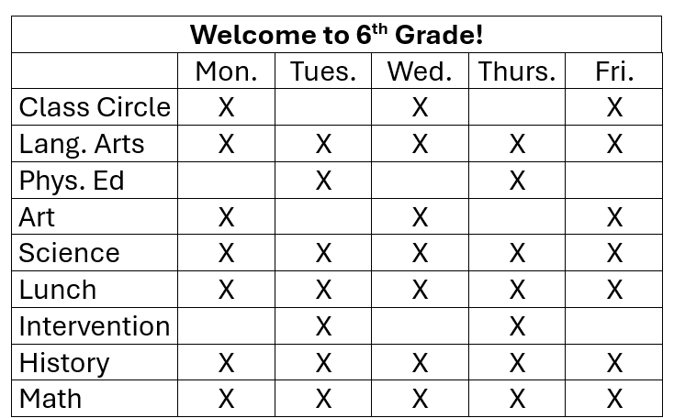
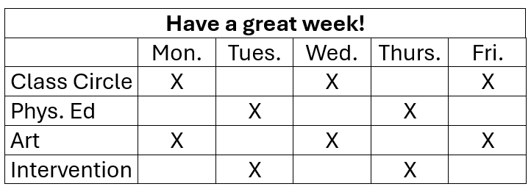
Fading Example
Behavior Interventions
At the start of the school year, place a copy of the student’s daily schedule in the front of the student's planner.
As the year progresses, remove the schedule and only put reminders of elective classes (e.g., art, P.E., choir) or special events (e.g., assembly) that may be more challenging to remember.
(FL PS/RTI, 2021; Crone et al., 2010)
Notes:
Main Takeaway: Behavior interventions can be faded in a variety of ways. One example of fading behavior intervention is shown on the slide. The slide gives an example of a more detailed beginning of year planner, and a less detailed post-intervention planner. The less-detailed planner is still supporting the student's needs, but not as intensively as the detailed planner.
At the beginning of the, the schedule shows every class of the day
As the year progresses, the schedule only shows classes that occur certain days of the week

Slide 103
Potential Actions When There is Questionable or Poor Response
Check fidelity of intervention, and:
  if the intervention is not being implemented with fidelity, use strategies to increase fidelity.
  if the intervention is being implemented with fidelity, teams must decide whether to:
    modify the current intervention;
    select a different Tier II intervention;
    intensify support through a Tier III intervention; or
    refer the student for a special education evaluation alongside a, b, or c listed above.
(FL PS/RTI, 2021)
Notes:
Main Takeaway: It’s important that interventions are responsive to student need. If students are not making adequate progress in an intervention, the team should check the fidelity of the intervention. If the intervention is not being implemented with fidelity, use strategies to increase fidelity. If the intervention is being implemented with fidelity, consider making a change to the intervention. Ways to adapt and change the intervention are listed on the slide. Other ways to change the intervention are also possible. Also, a referral for SPED is not an instructional change per se, but it is a potential action the team may consider as necessary.
Modify the current intervention by increasing the intensity of intervention sessions, changing intervention providers, changing the time of day the intervention is delivered, and/or changing the skills targeted for intervention (TDOE, 2023; TDOE, 2016).

Slide 104
Potential Actions When There is a Poor Response
  Teams can ask these questions when interpreting the data and considering potential adaptations:
  Would a greater dosage of the same intervention improve progress? Are there ways to increase or improve opportunities to respond and opportunities for feedback?
  Can we make minor adjustments to the current intervention so that it is more comprehensive, or explicit?
  Is the intervention aligned to the skills needed by the student? Would a different intervention target the needed skills more effectively?
(Fuchs et al., 2017; Walker & Kearns, 2022)
Notes:
Main Takeaway: If a student is demonstrating a poor response to an intervention, the team should consider potential adaptations. It can be difficult to interpret data and choose adaptations to interventions. The guiding questions listed on the slide help the team generate ideas for how to adapt the intervention.

Slide 105

Choosing the Best Course of Action
After considering options, the team should choose adaptations that
respond to the student’s specific needs,
consider the environment and available resources, and
provide the best opportunity for success.
Notes:
Main Takeaway: After considering options for adaptations, the team should choose adaptation that respond to the student’s specific needs, consider the environment and available resources, and provide the best opportunity for success.
Single or multiple adaptations can be made.
Its important to evaluate the effectiveness of adaptations by continuing to collect data.
Participants should consider these points while working through the Case Study Reflection Alignment Guide Activity at the end of this section.

Slide 106
Adapting Tier II Interventions
Use multiple sources of progress monitoring data to drive adaptation decisions.
Keep intervention adjustments simple!
  Make low-effort adjustments that require few additional resources.
  If a larger adjustment is needed, consider whether the intervention is appropriately designed or if a Tier III intervention may be more appropriate.
Review the intervention response of all students in the intervention group and consider whether changes to the intervention would benefit others in the intervention group.
Notes:
Main Takeaway: When adapting Tier II interventions, make sure that decisions are based on multiple data sources. Choose simple, low effort adjustments that provide the best opportunity for success. If a larger adjustment is needed, consider if an intervention change is needed or if the student needs a more individualized Tier III intervention. Consider all students in the intervention and whether changes could be made to benefit all.
When intensifying to a Tier III intervention, the intervention program can be changed or the current intervention can be adapted to increase dosage, comprehensiveness ,and/or alignment.
Intensification can also occur in the current tier. Tier II interventions can vary in intensity according to student need.

Slide 107
Whole Group Discussion
Share an example of how you have faded or intensified an intervention.
How did you determine your adaptations were the best course of action?
How did your student(s) respond to it? How did you determine if your adaptations were effective or if more or different adaptations were needed?
Reflecting back, what would you have done differently?
Notes:
Purpose: Participants reflect on how they have adapted interventions by fading or intensifying in their own practice and areas of future growth.

Slide 108
Elementary Example– 5th grader
Evaluate
Define: The student was identified as at risk in reading comprehension and written expression.
Analyze: Drill down also revealed difficulties in vocabulary which affected performance in both areas.
Implement: The team implemented a reading comprehension intervention program and a writing strategy intervention. Both included initial adaptations to meet student needs. The student has been in intervention for 9 weeks.
What should the team consider when evaluating the effectiveness of the intervention and the student’s response?
Notes:
Main Takeaway: This is a slide that build on the 5th grade example started on slides 26-27, 49, and 72. This is the Evaluate step of the problem-solving process. This slide summarizes how the team has applied the problem-solving process for this student. As a reminder, the 5th-grade student was identified as being at risk in reading and writing. Specifically, the student was having deficits in vocabulary which resulted in difficulties with reading comprehension and written expression. The student was also prescribed glasses. The team decided the student needed Tier II supports in reading comprehension and written expression. After summarizing this information, the presenter will ask participants what the team should consider when evaluating the effectiveness of the intervention and the student’s response.
This the Evaluate step, step 4 of the problem-solving process.
Possible considerations for evaluating the effectiveness of the intervention is how the goal was set, how progress was evaluated, and if multiple data sources were used to determine response; participants may generate additional considerations.
Methods for setting academic goals
End-of-year benchmarks: Use end of year benchmarks provided by the publisher or according to district or school expectations to set the goal.
Most appropriate when students’ performance is close to grade level
Rate of Improvement: Uses the rate of growth of typical peers (provided by the publisher of the assessment) to set goals.
This may be used if end-of-year benchmarks are a poor fit.
Should consider the students current ROI and if moving to a typical ROI would accelerate their progress.
Methods for evaluating progress of academic data
Four point method: compare recent data points to the goal line
If the four most recent data points are on or around the goal line, this is one indication of a positive response
If the four most recent data points are below the goal line, this is one indication of a poor response
Word of caution: The four-point method allows quick evaluation of progress, but is not appropriate to use in all situations. If student data is highly variable or if students do not have a clear pattern of four consecutive data points above or below the goal line, use trend line analysis instead.
Trend line analysis: compare students’ trend line to the goal line.
If student’s trend line is steeper or the same as the goal line, this is one indication of a positive response
If student’s trend line is flatter than the goal line, this is one indication of a poor response
Other sources of data that can be consulted when considering student response include daily formative assessments, program unit assessments, survey-level and/or diagnostic assessments, observations, and classroom assessments to determine if skills are transferring
Interventions chosen are the beginning point. Interventions should be adapted according to student response and changes can be made at any time; there is no minimum number of data points needed.

Slide 109
Secondary Example – 9th grader
Evaluate
Define: The student was identified as at risk in behavior due to emotional regulation.
Analyze: Drill down revealed the student skipped class on exam days, particularly in math. Parent and student interviews revealed the student struggles with test anxiety.
Implement: The team implemented an intervention focused on coping strategies that included initial adaptations to focus on math anxiety. The student also received Tier I supports in math.
What should the team consider when evaluating the effectiveness of the intervention and the student’s response?
Notes:
Main Takeaway: This is a slide that builds on the 9th grade example started on slides 28-29, 49 and 77. This is the Evaluate step where the team determines the effectiveness of the intervention. This slide summarizes how the team has applied the problem-solving process for this student. As a reminder, the team previously determined there were no skill deficits in math or ELA and low grades were due to the student skipping class on exam day which resulted in earning zeros for those exams. The mother and student did report test anxiety which the team thinks is the root cause behind behavioral and academic difficulties. Therefore, the team decided on a Tier I support for math (since no skill deficits were found in math and the team thought it would be a helpful avenue to build confidence for exams) and a Tier II support for behavior (coping strategies small group instruction for the test anxiety). The team also considers if a special education or 504 evaluation is warranted. After summarizing this information, the presenter will ask participants what the team should consider when evaluating the effectiveness of the intervention and the student’s response.
This the Evaluate step, step 4 of the problem-solving process.
Possible considerations for evaluating the effectiveness of the intervention is how the goal was set, how progress was evaluated, and if multiple data sources were used to determine response; Participants may generate additional considerations.
Guidelines for setting behavior goals
Baseline data is gathered before intervention begins.
Set goal slightly above baseline.
Review goals regularly and adjust as necessary.
Consider typical performance and classwide and schoolwide expectations for behavior performance when setting goals.
Guidelines for evaluating progress on behavior goals, consider level, trend, and variability
Variability: refers to the extent to which the data are similar in value.
Variable data makes it difficult to predict the next data point and assess change.
Stable data increase confidence that future data will be similar under similar circumstances.
Level: the amount of behavior or where data are in relation to vertical axis.
Can be categorized as low, moderate, and high.
Can be compared to evaluate trend (e.g., pre-intervention levels vs. intervention levels).
Trend: refers to the overall direction of the data path.
Can be categorized as increasing, decreasing, or no trend/change over time.
Different data sources for evaluating progress may include attendance on test days, student ratings of anxiety levels, the percentage of opportunities where the student applied their coping strategies, teacher report of student's behavior during test (e.g., did they see coping strategies being used?). Summative measures could include office discipline referrals for skipping class, test scores, and class grades.
Consider the team should continue to monitor academic progress as well as behavior difficulties impacting academic performance and should continue to monitor the possibility of skill deficits, particularly in math.
Interventions chosen are the beginning point. Interventions should be adapted according to student response and changes can be made at any time; there is no minimum number of data points needed.

Slide 110
Case Study Reflection
Alignment Guide Application Activity
Turn to the Case Study Reflection Activity in the Alignment Guide.
Review the documents and answer the questions as a team.
Be prepared to discuss what your team would recommend for this student.
Notes:
Purpose: The purpose of this activity is to provide school teams practice using the problem-solving process to support a student needing Tier II intervention.

Slide 111

Tier II Wrap Up
Alignment Guide Application Activity
Complete the Four Corners Activity and Next Steps After Training in your Alignment Guide. Then consider the questions below.
Does your current Tier II system include all the components discussed during this training?
Does your agenda facilitate all aspects of problem-solving shared during this training?
What actions does your team need to take to make necessary improvements, and what steps can be added to your SIFA annual implementation plan?
What school-based resource mapping tools must be updated to streamline implementation structures better?
Notes:
Purpose: The purpose of this activity is for school teams to generate ideas when solving implementation problems for RTI2 A+B at their school and map out potential next steps.

Slide 112
Wrap Up
Notes:
Main Takeaway: Here we wrap up our learning by revisiting our learning objectives.

Slide 113


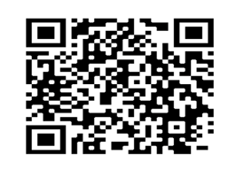
Connect With Us
To learn more about our services, connect with us on our website, through our newsletter , and on social media.
Website
Newsletter
Social Media
tennesseetsc.org
@tennesseetsc
Permission is granted to use and copy these materials for noncommercial educational
purposes with attribution credit to the Tennessee Department of Education. If you wish
to use these materials for reasons other than noncommercial educational
purposes, please contact the Office of General Counsel at (615) 741-2921.
Notes:
Main Takeaway: Please visit our website, subscribe to our newsletter using this QR code, and follow us on social media to stay connected to us in the meantime.

Slide 114
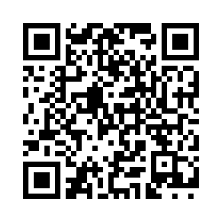
TN-TAN End-of-Session Survey (Full)
Please complete the evaluation survey using the following link or by scanning the QR code:
Open the TN-TAN End-of-Session Survey (https://tinyurl.com/3j4m7rb3).
Project provider: (Insert partner name here.)
Event title: Tier 2 Day 2
Learning objectives:
Refine their Data-based Decision-making Team's process to evaluate student need and select appropriate interventions by utilizing multiple data sources.
Enhance their skills in selecting and managing tailored interventions to meet diverse student needs and practice and reflect on these processes within their student populations.
Identify types of student response to intervention using fidelity monitoring and progress monitoring data.

Slide 115
References
Review a full list of references at Implementing Tier II Interventions and Supports Session 2.

Slide 116
References
Cooper, J.O., Heron, T.E., & Heward, W.L. (2019). Applied Behavior Analysis (3rd ed.). Hoboken, NJ: Pearson Education.
Crone, D.A., Hawken, L.S., Horner, R.H. (2010). Responding to challenging behavior in school: The behavior education program (2nd ed.). The Guilford Press.
Florida Problem Solving/Response to Intervention Project. (2021). Guiding tools for instructional problem solving (GTIPS). (3rd ed.). https://floridarti.usf.edu/resources/gtips/GTIPS_3rdEd.pdf
Fuchs, L., & Kern. L. (2014, February). Making Sense of Progress Monitoring Data to Guide Intervention Decisions [Webinar]. National Center on Intensive Interventions at the American Institutes for Research. https://intensiveintervention.org/resource/data-rich-information-poor-making-sense-progress-monitoring-data-guide-intervention
Fuchs, L.S., Fuchs, D., & Malone, A.S. (2017). The taxonomy of intervention intensity. TEACHING Exceptional Children, 50(1), 35-43. https://doi.org/10.1177/0040059918758166

Slide 117
References 2
Fuchs, D. & Mellerd, D. (2005, March 30). Response to Intervention. OSEP Leadership Conference, Washington, DC, United States.
Iovannone, R., Greenbaum, P.E., Wang, W., Dunlap, G., & Kincaid, D. (2013). Interrater Agreement of the Individualized Behavior Rating Scale Tool. Assessment for Effective Intervention, 39(4), 195-207 https://journals.sagepub.com/doi/epub/10.1177/1534508413488414
Johnson, E., Mellard, D.F., Fuchs, D., & McKnight, M.A. (2006). Responsiveness to intervention (RTI): How to do it. Lawrence, KS: National Research Center on Learning Disabilities.
Lemons, C. (n.d.) What are intensive interventions and why are they important?
{Webinar}. National Center on Intensive Interventions at the American Institutes for Research. https://intensiveintervention.org/resource/what-are-intensive-interventions-and-why-are-they-important
Majeika, C. E., Van Camp, A. M., Wehby, J. H., Kern, L., Commisso, C. E., & Gaier, K. (2020). An evaluation of adaptations made to Check-In Check-Out. Journal of Positive Behavior Interventions, 22(1), 25–37. https://doi.org/10.1177/1098300719860131

Slide 118
References 3
McDaniel, S. C., Bruhn, A. L., & Estrapala, S. (2024). Social, emotional, and behavioral supports in schools: Linking assessment to tier 2 intervention. Guilford Press.
McIntosh, K. & Goodman, S. (2016). Integrated multi-tiered systems of supports: Blending RTI and PBIS. New York, NY: Guilford Press.
McLesky, J., Maheady, L., Billingsley, B., Brownell, M.T., Lewis, T.J. (2022). High leverage practices for inclusive classrooms. New York, NY: Routledge.
National Center on Intensive Interventions at the American Institutes for Research. (2021). Considerations for effective implementation: 5 elements of fidelity [Infographic]. https://intensiveintervention.org/sites/default/files/5_Elements_Fidelity_508.pdf

Slide 119
References 4
National Center on Intensive Interventions at the American Institutes for Research. (2023, January). Data rich, information poor? Making sense of progress monitoring data to guide intervention decisions. https://intensiveintervention.org/resource/data-rich-information-poor-making-sense-progress-monitoring-data-guide-intervention
National Center on Intensive Intervention. (2023). How do I select an academic progress monitoring measure? https://intensiveintervention.org/select-academic-progress-monitoring-module ​
National Center on Response to Intervention (January 2013). Progress monitoring brief #3: Common progress monitoring graph omissions: Making instructional decisions. Washington, DC: U.S. Department of Education, Office of Special Education Programs, National Center on Response to Intervention. https://files.eric.ed.gov/fulltext/ED578046.pdf
Reading Elephant. (2018). oa and ow Reading Passage. https://www.readingelephant.com/2018/07/05/oa-and-ow-reading-passage-free/​

Slide 120
References 5
Scholastic Red. 2002. CORE Phonics Survey. https://esu11.org/wp-content/uploads/sites/13/2010/11/Phonics_Survey.pdf​
Tennessee Department of Education. (2022). Data-based decision making within the response to intervention framework [Webinar]. Tennessee Department of Education. ​
Tennessee Department of Education. (2018, April). Dyslexia resource guide https://www.tn.gov/content/dam/tn/education/special-education/dys/Dyslexia_Resource_Guide_September_2024.pdf​
Tennessee Department of Education. (2023, September). Response to instruction and intervention framework. https://www.tn.gov/content/dam/tn/education/special-education/rti/Updated_RTI2_Manual.pdf​
Tennessee Department of Education. (2023, December). TN universal reading screener administration guidelines for pre-kindergarten through grade 3. https://www.tn.gov/content/dam/tn/education/2020-21-leg-session/URS_Administration_Guidelines.pdf​

Slide 121
References 6
Yau, N. (2013, June). Understanding Data-Context. Big Think. https://bigthink.com/articles/understanding-data-context/​

Slide 122
Break
Newsletter
Social Media
@tennesseetsc

Slide 123
Lunch
Newsletter
Social Media
@tennesseetsc

