Slide 1
Welcome and Attendance
Complete the attendance survey using the QR code.
Introduce yourself in the chat box by sharing your:
  name,
  district, and
  position.

Slide 2
Tier II Intervention:
Check-In/Check-Out
Tennessee Tiered Supports Center

Slide 3
Disclaimer: Generative AI Tools
The State of Tennessee does not currently permit the use of generative AI tools (e.g., Otter, Fireflies) in meetings hosted on state resources. Meetings with contractors, vendors, and subrecipients are not public meetings and may involve discussion of protected state data. Generative AI tools are not adequately regulated and are designed to train on data that is collected and may misrepresent data or release protected data to the general public.
While the state supports your desire to maintain documentation of the meeting and what you learn, please respect our decision to safeguard information and do not attempt to use tools such as these. If you choose to use a tool such as these, the state will block such tools from the meeting.

Slide 4
Agenda
Welcome and Attendance
Linking Tier I Instruction and Tier II Intervention
Intervention Overview
Implementation
Implementation Tips
Resources

Slide 5

Tennessee Technical Assistance Network
(TN-TAN)
TN-TAN provides school districts, administrators, educators, and families access to free high-quality training, resources, and supports designed to improve outcomes for students with disabilities, ages 3–22. See below for our areas of support and the partners who lead the specific support areas:
Assistive Technology: Assistive Technology Project for Education (ATP)
Autism Supports: TRIAD at Vanderbilt
Family Engagement: The Arc Tennessee
Intensive Behavior: TRIAD at Vanderbilt
RTI²-A+B: Tennessee Tiered Supports Center
Secondary Transition: Transition Tennessee (TransitionTN)
Visit the TN-TAN website for more information: https://tn-tan.tnedu.gov.

Slide 6
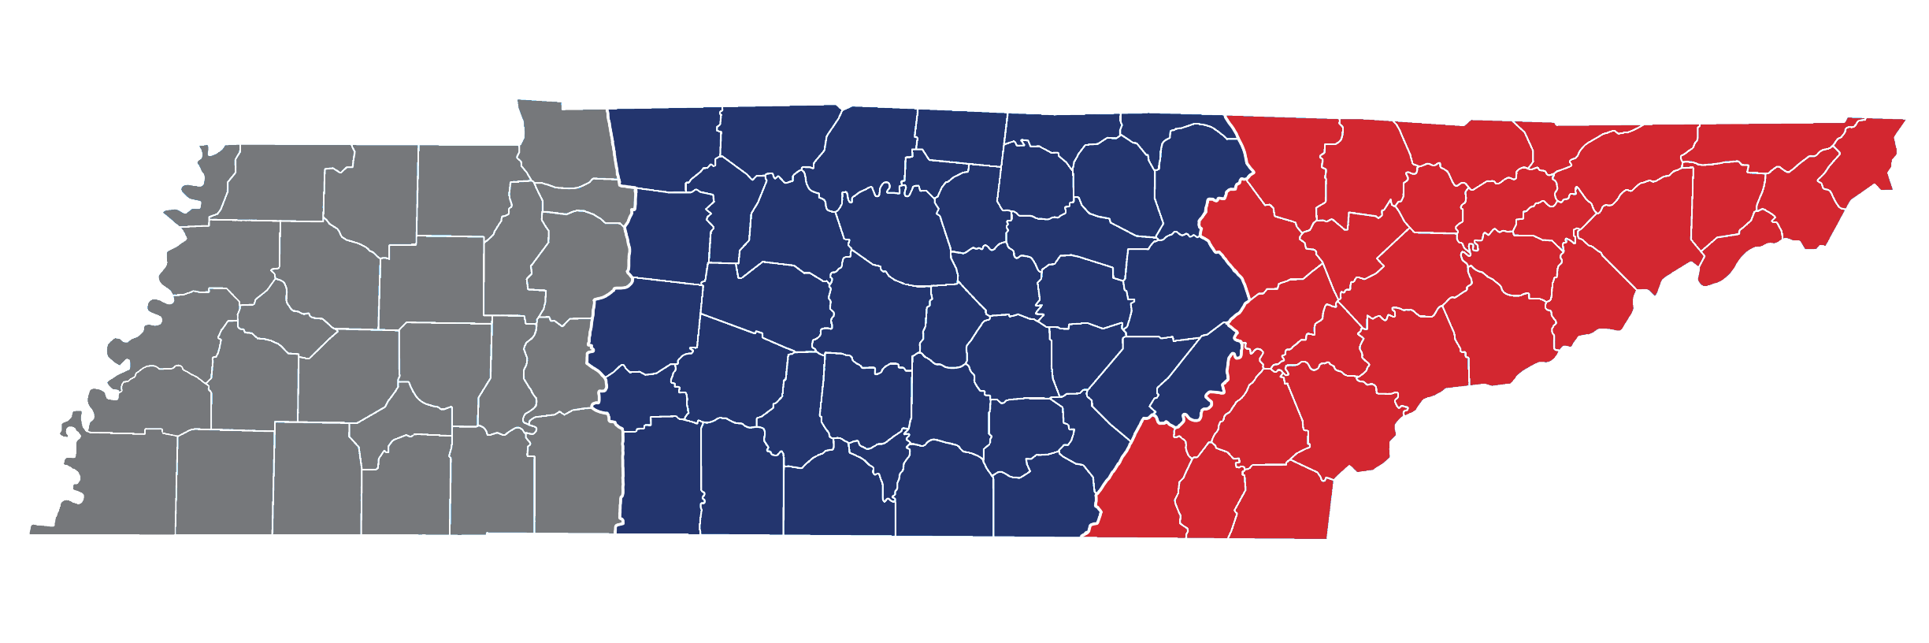
Tennessee Tiered Supports Center
Vanderbilt University – West TN Team
Vanderbilt University – Middle TN Team
University of Tennessee, Knoxville – East TN Team

Slide 7
Learning Objectives
Understand the importance of Tier I instruction and support and their relation to Tier II intervention.
Recognize the components of Check-In/Check-Out and conditions that make it effective as a Tier II intervention.
Understand the steps for setting up Check-In/Check-Out in your school.
Notes:
Main Idea:
The Learning Objectives covered during this training are:
Recognize the components of Check-In/Check-Out and conditions that make it effective as a Tier II intervention.
Understand the steps for setting up Check-In/Check-Out in your school.
Identify ways to evaluate the effectiveness of Check-In/Check-Out in your school.

Slide 8
Linking Tier I Instruction and Tier II Intervention

Slide 9
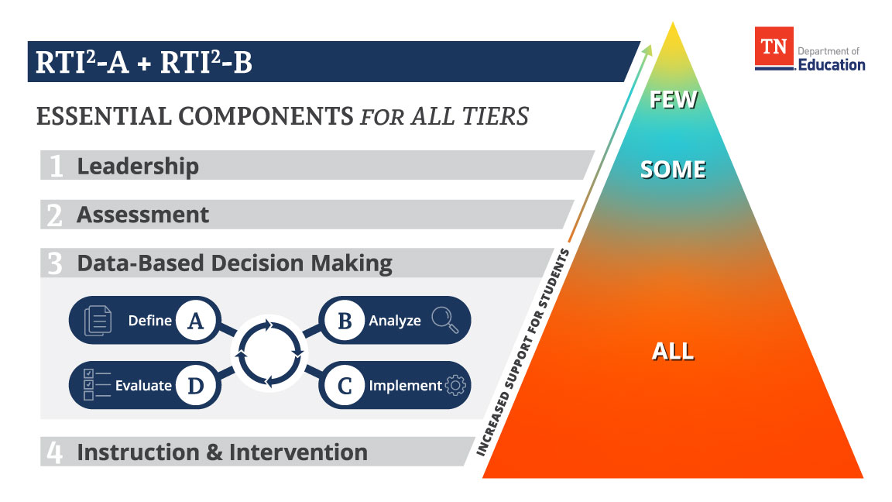
Tiered Supports
Notes:
Main Takeaway:
Tier I should be designed to provide access and opportunity for 100% of our students. Tiered intervention and other student supports are designed to further support student access to Tier I.

Slide 10
Importance of Tier I
Effective Tier II intervention depends on a solid Tier I foundation that:
  teaches and reinforces school-appropriate behaviors that empower students to access Tier I instruction fully,
  fosters supportive relationships and creates positive, safe, and predictable learning spaces for all students, and
  prioritizes data-driven decisions and continuous improvement of support for all students.
Notes:
Main Takeaway:
Tier I instruction and universal support are essential to an effective tiered support system and serve as the foundation for other more intensive supports, including Tier II interventions.
A solid Tier I foundation:
Teaches and reinforces school-appropriate behaviors that empower students to access Tier I instruction fully,
Fosters supportive relationships and creates positive, safe, and predictable learning spaces for all students, and
Prioritizes data-drive decisions and continuous improvement of support for all students.
When a school's Tier I foundation is strong, its tiered support system is more effective in preventing the emergence of significant student needs. Furthermore, educators are better equipped to identify students who may require additional support early, which leads to more targeted and effective interventions at Tiers II and III.

Slide 11
Qualities of a Solid Tier I: Instruction and Intervention
Tier I
School staff explicitly teach and review school-wide expectations for learning.
School staff use a continuum of strategies to promote student independence, academic engagement, and behaviors that align with school-wide expectations.
Teachers deliver explicit and culturally responsive instruction with access points for all students.
The school provides core (Tier 1) instruction that is based on grade-level standards, research-based, and delivered using high-quality instructional materials.
(Tennessee TSC, n.d.d, see p. 5)
Notes:
Main Takeaway:
Tennessee Tiered Support's Center's School Implementation Fidelity Assessment (SIFA) is one example of a tool school's can use to evaluate their Tier I academic and behavior supports.
The SIFA is a 39-item assessment that identifies key characteristics of Leadership, Data-Based Decision Making, Assessment, and Instruction and Intervention in an effective tiered supports system.
Items 32-35 (shown on slide) emphasize characteristics of a solid Tier I and shows the importance of having:
Teaching and reviewing 3-5 positively stated school-wide expectations,
Using a continuum of strategies that promote student independence, academic engagement, and behaviors that align school-wide expectations;
Delivering explicit and culturally responsive instruction with access points for all students; and
Providing core instruction that is based on grade-level standards and research-derived practices and uses high-quality instructional materials.
And, the assessment has a helpful rubric that can serve as a blueprint for schools working to enhance their Tier I instruction and supports for behavior.

Slide 12
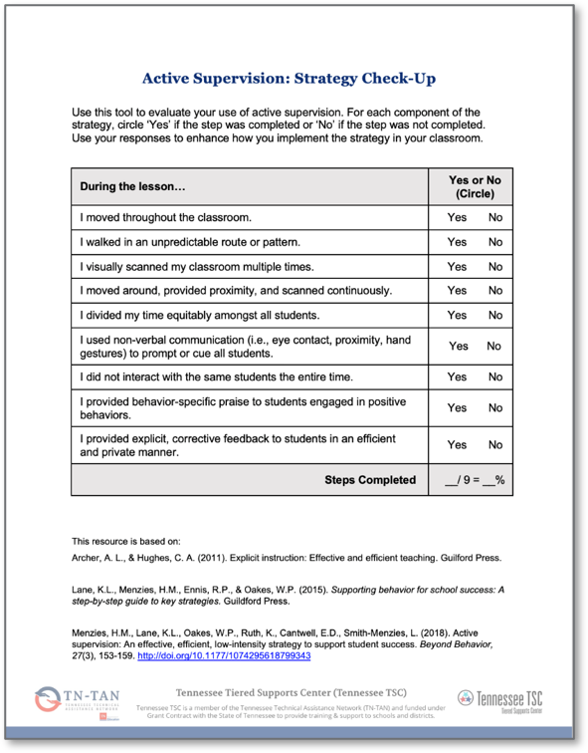
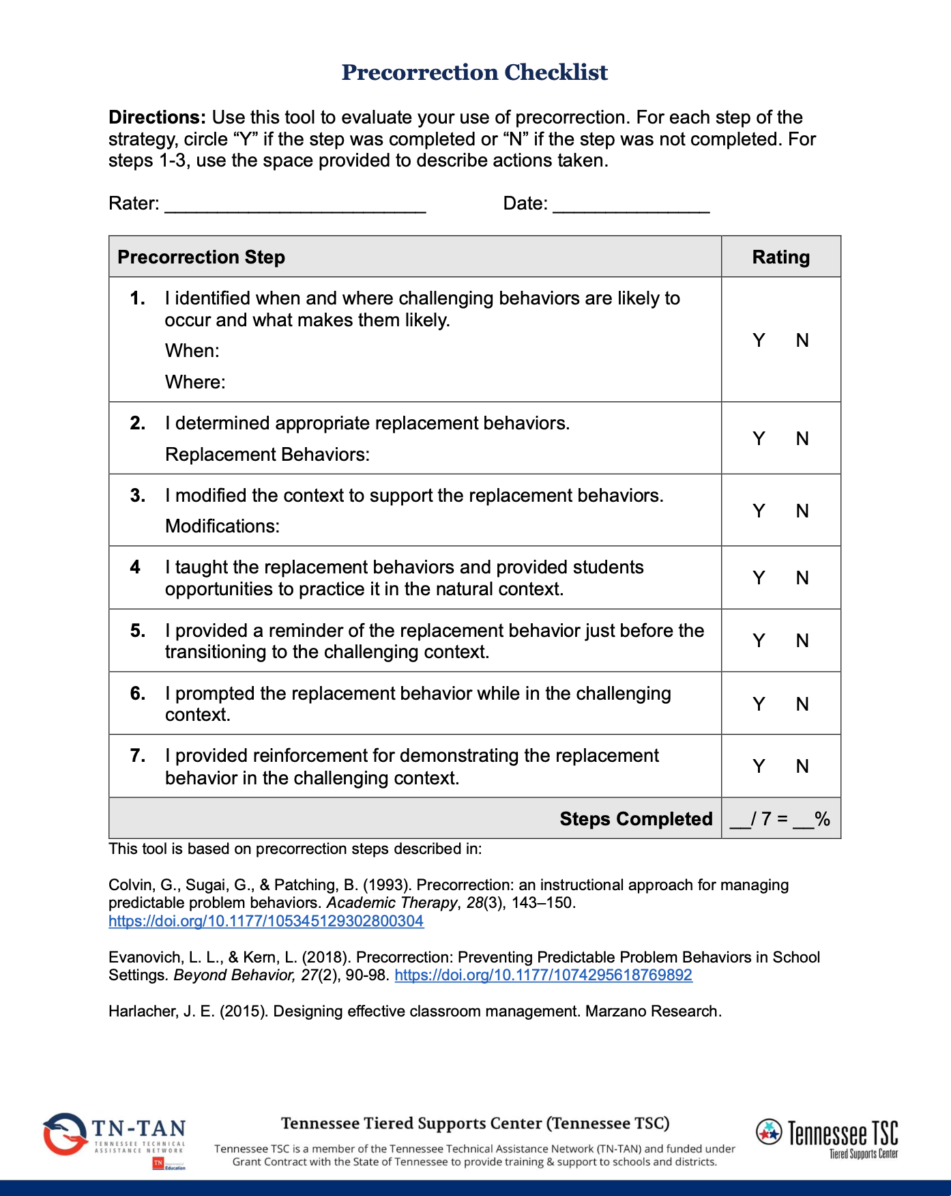
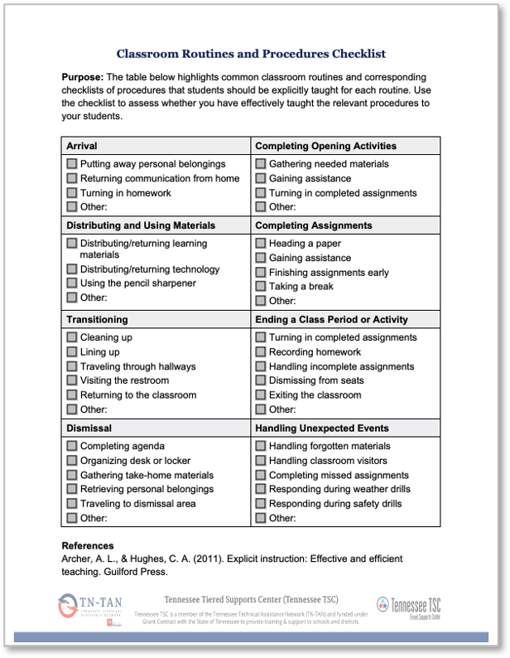
Qualities of a Solid Tier I in a Classroom
(Tennessee TSC, n.d.a,b,c)
Notes:
Main Takeaway:
When we think about the qualities of an effective Tier I, it’s important to think beyond school-wide supports for student behavior and include strategies that support student behavior in the classroom. Sometimes these are called “classroom management strategies.
Strategies like ensuring the physical classroom space supports student engagement, providing behavior-specific praise and opportunities to respond, teaching routines and procedures, and responding to challenging behavior in a manner that is instructional are all strategies that should implemented with all students, regardless of whether more intense supports are needed.

Slide 13
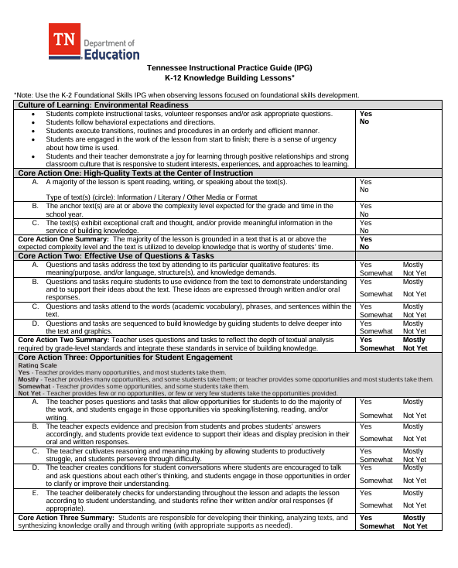
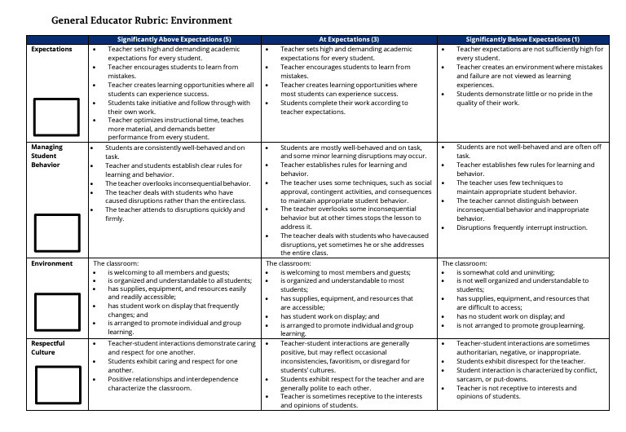
Tools to Support a Solid Tier I
(Tennessee Department of Education, n.d., 2022)
Notes:
Main Takeaway:
The Tennessee Department of Education’s Instructional Practice Guide (IPG) and Tennessee Educator Acceleration Model (TEAM) teacher evaluations also provide indicators of what solid Tier I instruction and behavior support looks like.
Both encourage practices that promote academic engagement and an instructional approach to responding to challenging behavior.

Slide 14
Enhancing Tier I Instruction
School Leadership Teams must use multiple sources when evaluating the effectiveness of Tier 1 instruction and making decisions to enhance the support provided for all students.
Example data sources include:
Discipline
School climate
Behavior screenings
Attendance
Teacher nominations
Caregiver requests
Student input
Classroom observations
School Implementation Fidelity Assessment
Academic
Resource Maps
Teacher Report
Notes:
Main Ideas:
As school’s take steps to enhance or strengthen Tier I instruction and behavior supports, it’s important to use a problem-solving process and multiple data sources at each decision point.
This slide shows some examples of data that could be helpful. These lists are not exhaustive.

Slide 15
Evaluating the Need for More Intense Support
Teams must use multiple data sources and should use a problem-solving process to identify students' strengths and areas of need and inform decisions about re-teaching, intervention, and enrichment.
When multiple data sources indicate that a student is not making adequate gains from Tier I alone, intervention is provided in addition to Tier I instruction.
In some cases, academic and non-academic intervention may be necessary.
(TDOE, 2023b)
Notes:
Main Idea:
Even with a strong Tier I foundation in place, some students may require support beyond what Tier I provides to be successful.
Again, teams must use multiple data sources and a problem-solving process to identify students' strengths and areas of need and inform decisions about re-teaching, intervention, and enrichment.
When multiple data sources indicate that a student is not making adequate gains from Tier I alone, intervention is provided in addition to Tier I instruction.
It is important to address academic and non-academic areas of needs; to do this, it may be necessary to provide more than one intervention or integrate interventions.
Check-In/Check-Out is an example of a behavior intervention that can be integrated into academic instruction.

Slide 16
Tier II Intervention
Tier II intervention includes explicit and systematic skill-based interventions designed to address the specific needs of students and have application opportunities anchored in grade-level content and expectations, whenever possible.
(TDOE, 2023b)
Notes:
Main Takeaway: Tier II interventions must be explicit, systematic, and research-based, targeting students' academic and behavioral needs, and provide application opportunities that are anchored in grade-level content and expectations. Students qualifying for Tier II support should always receive these interventions in addition to their core instruction rather than as a replacement.

Slide 17
Characteristics of Tier II Interventions
Tier II Interventions are:
cohesively linked to Tier I instruction and expectations,
supported by research,
standardized,
delivered by trained interventionists,
administered at an appropriate dosage,
comprehensive, and
aligned with needed skills or behaviors.
(Fuchs et al., 2017; National Center on Intensive Intervention, 2022)
Notes:
Main Takeaway:
These are all qualities of Tier II interventions. Tier II Interventions are....
Supported by research
Allows one to infer that the practice led to child or student improvement
Shown to have an evidence base through multiple high-quality studies
Reviewed by a reputable organization such as:
National Center on Intensive Intervention
What Works Clearinghouse
Evidence for ESSA
Standardized
Interventions that are standardized have well-articulated procedures for delivery with step-by-step directions.
The teacher follows the structure of the lesson accurately and delivers the intervention in the way that it is intended by the creator.
This standardization ensures fidelity.
Delivered by trained interventionist
These are individuals trained to deliver a prescribed intervention with fidelity.
Training should include:
standardized procedures for intervention delivery,
application of fidelity checklists or self-reflection logs,
answers to frequently asked questions, and
a variety of 'just in time' strategies to respond to student needs as those needs are presented.
Dosage
Dosage is the number of opportunities a student has to practice needed skills and receive feedback.
Dosage refers to the:
size of the instruction group,
number of minutes each session lasts, and
number of sessions provided in a week.
The intervention should provide ample time to practice needed skills after they are clearly explained and modeled.
Comprehensive
Comprehensiveness is the extent to which the intervention includes these elements of explicit instruction:
Simple, direct explanations*
Segment complex skills*
Draw student attention to important features of content*
Systematically fade support*
Create purposeful opportunities for practice and student response*
Systematic cumulative review
Improves the efficiency of instruction by practicing several skills during one practice session.
Allows for practice for previously mastered skills during subsequent instruction of new skills.
Review Tier II packaged interventions to ensure for embedded cumulative review.
Opportunities for feedback
Review and verify prerequisite skills
Aligned
Refers to marching intervention to function
Behavior ex: Intervention teaches an alternative behavior to match the perceived function of the target behavior.
Academic example: Explicitly linked to core content, whenever possible
Examples could include:
practicing the skill within core instruction or using core instructional materials,
pre-teaching academic vocabulary related to the skill, or
providing “just in time” support for missing grade-level skills.

Slide 18
Cohesion with Tier I
Instructional coherence ensures that instructional experiences are connected, and skill development is aligned with grade-level learning expectations at all tiers.

Slide 19
Connecting Tier I Instruction and Tier II Intervention
Cohesion between Tier I instruction and intervention can be strengthened through:
  regular communication and collaboration between interventionists and teachers,
  a unified approach to language and support strategies throughout a student's learning experience,
  opportunities to practice developing skills using grade-level content and expectations, and
  opportunities to generalize mastered skills across a variety of contexts.
(Tennessee Department of Education, 2024; Tennessee TSC, n.d.c)
Notes:
Main Points:
Intervention should not be provided in isolation from core/Tier 1 instruction.
There are many ways to ensure that a student's intervention and Tier 1 experiences are connected and mutually beneficial (review sub-bullets).
1. Regular communication/collaboration: Interventionists and teachers must possess a comprehensive understanding of their respective roles, as well as a shared knowledge of the strategies, materials, and curricula employed across instruction settings.
2. Unified approach to language and support strategies: Interventionists and teachers should strive for consistent language and methodologies/strategies whenever possible and appropriate.
3. Opportunities to practice developing skills using grade-level content and expectations: Interventions and teachers should provide students with opportunities to practice developing skills using grade-level content; interventions should incorporate grade-level content and materials into intervention lessons; teachers should incorporate opportunities to practice developing skills outside of intervention settings.
4. Opportunities to generalize mastered skills in a variety of contexts: Once a student has mastered a skill in one context, it is important for the student to practice and master the skill in other contexts (e.g., if a student learns a new communication skill in a small-group setting, it would be important for the student to practice the same skill with different people, perhaps in a larger group or in an environment where the need to perform the skill would be naturally occurring.

Slide 20
Intervention Overview

Slide 21
What Is Check-In/Check-Out?
Check-In/Check-Out is a Tier II intervention, supported by research, that teaches and reinforces expected school behaviors.
It is designed to support performance deficits, or behaviors, that a student is capable of demonstrating but struggles to demonstrate consistently.
It is ideal for students who continue to demonstrate challenging behavior even when Tier 1 instruction and support are provided with fidelity.
(Hawken et al., 2021)
Notes:
Main Points:
Check-In/Check-Out is a research-validated Tier II intervention that teaches and reinforces expected school behaviors.
Check-In/Check-Out builds off a school’s system wide Tier I supports by focusing on explicitly teaching and reinforcing the school-wide expectations and behaviors
This intervention should not be teaching an additional set of expectations or standards, but instead providing more intensive instructional supports on the targeted deficit areas, in this case, the school-wide behavior expectations
2. It is designed to support performance deficits, or behaviors that a student is capable of demonstrating but struggles to demonstrate consistently.
- Students receiving Check-In/Check-Out struggle to demonstrate the expected behaviors identified by the school’s school-wide expectations consistently as identified by school data teams.
- Students receiving Check-In/Check-Out are identified by data teams using multiple data sources and reviewing each student’s unique and comprehensive data profile through the problem-solving process
3. It is ideal for students who continue to demonstrate challenging behavior even when Tier 1 instruction and support are provided with fidelity.

Slide 22
How Does Check-In/Check-Out Work?
Students participate in a daily cycle that involves:
  a morning check-in with a mentor,
  use of a daily progress report,
  teacher feedback throughout the day,
  an afternoon check-out with a mentor,
  a reward for meeting a daily point goal, and
  communication with home.
(Hawken et al., 2021; Majeika et al., 2022)
Notes:
Main Idea: Check-In/Check-Out is an evidenced-based intervention where a student checks in and out daily with a trusted adult who provides the student with regular feedback and reinforcement for meeting goals and expectations.
Students participate in a daily cycle that involves:
a morning check-in with a mentor,
use of a daily progress report,
teacher feedback throughout the day,
an afternoon check-out with a mentor,
a reward for meeting a daily point goal, and
communication with home.

Slide 23
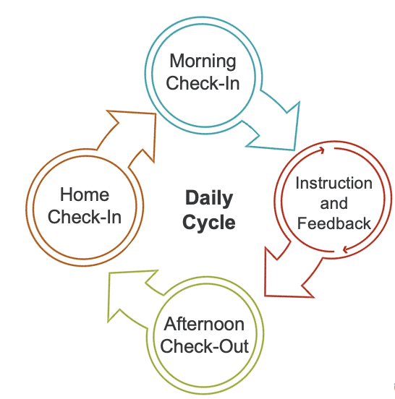
Daily Cycle
Notes:
Main Idea: Share the visual of the Daily Cycle to Support the previous slide.

Slide 24
Who is Check-In/Check-Out For?
Ideal for behavior that is:
Not for behavior that is:
externalized,
low in intensity,
within the student’s skill set or demonstrated competencies, and
observed across multiple environments.
internalized,
dangerous,
related to inattentiveness or impulsive tendencies, and
in need of individualized support.
(Hawken et al., 2021; McDaniel et al., 2024)
Notes:
Main Idea:
Check-in/Check-Out is appropriate for externalizing behaviors that are often associated with deliberate disregard for others and rules (e.g., tantrums; outbursts of anger; low-intensity aggression; bullying; lying; cheating; stealing).
These are behaviors that are typically occurring in low intensity, duration, and/or frequency
Students with serious infractions require more individualized support.
Serious infractions are typically behaviors that occur at a high intensity, duration, and/or frequency
Please note that students who engage in behaviors that could cause harm to themselves or others should be addressed through a crisis management plan, such as a behavior intervention plan when deemed appropriate or necessary by the data team
Ideal for behavior that is:
Externalized
These are behaviors that can typically be seen (acting out, yelling, disruptive behaviors)
Low in intensity
Behaviors are not explosive or behaviors that could cause harm to the individual student or others
Behaviors lead to only minor disruptions to classroom activities
Within the student’s skill set or demonstrated competencies
It is critical that we ensure that student has acquired the necessary prerequisite skills to be able to follow the expected behaviors in the school and classroom setting
This is also important to ensure the student has had an opportunity to be taught and learn the school-wide expectations and was explicitly taught these expectations with opportunities to practice and perform these behaviors before considering them a candidate for the Check-In/Check-Out intervention
The data team does not feel the reason for the student’s misbehavior is due to an underlying attention deficit that could impede their ability to engage in these behaviors
Observed across multiple environments
The data team has reviewed the student’s data including gathering information from teachers to understand when and where the target behavior is occurring
The data team has identified the student is not meeting the behavior expectation across multiple school locations, content areas, and/or teachers
Not for behavior that is:
Internalized
Behavior that you cannot see (anxiety, depression, withdrawn, etc)
Dangerous
Any behavior that could cause harm to the student or others should be immediately reviewed by the data team
Students who engage in behavior that could cause harm to themselves or others should be immediately addressed through a problem-solving process that includes evaluation and implementation of a crisis management plan, such as a behavior intervention plan to meet this students individual needs
Students who in engage in dangerous behaviors are beyond the scope of the Check-In/Check-Out Tier II intervention
Related to inattentiveness or impulsive tendencies
If the root or cause behind the behavior is related to attention deficits then the student should be supported and taught replacement behaviors to better support them in the school setting
Explicit instruction in school-wide expectations and replacement behaviors should occur on a frequent basis to help the student learn these skill deficits
Check-In/Check-Out components may be beneficial for these students, but should not be the only intervention support put in place for these students
In need of individualized support
Students who require individualized supports may require additional supports beyond the Check-In/Check-Out intervention
It is possible Check-In/Check-Out with intensification of supports or modifications could support these students, however, the data team should review all data sources to create a comprehensive and unique data profile for the student to determine the best intervention(s) and potential intensification of intervention(s) that are necessary to support the student

Slide 25

Let’s Check In!
Complete the poll by selecting all the answers that apply.
Notes:
A poll will be created by the trainer.

Slide 26
Implementation
Materials, the Daily Cycle, and Roles and Responsibilities

Slide 27

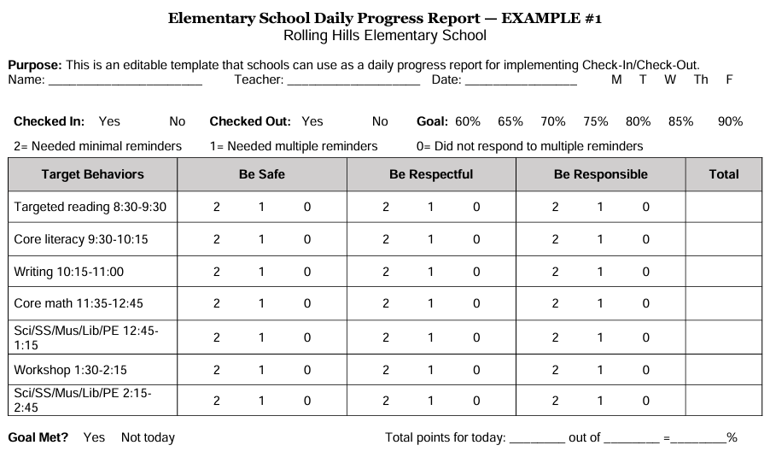
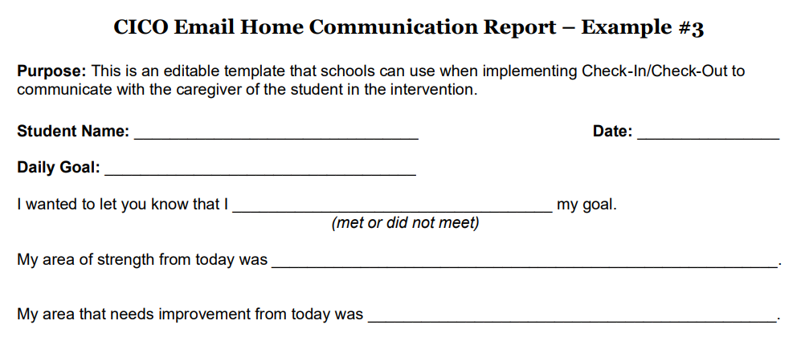
Materials
Daily Progress Report
Home Communication Report
(Tennessee Tiered Supports Center, 2023)
© Tennessee Department of Education
Notes:
Main Idea: In this section we will cover the aspects of a daily progress report, home communication and student rewards
Here is an example of a daily progress report (daily progress report) and home communication report. These examples share some possible suggestions that districts and schools could consider to include in their own daily progress report and home communication report.

Slide 28
Daily Progress Report
A Daily Progress Report is a standardized form that is used to evaluate student behavior.
The form includes:
  behavior expectations,
  intervals for evaluating student behavior throughout the school day,
  a behavior rating scale,
  opportunities to earn points throughout the day,
  space to total earned points and compare the total to a point goal, and
  space for a parent signature.
(Hawken & Horner, 2003)
Notes:
Main Idea: Share what a daily progress report is and what are the critical elements of a daily progress report.
A Daily Progress Report is a standardized form that is used to evaluate student behavior.
The daily progress report is not meant to be individualized for each student
The form includes:
behavior expectations,
Behavior expectations should be the listed school-wide behavior expectations
The reason for this is the reason this student has been identified to need the support of the Check-In/Check-Out is because they were not engaging in behaviors that meet these school-wide expectations and require additional instruction and support to learn these expectations
intervals for evaluating student behavior throughout the school day,
Intervals should be small segments of time throughout the school day
The student will be evaluated on their performance meeting the stated behavior expectations at the end of each interval
The number of intervals can vary from school to school
Some suggestions for intervals could include:
3-5 intervals per day
Intervals broken up at natural breaks or transitions during the school day
Intervals do not include transitions, passing periods, lunch, or recess – these times of day are not typically addressed on the daily progress report unless individualization needs to occur on the daily progress report for a particular student
This may look different based on the grade levels of the school (elementary vs middle school vs high school)
For example, Elementary schools may decide to put intervals after content areas (Reading, ELA, Math, Encore, etc)
Middle or High School may put intervals set after each class period
behavior rating scale,
Rating scale often ranges from 0 – 3 points per expectation for each interval
Important that the rating scale is defined to ensure consistent interpretation of the ratings
Rating scale should be the same across all behavior expectations and intervals
opportunities to earn points throughout the day,
The intervals should be spaced across the school day to ensure students are getting the opportunity to earn points throughout the school day
This is to ensure students are getting frequent access to receiving positive reinforcement and feedback that is critical in the Check-In/Check-Out cycle
space to total earned points and compare the total to a point goal, and
It is important students and teacher have a place to write the students total score for the day. This score is frequently used as one data source to monitor students response to the intervention, Check-In/Check-Out
Reviewing the total score and comparing the total to the students daily goal should also be reviewed during the Afternoon Check-Out with the Check-In/Check-Out mentor
The data team should review the students response to the intervention on a regular basis by looking at the students total scores and percentage of total points (total points earned/total points possible) to monitor their progress
It is important to mention, daily progress report data should not be the only source of data the data team reviewed to determine the student’s progress, the data team should review multiple data sources to determine if the student is making progress with meeting these behavioral expectations to improve their academic engagement
space for a parent signature.
Including a space for a parent signature is important to ensure parents are informed of the students progress
The signature also promotes two-way communication between the school and the parents
By requiring a parent signature, you are ensuring parents are aware of the student’s progress in the Check-In/Check-Out intervention

Slide 29
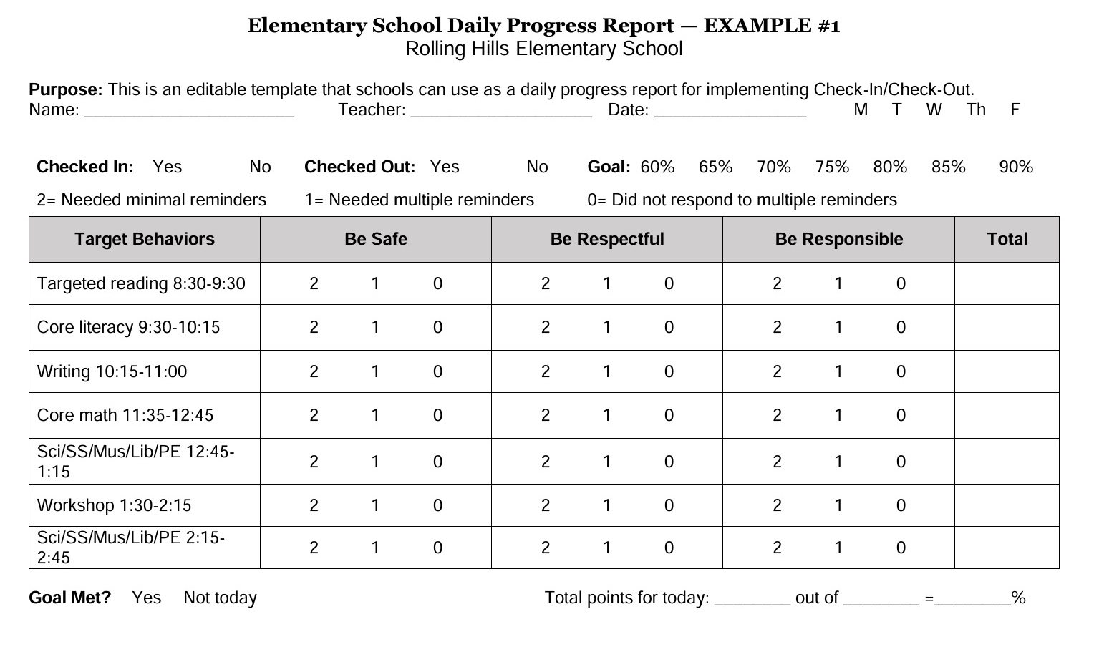
Elementary Daily Progress Report
(Tennessee Tiered Supports Center, 2023)
Notes:
Main Idea: This is an editable template that schools can use as a daily progress report for implementing Check-In/Check-Out. We will discuss daily progress report creation later in the presentation.

Slide 30
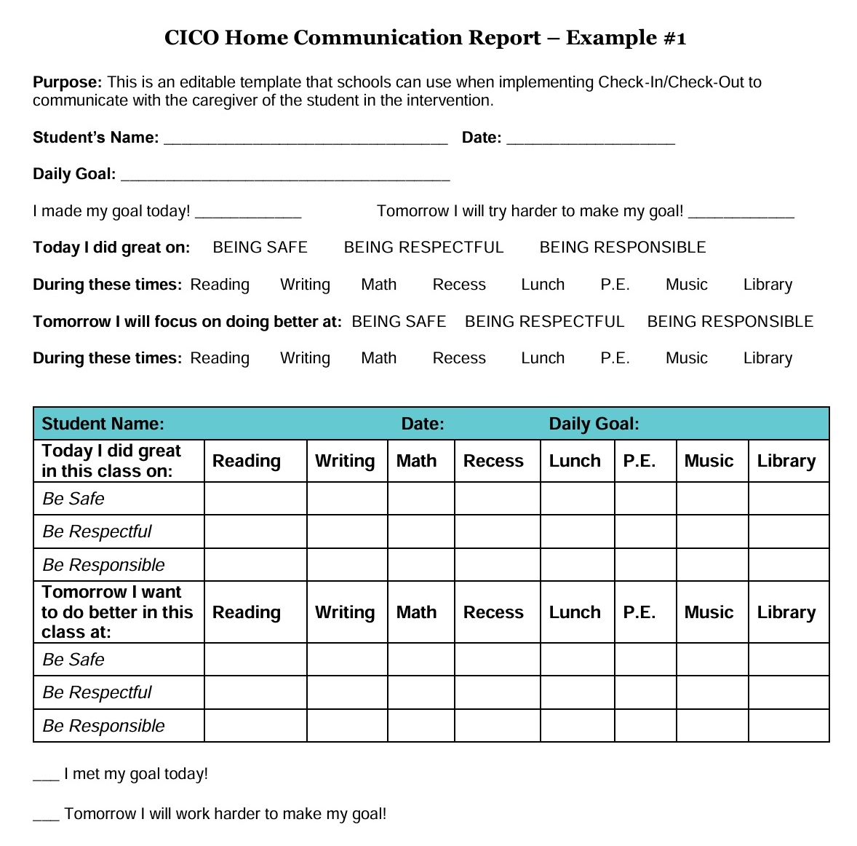
Home Communication
Home communication reports are used to share student progress with parents.
(Tennessee Tiered Supports Center, 2023)
Notes:
Main Idea: This is a template that schools can use when implementing Check-In/Check-Out to communicate with the caregiver of the student in the intervention. As with the daily progress report, focus on the positivity of the home communication report. This example does not have a caregiver signature and does not get returned to the school. You may add that component to your home communication form.

Slide 31
Point Goals and Rewards
Before intervention begins, a daily point goal is set for each student.
  The initial point goal is based on baseline data.
  The goal can change over time.
Students earn a reward for meeting their point goal.
  Rewards are selected based on student preferences and interest.
  Rewards can change over time and include no-cost, intangible options.
  The reward schedule should be faded over time.
(Tennessee Tiered Supports Center, 2023)
Notes:
Main Idea: Student incentives and rewards cand be used as reinforcers for Check-In/Check-Out.
1. Point goals
Initial point goals are based on baseline data, which involves rating the students behavior using the daily progress report without the students knowledge before the intervention begins.
There is no set number of data points to establish a baseline goal; the idea is to collect data until a good idea of how many points a student would earn on an average day.
The initial point goal should be just slightly higher than the baseline average. For example, the goal might be 75% if student would have earned 70% of points based on the teacher's ratings during baseline.
The goal can increase or decrease based on the patterns of student performance.
2. Rewards
Schools can use preference assessments to select rewards.
Rewards do not have to be tangible (e.g., prize items). Non-tangible items include time with preferred peers, time engaging in preferred activities, time helping the teacher, etc.
It is not necessary for all students to earn the same award, or for the same student to earn the same reward each day.
The reward schedule can be thinned.
For example, a student may have the opportunity to earn a reward each day initially. Once the student is reliably meeting the goal, the requirement might increase to two days of meeting the goal (or days in a row ) before a reward is available.

Slide 32
Roles and Responsibilities
The intervention involves participation from:
  a Check-In/Check-Out coordinator,
  a Check-In/Check-Out mentor,
  classroom teachers,
  the student, and
  a parent.
Each individual has unique intervention responsibilities.

Slide 33
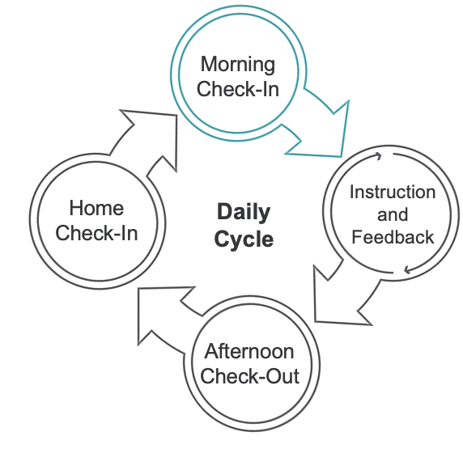
Morning Check-In
Notes:
Main Idea: Share the visual for the daily cycle for and emphasis the morning check-in.

Slide 34
Morning Check-In Roles and Responsibilities
Role
Responsibilities
Gives the student a Daily Progress Report
Reviews behavior expectations, behavior rating scale, and point goal
Ensures student has materials needed for school success
Provides encouragement
Mentor
Returns Home Communication Report from the previous day, if applicable
Receives a new Daily Progress Report and takes it to class
Student
(Hawken, 2021)

Slide 35
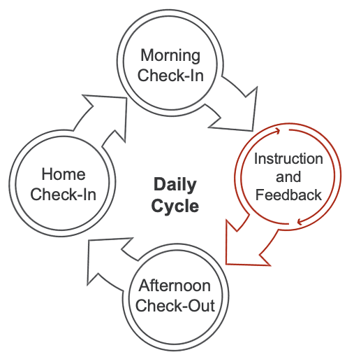
Instruction and Feedback
Notes:
Main Idea: Share the visual for the daily cycle for and emphasis instruction and feedback.

Slide 36
Instruction and Feedback Roles and Responsibilities
Role
Responsibilities
Checks in with student before instruction begins
Delivers instruction
Uses the Daily Progress Report to rate the student’s behavior at the end of class
Gives feedback to the student based on the ratings
Mentor
Brings the Daily Progress Report to class
Participates in a feedback conference with the teacher at the end of class.
Student
(Hawken, 2021)

Slide 37
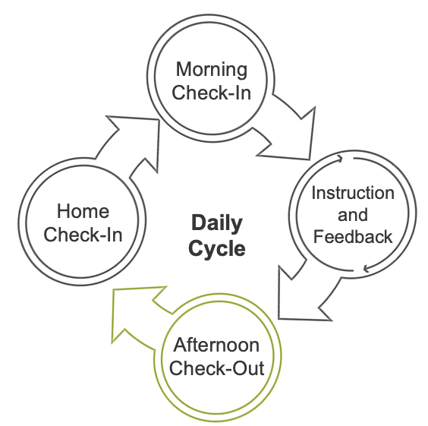
Afternoon Check-Out
Notes:
Main Idea: We will now focus on the Afternoon Check Out aspect of Check-In/Check-Out.

Slide 38
Afternoon Check-Out Roles and Responsibilities
Role
Responsibilities
Totals the student’s earned points and compares the total to the daily goal
Provides positive feedback and a reward, if earned
Completes a Home Communication Report
Records intervention data for progress monitoring purposes
Mentor
Receives reward if earned
Takes the completed Home Communication Form home
Student
(Hawken, 2021)

Slide 39
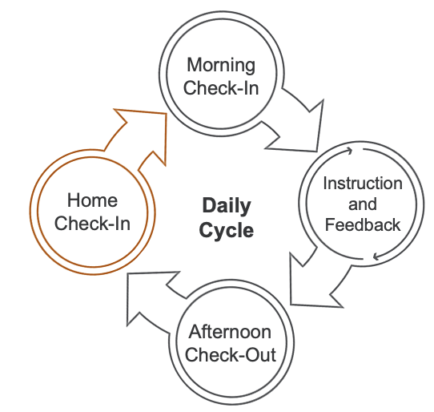
Home Check-In
Notes:
Main Idea: We will now focus on the Home Check In aspect of Check-In/Check-Out.

Slide 40
Home Check-In Roles and Responsibilities
Role
Responsibilities
Takes the Home Communication Report home
Returns the form, signed, to school
Mentor
Reviews the Home Communication Form
Provides positive feedback
Signs the form
Student
(Hawken, 2021)

Slide 41

Q&A
Do you have any questions regarding the Check-In/Check-Out process?
Notes:
A trainer will create a Zoom poll prior to the session.

Slide 42
Implementation Tips

Slide 43
How to Implement
Create a Daily Progress Report with connections to schoolwide behavioral expectations.
Offer Daily Progress Report templates with pictures instead of words.
Add incentives to strengthen participation in the intervention, including no-cost reward options.
Create an information packet to share with students and families.
Plan for implementation on atypical school days.
Consider locating morning check-ins and afternoon check-outs in easily accessible and semi-private areas, especially for secondary students.
Notes:
Main Idea: Create and offer Daily progress report templates and templates for introducing the intervention to students and families. Share no-cost reward options and add incentives to strengthen participation in the intervention.
1. Create a Daily Progress Report template with clear connections to schoolwide behavioral expectations.
2. Offer Daily Progress Report templates that rely on pictures instead of words.
- adding pictures could be beneficial for younger children or children with low literacy skills
- Visuals can also support the comprehension of the expectations and rating scale utilized on the daily progress report
3. Consider no-cost reward options.
Consider looking for free or activity-based incentives for students to help make the implementation of Check-In/Check-Out be sustainable
Consider surveying students to know what they may be interested in earning for incentives
4. Create information packets for introducing the intervention to students and families.
Information packets that provide details about the information including why we use the intervention, how the intervention works, and what the student and parents roles are in the intervention
Including examples of the daily progress report, checklists for what happens for each part of the Check-In/Check-Out cycle, and the roles and responsibilities for mentors, teachers, students, and parents
5. Plan for how the intervention will be implemented during atypical school days.
- The Check-In/Check-Out Coordinator, along with the team, should create a plan that will take place when there are irregular schedule days, including early dismissal, delayed starts, or days when the schedule has been changed due to special events
6. Add incentives to strengthen participation in the intervention.
- The primary reinforcement in Check-In/Check-Out is the attention the student receives from the mentors and teachers throughout the school day, however, adding additional positive reinforcement for the student when they meeting their daily point, meet their weekly goal, and continue to show progress based on progress monitoring data
7. Consider locating morning check-ins and afternoon check-outs in areas that are easily accessible and semi-private, especially for secondary students.
It is important the locations for the intervention are accessible and easy for the students to locate so they know where to go and does not take them a long time to get to the location from their classrooms in the school building
Locations for check-ins is ideally a semi-private location, this is especially important to consider with students in secondary school, this is to ensure students feel comfortable attending and meeting with their mentors, keeps anything discussed during their check-in and check-out sessions private between the mentor and the student, and may improve the student’s willingness to participate in the intervention
Potential locations might include the library, the counselor’s office, the health clinic, or the cafeteria

Slide 44
Bramble Elementary Example
Reinforcers for Check In Check out at Bramble Elementary are as follows:
Check-In- Students will receive Bramble Bucks.
Check-Out - Students will receive Bramble Bucks.
Daily Goal- Students will pull a stick from their “reinforcer honey pot” at the end of the day if they met their daily goal. The reinforcer honey pot was created with items they would like to earn from a preference assessment.
Weekly Goal- Students will have their name written on the Bramble Bee and posted on the “Best Behavior” bulletin board and will be invited to eat lunch with their Mentor and a friend if they meet their goal for a cumulative total of 5 school days.
(Tennessee Tiered Supports Center, 2023)

Slide 45

Reinforcing Desired Behaviors
Check-In/Check-Out has built-in opportunities for adult feedback, making it ideal for students who respond positively to adult attention.
When giving feedback, adults acknowledge the desired behaviors they observed and avoid reprimanding.
(Hawken et al., 2021)
Notes:
Main Idea:
1. Check-In/Check-Out has built-in opportunities for adult feedback, making it ideal for students who respond positively to adult attention.
2. When giving feedback, adults acknowledge the desired behaviors they observed and avoid reprimanding.
Check-ins
The intervention mentor has an opportunity to review expected behaviors included in the daily progress report and pre-correct patterns of behavior that may be preventing the student from earning daily progress report points.
Throughout the Day
Teachers deliver feedback to students at regular intervals using their observations of the student's behavior as the basis for their ratings.
Feedback is during brief and private student-teacher conferences at the end of each instructional block or natural transition period indicated on the student’s daily progress report.
Feedback is focused on observed DESIRED behaviors; negative feedback on challenging behavior is avoided.
Check-outs
The intervention mentor reviews the daily progress report with the student and acknowledges positive behaviors/met expectations that resulted in earned points.
Home Communication
Parents are trained to acknowledge progress and focus on positive behavioral outcomes of the intervention.
Guided Notes:

Slide 46
Intervention Logistics
Setting Up the Intervention and Key Collaborator Professional Development

Slide 47

Before Intervention Begins
Designate a Check-In/Check-Out Coordinator (optional) and identify mentors.
Create Daily Progress Report and Home Communication Form templates.
Create a system for managing student data.
Create and implement training protocols for staff, students, and families.
Plan for intensifying and fading the intervention.
(Miller, 2015; Tennessee Tiered Supports Center, 2023)​​
Notes:
Main Idea:
Schools must prepare to implement CICO before involving students.
This slide includes a set of ‘must do’ activities.

Slide 48
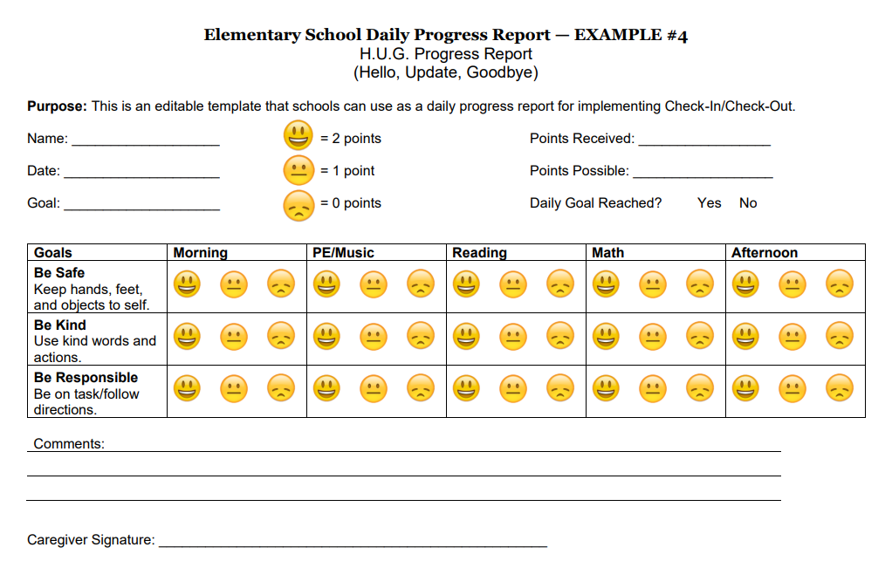
Creating an Elementary Daily Progress Report
Elementary Example
(Tennessee Tiered Supports Center, 2023, and Todd et al., 2008)​​
Notes:
Main Idea: This is an editable template that schools can use as a daily progress report for implementing Check-In/Check-Out

Slide 49
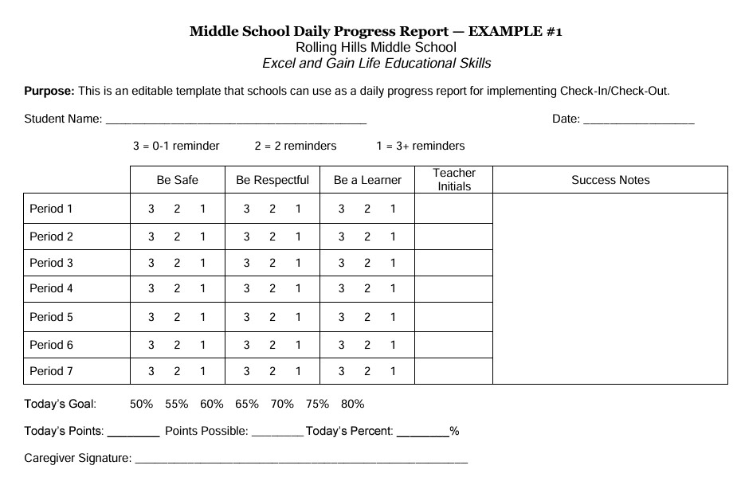
Creating a Middle School Daily Progress Report
Middle School Example
(Tennessee Tiered Supports Center, 2023, and Todd et al., 2008)​​
Notes:
Main Idea: This is an editable template that schools can use as a daily progress report for implementing Check-In/Check-Out

Slide 50
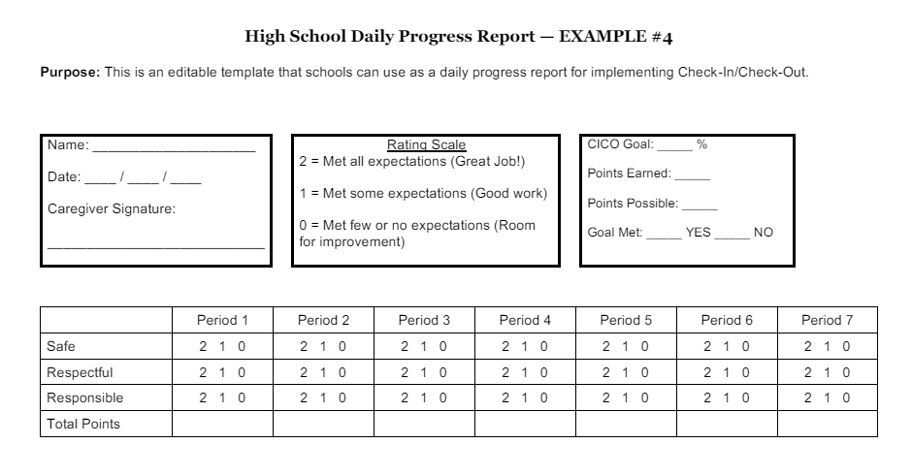
Creating a High School Daily Progress Report
High School Example
(Tennessee Tiered Supports Center, 2023, and Todd et al., 2008)​​
Notes:
Main Idea: This is an editable template that schools can use as a daily progress report for implementing Check-In/Check-Out

Slide 51
Data Management
Establish procedures for gathering and storing:
  completed Daily Progress Reports, and
  signed Home Communication Reports.
Establish procedures for logging a student’s:
  point goal,
  total points earned, and
  percentage of points earned.
Establish procedures for sharing data.
Assign roles and responsibilities.
(Tennessee Tiered Supports Center, 2023)​​
Notes:
Main Idea:
It is important to have a system and procedures in place for gathering, storing, and logging student data.
1. Establish procedures for gathering and storing:
completed Daily Progress Reports and
signed Home Communication Reports.
2. Establish procedures for logging a student’s:
point goal,
total points earned, and
percentage of points earned.
3. Assign roles and responsibilities for data collection.
Who will enter the data
How frequently will data be entered
How frequently will data be reviewed by the data team

Slide 52
Student Learning Goals
Topics to cover include:
  intervention purpose,
  check-in and check-out location,
  intervention materials and steps,
  behavior rating scale and daily point goal,
  caring for the Daily Progress Report,
  receiving teacher feedback,
  handling met and unmet point goals,
  reward preferences, and
  the Home Communication Report.
(Hawken et al., 2021)
Notes:
Main Idea: Train students on the intervention purpose and logistics. Students participating in Check-In/Check-Out should be trained in these different responsibilities before intervention begins.
1. Topics to cover include:
intervention purpose;
Students need to understand why they are in the Check-In/Check-Out intervention program and what the Check-In/Check-Out intervention program is meant to help them with
Students need to understand the goal for Check-In/Check-Out is to provide them with more frequent opportunities to review their progress and get feedback from their teachers on how well they are following school-wide behavior expectations
Students need to understand that when they are following the school-wide expectations then they will have access to rewards
behaviors supported by the intervention;
Students need to understand the reason they are in the Check-In/Check-Out program
Students need to understand the problem behaviors they engaged in that lead to them being placed in the Check-In/Check-Out intervention and what behaviors they will be taught to promote them meeting school-wide expectations
check-in and check-out location;
Students need to know when and where to go to complete their morning check-in and afternoon check-out
Students need to know alternative locations to go to if their mentor is unavailable
intervention materials and steps;
Students need to know what materials they will be using during the intervention (i.e, daily progress report, home communication report)
Students need to also know how to use the materials in the intervention
behavior rating scale and daily point goal;
Students need to be explicitly taught the behavior rating scale; what it is, how it works, and what the criteria for each point level is
Students need to understand their point goal, what happens when they meet their goal, what happens when they do not meet their goal
caring for the Daily Progress Report;
Since the daily progress report is the tool or mechanism that ensures the teachers and student are engaging and the student is getting access to adult attention and how they earn they points towards their reward, then students need to see the value in using the daily progress report, keeping up with the daily progress report, and giving the daily progress report to the teacher to initiate the feedback conference session
receiving teacher feedback;
Student needs to be taught how to receive the teacher feedback including positive feedback and constructive feedback
Student needs to be taught how to receive the constructive feedback in a socially appropriate manner
The student needs to be taught how to effectively response to the teacher’s feedback in a socially appropriate way
handling met and unmet point goals;
The student needs to be explicitly taught what they will do when they meet their point goal including how to receive their rewards
The student needs to be explicitly taught what they will do when they do not meet their point goal and how they will response to the mentor in a socially appropriate way
reward preferences; and
The student needs to know how to share their preferences for different rewards to their mentor while participating in the intervention
Surveys to gather students preferences for rewards are encouraged
Home Communication Form
The student needs to know that it is their responsibility to take the home communication report home and to show it to their parents
Once parents have seen and signed the home communication report the student should return it to school to their Check-In/Check-Out mentor

Slide 53
Informing Parents
Topics to cover include:
  intervention purpose,
  behaviors supported by the intervention,
  intervention materials and steps,
  how to provide feedback to the student,
  how to use home communication report, and
  how to monitor progress.
(Hawken et al., 2021)
Notes:
Main Idea: Train parents on the intervention purpose and logistics. Parents of students participating in Check-In/Check-Out should be trained in these different responsibilities before intervention begins.
Topics to cover include:
intervention purpose;
Parents need to understand why their child is in the Check-In/Check-Out intervention program and what the Check-In/Check-Out intervention program is meant to help them with
Parents need to understand the goal for Check-In/Check-Out is to provide their child with more frequent opportunities to review their progress and get feedback from their teachers on how well they are following school-wide behavior expectations
Parents need to understand that when their child are following the school-wide expectations then they will have access to rewards
behaviors supported by the intervention;
Parents need to understand the reason their child are in the Check-In/Check-Out program
Parents need to understand the problem behaviors their child engaged in that lead to them being placed in the Check-In/Check-Out intervention and what behaviors they will be taught to promote them meeting school-wide expectations
intervention materials and steps;
Parents need to know what materials their child will be using during the intervention (i.e, daily progress report, home communication report)
Parents need to also know how their child will use the materials in the intervention
how to provide feedback to the student based on the student’s performance in the intervention;
Parents need to be taught how to provide positive feedback to the students so they can provide the additional positive feedback with their child at home
How to use the Home Communication Form
The parent needs to know that it is their responsibility ask their student to view the home communication report, sign it, and give it back to their child to return to school
monitoring progress.
The parent needs to be taught how to check how the student is making progress in the Check-in/Check-Out intervention by seeing the home communication reports on a daily basis as well as interpreting the result of the progress reports on the student’s data for Check-In/Check-Out

Slide 54
Staff and Mentor Professional Learning
Topics to cover include:
  intervention purpose,
  behaviors the intervention is designed to target,
  intervention materials and steps,
  check-in and check-out location,
  completing the daily progress report,
  providing student feedback,
  providing rewards,
  managing student data, and
  communicating with parents.
(Hawken et al., 2021)
Notes:
Main Idea: Train staff and mentor on the intervention purpose and logistics. Check-In/Check-Out Mentors and staff should be trained in these different responsibilities before intervention begins.
1. Topics to cover include:
intervention purpose;
Sharing with staff the purpose of Check-In/Check-Out intervention as a Tier II intervention to support students who appear to engage in low-intensity behavior and respond well to attention from adults with the goal to help students meet the school-wide behavior expectations consistently
behaviors the intervention is designed to target;
Check-In/Check-Out is meant for students who engage in low-intensity behaviors, across different school settings, but the students are responsive to adult attention
intervention materials and steps;
Check-In/Check-Out includes various materials including daily progress report, home communication report, data tracking systems, and information package for students and parents
It is important that all staff and mentors are trained how to utilize these materials
check-in and check-out location; e
Staff and mentors should be trained where they will conduct the morning check-in and afternoon check-out, where to access the materials required of them when doing these checks with the student (i.e., where are the daily progress reports kept, extra pencils) and where students should go if that location is not an option or unavailable (back up location)
completing the daily progress report;
Staff need to know how to complete the daily progress report including what the behavior expectations are, what the ratings mean, and how frequently or when they are expected to do a feedback conference with the teacher throughout the day
providing student feedback;
Staff need to be trained how to provide both positive feedback and constructive feedback; this feedback should specifically share what behaviors the student did well or did not do well to earn them the ratings they received on the daily progress report, if the student receives constructive feedback it is also important to tell them what the expected behavior is so they can work to improve this behavior for next time
providing rewards;
Staff and mentors need to be trained on what the potential rewards for the student are, where or how to give them access to these rewards, and when is the appropriate to give access to the rewards.
Staff and mentors also need to be trained to pair the providing of the reward with the positive feedback to help the student connect the behaviors they engaged in and how that allowed the student to earn access to these rewards.
managing student data; and
Staff and mentors need to be trained to know how to total the daily progress reports points, calculate the total percentage, what they are supposed to do with the daily progress reports each day, and if or when they are supposed to log the student’s data to get an average and graphically represent the data so it can be reviewed by the Check-In/Check-Out Coordinator and data teams
communicating with parents.
Staff and mentors need to be trained to know how to explain the intervention to parents, how to complete the parent communication report for the student, and how to give additional feedback to parents when the student is either responding to the intervention positively or negatively
Don’t forget to “onboard” new students, families, and teachers or mentors when you add additional members throughout the school year

Slide 55
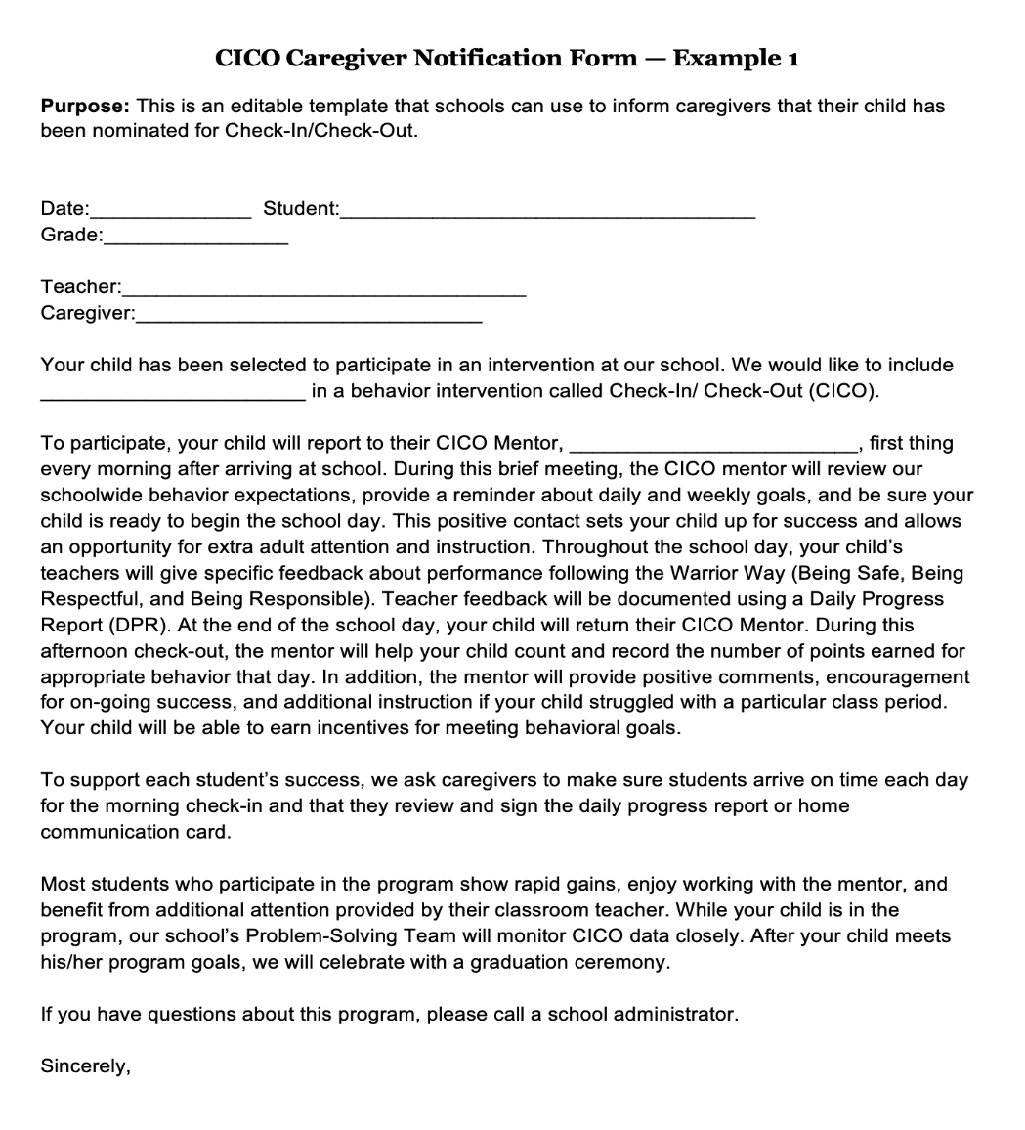
Parent Engagement
(Tennessee Tiered Supports Center, 2023)
Notes:
Main Idea: This is an example of a Parent Notification Form. Parent notification forms inform parents that their child has been nominated for the intervention. Discuss the components.

Slide 56
Resources

Slide 57
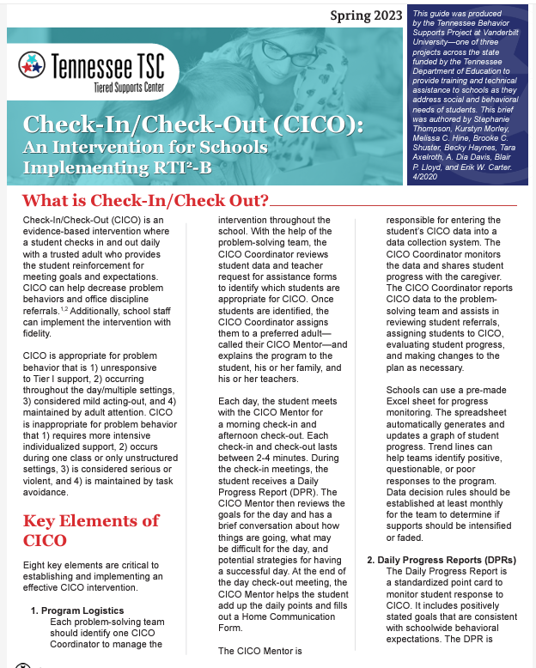

Check-In/ Check-Out Resources
Access Check-In/Check-Out Brief
Access Check-In/Check-out Implementation Materials.
(Tennessee Tiered Supports Center, 2023;
Tennessee Tiered Supports Center, 2024)
Notes:
Resources:
Check-in/Check-out Brief: https://tennesseetsc.org/wp-content/uploads/2024/04/Check-in-Check-Out-Brief.pdf_Comms-Approved_41124.pdf
2. Check-in/Check-out Implementation Materials: https://tennesseetsc.org/wp-content/uploads/2024/05/Check-In-Check-Out-Implementation-Materials_Comms-Approved_43024.pdf

Slide 58
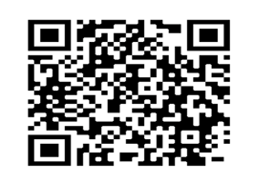
Connect With Us
To learn more about our services, connect with us on our website, through our newsletter, and on social media.
Website
Newsletter
Social Media
tennesseetsc.org
@tennesseetsc
Permission is granted to use and copy these materials for noncommercial educational purposes with attribution credit to the Tennessee Department of Education. If you wish to use these materials for reasons other than noncommercial educational purposes, please contact the Office of General Counsel at (615) 741-2921.

Slide 59
Thank you!
Questions?
Contact information
  East Tennessee: tennesseetsc@utk.edu
  Middle Tennessee: tennessseetsc@vanderbilt.edu
  West Tennessee: victoria.s.perry@vanderbilt.edu
Permission is granted to use and copy these materials for noncommercial educational purposes with attribution credit to the Tennessee Department of Education. If you wish to use these materials for reasons other than noncommercial educational purposes, please contact the Office of General Counsel at (615) 741-2921.

Slide 60
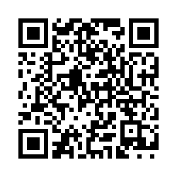

TN-TAN End-of-Session Survey (Full)
Please complete the evaluation survey using the following link or by scanning the QR code:
Open the TN-TAN End-of-Session Survey (https://tinyurl.com/3j4m7rb3).
Project provider: Tennessee TSC
Event title: CICO
Learning objectives:
Understand the importance of Tier I instruction and support and their relation to Tier II intervention.
Recognize the components of Check-In and Check-Out and conditions that make it effective as a Tier II intervention.
Understand the steps for setting up Check-In and Check-Out in your school.

Slide 61
References
CICO Slide Deck Reference List

Slide 62
References 1
Fuchs, L.S., Fuchs, D., & Malone, A.S. (2017). The taxonomy of intervention intensity. TEACHING Exceptional Children, 50(1), 35-43. DOI: 10.1177//0040059917703962
Hawken, L.S., Crone, D.A., Bundock, K., & Horner, R.H. (2021). Responding to problem behavior in schools: The check-in, check-out intervention (3rd ed.). The Guilford Press.
Hawken, L. S., & Horner, R. H. (2003). Evaluation of a targeted intervention within a schoolwide system of behavior support. Journal of Behavioral Education, 12(3), 225-240.
Kilgus, S., Klingbeil, D., & Porter, J. (2024). Integrating academics and social behavior interventions at Tier 2. In Sara C. McDaniel, Allison L. Bruhn, & Sara Estrapala (Eds.), Social, emotional, and behavioral supports in schools: Linking assessment to intervention (pp. 116-131). Guildford Press.
Majeika, C. E., Wehby, J. H., & Hancock, E. M. (2022). Are breaks better? A comparison of breaks are better to check-in check-out. Behavioral Disorders, 47(2), 118-133. https://doi.org/10.1177/01987429211001816

Slide 63
References 2
McDaniel, S. C., Bruhn, A. L., & Estrapala, S. (2024). Social, emotional, and behavioral supports in schools: Linking assessment to tier 2 intervention. Guilford Press.
Miller, L. M., Dufrene, B. A., Joe Olmi, D., Tingstrom, D., & Filce, H. (2015). Self-monitoring as a viable fading option in check-in/check-out. Journal of School Psychology, 53(2), 121–135. https://doi.org/10.1016/j.jsp.2014.12.004
National Center on Intensive Interventions at the American Institutes for Research. (2022, December). Levels of Intervention and Evidence: Tier 2 (Validated Intervention Program). https://intensiveintervention.org/tools-charts/levels-intervention-evidence
Tennessee Department of Education. (2022, April). General educator rubric: Planning. Tennessee Educator Acceleration Model (TEAM). https://team-tn.org/wp-content/uploads/2022/06/TEAM-General-Educator-Rubric.pdf

Slide 64
References 3
Tennessee Department of Education. (2023a, June). Tennessee instructional practice guide (IPG) K-12 knowledge building lessons checklist. https://bestforall.tnedu.gov/lessons-and-learning-item?content-id=4313
Tennessee Department of Education. (2023b, August). Response to instruction and intervention manual. https://www.tn.gov/content/dam/tn/education/special-education/rti/Updated_RTI2_Manual.pdf
Tennessee Department of Education. (2024, February). Data-based decision making in RTI²: Screening, identification, and service of students [PowerPoint slides].
Tennessee Tiered Supports Center. (n.d.a). Active supervision strategy check up. https://tennesseetsc.org/community-of-practice-supporting-resources/
Tennessee Tiered Supports Center. (n.d.b). Classroom routines and procedures checklist. https://tennesseetsc.org/community-of-practice-supporting-resources/

Slide 65
References 4
Tennessee Tiered Supports Center. (n.d.c). Precorrection checklist. https://tennesseetsc.org/community-of-practice-supporting-resources/
Tennessee Tiered Supports Center. (n.d.d). School implementation fidelity assessment. https://tennesseetsc.org/wp-content/uploads/2024/06/School-Implementation-Fidelity-Assessment_September-2024_FINAL.pdf
Tennessee Tiered Supports Center. (2023). Check-in/check-out: An intervention for schools implementing RTI2-B. Retrieved from: tennesseetsc.org.
Tennessee Tiered Supports Center. (2024). Check-in/Check-Out: Implementation Materials. Vanderbilt University, Nashville, TN. Retrieved from: tennesseetsc.org.

Slide 66
References 5
Todd, A. W., Campbell, A. L., Meyer, G. G., & Horner, R. H. (2008). The effects of a targeted intervention to reduce problem behaviors: Elementary school implementation of check in—check out. Journal of Positive Behavior Interventions, 10(1), 46-55. https://doi.org/10.1177/1098300707311369
U.S. Office of Special Education Programs. (2015). Supporting and responding to behavior: Evidence-based classroom strategies for teachers. https://osepideasthatwork.org/supporting-and-responding-behavior-evidence-based-classroom-strategies-teachers
U.S. Department of Education. (2004). Individuals with disabilities education act. Public Law 108-446. https://www.congress.gov/bill/108th-congress/house-bill/1350/text

