Slide 1
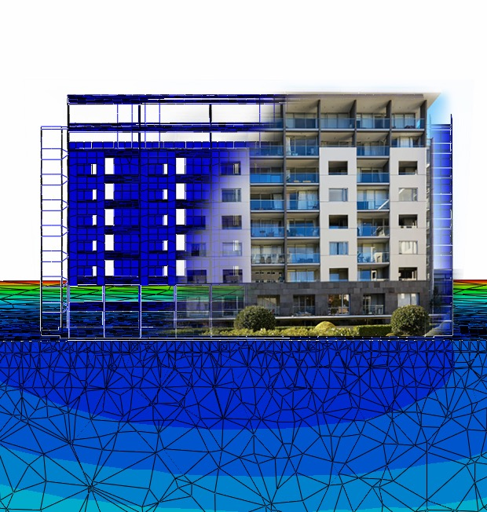
Soil-Structure Interaction (SSI) Analysis
Miyamoto New Zealand

Slide 2
Why SSI?
Improved Structural Safety and Performance
SSI analysis helps in understanding how a structure interacts with the surrounding soil, leading to designs that can better withstand seismic and other dynamic loads. This can prevent structural failures and enhance the overall safety and longevity of the structure.
Tailored Solutions
SSI analysis allows for the design of foundations and structural systems that are tailored to the specific soil conditions of a site. This can be particularly beneficial in areas with challenging soil conditions, such as soft clay, liquefiable soils, or highly variable soil profiles.
By accurately modeling the behavior of the soil-structure system, engineers can optimize the design to use materials and resources more efficiently, potentially reducing construction and maintenance costs without compromising safety
Cost Efficiency
Understanding the interaction between the soil and the structure can help in identifying and managing risks associated with soil settlement, liquefaction potential, slope stability, and other geotechnical hazards, thereby reducing the likelihood of unexpected issues during and after construction.
Risk Management
Enhanced Predictive Accuracy
Incorporating the dynamic interaction between the soil and the structure into the analysis can lead to more accurate predictions of structural responses to different loads. This includes better assessments of displacements, stresses, and forces that the structure and foundation are subjected to during events like earthquakes.
Optimization of Foundation Design
SSI analysis can lead to more efficient foundation designs by accurately determining the best type of foundation system (shallow vs. deep) and its dimensions based on the soil-structure interaction, thus avoiding overdesign or underdesign.

Slide 3
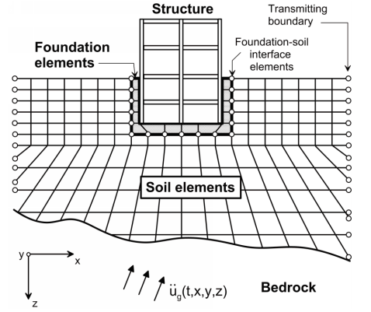
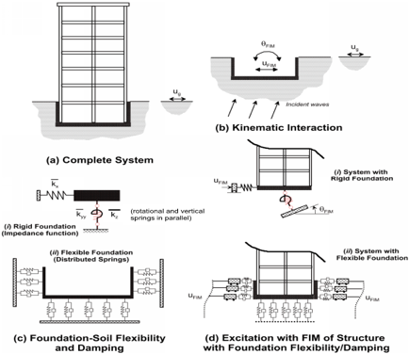
Different SSI Analysis
Substructure Approach
Direct Analysis
In Direct Analysis, the soil is often represented as a continuum (e.g., finite elements) along with foundation and structural elements, transmitting boundaries at the limits of the soil mesh, and interface elements at the edges of the foundation
In Substructure Approach, the total system is divided into two main components: the superstructure (above ground) and the substructure (foundation and soil).

Slide 4
Limitations
Substructure Approach
SOLVED
Direct Analysis
  The Characteristics of Springs and Dashpots
    These parameters are external parameters influenced by various factors rather than inherent soil properties
  Distribution of Spring and Dashpots
    the stiffness of the superstructure can alter spring and dashpot distribution, significantly impacting outcomes
  Modelling Structure in FEM software
    FEM programs aren't inherently streamlined for easy modeling of structures
  Modelling Far Field condition
    For far-field conditions, selecting proper boundaries is crucial
  Post-Processing
    FEM tools may not be ideal for checking or designing structural components during post-processing

Slide 5
How Solved?
Using ABAQUS
  Abaqus FEA (formerly ABAQUS) is a software suite for finite element analysis and computer-aided engineering, originally released in 1978.
  The Abaqus products use the open-source scripting language Python for scripting and customization.
  Abaqus offers robust capabilities for modeling contact interactions, including those that allow for separation which is essential for modelling rocking.
ETABS to ABAQUS converter
  M. Kamali developed a Python code enabling the simulation of structures in ABAQUS that were initially modeled in ETABS, addressing the challenges of structural modeling in ABAQUS.
  By incorporating the actual soil conditions under the structure, this approach provides a comprehensive soil-structure model.
Simulating Free-Field boundary Conditions
  Utilizing a User Element (UEL) subroutine developed externally, a free-field boundary is established, serving three key purposes:
  simulating the static and dynamic behavior of a free field
  transforming elastic stresses into surface tractions on the model's adjacent face
  creating an absorbing boundary for seismic waves within the model
Post Processing
  Post-processing for general conditions, like soil and rocking conditions, is performed using ABAQUS post-processing tools
  For structural elements, ETABS or similar structural analysis software is used, refined with data derived from ABAQUS simulations

Slide 6

ETABS to ABAQUS Converter

Slide 7
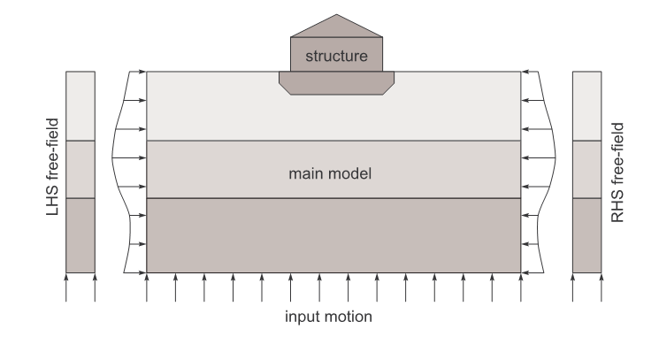
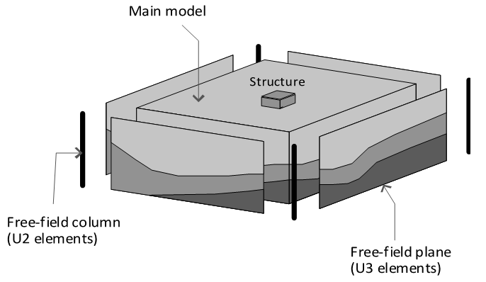
Free-field boundary condition
Absorbing boundary conditions are required to simulate seismic wave propagation in elastic media.
In dynamic problems, fixed boundary conditions cause the reflection of outward propagating waves, effectively trapping energy inside the model.
We use developed “user element subroutine” by Andreas H. Nielsen
For further information see “Absorbing Boundary Conditions for Seismic Analysis in ABAQUS, Andreas H. Nielsen, 2006 ABAQUS Users’ Conference”

Slide 8
Process-Time History Analysis
  Structure would model and design initially in ETABS or other structural software
  Structure would transfer to ABAQUS by specified code developed by M. Kamali
Modelling Structure in ETABS
Transferring Structure to ABAQUS
SSI Analysis in ABAQUS & Refine ETABS
Comparing Structure Response
  Soil media which verified by other methods would be added beneath structure, free-field boundary would be defined, selected ground acceleration would be inserted to the base of the model, and it would run.
  Based on the general behaviour of model, the model on ETABS and spring and dashpots would be refined
  Natural frequency would be extracted in both model with assumption of fixed based to check the structure model in ABAQUS

Slide 9
Process-Pseudo Static Analysis
Dividing Foundation to small sub-areas in ETABS
Transferring whole or part of structure to ABAQUS (without loads) and put it on Soil
Specifying initial Ks to each sub-areas in ETABS
Running ETABS model and extracting columns and walls reactions on foundation
Applying extracted forces from ETABS to ABAQUS
Running ABAQUS model and extracting average soil pressure and settlement in each sub-areas and calculating their equivalent Ks
Revising calculated Ks in each sub-area in ETABS
Continue 4 to 7 until convergence of results
PYTHON CONTROL CENTER
Transfer data between software
Revise models in software
Run and Extract Data on Software
Continue until Result Convergence
ETABS
Revise Ks
Run Model
Read New Loads
ABAQUS
Revise Loads
Run Model
Read New Ks

Slide 10

Case Study-Sanctum Apartment
Existing Building in Wellington
Time History SSI Analysis
Rocking Problem
Checked on 6 modified ground motion for Wellington

Slide 11
Case Study-Garrett Street
Seismic Strengthening and adding new storey
Optimising piles
Extracting shears and moments on piles

Slide 12
Case Study-MK House
Seismic Strengthening of 27 storey building
Nonlinear Time History Analysis
By determining of distribution of soil subgrade reaction modulus, strengthening to the foundation has been eliminated

Slide 13
Case Study-Waste Water Treatment plant
Optimising the foundation design and number of piles using SSI
Original Pile Depth: 30m
Optimised Depth: 16m

Slide 14
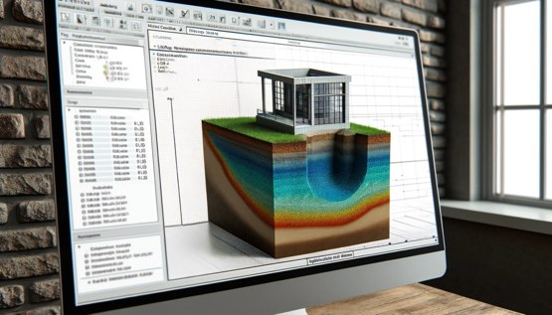
Future Directions: Modelling Liquefaction in SSI Analysis
Expanding the Horizon of SSI with Advanced Liquefaction Modeling
  Our next ambitious milestone aims to integrate dynamic soil constitutive models into ABAQUS, enhancing our approach to liquefaction analysis. Current methods predominantly serve as indicators for the likelihood of liquefaction occurrence; however, they often overlook the residual strength of soil post-liquefaction.
Bridging the Gap with Comprehensive Modeling
  We are developing methodologies to not only predict the onset of liquefaction but also to accurately simulate its aftermath on soil behavior. This involves:
    Considering the Residual Soil Strength
    Localized Liquefaction Effects
    Interaction with Structural Stiffness

