Slide 1











Notes:
Heading font is DynaPuff, which you can download here if you would like to edit these slides.

Slide 2







Students analyse how the media they take in shapes their understandings of gender, sexuality and beyond.
Students identify and explain the implicit and explicit messages they learn from the media they consume.
Students describe how media algorithms work and how that impacts what they see.

Slide 3

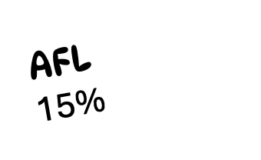

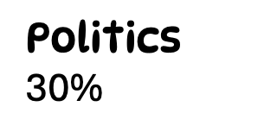





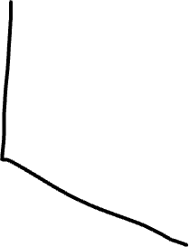

Reality TV
15%

Slide 4


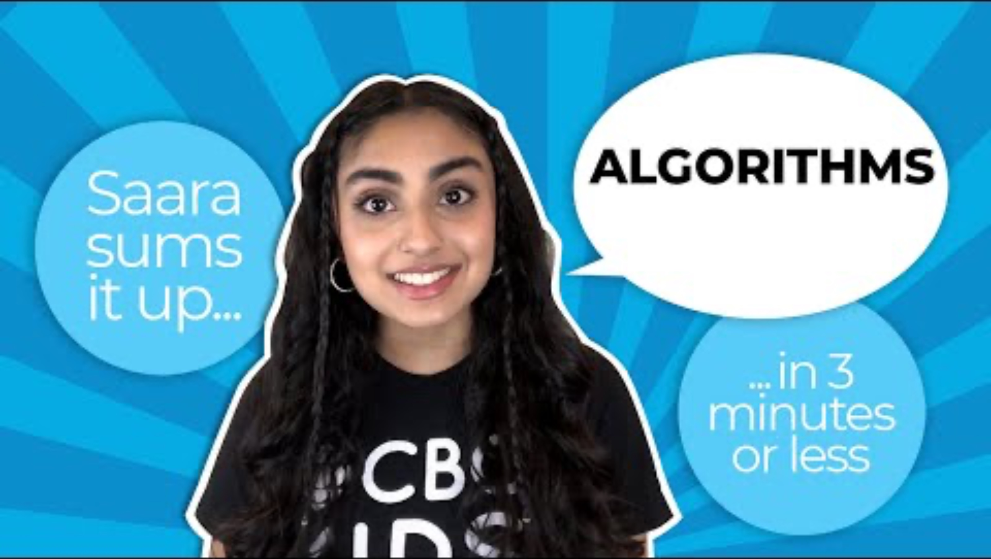



CBC Kids News. (2021). Social media algorithms explained [Video]. https://www.youtube.com/watch?v=F5tz887wXCY

