Slide 1











Notes:
Heading font is DynaPuff, which you can download here if you would like to edit these slides.

Slide 2







Students learn how subtle actions can impact LGBTQ+ people and why they are more vulnerable to these.
Students can identify simple and subtle ways to make LGBTQ+ people feel safe and welcome.
Students can identify language and actions that make LGBTQ+ people feel ‘othered’.

Slide 3




Small things that we do or say, whether it’s making a face, raising an eyebrow, or saying something small to communicate how we feel. These can be positive, negative or totally neutral.

Slide 4


Small things that we do or say, whether it’s making a face, raising an eyebrow, or saying something small to communicate how we feel. These can be positive, negative or totally neutral.
Types of everyday discrimination that are typically subtle or disguised and often done unintentionally. They exclude people, making them feel like they are ‘othered’ and like they don’t belong.

Slide 5


Small things that we do or say, whether it’s making a face, raising an eyebrow, or saying something small to communicate how we feel. These can be positive, negative or totally neutral.
Types of everyday discrimination that are typically subtle or disguised and often done unintentionally. They exclude people, making them feel like they are ‘othered’ and like they don’t belong.
Subtle behaviours or phrases which are acts of inclusion and respect. They may be conscious or unconscious decisions.

Slide 6


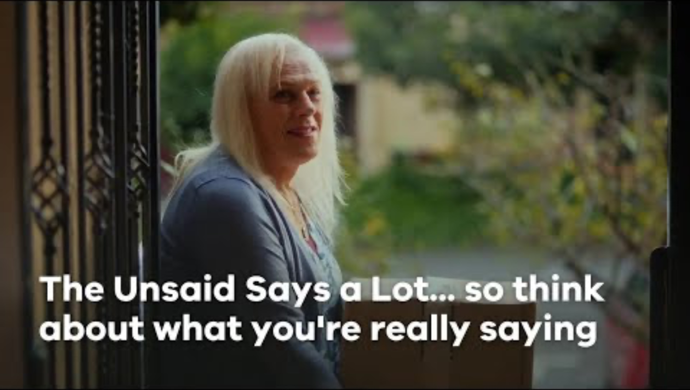

Victorian State Government. (2024). The unsaid says a lot [Video]. https://youtu.be/HV-C-8Ev62c

