Slide 1
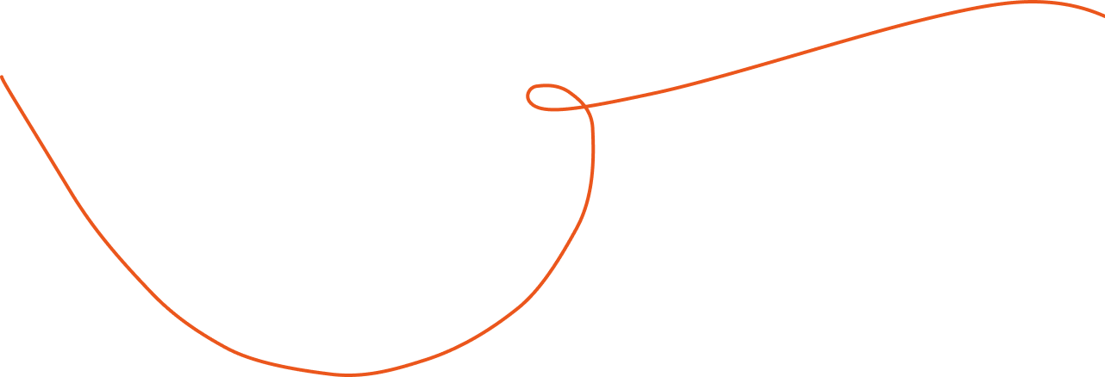
Notes:
Heading font is DynaPuff, which you can download here if you would like to edit these slides.

Slide 2
Students investigate their own and others’ virtual schoolbags to understand the different things they bring to conservations about gender and sexuality.
Students can describe their virtual schoolbags and explain why it matters to understand what they and others bring to school.

Slide 3
Imagine two children about to start school. They are both five years old and are eagerly anticipating their first day. Imagine that each brings with them to school a virtual schoolbag full of things they have already learned at home, with their friends, and in and from the world in which they live. The first child is a boy called Thanh. He lives in an extended family where he has been chatted and read to in Vietnamese and Chinese since he was very small. He has watched Australian television, visited shopping centres, and worked with his family in its restaurant—doing small tasks like collecting dishes, giving out menus and change, and washing vegetables. His parents spent much of their married adult lives in separate refugee camps and were not reunited until they got to Australia.
Excerpt from Thomson, P. (2002). Schooling the rust belt kids: Making the difference in changing times. Allen & Unwin.

Slide 4
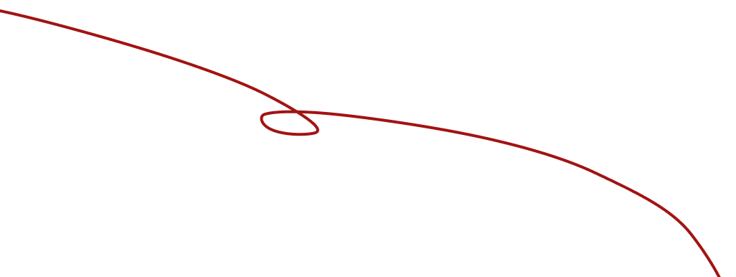
Thanh’s father carried a nguyet (a guitar-like instrument) with him on the long walk from the town where he was born to the camp in Thailand and kept it safe until he reached his new home in Australia. When he is not too tired he plays it, and Thanh loves to listen to the traditional songs handed down through the generations. He also loves to hear his older brother and sister talk about school. His parents’ formal education was disrupted by the civil war, but both of them are literate in two languages and treasure books. They have worked long hours and several jobs to finally open, with the help of the hui (the community financial system), the restaurant where they now work most days and nights. Thanh comes to school with three spoken languages in his virtual schoolbag, a love of music, an understanding of the restaurant trade, a capacity to get on with a wide range of people, knowledge about Vietnam, China, Thailand, and Australia, and an understanding that school is important.
Excerpt from Thomson, P. (2002). Schooling the rust belt kids: Making the difference in changing times. Allen & Unwin.

Slide 5
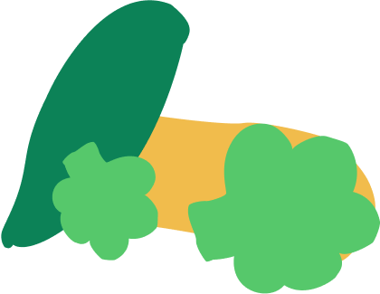
The second child is Vicki. Her parents are both university educated and Vicki’s mother runs a small catering business at home, supplying gourmet cakes to cafes. Her father is a teacher at the local high school and is currently researching his Irish family heritage. She is the oldest child and has one younger brother. Vicki has been to both childcare and preschool and has already begun to read, much to her parents’ delight. Vicki loves to help her mother and regularly plays on the family computer with the database of recipes, customers, and accounts. Vicki also has a small dog and her current ambition is to be a vet.
Excerpt from Thomson, P. (2002). Schooling the rust belt kids: Making the difference in changing times. Allen & Unwin.

Slide 6
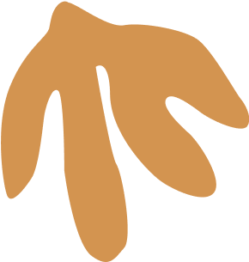
She watches a lot of television and can sing along with all of the advertisements, much to her father’s disquiet. She loves being read to at night and knows that her parents expect her to join in and comment on the connections between the illustrations and the story. She knows that when she is read to, she is expected to sit still and listen. Vicki’s schoolbag consists of spoken and written English, well schooled reading behaviours, knowledge about the white colonial history of Australia, and understandings about popular culture, animals, business, and the computer. Both children’s schoolbags contain roughly equal but different knowledges, narratives, and interests.
Excerpt from Thomson, P. (2002). Schooling the rust belt kids: Making the difference in changing times. Allen & Unwin.

Slide 7
