Slide 1


Slide 2
A collaboration….

Slide 3
“Surgery doesn’t worry me. I’m nervous about how much it is going to change my life . . . I just keep saying lifetime, lifetime, it’s a lifetime… You’ve got to tell yourself that this is it”
Patient participant from CM Health on getting psychologically prepared for bariatric surgery

Slide 4
Context
Over the past three decades rates of obesity have been increasing in New Zealand across all age groups (Ministry of Health, 2015a).
Rates of obesity vary starkly between ethnic groups and are the highest among Pacific adults, with 61 per cent of males and 68 per cent of females obese (Ministry of Health, 2015a).
Bariatric surgery is an elective surgery which is offered in New Zealand as a tool for weight loss (Health Navigator NZ, 2017). There is a high demand for bariatric surgery in New Zealand.
Improving health literacy and whānau participation is critical for improving equity of access and equity of outcome for bariatric surgery.

Slide 5
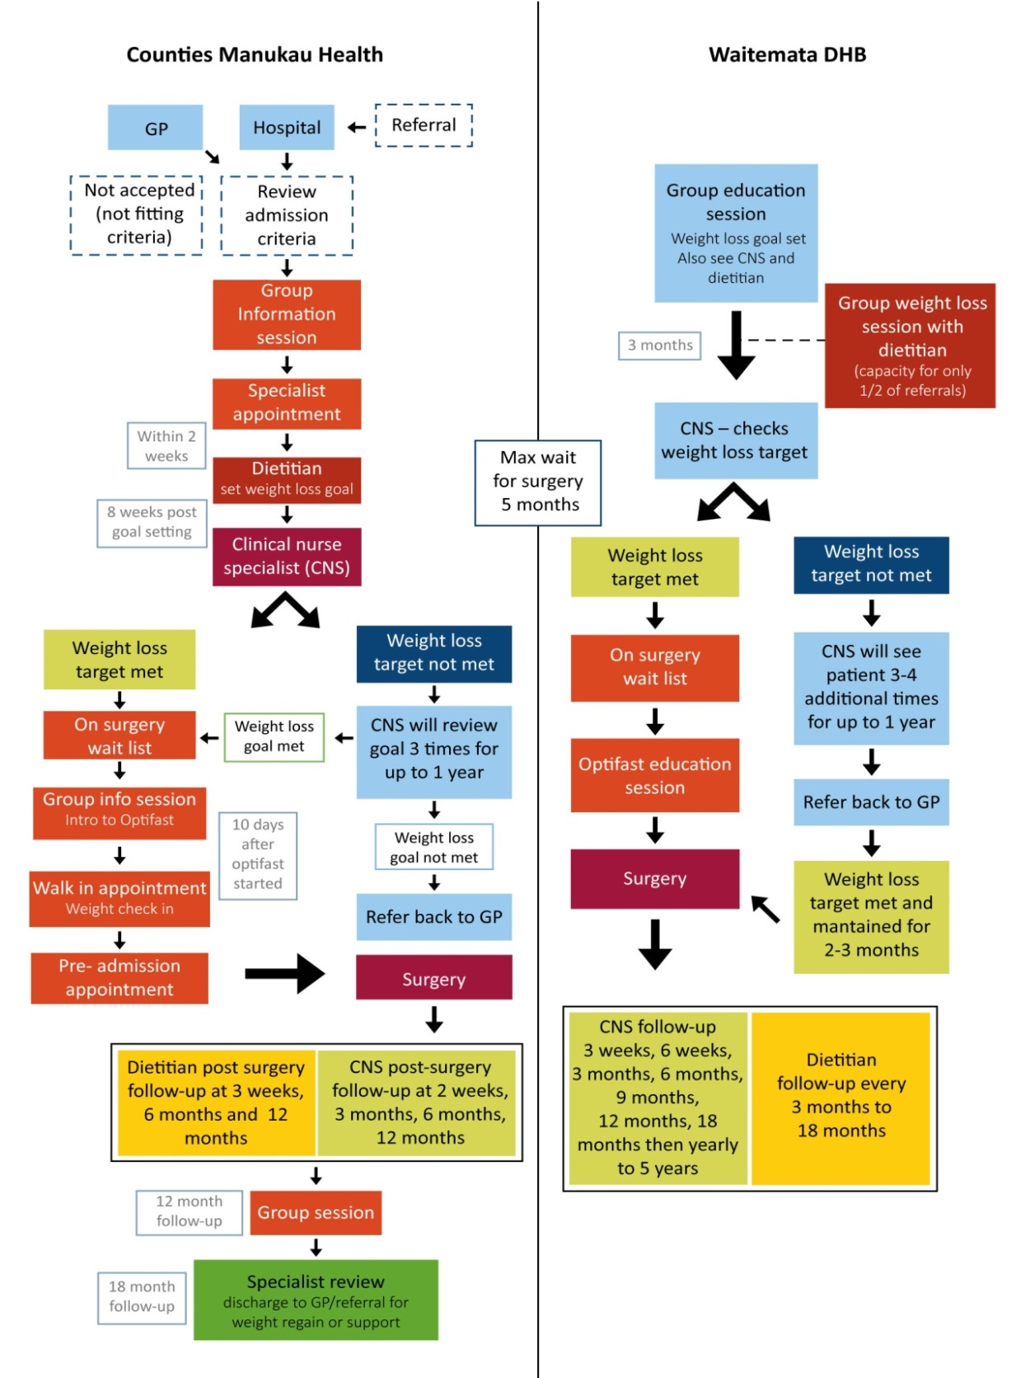
Notes:
The pathway for patients to become eligible for bariatric surgery can take up to 18 months. It requires a commitment to weight loss by the patient and a range of health and psychological assessments and supports.
Health literacy demands.

Slide 6

He Awatea Hou: ‘a new dawn’
Navigation support for the whole whānau.
The aim of the programme is to support health literacy for patients and their whānau. Also support service change.
Goal setting at home, going to the supermarket together, advocating to clinical staff where needed, supporting whānau understanding, linking with other services, attending clinical appointments, translating medical information.

Slide 7
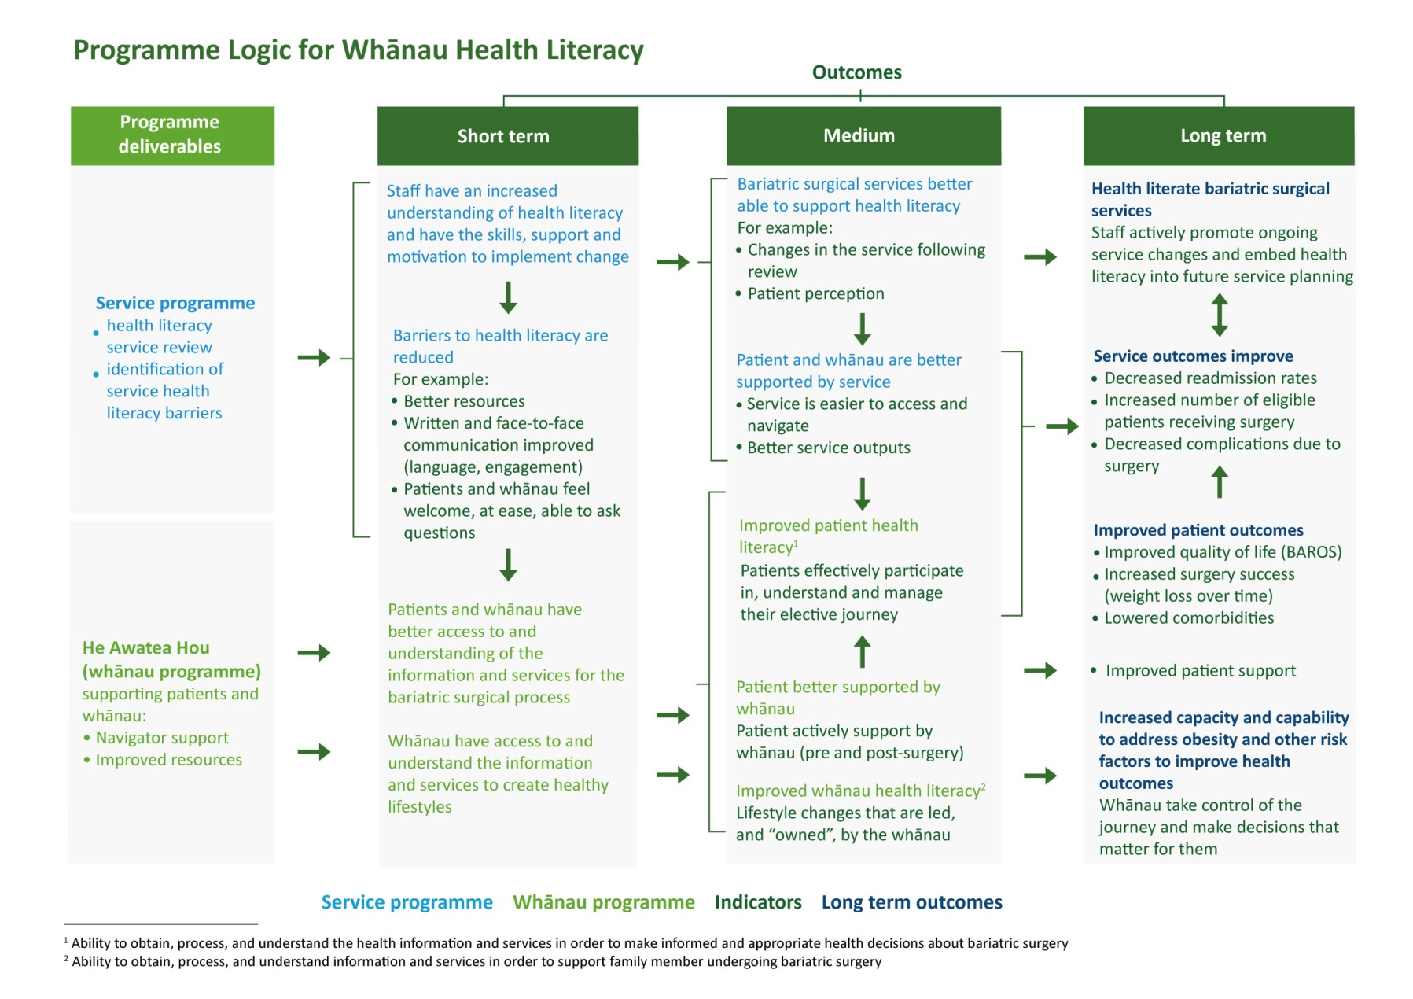

Slide 8
Evaluation focus
This evaluation aimed to determine the effectiveness of the whānau health literacy pilot project by measuring changes to:
Patient health literacy and health outcomes.
Whānau health literacy, including:
  ability to support the family member undergoing surgery.
  ability to make lifestyle changes that are led and owned by the family.
Delivery of services (bariatric surgery) at Middlemore and North Shore Hospitals.

Slide 9
Evaluation participants
In total, 65 participant consented to participate in the evaluation; 33 in the comparison group, and 32 who were supported by Navigators.
Comparison group participants (N=32, 14 CMH and 18 Waitemata)
Age group |  | Sex, N / % (0 d. p.) |  | Ethnicity N / % (0 d.p.)
0 – 25 years | 2/ 6% | Female | 21/ 66% | Maori | 8/ 25%
26 – 45 years | 18/ 56% | Male | 11/ 34% | Pacific Island | 5/ 16%
46 – 65 years | 12/ 38% |  |  | European | 13/ 41%
65 + | 0 |  |  | Asian | 0/ 0%
Unknown | 0 |  |  | Not stated | 1/ 3%
 |  |  |  | Other | 5/ 16%
Intervention group participants (N=29, 18 CMH and 11 Waitemata)
Age group |  | Sex, N / % (0 d. p.) |  | Ethnicity
0 – 25 years | 1/ 3% | Female | 18/ 62% | Maori | 14/ 48%
26 – 45 years | 15/ 52% | Male | 11/ 38% | Pacific Island | 7/ 24%
46 – 65 years | 12/ 41% |  |  | European | 6/ 21%
65 + | 0 |  |  | Asian | 1/ 3%
Unknown | 1/ 3% |  |  | Not stated | 0/ 0%
 |  |  |  | Other | 1/ 3%
Five participants were excluded from the clinical indicator analysis as their NHI’s or other personal information was not able to be matched and validated with clinical records accessible to analysts at each DHB.

Slide 10
Participation in evaluation activities
 | POC1 | POC2 | POC3 | Whānau interview
Comparison group participants (N=33) | 33 interviews and 32 POC1 surveys completed | 25 interviews and 22 POC2 surveys completed | 16 interviews and 14 POC3 surveys completed | 4 interviews and 4 surveys completed
Intervention group participants (N=32) | 23 interviews and 20 POC1 surveys completed | 16 interviews and 18 POC surveys completed | 8 interviews and 3 POC3 surveys completed | 3 interviews and 3 surveys completed
Total | 56 interviews and 52 POC1 surveys | 41 interviews and 40 POC2 surveys | 24 interviews and 17 completed POC3 surveys | 7 completed whānau interviews and surveys
Notes:
128 interviews and 116 surveys.

Slide 11
CM Health findings: clinical indicators
Indicator | Result
Achieving bariatric surgery between June 2016 to July 5th 2017 | 56% of intervention got surgery and 43% of the comparison group (this difference is not statistically significant OR 0.76 (95% CI 0.23-2.5), p=0.65
Time to theatre from first contact date to the operated date, in days | Average time to theatre was 213.5 days (range 157.7-291.7) in the intervention group, and 310.8 days in the comparison group (range 214-433.7). This difference was statistically significant (p=0.01166).
Length of stay (LOS) after surgery | LOS was shorter in intervention group (1.9 days mean, range 1.19-2.3) compared to control group (2.43 mean, range 1.19-2.33).
30 day readmission after surgery | 30 day readmission after surgery was double in the comparison group than the intervention (43% versus 22%). This difference is not statistically significant OR=2.1 (95%CI 0.50-8.75) p=0.30
Readmission length of stay (LOS) | LOS for readmissions was less than half in the intervention group at 3.1 days on average for the intervention group (range 2.1-4.2) and 7.9 days on average in the comparison group (range 0.2-38.8). This result was statistically significant (p<0.0001).
30 day readmission after last outpatient (OP) clinic | 30 day readmission after last OP clinic was higher in the comparison group than the intervention (57% versus 44%, this difference is not statistically significant OR=1.24 (95%CI 0.39-3.97), p=0.71
LOS for readmissions following OP clinic | The LOS was halved in the intervention group (3.01 days on average, range 0.4-5.0) when compared to the comparison group (6.35 days on average, range 0.8-32.8). This result was statistically significant (p<0.0001).
Mental Health Service admissions | No patients (including comparison and intervention groups) were admitted to Mental Health services within a year after surgery. Note that it has not been a year since surgery for all patients.
Did Not Attend rate (DNA) | Patient DNA rate was lower in the intervention group (0.67 appointments per patient on average) when compared with the control group (0.86 appointments per patient on average).
Mortality | There were no patient deaths in the study group.
Notes:
time to theatre (from initial seminar or information session to operation day), with intervention group participants reaching theatre sooner than comparison group participants (p= 0.01166).
readmission length of stay (LOS) was shorter (less than half) for readmissions to hospital within 30 days of their operation for intervention group participants (p<0.0001).
AND ALSO
LOS for readmissions following patients’ last outpatient clinic was shorter (less than half) for intervention group participants (t=4.68, p<0.0001).

Slide 12
Waitemata DHB: clinical indicators
Indicator | Result
Achieving bariatric surgery between June 2016 to July 5th 2017 | 28% of the intervention and 71% of the comparison group achieved surgery OR=2.44 (95%CI 0.56-10.64) (this difference is not statistically significant p=0.23)
Time to theatre from first contact date to the operated date, in days | Average time to theatre was 353 days intervention group who received surgery (N=4, range 177-457) and 278 days in the comparison group (N=10, range 128-421).
Length of stay (LOS) after surgery | Average LOS was shorter in the intervention group (2.75 days mean, range 2-5) and 3.1 days in the comparison group (range 2-5).
30 day readmission after surgery | There were no readmissions within thirty days of surgery in the intervention group and only one (5.5%) in the comparison group.
Readmission length of stay (LOS) | NA
30 day readmission after last outpatient (OP) clinic | There were no readmissions for Waitemata patients.
LOS for readmissions following OP clinic | There were no readmissions following the last OP clinic at Waitemata.
Mental Health Service admissions | No patients (including comparison and intervention groups) were admitted to Mental Health services within a year after surgery. Note that it has not been a year since surgery for all patients.
Did Not Attend rate (DNA) | Patient DNA was lower in the comparison group (0.3 appointments per patient on average) than in the intervention group (0.43 appointments on average).
Mortality | There were no patient deaths in the study group.

Slide 13
Whānau indicators
Although they did not reach statistical significance, whānau supported by navigators indicated moderate to large improvement on the following indicators:
finding the doctors and nurses friendly and welcoming (d= .5)
feeling well informed (d= .5)
feeling helpful supporting their whānau to reach their pre-surgery goals (d= .5)
taking care of their whānau following surgery (d= 0.67).
pre-surgery preparation support from patients ‘brothers and sisters’ (d = .69), ‘other people in my household’ (d = .65), ‘other’ supports (d = 1.37).
post-surgery supports, including ‘my partners parents’ (d = -.54), the ‘dietitian’ (d = -.79), and ‘my brothers or sisters’ (d= .96)
Notes:
A large effect size which favoured the comparison group was also calculated for ‘my children’ and ‘my partner’ both pre and post surgery, perhaps resulting from the introduction of navigator support which reportedly reduced burden of care on family or whānau.

Slide 14
Navigator support
Accountability
Holistic support
Manākitanga
Information and resources
In completed support scales patients rated Navigators as “very helpful” both pre (4.0 average on a 1-5 point scale) and post (4.38 average) surgery
Notes:
Overall, high degree of patient or consumer acceptability of navigator support.
Overall, feedback about Navigator was largely positive, and intervention group participants expressed a lot of gratitude for the support provided by the Navigator they worked with. In completed support scales patients rated Navigators as “very helpful” both pre (4.0 average on a 1-5 point scale) and post (4.38 average) surgery (Figure 8).
Accountability for behaviour change “keeping me on track”. Checking in, monitoring, being that person who kept them honest (important as the pathway could be quite isolated at times).
- Holistic support: someone to explore the medical, psychological and social aspects of the bariatric pathway with patients, family and whaanau they supported (POD from support that the clinical teams provide, and also in the context of their daily lives environments at home).
Manakitanga: having someone else who really cared made them feel good. Not used to putting themselves first so this was important.
Information and resources:

Slide 15
“I’ve found the Fono service really helpful. I’m reminded, I’m prompted and just knowing someone’s there who really understands. My family is awesome but they don’t understand what this is all about. There are things as a mother and a wife you don’t want to share with your family due to them worrying so having Fono around me as a support and being part of my journey is awesome because 1. They understand and 2. They’re there to encourage me” Patient participant on Navigator support from The Fono
“I can’t think what bariatric surgery would be like without your help. We’d probably be lost ae. Without any other help we’d be lost. . . I don’t think there is more you could have done [to help]” Whānau participant, on Navigator support from The Fono

Slide 16
Qualitative findings: 126 interviews
Key theme one: ‘The psychological journey is a central part of the bariatric experience’
Key theme two: ‘The journey is largely self and whānau directed’

Slide 17
Qualitative findings
‘The psychological journey is a central part of the bariatric experience’
“Getting in the right mindset”
Coping and support seeking, ability to understand health information, new (or renewed identity), relationships with food.
Gaps in bariatric pathway support
Notes:
A few teaspoons of yoghurt a day
A key theme in the kōrero of all evaluation participants was an emphasis on the mental aspects of both preparing for and recovering from bariatric surgery.
THIS was central: an important part of our discussion.

Slide 18
“It’s your head. Your head has to be in the right place and you can have a million support workers, you can have millions of dollars but if your head is not in the right place you’re not going to do it. . . It’s a huge part of it and I think that’s why people end up failing at the other end. You have to be mentally prepared and you have to have the focus of why you want to do it and what you expect to get out of it and your long-term goals. I wasn’t ready for any of that before but I am now.” Patient participant from Waitemata DHB

Slide 19
“I think the fact that we’re forced to sit back and finally look after ourselves and think of ourselves first and that’s part of the stuff I don’t think she was clear about. Because for some reason, particularly for instance a Pacifica Mum, I’m sorry but her whole role is to look after everyone else, that’s what everyone expects of her and to suddenly say to be selfish about this or whatever is probably quite, almost offensive in some ways. And yet at the same time they’re in this state because they haven’t been able to look after themselves and they’re not able to so you’re asking them to do something they technically don’t feel they can..” Patient participant from Waitemata DHB

Slide 20
Qualitative findings
‘The psychological journey is a central part of the bariatric experience’
Gaps in bariatric support
The role of whānau support
Evaluation findings emphasise that it is essential to prepare participants for the psychological (ie. emotional and social) impact of bariatric surgery, and the extensive level of self and whānau-directed care that is needed on the bariatric pathway.
Notes:
Evaluation findings emphasise that it is essential to prepare participants for the psychological (ie. emotional and social) impact of bariatric surgery, and the extensive level of self and whānau-directed care that is needed on the bariatric pathway.

Slide 21
Qualitative findings: 126 interviews
Key theme two: ‘The journey is largely self and whānau directed’
 | Minimum duration from seminar to date of surgery | Maximum duration from seminar to date of surgery | Total average
CM Health | 157.72 days, 13 attended appointments; average 11.26 days between appointments | 433.73 days, 15 attended appointments; average 27.10 days between appointments | 256.74 days, 9.5 attended appointments; 24.45 days between appointments
Waitemata DHB | 128 days, 12 attended appointments; average 9.8 days between appointments | 457 days, 10 attended appointments; average 41 days between appointments | 269.64 days, 10.21 attended appointments; 26.39 days between appointments

Slide 22
Qualitative findings: 126 interviews
Key theme two: ‘The journey is largely self and whānau directed’
Limited opportunities to connect and network with others on the bariatric pathway
Information and support seeking
Decision making

Slide 23
“I went to the seminar last year and then I sort of got left for a month or two where I didn’t know what was happening” Patient participant from CM Health
“. . . When I went to my most recent appointment the surgeon asked how I even got to this stage without attending a nutrition seminar or seeing a nutritionist or a dietician. I just said I wasn’t aware that was something that was to be done. I was actually quite in the dark about it and wasn’t sure how to go about finding that information apart from just going and seeing another nutritionist that’s not affiliated” Patient participant from Waitemata DHB

Slide 24
Service trends (1)
Did not attend (DNA) rates per patient for appointments on the bariatric pathway have decreased at both DHBs over time

Slide 25
Service trends (2)
Increasing referrals at both DHBs.
Proportion of referred patients who achieve bariatric surgery has decreased at both DHBs
Average LOS per patient that underwent bariatric surgery has decreased at Waitemata every year since 2013 from an average of 3.6 days (2013) to 1.09 days (2016)
At CMH the LOS was highest in 2013 at 2.33 days and has since decreased to 1.79 days in 2016
Readmission LOS has also decreased at both DHBs

Slide 26
Becoming a health literate service
Health literacy review
Action Plan development
Action Plan adoption
Notes:
The aim of the service programme was to identify barriers to health literacy, formulate actions to address the barriers and support the services to address these barriers. Barriers to health literacy are the social and organisational factors which impact on a person’s capacity “to find, interpret and use information and health services to make effective decisions for health and wellbeing” (Ministry of Health, 2015, p.1).
The CM Health review was undertaken in July – October 2015, and the WDHB review was undertaken August – December 2015.
The barriers identified across the two DHBs were similar:
Health literacy is not understood and therefore undervalesd by some staff
Understanding and use of the universal precautions approach to build patient health literacy is low amongst staff
There are few formal policies or processes focused on health literacy
There are limited opportunities patient and whānau involvement in the design and delivery of bariatric surgical services
Patients identified gaps in support on the bariatric pathway
Not all patients were able to access the support they needed from the service or their family to achieve successful outcomes
The quality (actionability and readability) of written resources varied greatly
Effective communication strategies were not consistently utilised by all health professionals.

Slide 27
Action undertaken
A small number of interventions identified within the Action Plan were actioned by members of the PSGs at both DHBs. PSG members implemented the interventions that were directly within their control and those they had the power, knowledge and skills to address. Other actions that were arguably more important were not implemented.
Notes:
CM Health made changes to the chairs removing the fold down arm so that people could more easily fit in the seats.
Changes have also been made to the manner in which people consent to go forward after the information session, with the addition of a consent form requesting that patients confirm that they understand the information that has been provided to them. This consent form was not reviewed as part of this evaluation.
Changes to the information booklet, which scored 29% for understandability and 33% for usability are “a work in progress” (Bariatric team member at CM Health) and are planned to be completed this year.
The dietitians at WDHB revised the patient nutrition resources, moving them from scores of 57% for understandability and 71% for usability to scores of 100% for both understandability and usability (based on scores using the Patient Education Materials Assessment Tool (PEMAT)). However, no changes were made to the WDHB information booklet, written by one of the surgeons, which scored 25% for understandability and 17% for usability.
At WDHB the Whānau Health Literacy Pilot became part of a wider Bariatric Service Project (the Project), which is also working in partnership with the Auckland Regional HealthPathway for Bariatric Surgery initiative.
PEMAT is an instrument to assess the understandability and actionability of print and audiovisual patient education materials https://www.ahrq.gov/professionals/prevention-chronic-care/improve/self-mgmt/pemat/index.html

Slide 28
Service outcomes
“It seems to me that after the review occurred, which was with the best of intentions, nothing much has happened” (Clinical staff member).

Slide 29
Barriers to service change
Lack of supportive systems, leadership, management and culture
Health literacy is not understood by all staff and therefore can be undervalued or de-prioritised
Notes:
Health literacy is not understood by all staff and can therefore be undervalued
Understanding and use of the universal precautions approach to build patient health literacy is low amongst staff
There are few formal policies or processes focused on health literacy
There are limited opportunities patient and whānau involvement in the design and delivery of bariatric surgical services
Patients identified gaps in support on the bariatric pathway
Not all patients were able to access the support they needed from the service or their family to achieve successful outcomes
The quality (actionability and readability) of written resources varied greatly
Effective communication strategies were not consistently utilised by all health professionals.

Slide 30
Learning for us all
He Awatea Hou navigator support demonstrates promise in improving patient, family and whānau health literacy, and patient health outcomes for elective bariatric surgery patients.
Patient feedback demonstrates a high level of patient acceptability and satisfaction with navigator support.
Evaluation findings emphasise that it is essential to prepare participants for the psychological (ie. emotional and social) impact of bariatric surgery, and the extensive level of self and whānau-directed care that is needed on the bariatric pathway.
We have to do more to support service change: He Awatea Hou service programme had little impact on aims to create more health literate services.
Notes:
The report concludes with a series of recommendations
Linking projects back in with Development and Delivery
Health Literacy as an espoused value of our DHB

