Slide 1




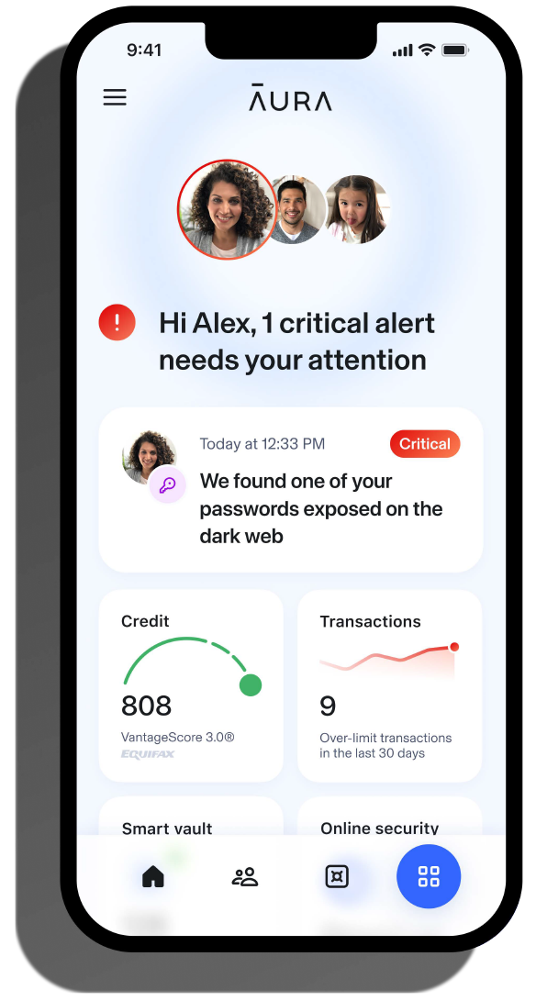
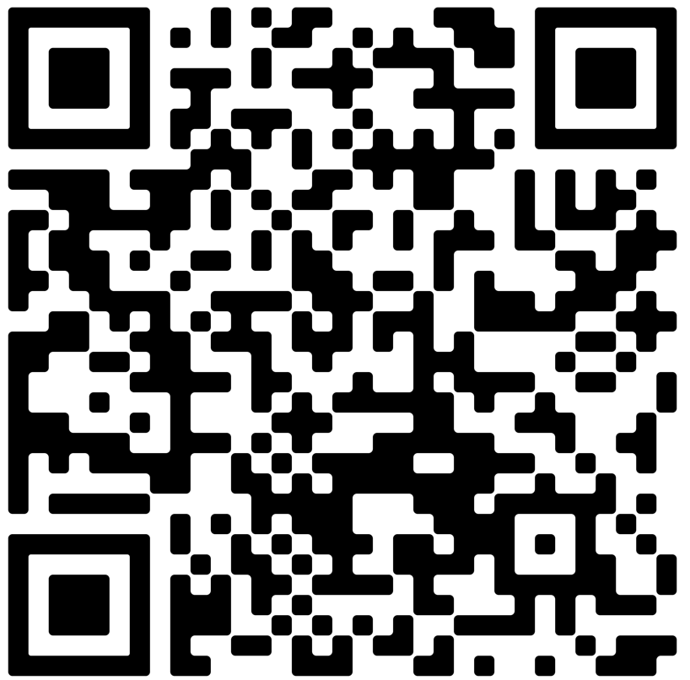
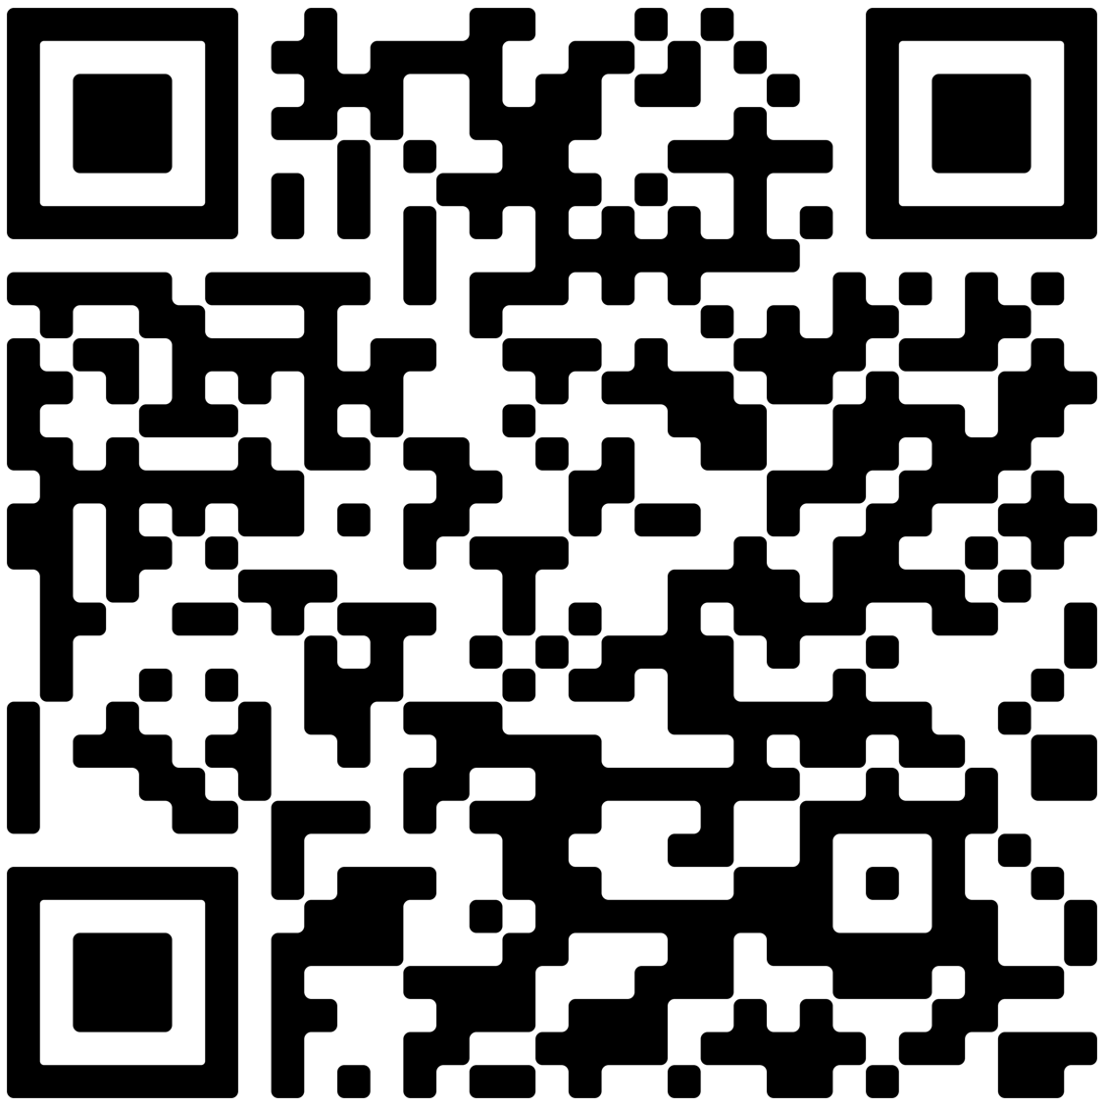
Smart, simple identity and fraud protection all in one place.
Congratulations on taking the first step in keeping your identity and finances secure.
Now that you are enrolled in MetLife and Aura Identity & Fraud Protection, you can benefit from credit monitoring, dark web monitoring, public records monitoring and other protections.
To get the most out of the benefit, set up your personalized account by going to my.aura.com/start.
Account setup is as easy as 1-2-3
¹
Create your user ID and password by going to my.aura.com/start.
²
Activate and utilize additional features, view alerts, set your contact preferences, add members to a family plan and more.
³
Download the Aura app for convenient access to your features from anywhere.
.
The more personal and financial information you add for monitoring, the stronger your protection.
Apple Store
Google Play
Have questions? Aura’s customer support team is available 24/7/365. Call 1-844-931-2872.
No one can prevent all identity theft or monitor all transactions effectively.
Aura is a product of Aura Sub, LLC. Aura Sub, LLC. is not affiliated with MetLife, and the services and benefits they provide are separate and apart from any MetLife product.
MetLife Consumer Services, Inc. | 200 Park Avenue | New York, NY 10166
L4549168[exp0727][All States and][PR, MP, VI, GU, DC]
© 2025 MetLife Services and Solutions, LLC

