Slide 1


“To accelerate bold, meaningful change, assisting BOP communities and the environment to flourish”
Bay of Plenty Community Trust and its 100% owned subsidiary BayTrust Charities Limited
36th Annual Public Meeting – 6 September 2024

Slide 2
Welcome from Chair – Tane Phillips
Welcome – Karakia Haimona Te Nahu TALT 2:30
Minutes, BayTrust Year to 31 March 2024 Tane Phillips Chair 2:35
Looking Ahead Alastair Rhodes CEO 2:45
Te Arawa Lakes Trust Sara Wharekura TALT 3:00
Questions, Comments and Discussions Tane Phillips Chair 3:20
Close – Karakia Haimona Te Nahu TALT 3:30
Afternoon Tea 3:35
Notes:
Tane
Tena Koutu, Tena Koutu, Tena Koutu Katoa and thank you for joining us today at the 36th annual public meeting of BayTrust. My name is Tane Phillips, and I am privileged to be the current Chair of BayTrust. Before we start, I would like to thank everyone who has joined us today and note we have received apologies from several people who unfortunately could not be with us today.
I would now like to welcome Haimona from the Te Arawa Lakes Trust who are one of our key strategic partners and who as mana whenua will lead us in a karakia to open our meeting. (after karakia, thank Haimona).
Today is an opportunity for us to share with you our story over the past year and to talk about our plans for the future.
Firstly, I will cover the formal part of the meeting including confirming the minutes from our last APM, our financial results, and highlights of the past year.
With regards to this formal part of the proceedings, I note that this is a Public meeting, not a General meeting, i.e. it’s a meeting of the Trustees held in public, which means that members of the public cannot vote, but are welcome to raise questions and comments.
We will then hear from our CEO Alastair Rhodes who will outline the year ahead which will be followed by a presentation from Te Arawa Lakes Trust on some of the fantastic work they are doing in this region, and we will then finish with plenty of time for questions and afternoon tea.

Slide 3
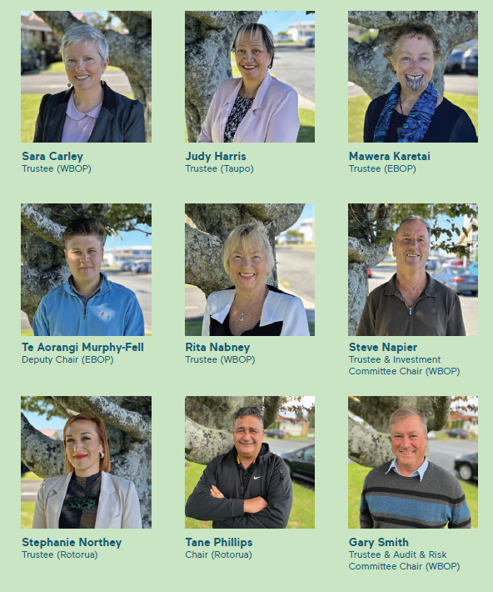
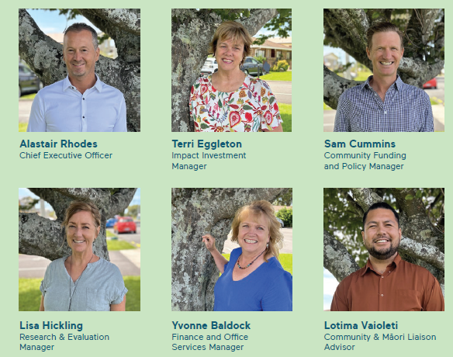
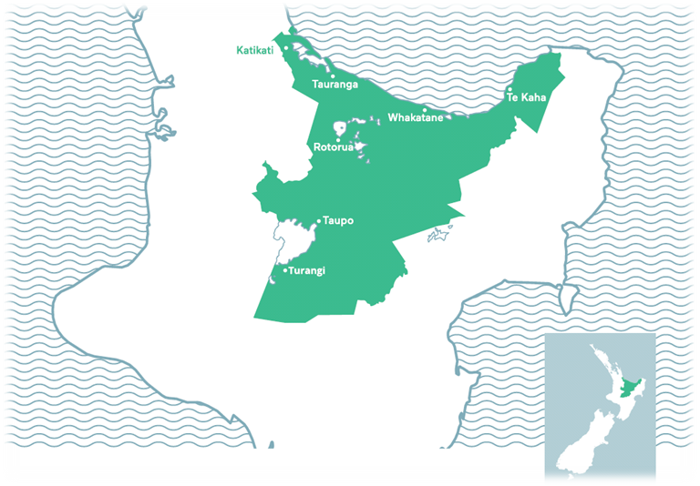
The BayTrust Team & Region
Staff
Trustees
Notes:
Tane
Whilst a lot has changed within the Trust and within our communities over the years, the purpose of the Trust and the region we support remains the same and we are incredibly proud to be able to support Bay of Plenty communities as required under our deed.
I would like to quickly acknowledge and introduce our Trustees. We currently have 9 fantastic and dedicated Trustees ~representing a region from Katikati to Te Kaha, from Turangi to Tauranga and all places in between, who act as custodians of this Taonga for you.
From the Eastern Bay we have Mawera Karetai and Te Aorangi Murphy–Fell (our Deputy Chair). From the Western Bay we have Sara Carley, Rita Nabney, Steve Napier and Gary Smith (an apology today). From Rotorua we have Stephanie Northey and myself and from the Taupo region Judy Harris.
Note that our Trustees are appointed by the Associate Minister of Finance on terms of four years with a maximum of a two-term limit to represent the ~350,000 individuals in the BOP and we anticipate we will have some new trustees appointed later this year.
Looking back over the past 2 years since I have been Chair, it has been a real pleasure for myself to work alongside Alastair and his very capable team (Yvonne, Sam, Terri, Lisa and Loti) plus our dedicated Trustees, Advisors and Community Groups and I feel we are in a great place to continue to deliver on our purpose of accelerating bold meaningful change assisting BOP communities and the environment to flourish.
If there are no objections from any of our Trustees, I will now confirm that the Minutes from last year’s APM held in Taupo on 25 August 2023 are correct and that the Chair and CEO’s consolidated report on the operation of BayTrust which includes Bay of Plenty Community Trust Inc and its 100% owned subsidiary BayTrust Charities Limited for the 12 months to 31 March 2024 and the Annual Accounts and Annual Report to the same date is received and adopted.
Thank you.
Last year was an extremely busy year for the Trust and I would like to quickly touch on the key highlights in the following slides and note that further details are included in the annual report, which is available on our website.

Slide 4
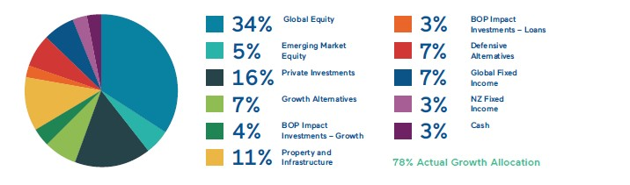
Financial Performance for Y/E 31 March 2024
 | 2024 | 2023 | Change
 | $m | $m | $m
Revenue | 30.1 | -5.1 | 35.2
Less: Expenses | 1.8 | 1.7 | (0.1)
Grants Approved | 5.9 | 8.6 | 2.7
Surplus / (Deficit) for the year | 22.4 | -15.3 | 37.7
Cash Granting | 8.4 | 8.9 | (0.5)
Return on Investment | 12.1% | -1.3%
Benchmark Return | 13.4% | -0.9%
Trust Equity:
Trust Capital | 89.3 | 89.3 | -
Inflation Reserve | 81.4 | 74.8 | 6.6
Population Reserve | 52.4 | 50.4 | 2.0
Grants Reserve | 32.0 | 18.3 | 13.7
Total | 255.2 | 232.8 | 22.4
Over the last year, the Trust with the assistance of its Investment Advisors, Cambridge Associates ran a well-diversified and global portfolio of $264m of responsible and increasingly sustainable investments which performed very well.
Our Capital has grown by $166m since inception and we have granted ~$100m over this period.
Notes:
Tane
Overall, it has been a very strong year financially and operationally for the Trust, with our total equity increasing from $233m to $255m.
During this time, we have continued our move to a lower carbon and more impactful investment portfolio, not only helping the planet but also assisting in maximising our impact in our communities as well as delivering strong investment returns. We and our advisors, Cambridge Associates, have a firm view that investing sustainably is where the best and brightest want to work, where the consumer demand is growing, where the regulatory environment will support, and where investment capital is flowing which will not just maximise our positive impact but also our financial returns.
We have continued to refine and significantly grow our impact investments in particular in the Housing space, actioned our Trust’s Climate Change Action Plan and our 2025/2030 strategy which Alastair will take you through in more detail in his session. All of this, whilst maintaining a stable and well-respected team of Trustees and staff actively involved in the community and aligned to our core values and funding priorities.
Looking at the Trust’s financial performance; the Trust’s investments performed strongly. The Trust returned 12.1% or $30m for the year which is a welcome improvement on our $5m loss last year. This volatility in investment markets from year to year (which we expect to continue), re-enforces our approach with regards to making consistent long-term investment decisions and our desire for stable granting with our grant budget being based on ~3.4% of our average 3 prior years investment values.
As a result of this strong revenue performance and keeping a close eye on costs, BayTrust’s expenses and committed granting were more than covered, leading to an overall surplus of $22m for the year. Further, I note that although it appears that our granting has reduced from $8.6m to $5.9m, this is committed granting, and our cash grants that were paid out last year were in alignment with our budget at $8.4m and comparable to the previous years $8.9m.

Slide 5
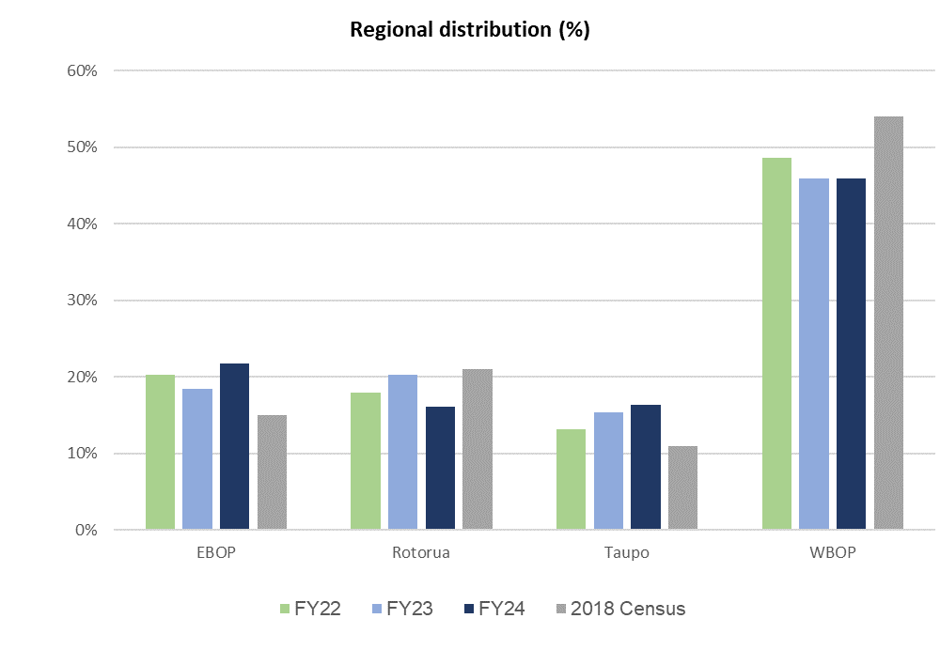
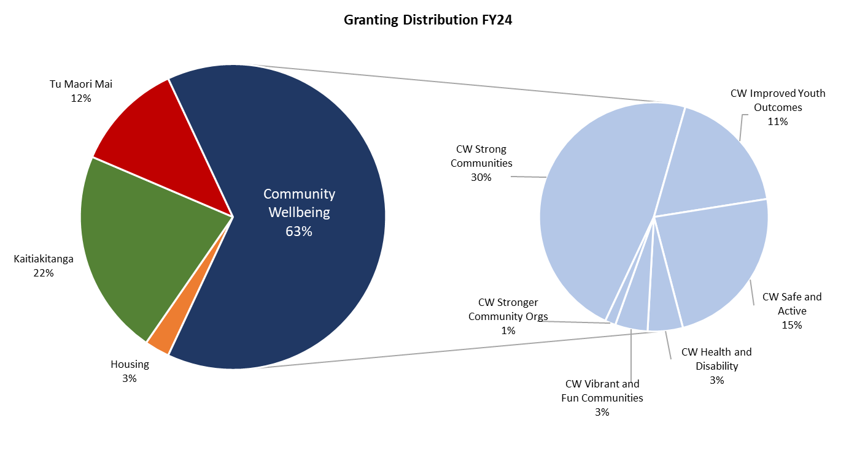
$8.4m of Grants Paid in 2024
To help achieve its purpose, the Trust paid out $8.4m (2023: $8.9m) in grants distributed equitably across our region and our priority areas as outlined below.
The number of grants 251 (2023: 246) has increased with the approval rate at ~80%.
~50 organisations are now on multi-year funding for operational costs.
Granting across region
Granting across priority areas
Notes:
Tane -
As mentioned earlier, BayTrust paid out over $8.4m of grants last year into our BOP communities. These grants were made to 251 community organisations and over 50 of our groups we support are now multi-year funded which is fantastic in these challenging times.
2024 saw a continuation of our investment into the environmental space, with many of the groups we support being hit hard due to the cessation of the Jobs for Nature programme. It's pleasing to see our increased commitment and focus on the environment being reflected in grant applications and we also anticipate granting into the Tu Māori Mai outcome area will increase this year, noting that the % in this chart does not reflect all funding that we provide that impacts on Maori which we estimate is over 40% of our funding.
Along with our grants, the Trust also provided other significant community support during the year delivered in a variety of ways including capacity-building opportunities such as workshops, which were extremely well received within our communities with 16 organisations receiving toolbox funding. We also worked hard with our funding partners contributing to the BOP Regional Council School Sustainability and Resilience Fund that enabled more schools and early child education centres to receive grants this year and to the Climate Action Aotearoa’s Kaupapa of National Significance Fund that enabled multi-year granting to climate action projects.
Going forward we will look to support more innovative ideas and projects, work in a true partnership manner with many organisations and our communities including increasing our multi-year funding whilst ensuring our climate change and treaty commitments are embedded in everything we do. In these tough times, we are also working closely with our other BOP funding partners on granting efficiencies and collaborative funding opportunities.

Slide 6
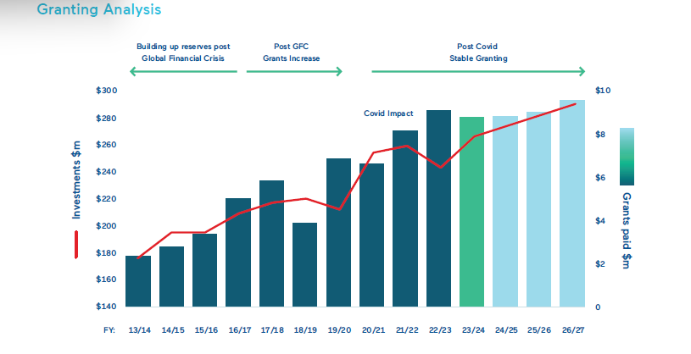
Healthy Reserve Position
Forecast to maintain stable granting at ~$8.5m per year
Notes:
Tane
Lastly, before I hand over to Alastair, I want to touch base on our projected future granting. As noted earlier, our total equity has grown from $89m - 36 years ago when we were first established to just over $255m at the end of March 2024.
Looking forward, BayTrust and our Investment Advisors, Cambridge Associates continue to be cautious around future returns, and the recent market volatility is evidence of why this caution is well placed. However, despite this caution, our significant reserves has allowed us to maintain confidence in our forecast granting levels. As such, we expect to grant $8.5m this year which is a slight increase from the prior year as well as significantly increase our local impact investments with these forecast to be over $20m within 3 years.
I would now like to introduce and hand over to our CEO Alastair Rhodes, who will take us through the key priorities for the Trust looking forward.

Slide 7
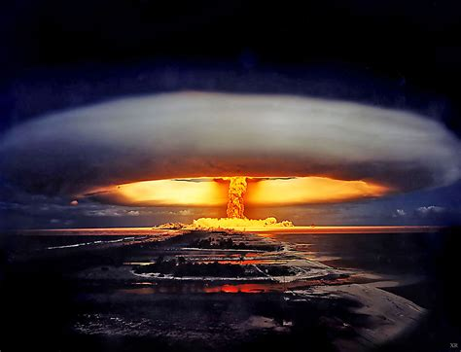

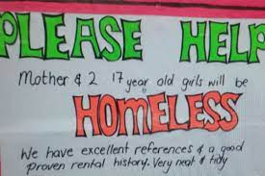
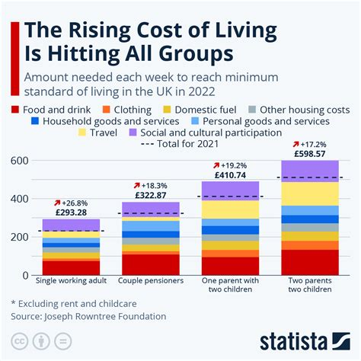

Yikes!
In these challenging times, funders must also change and use all their tools and we are positioned as well as we can be:
Traditional Granting
Longer Term Strategic Granting
Capacity Building
Partnerships
Best in Class Governance / Staff
Sustainable and Impact Investments
Advocacy / Leadership / System Change
Notes:
Alastair
Tēnā koutou, tēnā koutou, tēnā koutou katoa,
Nō Scotland ōku tīpuna
I tipu ake au ki Kirikiriroa
E noha ana au ki Tauranga Moana
Ko Mauao te maunga
Ko mighty Waikato te awa
Ko Indy raua ko Riley aku tamāhine,
Ko au te CEO o BayTrust
Ko Alistair toku ingoa
Nō reira, tēnā koutou katoa!”
and welcome everyone.
Thanks for that Tane, BayTrust is a fantastic organisation, and I feel incredibly privileged to be involved in this organisation helping to accelerate bold, meaningful change, assisting BOP communities and the environment to flourish. As we all know it is Friday afternoon, and you will be looking forward to your weekend so I will try as hard as I can to keep this fairly short and sharp, also please feel free to ask questions afterwards as I feel that questions encourage the best discussions, and if you don’t ask any then, I'm likely to ask a few myself.
I want to start by briefly focusing on the world we are living in – which will help give context to our priorities for the year ahead.
Last year I mentioned our view is that it's an increasingly volatile and challenging world out there and since then although inflation and covid fears are receding we continue to confront the very real threat of nuclear/global war, the cost-of-living crisis, increasing inequality and political and cultural polarisation. Whilst there are many things that we cannot control, we are convinced as a Trust that moving to a more pro-active system funding approach in the areas that we can make a difference is what will have the biggest impact on our communities.
As a community and despite the current challenges, we do need to prepare for a driverless world, increased working from home, the impacts of climate change and geo-political tensions. These changes will create opportunities for some and challenges for others and for BayTrust, this complex world is reflected in the changing needs and demographics of the communities we support. As a funder we have accepted that there is a burning platform for change, and we must also change and innovate to support our communities. - As Winston Churchill said, – “never waste a good crisis!”
Funders like ourselves have traditionally focussed on using their granting to help achieve their mission and we will continue to do this. However, with grant funding very limited and with key wellbeing metrics deteriorating (environment, housing, inequality, child poverty) if we are to truly make a positive change in our communities then we will increasingly focus on our other tools to maximise our impact. We are now also engaging in advocacy, leadership and increasingly using our investment base to make a difference (and to attract other commercial capital into this space) I believe we are positioned as well as we possible can be to help our communities through these volatile times.

Slide 8
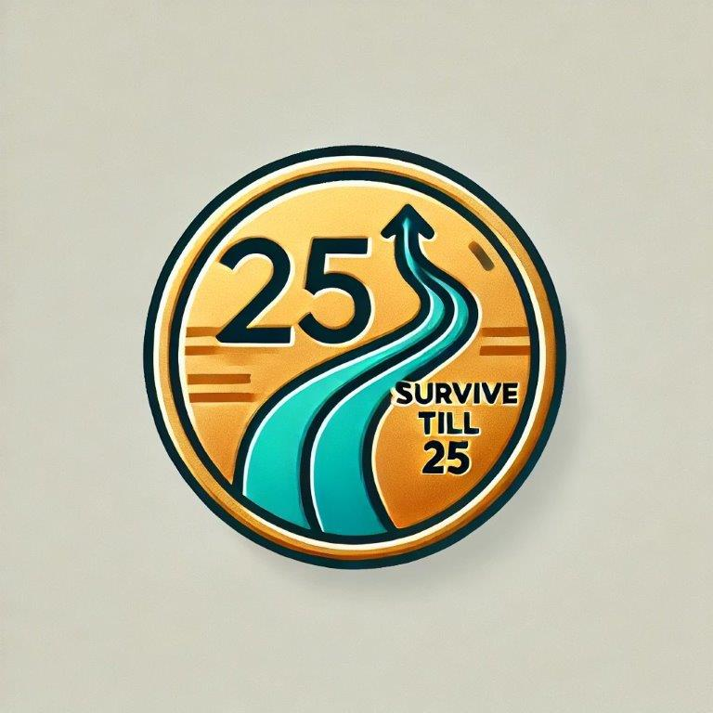
Survive till 2025…
NFP sector under the most pressure we have seen in 10 years:
Local and Central Govt Funding Cuts
Increased Demand for Services
Increased Costs
Less Disposable Income
Philanthropic Funding Being Flat
As a funder we are:
Seeing demand for our granting increase by ~25% YoY
Open to supporting groups to collaborate, amalgamate/consolidate - reduce costs and increase impact
Looking at ways to work with other BOP funders to reduce our own costs and increase revenue (ie combined funding pools/aligned investment decisions)
Notes:
And I do want to acknowledge the pressure the NFP sector is under, and I feel like there is a lot of truth in the saying, survive till !!25.
I have been in this sector nearly 10 years and I cannot think of a more difficult time with local and central govt funding cuts, increased demand for services and higher costs and we are doing everything we can to assist but unfortunately, we do know that for some groups that may not survive, and my advise would be if you are in difficulties the earlier you can have a discussion with our staff on how we may be able to assist the better.
As such, I want to shed some light on how we make our grant decisions by utilizing an impact assessment tool which is critically important with our grants funding coming under increasing pressure.

Slide 9

Granting Impact Assessment Tool
To help us make our granting decisions as robust and objective as possible, BayTrust uses an impact assessment tool
Each application is given an “impact score” out of 10 against several impact criteria, which include; how much need is in the community, impact on the environment, who and how many people benefit, how much impact our funding has on the activity going ahead and how it benefits Māori amongst other considerations.
Each application is also scored on how closely it aligns to our purpose of Bold Meaningful Change… which is scored out of 20.
The full impact scoring criteria can be found on our website under our funding framework.
Notes:
Whilst we acknowledge that this tool is not perfect, and it contains elements of subjectivity,, it does mean that grants will target those groups that align most closely with our purpose, our four priorities, community needs, climate change, and treaty commitments as well as those that are innovating.
If you have any questions on this, our website contains a much better description and sam and loti in my team are also always available to answer any questions.

Slide 10

BayTrust Theory of Change
Toi tāngata
Toi tute taiao
Toi te hua mākoha koha
Impacts
Greater equity; better health and wellbeing; strong communities and flourishing environment in the BOP
We will:
Use all our resources including investments, personnel and granting to progress our priorities
Operate in true partnerships with our communities
Be bold, flexible, innovative and provide leadership
Live and practice our Kaupapa in everything we do
Become a climate responsible (Tiakina te ao tūroa) organisation
Work with Māori in a way that is consistent with the principles of Te Tiriti o Waitangi
Recognise that there are significant interdependencies between the strategic priorities and leverage these to maximise our impact
Improvement in environmental indicators and increased biodiversity
Climate Change responsiveness
GHG reduction in BT, BOP and beyond
Supported Mātauranga Māori
Supported community organisations enabled to deliver community benefits
Engaged youth in employment pathways
Greater participation in sport and rec
Increased housing affordability
Decreased homelessness
Reduced housing shortage
Better housing outcomes for Māori
Māori aspirations supported
Well established relationships with iwi/ hapū
Increased community appreciation for Te Ao Māori culture
Outcomes
Inputs
Grants budget, impact & other investments, staff resources, advocacy and leadership, partnership with Māori, community, other funders and investors
Strategic Priority
Healthy, secure affordable housing
Community Wellbeing
Kaitiakitanga
Tu Māori Mai
Purpose
To accelerate bold meaningful change, assisting BOP communities and the environment to flourish
Notes:
As mentioned earlier with increased funding demand, our granting will focus on those groups that have the most ability to help us achieve our Theory of Change as I have outlined in this slide. I note that we have continued to refine and review our strategy, however the basic buildings blocks of what we support have not changed, a flourishing environment, healthy homes, supporting Maori aspirations and community wellbeing will lead to great equity, better health and well-being, strong communities and a flourishing environment in the BOP.
In Feb. next year we will have a full refresh on what our goals will be for these four areas in 2050. 2050 is now only 25 years away (or effectively a generation) and once we have reset these we will then determine our medium-term (5-year 2030) and short-term goals and KPI’s.
I will now touch on our key goals for each of these four areas for the year ahead.

Slide 11
FY25 BT will…
Be committing 25% of SPF/CAF grants to Kaitiakitanga ($6.5m over 3 yrs)
Kaitiakitanga
BOP people live in harmony with the natural environment enabling it to support our future generations.
Invest in nature carbon solutions
Support at least 2 Māori/Mātauranga Māori initiatives that contribute to CC Action
Demonstrate CC
responsiveness
  Ensure our investment portfolio is carbon neutral by 2030
  Achieve climate positivity
  Support all SPF/II partners on CC journey
Demonstrate leadership and collaboration and explore co funding pools with other BOP Funders
Focus on Impact Investments in the Environmental space/mitigating CC to grow to up to 10% of II portfolio
Work successfully with other funders/ partners to co-fund climate change actions
Notes:
Our view continues that the environment is the foundation of our communities, its one of the key reasons people choose to live in the BOP and without the environment we have nothing and lisa in my team does a fantastic job as the stream lead in this area. As such, we want to play a leading role in assisting the BOP to become a place where BOP people live in harmony with the environment and it can support our future generations, where waterways are swimmable, and coast ecosystems are sustainable and where we are carbon neutral to name just a few.
However, we realise that alone we cannot achieve this and key actions in FY25 include:
Exploring a BOP Carbon offset opportunity whereby we want all BayTrust's scope 1,2 and 3 emissions offset locally with co-benefits by 2050 that others can also co-invest into.
Explore co-funding and combined funding pool with other BOP funders.
Continue to commit ~ 25% of our funding to environmental initiatives

Slide 12

FY25 BT will…
One investment per year supporting equity for Māori in housing space (outside of BOP HEF)
Housing
Everybody in the BOP should be housed in suitable, adequate and affordable accommodation that fits their whanau and cultural requirements.
Dedicate ~5% of our grants budget per year to non-capital housing projects
Aim to impactfully deploy ~30% of the $120m in capital of the BOP Housing Equity Fund in the 2025-year
Provide leadership in the housing space
Reach and maintain a level of 6% of our total portfolio into addressing housing needs
Notes:
We continue to believe that everyone in the BOP should be housed in suitable, adequate and affordable accommodation that fits their whanau and cultural requirements and Terri in my team is the expert in this, where we are using our balance sheet to maximise our impact. For a region as rich as ours to have children living in cars and motels is not acceptable. For me, the disaster that we have in housing really hit home when a billboard that had been up for five years down the road for me by Baypark advertised house and land packages for $500k is now for a smaller house and land over $1m. That is unaffordable!
Key actions in FY25 include:
Assist in addressing existing shortages housing investment through the BOP Housing Equity Fund and impactfully deploy ~30% of its $120m in capital. This is one of the most exciting and impactful initiatives we have launched where with our $10m of seed capital we have attracted a further $50m of equity cheques and when coupled with debt of $60m means we now have $120m of capital to deploy. The long-term intentions of this fund are to attract kiwisaver investment once a strong track record is obtained, I have a vision in 5 years that KiwiSaver's can go to all BOP residents do they want to invest in a local fund with strong track records building the housing we need in our communities.
Provide leadership in the housing space through active participation and financial support for research, attendance at forums, development of materials supporting housing investment, driving impact evaluations, provide advocacy to CHP sector.
Increase Housing Impact Investment from 3% to ~6% of portfolio and across the spectrum of need.

Slide 13
FY25 BT will…
Ensure 50% Iwi and 25% hapū understand who BT is and what we do
Tū Māori Mai
Māori aspirations supported
Successfully Implement funding for Marae as part of Quarterly Strategic Funding
Effectively support Iwi/hapū groups/Māori organisations
Increase % of support towards Tū Māori Mai applications from ~12% to 15% of grants budget, recognizing that 40% of direct beneficiaries are Māori
Improve our rating against the PNZ Ki te Hoe framework from
B- to B+
Develop well-established relationships with Iwi/Hapū
Increase collaborative investments into/with Iwi/hapū Māori
Notes:
One of the areas we are really excited about about is our increased focus on Tū Māori Mai with Loti in our team focussed on this area. To increase our impact, we are committed to engaging and maintaining meaningful relationships with Iwi, Hapū, and Māori organisations in the BOP. Creating an opportunity to support Māori aspiration and intergenerational solutions with focus on the positive of what Māori are doing for the community and whenua. We accept that the best outcome for Māori is achieved when services being provided, are by Māori and support Māori aspirations, which Tū Māori Mai is designed to support.
Key actions in FY25 include:
- Successfully Implement funding for Marae as part of Quarterly Strategic Funding.
- Increase % of support towards Tū Māori Mai applications from ~12% to 15% of grants budget, recognizing that 40% of direct beneficiaries are Māori.

Slide 14
FY25 BT will…
Contribute to overall community physical activity participation through sport recreational activity
Community Wellbeing
BOP Communities flourish when they are equitable, vibrant, fun and safe
Meet our Trust Deed obligations of being an intergenerational funder to all beneficiaries
Support the delivery of SQF partners’ impacts
Efficiently support community groups to deliver those services that are in line with BT strategic priorities
Facilitate greater collaboration with other funders including a collaborative youth funding project
Encourage collaboration between community groups
Review and simplify funding framework
Notes:
Lastly, but certainly not the least is our traditional community wellbeing funding area, where we are focusing on equity, youth engagement, culture, arts, safety and sport and recreation to ensure BOP communities flourish, are equitable vibrant fun and safe. Sam who is known as the face of BayTrust leads this area.
Key actions in FY25 include:
- Facilitate greater collaboration with other funders including a collaborative youth funding project
- Review and simplify funding framework
- Encourage collaboration between community groups
- Meet our Trust Deed obligations of being an intergenerational funder to all beneficiaries

Slide 15
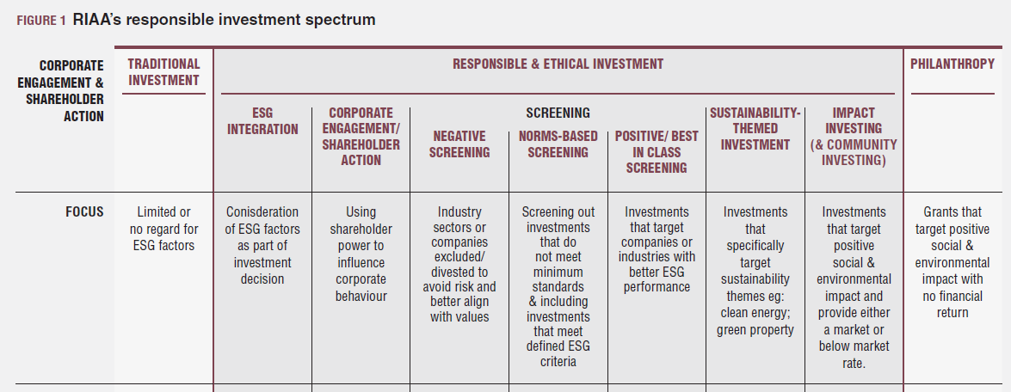
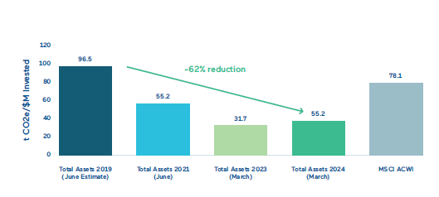

2024 - A Positive $250m+ Investment Portfolio
Our Investment Intentions:
Transition to a fully sustainable investment portfolio by 2030 where all the Trust’s investments will look after the environment, our communities & our financial returns
Drive a 50% reduction in climate change emissions by 2025 and be carbon neutral by 2030
Continue to grow our Private investments to help target the transition
Materially grow our BOP Impact Investments
Continue to deliver strong and sustainable investment returns.
62% reduction in investment carbon footprint since 2018
BOP impact investments to increase to $20m+ by 2025
BT top quarter in FY24 of C/Trusts @ 12%
Notes:
Lastly, as well as our four priority areas, I want to touch base on how we are also looking to make a positive impact with our investments and it also would be remiss of me not to also thank Yvonne in my team who is the backbone of our Trust and keeps everything together.
In terms of our investments, as part of our commitment to be bold and to use all our resources including our investments to make a difference, we are in the process of transitioning our entire $250m global investment portfolio to be sustainable and carbon neutral within 10 years where what we invest in is consistent with a low-carbon, prosperous, equitable, healthy and safe society.
We have already decreased our carbon investment exposure by over 50% in the last few years and believe we can have our investments carbon neutral by 2030. We are doing this and moving to sustainable investments not just because it’s the right thing to do and aligns with our Kaupapa as a perpetual Trust, but also because we fundamentally believe this will also drive superior financial returns as the best and brightest want to work in this sustainable space, the regulatory environment supports it, this is where the innovation is occurring, and capital is flowing into it. Our strong returns that Tane just spoke about back this statement up.
As part of this we approach we will:
Grow and be much more active in the private investment space where there is a better opportunity for the Trust to target sectors that perform and align with our Kaupapa of making a positive impact on the community and environment.
Significantly increase our BOP impact investments - predominately in the housing and CC areas, where they have co-benefits (i.e. jobs, clean rivers etc) and where we are likely to invest alongside Māori/ iwi and other similar mission-aligned investors.
I also want to acknowledge Bill Cleghorn who was our Investment chair when I first started at BayTrust and who helped start us on this investment journey who sadly passed away last month from natural causes after a long and impactful life.
I would now like to handover to Sarah Wharekura from the Te Arawa Lakes Trust who are one of our key strategic environmental partners, with Baytrust committing $600k over 3 years to help them restore the mauri of the Rotorua lakes and he will share some of the amazing mahi they are doing around this area before tane and I close things off with the had questions.

Slide 16
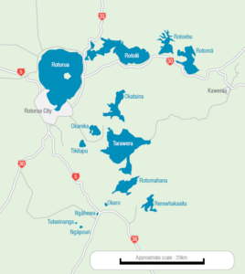

Te Arawa Lakes Trust

Slide 17

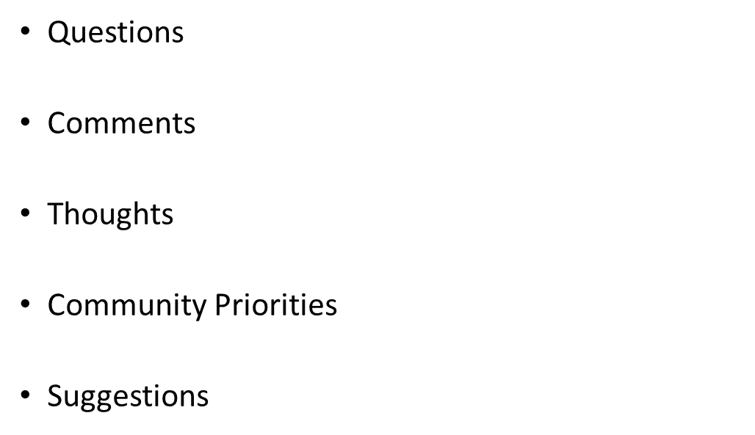
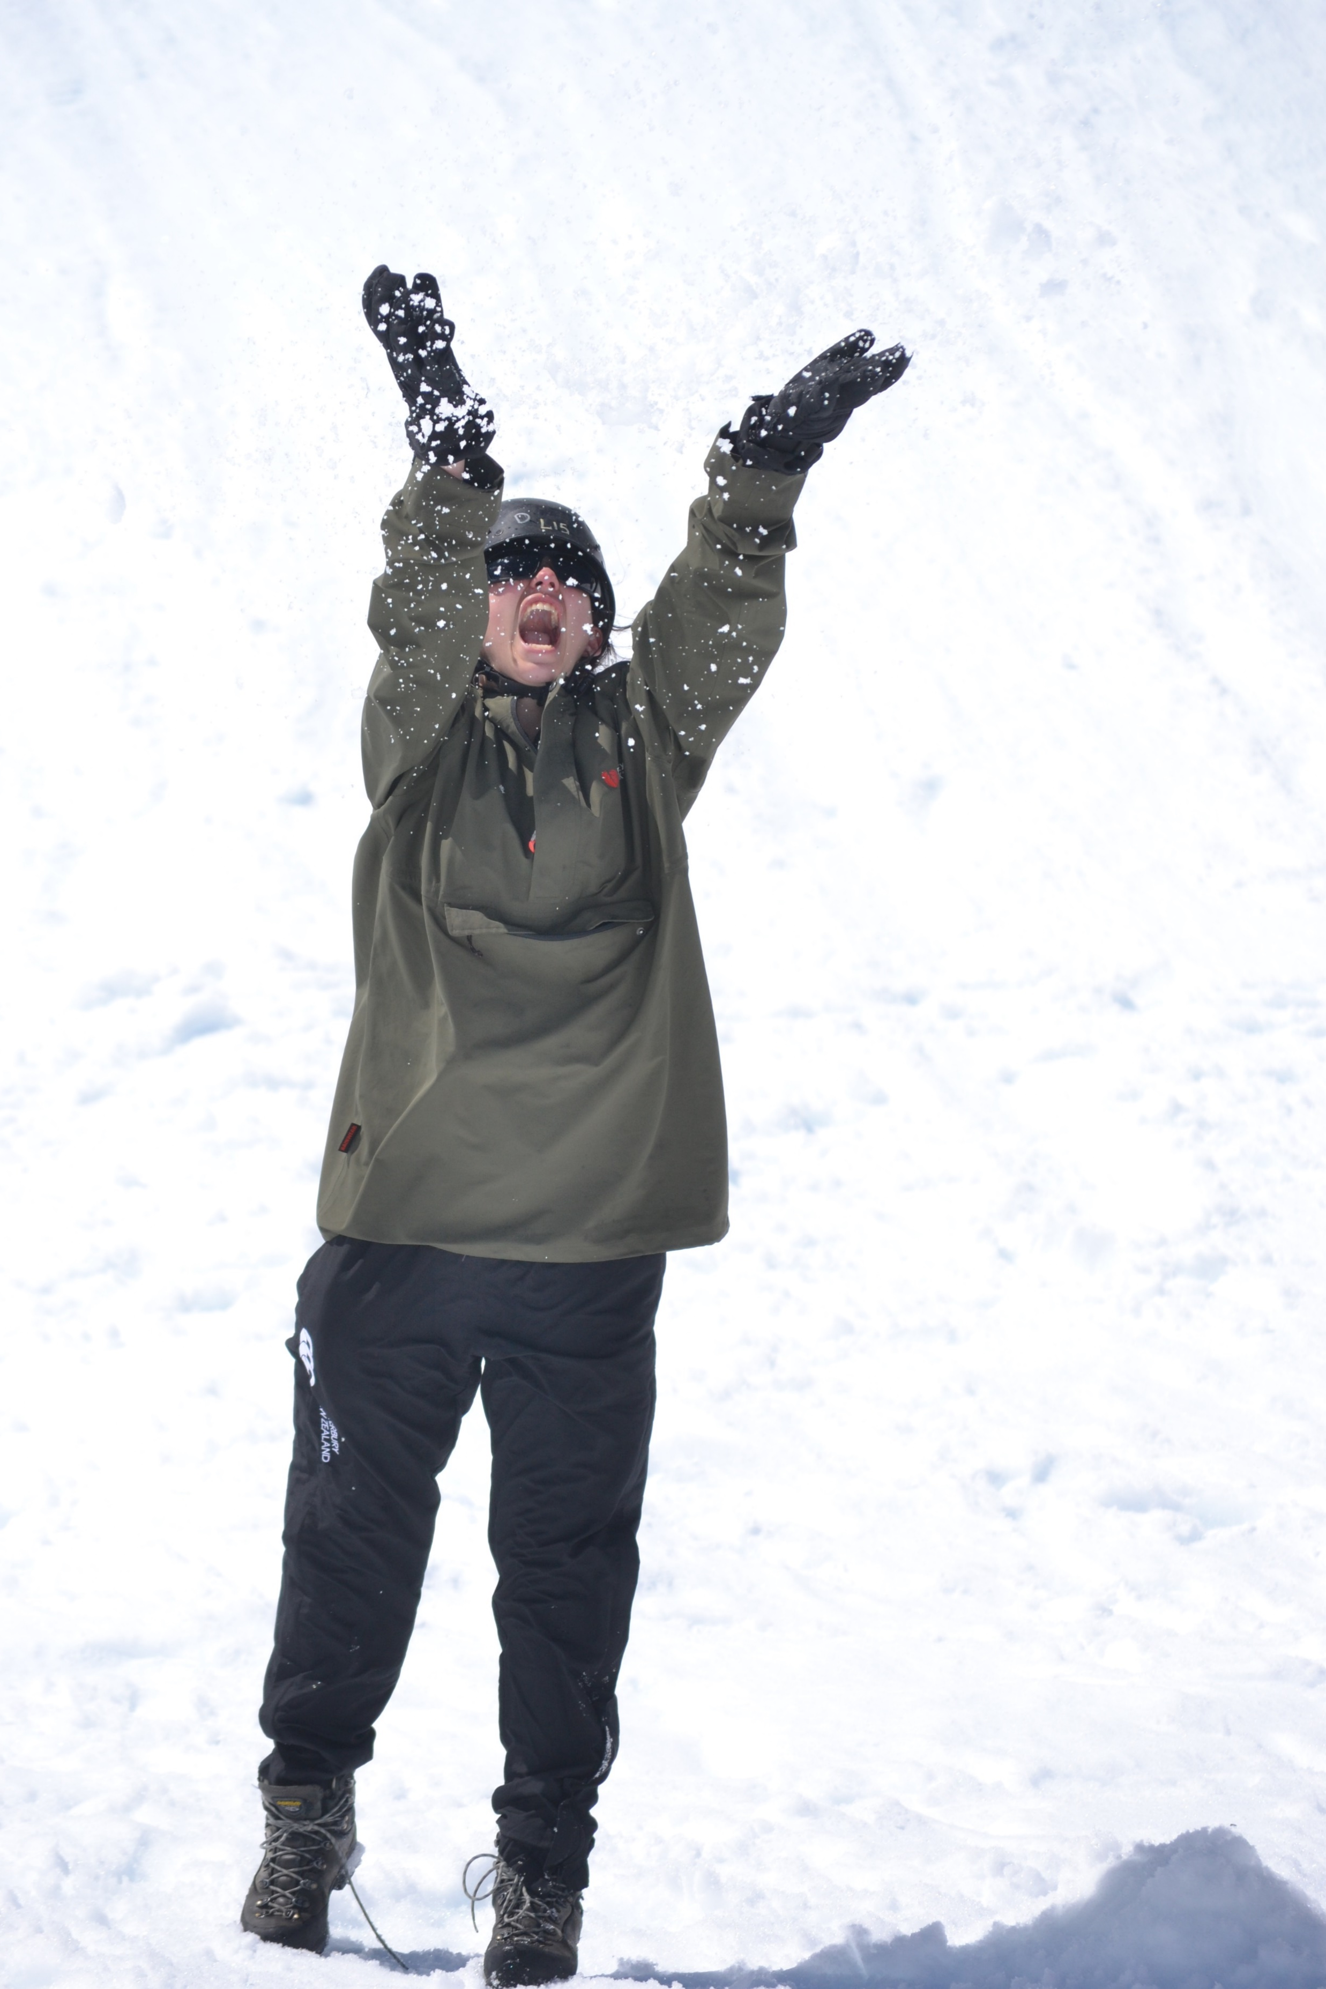

Notes:
Tane
I would now like to open the floor for questions.
Post questions, I would like to finish by thanking everyone for your time today and I look forward to myself and the rest of the BayTrust team working with you all to help achieve our kaupapa “To accelerate bold, meaningful change, assisting BOP communities and the environment to flourish.
Stay safe and look after each other.
kia ora koutou katoa
Haimona to close with Karakia and thank Haimona

