Slide 1


UNDERSTANDING
MOISTURE VAPOR SUPRESSION

Slide 2
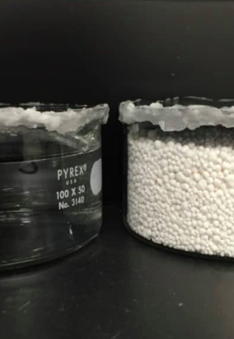
WATER VAPOR TRASMISSION TESTING
ASTM E96
Defines the Water Vapor Transmission rate of materials
  1 Perm = 1 grain/h·ft²·inHg (grains per hour, per square foot, per inch of mercury).
Let's break this down:
  1 Grain of moisture: A unit of weight (1 grain = 0.065 grams or 1/7000 lb).
  Hour: The time duration.
  Per ft² (Square Foot): The area of the test material sample (the adjusted area calculation to equal 1 sq. ft.).
  Per inHg (1 Inch of Mercury): The pressure differential (driving force) created by the difference in humidity on opposite sides of the material. 1 inch of Mercury is roughly equal to .49 p.s.i.
What Test indicates in building science:
  Low values (e.g., < /= 0.1 perms): Indicates a very low permeability or a CLASS 1 vapor RETARDER (e.g., poly sheeting, metal foils).
  High values (e.g., > 10 perms): Indicates a high permeability or "breathable" material (e.g., house wrap, fiberboard).

Slide 3
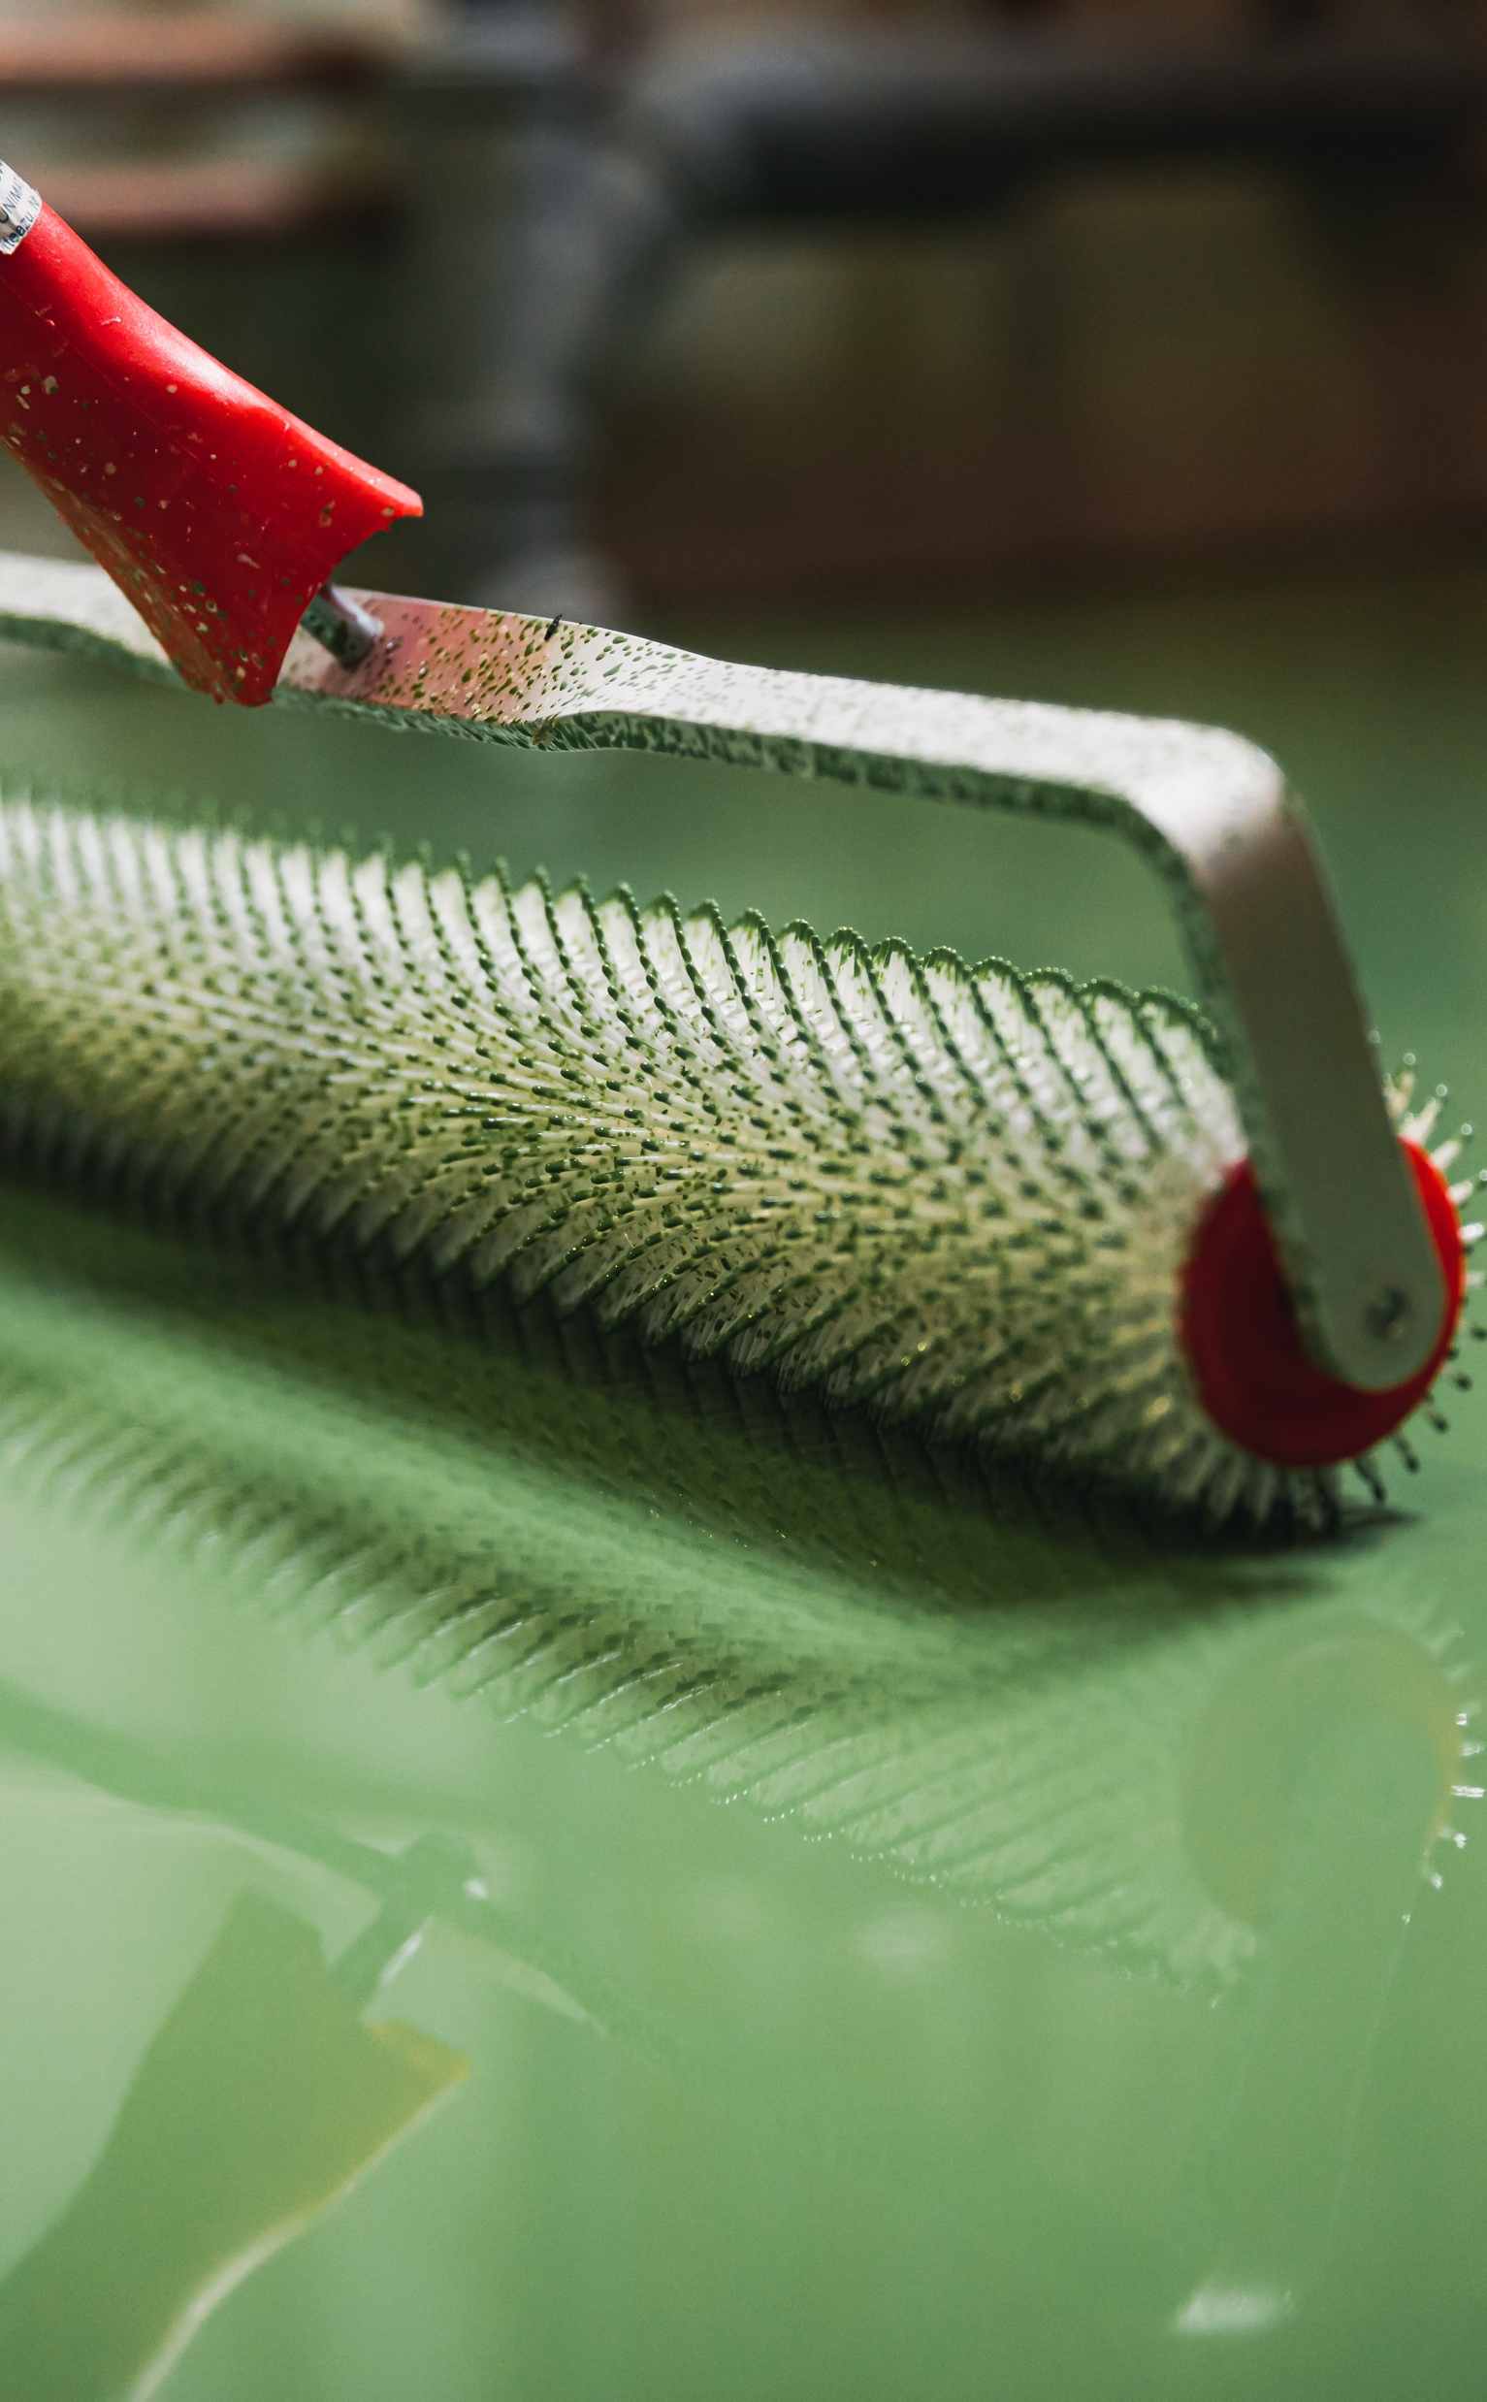
MOISTURE VAPOR SUPPRESSION
NOT A VAPOR BARRIER
ICRI PAMPHLET 03741 defines a vapor barrier as one that allows 0 perms. Recent code updates now classify vapor retarders (supression) into three distinct classes:
Class I
.01 perm or less (not a “vapor barrier”)
Class II
Greater than 0.1 perm and less than or equal to 1.0 perm
Class III
Greater than 1.0 perm and less than or equal to 10 perms

Slide 4
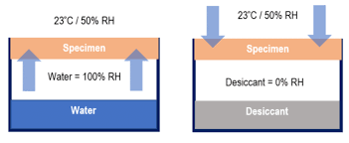

TWO METHODS TO DETERMINE WATER VAPOR TRANSMISSION
ASTM E96
Desiccant Method A (Dry Cup)
Water Method B (Wet Cup)
Test Method A
  Both methods measure the rate of water vapor movement through materials by sealing samples over test dishes and monitoring weight changes over time.
  Method B typically generates higher perm ratings than A. It is theorized that this is because the RH is 100% under the cup in B vs 50% RH in the air above the cup in A.
  Test results derived from either are not interchangeable.
Test Method B

Slide 5
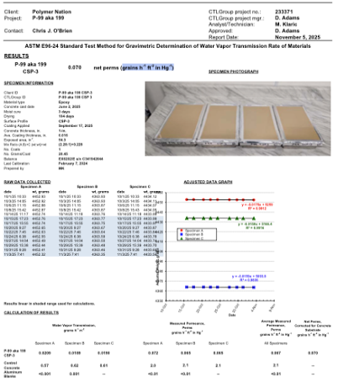
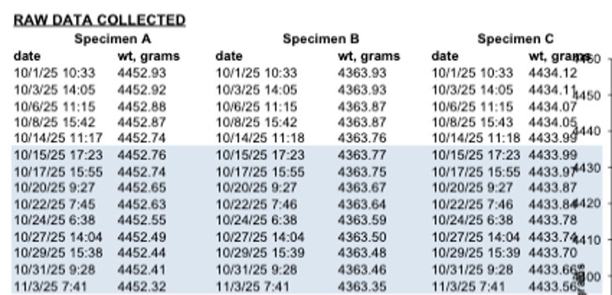
DATA SET
A minimum of 6 data points with very similar results
Consistent weight loss over these data points becomes a key measurement to final perm results per the test
Documented Controlled environment is required to perform test
Should be tested by independent accredited lab

Slide 6
ADDITIONAL NOTES
Three test specimens tested over water must have 1 tested exactly like the others, except that no water is put in the dish. This is to measure moisture lost from the concrete substrate. Any loss from concrete is not counted against the coating being tested. Additionlly, barometric pressure can affect moisture vapor, and this 4th test is used to make appropriate adjustments.
There is no correlation between ASTM E96 and F1869, F2170 or F2420.
Manufacturers who make claims without citing a repeatable test method should be avoided. Always ask for independent test data!

Slide 7
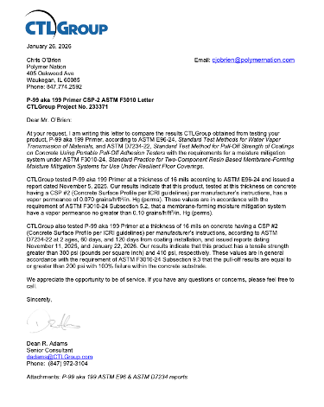
ASTM F3010
This practice covers the properties, application, and
performance of a two-component resin-based membrane-forming
moisture mitigation system to high moisture concrete
substrates prior to the installation of resilient flooring.
2 component membrane forming coating
A perm rating of .1 or less per ASTM E96
Coating shall not contribute unacceptable indentions on some types of resilient flooring
Pre-Installation Testing:
  Moisture testing per standard F3010
  Concrete tensile testing per ASTM C1583 >/= 200 psi
  Mock-up Sample
    At least 100 square feet using same procedures anticipated for use on the entire project
    Perform adhesion testing at intervals and using methods as outlined in ASTM F3010
      Minimum 200 psi with 100% concrete failure

Slide 8
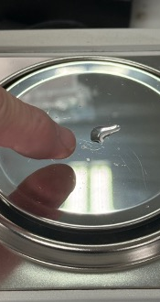
TEST RESULTS FOR
P-99 average of three test specimens was .07 perms.
P-99
The picture at left shows the amount of water, by weight, that is able to pass through the 16 mil film of P-99 as vapor per 24 hours at 1 inch of mercury.
Higher inches of mercury may force more vapor through the coating.
Basements, deep in the ground, in wet areas, have a higher risk of moisture related issues.
Repeated testing shows extremely low permeability (Class 1)
Has been tested with our 1339 pigment packs (Class 1)
Broadcasting into P-99 with aggregate or flake can be done but reduces the test results from a class 1 to a class 2 vapor retarder (.14)

Slide 9
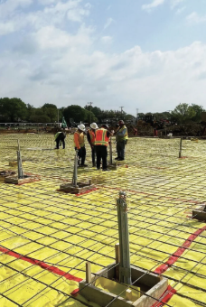
POSITIVE SIDE VAPOR BARRIER
BEST PRACTICE
Positive-side (installed underneath the concrete slab) is superior to a negative-side application (on top of the slab) because it prevents moisture, contaminants, and soil gases from entering the concrete slab in the first place, rather than attempting to contain them afterward.
Stops infinite amount of available moisture from being available to the underside of the concrete slab.
Better controls against porous concrete.
Helps as a vital barrier against dangerous, radioactive radon gas.
Care must be taken to avoid punctures during steel and concrete installation.

Slide 10
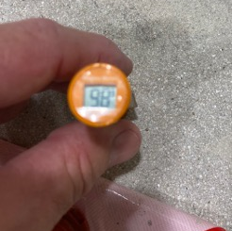
NEGATIVE SIDE
VAPOR RETARDERS HELP
Allow projects with higher moisture reading to move forward
Slow down moisture vapor intrusion through the primer (P-99) to protect moisture sensitive flooring
Slow upward migration of moisture, reducing the risk of delamination, buckling, and warping of hardwood, laminate, and luxury vinyl flooring

Slide 11
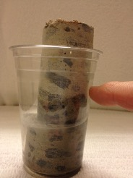
NEGATIVE-SIDE MVS COATINGS HELP BUT THEY
Cannot stop water before entering concrete slab
  Concrete without a functioning positive-side Moisture Vapor Barrier is susceptible to hydrostatic, capillary and osmotic conditions
    Osmotic pressures sometimes exceed the coating bond strength to concrete.

Slide 12
WATER TO CEMENT RATIO
PLAYS THE LARGEST ROLE IN CONCRETE PERMEABILITY
Lower W/C ratio means less permeable concrete
Higher W/C ration means more permeable concrete.
High W/C ration without a positive-side moisture retarder or barrier is recipe for blisters
  Exclude moisture related warranty if you do not know if there is a positive-side retarder/barrier
    Must core to know if not on as-built drawings

Slide 13

NOT KNOWING THE CONCRETE YOU COAT
IS LIKE NOT KNOWING YOUR MATE BEFORE MARRIAGE
Before You Coat Do You Know
  The water to cement ratio of the placed concrete?
  The concrete thickness?
  What contaminants are in the concrete?
  How the Concrete was cured?
  The slab support design and placement
  The amount of moisture available under slab
  The concrete mix design and conditions of placement (was the concrete poured in winter, summer, etc.)
  The existence or condition of a positive-side vapor barrier?
  Performing moisture testing on slabs without a functioning positive-side moisture vapr barrier or retarder is not meaningful because the test data will change as under-slab moisture availability changes.

Slide 14
HERE IS HOW I APPROACH THIS SUBJECT WITH CUSTOMERS
If the existence of a positive-side vapor barrier/retarder is unknown, I recommend performing core samples for a price.
  Making this offer will shows that I am serious about understanding the concrete.
  Core samples will show slab thickness and allow verification of the existence of a vapor barrier or retarder. Without knowing the slab thickness, sub-soil moisture or existence of a vapor barrier/retarder I cannot properly evaluate a long-term solution. I make sure they understand these points and explain that I have no history of their concrete. I make the decision theirs not mine!
  If they elect to forego the cores, I share with them the P-99 CTL test data explaining that P-99 is shown to reduce moisture vapor to .07 perms per ASTM E96 and that it has a long track record of success. I share that there is a high liklihood P-99 will solve any moisture issue and a low liklihood it won't.

Slide 15
HERE IS HOW I APPROACH THIS SUBJECT WITH CUSTOMERS
If they are willing to take the risk, I move forward with the quote.
If they object:
  I offer a more breathable system such as P-21 with a flake broadcast, topcoated with 10-12 mils polyaspartic or P-03 with U-51 and non-skid (keeping the system thin better allows vapor to pass through the floor coating).
  I offer and price out the Polymer Nation 5 year warranty.
NOTE
High Build resinous floor systems, like metallics, are most susceptible to moisture issues because they cannot release the moisture vapor and the pressures developed at the coating/concrete bondline can exceed the bond and cause blisters and/or disbondment. Subterrainian floors are even more susceptible.

Slide 16
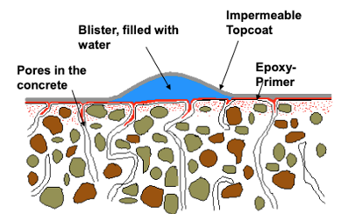
BLISTERS
Typically, these blisters are filled with water and small amounts of inorganic salts or organic compounds.
MVS primer must maintain superior adhesion to the concrete to avoid blister formation. A CSP 3 or higher is needed for superior bond.
All concrete pores must be filled
The formation of blisters is a well-known phenomenon in the flooring industry and a continual challenge for contractors because of the high replacement costs caused by these failures. The appearance of blisters after weeks, months, or even years, is also known as “osmotic blistering”. The root cause of these blisters is still unclear and has been the subject of many technical and scientific investigations. However, it is well-accepted that four preconditions are needed for the formation of blisters:
  presence of free water
  presence of an impermeable topcoat
  presence of pores in the concrete
  presence of water-dilutable or soluble chemical substances
Accordingly, ground levels of parking garages, basements or in general subterranean buildings like water storage tanks are prone to this effect.
High alkalinity in concrete, often triggered by moisture migrating upward through a slab, can cause blister dis-bondment of resinous moisture vapor retarders. This process, known as alkaline hydrolysis breaks down the chemical bond between the epoxy and the concrete, causing blisters, softening, and, eventually, complete failure.

Slide 17
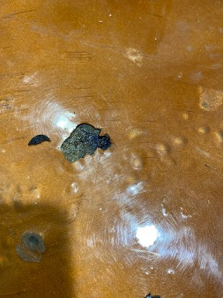
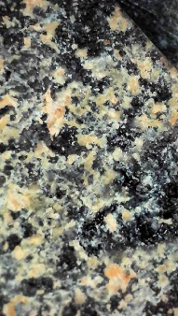
BLISTERS
Notice back side of coating removed from blister has particulate on back side indicating partial substrate removal and soluble substances

Slide 18
CLOSING REMARKS
Polymer Nation relies on our distribution network to sell our products to skilled, well-trained contractors. Polymer Nation expects our distributors to understand the content of this presentation and to share its content with their customers. Succesful project evaluation, concrete preparation and coating installation requires knowledge and experience. Moisture related coating failures are most often not the result of defective product but of a lack of understanding as to what the product can and cannot do. P-99 has been proven to have one of the lowest perm rates in the flooring market. Unfortunelaty, a low perm rating does not change the laws of physics or the physical characteristics of concrete. As such, if P-99 loses bond to concrete because of Inadequate surface preparation, osmotic, capillary, hydrostatic pressures (exceeding the coating bond strength) and/or alkaline hydrolysis (an eroding of the chemical bond between the P-99 due to extreme ankalinity) blisters and delamination of the P-99 can occur.
If a project needs a warranty the following must be adhered to
    Project Warranty must be approved in writing prior to starting project.
    P-99 must be installed per our TDS
    P-99 must be installed per ASTM F3010
    There are no exceptions to these requirements
Shoes

Slide 19
THANKS FOR VIEWING

