Slide 1
failing to succeed
vinod khosla
vk@khoslaventures.com

Slide 2
conventional wisdom…
score A’s
color inside the lines
behave properly
show respect
be thoughtful, don’t take risks
or else you might fail!!

Slide 3
the lesson your parents don’t want you to hear…

Slide 4
fail well, with effort … and often
…nobody remembers your failures, & mostly they don’t matter

Slide 5
be irreverent, disrespect authority
…disrespect experts
…challenge your teachers
…get evicted, you’ll survive

Slide 6
don’t worry about your score
learn to explore

Slide 7
don’t be proper or show good behavior!
…be irreverent,
…throw some food,
…throw an eraser

Slide 8
drop out of school?
…my daughter did!

Slide 9
be on the edge
…do the unexpected (don’t be a doctor)
Notes:
Throwing food at my kids

Slide 10
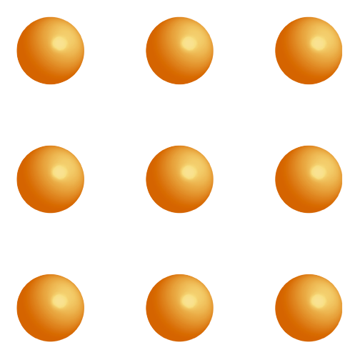
how many lines to connect all the dots?
‹#›
Source: Amory Lovins, RMI
Notes:
‹#›

Slide 11
standard nine dots solution
‹#›
Source: Amory Lovins, RMI
Notes:
‹#›

Slide 12
“thinking outside the box” solution
‹#›
Source: Amory Lovins, RMI
Notes:
‹#›

Slide 13
better: use just three lines
But…how about just one line?
‹#›
Source: Amory Lovins, RMI
Notes:
‹#›

Slide 14
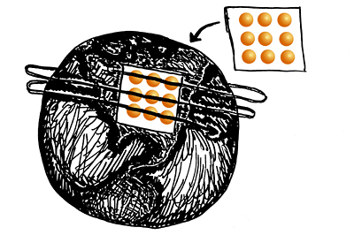
geographer’s solution
‹#›
Source: Amory Lovins, RMI
Notes:
‹#›

Slide 15

mechanical engineer’s solution
‹#›
Source: Amory Lovins, RMI
Notes:
‹#›

Slide 16
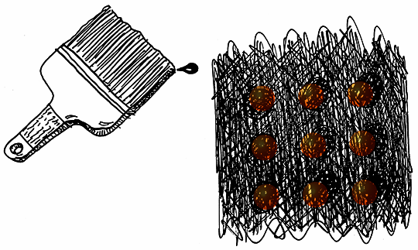
wide line solution
‹#›
Source: Amory Lovins, RMI
Notes:
‹#›

Slide 17
don’t just color outside the lines
…fold the paper up, cut holes in it and burn it!

Slide 18
is failure so bad?

Slide 19
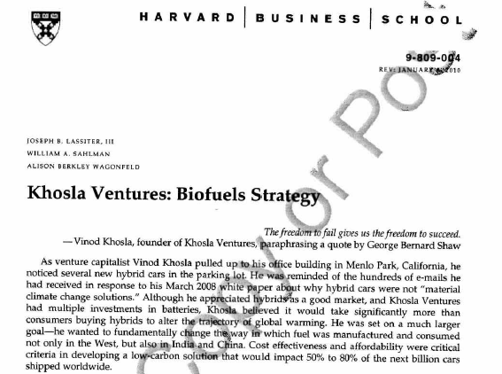
“the freedom to fail gives us the freedom to succeed”
Notes:
Since 2004 – 12+ biofuels investments, every approach, biggest portfolio
Expected 90% failure, now looking like closer to ~50% or better success
1st gen ethanol 2005/2006 (cilion, altra)
2nd gen biofuel (range, mascoma, verenium, coskata, lanza)
Future fuels (ls9, gevo, amyris, kior)
Sugars (Virdia)

Slide 20
“I don’t care about the failures and what people think – I only care about trying what’s worth trying – and just do it”

Slide 21
“I don’t mind failing, but if we succeed, it better be worth succeeding”

Slide 22
“ever tried. ever failed. no matter. try again. fail again. fail better."
Samuel Beckett

Slide 23
“it is not because things are difficult that we do not dare, it is because we do not dare that they are difficult.”
Seneca

Slide 24
“courage is doing what you're afraid to do. There can be no courage unless you're scared.”
Eddie Rickenbacker

Slide 25
“try and fail, but don't fail to try.”
Stephen Kaggwa

Slide 26
“only those who dare fail greatly can achieve greatly.”
Robert F. Kennedy

Slide 27
“you will face many defeats in your life, but never let yourself be defeated.”
Maya Angelou

Slide 28
“you will face many defeats in your life, but never let yourself be defeated.”
Maya Angelou

Slide 29
“I've missed more than 9000 shots in my career. I've lost almost 300 games. 26 times, I've been trusted to take the game winning shot and missed. I've failed over and over and over again in my life. And that is why I succeed..”
Michael Jordan

Slide 30
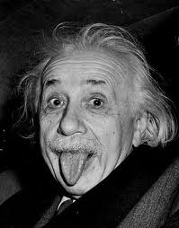
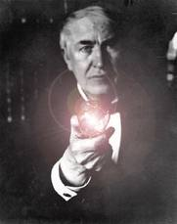
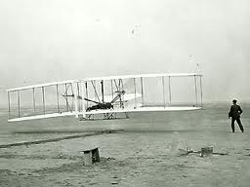
failures are in good company
teachers described him as "mentally slow, unsociable, and adrift forever in foolish dreams."
“I have not failed. I've just found 10,000 ways that won't work.”
first flight – for 4 years, methodically built on successive failures to achieve the first flight
Notes:
Einstein - did not speak until he was 4-years-old and did not read until he was 7. His parents thought he was "sub-normal," and one of his teachers described him as "mentally slow, unsociable, and adrift forever in foolish dreams." He was expelled from school and was refused admittance to the Zurich Polytechnic School. He did eventually learn to speak and read. Even to do a little math.
Einstein didn't like to study except for those things that interested him. Albert was interested in mathematics and philosophy. He just didn't bother with the other stuff.
A high school official wanted young Einstein expelled from school. The teacher complained that Einstein never said anything. He just sat in the back of the class and smiled. At the age of sixteen Albert dropped out of school. (although he then went to another school due to his growing math prowess, which he graduated from the next year)
Edison – took 2 years of failed attempts to make a lightbulb – fast iteration and failure
“I am not discouraged, because every wrong attempt discarded is another step forward”
“I have not failed. I've just found 10,000 ways that won't work.”
“Many of life's failures are men who did not realize how close they were to success when they gave up.”
“Nearly every man who develops an idea works at it up to the point where it looks impossible, and then gets discouraged. That's not the place to become discouraged.”
http://quotations.about.com/od/stillmorefamouspeople/a/ThomasEdison3.htm
http://www.forbes.com/sites/nathanfurr/2011/06/09/how-failure-taught-edison-to-repeatedly-innovate/
Wright Brothers – first flight – for 4 years, methodically built on successive failures to achieve the first flight
http://failuremag.com/index.php/feature/article/get_your_wings/
After four-and-a-half years of extensive research and experiments, the Wright Brothers made manned flight a reality on December 17, 1903

Slide 31
when your parents tell you not to take that risk…
“cynics never do the impossible, achieve the improbable, take on the inadvisable. Hope is only path to extraordinary success”
Anonymous tweet

Slide 32
improbable is not unimportant
‹#›
Notes:
Biofuels… 7-8 investments, each have a different appraoch. Intelligently analyzed, chose the best teams, and viable approaches. You don’t see an algae investment, but we’ve done our homework.
Storage, different battery approaches, even CAES
Solar: Izar, SiWire, Stion, Cogenra

Slide 33
“mindset”
Notes:
critical factor in rate of innovation

Slide 34
dream the dreams
… & be foolish enough to try and make them come true
Notes:
Reading about Intel, soy milk company

Slide 35
you don't do extraordinary things by attempting ordinary things, reasonable things
be unreasonable!
‹#›
Notes:
Getting into GSB, datadump, … Sun

Slide 36
shoot for the moon!
Notes:
Moon or bust @ Sun;
Juniper,
Infinera

Slide 37
question everything
…especially your teachers

Slide 38
if you’re not failing, try harder & more!
…you’re not taking enough risk, you are not on the edge
Notes:
Read about intel when he was 16 (in 1972)
Soy milk – age 20 in delhi – no phone
MBA 1980
Daisy

Slide 39
with persistence!
… like my stanford MBA admittance
Notes:
Read about intel when he was 16 (in 1972)
Soy milk – age 20 in delhi – no phone
MBA 1980
Daisy

Slide 40
Push yourself :
good isn’t good enough….great is barely acceptable
Notes:
Eviction,… chasing goals , breaking the rules … but not always figuring it out
…fun, attitude, bravado,….

Slide 41
with fun, attitude, bravado, irreverence….
Notes:
Eviction,… chasing goals , breaking the rules … but not always figuring it out
…fun, attitude, bravado,….

Slide 42
with guts and premature confidence
…and paranoia
Notes:
Kodak, Cerrent,
Excite netscape bid
-Cisco,….

Slide 43
admit when you’ve failed –
just get up and get going again
Notes:
Getting into GSB, datadump, … Sun

Slide 44
jump without a parachute (& annoy your parents)
…create necessity
Source: On being Certain – Robert Burton
Notes:
investigating the neuroscience behind certainty, and finds that certainty is a feeling like any other, but comes from a localized and primitive region in the brain
This means that the feeling of knowing something to be true is actually incredibly strong and unrelated to the existence of contradictory evidence
Not only that, it’s genetic! Some people naturally get the feeling of knowing much easier than others.
For the entrepreneur in a startup: regardless of the risks and low probabilities, the entrepreneur will not give up because of the certainty the entrepreneur feels in his venture.
Certainty actually feels good, rewarding, even. And since we validate our conclusions internally through feelings rather than reason, certainty can drive the entrepreneur. It’s like jumping out of a plane without a parachute in a state of seemingly ignorant bliss.

Slide 45
get into trouble with no easy way out
Notes:
In situations when most people would throw in the towel given the enormity of the issues, entrepreneurs, driven by the need for funding, religious beliefs in their passions and mission, keep going and become even more creative problem solvers.
In this world, where only the paranoid survive, but the overconfident innovate, there is a value to what I call “ignorant bliss.” It is not unlike jumping out of a plane without a parachute and having to find a way to land softly while in free fall.
Whether one does or does not know that a parachute is necessary, once in the situation, the innovator must create something (maybe a parachute and maybe some new contraption altogether) to survive!
My experience is that innovators with their backs against the wall think bolder, solve the toughest problems and search much more broadly for solutions. If you’re too comfortable or complacent, you lack the drive, passion and obsession of needing to get through the next milestone! Teams with a safety net don’t push as hard, or they give up and take the easy road when things get tough. Entrepreneurs/innovators focus on experimentation and iteration driven by their naivety/religion/passion; belief in intuition may be more important than intuition itself. This is because intuition can serve a valuable purpose of getting you into a lot of trouble (your overconfidence and naivety leads one to ignore all the problems the experts could have told you about), creating a moment where you panic (“oh shit!”) and then innovate your way out, because necessity is the mother of invention.
“getting people in trouble when they have no easy way out but to bang their head against the wall or be creative about solutions” is a powerful technique in fostering innovation. In situations when most people would throw in the towel given the enormity of the issues, entrepreneurs, driven by the need for funding and almost religious beliefs in their passions and mission, keep going and become even more creative problem solvers. In this world, where only the paranoid survive – but the overconfident innovate – there is a value to what I call “ignorant bliss.” It is not unlike jumping out of a plane without a parachute and having to find a way to land softly while in free fall. Whether one does or does not know that a parachute is necessary, once in the situation, the innovator must create something (maybe a parachute and maybe some new contraption altogether) to survive!

Slide 46
be obstinate about your vision, not your tactics

Slide 47
know when to stick to it, and when to bail

Slide 48
make each failure as small as possible

Slide 49
and when you fail – ask lots of questions

Slide 50
beware : failed strategies vs. failed tactics
Notes:
There is a big – but often ignored – difference between a failed strategy and a failed tactic
There were many a Facebook like strategies that predated Facebook, including Orkut, Myspace and Friendster (Good examples of why the thinking that “it’s been tried it before and it won’t work” is only true until it’s suddenly not
Google vs altavista
Ipod vs Mp3 players

Slide 51
some assumptions will be wrong in 10 years
most will be wrong in 20

Slide 52
…will we need doctors?
…will we need teachers?

Slide 53
“the best way to predict the future is to invent it”
Alan Kay
Notes:
I add: the more entrepreneurial way is not to forecast the future by extrapolating from the past but rather to “invent the future one wants.”

Slide 54
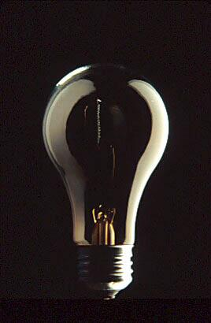
Comments?
Notes:
critical factor in rate of innovation

