Slide 1



Activating Untapped Talent in Your Region Template
The Case for STARs
Notes:
This is an instruction slide. Delete this slide before presenting to your partners.

Slide 2


About This Deck
This template is designed to support government leaders who are championing skills-based practices in their organization to make the case for workers Skilled Through Alternative Routes (STARs) instead of a bachelor’s degree to address workforce challenges.
It provides a helpful outline that can be tweaked to a particular state, region or locality to deliver a customized narrative about who STARs are and how they can expand the talent pool of workers using STARSight. STARSight is a free, dynamic resource that can pull data and create visualizations to empower decision-makers with the data needed to drive action.
This deck includes talking points in the speaker notes. Directions for how to complete this template can be found in the Companion Guide on the STARSight Help Center.
Notes:
This is an instruction slide. Delete this slide before presenting to your partners.

Slide 3

How to Use This Template
Each section is designed with our recommendations to drive a relatable narrative, using common points of interest.
We are using Pennsylvania and the metro area of Philadelphia as the examples throughout the deck.
Use all, use some – you decide!
Many of the slides relating to national level data are ready to use as-is.
Look for guidance in the Companion Guide for instructions on how to enhance a slide or create a new version unique to your state or region.
Talking points have been provided in the speaker notes for Section 2.
For slides leveraging STARSight data, we have included step-by-step instructions to replicate.
Citations are provided on each slide throughout the deck for Section 2 and Section 3. These denote where the data is found for visualizations and data pulled from STARSight.
Notes:
This is an instruction slide. Delete this slide before presenting to your partners.

Slide 4

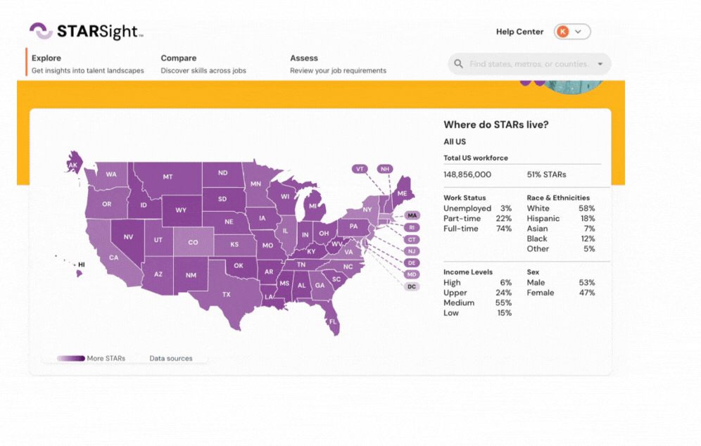
Getting started with STARSight
STARSight is an interactive digital dashboard that synthesizes the latest national labor market data - about jobs and workers - into intuitive actionable insight.
If you haven’t already,
please create a free account
at starsight.org
Notes:
This is an instruction slide. Delete this slide before presenting to your partners.

Slide 5

A Note About the Data Available in STARSight
STARSight utilizes a number of data sources to help better understand the opportunities available for STARs.
This page on STARSight details the datasets and methodologies
that help shine a light on STARs, critical contributors to the labor force.
In many cases, estimates provided on STARSight are based on survey data. While this survey data is designed to be representative of the local workforce, estimates may be less reliable for smaller populations. Therefore, users should exercise caution when making interpretations based on detailed worker subpopulations.
Source: Opportunity@Work analysis of the US Census Bureau 2021 American Community Survey as distributed through IPUMS USA, Version 10.0
Notes:
This is an instruction slide. Delete this slide before presenting to your partners.

Slide 6


Table of Contents
Use these sections to support constructing a compelling narrative.
01.
Your Region’s Workforce Needs
02.
Introduction to STARs
03.
Seeing STARs
in Your Region
04.
Next Steps
Set the stage by connecting stakeholders with your shared workforce needs.
Give a brief overview of who STARs are and what skills they have at the national level.
Describe who STARs are, where they live, and what skills they have in your particular region.
Close out the presentation with a few concluding thoughts and tangible next steps to compel action.
Notes:
This is an instruction slide. Delete this slide before presenting to your partners.

Slide 7
Activating Untapped Talent in [Region]
The Case for STARs
Notes:
Slide Instructions: Insert your region or state’s name in [Region]

Slide 8
[Your Region]’s Workforce Needs
Notes:
Slide Instructions: Insert your region or state’s name in [Your Region]

Slide 9

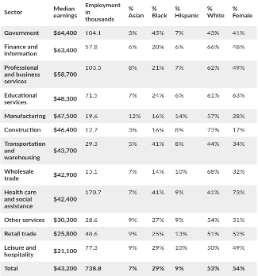
Looking Back
Pre-pandemic times (2010-2019)
Economy performed pretty well, matching or outperforming the national averages for job creation
Job gains were not created equal:
Largest growth was in roles that required a
higher level of education and training
High concentration of jobs in low wage
sectors
Poverty rate was highest of 10 largest cities
EXAMPLE - REPLACE
Source: Pew Charitable Trusts: How the Pandemic has Affected Philadelphia’s Economy and Jobs, February 9, 2022
Notes:
Slide Instructions: Delete this slide before presenting to your partners and replace it with a slide that addresses your current workforce challenges and/or needs. Insert your own talking points based on your region or state’s current workforce challenges and/or needs. See Companion Guide for additional instructions.
Talking Points:

Slide 10
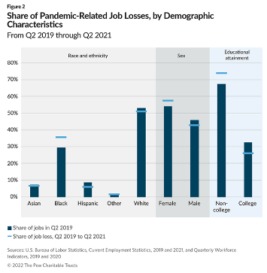
Pandemic Job Losses
What happened and who was affected
City and region has recovered much slower than rest of the country; job rates are still not at pre-pandemic levels
Blacks, women, and non-degree holders were disproportionately affected by job losses
Job losses were largest in low wage sectors (24.2% of jobs lost in leisure and hospitality)
EXAMPLE - REPLACE
Sources: Pew Charitable Trusts: How the Pandemic has Affected Philadelphia’s Economy and Jobs, February 9, 2022; Pew Charitable Trusts: How can Philadelphia Grow Middle Wage Jobs, November 16, 2022
Notes:
Slide Instructions: Delete this slide before presenting to your partners and replace it with a slide that addresses your current workforce challenges and/or needs. Insert your own talking points based on your region or state’s current workforce challenges and/or needs. See Companion Guide for additional instructions.
Talking Points:

Slide 11
Introduction to STARs

Slide 12
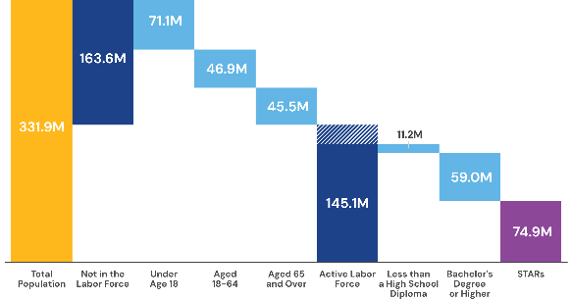
Who Are STARs
The majority of US Workers are Skilled Through Alternative Routes
STARs are workers who are Skilled Through Alternative Routes. STARs are aged 25 or older, active in the labor force, have a high school diploma or equivalent, and have developed their skills through alternative routes such as community college, apprenticeships, bootcamps, and most commonly, and through on-the-job experience.
There are more than 70 Million STARs in the US Labor Force
* Estimates are limited to the civilian, non-institutionalized, labor force aged 25 and older. This excludes approximately 23.3 million workers.
Source: Opportunity@Work analysis of the 2021 1-Year American Community Survey, Integrated Public Use Microdata Sample.”
Notes:
Talking Points
Of the approximately 145 million American workers who are active in the labor force today, about 59 million have a college degree or higher level of educational attainment. These workers have traversed a pathway in higher education that is critical to our workforce.
However, 74 million, or more than half of our entire active workforce, are workers that are Skilled Through Alternative Routes (STARs), including military service, community college, boot camps, other training and, most commonly, learning on the job by showing up day in and day out.
TRANSITION TO NEXT SLIDE: However, STARSs face many barriers in the workforce.

Slide 13




Degree requirements, social networks and misperceptions present barriers to STARs
50+%
of Managers overestimate the proportion of the workforce who do have a bachelor’s degree
70%
of new jobs between 2012 and 2019 were in occupations where employers typically require a 4-year college degree
3x
Degree holders are 3 times more likely to have a strong network than non-degree holders in the USA
*Opportunity@Work analysis of typical entry-level education categories from the Bureau of Labor Statistics Employment Projections program and the 2012 and 2019 Annual Social and Economic supplement to the Current Population Survey, Integrated Public Use Microdata Series. Citation: Reach for the STARs *** Spotlight on STARs in the Workplace.
Notes:
Talking Points
STARs face degree barriers. 70% of new jobs added to the labor market in the past decade are ones where employers frequently require a degree. Yet we see STARs make up 50% of the workforce.
STARs face barriers in their professional networks. In research done by Opportunity@Work and LinkedIn, they found that workers with a BA degree have professional networks that are 3x as strong as STARs.
STARs also face incredible misperceptions. The majority of managers in this country believe the majority of the workforce has a degree. This impacts managers’ perceptions of who should get jobs, and how they should invest in their workforce.
TRANSITION TO NEXT SLIDE: All of which contributes to STARs being left behind.

Slide 14
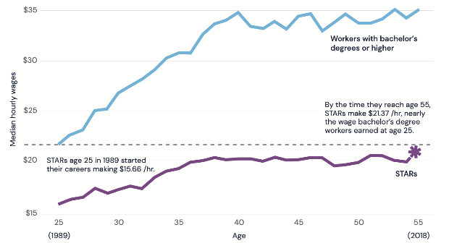
A Generation of STARs Have Lost Mobility
Median wages, Age 25 to 65
It takes a STAR 30 years to reach the starting wages of a recent college graduate.
In other words, our labor market equates four years of learning in college with three decades of work experience.
Workers with a BA+
STARs catch up to BA workers 30 years into their career
Median hourly wage
.
.
.
STARs
Age
Note: Median hourly wages in 2019 dollars for workers aged 25 to 29 in 1989. Dotted line indicates median hourly wages for workers with a bachelor’s degree at age 15 ($21.59).
Source: Adapted from Blair, Debroy, and Heck (2021). Data are from the 1989 to 2019 Current Population Survey, Annual Social and Economic Supplement, Integrated Public Use Microdata Series.
Notes:
Talking Points
There has always been a wage gap between STARs and workers with degrees but this gap has widened over the past 30 years.
When a STAR entered the workforce in 1989 at the age of 25, they were earning less than the worker with a bachelor’s degree. That has traditionally been the case.
Thirty years into their career, at the age of 55, STARs just start to earn what the bachelor’s degree worker was earning at the beginning of their career at age 25.
STARs today never catch up to their degreed counterparts, making this the first generation that does not do better than their parents.
We are effectively equating four years of education with 30 years of work and lived experience.
TRANSITION TO THE NEXT SLIDE: When we fail to provide career opportunities to STARs, we leave behind half of American workers. This affects large groups within our labor force.

Slide 15
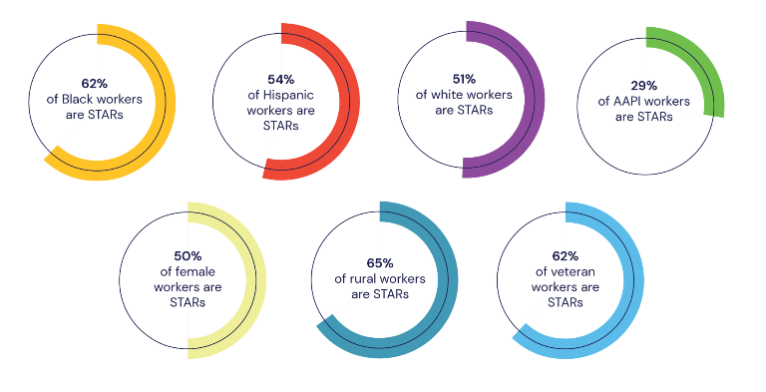
Race Equity: STARs of all backgrounds held back, including majorities of Black & Hispanic workers
Source: Opportunity@Work Analysis of the 2021 1-year American Community Survey Integrated Public Use Microdata Series.
Notes:
Talking Points
When we leave behind STARs, we leave behind: 62% of Black workers, 54% of Hispanic workers, 65% of rural workers, 62% of veterans -they’re all STARs.
As you can see, STARs represent the majority of many demographic groups.
TRANSITION TO NEXT SLIDE: Let’s see how this leaving behind STARs is playing out in the labor market.

Slide 16
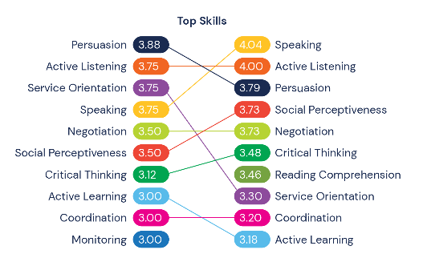
Many STARs Have the Skills for Higher-Wage Work
Occupation:
Retail Salesperson
Wage:
$18.75/hour
Occupation:
Sales Representative, Wholesale
Wage:
$31.25/hour
This figure shows the high skills overlap between two sales roles. The first is accessible to STARs, while the second is less so. About 96,000 STARs have made this transition in the five-year period from 2017 to 2021.
Source: Opportunity@Work analysis of the O*NET 25.3 Database and 2017 to 2021 Current Population Survey, Annual Social and Economic Supplement, Integrated Public Use Microdata Series.
Notes:
Talking Points
All of us bring skills to our jobs every day - some of these skills we learned through college, many of them we gained on the job.
Let’s look at the retail salesperson as an example: they bring persuasion, active listening and speaking skills to their job every day. Those skills position them for many other jobs in the US labor market. This is an example of how skills are used by a worker to make a transition to another job that pays more: the sales representative occupation - the occupation you see on the right side of the page.
TRANSITION TO THE NEXT SLIDE: This visual just shows you one transition but Opportunity@Work has studied millions of them.

Slide 17
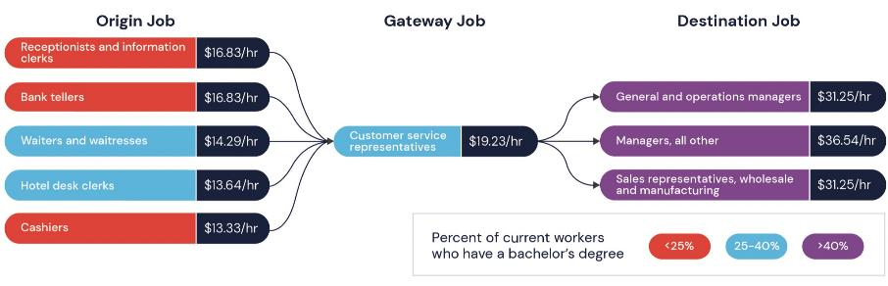
Study of 130 million worker transitions shows STARs Achieve Mobility Through Gateway and Destination Jobs
Note: Wages calculated for workers aged 25 and older.
Source: Opportunity@Work analysis of the 2021 Current Population Survey, Annual Social and Economic Supplement, Integrated Public Use Microdata Series.
Notes:
Talking Points
Opportunity@Work has studied 130 million transitions that workers made in the labor market in the past 10 years to understand when, and how STARs translate their skills to higher wages. What they found is that STARs do make transitions to higher wages, using their skills, and when they do, they move to a job they would call a Gateway job or a Destination Job. There are about 300 Gateway or Destination jobs. Of the 300, 50 jobs are Gateway jobs: jobs workers move to from lower wage occupations that allow them to experience further wage mobility.
TRANSITION TO THE NEXT SLIDE: You can think about this movement from origin job to gateway job to destination job as pathways to upward mobility & financial security.

Slide 18
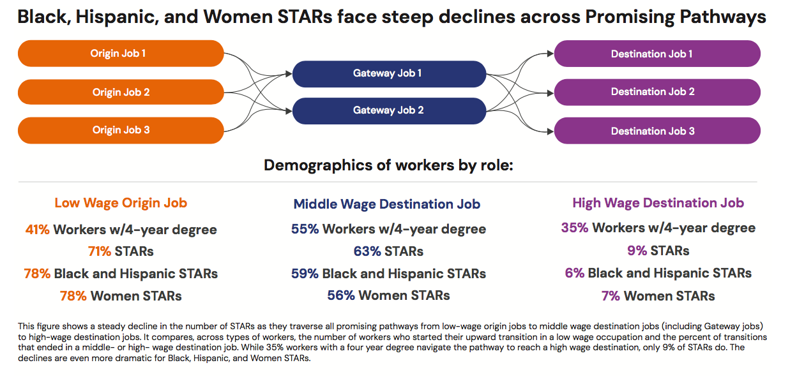
These pathways are often blocked, especially for Hispanic and Black STARs; also inequitable for women
Notes:
Talking Points
You can also see that STARs do not experience these pathways equitably: Black and Hispanic STARs are less likely to make these upwardly mobile transitions, as you’ll see in the percentages noted at the bottom half of the slide. When they do move upward, they - along with women - likely do not meet wage parity with their male counterparts.

Slide 19
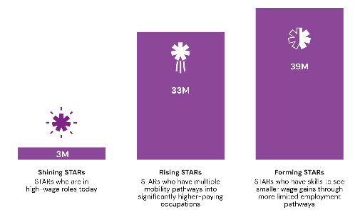
Nationally, more than 30 million STARs are ready for higher-wage work - today
Ready for higher wage work today!
When we analyze the skills overlaps across jobs, we can identify STARs’ potential transitions from their current job to a higher paying one.
3M Shining STARs are in high wage roles today
33M Rising STARs are in jobs with skills that position them for jobs in a higher wage category
39M Forming STARs are in jobs with skills with a smaller wage gain
Source: Opportunity@Work analysis of the Occupational Information Network (O*NET) 27.3 Database; 2013 to 2022 Current Population Survey, Annual Social and Economic Supplement; 2021 1- and 5-year American Community Survey, Integrated Public Use Microdata Series.
Notes:
Talking Points:
There are over 70 million STARs working in the country today.
The skills profiles within the STARs talent pool vary – but we know there are millions who are being held back by the “paper ceiling.”
By analyzing the skills required for their current job, we segmented STARs based on their skills-readiness for higher-wages.
The results reveal three distinct STARs segments, each with specific implications for employers, workforce development organizations and policy makers. Our research shows that:
3M Shining STARs are in high wage roles today - these are the folks who have broken through the paper ceiling and are in high-wage roles, even in a system set-up to screen them out
33M Rising STARs are in jobs with skills that position them for jobs in a higher wage category - these are the workers being held back by the “paper ceiling.” They are the ready for higher wage work today.
39M Forming STARs are in jobs with skills with a smaller wage gain. These folks may benefit from more training or work experience to build new skills

Slide 20
Seeing STARs in
[Your Region]

Slide 21
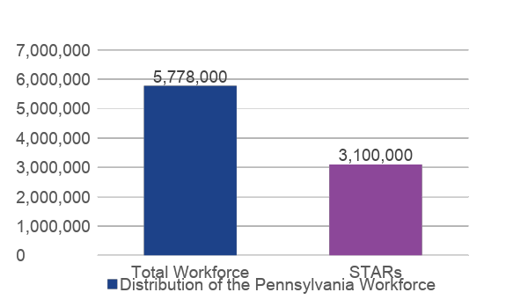
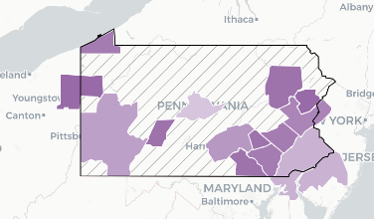
The Majority of Workers in Pennsylvania are STARs
STATE EXAMPLE
There are nearly 3.1 million STARs in Pennsylvania: 53%.
EXAMPLE - REPLACE
.
.
.
Note: We exclude workers under the age of 25 from our analysis of the labor force to ensure that the majority of the population studied has completed their education.
Source: Opportunity@Work analysis of the US Census Bureau 2021 American Community Survey as distributed through IPUMS USA, Version 10.0
Notes:
Slide Instructions: Delete this slide before presenting to your partners and replace it with a slide that shares data on STARs in your region or state. Insert your own talking points based on your region or state’s data on STARs. See Companion Guide for additional instructions.
Talking Points:

Slide 22
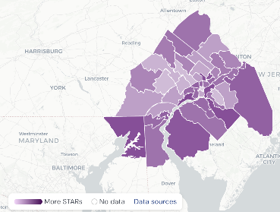
More than 1.4 million workers in Greater Philadelphia are STARs
REGION EXAMPLE
EXAMPLE - REPLACE
That means just
about half
of the region’s workforce are STARs.
Note: We exclude workers under the age of 25 from our analysis of the labor force to ensure that the majority of the population studied has completed their education.
Source: Opportunity@Work analysis of the US Census Bureau 2021 American Community Survey as distributed through IPUMS USA, Version 10.0
Notes:
Slide Instructions: Delete this slide before presenting to your partners and replace it with a slide that shares data on STARs in your region or state. Insert your own talking points based on your region or state’s data on STARs. See Companion Guide for additional instructions.
Talking Points:

Slide 23
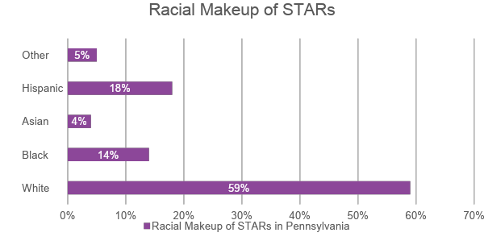
STARs Represent the Full Diversity of The State Workforce
STATE EXAMPLE
STARs not only have the skills to fill in-demand roles, they represent the diversity of our country; screening in STARs naturally adds greater diversity to your talent pool
EXAMPLE - REPLACE
Source: Opportunity@Work analysis of the US Census Bureau 2021 American Community Survey as distributed through IPUMS USA, Version 10.0
Notes:
Slide Instructions: Delete this slide before presenting to your partners and replace it with a slide that shares data on STARs in your region or state. Insert your own talking points based on your region or state’s data on STARs. See Companion Guide for additional instructions.
Talking Points:

Slide 24
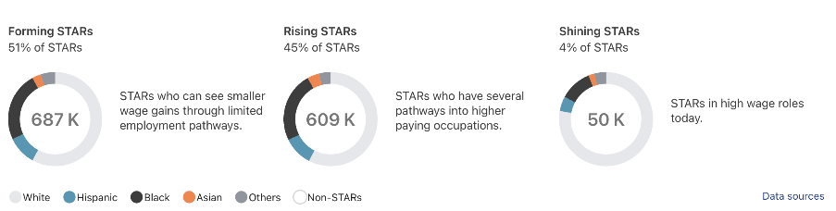
There are 609K STARs who have skills for higher wage work in Philadelphia right now
REGION EXAMPLE
EXAMPLE - REPLACE
Source: Opportunity@Work analysis of the US Census Bureau 2021 American Community Survey as distributed through IPUMS USA, Version 10.0
Notes:
Slide Instructions: Delete this slide before presenting to your partners and replace it with a slide that shares data on STARs in your region or state. Insert your own talking points based on your region or state’s data on STARs. See Companion Guide for additional instructions.
Talking Points:

Slide 25
Next Steps

Slide 26
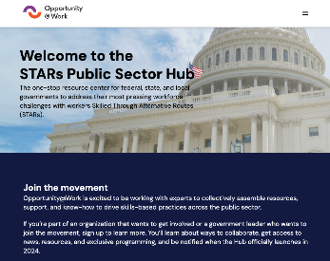
Explore the STARs Public Sector Hub
The Hub equips government leaders with the resources, relationships, and know-how needed to tap into STAR talent through skills-based practices.
Become a member to access:
ANALYTICS & INSIGHTS
NARRATIVE DESIGN
Trusted data about the workforce, local employer demand and needed skills to identify unique opportunities for employers to leverage STARs
Proven, effective messaging based on research and testing that is tailored to each region
RESEARCH & RESOURCES
COMMUNITY
Research that results in the design and delivery of trusted resources, like playbooks, case studies, tools, templates, and products
Participatory and collaborative engagement of government leaders to learn from one-another, crowdsource ideas, and build shared solutions
Sign-up: https://opportunityatwork.org/stars-policy-project/public-sector-hub/
Notes:
Talking Points
To continue your journey of supporting STARs and skills-based hiring consider joining Opportunity@Work’s STARs Public Sector Hub. The Hub will equip you with the resources, relationships, and know-how needed to tap into STAR talent through skills-based practices.
Becoming a member will allow you to access analytics and insights, research and resources, narrative design, and community.

