Slide 1

Postpartum Psychosis

Slide 2
Objectives
Identify signs and symptoms of postpartum psychosis
Understand risk factors for development of postpartum psychosis
Management of postpartum psychosis
Strategies for prevention of postpartum psychosis

Slide 3
Postpartum Psychosis: Diagnosis
Not included in DSMV
A new occurrence of the following symptoms within 6 weeks postpartum
Mania/mixed episodes with or without psychotic features
Depression with psychotic features
Psychosis without mood symptoms
Bergink, 2016

Slide 4
Postpartum Psychosis
Occurs in 1-2/1000 deliveries
Symptoms often develop quickly after delivery
90% of all postpartum psychotic episodes occur within the first four weeks after delivery
60% of all postpartum psychotic episodes occur within the first 2 weeks after delivery
Typical time of symptom onset is between postpartum day 3 & 10
Bergink, 2016

Slide 5
Postpartum Psychosis: Contributors
Postpartum hormonal shifts
Obstetrical Complications
Sleep Deprivation
Increased Environmental Stressors
Significant hormone changes may alter dopamine regulation and sensitivity
Immunological changes
Bergink 2012; Bergink, 2016

Slide 6
Postpartum Psychosis: Symptoms
Insomnia
Rapid, Intense Shifts of Mood
Restlessness
Irritability
Often present with a delirium-like picture:
- Disorientation
Confusion
Derealization
Depersonalization
Symptoms may Wax and wane
Mania, depression, mixed state
Bergink, 2016

Slide 7
Postpartum Psychosis: Symptoms
Often experience mood-incongruent delusions, often focusing on childbirth and infant
Obsessive thoughts of the newborn
May include thoughts of harm to the infant which are ego-syntonic (They are comfortable with these behaviors and don't feel guilty or want to change them.)
Among hospitalized individuals with postpartum psychosis, 28-35% described delusions about infants, 9% had thoughts of harming infant
Loss of reality testing
Bergink, 2016; Chandra, 2006

Slide 8
Postpartum Psychosis: Risk Factors
Rate is 100X higher in women with bipolar disorder or history of postpartum psychosis
Relapse rates for individuals with history of postpartum psychosis is 20-50%
Majority of patients admitted with postpartum psychosis do not have a prior psychiatric disorder
Postpartum psychosis 3-4x more likely in first time moms (if first pregnancy is not complicated by postpartum psychosis, risk drops substantially for future pregnancy)
Chandra, 2006; Bergink, 2016; Bergink, 2011

Slide 9
Postpartum Psychosis: Safety
2/1000 women with postpartum psychosis die by suicide
4% of women with postpartum psychosis commit infanticide
Psychiatric Emergency- inpatient admission recommended
Chandra, 2006

Slide 10
Postpartum Psychosis: Etiology
Unique Diagnostic Etiology (estimated 20-50% of episodes will only occur in the postpartum period)
Bipolar disorder (estimated 50-80% will go on to develop mood symptoms outside of the perinatal period consistent with bipolar affective disorder)
Bergink, 2015

Slide 11
Postpartum Psychosis: Etiology
Variant of Bipolar disorder
By far, the most important risk factor for postpartum psychosis is a history of bipolar disorder
95% of postpartum psychosis cases fulfilled research diagnostic criteria for bipolar disorder at 5 year follow up
One study showed 260/1000 deliveries of women with diagnosis of bipolar disorder developed postpartum psychosis (as compared to 1-2/1000 of non-bipolar disorder women
Bergink, 2015

Slide 12
Postpartum Psychosis: Etiology
Unique Diagnostic Entity
Unique risk profile phenomenology
Absence of Manic or psychotic symptoms outside the postpartum period
For some women, the occurrence of a postpartum episode of affective psychosis will remain exclusively limited to the postpartum period
Bergink, 2015

Slide 13
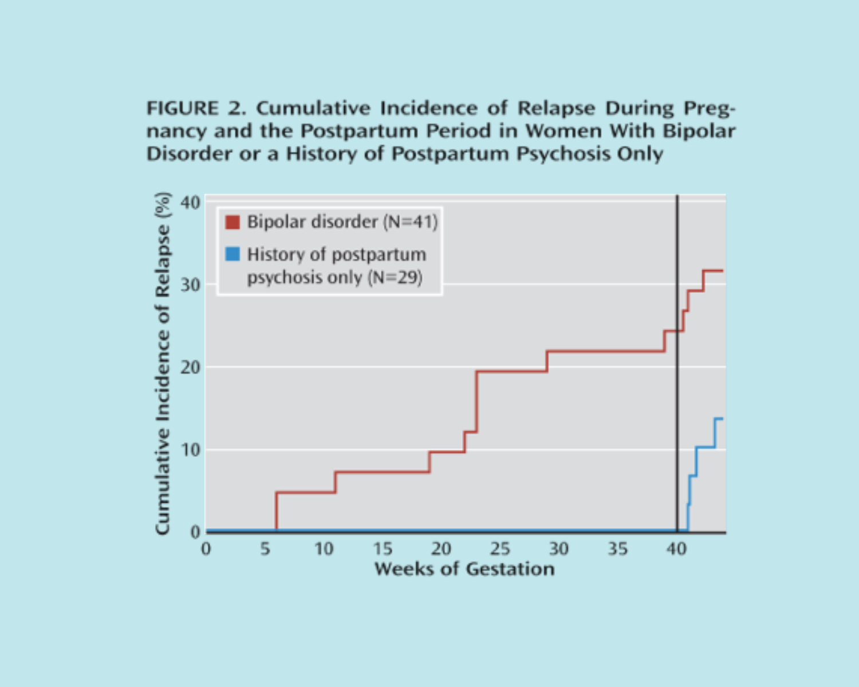

Slide 14
Postpartum Psychosis: Evaluation
Ruling out other causes
Obtain labs:
TSH, T4, TPO antibodies, ammonia level, UA, UDS
Perform physical and neurological examinations
If neurologic sx are present consider imaging, CFS analysis
Bergink, 2016

Slide 15

Postpartum Psychosis: Care Manager
Symptoms occur quickly after delivery, often within the first few days/weeks.
Delirium like presentation
Assess for concerns/delusions surrounding infant
Is associated with suicide and infanticide
Recommendation for inpatient admission

Slide 16
Postpartum Psychosis: Care Managment
Psychotic symptoms can be overlooked due to fluctuation of sx or hidden sx. Important to ask both patient and family about symptoms
Direct questions about suicide and infanticidal thoughts
Collaborating with partners/family members can be helpful in monitoring medication compliance, maternal and infant safety monitoring and support of patient
Bergink, 2016

Slide 17
Treatment of Postpartum Psychosis
Step 1: Benzodiazepines QHS
allows for restoration of sleep and can lead to recovery in a subgroup of patients
Step 2: Add Antipsychotic Medication
Step 3: Add lithium – usually needed in bipolar diagnosis
Step 4: ECT
Bergink, 2015;
Bergink, 2016

Slide 18
Treatment
Identify and engage the birthing person’s significant other/family who will be allies in their treatment and recovery
Re-stablish regular sleep and circadian patterns will be important in recovery
Careful discussion and balance of benefits of breastfeeding and it’s risks of disrupting sleep
Maintenance treatment with lithium during first 6-9 months postpartum with gradual taper in women who have only postpartum episodes and remain in full clinical remission
Bergink, 2016

Slide 19
Treatment
Support self esteem
Confidence in mothering
Social and family function
Infant health and emotional development
Bergink, 2016

Slide 20
Psychosis in Postpartum period: Different Etiology
Schizophrenia-
Poor family planning
High risk for sexual assault
More likely to be unmarried with few social supports
Higher rate of unplanned/unwanted pregnancies
More likely to be victim of violence when pregnant
Risk of removal of children
Delayed recognition of pregnancy
Psychotic denial of pregnancy
Misinterpretation of labor signs
Precipitous/unassisted delivery
Nenonaticide
Robinson, 2012; Solari, 2009

Slide 21
Schizophrenia Risks
Risk of relapse @ 2yrs:
50% for no medication
15% for medication
Poor infant care
Rejection of the infant
Poor parental relationships
Suicide
Infanticide
Long-term failure to bond with the child
Delayed infant development
Failure to thrive
Robinson, 2012

Slide 22
Schizophrenia Management in Postpartum Patients
Checking for delusions
Patient knowledge of body changes and signs of labor
Evaluating for history of sexual assault
Recruiting social support for pregnancy and postpartum
and access to community services and transportation
Prenatal classes; Parenting classes
Assessment of capacity to care for newborn
Establish support systems
Medication management
Solari, 2009; Robinson, 2012

Slide 23
Postpartum Psychosis: Prevention
For individuals with Bipolar Disorder
Use of prophylactic/mood stabilizing medication both during and after pregnancy is recommended to prevent postpartum psychosis
For individuals with only history of postpartum psychosis
- Medication prophylaxis at time of delivery (preferably lithium) may allow for avoiding pregnancy exposure
Bergink, 2016, Bergink, 2012

Slide 24
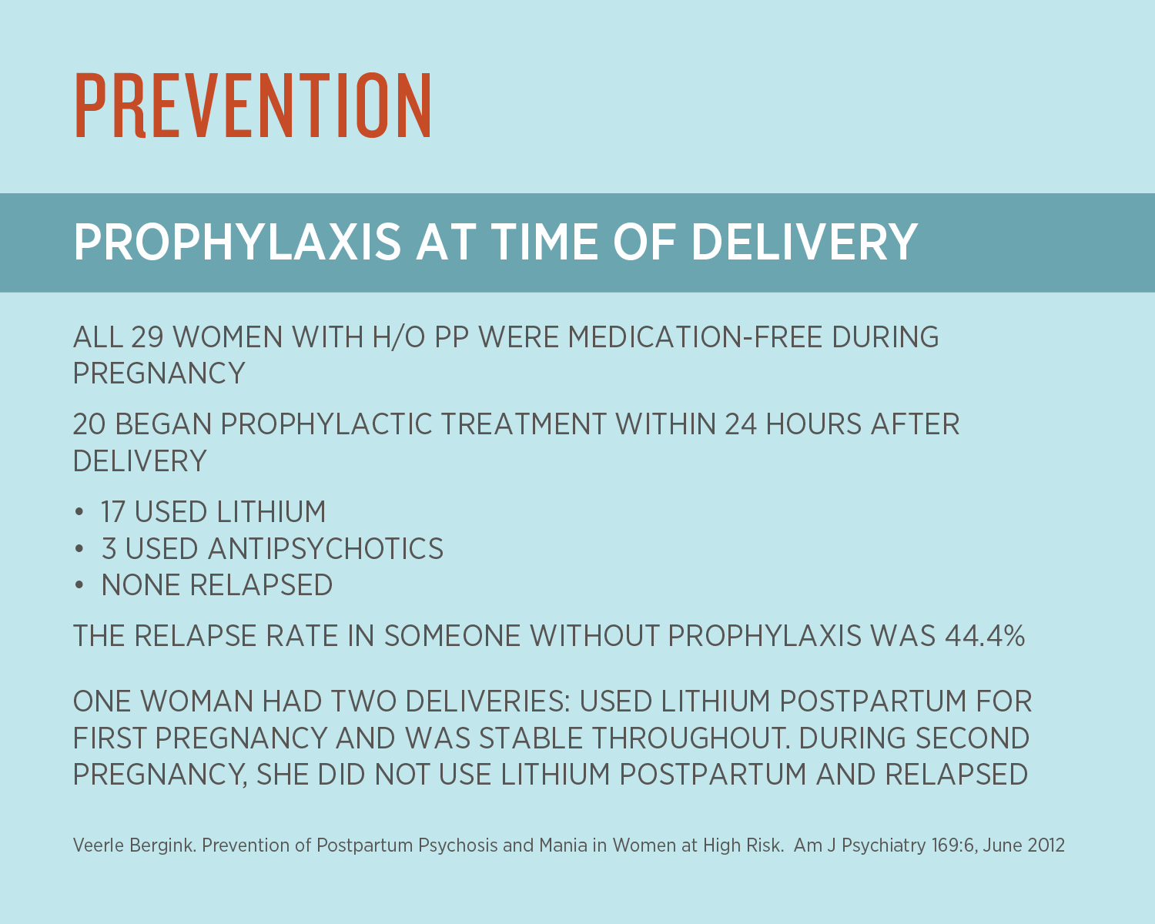

Slide 25
Postpartum Psychosis: Prevention
Develop an individualized postpartum relapse prevention plan in collaboration with the patient, family, and obstetrical and pediatric care professionals
Description of medication prophylaxis (during pregnancy and/or after delivery)
Progressive intervention strategies to be implemented, beginning with the earliest signs of prodromal symptoms of relapse
Coordination of pregnancy, labor and pain management plan with obstetrical team
Coordination with pediatric staff for monitoring of infant with in utero medication exposure
Preference for feeding (breast vs formula)
Strategies to assist in obtaining adequate sleep and maintain a stable circadian rhythm (partner/family to provide night feeding, sleep medication)
Stress management planning for the family
Support newborn attachment with family involvement
Bergink, 2016, Bergink, 2012

Slide 26
Postpartum Psychosis: Prevention
Before Hospital Discharge
Education regarding sleep
Minimization of stressors
Family psychoeducation
Close follow up required
Communication with OB and pediatrician
Robinson, 2012

Slide 27
Postpartum Psychosis: Summary
Postpartum psychosis is psychiatric emergency requiring inpatient admission and medication management
Prevention strategies and collaborative care are key to maintaining stability
Collaborative model offers early recognition needed for safety and treatment

