Slide 1

SI Screening protocol

Slide 2
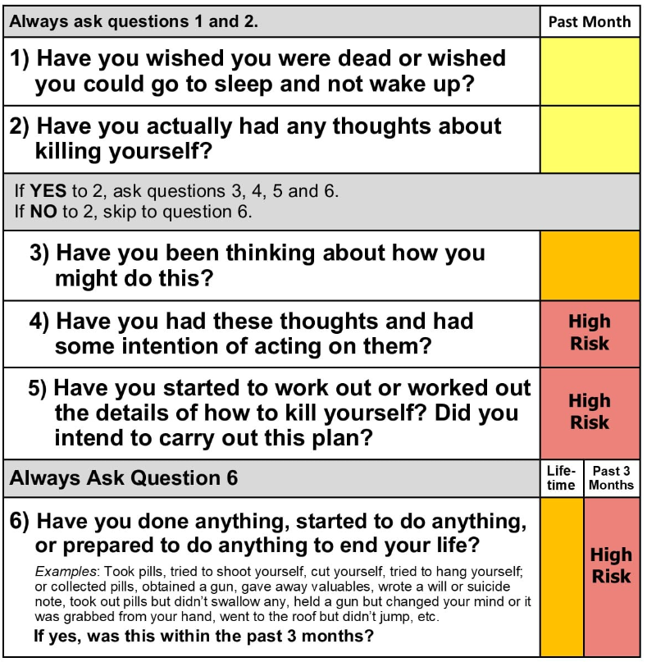

SI Screening and Management Algorithm
Positive SI (>0 on Question 9 on the PHQ-9)
C-SSRS
Screen was done in clinic
Screen was done via Care Registry
Contact CM who will Administer C-SSRS.
If CM unavailable, staff should complete CSSRS – send message to CM, and follow existing clinic protocol.
Patient is automatically screened with the C-SSRS via Care Registry
Care Manager follows up with patient based on Risk Level (next slide)

Slide 3
SI Screening and Management Algorithm
Care Manager Identifies Risk Level Based on C-SSRS
Risk Level: LOW
Risk Level: MODERATE
Risk Level: HIGH
Risk Level | Initial Response | Follow-up
LOW | Outreach to patient within 1 week and schedule appointment with Care Manager.
MODERATE | Outreach to patient within first business day and conduct Stanley-Brown Safety Plan. Schedule a follow up visit with a behavioral health clinician (patient’s Care Manager or outpatient therapist, ED, outpatient psychiatry, partial program, or IOP) within 3 days. Consult Perinatal Psychiatrist as needed. | If contact isn't made within 24 hours of initial outreach (or outreach via OB), then call emergency contact. If still no contact, have OB office schedule an appointment within a week. Care Manager coordinates with OB so they are available during that time.
HIGH | Outreach to patient within an hour and conduct Stanley-Brown Safety Plan. Care Manager will consult with perinatal psychiatrist. Patient must be evaluated by a behavioral health clinician within 24 hours of Care Manager observing positive screen. | If patient cannot be reached within 3 hours, then call emergency contact. If no contact made, call for a wellness check. Automated responses to high-risk scores will describe emergency response and encourage patients to answer their phones.

