Slide 1
“Re-naming or Re-Framing”
Rethinking terminology toward positivity and unified purpose
Timeliness - EViPRG consideration/debate regarding name
Irish services currently reconsidering issue
Reflections 2000-2025 [EVPRG/ENTMA/Practice]
Dichotomous perception aggression and violence management and seclusion and restraint reduction
Future pathway towards, narrowing the gap/ potentially unifying these endeavours,
Thoughts of group -
Kevin McKenna Dundalk Institute of Technology Ireland

Slide 2
“Re-naming or Re-Framing”
Rethinking terminology toward positivity and unified purpose
Relationship between A&V and S&R
Does all S&R function of A&V
Does all A&V result in S&R
Similarities and differences in training
Kevin McKenna Dundalk Institute of Technology Ireland

Slide 3
Aggression and Violence within Mental Health Services
Rosenbaum (1990) “from 1935 onwards, no reference whatsoever” until 1966 and “no article devoted to the subject until 1968” [p.115].
Prior to 1966 Rosenbaum suggested violence:
“was not frequent enough or considered important enough for clinical investigation” [p.115]. .
Rosenbaum 1990
Notes:
3

Slide 4
Aggression and Violence within Mental Health Services
Elkbolm (1970), reviewed the literature on violence by psychiatric patients between 1889 and 1970 in less than two and a half pages (Madden et al. 1976).
Lanza (1980) reported that her search of Medline found only 200 citations on patient assault.
Of these, only one dealt specifically with the frequency of assaults on nurses, and none examined nurse's reactions to being assaulted.

Slide 5
“Occupational Response”
US: The Occupational Safety and Health Act of 1970 mandates that, in addition to compliance with hazard-specific standards, all employers have a general duty to provide their employees with a workplace free from recognized hazards likely to cause death or serious physical harm.
“employers can be cited for violating the General Duty Clause if there is a recognized hazard of workplace violence in their establishments and they do nothing to prevent or abate it” [OSHA 2003 p.v]

Slide 6

https://hansard.parliament.uk/Lords/1988-07-26/debates/34d10ba1-b221-44b2-9ae9-7fbd0eaa5827/Dhss PublicViolenceToStaff Debated Tuesday 26 July 1988
Lord Skelmersdale: “Copies of the committee's report, …are today being sent to health authorities, family practitioner committees, ….services authorities and to managers within the Department of Social Security.
“We continue to be very concerned about violence against staff by members of the public and we take seriously our duty to protect those who work for us”

Slide 7
“Occupational Response”
UK Department of Health and Social Security (DHSS 1988) in 1986 held a special conference on aggression and violence toward staff which served as the impetus for much of the attention to the problem within healthcare since.
The conference conclusion stressed the special value and emphasis on training with a frequently cited caution that ‘effective training could, literally, be the difference between life and death’ (DHSS p.23).

Slide 8
U.K. Health Services Advisory Committee (1987)
UK (HSAC 1987, p.3): seminal study of 0.5% of the entire NHS personnel (n=5000) reported that aggression and violence was a
“is a significant problem” affecting:
a “wide range of occupations” affecting staff
“at almost any location” whatever their occupation or department’.
(1987 p3)
Notes:
8

Slide 9
UK NHS Security Management Service
58,695 physical assaults on NHS staff in England during 2005/06 by patients and relatives
41,345 assaults were against mental health and learning disability staff
Kevin McKenna Project Officer Programme on Work Related Violence Health Service Executive Ireland
Notes:
9

Slide 10


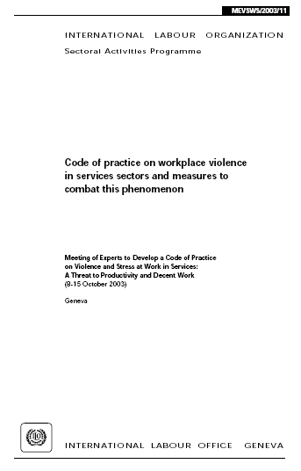
Universal Recognition
Notes:
10

Slide 11
Irish Context
Advisory Committee on Health Services Sector:
[ACHSS 2001]
“Two notable exceptions, needle stick injuries and assaults upon personnel”
aggression toward personnel..an occupational risk “peculiar to the health services”
3rd leading cause of accidents
14.9% of all occupational injuries in 2000
19% of insurance carrier notifications 1994-00
Factories Act 1955; Safety in Industry Act 1980; repealed by the Safety, Health and Welfare at Work Act 1989 and S.I. No. 237 of 1989 and S.I. No. 357 of 1995.
Notes:
11

Slide 12
Aggression and Violence within Mental Health Services
Initiatives that advanced
Training
Risk Assessments
Safewards
Initiatives less certain
Zero Tolerance

Slide 13
Seclusion and Restraint Reduction
Risks to service recipients
Practice dissatisfaction
Ideological
Rights based imperatives
Legal/regulatory
Notes:
13

Slide 14

Notes:
14

Slide 15
Hartford Courant Report [1998] “Deadly Restraint”
METHOD OF RESTRAINT | %
Physical restraints, therapeutic holds | 47.2
Mechanical restraints | 44.1
Combination physical & mechanical | 3.1
Seclusion-related | 5.5
Notes:
15
15

Slide 16
United States
General Accounting Office
“improper restraint and seclusion can be dangerous to people receiving treatment”
“we found that at least 24 deaths.. investigated in fiscal year 1998 were associated with the use of restraint or seclusion”
“We believe there may have been many many more deaths”
“federal and state regulations ..that govern the use of restraint… are not consistent”
Testimony Before U.S. Senate October 26, 1999
Notes:
5/15/25
Copyright McKenna K August 2009. No replication or reproduction by any means without prior written permission.
16

Slide 17
Seclusion and Restraint:
Diversity of Opinion
Conflicting professional/expert opinion:
Fisher (1994) concluded that it would be ‘nearly impossible’ to operate a mental health programme without access to some form of seclusion, physical or mechanical restraint.
Mildred, L. (2002) in California reframed the use of seclusion and restraint within mental health services as a ‘failure’ and ‘not a treatment’

Slide 18
Seclusion and Restraint:
Diversity of Practice
Steinert et al (2010) review from twelve European countries revealed huge differences between in the frequency of coercive interventions, the types of interventions used and the duration of their use.
Rates by percentage of admissions ranged for 3.3% to 35%,
Duration of interventions ranged from nine minutes to 1182 hours,
Number of interventions per 100,000 ranged from 0 to 580.
Steinert et al (2009) clinical vignette study of 16 EVPRG revealed a lack of clinical uniformity with variance of use including ‘net beds’ ‘involuntary medication intravenous’ and ‘physical restraint’ - interventions routinely used in one country were legally and/or ethically forbidden, or regarded as inhumane or unsafe in others.

Slide 19
California Department of Public Health (2012) Health Services Advisory Group White Paper: Chemical Restraint Use. California Department of Public Health
Opinion divided on the use of medication
experts disagreed on the use of enforced medication use in mental health, with
some perceiving it to be ‘chemical restraint’
while others proposed medications used to treat specific psychiatric illnesses should be considered treatment measures rather than a restraint.

Slide 20
Sees, D. L. (2009) Impact of the Health Care Financing Administration regulations on seclusion and restraint usage in the acute psychiatric setting. Archives of Psychiatric Nursing, 23. 277–282.
Investigation of restraint and seclusion use before and after new regulations imposed by the Health Care Financing Administration.
Fewer patients restrained or secluded (P ≤ .0005).
Less time spent in restraint or seclusion (P = .0011)
Keski-Valkama, A., Sailas, E., Eronen, M., Koivisto, A.-M., Lönnqvist, J. & Kaltiala-Heino, R. (2007) A 15year national follow-up: legislation is not enough to reduce the use of seclusion and restraint. Social Psychiatry and Psychiatric Epidemiology, 42. 747–752.
Notes:
20

Slide 21
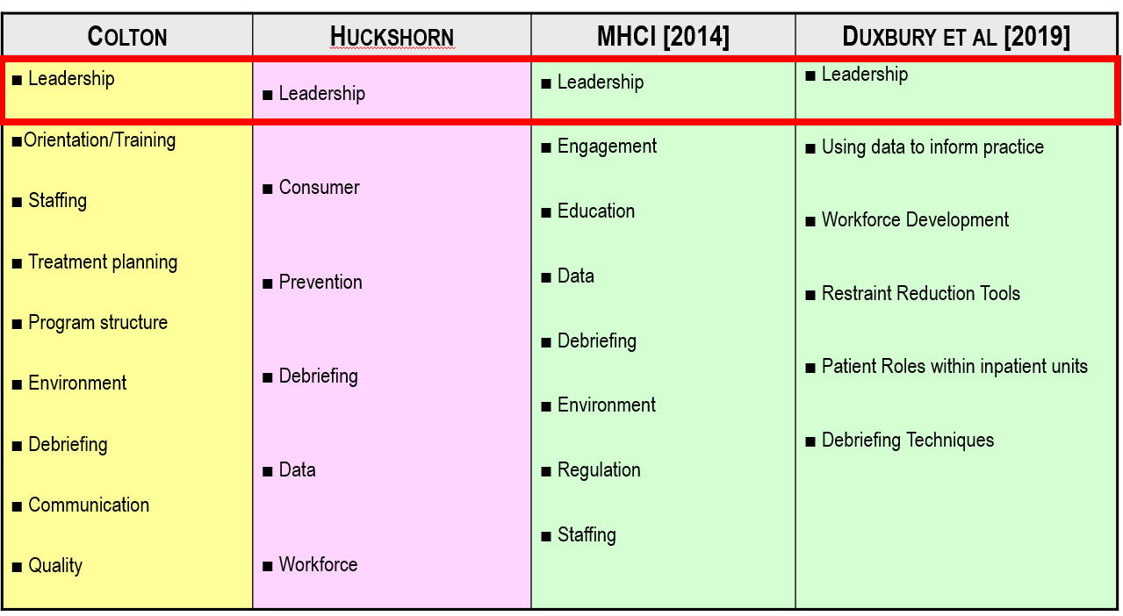

Slide 22
Focus | Aggression and Violence | Seclusion & Restraint Reduction
Drivers for Action [Controller?] | Health & Safety/Leglislative | Professional Bodies/Regulators
 | Risk Management | Practice Dissatisfaction
 | Safety =Hazard = Risk | Inherent Risk [to Service Users]
Primary Constituent | Staff | Service Users
Strategies | Training | Six Core Strategies
 | Risk Assessment | Colton Organisationl
 | Procedures | Frameworks [Re-Strain/Sophie]
Outcomes | Compliance Vs Prosecution | Compliance Vs Sanction
 | Improved Care Experience | Improved Care Experience
 | Improved Safety | Improved Safety

Slide 24
Debriefing: Caution
“term “debriefing” is widely used and means many different things….are many different types of “debriefings” in use
One needs to be very careful and know exactly what type of debriefing they are discussing. Precision in the use of terminology is extremely important.
Inaccurate definitions lead to faulty practice and flawed research. [Mitchell 2020]

Slide 25
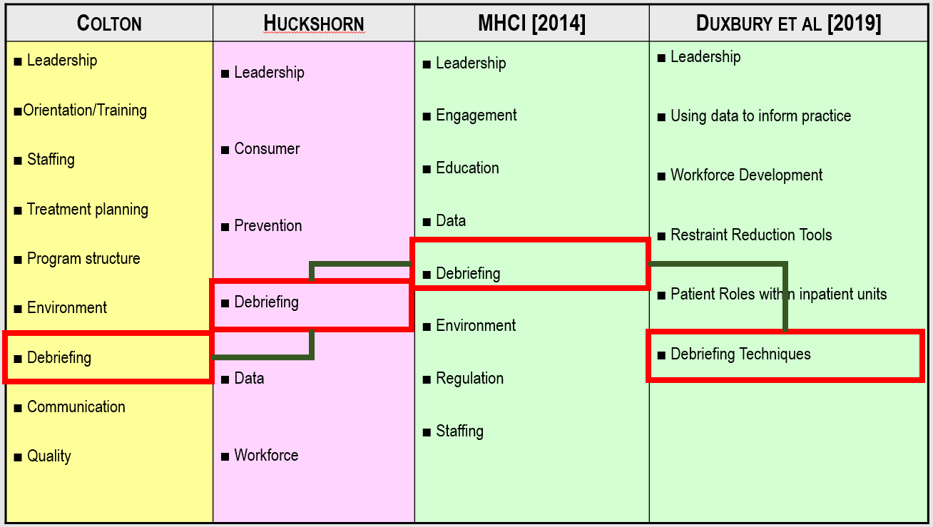

Slide 26
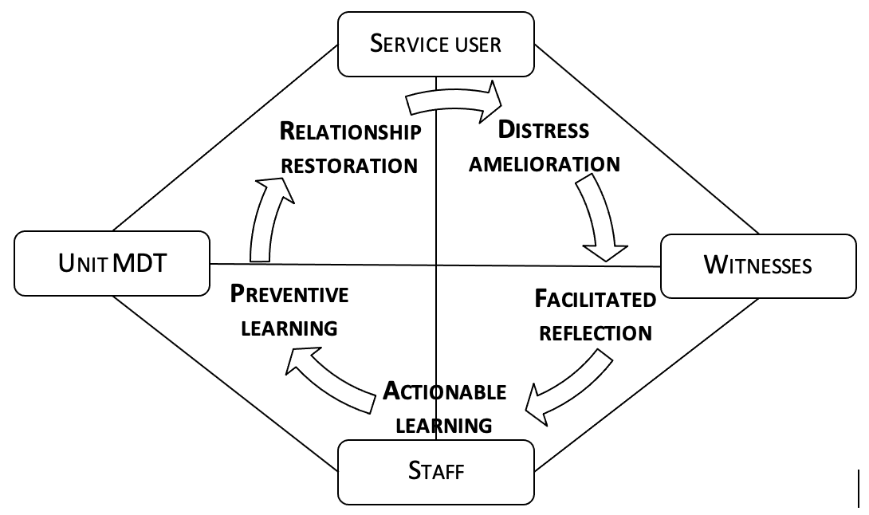

Slide 27
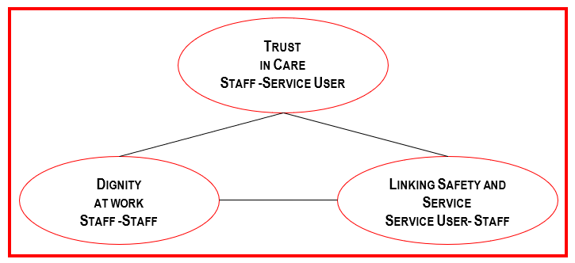
“Complex Encounters”

Slide 29
Re-Name or Re-Frame
Inclusive: All constituents Collective/Shared
Needs Based: Needs assessed rather than Procedural/Actions
Shift in Terminology: Promote Foster [PBS] Vs Prevent/Reduce
Proactive Vs Reactive Toward ‘Doing’ rather than ‘Stopping’
Shift in Language: ‘Aggression Violence’ ‘Seclusion & Restraint’
Shift in methodology: Shared ‘Nothing About Me Without Me’
Done with me rather than done to me of done for me

