Slide 1

What You Need to Know – Updated!
Presented by:
Leslie S. Johnson
G. Roland Love
Cole Shooter
Notes:
Leslie

Slide 2


What We Will Cover
Overview of Rule
The Rule
Application Analysis
Deep Dive on:
  Reportable Transaction
  Reporting Person
Reporting Obligations
  What, When, and Where
Penalties
Questions … and Answers?
FinCEN Resources
Notes:
Leslie

Slide 3
Overview of the Rule
  Arises from FinCEN authority under Bank Secrecy Act (“BSA”) – 12 USC §1829b and §1951-1960, as amended by the AML Act – 31 USC §5318(h)
  Requires Financial Institutions (“FI”) to establish anti-money laundering (“AML”) programs
  FI includes “persons involved in real estate closings & settlements” – 31 USC §5312(a)(2)
  Per the Rule: Includes title companies and lawyers
  FinCEN previously exempted these people from regulation under BSA – but no more!
Notes:
Leslie

Slide 4
Reason for the Rule
Grew out of successes of Geographic Targeting Orders (GTOs)
“Demonstrated need for increased transparency and further regulation of sector”
  But GTOs are limited:
  Geographically limited, only info on buyer, threshold $ amount
  Intended to be temporary – end 2/28/26
International pressure to create program to capture money-laundering
FinCEN’s mission is to collect data
Notes:
Leslie

Slide 5
History and Effective Date of Rule
  Final Rule issued Aug. 29, 2024
  Effective Date = December 1, 2025
  Reporting Obligations Begin = March 1, 2026
    If date of closing occurs on or after 3/1/26, the Rule will apply
    “Date of Closing” is defined as “date on which the transferee entity or transferee trust receives an ownership interest in residential real property.”
Notes:
Leslie

Slide 6
THE RULE
The Reporting Person in a Reportable Transfer (a Non-Financed Transfer of an interest in Residential Real Property to a Transferee Entity or Transferee Trust that is Not Exempt) Must file a Real Estate Report with FinCEN by a certain Date.
Notes:
Leslie

Slide 7
THE (PLAIN ENGLISH) RULE
“Reporting Person” must report to FinCEN specific personal information about the parties to all cash or private financing sales of residential real property to entities or trusts.
Notes:
Leslie

Slide 8

Rule Application Analysis
Is the transaction reportable?
If so, who reports it?
What information must be reported?
When must it be reported?
Where must it be reported?
What records must be retained?
Notes:
Leslie

Slide 9
1. Is it Reportable?
A. Is it a Non-Excluded Transfer of an ownership interest in Residential Real Property?
“Residential Real Property”
  Real property located in U.S containing structure designed principally for occupancy by 1-4 families;
  Land in U.S. on which transferee intends to build 1-4 family structure;
  Unit in structure in U.S. designed for 1-4 families; or
  Shares in co-op housing corporation for which underlying property is in U.S.
Notes:
Roland

Slide 10
1. Is it Reportable?
A. Is it a Non-Excluded Transfer of an ownership interest in Residential Real Property?
Reportable Transaction Does NOT Include (8 categories):
  Grant, transfer, or revocation of easement;
  Transfer resulting from death (via will, terms of trust, operation of law (intestacy), or contractual provision);
  Transfer incident to divorce;
  Transfer to a bankruptcy estate;
Notes:
Roland

Slide 11
1. Is it Reportable?
Reportable Transaction Does NOT Include:
  Transfer supervised by court in U.S. (receivership, probate, etc.);
  Transfer by individual (with or without spouse) for no consideration to a trust where individual or spouse is settlor of trust;
  Transfer to qualified intermediary for purposes of a 1031 exchange; or
  Transfer for which there is no Reporting Person.
Notes:
Roland

Slide 12
1. Is it Reportable?
Takeaways:
  NO EXEMPTIONS for:
    No consideration transfers, such as:
      Gifts
      Transfers between related entities
      Transfer to business entity that isn’t publically traded
  Non-judicial foreclosures
  Minors in title
  Seller financed transactions
Notes:
Roland

Slide 13
1. Is it Reportable?
B. Is it a Non-Financed Transfer?
“Non-Financed Transfer” occurs where there is no extension of credit that is both:
  Secured by an interest in the subject real property, and
  Extended by a financial institute subject to AML and SAR obligations under BSA
  Take Away: If there is no loan from a traditional lender, then it is likely reportable
Notes:
Roland

Slide 14
1. Is it Reportable?
C. Is the Transferee a Non-Exempt Transferee Entity or Transferee Trust?
“Transferee Entity”
  Any person other than a “Transferee Trust” or an individual
  In other words: A business entity
Notes:
Roland

Slide 15
1. Is it Reportable?
“Transferee Entity” Does NOT Include:
Securities Reporting Issuer | Governmental Authority
Bank | Credit Union
Depository Institution Holding Company | Money Services Business
Broker or Dealer in Securities | Securities Exchange or Clearing Agency
Other Exchange Act Registered Entity | Insurance Company
State-Licensed Insurance Producer | Commodity Exchange At Registered Entity
Public Utility | Financial Market Utility
Investment Company | Subsidiary of Exempt Entity
Notes:
Roland

Slide 16
1. Is it Reportable?
“Transferee Trust”
  Legal arrangement when settlor places assets under control of trustee for benefit of beneficiary or for specific purpose, as well any similar arrangement
  Still a “transferee trust” regardless of whether title goes into trust or trustee
Notes:
Cole

Slide 17
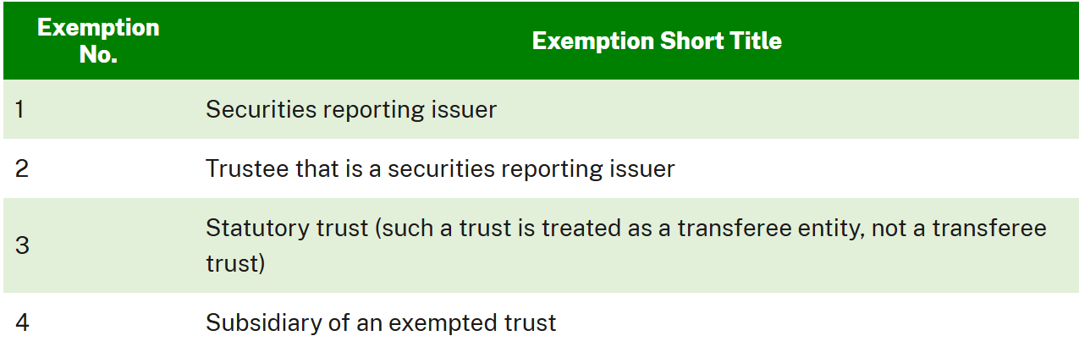
1. Is it Reportable?
“Transferee Trust” Does NOT Include:
Notes:
Cole

Slide 18
1. Is it Reportable?
TAKE AWAYS:
Reportable Transaction will be:
  Residential property
  All cash or private lender
  At least one entity or trust/trustee purchaser
What if it’s Not Reportable?
  Nothing to do under the Rule
  Consider noting file
Notes:
Roland

Slide 19
2. Who Reports?
A. Who is First on the “Waterfall” or “Cascade”?
  Person listed as closing or settlement agent on closing or settlement statement
  If none, person that prepares the settlement statement
  If none, person that records the deed
  If none, person that issues the owner’s title insurance policy
  If none, person that disburses greatest amount of funds in connection with transaction
  If none, person that provides evaluation or status of title
  If none, person that prepares deed or other legal instrument that transfer ownership
Notes:
Leslie

Slide 20
2. Who Reports?
Who is First on the “Waterfall” or “Cascade”, continued:
“Closing or Settlement Agent” defined as:
  Any person (whether or not acting as agent for title agent or company, licensed attorney, real estate broker, or real estate salesperson);
  Who (for another and with or without commission, fee, or other valuable consideration and with or without the intention or expectation of receiving commission, fee, or other valuable consideration (directly or indirectly));
  Provides closing or settlement services incident to transfer of residential real property
“Closing or Settlement Statement” defined as:
  Statement of receipts and disbursements prepared for the transferee for a transfer of residential real property.
Notes:
Leslie

Slide 21
2. Who Reports?
B. Can Use a Designation Agreement
  Reporting person can agree with any other person in Waterfall that other person will make the report
  Must be in writing and include:
    Date of agreement;
    Name and address of transferor and transferee;
    Required info about real property;
    Name and address of designated person to make report; and
    Name and address of all other parties to agreement
  No “global” designation agreements
Notes:
Leslie

Slide 22
3. What is Reported?
Categories of Information Required:
  The Reporting Person;
  Transferee Entity or Trust receiving property (buyer);
  Beneficial Owners of Transferee Entity or Trust;
  Individuals signing docs on behalf of Transferee Entity or Trust;
  Transferor (seller) – even if individual;
  Property being transferred; and
  Total consideration and info about payments made.
Notes:
Leslie

Slide 23
3. What is Reported?
Beneficial Owner of Transferee Entity:
  An individual who, on the date of closing, either directly or indirectly:
    Exercises substantial control over the transferee entity, or
    Owns or controls at least 25% of the transferee entity’s ownership interests
  If layered entity, must go until you reach individual
  Same analysis as under Corporate Transparency Act – see https://www.fincen.gov/boi for info
Notes:
Leslie

Slide 24
3. What is Reported?
Beneficial Owner of Transferee Trust:
  An individual who, at the date of transfer to the trust:
    Is a trustee;
    Has authority to dispose of trust assets (e.g., trust protector);
    Is a trust beneficiary who is sole permissible recipient of income and principal from trust or who has right to demand distribution of, or withdraw, substantially all of assets of trust;
    A grantor or settlor who has right to revoke trust or otherwise withdraw assets of transferee trust; or
    Is beneficial owner of legal entity or trust that holds one of the positions described in above four categories
Notes:
Cole

Slide 25
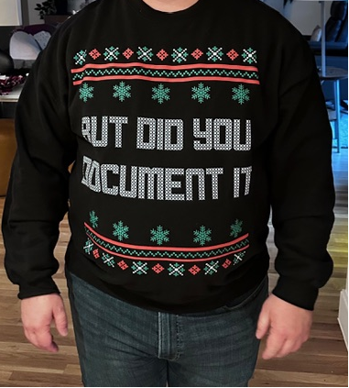
3. What is Reported?
  Reasonable Reliance is Permissible
  Reporting Person may reasonably rely on info provided by others, so long as:
    No knowledge of facts that would call info into question reliability, and
    For beneficial ownership info, person providing info must certify in writing accuracy of info to best of person’s knowledge
Notes:
Leslie

Slide 26
3. What is Reported?
TAKE AWAYS:
  Will require significant data collection from parties to transaction
  Must obtain this information prior to closing, or will likely never get it
  COLLECTION and CERTIFICATION FORMS are KEY
Notes:
Leslie

Slide 27
3.5 How to Report?
  All info will be reported to FinCEN on a Real Estate Report available at: https://bsaefiling-sandbox.fincen.gov/supported-forms
  111 data points
    Can be much more or less depending upon complexity of parties and transaction
  Consider how you will:
    Transfer information from collection form to Real Estate Report, and
    Keep client’s data secure
Notes:
Leslie

Slide 28
4. When to Report?
Must Report by the LATER OF:
  Last day of the month following the month in which date of closing occurred
    Example: Closing occurred on June 9, 2026 – Report would not be due until July 31, 2026
  30 calendar days after date of closing.
    Example: Closing occurred on January 31 – Report would not be due until March 2 (or March 1 in leap years)
  Remember: “Date of Closing” = date on which transferee entity or trust receives ownership interest in property
Notes:
Leslie

Slide 29
5. Where to Report?
Real Estate Report must be filed electronically with FinCEN
Will be FinCEN’s BSA e-filing system, same as GTOs https://bsaefiling.fincen.treas.gov/main.html
Must create:
  BSA e-filing account: https://bsaefiling.fincen.gov/AddUser
  Login.gov account: https://login.gov/create-an-account/
Notes:
Leslie

Slide 30
6. What to Retain?
Reporting Person must retain Reasonable Reliance Certification (used for Beneficial Ownership information)
All parties to Designation Agreement for reporting person must retain the agreement
Do NOT have to retain Real Estate Report
Must retain for FIVE YEARS
Notes:
Cole

Slide 31
Penalties
CIVIL | CRIMINAL
Negligent Violations: Civil penalties not more than $1,394 for each violation and additional penalty of up to $108,489 for pattern of negligent activity. | N/A
Willful Violations: Not more than greater of the amount involved in the transaction (not to exceed $278,973) or $69,733.30. | Willful Violations: Term of imprisonment of not more than 5 years or criminal fine of not more than $250,000, or both.
Notes:
Roland

Slide 32
Questions and Answers…?
Isn’t my client’s information protected by the attorney-client privilege?
What if my client will not provide the required information?
Is the sale of a ranch or farm (acreage) a reportable transaction?
With vacant land, how do you determine if a buyer intends to build a 1-4 family structure?
Notes:
Roland

Slide 33
Questions and Answers…?
Are mixed-use or commercial properties that include a residential component (e.g., apartment complexes, retirement communities, hotels with residences, etc.) considered “residential real property”?
Are non-judicial foreclosures exempt from reporting?
What about Lady Bird Deeds and TODDs?
How do I know if a lender has an AML program?
Will my client’s data be secure once I submit to FinCEN?
Notes:
Roland

Slide 34
Questions and Answers…?
How do I, as counsel, handle Rule compliance?
Consider the following:
  Draft entity docs to add duty to provide info
  Revise retention agreement to address reporting obligations
  Include contractual reps and warranties in the PSA
  Require buyer affidavits with indemnity
  Seller client desire to avoid reportable contracts?
Notes:
Roland

Slide 35
Pending Litigation
FNF and Fidelity Nat’l Title Ins. v. Bessent, et al., Civil Action No. 3:25-cv-00554, Middle Dist. Fla.
Flowers Title Companies LLC v. Bessent, et al., Civil Action No. 6:25-cv-00127, Eastern Dist. Tex.
Jason Corely and Zachary Long v. U.S. Depart. of Treasury, et al., Civil Action No. 5:25-cv-86, Northern Dist. of Texas
Notes:
Leslie

Slide 36
FinCEN Website Resources
  FinCEN Rule Home Page: www.fincen.gov/rre
  Rule FAQs: www.fincen.gov/rre-faqs
  Rule Reference Materials: www.fincen.gov/rre-reference-materials
  Subscribe to FinCEN Updates: https://service.govdelivery.com/accounts/USFINCEN/subscriber/new
Notes:
Leslie

Slide 37



Thank You!
Leslie S. Johnson
WFG National Title Insurance Co.
LJohnson@wfgtitle.com
469-410-4701
Cole Shooter
Greak, Shooter & Uryasz, P.C.
806-783-0081
cole@greaklaw.com
G. Roland Love
Independence Title Co.
rlove@independencetitle.com
Notes:
Leslie

