Slide 1


Fundraising Committee Report to the Executive Committee
October 2, 2019

Slide 2
Our Committee
Kathy Adams Seay
Germaine Bolds-Leftridge
Roslyn Brock
Elizabeth Clark Adams
Gail Clark
Lisa Harbour Carter
Donna Hill Staton
Lenaye Lawyer
Vivian Lawyer
Regina Little Hollis
Judy L. Smith
Lisa Loury-Lomas
Myra Smith

Slide 3
Fundraising Vision and Relationships
Fundraising Committee Vision
Focus our fundraising efforts on executing unique, scalable, profitable events that are consistent with National, Regional and Chapter priorities, and that enhance our reputation and brand among our Links and Columbia/Howard County communities.
Key Relationships:
Internally
  Strategic Planning to tie fundraising activities with Chapter and Facet goals and measures of success
  Communications Committee – Creating marketing collateral to assist in raising funds
  Budget/Finance Committee- Fundraising has significant implications for meeting budget obligations.
Externally
  Identifying and cultivating new sponsors

Slide 4

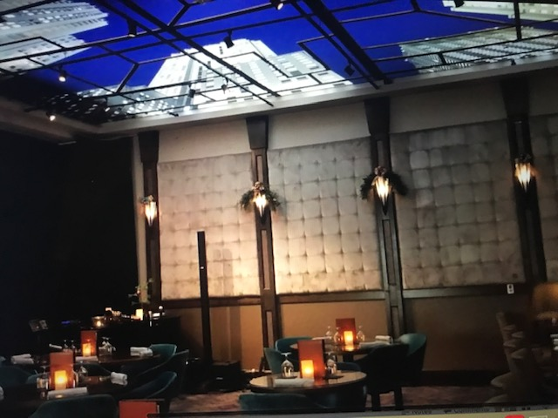
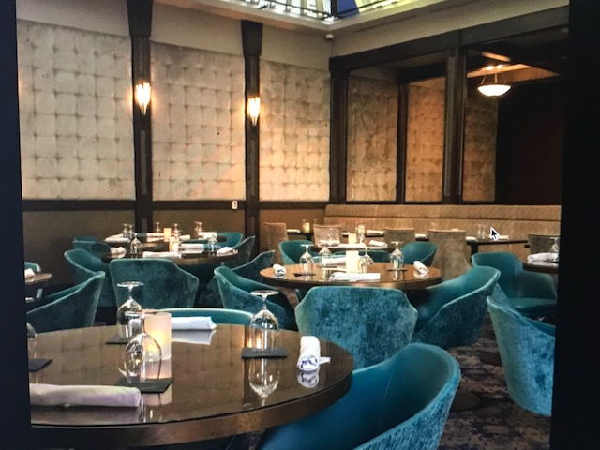
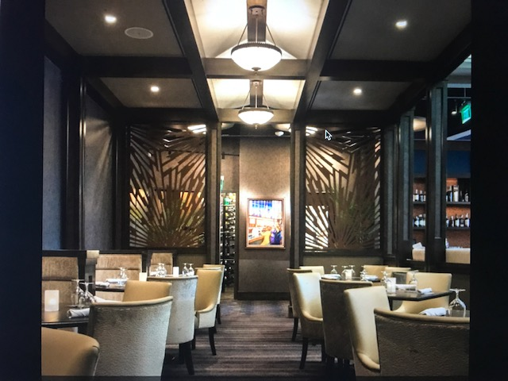
18th and 21st Scholarship Benefit Fundraiser

Slide 5
18th & 21st Scholarship Benefit Fundraiser- Approval Request
Date: March 18th 2020, Wednesday evening
Suggested ticket price $125
Suggested capacity- 80-100
Includes food, drinks, and entertainment
  Food/beverages have included crab balls, chicken skewers, deviled eggs, lobster salad, hummus, salad, wine, beer and cocktails
  Music- wide range of choices including a pianist, 3 piece jazz band and or vocalist
Our Cost- $0 or minimal if we want something special in the way of decorations etc.
Profit- conservatively 80 tickets at $125 would net $10,000
Benefits-
  No cost for not-for-profits. This will likely change in the future
  All funds generated will be PROFIT!
  Minimal level of effort
  Would provide us with additional visibility within the Columbia/Howard County community (opportunity to invite potential sponsors)
  Opportunity to focus on scholarships (suggested focus on HBCU’s; consistent with National)
  Net proceeds could defray expenses associated with our next major fundraiser
  Tax deductible
Challenges-
  Capacity constraint

