Slide 1

Fundraising Committee
September 26, 2024

Slide 2


Our Linkspiration

Slide 3

2024 Invitation
Notes:
We will have Madam Recording Secretary send the invitation after the meeting.

Slide 4

Sponsorship Packet
https://online.flippingbook.com/view/608862640/

Slide 5
Agenda
Welcome and Introductions (2 minutes)
Brief welcome and Linskspiration
Overview of meeting objectives.
Communication Plan Link Rebecca/ Link Judy (10 minutes)
Review current communication strategies.
Letters to dignitaries.
Event Update – Link Rebecca/ Link Audra (10 minutes)
Progress report on key aspects of the event vendors- Vendor fee is updated to $300.
Sponsorship Overview Link Yvette (10 minutes)
Current- status of sponsorships.
Emerald
Gold
Vendors

Slide 6
Agenda
Link Greta (4 minutes) - Student video or acknowledgment from scholarship recipients.
Photographer Update- Link Rebecca (4 minutes)
360-degree Photographer- Paid
Epic Photography – Paid
Discuss Chapter Photo at the October meeting.
Seating Assignment review- Link Vivian (8 minutes)
Discuss requirements for Link sisters to submit a guest list.
Confirm we’re at capacity; 60 tables sold.
Decor Planning – Link Rochelle / Link Tracey (3 minutes)
Update on runner and creation of prototype.
Music Selections- Link Regina- recommend playlist for the band.
Next Steps (10 minutes)
Summarize key action items and deadlines.
Schedule the next meeting and action items.
Address any final questions or comments.
Closing Remarks (2 minutes)
Recap of meeting highlights

Slide 7

2024
SEATING CHART

Slide 8
Timeline
April- Contract Signed and Deposit paid
May- Invitations and Sponsorship Packets
July- Event Insurance Application Submitted
July- Secure Photographers
July- Send Invitation and Event Request form to Madam EAD
September- Send Invitations to Dignitaries
August 30th- Chapter Assessment Due
NEW DUE DATE October 11th
EXTENSION- NEW DATE October 11th
All Ads, Sponsorships, & Vendor Payments

Slide 9
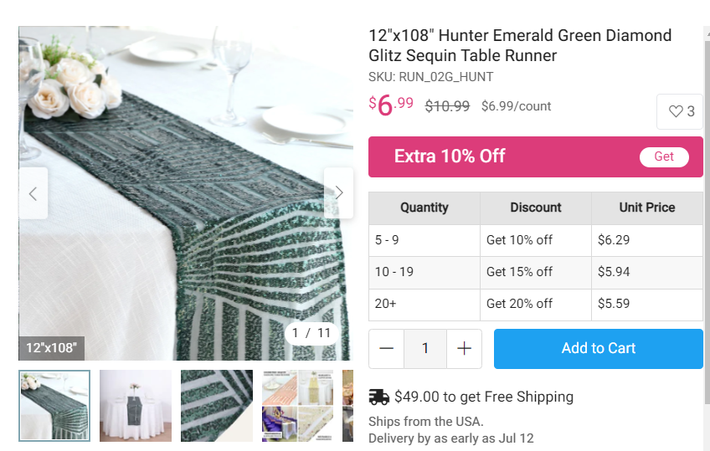
Table Décor Examples

Slide 10
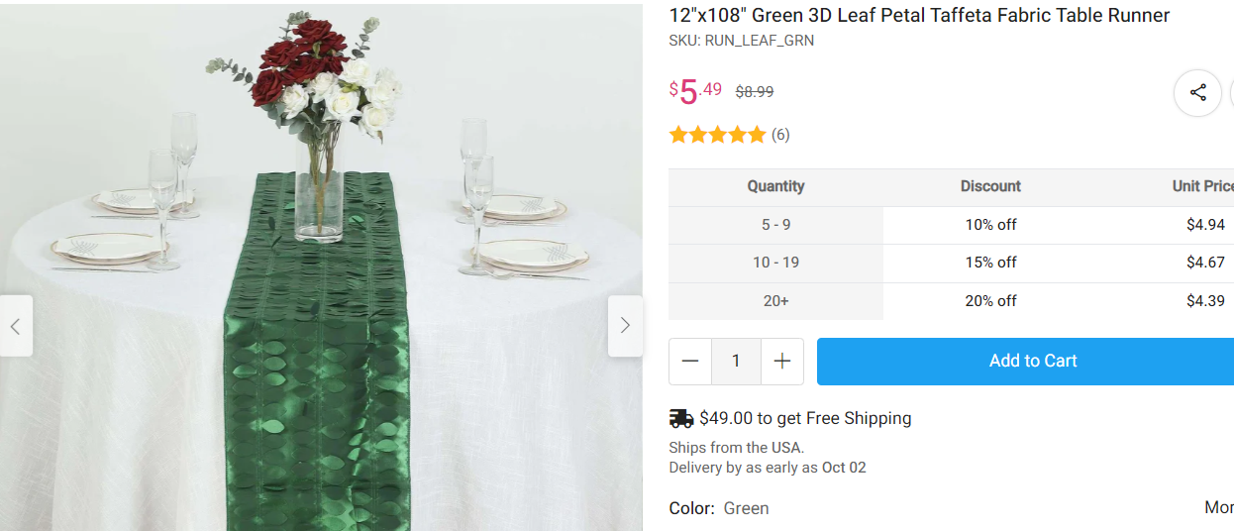
Table Décor Examples

Slide 11



Slide 12
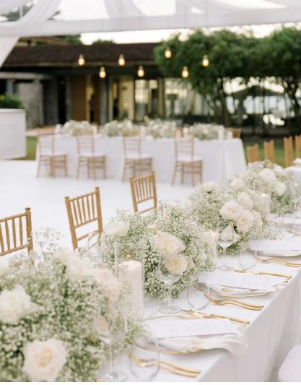
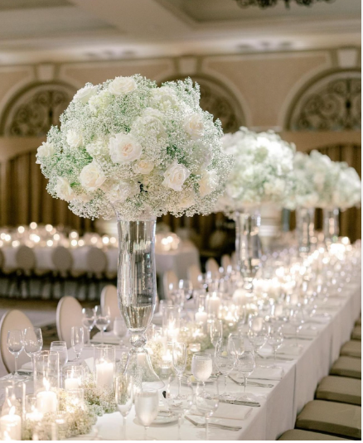

Slide 13
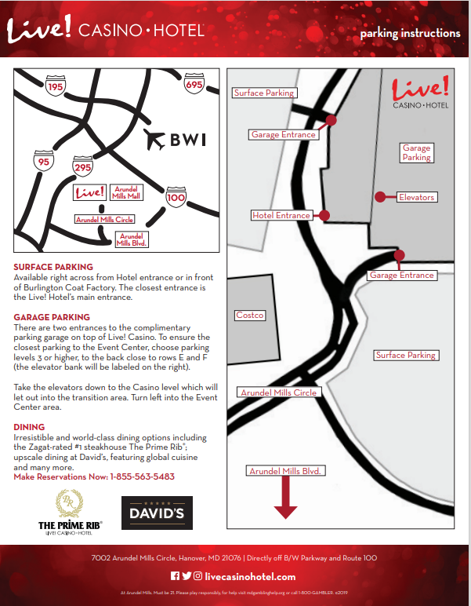
EVENT PARKING

Slide 14
Action Items
Link Judy
Communications handoff to the new committee (Link Cathy &Link Germaine)
Link Vivian
Start logging table assignments on the Excel sheet
Meet with/ Link Yvette & Link Rebecca to reconcile paid tickets and assessments to table assignments.
Link Rochelle, Link Tracey, & Link Rebecca
Decided to use last year’s table runners.
Finalize the table arrangements.
Order fabric white flowers.
Link Rebecca
Confirm guest count with LIVE!
Submit Final payment.
Link Greta
Determine Video for scholars

Slide 15

Thank you, for your continued support!

